Slide 1
RAGNAROK
TRIAL OF THE NINE REALMS
An agentic intelligence system for investigating supply-chain disruption
AGENTIC AI HACKATHON · RAGNAROK
TEAM VIKSIT CODERS
Notes:
KEY POINT: Introduce Ragnarok in one breath: a multi-agent system that investigates a supply-chain disruption and earns its conclusion.
SCRIPT: Good morning. We are Team Viksit Coders, and this is Ragnarok: Trial of the Nine Realms. When a trade corridor shuts down, someone has to answer a hard question quickly: who is exposed, and by how much? We built a system that answers it the way a careful investigation would, with research, competing arguments, cross-examination and a judge who rules from the evidence.
TRANSITION: Let me start with why that question is hard.
IF ASKED: The names come from Norse mythology, but each one is a concrete role in the code: an investigator, two opposing advocates and a judge.

Slide 2

A disrupted corridor can become a national risk
before the picture is clear
THE PROBLEM
official notice · T1
QUESTIONS THAT ARRIVE AT ONCE
correction
Which countries and sectors are exposed?
Importer A
rumour · T4
wheat, maize
×
How much trade is actually at risk?
trade table
Exporter
Can other routes, suppliers or stocks cover it?
grain by sea
report after as-of
×
conflicting report
Which claims rest on reliable evidence?
corridor agreement ends
What is still missing?
Importer B
wheat, maize
Alternatives?
The hard part is not finding information. It is reconciling it into a defensible assessment.
other suppliers, rail
Illustration. Roles taken from the Runemark dev pack (fictional).
Notes:
KEY POINT: The difficulty is reconciling scattered, conflicting evidence, not finding it.
SCRIPT: Picture an export corridor for grain whose agreement simply ends. Two importing countries depend on it. Within days the questions pile up: who is exposed, how much trade is at risk, can other suppliers or a rail link cover the gap, and which of the claims flying around are actually reliable? The evidence is spread across official notices, trade tables, corrections of earlier reports, rumours, and even reports dated after the moment you are asking about. Finding documents is easy. Turning them into a defensible assessment is the hard part.
TRANSITION: So why not just ask a single model?
IF ASKED: The challenge dataset, Runemark, is fictional but deliberately messy: an empty file, a cut-off copy, a UTF-16 body, documents after the as-of date, a retracted renewal report, tier-4 rumours and an embedded instruction aimed at the AI.

Slide 3

One answer can hide an entire side of the story
THE INSIGHT
ONE ANSWER
RESEARCH
Heimdall builds the case file and names what is missing
CHALLENGE
Thor and Loki argue opposite sides and attack each other's claims
VERIFY
Code checks citations and does every calculation
Incomplete evidence
One-sided interpretation
JUDGE
Odin rules on each claim and decides if more research is needed
Numbers no one can check
A single answer can be right. Separating the stages makes disagreement and evidence gaps visible instead of hidden.
Notes:
KEY POINT: Our design principle is Research, Challenge, Verify, Judge, each as a separate stage.
SCRIPT: A single model answer is one voice. It can be right, but you cannot see what it left out, which side of the argument it never considered, or whether its numbers add up. So Ragnarok splits the job. One agent researches. Two agents argue opposite sides and attack each other. Code, not the model, checks every citation and does every calculation. And a judge rules claim by claim, and can send the case back when something essential is missing.
TRANSITION: Here are the four agents that do this.
IF ASKED: We do not claim single-agent systems always fail. The point is visibility: every disagreement and every gap ends up in the record.

Slide 4


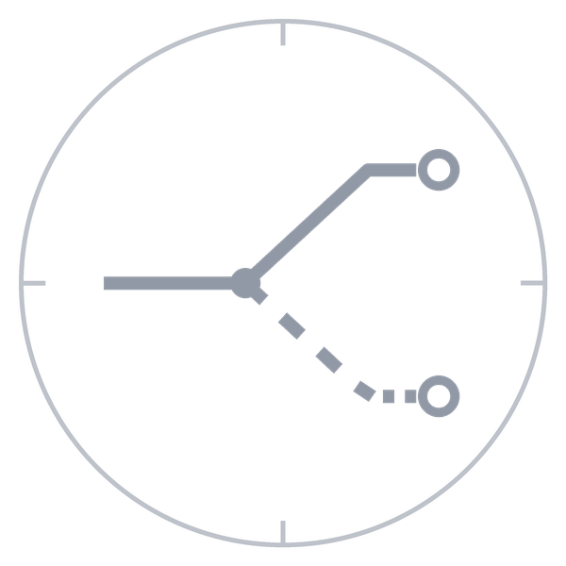

Meet the four agents behind the investigation
THE SYSTEM
HEIMDALL
THOR
LOKI
ODIN
THE INVESTIGATOR
HIGH EXPOSURE
LIMITED EXPOSURE
THE JUDGE
Searches documents and trade tables
Verifies the event, builds the case file
Flags corrections, rumours and gaps
Runs targeted research on a send-back
Argues exposure is high
Cited claims, high estimate
Makes the case for severity
Argues independently for limited exposure
Substitutes, other routes, stocks
Challenges overstated claims
Rules on every claim
Builds his own range from evidence
Decides if more research is needed
Writes the briefing from his rulings
Heimdall opens every case. Odin has the last word. Thor and Loki see each other's claims only at cross-examination.
Notes:
KEY POINT: Four agents, four distinct jobs; each name maps to a concrete role and tool set.
SCRIPT: Heimdall, the watchman, investigates first: he searches the documents and trade tables, checks that the event really happened, notes corrections and rumours, and lists missing data in a case file. Thor argues that exposure is high. Loki, independently, argues that it is limited: substitutes, other routes, stocks. Neither is a villain; they are two analytical perspectives, and each must cite evidence. Odin is the judge. He rules on every claim, builds his own range from the evidence, decides whether more research is needed, and writes the final briefing only from his rulings.
TRANSITION: The important part is how they work together.
IF ASKED: Tool permissions are enforced in code. Heimdall, Thor and Loki can search; Odin cannot search at all. He can read documents, replay calculations and validate citations.

Slide 5
Not four chatbots. One orchestrated investigation.
THE WORKFLOW
Thor
claims, high estimate
Question
Heimdall
in parallel
Cross-exam
Odin
Briefing
and as-of date, from the user
research, case file, event check
attack; defend with new evidence or concede
rulings, own range, sufficiency
from rulings only
Loki
claims, low estimate
SEND-BACK · evidence missing → new targeted searches → run 2
FLOW IN CODE
SHARED CASE FILE
RECORDED DEBATE
BOUNDED LOOP
An explicit state machine checks every transition. Agent output never picks the next step.
Every agent works from Heimdall's case file and cites the same stable paragraph and row refs.
Claims, attacks, defenses, concessions and rulings are append-only audit events.
Repeated queries are refused; only new evidence counts. Runs are capped at 2 by default.
Notes:
KEY POINT: The workflow is fixed in code, with one conditional loop that Odin can trigger.
SCRIPT: Here is the whole investigation. The user asks a question with an as-of date. Heimdall researches and builds the case file. Thor and Loki then work in parallel, each running their own searches. Cross-examination follows: each side attacks the other's claims, and each attacked claim must be defended with new evidence or conceded. Odin then rules on every claim. If the evidence is sufficient, he writes the briefing. If something essential is missing, he sends the case back: Heimdall runs new targeted searches, and the trial runs again with whatever new evidence turns up.
TRANSITION: Let us zoom into what happens to a single claim.
IF ASKED: There is no central planner. The state machine is USER, HEIMDALL, THOR and LOKI, CROSS_EXAMINATION, ODIN, then BRIEFING or HEIMDALL_RESEARCH. Odin names the missing evidence but never assigns tasks. Run 2 refuses repeated queries and excludes paragraphs already seen.

Slide 6
Every claim must survive scrutiny
HOW THE SYSTEM REASONS
CLAIM
ATTACK
RESPONSE
RULING
Loki · L1-2 · inference
Thor · A1-T3
Loki · concedes in part
Odin · R-L1-2
Midgard's maize imports from Orvan stayed more resilient after the agreement ended, thanks to delayed delivery terms.
"Resilient" describes a delay. November value fell from USD 84.7M (2025) to 31.9M (2026).
"Resilient" inaccurately describes the maize trade. The claim is revised to a delayed but significant decline.
Conceded. The proponent acknowledged the objection; the trade suffered heavy year-on-year losses.
ORV-0030 P14
ORV-0030 R4
ORV-0030 R11
ORV-0030 R5
FOUR VERDICTS, USED EVERYWHERE
established
contested
conceded
rejected
survived scrutiny on valid evidence
support, but credible counter-evidence
the claim's author withdrew it
Odin judged it unsupported
Conceded comes from the author; rejected from Odin. Every claim is tagged fact or inference. Real exchange from the saved case, condensed.
Notes:
KEY POINT: A claim only stands if it survives attack, and the four verdicts mean different things.
SCRIPT: This is a real exchange from our saved two-run case. Loki claimed that Midgard's maize imports stayed resilient after the agreement ended, citing a trade note. Thor attacked with two trade rows: November value fell from 84.7 to 31.9 million dollars year on year. Loki could defend only with new evidence, and had none, so he conceded in part. Odin then recorded the claim as conceded. There are four verdicts. Established means it survived scrutiny. Contested means credible counter-evidence remains. Conceded means the author backed down. Rejected means Odin judged it unsupported. Conceded and rejected are deliberately different.
TRANSITION: Claims often carry numbers. Here is how we make those numbers trustworthy.
IF ASKED: The code refuses generic attacks: an attack needs a target claim, a specific objection, and counter-evidence or a named gap. A defense that cites nothing new is recorded as invalid, and the claim stays undefended for Odin. "Conceded" is only possible if the author actually conceded.

Slide 7
The model reasons. Code does the arithmetic.
NUMBERS YOU CAN TRACE
SOURCE DOCUMENT
CITED TRADE ROWS
DETERMINISTIC CALCULATION
EXPOSURE RANGE
BRIEFING
ORV-0009
Trade note: Orvan to Midgard, wheat
tier 1 · 2027-01-19
Sep–Dec 2026
R3 R4 R5 R6
Sep–Dec 2025
R9 R10 R11 R12
CALC-2471c1 · yoy_change
sum(current) − sum(prior)
142.1 − 358.3 = −216.2 USD M
CALC-cb98e8 · Oct–Dec only
103.9 − 260.4 = −156.5 USD M
inputs kept · excluded rows: none
156.5 – 216.2
USD M · Midgard wheat
Odin's range: the year-on-year fall in import value
Inline citation
[ORV-0009 R3,
2027-01-19]
The model picks rows and an operation. Python computes the result and keeps the inputs.
Each bound must equal a cited calculation result, and both bounds must be the same kind of calculation.
Trade value at risk is not economic loss. A missing value is never treated as zero.
Every estimate states metric, unit, period, denominator, assumptions, missing data and confidence. Figures from case-20261026-005913-e4e654.
Notes:
KEY POINT: Every number in a briefing can be replayed from cited rows by deterministic code.
SCRIPT: Models are unreliable at arithmetic, so they do none. Here is a real chain from our saved case. Trade note ORV-0009, a tier-1 document, supplies eight monthly rows: September to December of 2026 and of 2025. A Python function computes the year-on-year change: 142.1 minus 358.3, a fall of 216.2 million dollars. A second record covers October to December: 156.5. Odin's range for Midgard wheat is exactly those two results, cited inline with dates. And this is trade value at risk, not an economic loss estimate.
TRANSITION: Here is what all of this looks like in the product.
IF ASKED: Operations are sum, mean, share, yoy_change, yoy_pct_change, period_change and net_offset. Each record keeps its input rows, any excluded rows with the reason, the formula and the result, and replays identically. Code rejects a range whose bounds come from different kinds of calculation, for example a sum joined to a year-on-year change.

Slide 8
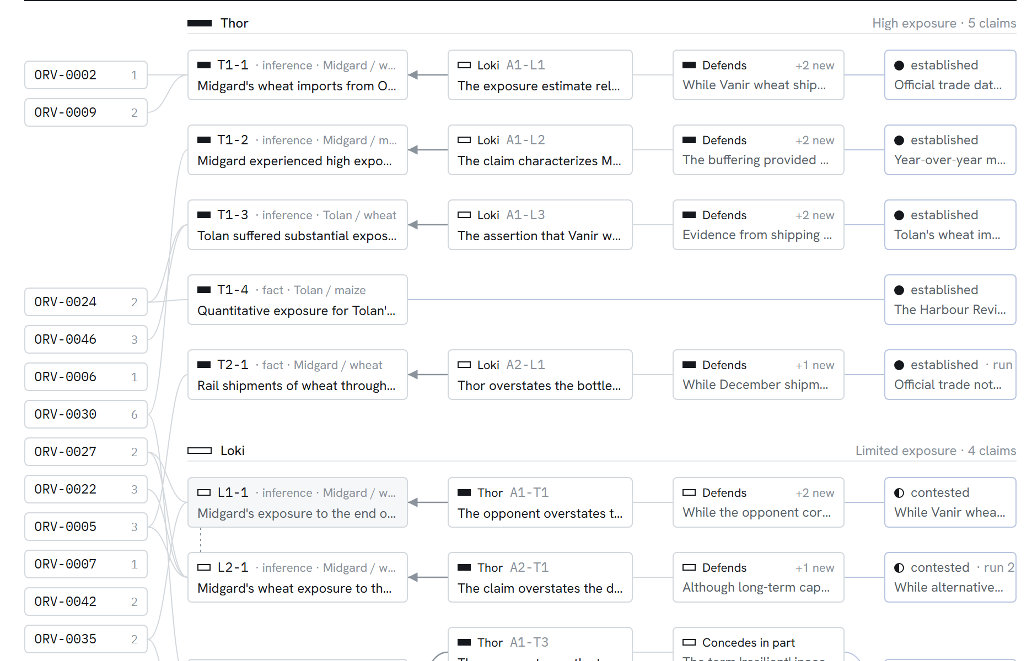
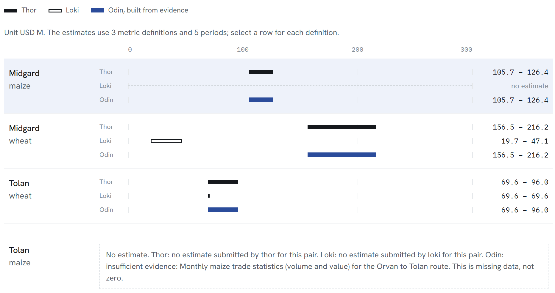
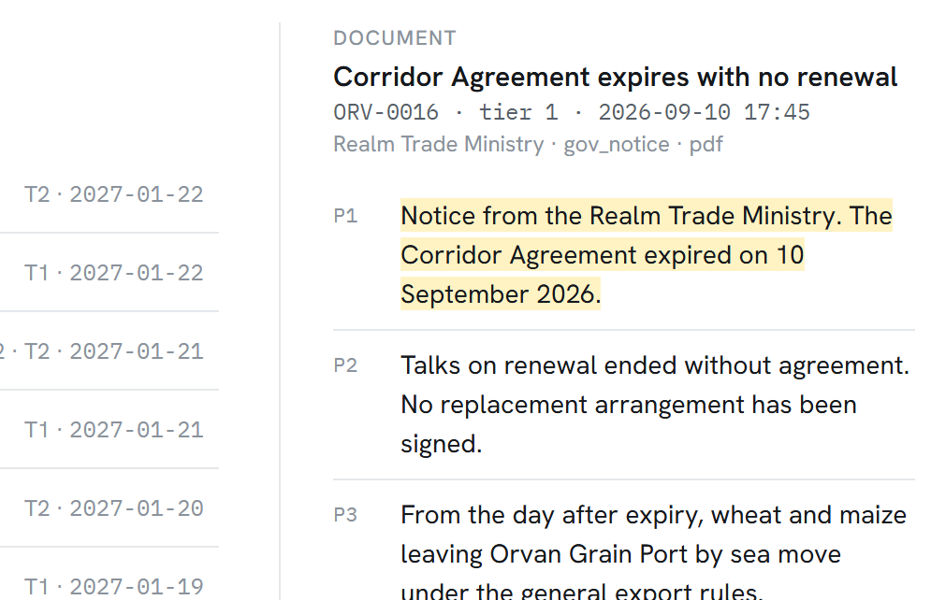
From investigation to decision-ready intelligence
THE PRODUCT IN ACTION
EXPOSURE
Thor, Loki and Odin on one axis; missing is never drawn as zero
CLICK-THROUGH
Any citation opens the source with the cited paragraph highlighted.
Real captures, saved two-run case.
ARGUMENT MAP
Cited documents → claims → attacks → responses → Odin's rulings, one lane per claim
Notes:
KEY POINT: It is a working, inspectable application; every element on screen is a recorded event or a stored document.
SCRIPT: These are real captures from the saved case. On the left, the argument map: each lane runs from the cited documents, to the claim, to the attack, the response, and Odin's ruling, so you can see the whole debate at once. Top right, the exposure view: Thor's, Loki's and Odin's ranges on one shared axis. Where there is no evidence, it says no estimate, and the reason. It never draws a zero. Bottom right, click-through: any citation opens the source document with the cited paragraph highlighted, so a judge can check every claim in two clicks.
TRANSITION: A system like this must also know what it should not use.
IF ASKED: The dashboard has six views: Trial, Argument map, Exposure, Evidence, Briefing and Run trace. It follows the case live over Server-Sent Events with a polling fallback, and nothing on screen is simulated.

Slide 9
The system must know what it cannot safely use
EVIDENCE, SAFETY AND TRUST
DOCUMENTS
VALIDATED INGEST
INJECTION SCAN
AS-OF GATE
CITATION CHECK
AGENTS
PDF · TXT · DOCX, packs and uploads
see only wrapped evidence
Type and size checked, safe file names. The original is kept with its content hash. Damaged files and rows are flagged, never used as valid numbers.
Role labels and override phrases are flagged. The span stays on record but is withheld from agent prompts.
Enforced in code on search, reads, trade rows, calculations and citations. A later document is refused (HTTP 403).
At briefing build: the paragraph or row exists, the quote matches, the date is in the window. Failures are dropped and listed.
TRAP_INJECTION
CLOCK_VIOLATION_BLOCKED
TRANSPARENT UNCERTAINTY
No estimate is shown as missing, never as zero. A briefing is labelled complete, partial or incomplete; it never claims completeness falsely.
EVERYTHING ON THE RECORD
Append-only audit log in SQLite with JSONL export. Corrections, retractions and duplicates stay linked to the reports they affect.
Notes:
KEY POINT: Safety is enforced in code at four gates, and uncertainty is shown, not hidden.
SCRIPT: Every document passes four gates before it can influence anything. Ingest validates files, keeps the original with its content hash, and flags damage instead of repairing it silently. An injection scanner flags text such as a fake SYSTEM instruction; the span stays on record, is shown on the dashboard, but never reaches an agent's prompt. The as-of gate is enforced on every path, so a document published after the question's date is refused and the attempt logged. Finally, when the briefing is built, every citation is checked again and anything that fails is dropped and listed. And when evidence is missing, the system says so. It labels briefings complete, partial or incomplete.
TRANSITION: Here is how those pieces fit together technically.
IF ASKED: Tests show that a malicious document cannot skip cross-examination, change the question or the as-of date, force Odin to establish a claim, or force endless send-backs. We make no claim of being hallucination-free; we make every claim checkable.

Slide 10
A transparent application around a specialised agent workflow
TECHNICAL ARCHITECTURE
FRONTEND
Dashboard
Six views
Case state
React · Vite · TypeScript · Tailwind
Trial · Argument map · Exposure · Evidence · Briefing · Run trace
typed API client, live event stream
API
FastAPI on Uvicorn
Live updates
Evidence access
POST /cases · GET /cases/{id} · /resume
/events Server-Sent Events, polling fallback
/docs · /trade · /feed · POST /ingest
AGENT LAYER
Trial state machine
Four agents
LLM client
explicit stages, checked transitions, run limit
own prompt and tool allow-list; Pydantic-validated output, one repair
Gemini by default, Anthropic optional; model chain, budgets, reply cache
EVIDENCE AND AUDIT
Ingest
Hybrid retrieval
Calculations + store
PDF · TXT · DOCX, trade tables, damage and injection flags
BM25 + bge-small vectors, RRF, metadata filters, as-of gate
deterministic records; SQLite audit log, memories and caches
Logical view. Runs locally as two processes (API on :8000, dashboard on :5173). 382 automated tests use a scripted model.
Notes:
KEY POINT: The architecture is a plain, inspectable stack; the intelligence sits in a small, code-governed agent layer.
SCRIPT: The dashboard is React, Vite, TypeScript and Tailwind. It talks only to a FastAPI backend on Uvicorn and follows a case live through Server-Sent Events, with polling as a fallback. Inside, an explicit state machine runs the trial. Each agent has its own prompt and tool allow-list, and every model reply is validated against a Pydantic schema. The client defaults to Gemini and can pause and resume a case without losing work. Underneath: ingestion, hybrid BM25 and vector retrieval, deterministic calculations, and a SQLite audit log.
TRANSITION: Let me show you one case from start to finish.
IF ASKED: Retrieval fuses BM25 and one vector index (bge-small-en-v1.5, local, via fastembed) with Reciprocal Rank Fusion, plus filters on country, sector, event, source type, reliability tier and dates. A two-run case uses about 22 to 25 model requests. This diagram is logical; we have not deployed to production.

Slide 11
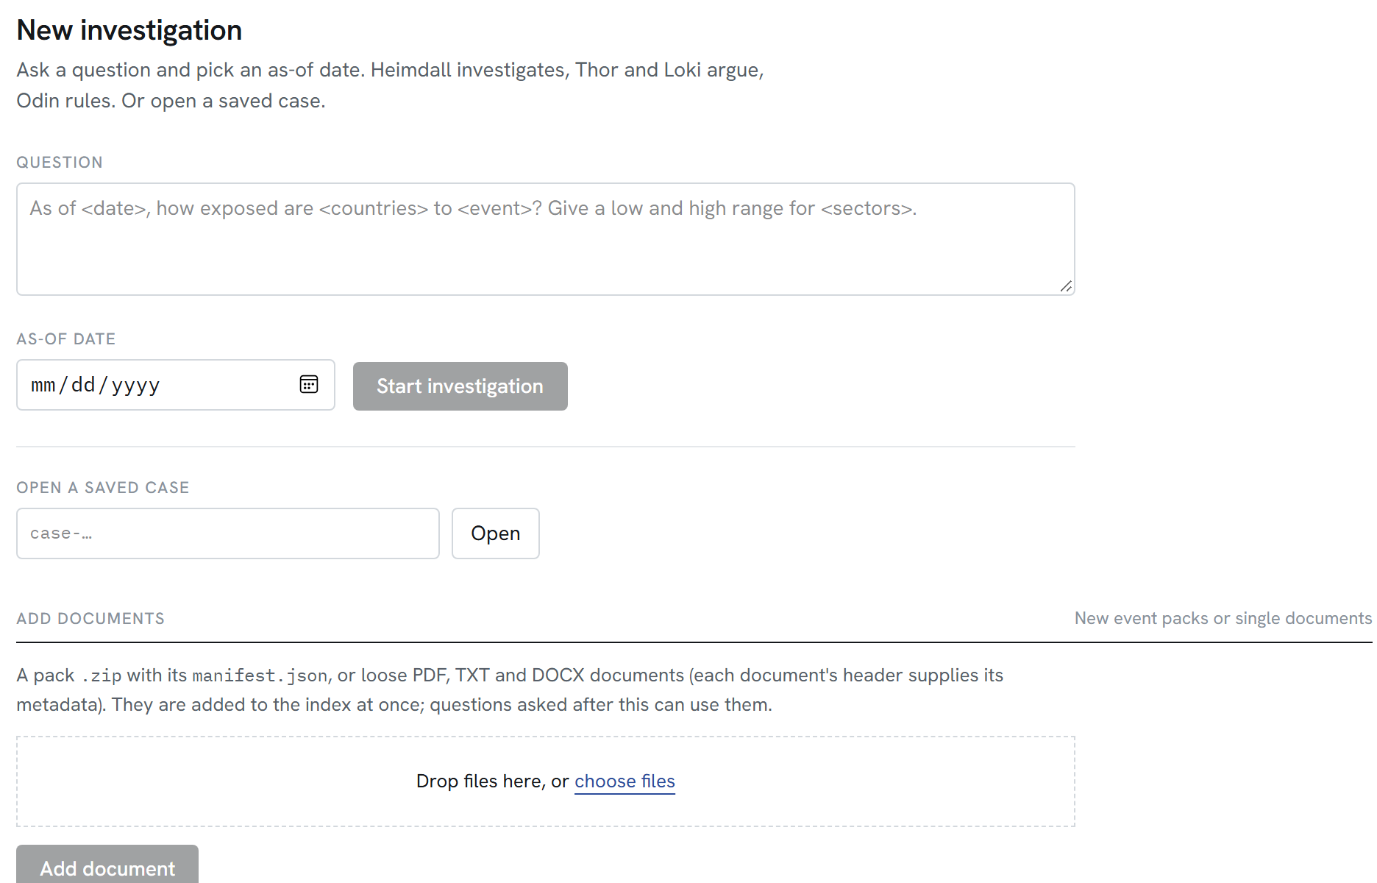
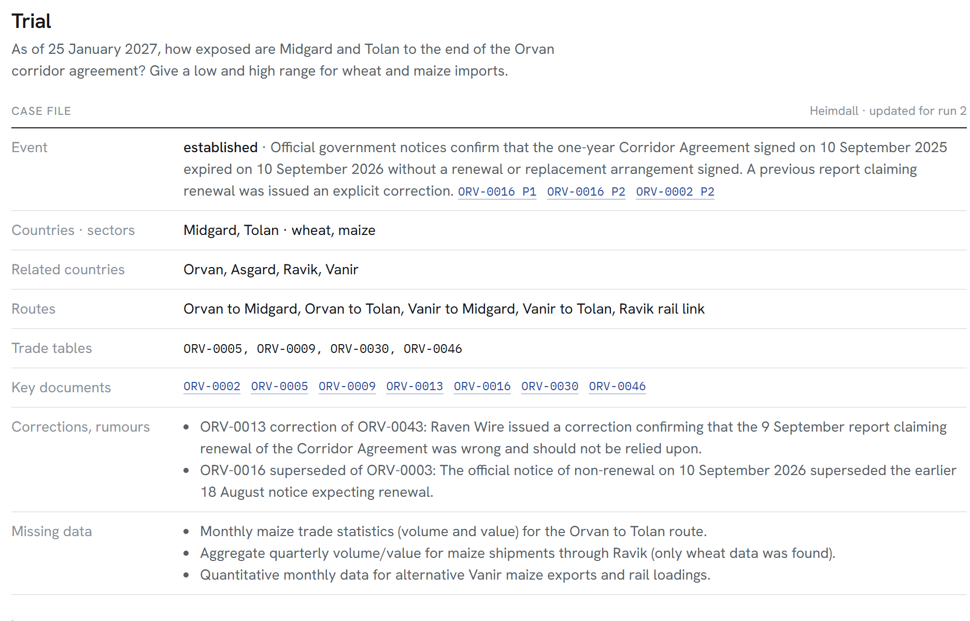
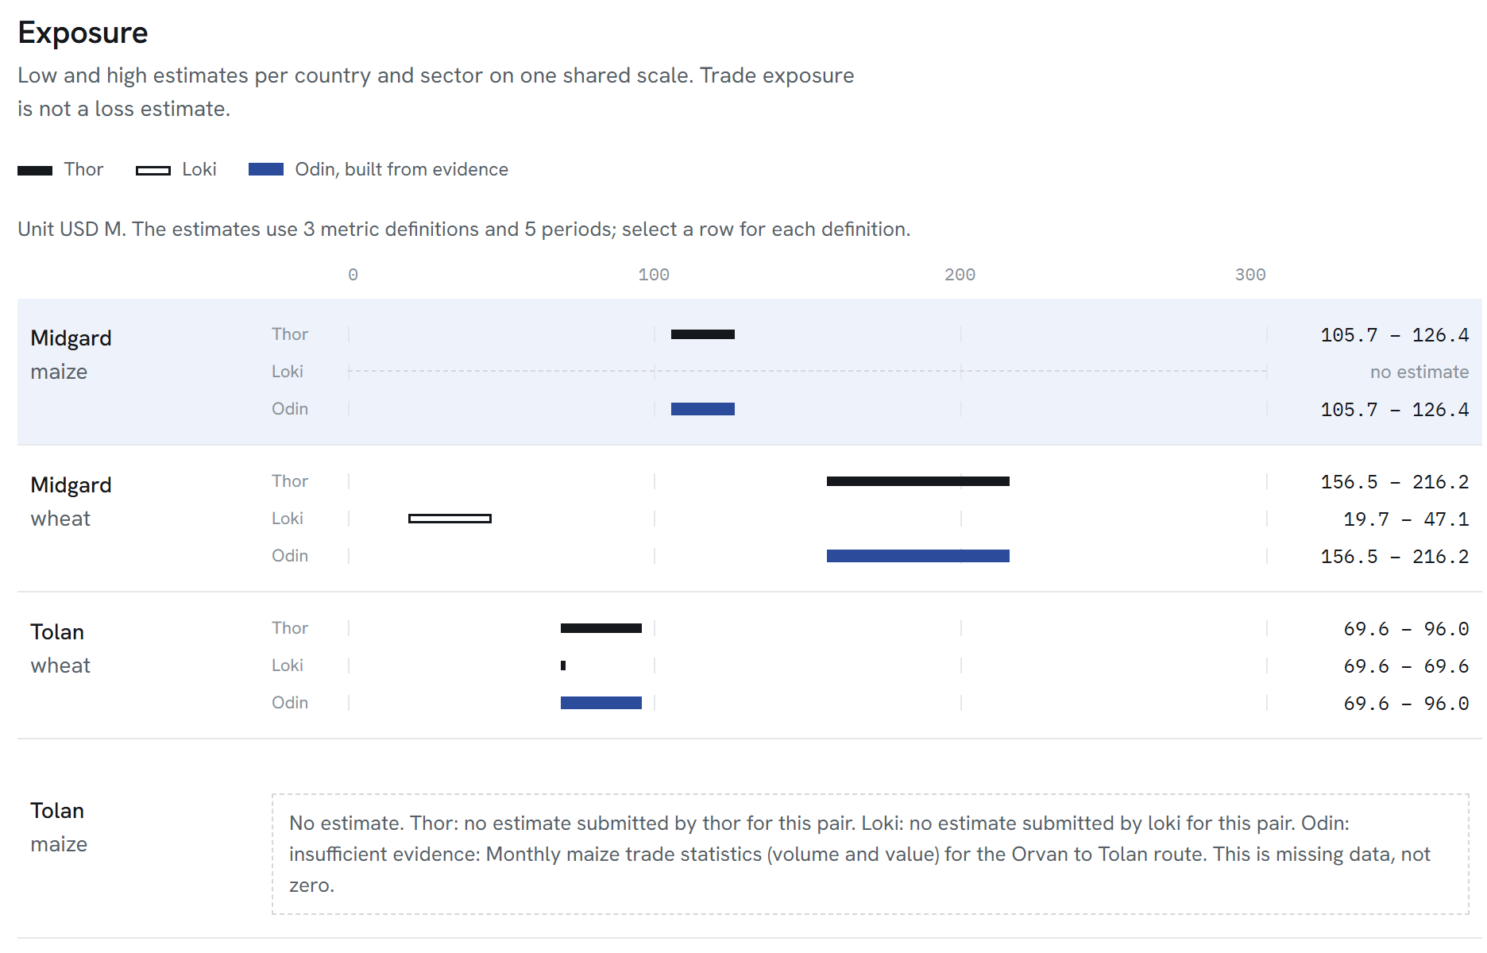
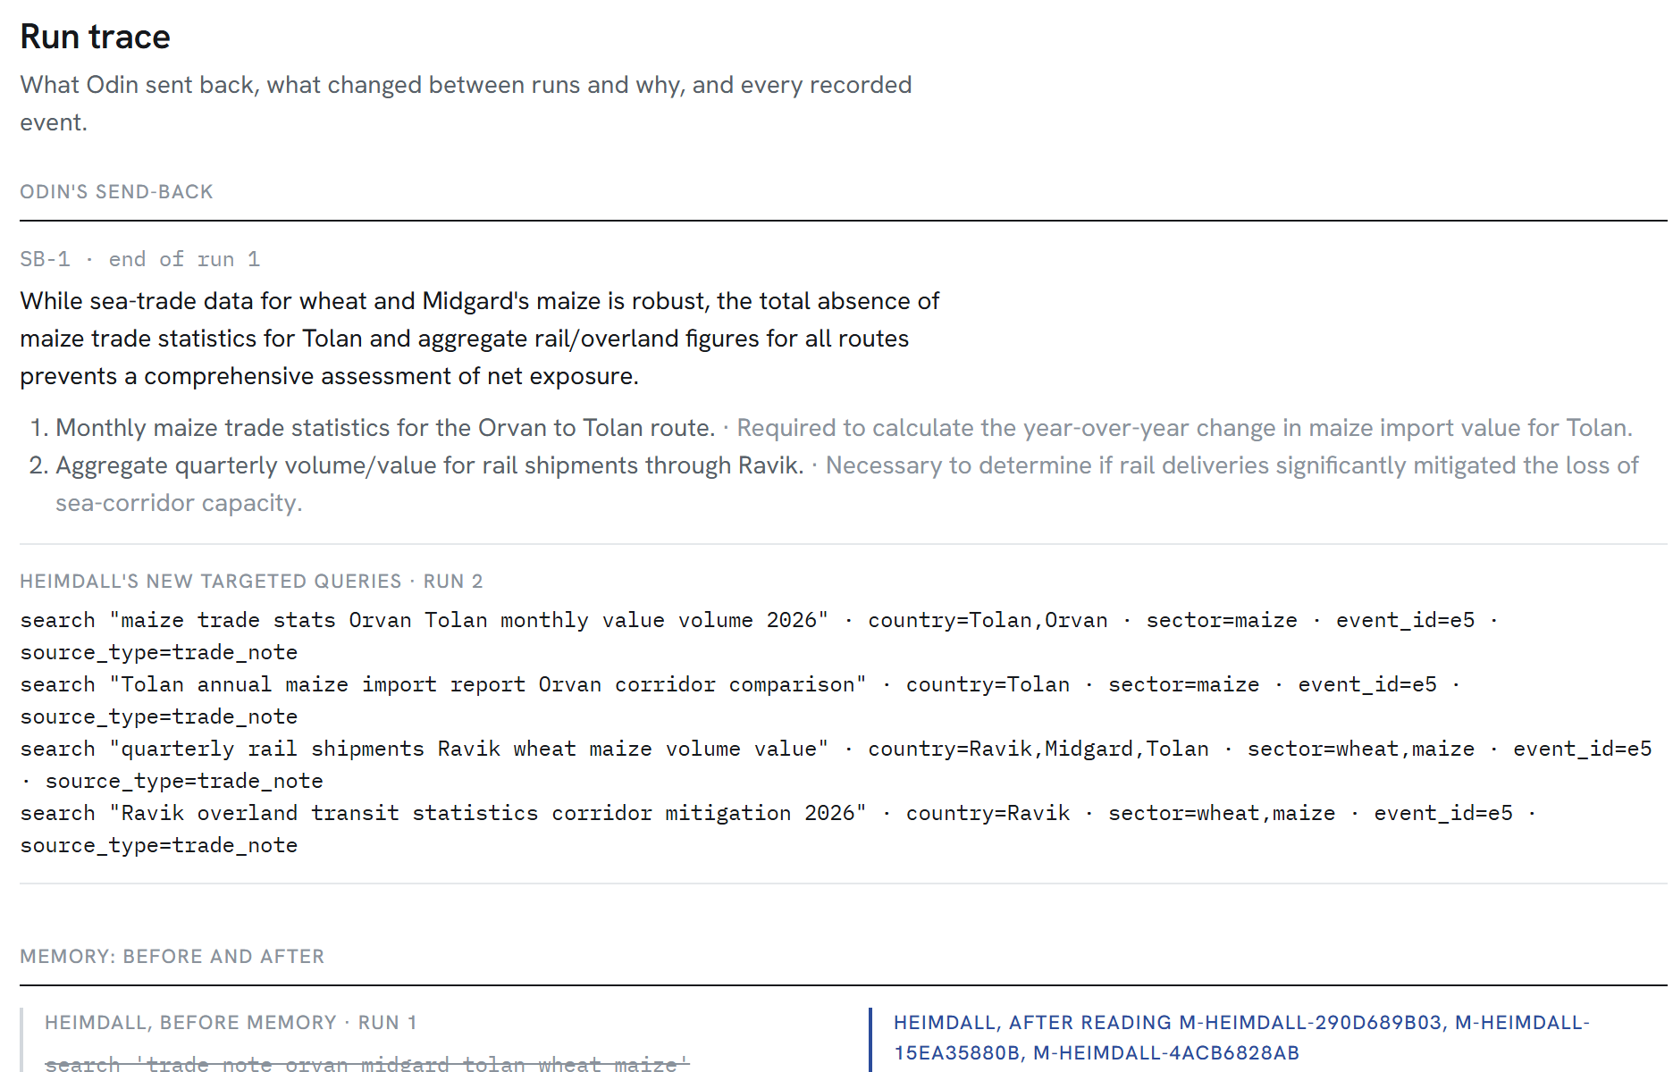
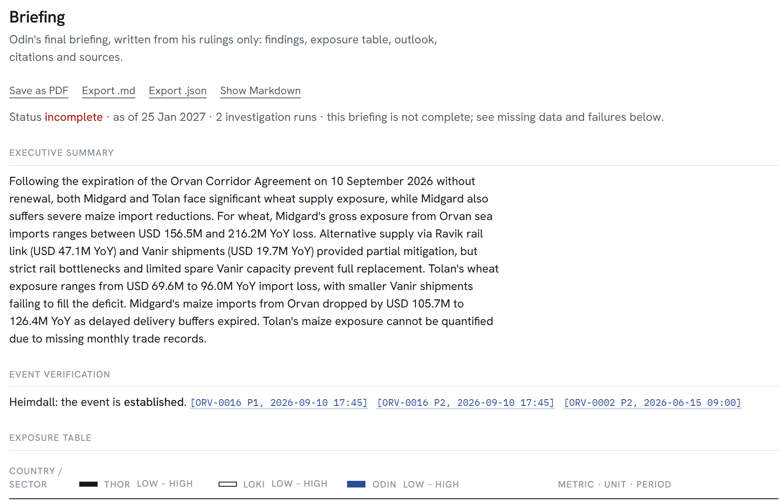
Follow one case from question to judgment
DEMONSTRATION
1 Ask
2 Investigate
3 Argue
4 Verify
5 Measure
6 Trace
7 Brief
question and as-of date
Heimdall's case file
claims, attacks, rulings
open a cited source
ranges and calculations
send-back, run 2, memory
report and exports
THE SAVED TWO-RUN CASE, A REAL GEMINI RUN ON THE DEV PACK
24
9
8
13
6
model requests
claims ruled
attacks, 4 each way
new references in run 2
logged memory changes
LIMITATIONS
Conclusions are only as good as the evidence available.
Cases can stay incomplete. This one did: no Tolan maize data is in the pack.
Argument quality depends on the model; claims still need scrutiny.
Daily model quotas can pause a run until the reset.
A second run does not guarantee new evidence.
Notes:
KEY POINT: One real case shows the whole loop, including an honest "incomplete" result.
SCRIPT: In the demo we ask the sample question with its as-of date. Heimdall confirms the event and notes a corrected renewal report. Thor and Loki submit nine claims, attack each other eight times, and Odin rules on every claim. We open a citation, then the calculation behind a range. Odin sent the case back; in run 2 Heimdall found thirteen genuinely new references and the advocates revised their claims. Tolan maize data is not in the pack, so the briefing is labelled incomplete. That is the correct answer, stated plainly, in 24 model requests.
TRANSITION: To close.
IF ASKED: Memory: Heimdall's lessons from earlier cases added searches for correction and retraction notices; the log records the plan without memory, the plan with it, and the lesson used. Paused cases resume after the quota reset, and finished steps replay from a reply cache with no new requests.

Slide 12
When the evidence is contested,
the decision must be earned.
Research the event. Challenge the claims. Trace the numbers. Judge the evidence.
RAGNAROK · TRIAL OF THE NINE REALMS
Questions?
Notes:
KEY POINT: Leave the judges with the differentiator: a decision that is earned through research, challenge, verification and judgment.
SCRIPT: Ragnarok is not one model answering a question. It is an investigation: an investigator that names what it does not know, two advocates who must defend every claim against attack, code that does the arithmetic, and a judge who rules from the evidence and sends the case back when the evidence is not enough. When the evidence is contested, the decision must be earned. Thank you. We are happy to take questions, or to open any claim in the live dashboard.
TRANSITION: Questions.
IF ASKED: The saved two-run case, its logs, the README and the dashboard guide are all in the repository, and a judge can open any citation in the case.

Slide 13
Endpoints, live updates and ingestion
APPENDIX A · TECHNICAL REFERENCE
ENDPOINT | PURPOSE
POST /cases | start a case (one at a time)
GET /cases/{id} | status and results
GET /cases/{id}/events | Server-Sent Events of the audit log
POST /cases/{id}/resume | resume a failed, partial or paused case
GET /docs/{id}[/{para}] | documents, as-of gated
GET /trade/{table}[/{row}] | trade rows, as-of gated
GET /feed?as_of= | documents with tier, correction, damage badges
POST /ingest | pack .zip or loose PDF, TXT, DOCX
LIVE UPDATES
The dashboard follows /events over Server-Sent Events and falls back to polling. Every visible action is a recorded event.
INGESTION FLOW
Manifest and header parse → text extraction with segment-wise encoding detection → [Pn] paragraphs and trade rows → damage, injection, duplicate and correction flags → hybrid index. New packs need no code changes.
OUTPUTS PER CASE
state, case file, claims, cross-examination, rulings, per-run folders, briefing (.md, .json), memory, model-request ledger, events.jsonl.
Notes:
KEY POINT: Reference slide for technical questions; not presented in the main pitch.
SCRIPT: Use only if a judge asks about the API or data flow. The interactive API documentation is served at /api/docs. All document and trade paths are gated by the case's as-of date; a later document returns HTTP 403 and is logged as CLOCK_VIOLATION_BLOCKED.
TRANSITION: Back to questions, or Appendix B for design decisions.
IF ASKED: Unseen packs were tested with a random pack generator: three seeds, each 26 of 26 ingest checks passing, and full trials on two of them.

Slide 14
Why the investigation is split into stages
APPENDIX B · DESIGN DECISIONS
Separate research from argument
Two opposing advocates
Heimdall establishes the facts and the gaps before anyone takes a side, so advocates start from the same case file.
Thor and Loki search independently; the argument for limited exposure is never an afterthought.
Cross-examination with rules
A judge who cannot search
Attacks need a target and counter-evidence or a named gap. Defenses need new evidence, or they concede.
Odin rules from the record. He names missing evidence and can send the case back, but never assigns work.
Arithmetic in code
Private memory per agent
Replayable calculation records make every number in the briefing checkable.
General lessons carry across cases. The log shows the plan without memory and with it, so influence is visible.
NOT IMPLEMENTED · POSSIBLE NEXT STEPS
OCR for scanned PDFs (today they are ingested as empty, damaged documents) · non-English documents · Odin building ranges that differ from both advocates more often · more than one case at a time per API process
Notes:
KEY POINT: Each structural choice exists to make a specific failure visible or impossible; future work is labelled as such.
SCRIPT: Use only if asked why the architecture looks like this. Every stage answers a failure mode: incomplete evidence (Heimdall and the send-back), one-sided interpretation (two advocates plus cross-examination), unverifiable numbers (code-only arithmetic), and unearned conclusions (Odin rules claim by claim and labels the briefing honestly).
TRANSITION: Back to questions.
IF ASKED: Known limitation from our own testing: Odin often adopts the better-supported advocate's range rather than building a different one. Code ensures his bounds reproduce from calculation records, but it is an honest observation.

