Slide 1
Neural Network approaches for Physical Problems(with application to SDOF system)
Aditya Garg
SRF student, NMCAD lab, Dept. of Aerospace Engineering, IISc

Slide 2
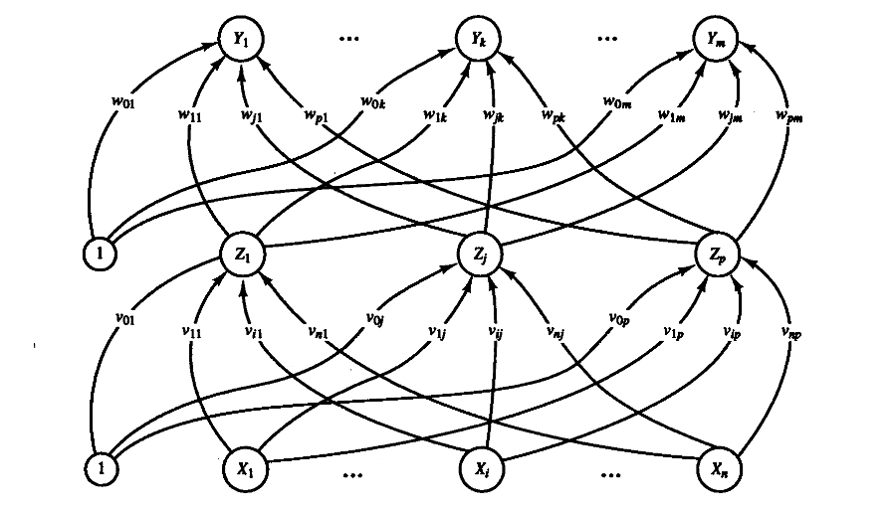
Neural Networks
A neural network is a deep learning method that is used for value prediction, pattern recognition and other applications
A neural network is characterized by the structure of its layers, associated activation functions and the pattern of connection between its layers(weights and biases).
Each neuron acts on the net input through an activation function. Commonly used activation functions are Hyperbolic tangent, Rectified linear unit, bipolar sigmois.
Fig 1: An example of neural network architecture (from [4])

Slide 3
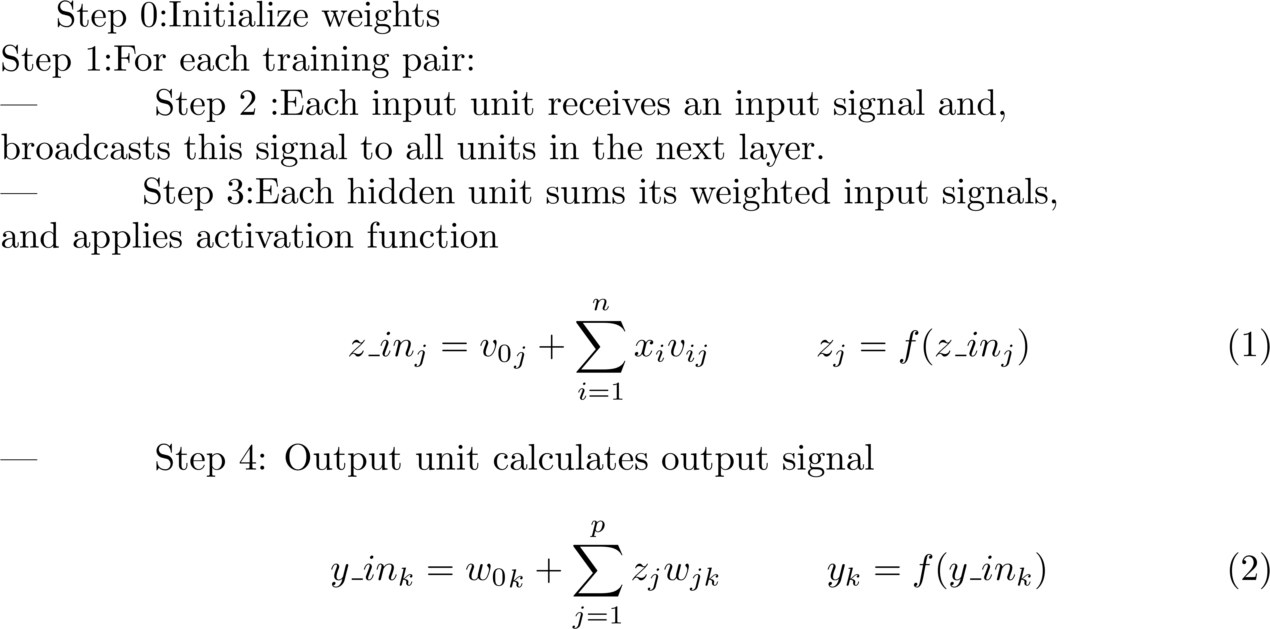
Working of Neural Networks
The example assumes a network with 1 hidden layer similar to fig. in slide 2

Slide 4
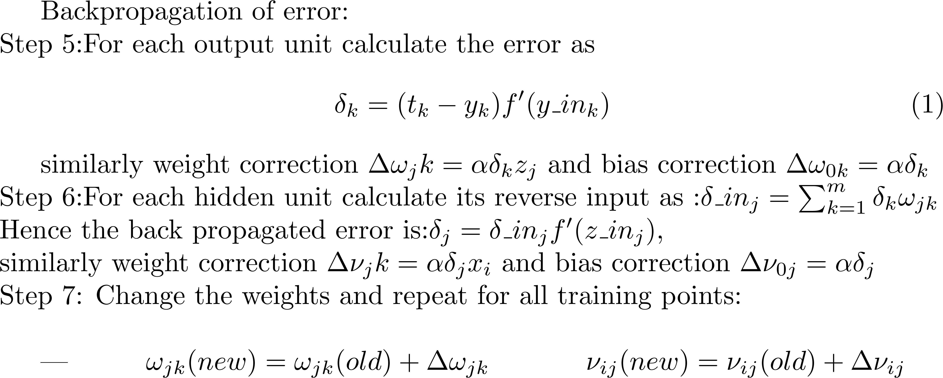
Working of Neural Networks(contd.)

Slide 5
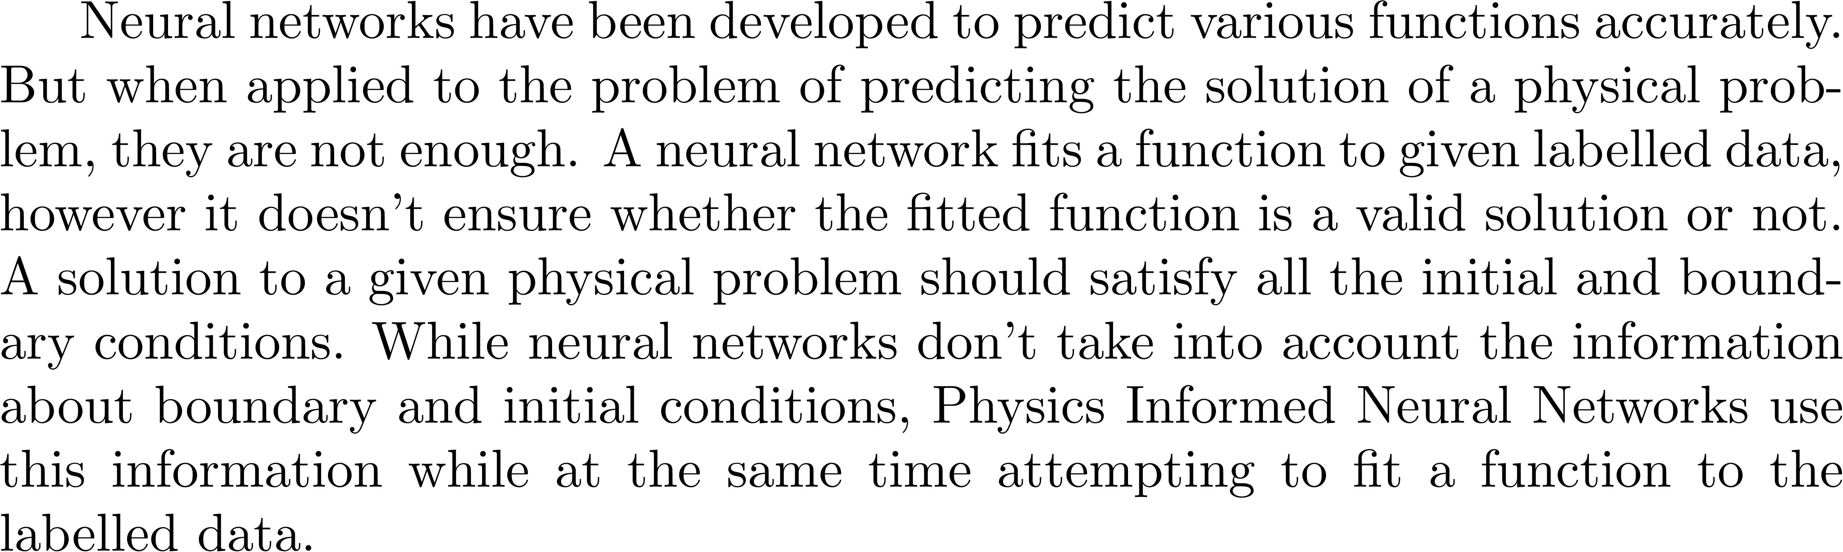
Need for Physics Informed Neural Networks(PINNs)

Slide 6
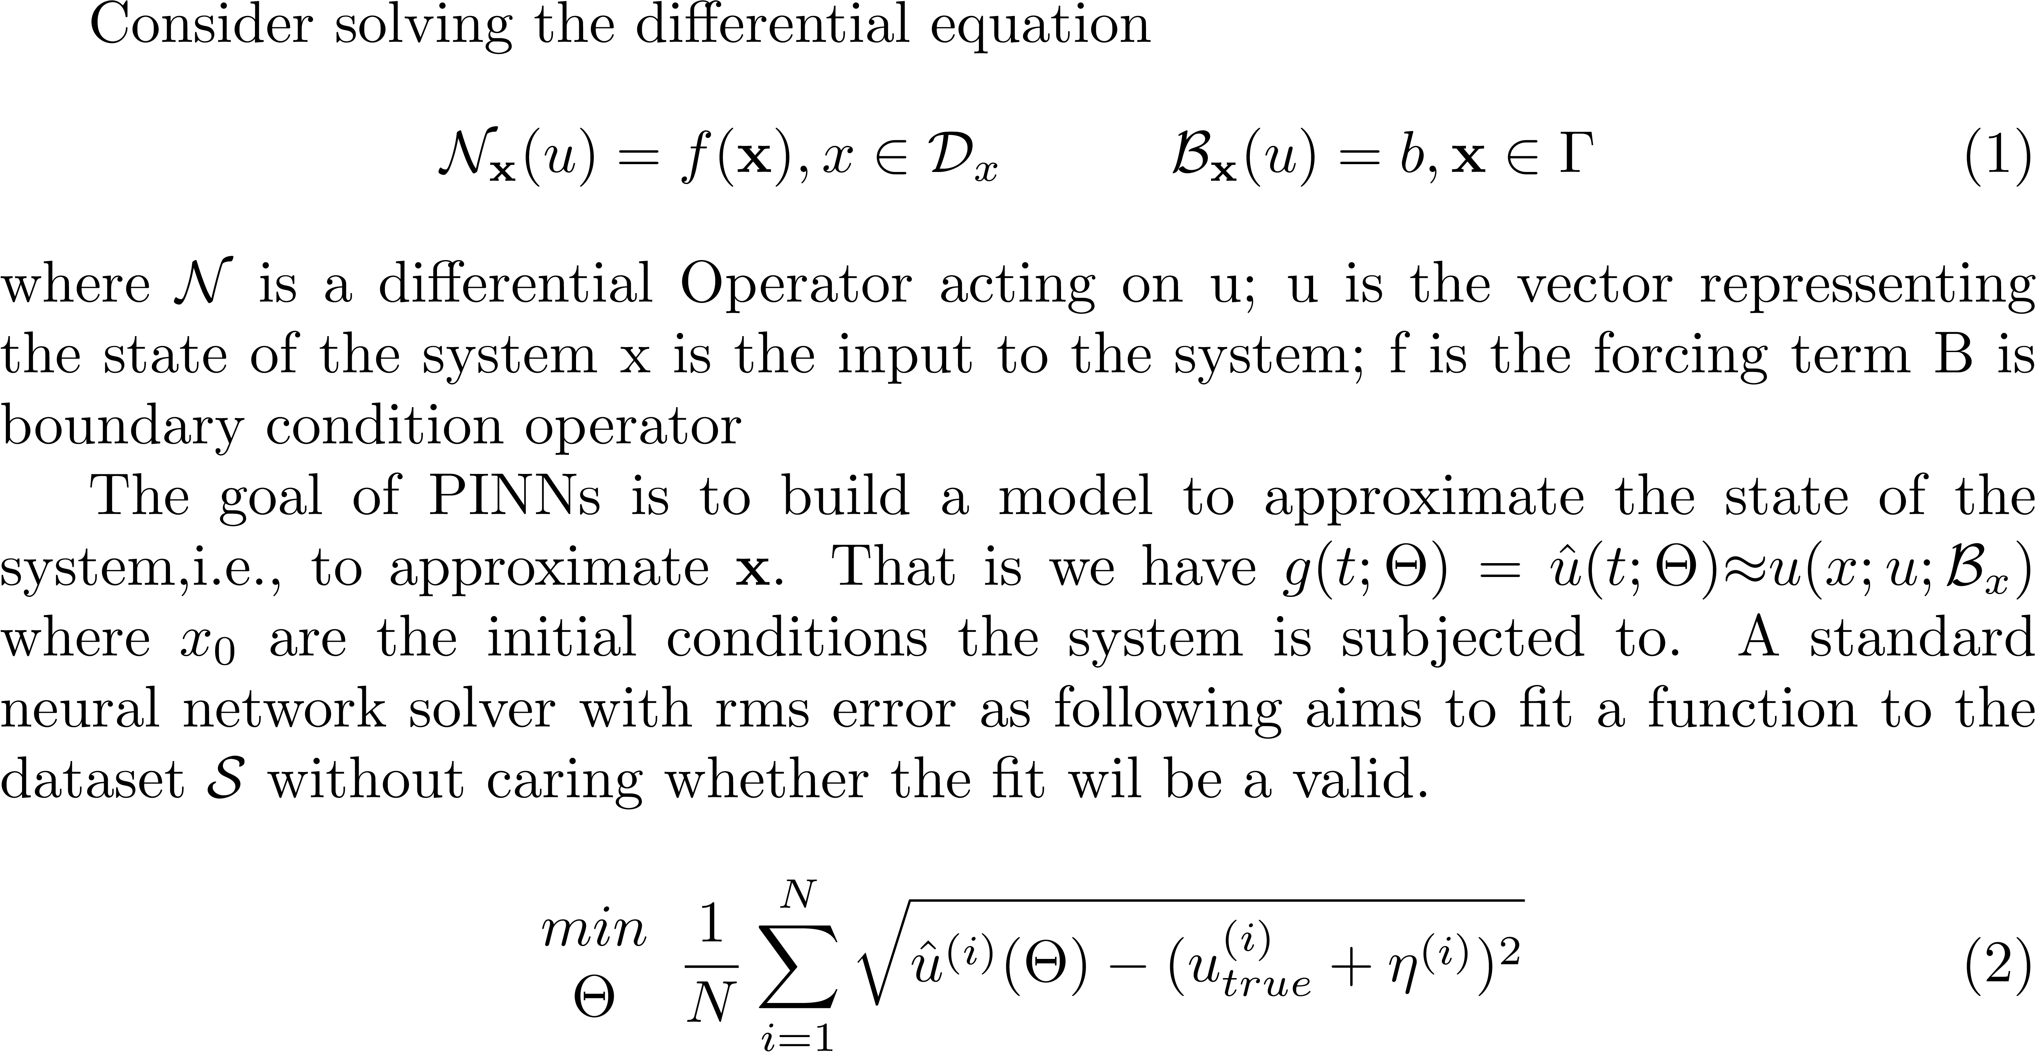
Physics Informed Neural Networks(PINNs)

Slide 7
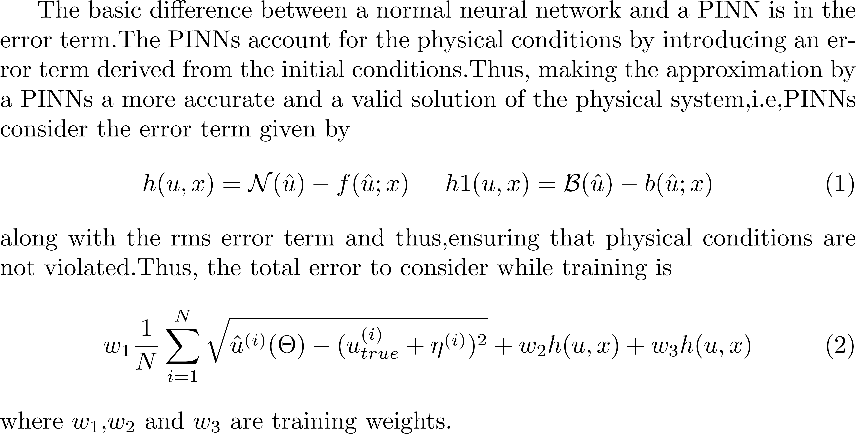
Physics Informed Neural Networks(PINNs) contd.

Slide 8
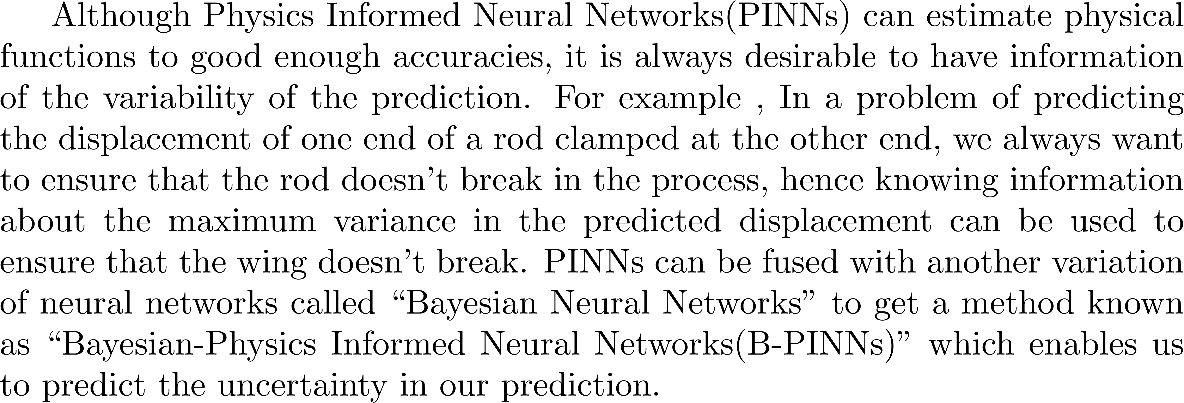
Need for Uncertainty quantification

Slide 9
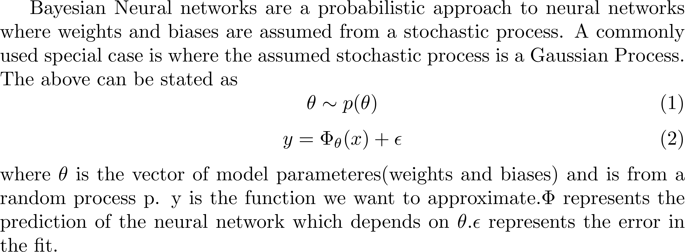
Bayesian Neural Networks

Slide 10
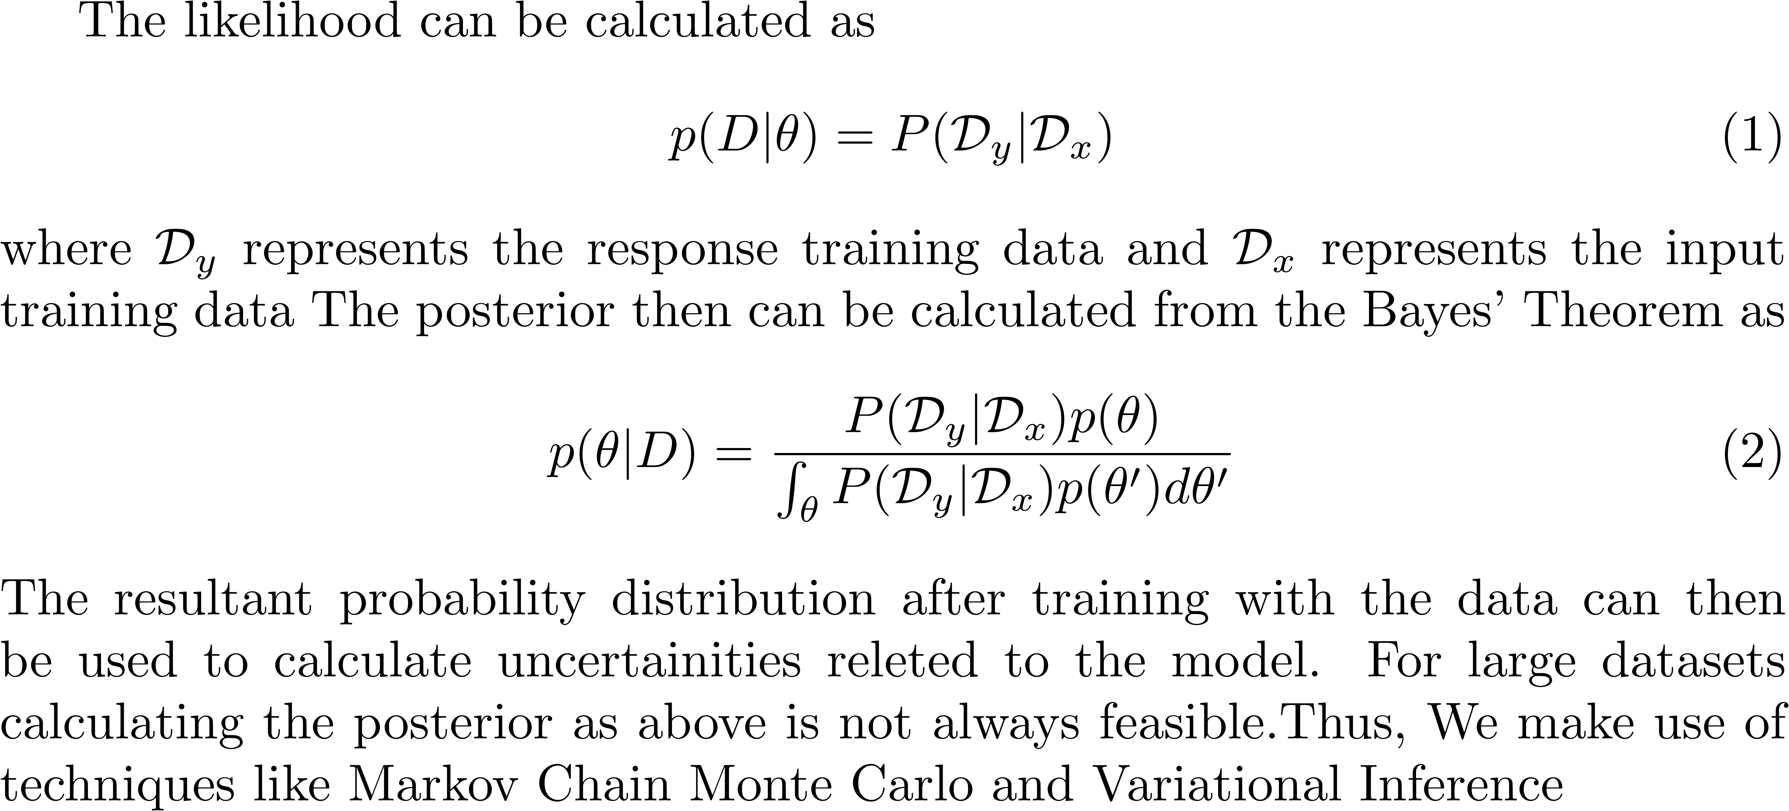
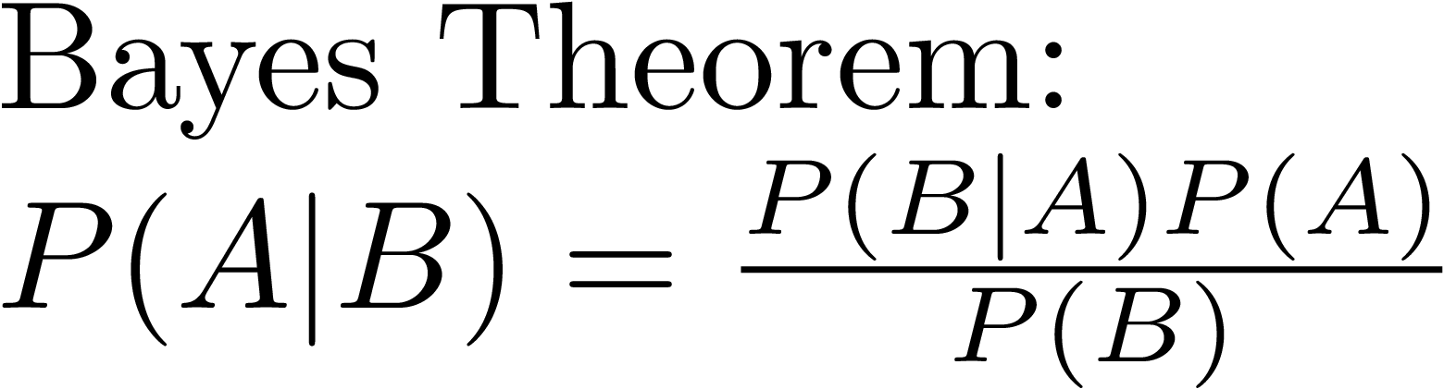
Bayesian Neural Networks

Slide 11
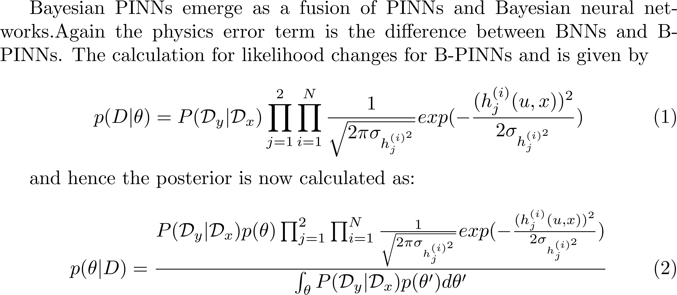
Bayesian PINNs
An assumption of Gaussian Process for errors has been made to write the likelihoods

Slide 12
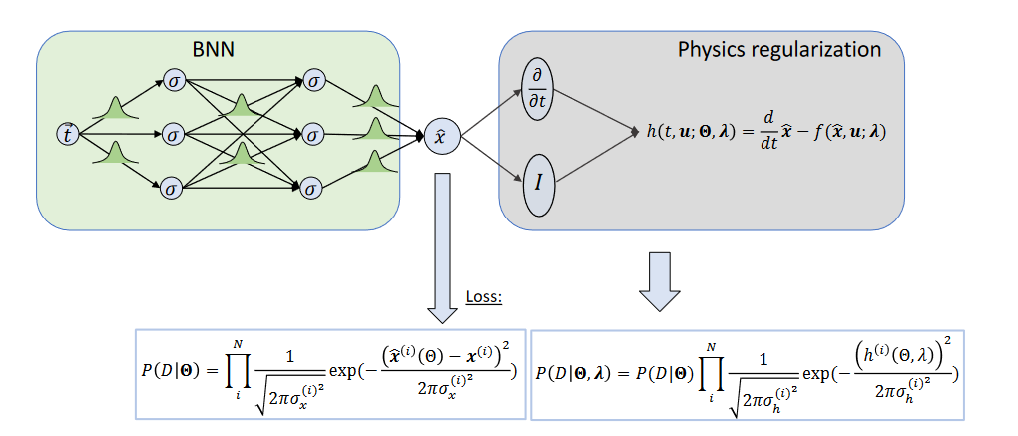
Bayesian PINNs
Fig 2: A depiction of working of Bayesian PINNs( from [1])

Slide 13
Differences in the three methods
Neural Networks
Bayesian PINNs
Physics Informed Neural Network
Aims to fit a function to the given data without accounting for physical conditions.
The fit might not be an appropriate solution for the physical problem.
Weights and biases are discrete.
Does not account for the uncertainty of the model
Aims to fit a function to the given data while accounting for physical conditions as well.
The fit is an appropriate solution for the physical problem.
Weights and biases are discrete.
Does not account for the uncertainty of the model
Aims to fit a function to the given data while accounting for physical conditions as well.
The fit is an appropriate solution for the physical problem.
Weights and biases are assumed to follow a probability distribution
Does account for the uncertainty of the model

Slide 14
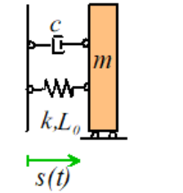
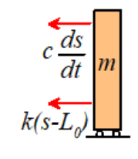
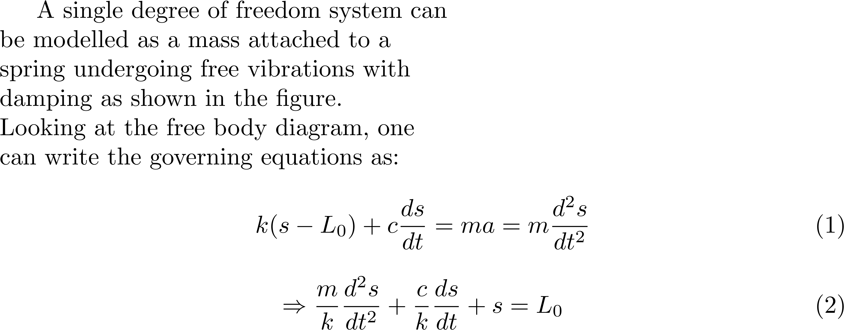
Single degree of freedom(SDOF) systems(Theory)
Fig 3: Free body diagram for SDOF system(from [5])

Slide 15
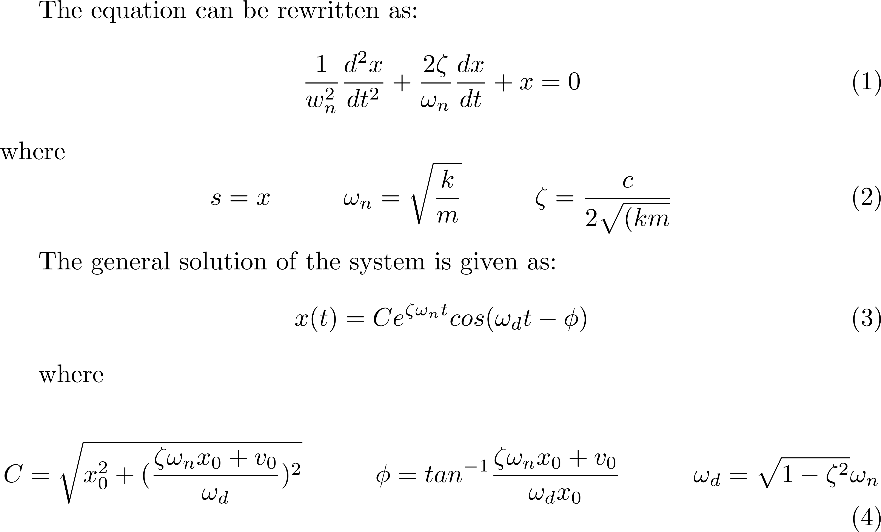
Single degree of freedom(sdof) systems(Solution)

Slide 16
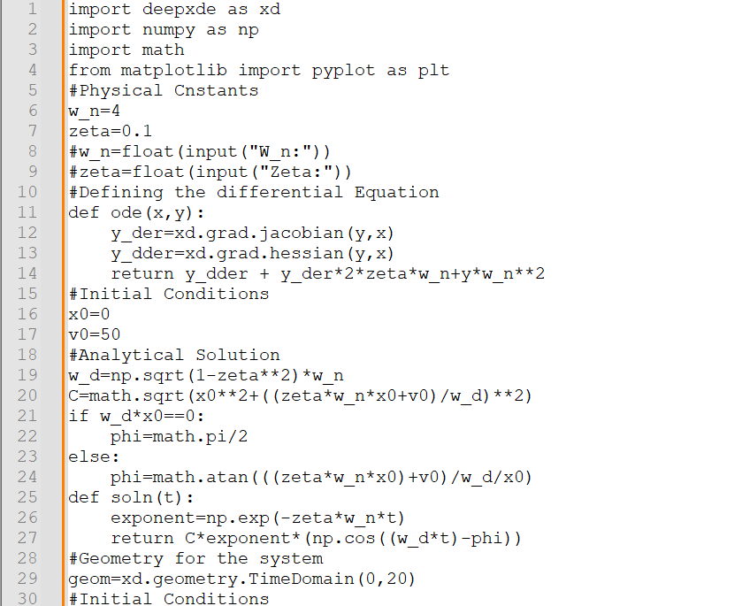
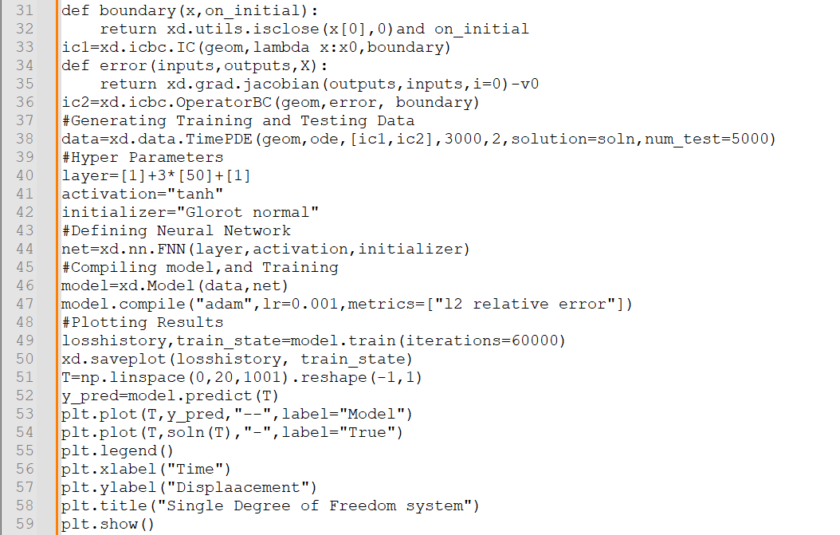
Ex: Single degree of freedom(SDOF) systems PINN(Code:DeepXde)

Slide 17
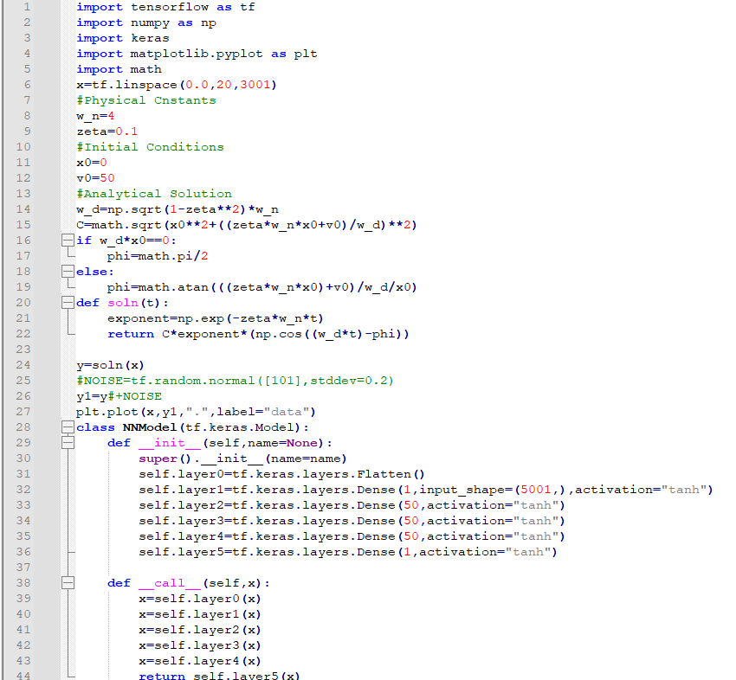
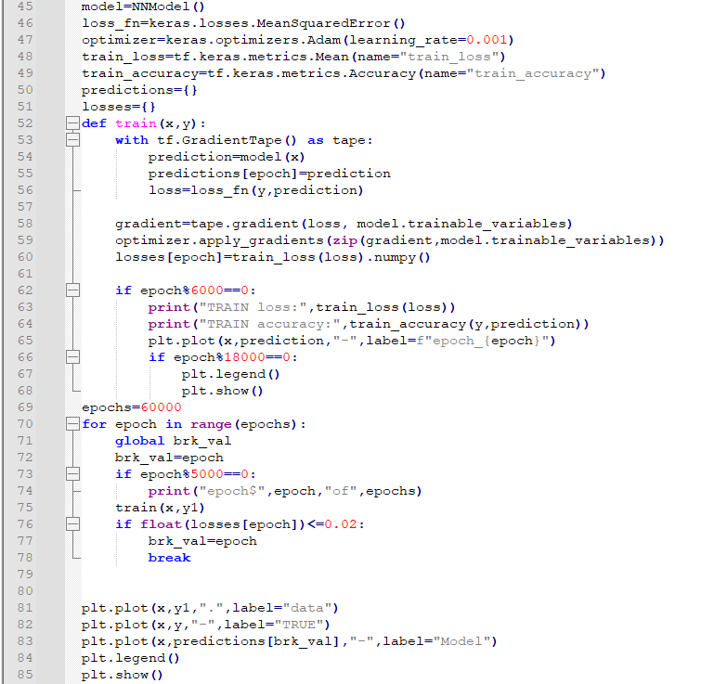
Ex: Single degree of freedom(SDOF) systems NN(Code:Tensorflow)

Slide 18
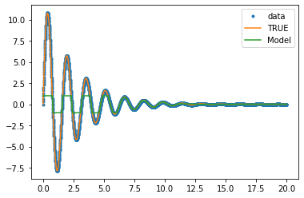
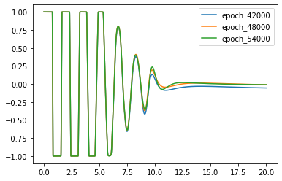
Plots for NN

Slide 19
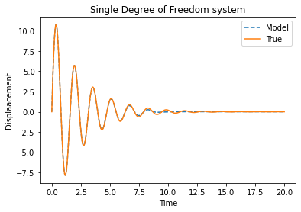
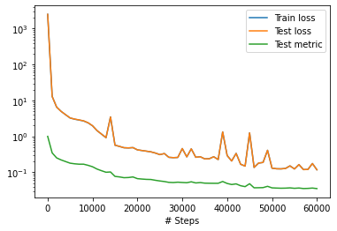
Plots for PINN

Slide 20
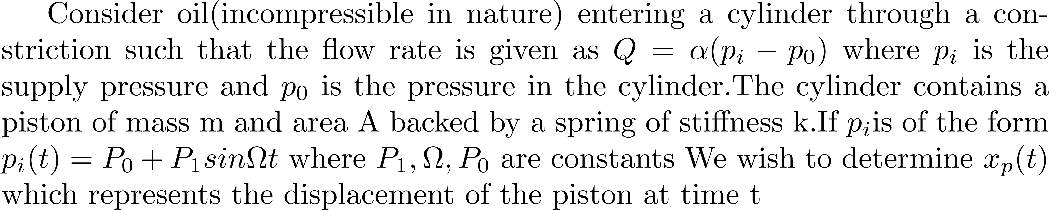
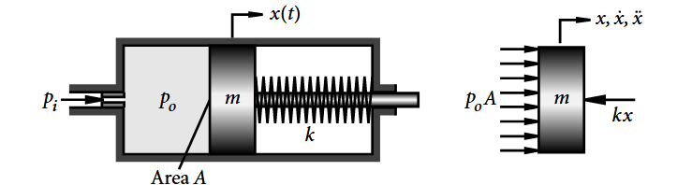
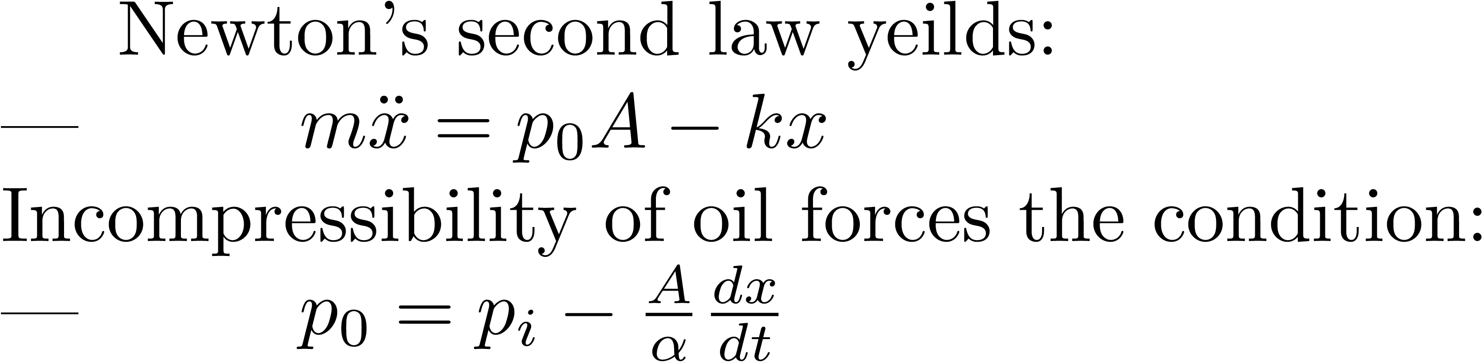
Piston Vibration(ODE Problem)
Fig 4: Depiction of the problem (from [6])

Slide 21
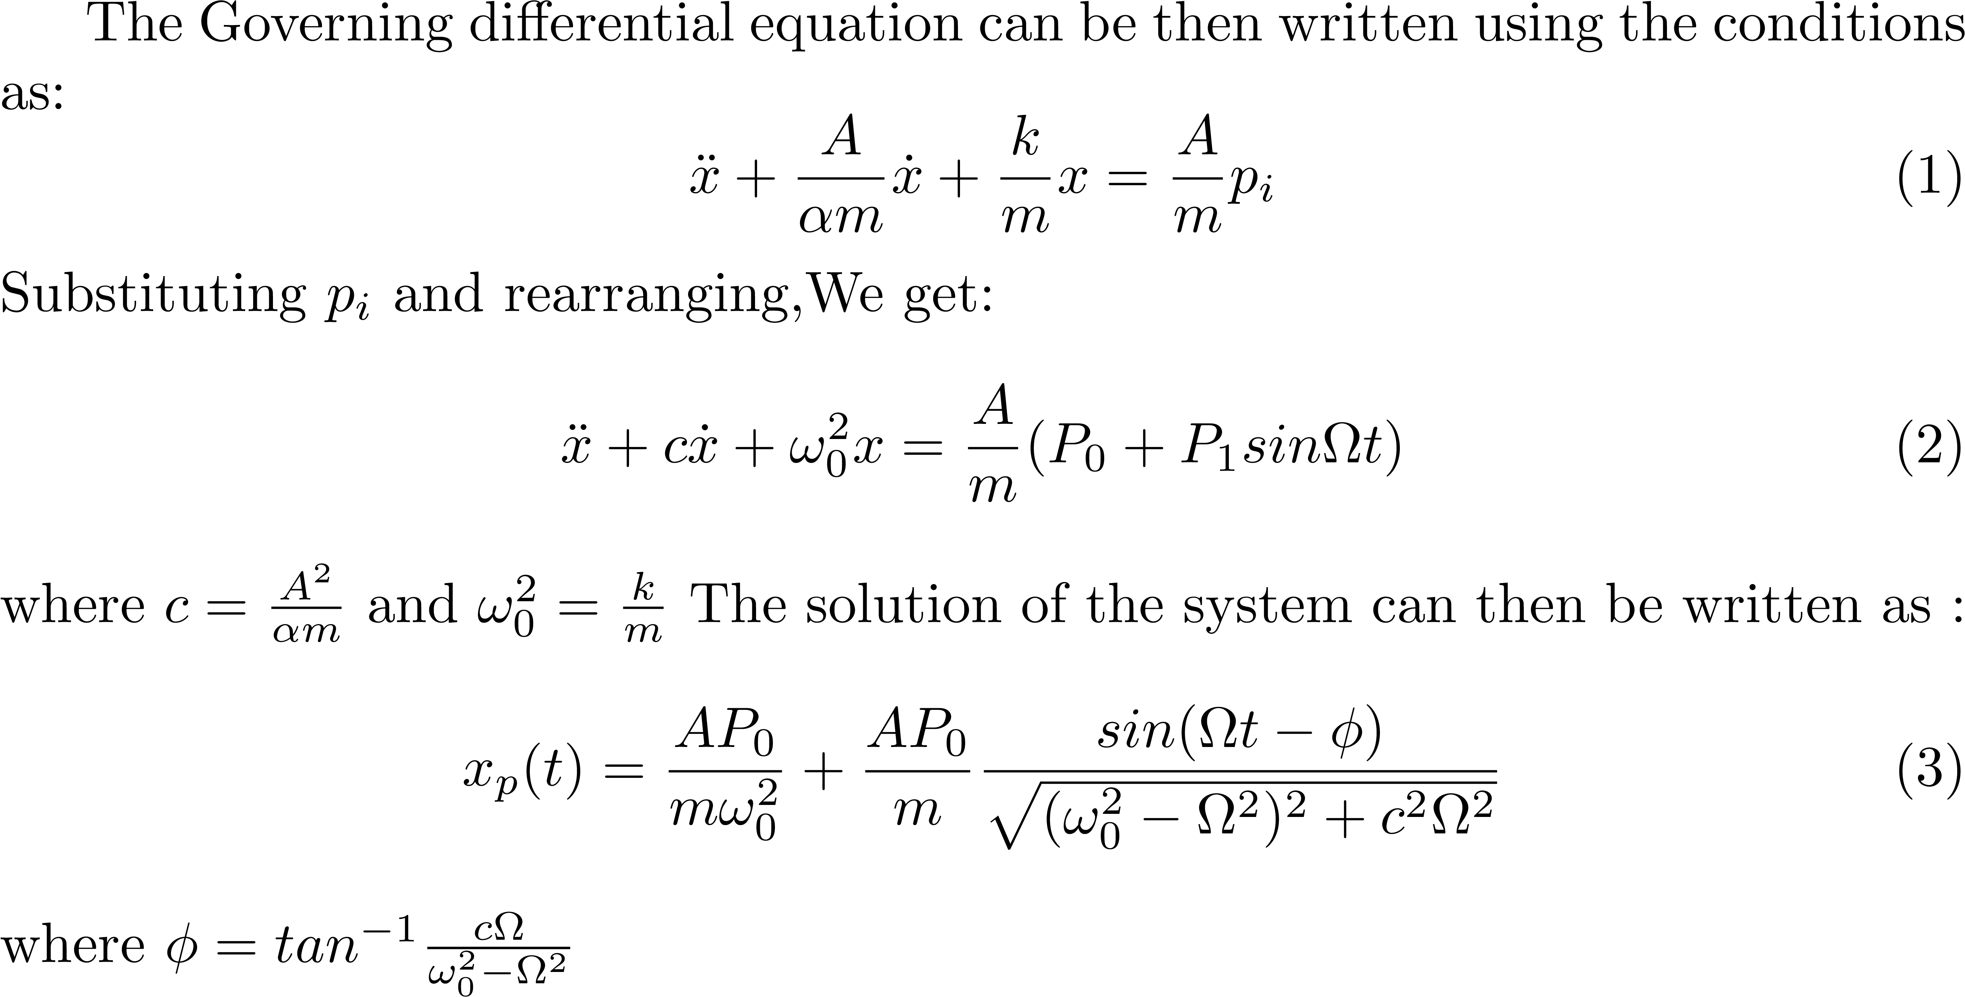
Piston Vibration(ODE Problem)(Contd.)

Slide 22
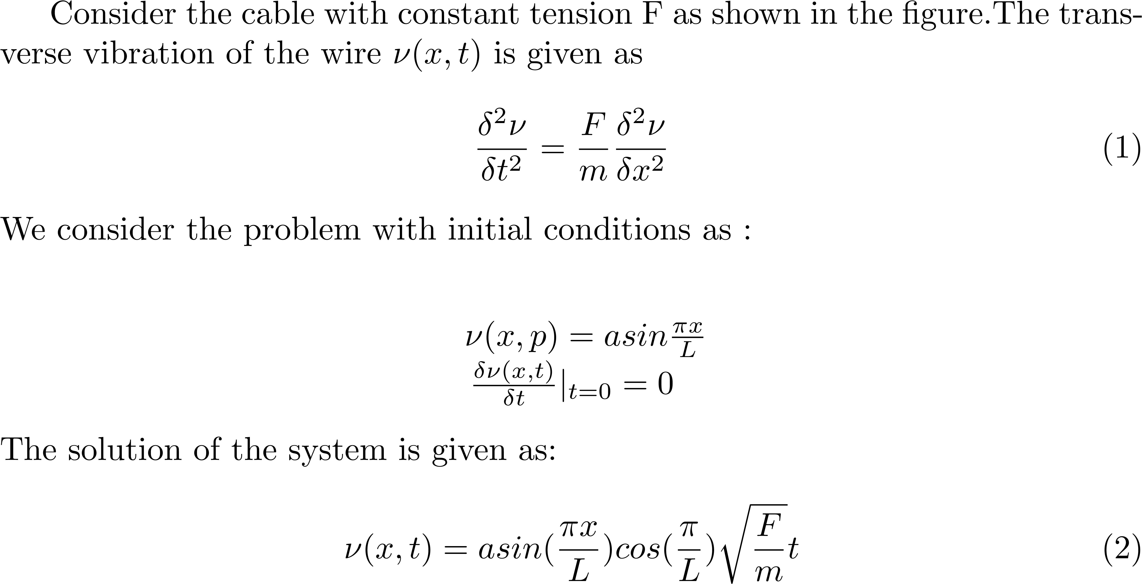
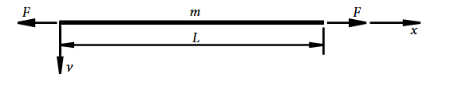
Transverse Vibration Problem(PDE Problem)
Fig 5: Depiction of problem [6]

Slide 23
References Used:
[1] Yang, Liu, Xuhui Meng, and George Em Karniadakis. "B-PINNs: Bayesian physics-informed neural networks for forward and inverse PDE problems with noisy data." Journal of Computational Physics 425 (2021)
[2] Jospin, Laurent Valentin, et al. "Hands-on Bayesian neural networks—A tutorial for deep learning users." IEEE Computational Intelligence Magazine 17.2 (2022): 29-48.
[3] Stock, Simon, et al. "Bayesian physics-informed neural networks for robust system identification of power systems." 2023 IEEE Belgrade PowerTech. IEEE, 2023
[4] Fausett, Laurene V. Fundamentals of neural networks: architectures, algorithms and applications. Pearson Education India, 2006.
[5]https://www.brown.edu/Departments/Engineering/Courses/En4/Notes/Vibrations/Vibrations.htm#Sect52
[6] Xie, Wei-Chau. Differential equations for engineers. cambridge university press, 2010
[7] Meirovitch, Leonard. Fundamentals of vibrations. Waveland Press, 2010.
Codes:
  (i) Neural Network code https://github.com/adi0ga/SRFP2024/blob/main/Spring%20mass%20System/Springmass_tf_NN.py
  (ii) PINN code https://github.com/adi0ga/SRFP2024/blob/main/Spring%20mass%20System/Springmass_alternate.py

