Slide 1

Eye For The Blind

Slide 2
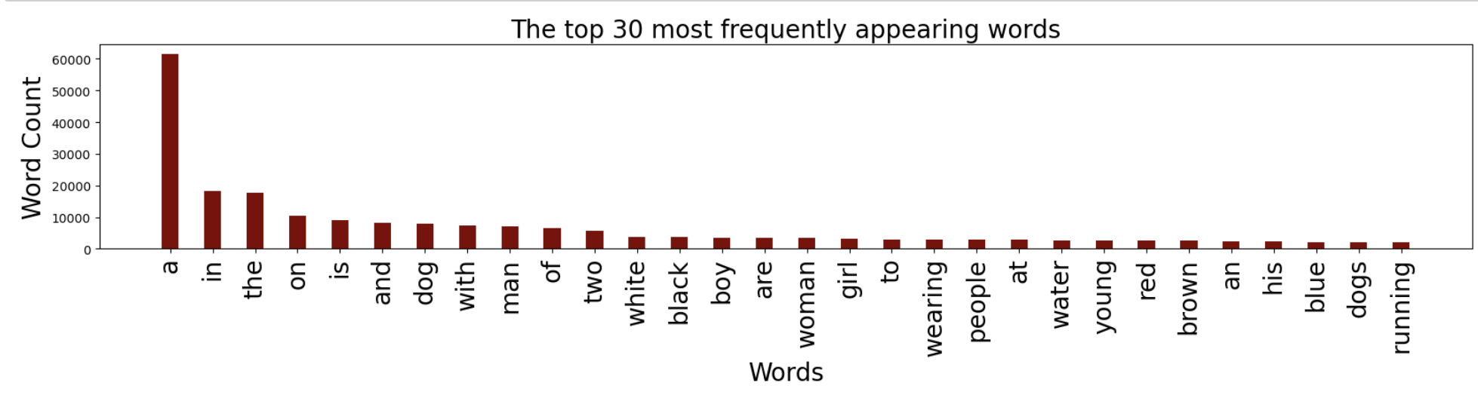
Word Count Analysis
Understanding the volume of different words appearing during the training
A appears most of the times as per the analysis
Other words appear frequenty

Slide 3
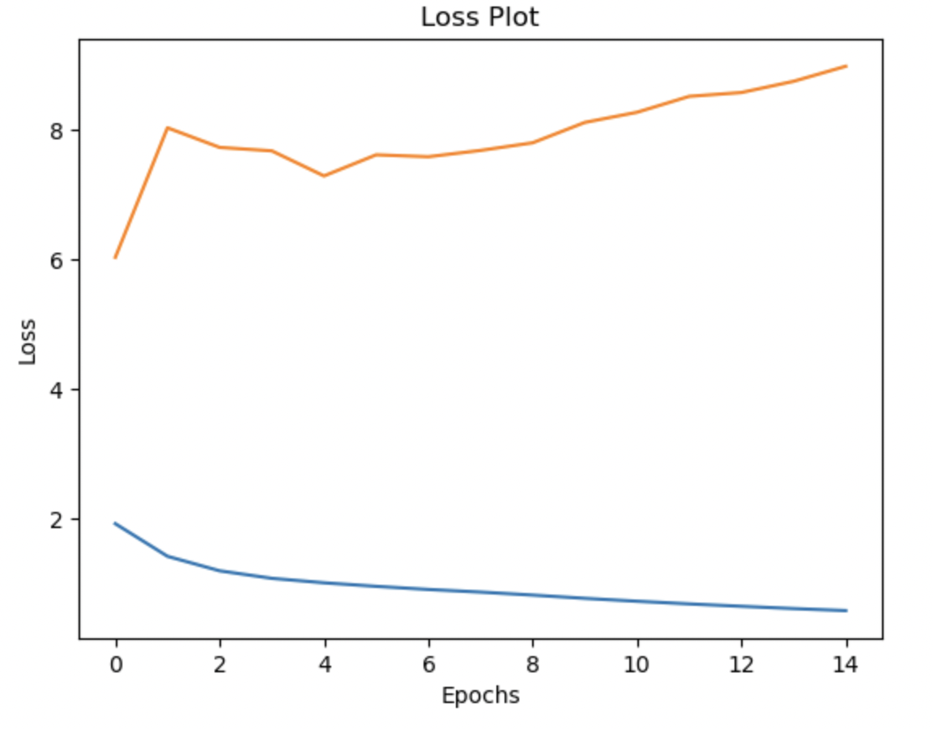
Loss plot
As we can see how the loss plot increases with the increase in epochs.
The most efficient epoch comes out to be the fourth one with minimum loss

Slide 4
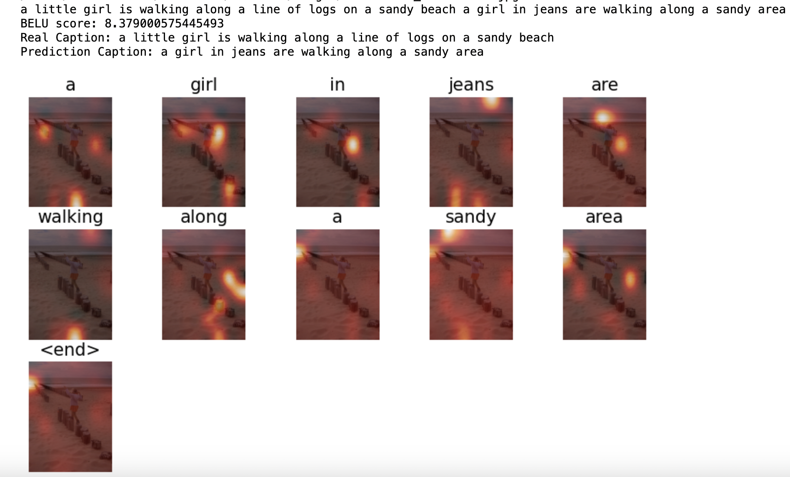
Prediction Result
As per the original understanding of the image it should be a girl walking along the line of logs on a sandy beach
The prediction is very close but misses out few key words

Slide 5
SPEAKING IMPACT
High Performance: The project's CNN-RNN architecture has demonstrated promising results in translating visual information into a format accessible to blind individuals.
The high BELU score (8.12) indicates a strong level of similarity between the machine-generated descriptions and human reference translations.
Effective Fusion of CNN and RNN: The combination of Convolutional Neural Networks (CNNs) for image feature extraction and Recurrent Neural Networks (RNNs) for sequential processing has proven effective in understanding and describing visual content.
Usability and Impact: While the technical performance seems promising, the ultimate success of the project also depends on its usability and real-world impact. Consideration should be given to factors such as user experience, accessibility, and practicality for blind users.

