Slide 1
UNIT-V
Presented By
Mrs.T.Rajya Lakshmi M.Tech.

Slide 2
Agile Methodology
The Agile methodology is a project management and software development approach that emphasizes flexibility, collaboration, and customer-centricity.
It is the latest model used by major companies today like Facebook, google, amazon, etc.
It follows the iterative as well as incremental approach that emphasizes the importance of delivering of working product very quickly..

Slide 3
What is Agile?
Agile is a project management and software development approach that aims to be more effective.
It focuses on delivering smaller pieces of work regularly instead of one big launch.
This allows teams to adapt to changes quickly and provide customer value faster.

Slide 4
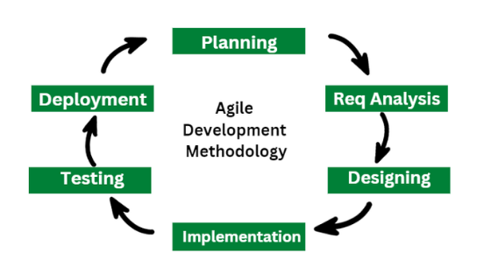

Slide 5
The 12 Agile Principles:
Customer Satisfaction through Early and Continuous Delivery
Deliver valuable software frequently to keep customers happy.
Welcome Changing Requirements, Even Late in Development
Agile embraces change to provide a competitive advantage.
Deliver Working Software Frequently
Prefer short development cycles (e.g., every 2-4 weeks) instead of long releases.
Business and Developers Must Work Together Daily
Encourage continuous collaboration between business stakeholders and technical teams.
Build Projects Around Motivated Individuals
Empower teams by giving them the trust and support they need
.

Slide 6
Cont..
Face-to-Face Communication is Most Effective
Direct conversations (or video calls for remote teams) reduce misunderstandings.
Working Software is the Primary Measure of Progress
Functional software is more important than detailed documentation.
Sustainable Development with a Consistent Pace
Teams should maintain a steady work rhythm to avoid burnout.
Continuous Attention to Technical Excellence and Good Design
Focus on high-quality coding, refactoring, and best practices.
Simplicity – The Art of Maximizing Work Not Done
- Avoid unnecessary work and keep processes lean and efficient.
Self-Organizing Teams Create the Best Designs and Solutions
- Trust the team to make technical and process-related decisions.
Regular Reflection and Adaptation
-Teams should review and improve their processes regularly

Slide 7
ADAPTing to Scrum
Adapting to Scrum is a structured approach to transitioning to Scrum, a popular Agile framework.
Adapting to Scrum can bring several benefits to teams and organizations, especially when working on complex projects that require flexibility, fast feedback, and continuous improvement.

Slide 8
CONT..
Adapting to Scrum helps teams work more efficiently, respond to change quickly, and deliver higher-quality products while maintaining a focus on customer value and team empowerment.

Slide 9
The ADAPT Framework in Scrum
1. A - Awareness
Recognize the need for change.
Understand the limitations of current processes (e.g., inefficiencies, missed deadlines, poor quality).
Identify how Scrum's iterative, incremental approach addresses these challenges.

Slide 10
2. D - Desire
Build motivation and commitment within the organization to adopt Scrum.
Communicate the benefits of Scrum, such as enhanced adaptability, improved collaboration, and better product quality.
Garner leadership support and align teams with the vision for Agile transformation.

Slide 11
A - Ability
Provide necessary training on Scrum roles (Scrum Master, Product Owner, Development Team), events (Sprint Planning, Daily Stand-ups, etc.), and artifacts (Product Backlog, Sprint Backlog, Increment).
Ensure teams have the tools and skills to implement Scrum effectively.
Promote hands-on practice with pilot projects.

Slide 12
P - Promotion
Showcase early successes from Scrum adoption.
Share success stories within the organization to build trust and momentum.
Encourage incremental progress rather than a complete overhaul.

Slide 13
5. T - Transfer
Scale Scrum practices to more teams and departments.
Embed continuous improvement as a cultural norm through retrospectives and feedback loops.
Ensure the sustainability of Scrum adoption by aligning organizational structures, policies, and leadership support.

Slide 14
Key Considerations for ADAPTing to Scrum:
Start small: Implement Scrum in one team or project before scaling.
Be patient: Cultural and behavioral changes take time.
Empower teams: Encourage self-organization and ownership.
Focus on outcomes: Measure success by value delivered, not just adherence to the process.

Slide 15
Patterns for Adopting Scrum
Adopting Scrum successfully requires a structured approach and an understanding of common patterns that help organizations transition effectively.
Here are some key patterns for adopting Scrum:

Slide 16
Cont..
Organizational Commitment Patterns
Team Formation Patterns
Incremental Adoption Patterns
Sprint Execution Patterns

Slide 17
1. Organizational Commitment Patterns
Executive Sponsorship – Leadership support is crucial for a successful Scrum adoption. Leaders must understand and promote Agile values.
Change Agents – Appoint Agile Coaches or Scrum Masters to guide the transformation.
Scrum Education – Train teams and stakeholders on Scrum principles and practices.
2. Team Formation Patterns
Stable, Cross-functional Teams – Form teams with all necessary skills to deliver a working product increment.
Dedicated Teams – Ensure team members are fully dedicated to one Scrum Team to avoid context-switching.
Self-Managing Teams – Empower teams to make decisions and self-organize.

Slide 18
3. Incremental Adoption Patterns
Start Small, Scale Gradually – Begin with a few teams and expand Scrum adoption progressively.
Pilot Teams – Select a few teams to experiment with Scrum before a company-wide rollout.
Scrum of Scrums – Coordinate multiple Scrum Teams when scaling Agile.
4. Sprint Execution Patterns
Definition of Done (DoD) – Establish a clear standard for completed work.
Time boxed Sprints – Stick to consistent Sprint lengths (e.g., 1-4 weeks).
Daily Scrum Ritual – Conduct daily stand-up meetings to inspect progress and adjust plans

Slide 19
Fundamentals of DevOps
Architecture
Deployments
Orchestration Need
Instance of applications
DevOps delivery pipeline
DevOps eco system.

Slide 20
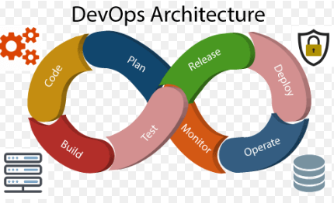

Slide 21
DevOps is a collection of two words, “Development” and “Operations,” representing a cultural approach that emphasizes collaboration between development and operations teams to streamline the entire software delivery lifecycle.

Slide 22
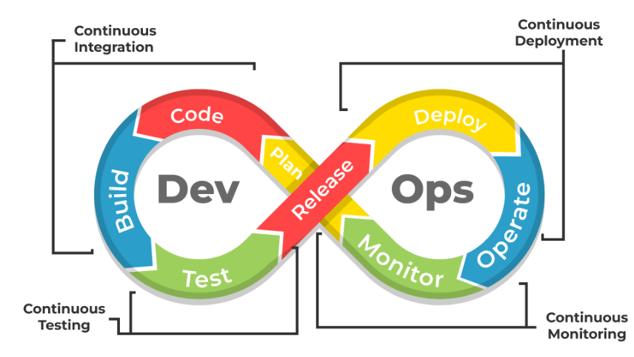

Slide 23
Orchestration Need
Orchestration is the coordinated execution of multiple IT automation tasks or processes. Orchestration is usually applied across multiple computer systems, applications, and services to ensure that deployment, configuration management, and other processes are performed in the proper sequence.

Slide 24
Automation and orchestration are distinct, but related concepts.
Automation is the use of software to perform tasks without human intervention, to minimize errors and reduce the time spent manually performing the operations needed to deploy, manage, and scale IT applications and infrastructure.

Slide 25
Real Time Example
Online Food Delivery

Slide 26
Real Time Example
Orchestration Example: Online Food Delivery
Order Placement – Customer places an order; the orchestrator initiates the workflow.
Restaurant Confirmation – Orchestrator sends request to restaurant; if rejected → offer alternatives.
Payment Processing – Orchestrator triggers payment; if successful → proceed; if failed → notify user.
Delivery Assignment – Orchestrator assigns a driver; if no driver available → retry or cancel.
Order Tracking – Orchestrator manages real-time updates (Confirmed → Preparing → Delivered).
Completion and Feedback – Orchestrator finalizes order, triggers payment settlement, and collects feedback.

Slide 27
🔥 Why Orchestration Matters:
✅ Centralized control for smooth execution ✅ Error handling and recovery ✅ Real-time updates and better user experience ✅ Scalable and adaptable to high order volumes
👉 Outcome: Fast, reliable order fulfillment with minimal errors and high customer satisfaction

Slide 28
Instance of applications in DevOps
In DevOps, applications play a crucial role in the software development lifecycle.
These are
Continuous Integration Tools
Continuous Delivery Tools
Infrastructure as Code (IaC) tools
Monitoring and Logging Tools
Collaboration Tools

Slide 29
Some instances of applications in DevOps include:
1.Continuous Integration (CI) tools: These tools are used to automate the process of building and testing code changes as they are committed to the repository.
Examples of popular CI tools include Jenkins, Travis CI, and CircleCI.
2. Continuous Delivery (CD) tools: These tools automate the process of deploying code changes to production.
Examples of popular CD tools include Spinnaker, AWS CodeDeploy, and Octopus Deploy.

Slide 30
3. Infrastructure as Code (IaC) tools: These tools enable the automation of infrastructure provisioning and management through the use of code.
Examples of popular IaC tools include Terraform, Ansible, and Puppet

Slide 31
4.Monitoring and Logging tools:
These tools help in detecting and addressing issues in production environments.
Monitoring and Logging tools help in detecting and addressing issues in production environments.
Examples of popular monitoring and logging tools include Prometheus, Grafana, and ELK Stack.
5. Collaboration tools:
These tools help in team communication and collaboration, enabling a smooth workflow.
Examples of popular collaboration tools include Slack, Microsoft Teams, and Jira.

Slide 32
DevOps delivery pipeline
A DevOps delivery pipeline is a structured process that automates the building, testing, and deployment of software.
It ensures that code changes are continuously integrated, tested, and released into production with minimal manual intervention, improving the speed and reliability of software delivery.

Slide 33
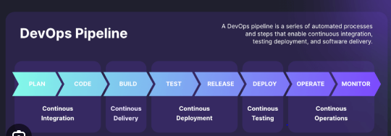

Slide 34
DevOps ecosystem
The DevOps ecosystem refers to the collection of tools, practices, and cultural philosophies that enable organizations to deliver applications and services at high velocity.
DevOps integrates development (Dev) and operations (Ops) to improve collaboration, automate processes, and shorten the software development lifecycle (SDLC).

Slide 35
Core Components of the DevOps Ecosystem
1. Planning
2. Development
3.Building
4. Testing
5. Release
6. Deploy
7.Operate
8.Monitor and Feedback

Slide 36
1. Planning
Define requirements, goals, and roadmaps.
Tools:
Jira
Jira is a work management tool for software teams that need to organize and track their work
Trello
Trello is the visual work management tool that empowers teams to ideate, plan, manage, and celebrate their work together in a collaborative, productive, and organized way. Whether you and your team are starting something new or trying to get more organized with your existing work, Trello adapts to any project.
Confluence

Slide 37
2. Development
Write, review, and manage code.
Tools:
Git (version control)
GitHub, GitLab, Bitbucket
Visual Studio Code, IntelliJ

Slide 38
3.Building
Automate code compilation and build process.
Tools:
Maven
Gradle
Bazel

Slide 39
4. Testing
Automate testing to catch bugs early.
Tools:
JUnit, Selenium (unit testing)
SonarQube (code quality)
TestNG, Cucumber

Slide 40
5. Release
Manage deployment pipelines.
Tools:
Jenkins
GitLab CI/CD
Spinnaker
Travis CI

Slide 41
6. Deploy
Automate and manage deployments.
Tools:
Docker (containerization)
Kubernetes (orchestration)
Ansible, Terraform, Helm (infrastructure as c

Slide 42
Docker
Docker is a software platform that allows you to build, test, and deploy applications quickly. Docker packages software into standardized units called containers that have everything the software needs to run including libraries, system tools, code, and runtime.

Slide 43
Kubernetes
Kubernetes automates operational tasks of container management and includes built-in commands for deploying applications, rolling out changes to your applications, scaling your applications up and down to fit changing needs, monitoring your applications, and more—making it easier to manage applications.

Slide 44
7. Operate
Monitor and manage infrastructure and applications.
Tools:
Prometheus (monitoring)
Grafana (visualization,query,Sorting and finding Data)
Datadog
Datadog is a cloud-based monitoring and analytics platform that helps companies keep their applications and services running smoothly.

Slide 45
8. Monitor and Feedback
Gather insights and improve processes.
Tools:
ELK Stack (Elasticsearch, Logstash, Kibana)
Splunk
PagerDuty (incident response)

Slide 46
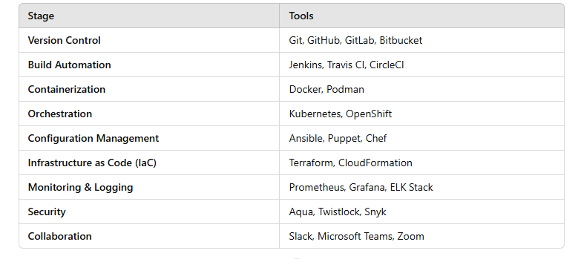
Popular DevOps Tool Chain

