Slide 1
Business Overview
Entity Relationship Diagram
Presented by: Aditya Kamboj (Adi)

Slide 2
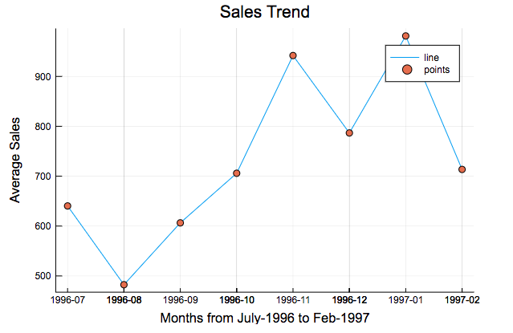
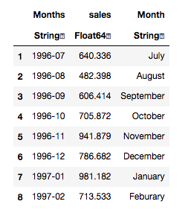
Sales analysis
Company’s sales trend over time? (Monthly)
November, 1996 and January, 1997 were our busiest months. We experienced a significant increase over previous months

Slide 3
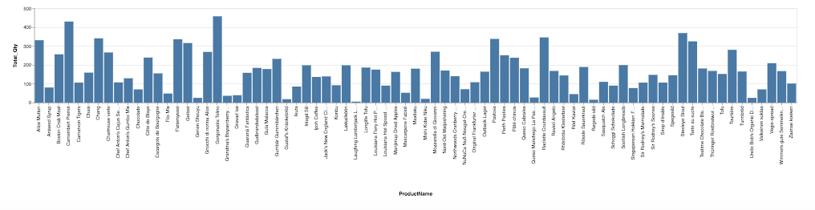
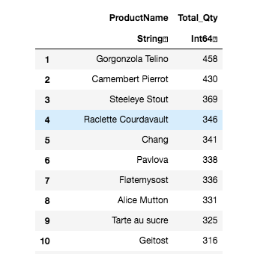
Product Analysis
Product popularity by quantity sold since inception
Following are the top ten products that generates 29% of the revenue and bar chart depicts volume sold for each product

Slide 4
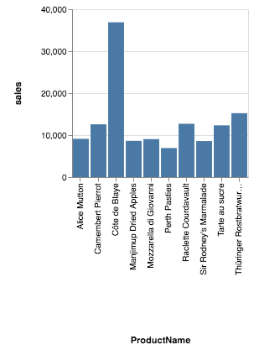
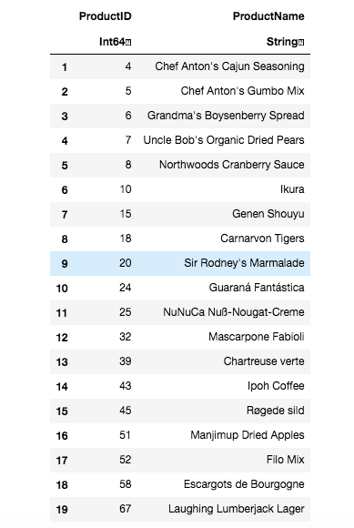
Product Analysis
Top 10 revenue generating products in the Fiscal Year
Products that have not been ordered in the past three months as measured from Fiscal Year End
Majority of the revenue is driven by the top 10 products which accounts for an aggregate of $132,046 i.e., almost 45% of the total products sales

Slide 5
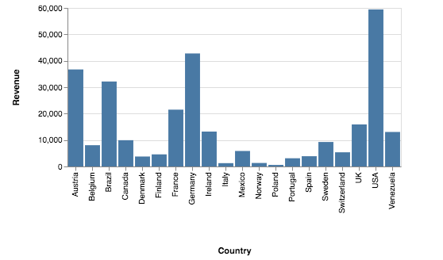
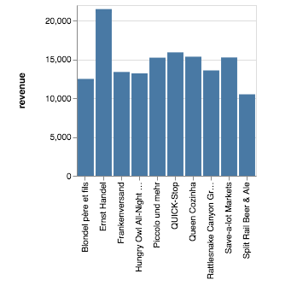
Customer Analysis
Fiscal year Revenue by customer’s Country
Top 10 customers by revenue during Fiscal year
65% of the revenue is generated from the customers living in USA, Germany, Australia, Brazil and France
Our top 10 customers are the most profitable customers, as they generate 65% of the total revenue generated by the customers

Slide 6
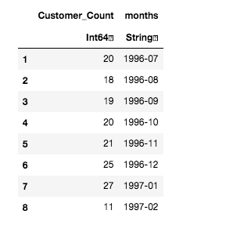
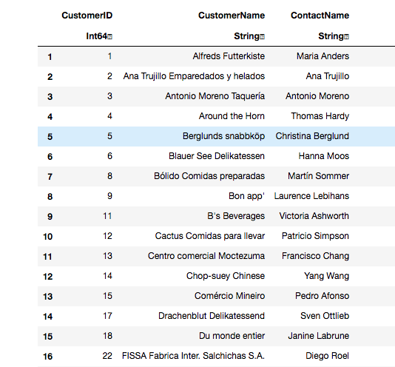
Customer Analysis
Customer acquired each month
In total, there are 57 customers that have not ordered in past 6 months and
are deemed attrited
Customer acquisition gained pace after October-1996

Slide 7
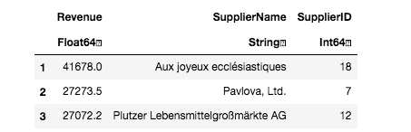
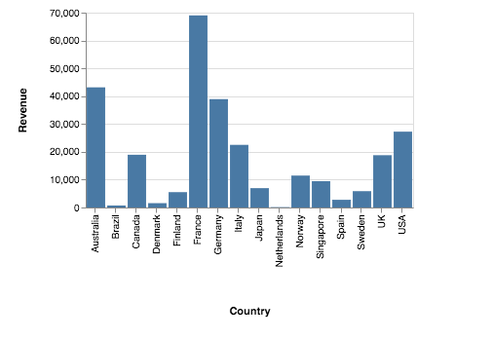
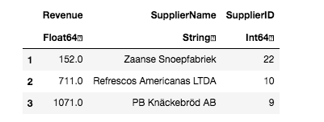
Supplier Analysis
Fiscal year Revenue by supplier Country
Top 3 suppliers by business volume ($)
Top 3 suppliers by business volume ($)
France, Germany and Australia are our top 3 countries by suppliers. 54% of the revenue generated come from products supplied from suppliers pf these countries
Aux joyeux eccl√©siastiques, Pavlova, Ltd. and Plutzer Lebensmittelgro√üm√§rkte AG are our top 3 suppliers – 34% of the revenue is generated from them

