Slide 1
SPARSE REPRESENTATION BASED ITERATIVE INCREMENTAL FACIAL IMAGE DEBLURRING
Team Members:
Jayakrishna Narra jn1711
Sahil Paneri sp4313

Slide 2
Objective and GOAL
Objective :
- Deblurring to attain Clean Facial images for better face recognition.
Goals:
- Sparse representation of images
- Dictionary Learning
- Sparse Iterative Incremental Deblurring

Slide 3
Sparse Representation
Sparse representation means
- to look for a good expression with fewest words.
In terms of images given an image x, we can represent it as
x = Dα
- where D is the Dictionary and α is the sparse representation.
Popular selection for D : Fourier, Wavelet, Curvelet etc.

Slide 4
Dictionary Learning
No single method can represent an image desirably and generally.
It will be beneficial if we can design a dictionary D that is more
- flexible
- adaptive
Learn the dictionary adaptively from similar images.
- K-SVD

Slide 5

K-SVD [2]
K-SVD consists of two steps:
-Sparse Coding Stage
Searching for the sparse representation for each sample.
-Dictionary Update Stage
Revising the dictionary using SVD decomposition.

Slide 6
SPARSE ITERATIVE INCREMENTAL DEBLURRING [1]
min || y- Hx ||₂
s.t. ( x )_{i} ≥ 0 and x = Dα , || α ||₀ ≤ λ
Given dictionary D, Initialize x_{0.}
Calculate frequency error
S_{k}(ω) = Y(ω) - X_{k}(ω) H(ω)
Update the (k+1)th iteration through
X_{k+1}(ω) = X_{k}(ω) + (H*(ω) S_{k}(ω)/(|H(ω)|² + γ))

Slide 7
SPARSE ITERATIVE INCREMENTAL DEBLURRING contd..
Perform inverse Fourier Transform to get x_{k+1}
Apply non-negative constraint to get x_{k+1,p}
Apply sparseness constraint by calculating α using Orthogonal Matching Pursuit (OMP) to get x_{k+1,p,s} through x = Dα
Set x_{k+1,p,s} as the current estimate

Slide 8
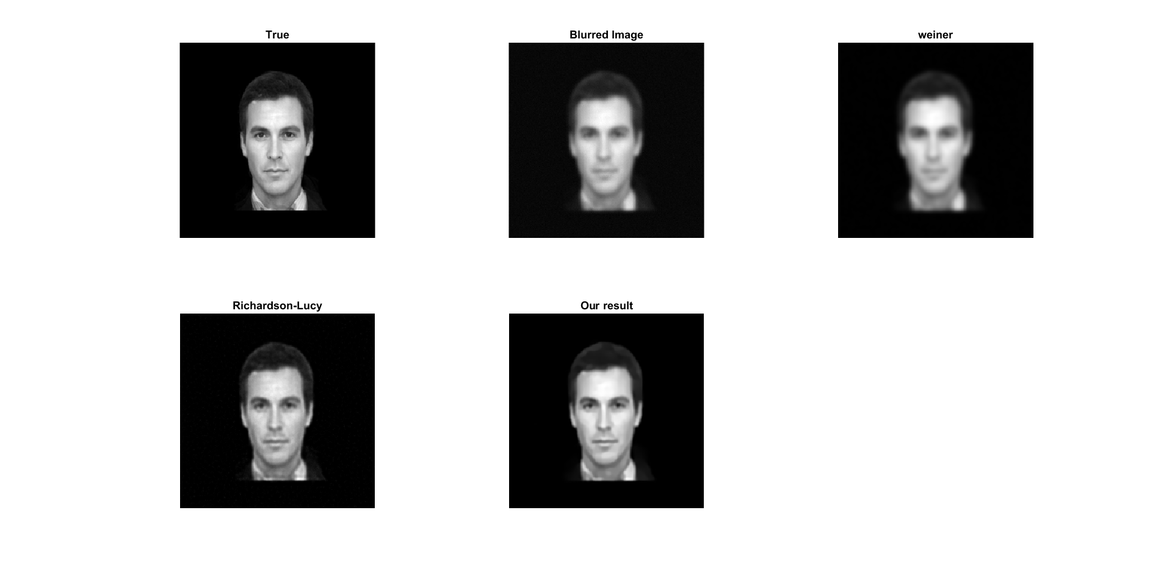
Results Gaussian 15X15, sigma=2

Slide 9

Results Motion filter, length = 20, angle = 45

Slide 10

Results Motion filter, length = 30, angle = 0

Slide 11
Future Work
Develop a blind deconvolution method that estimates the kernel [3].
Verify this algorithm with different face recognition methods.

Slide 12
References
Zhang, Haichao, and Yanning Zhang. "Sparse representation based iterative incremental image deblurring." Image Processing (ICIP), 2009 16th IEEE International Conference on. IEEE, 2009.
M. Aharon, M. Elad, A. Bruckstein, K-SVD: An Algorithm for Designing Overcomplete Dictionaries for Sparse Representation, IEEE Trans. on Signal Processing, pp.4311-4322, 2006
Zhang, Haichao, et al. "Sparse representation based blind image deblurring." Multimedia and Expo (ICME), 2011 IEEE International Conference on. IEEE, 2011.
L. B. Lucy, An iterative technique for the rectification of observed distributions, Astronomical Journal, pp.745-754, 1974
R.C. Puetter, T.R. Gosnell, A. Yahil, Digital Image Reconstruction: Deblurring and Denoising, ARAA, pp.139-194, 2005

Slide 13
Thank you

