Slide 1
The Social Network
Group 9
Aditya Rajguru
Edgar Gonzalez
Atafo Ayodele Abure
Tufan Acharya
Joshua Abuto
Instructor: Bud Davis
An interactive program that enables users to share ideas and connect with each other.

Slide 2
Contents
Introduction
About The social Network
Software development process
How the program works
Transition from Iteration I to Iteration II
Program in use.

Slide 3
Introduction
A program to communicate, post ideas and interests.
Currently targeted for CSE 3310 class.
Runs on command-line interface.
First version released on 09/29/2018, was not fully functional.
Resolved the issues from first version and added more functionality to version 2.0.

Slide 4
About the social network
User1
OS
Request Post
Message Sent
User2
User1
User2
Receive Post
OS
Message Received
OS
A user can request post from other user.
A user can send direct message to other user.
User3
All users are connected to each other through open splice.
POST
User
Local Machine
OS= Open Splice

Slide 5
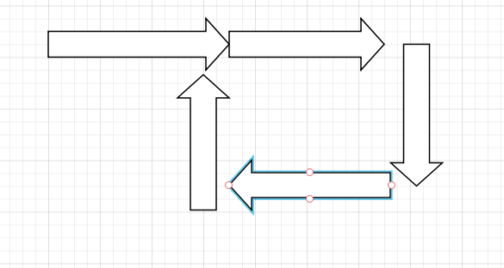
Software development process
Agile development process
Steps:
Requirements
Design
Development
Testing
Release
Receive Feedback
Add functionality
Requirements/Design
Develop
Next Iteration
Test
Feedback
Release

Slide 6
How the program Works
TODO

Slide 7
Transition from Iteration I to Iteration II
Mostly resolved the issues from Iteration I.
Functionality addition
Send direct message to another user
Notification when new user is online

Slide 8
Transition from Iteration I to Iteration II
SLOC Iteration I | SLOC Iteration II

Slide 9
Program in use
Some screenshots of the program in use

