Slide 1
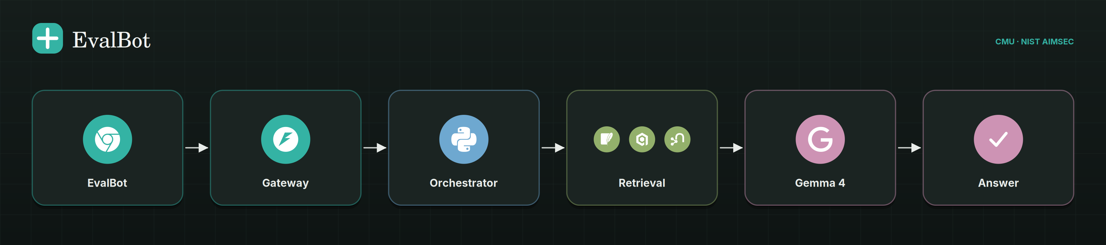
An evaluation assistant
for clinical AI
Ask what to evaluate for a clinical model. It answers with a cited evaluation plan, a checklist you can tick off, and the standard that applies.
CMU · NIST AIMSEC
Gemma 4 26B-A4B
15,954 papers
github.com/adi274903/MARS-Healthcare · live at localhost:8080

Slide 2
THE GAP
Evaluation is scattered. Claims go out unaudited.
— Reporting guidance is splintered. TRIPOD+AI, PROBAST+AI, CONSORT-AI, DECIDE-AI, CLAIM, CHART.
— Governance sits elsewhere. NIST AI RMF, FUTURE-AI, WHO, FDA GMLP/PCCP/SaMD, CHAI, EU AI Act, ISO/IEC 42001.
— The evidence of what the field actually did is buried in 15,954 papers nobody has time to read.
— So every team invents its own checklist, and a model card becomes an act of memory rather than a citation.
the problem is retrieval + synthesis, not a lack of knowledge

Slide 3
WHAT IT DOES
Four things, on every question
01
02
Plans
Cites
Turns “should we trust this model?” into concrete, checkable evaluation items.
Every item points at a PubMed or DOI record, with the claim it supports attached.
03
04
Names the standard
Counts exactly
TRIPOD+AI, PROBAST+AI, FDA SaMD, EU AI Act, NIST AI RMF — matched, not guessed.
Corpus totals come from SQL, never from the model's arithmetic.

Slide 4
HOW ONE QUESTION FLOWS
Routed by intent before a single token is generated
ASK
ROUTE
RETRIEVE
COMPOSE
ANSWER
system type
stage · region
aggregate · faceted
semantic · multihop
SQL · BM25
vectors · graph
evidence + stats
+ guidance
streamed, cited
or refused
WHY THE ROUTER MATTERS
— “How many papers…” never reaches the model. It is a SQL aggregate, quoted verbatim.
— A question about a regulation pulls guidance, not an arbitrary paper.

Slide 5
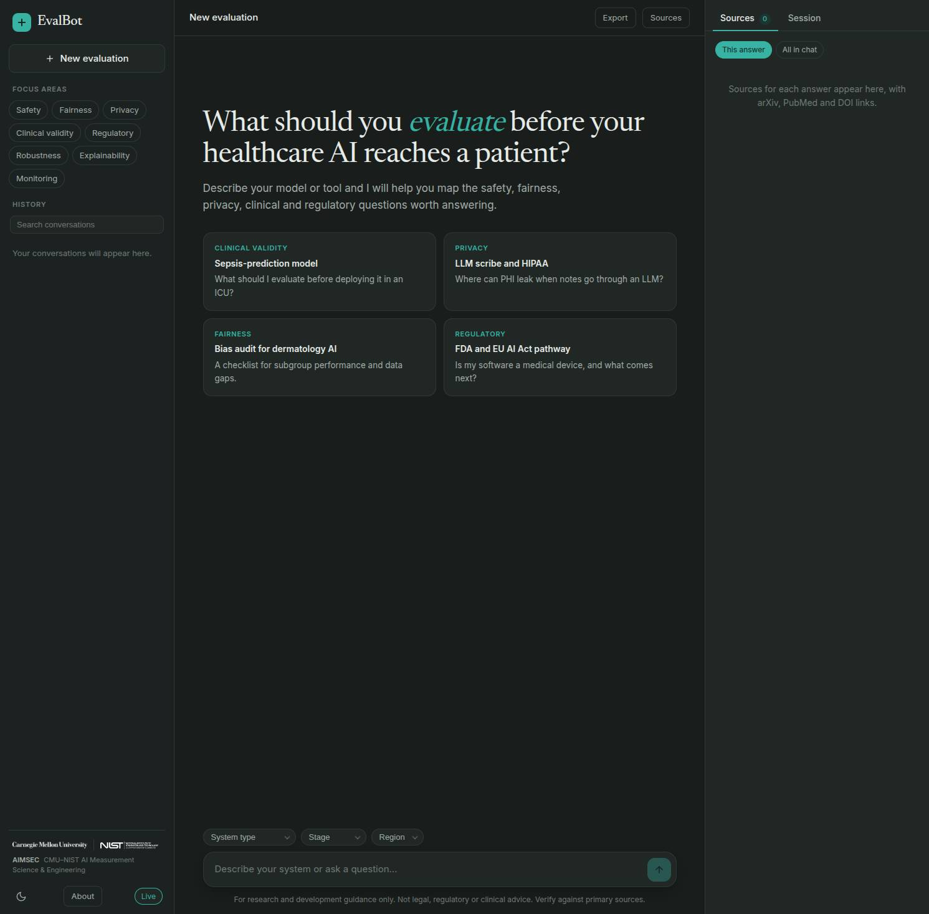
DEMO · 1
Start from a clinical system
Pick system type, stage and region; ask in plain language. The UI shows how many papers the answer stands on.
live capture from localhost:8080 · Gemma 4 26B-A4B via OpenRouter

Slide 6
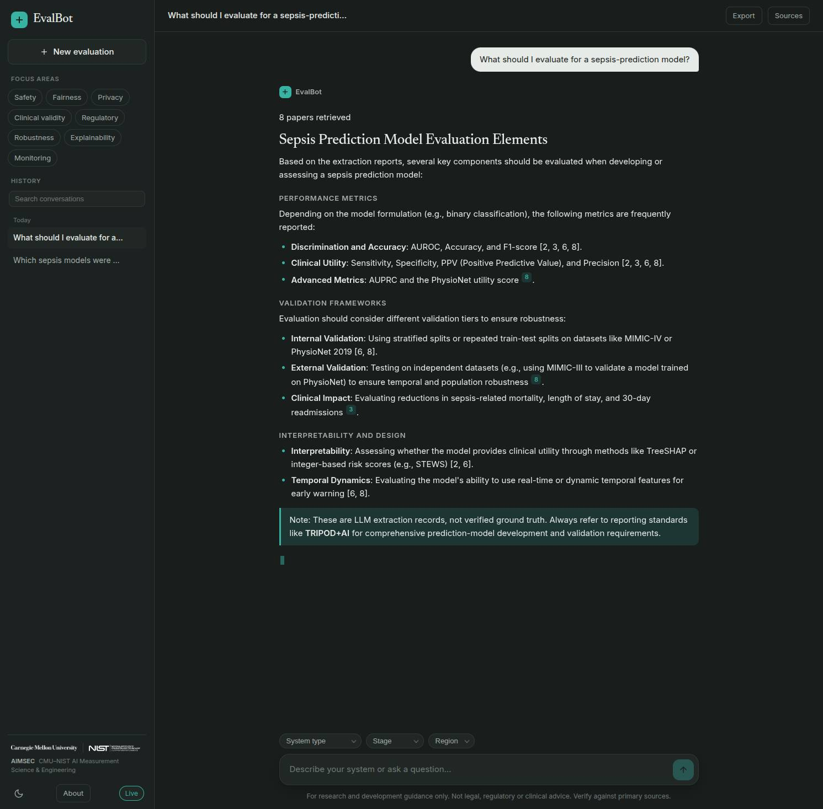
DEMO · 2
It plans the evaluation, live
Performance metrics, validation frameworks, interpretability — generated as you watch, with citations appearing inline.
live capture from localhost:8080 · Gemma 4 26B-A4B via OpenRouter

Slide 7
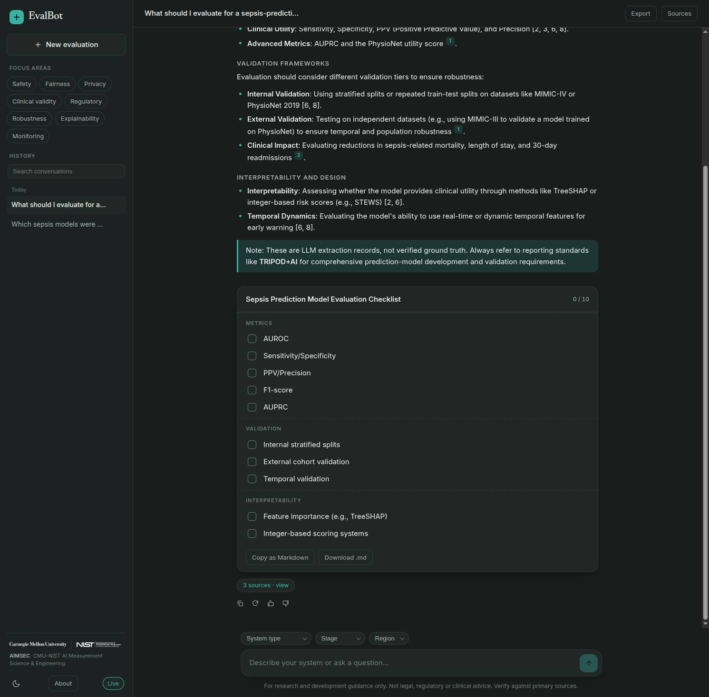
DEMO · 3
The deliverable: a checklist
10 items across metrics, validation and interpretability. Tick them off, copy as Markdown, or download the file.
live capture from localhost:8080 · Gemma 4 26B-A4B via OpenRouter

Slide 8
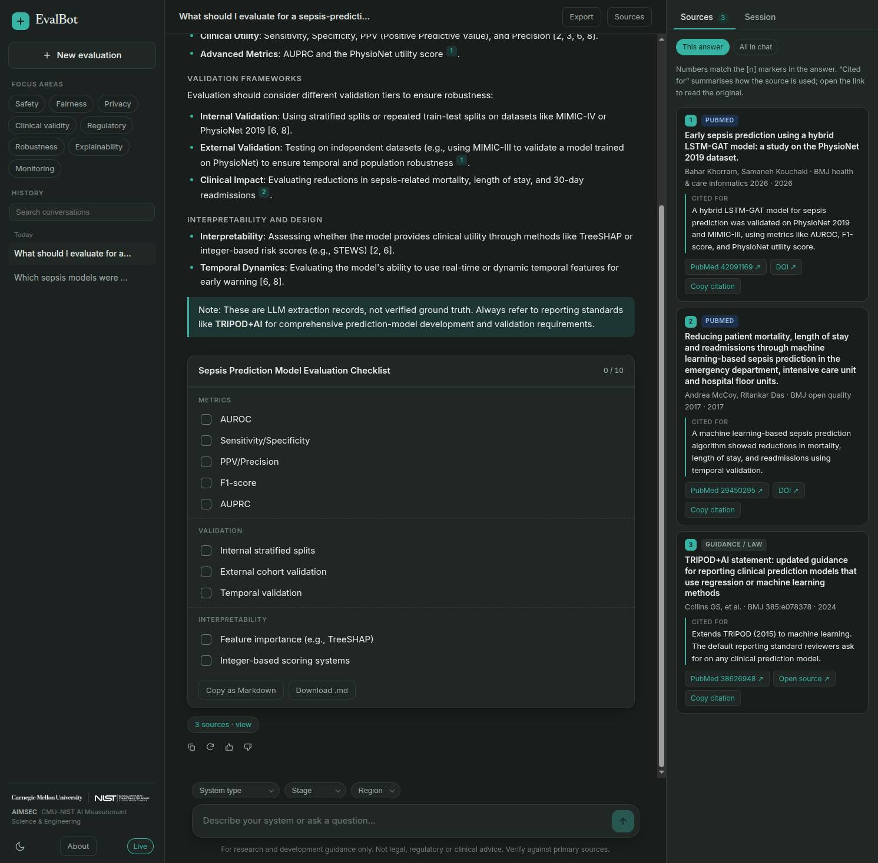
DEMO · 4
Every item is traceable
PubMed records with PMID and DOI, and a GUIDANCE / LAW card for the standard that applies — here TRIPOD+AI.
live capture from localhost:8080 · Gemma 4 26B-A4B via OpenRouter

Slide 9
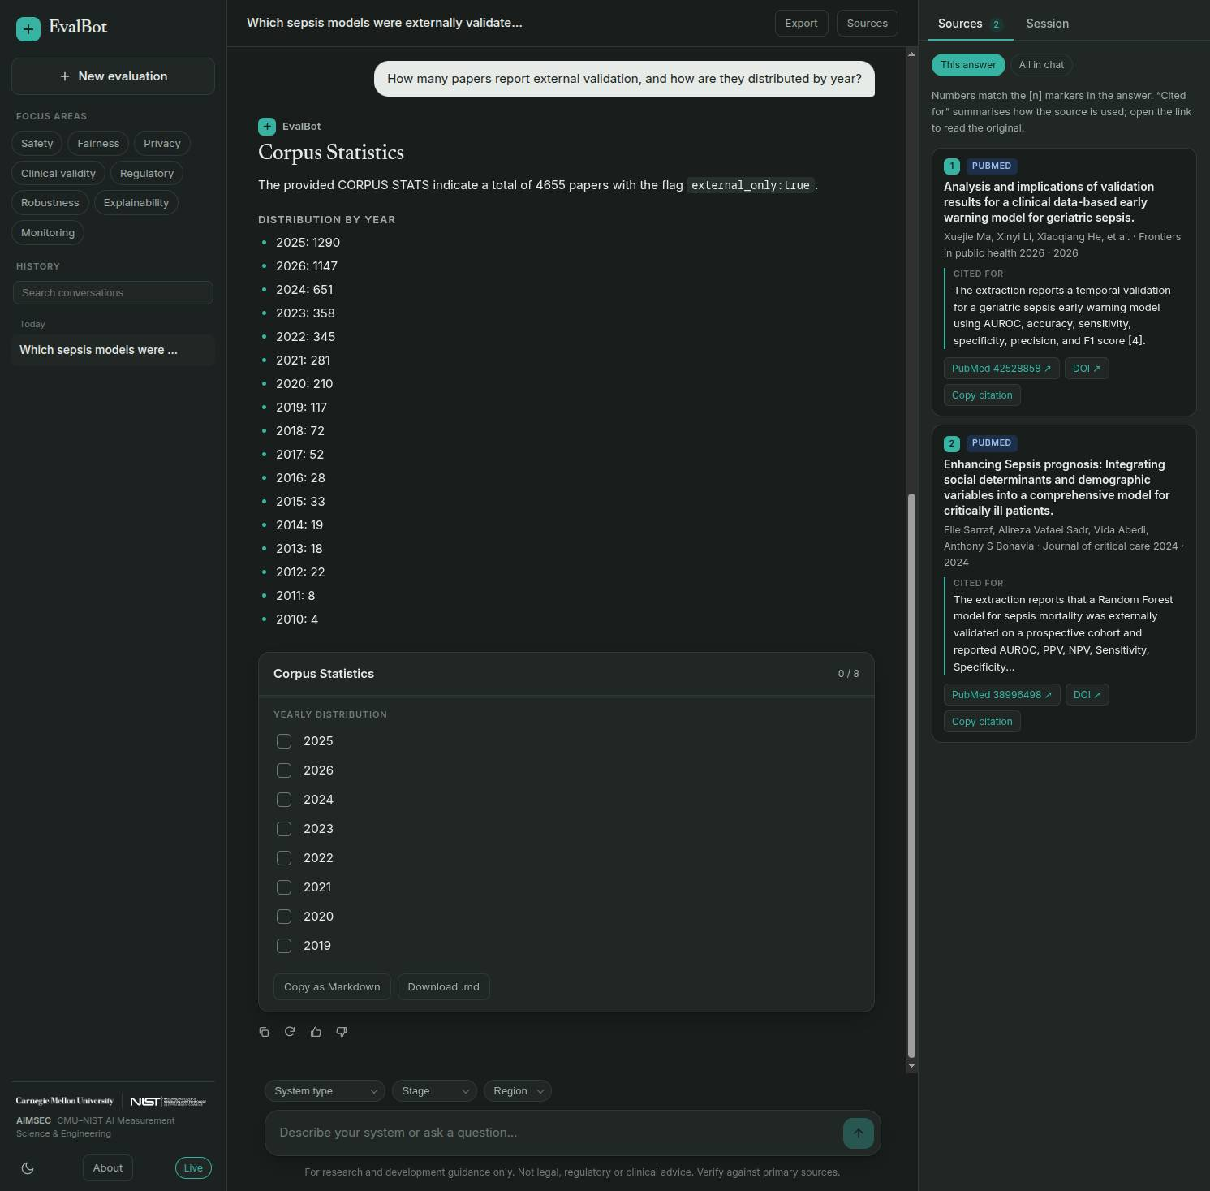
DEMO · 5
Counts come from SQL
“How many papers report external validation?” → 4,655, with a year breakdown. Not a guess.
live capture from localhost:8080 · Gemma 4 26B-A4B via OpenRouter

Slide 10
WHAT IS INSIDE
Numbers a reviewer can check
15,954
4,655
24
124
papers
externally validated
frameworks
offline tests
7 extraction axes
flag, not text match
8 reporting · 6 governance
no network in CI
— Cross-store consistency: 15,954 rows in JSONL and SQLite, 15,954 papers in the graph (100,185 authors, 6,068 MeSH terms).
— Flags reproduce exactly: external 4,655 · temporal 1,352 · internal 14,738 · deployed 628 · RCT 368 · CI 8,348.
numbers printed by the build, not remembered

Slide 11
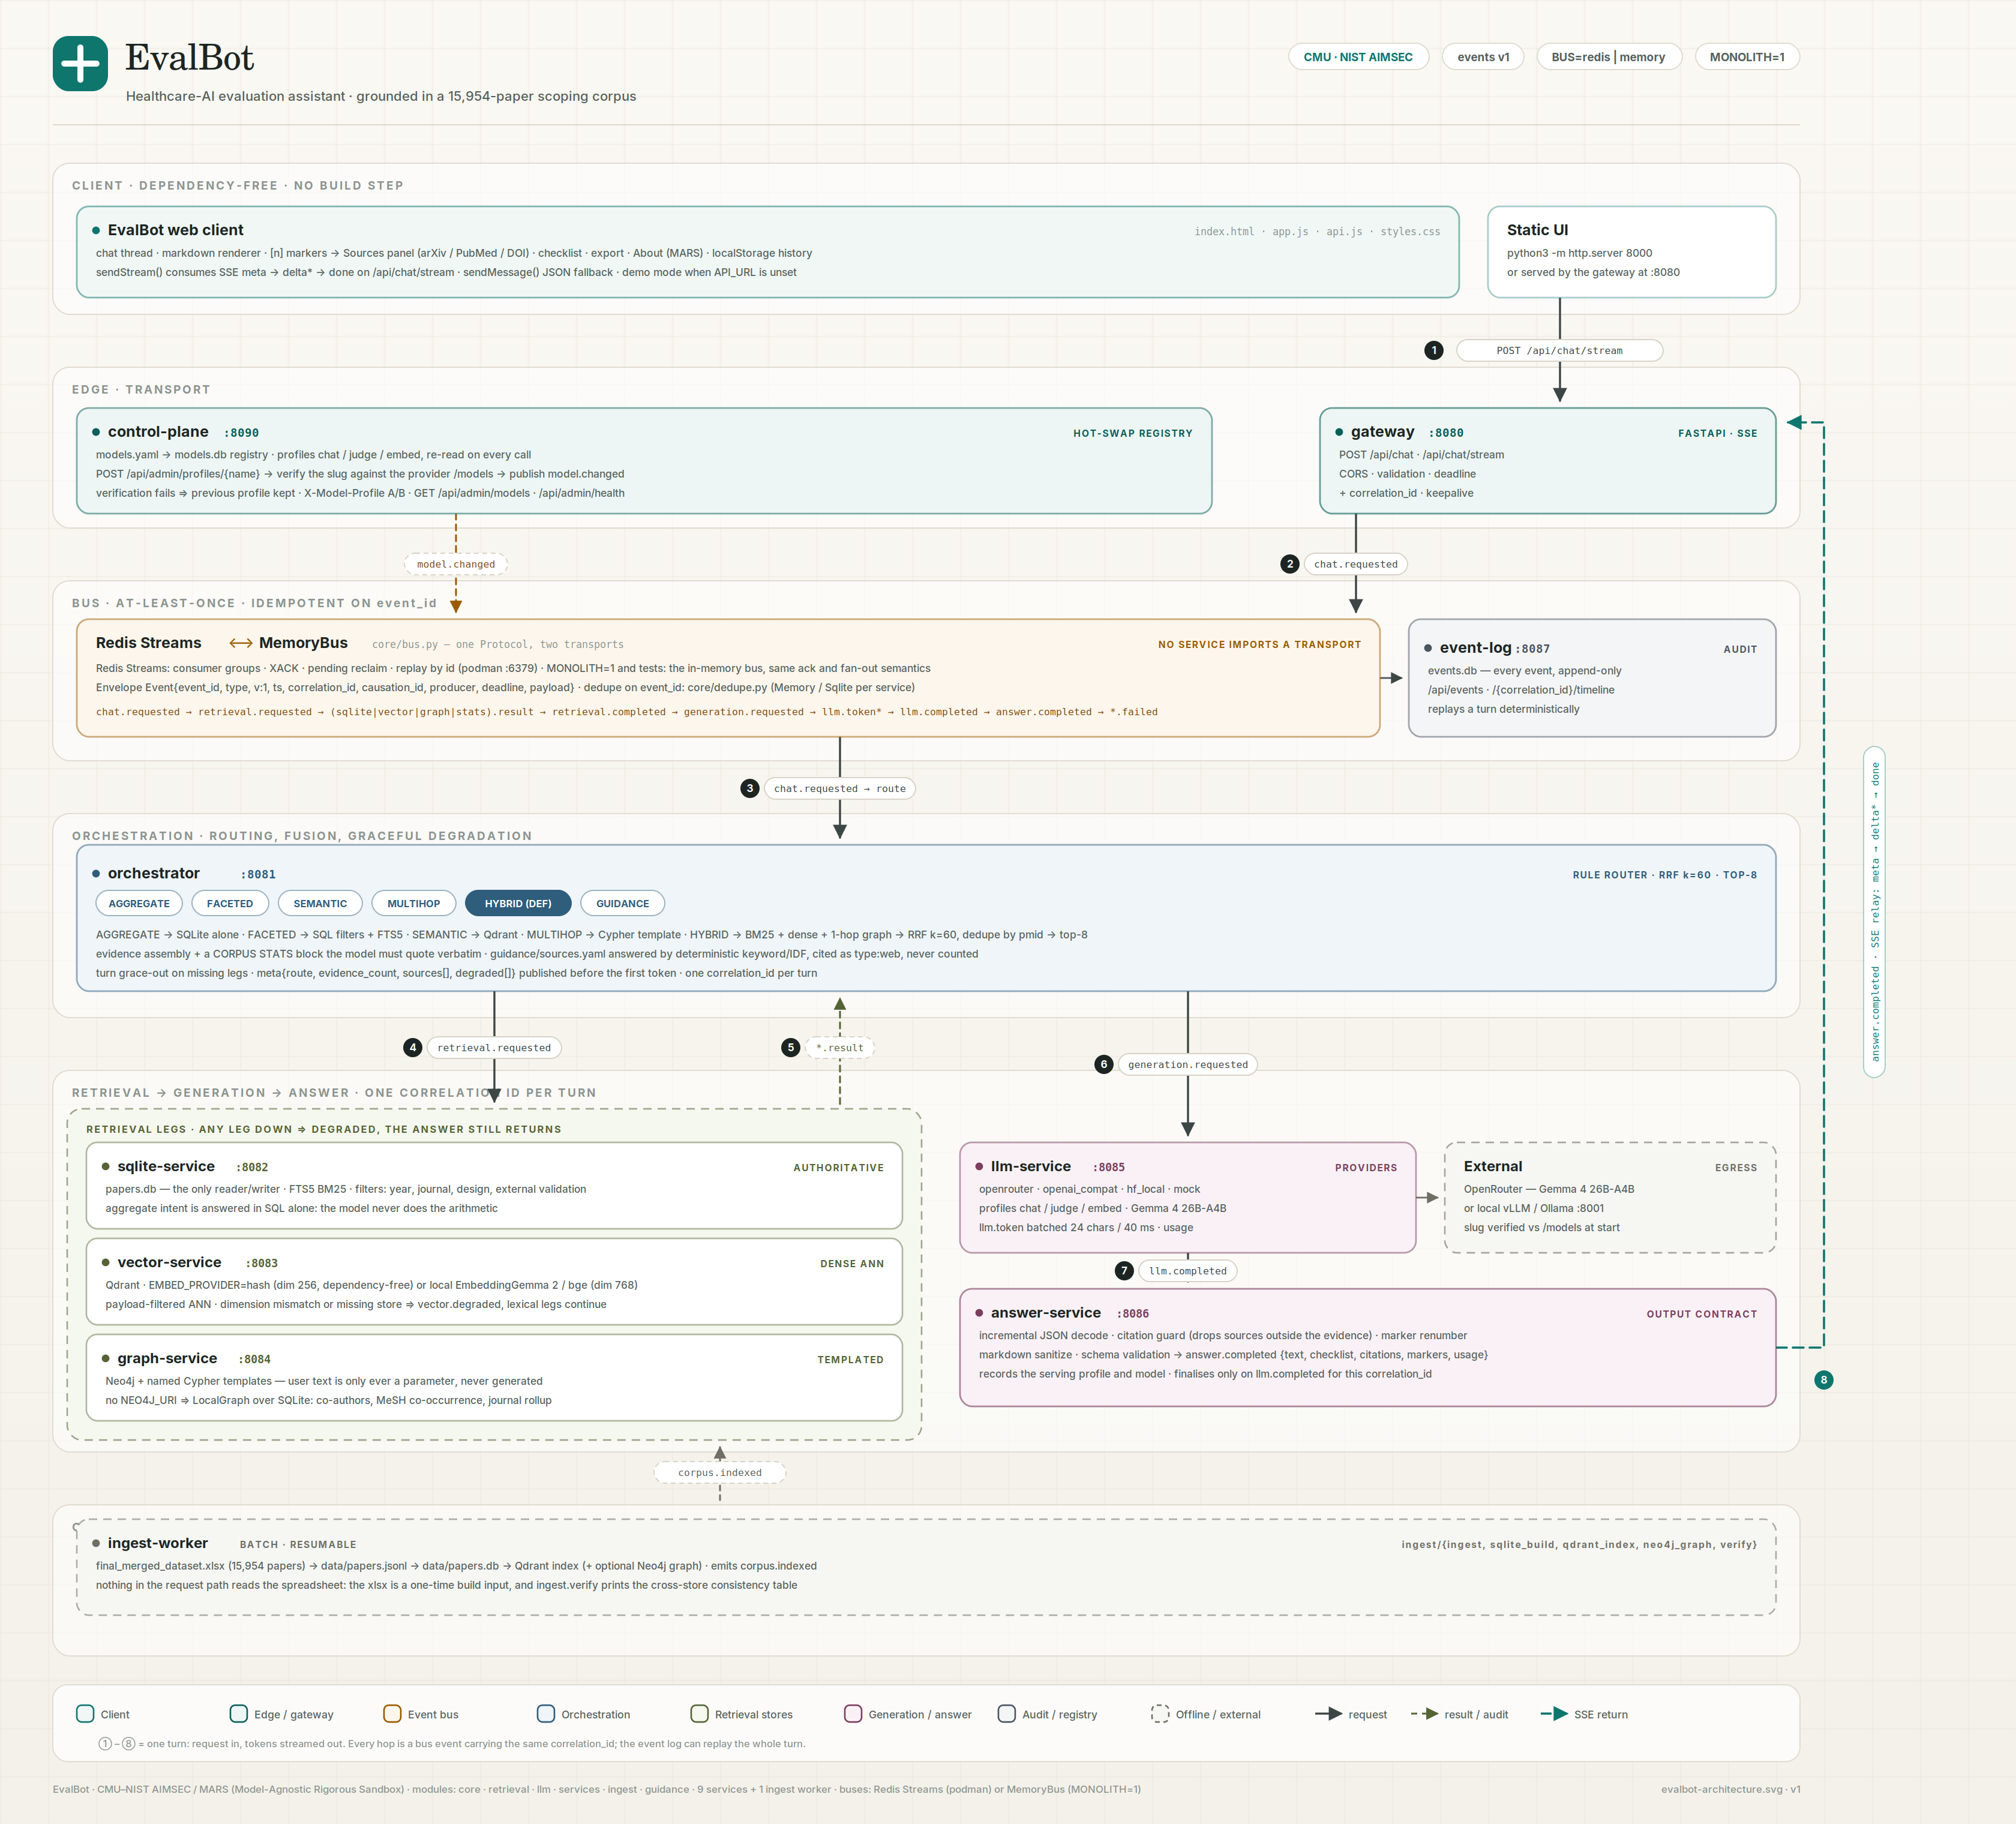
HOW IT IS BUILT
Nine services, one event bus
— SQLite is the system of record: 15,954 rows, FTS5, every exact count.
— Qdrant holds 768-d EmbeddingGemma-2 vectors; Neo4j holds the paper graph.
— Both are derived: rebuildable from the JSONL, and the answer still works if either is down.
same code runs as one process (MONOLITH=1) or nine over Redis Streams

Slide 12
THE PARTS THAT MATTER
Three stores, one rule: the record is the source of truth
SQLite
Qdrant
Neo4j
SYSTEM OF RECORD
DENSE RECALL
MULTI-HOP GRAPH
15,954 rows · FTS5 BM25 · every exact count and facet filter. Read-only at request time.
768-d EmbeddingGemma-2 with asymmetric query/document prompts; bf16 on an 8 GB GPU.
papers, authors, journals, MeSH. Named Cypher templates only — with a SQLite fallback.
Qdrant and Neo4j are derived and rebuildable — SQLite stays authoritative

Slide 13
THE SAFETY BEHAVIOUR
It refuses more than a chatbot does
— No invented citations. Citations are built from retrieved records; markers outside the evidence are dropped.
— No invented numbers. Corpus statistics are SQL results quoted verbatim.
— No false authority. Extraction fields are labelled unverified — 40-paper audit found CI fields wrong ~70% of the time.
— No silent failure. A missing leg is reported as degraded; a missing model returns a readable error.
cite-or-refuse is the product, not a feature flag

Slide 14
What should we evaluate,
and what does the evidence say?
Ask it about your own model. Every answer is cited or refused; every number comes from the corpus; the model behind it is swappable at runtime.
github.com/adi274903/MARS-Healthcare
demo video + PDF

