Slide 1
Attendance and Academic Performance: A Statistical Analysis
Aditya Teraiya and Raj Gehlot

Slide 2
Rough idea
Read student attendance and marks from a CSV file
And displays results such as statistics(mean, deviation, etc), tests(p-tests, t-statistic), and graphs(histogram, correlation, etc).
Analyzes how they relate

Slide 3
(Synthetic data) every Quiz avg and midsem score are out of 100 and 61 entries.
id | attendance | midsem | quiz
101 | 57.6 | 63.4 | 60.9
102 | 68.3 | 57.2 | 50.6
103 | 83.2 | 87 | 49.1
104 | 56.6 | 65.3 | 56
105 | 99 | 97.2 | 65.6
106 | 71.9 | 90.9 | 57.4
107 | 64.2 | 55.9 | 51.2
108 | 78.2 | 72 | 56.1

Slide 4
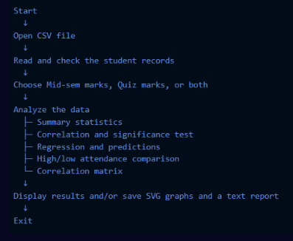

Flowchart

Slide 5
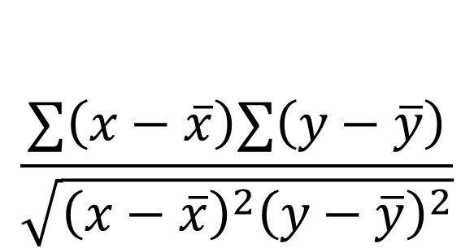
$$\frac{∑\left(x−\overline{x}\right)∑\left(y−\overline{y}\right)}{\sqrt{{\left(x−\overline{x}\right)}^{2}{\left(y−\overline{y}\right)}^{2}}}$$

Slide 6
HISTOGRAM

Slide 7
Note: Everything is a shade of red

Slide 8
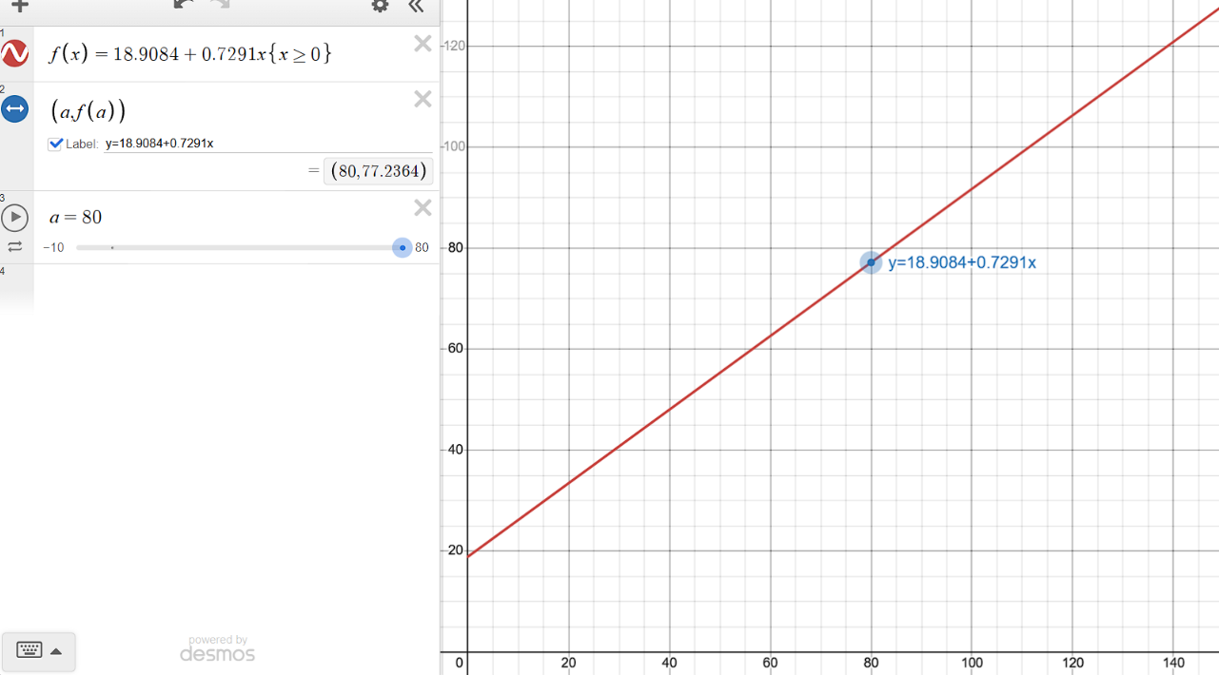
LINEAR REGRESSION(PREDICTION)

Slide 9
We found a positive strong relationship between attendance and marks, with Pearson’s r of 0.77.
The p-value was 0.0019, so this result was statistically significant at the five-percent level. The regression’s R=r-squared was 0.59 meaning the fitted linear relationship accounted for about 60% of the
variation in marks in this dataset.

Slide 10
Or in simple terms, don’t miss class.

Slide 11
Thank you

