Slide 1
Diagnosing Kubernetes
Networking Failures
Using eBPF Kernel Traces
GRS 2026
Graduate Systems Course
5 Fault Types
2 Scenarios
An eBPF-Based Observability Framework
. Aditya Malik (MT25011)
· Suhani Agarwal (MT25046)
. Asmit Sethy (MT25020)
· Apoorva Chaudhary (MT25016)
. Harsh Sharma (MT25023)
Group-17
3 eBPF Probes
April 2026
1 / 14

Slide 2
PROBLEM & MOTIVATION
The Observability Gap in Kubernetes
The Problem
Why eBPF Solves This
kubectl, Prometheus, Grafana say a pod is slow — not WHY
Same symptom (high latency) can be packet loss, CPU contention, or slow application code
Without kernel evidence, engineers debug the wrong component for hours
Attaches directly to kernel events — no kernel changes, no pod restarts
Answers: how many packets dropped? Is TCP retransmitting?
Produces a structured elimination chain: rule out network → rule out CPU → confirm app
Two parts to this project:
Part 1 — Controlled Fault Injection: 5 faults injected with tc netem/stress-ng, kernel events verified against expected patterns Part 2 — Real-World Debugging: 2 hidden causes diagnosed from eBPF evidence alone, without prior knowledge
https://github.com/adi620/G17_Kubernetes_observation
2 / 14

Slide 3
SYSTEM ARCHITECTURE
Three-Layer Design — Everything Runs in Parallel
WORKLOAD LAYER
FAULT INJECTION LAYER
eBPF OBSERVABILITY LAYER
nginx web pod (nginx:stable, port 80)
tc netem: delay / loss / reorder
tcp_retransmissions.bt → RETRANSMIT events
Traffic pod: curlimages/curl, 1 req/sec
tc tbf: bandwidth cap at 1 mbit
packet_drops.bt → reason code 82 (tc netem)
Records time_total per request → CSV
stress-ng: 4 CPU workers via docker exec
sched_latency.bt → all process scheduler events
Dynamic veth detection — no hardcoding
Boundary markers per experiment in logs
⟵ All three layers run concurrently throughout every experiment ⟶
Single command: sudo ./run_full_pipeline_extended.sh — 5 faults × 60s each, fully automated
3 / 14

Slide 4
BACKGROUND
How the Three eBPF Probes Work
kprobe:tcp_retransmit_skb
kprobe:tcp_retransmit_skb {
printf("%lu %s RETRANSMIT\n",
nsecs, ntop(args->skb->...)); }
Fires every time TCP decides to retry a lost segment
Count = 0 → rules out packet loss
Count > 0 → confirms network-layer loss
tracepoint:skb:kfree_skb
tracepoint:skb:kfree_skb {
printf("%lu reason:%d DROP\n",
nsecs, args->reason); }
Fires when the kernel discards a packet. The reason field identifies the cause
Reason 82 = SKB_DROP_REASON_TC_EGRESS
→ confirms tc netem dropped the packet
tracepoint:sched:sched_stat_runtime
tracepoint:sched:sched_stat_runtime {
printf("%lu %-20s %d %lu\n",
nsecs, comm, pid, args->runtime); }
Fires after each scheduling quantum for any process on the node
High events + high runtime for stress-ng
→ confirms CPU contention as root cause
4 / 14

Slide 5
EVALUATION — PART 1: CONTROLLED FAULTS
Experiments 1, 2 & 4 — Baseline, Delay, Bandwidth
2.0ms
402.5ms
0
2.1ms
Baseline Mean
(n=48, σ=0.4ms)
200ms Delay Mean
(n=37, σ=0.7ms)
Retransmissions
(delay ≠ loss confirmed)
1mbit BW Mean
(small payloads unaffected)
200ms Delay — Deterministic Result
1mbit Bandwidth Cap — Latency vs Throughput
tc netem delay 200ms on web pod veth interface
Round-trip = 2 × 200ms + 2ms baseline ≈ 402ms
All 37 samples within 401–405ms band (σ = 0.7ms)
Small HTTP responses (~850 bytes) still complete in ~2ms
A single packet fits in the burst window before rate limiter engages
Large file transfers capped to ~125 KB/s (1mbit ÷ 8)
Key insight: Bandwidth caps affect throughput, not latency. A latency alert from a bandwidth-capped service means large payloads — not the API response time itself.
6 / 14

Slide 6
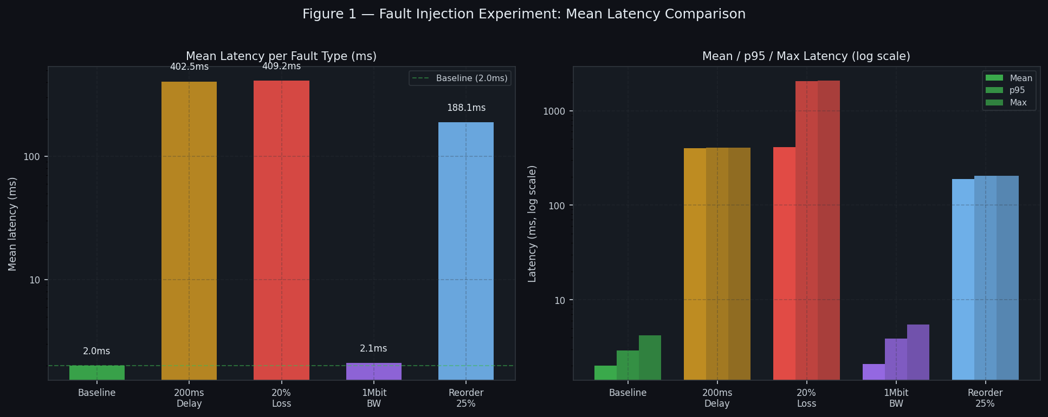

Slide 7
EVALUATION — EXPERIMENT 3
20% Packet Loss — TCP Retransmit Backoff Tiers
409ms
25 / 11
3
Mean latency
(vs 2ms baseline)
Clean / Backoff
samples (n=36)
TCP RTO tiers
observable
TCP Exponential Backoff — How It Works
~200ms
1st RTO — TCP waits 200ms then retries
~1000ms
2nd RTO — doubles to ~1000ms on 2nd loss
~2058ms
3rd RTO — doubles again; matches kernel exactly
eBPF: tcp_retransmit_skb probe active throughout; bimodal shape alone confirms the backoff mechanism
7 / 14

Slide 8
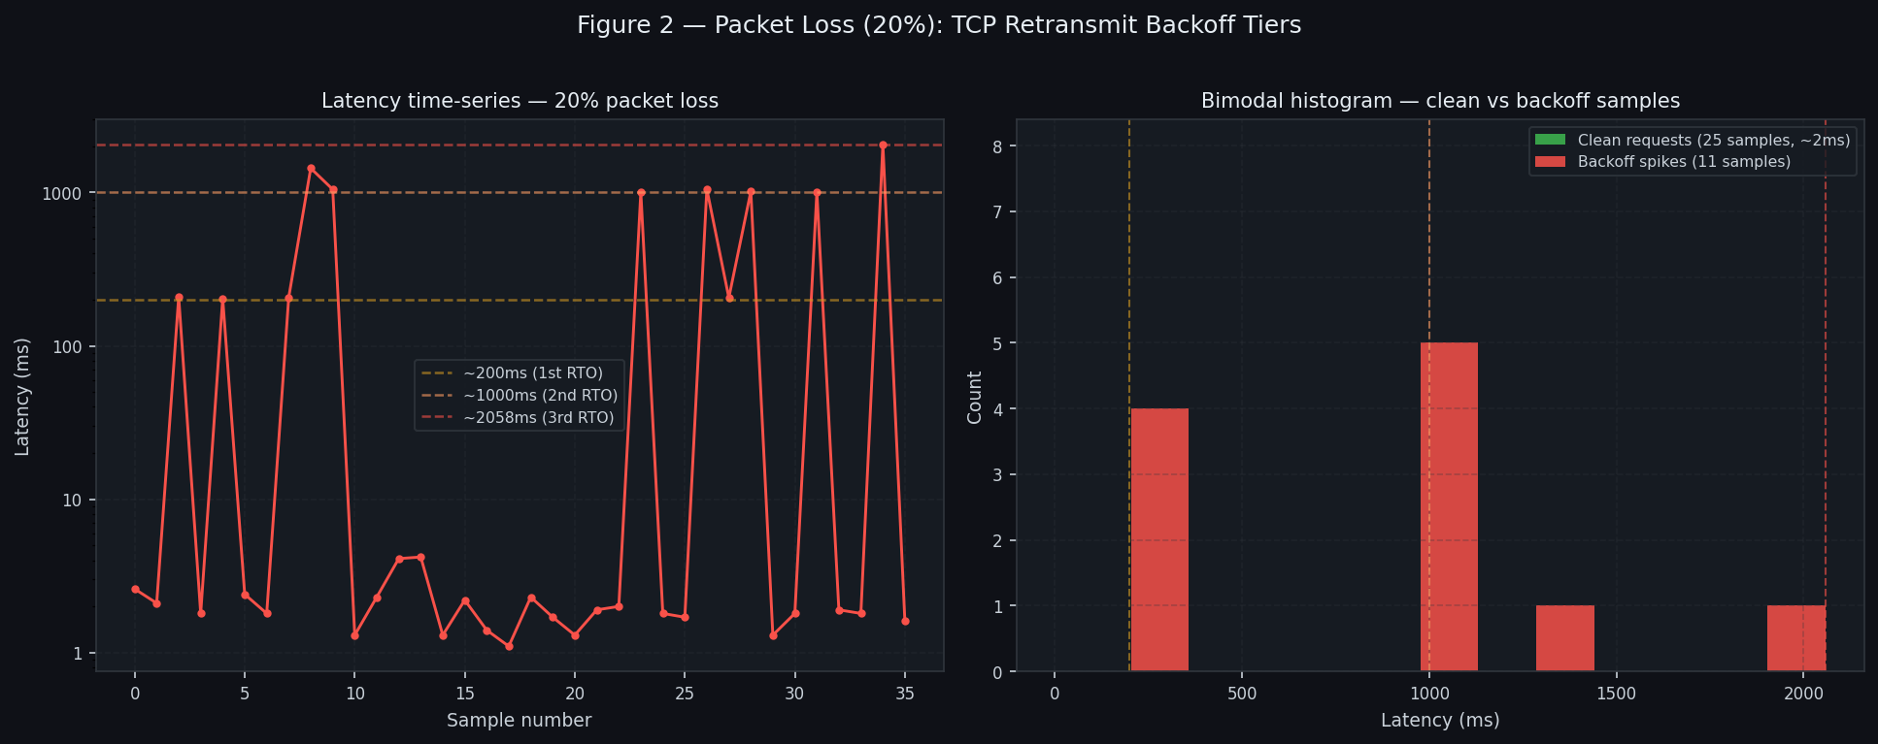

Slide 9
EVALUATION — EXPERIMENT 5
25% Packet Reordering — Two Distinct Latency Tiers
188ms
36 / 6
0
Mean latency (n=42)
~202ms / ~102ms
samples
Retransmit events
(reorder ≠ loss)
Why Two Tiers Appear
tc netem reorder 25% gap 1 delay 100ms applied
100ms base delay on all packets
25% of packets arrive out of order
Out-of-order delivery triggers TCP duplicate ACKs → fast-retransmit fires in ~102ms
Normal path: waits full 100ms delay → arrives at ~202ms
Zero retransmit events in tcp_retransmit_skb log — fast-retransmit is not the same code path as RTO retransmit
8 / 14

Slide 10
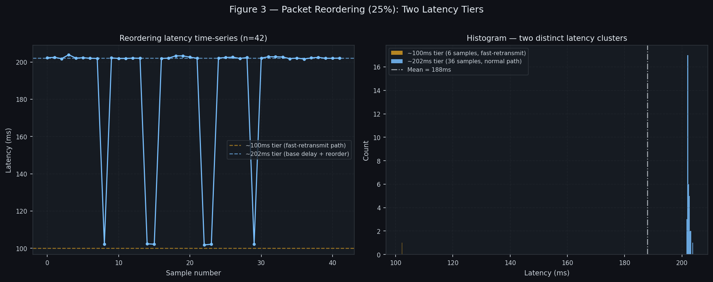

Slide 11
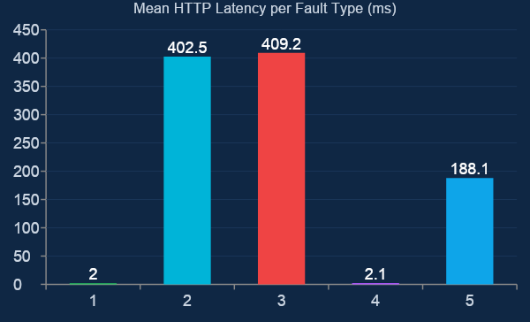
EVALUATION — SUMMARY
Fault Injection Results — All 5 Experiments
Fault | Mean | σ | eBPF Confirm
Baseline | 2.0ms | 0.4ms | 0 retrans, 0 drops
200ms Delay | 402.5ms | 0.7ms | 0 retrans — delay ≠ loss
20% Loss | 409.2ms | 478ms | Bimodal, 3 RTO tiers
1mbit BW | 2.1ms | 0.7ms | 0 retrans; BW cap only
Reorder 25% | 188.1ms | 35.5ms | 0 retrans; 2-tier split
Every fault produces a distinct latency pattern:
Flat high band (delay) · Bimodal with RTO tiers (loss) · Two-tier split (reorder) · Near-baseline (small payload + BW cap)
9 / 14

Slide 12
PART 2 — REAL-WORLD DEBUGGING MODULE
Unknown Causes — eBPF Must Find the Root Cause
No tc netem rules. No announced faults. An operator sees a latency alert and must diagnose the cause using only eBPF evidence — exactly like a real production incident.
Scenario A — CPU Noise
Scenario B — App Delay
stress-ng --cpu 4 run on the KIND node via docker exec
Saturates 4 CPU cores — no tc rules touched
Operator sees: latency HIGH, highly variable
Challenge: find the cause using only eBPF
Web pod patched to Python server with time.sleep(0.2)
Simulates slow DB query / middleware call
Operator sees: latency HIGH, stable ~200ms
Challenge: find the cause using only eBPF
Diagnosis approach: Retransmissions zero? → not loss. Drops zero? → not tc netem. Scheduler HIGH + stress-ng visible? → CPU. Scheduler normal + stable 200ms floor? → app code.
10 / 14

Slide 13
REAL-WORLD — SCENARIO A
CPU Noise: Scheduler Trace Identifies the Culprit
35.8ms
121ms
278ms
292s
Baseline mean
(10 samples)
CPU noise mean
(15 samples)
Std deviation σ
(high jitter)
stress-ng CPU time
in 90s experiment
What the scheduler log shows
734,033 total sched events captured
stress-ng-cpu: 72,804 events, 292s CPU time — highest of any single process
Ran on multiple cores (4 workers × 90s = 360s max; 292s observed)
Zero retransmissions, zero drops → network ruled out
Diagnosis: Retransmits = 0. Drops = 0. stress-ng-cpu dominates scheduler. High σ = scheduling jitter. → Root cause: CPU contention from noisy neighbour
11 / 14

Slide 14
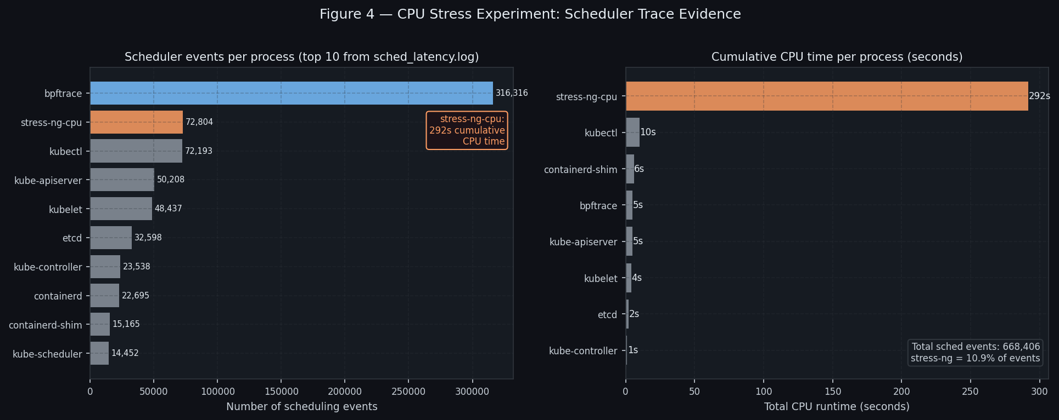

Slide 15
REAL-WORLD — SCENARIOS A VS B
CPU Noise vs App Delay — Same Symptom, Different Cause
eBPF Elimination Chain
Check | CPU Noise | App Delay
TCP Retrans | 0 | 0
Pkt Drops | 0 | 0
Sched events | 72k HIGH | Normal
Jitter (σ) | 278ms HIGH | 103ms
Stable floor | No (3ms min) | Yes (201ms)
ROOT CAUSE | CPU noise | App code
The critical discriminator: jitter (σ)
CPU noise σ = 278ms vs App delay σ = 103ms. 2.7× more jitter → scheduling cause, not stable app code. Combined with stress-ng in scheduler trace, root cause identified without prior knowledge.
12 / 14

Slide 16
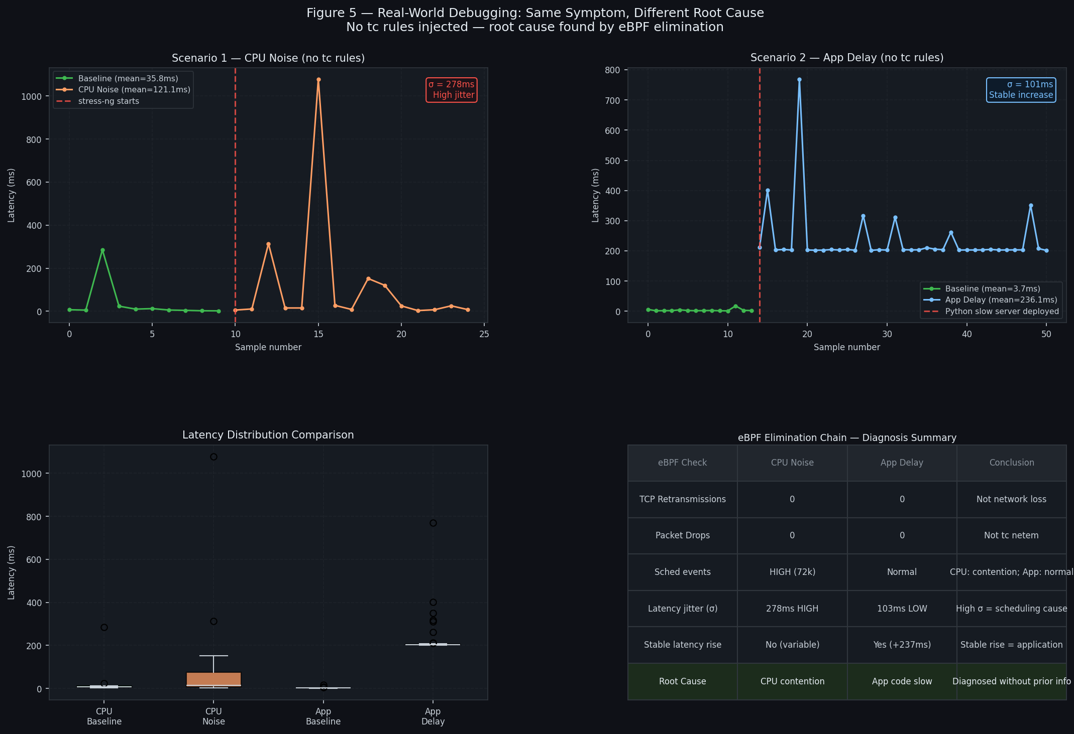

Slide 17
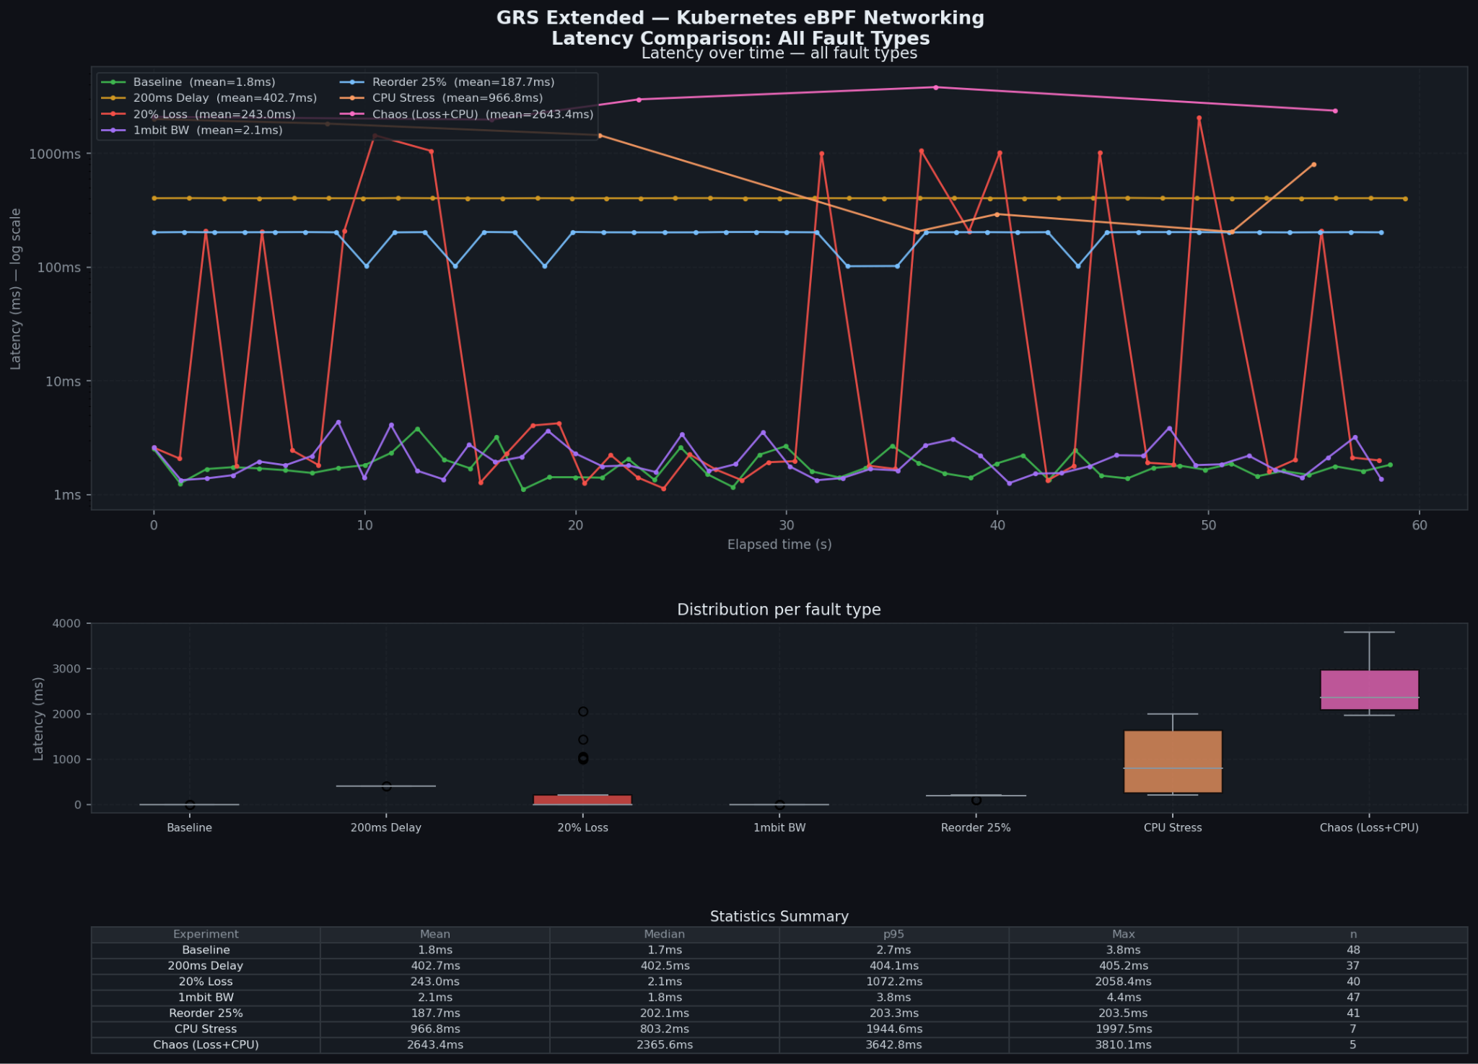

Slide 18
OUTCOMES
What We Achieved
01
Dynamic veth detection fixed
02
5 distinct latency signatures verified
03
eBPF confirms kernel cause for every experiment
All 5 fault injections work across cluster restarts. Core bug from initial submission fully resolved.
Flat band (delay) · Bimodal/RTO tiers (loss) · Two-tier (reorder) · Baseline (BW small) · High jitter (CPU)
Drop reason 82 = tc netem. Zero retransmits = no loss. 72k stress-ng events + 292s CPU = CPU contention.
04
Root cause diagnosed without prior knowledge
05
Full automated pipeline — one command
CPU noise and app-level slowness diagnosed from jitter σ, scheduler activity, and retransmit counts alone.
run_full_pipeline_extended.sh + run_real_world_pipeline.sh — reproducible, end-to-end, no manual steps.
13 / 14

Slide 19
Conclusion
eBPF Fills the Observability Gap
Standard tools report slow. eBPF explains why.
Part 1 — Controlled Faults
Part 2 — Unknown Causes
5 fault types, 5 distinct signatures. Every pattern matches the kernel's known behaviour exactly. The cause-kernel-application chain is verified end-to-end.
CPU noise vs application delay — both elevated latency, different cause. eBPF eliminates wrong hypotheses and reaches the right diagnosis without prior knowledge.
The core contribution:
A reproducible, automated pipeline that produces kernel-level evidence for every fault type, and a real-world debugging workflow that can identify an unknown cause from eBPF evidence alone — applicable directly to production incident diagnosis.
https://github.com/adi620/G17_Kubernetes_observation
G-17 · GRS 2026 · April 2026
14 / 14

Slide 20
THANK YOU!
https://github.com/adi620/G17_Kubernetes_observation
G-17 · GRS 2026 · April 2026
14 / 14

