Slide 1

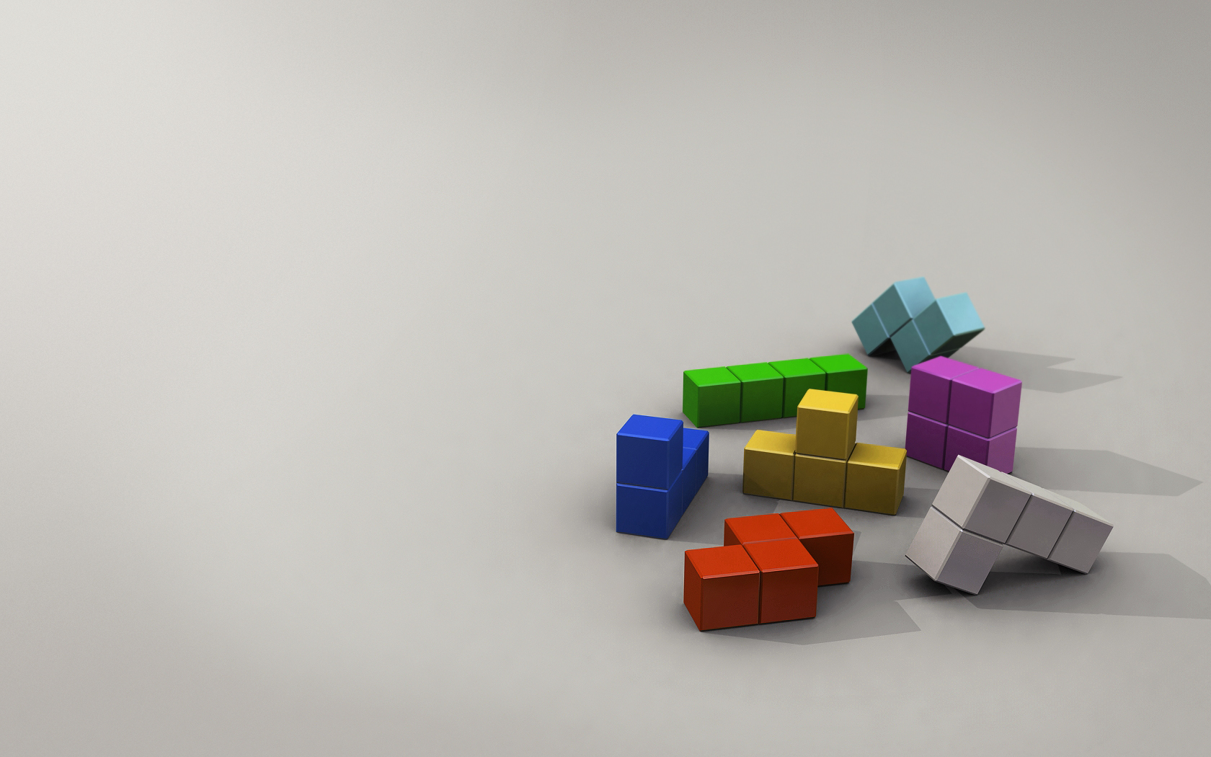
Students’ names:
Adi Ovadia & Chen Dahan
Lecturer’s name:
Roi Zimon

Slide 2
Structure of the presentation
* A little bit about Tetris
* The problem
* Possible solutions
* The selected solution
* User stories
* Security user stories
* TDD
* Scrum sprints
* References
* Summary and conclusions

Slide 3
A little bit about Tetris
* Tetris is a tile-matching puzzle video game
* Originally designed and programmed by
Russian game designer Alexey Pajitnov on 1984
* He derived its name from the Greek
numerical prefix tetra and tennis,
Pajitnov's favorite sport
Notes:
* להסביר את חוקי המחשק
* טטריס מהמילה היוונית טטרה (ארבע כי כל הצורות מורכבות מ4 קוביות) ומטניס

Slide 4
The problem
* Creating an interactive computer game, Tetris
* Including database
* Including client server architecture

Slide 5
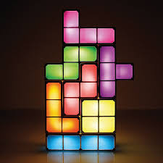
Possible solutions
* Web application
* Mobile application
* Computer application

Slide 6
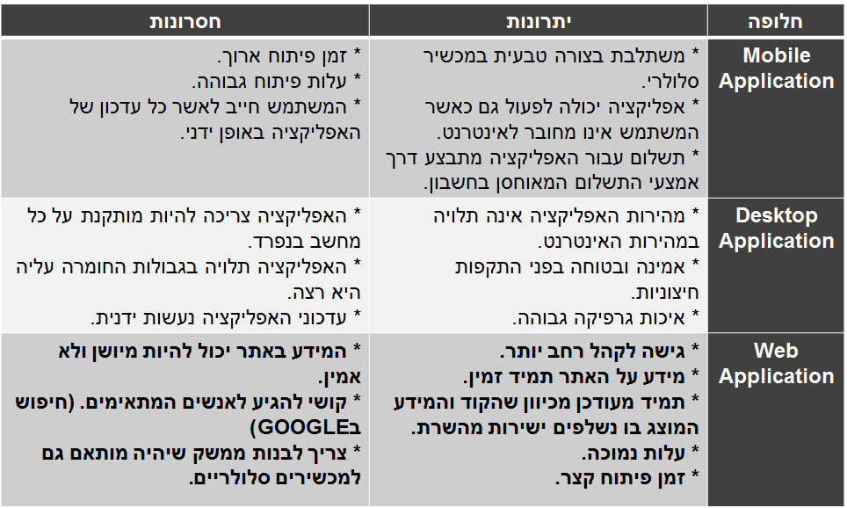
Possible solutions

Slide 7
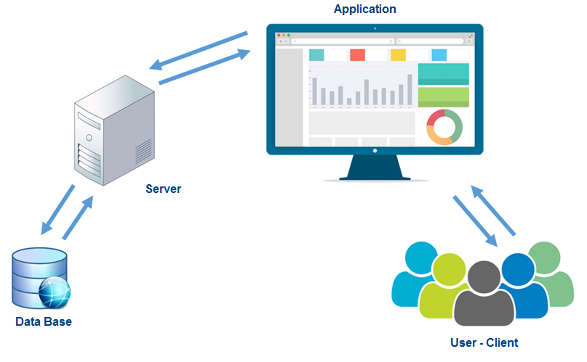
The selected solution – web application

Slide 8
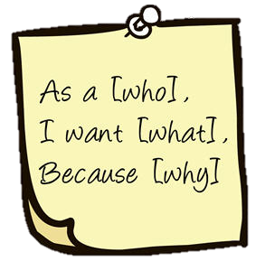
User stories
Move the shape:
As a player
I want to change the direction and the location of the shape
Because I need to put the shape in the requested location
Delete a completed row:
As a system
I want to delete a completed row and to add points to the player
Because After a player completed a row he needs to get points and to a space for the other shapes
Save data on the database:
As a system
I want to save the player details
Because I need to present the winner table

Slide 9


User stories
Tetris
Open a game
Present the winner table
Move the shape
Save data on the database
Player
System
Delete a completed row
Register to the game

Slide 10

Security user stories
Impersonating the player:
As a fraudster
I want to Impersonating the player
Because in this way I can to lower his score
Solution: In each game the player will register with other name
Overloading the server:
As a fraudster
I want to overload the server
Because in this way I can to shutdown the game
Solution: There is a limit of 5 games at the same time
Overloading the server:
As a fraudster
I want to change the data on the database
Because in this way I can to change the game to be in my favor
Solution: Only the system saves the data through the server

Slide 11
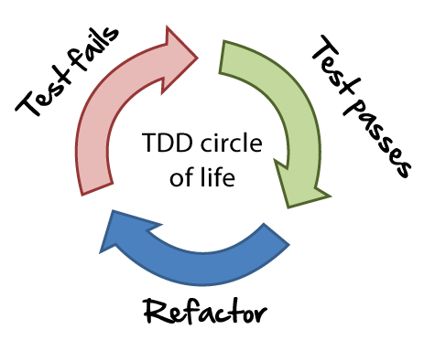
TDD
* Logic tests:
- Test for the game opening, for single player
and for multi players.
- Test for the legality of the game:
move the shape, delete a completed row,
end game when the board is full and etc..
* Server-Client tests:
- Test for validation the transferred data between
the server and the client.

Slide 12
TDD
* Database tests:
- Test for validation the stored data at the database
for the winner table
- Test for the players’ name, each name is unique.

Slide 13
Scrum sprints
Sprint 2 | Sprint 1
Planning the connection between the client and the server | Planning the Tetris game with his legality | Plan
Build the client-server connection based on the design | Build the game interface by the design | Build
Check the reliability of the data transferred between the server and the client | Check the legality of the game | Test
Review improvements for the connection | Review improvements for the game | Review

Slide 14
Scrum sprints
Sprint 4 | Sprint 3
Planning the security of the game and the final tests | Planning the database it tables and it constrains | Plan
Build identification interface, limited the number of games to 5 | Build the database by the ERD design and a winner table | Build
Test the security and the final tests | Check the reliability of the stored da | Test
Review the all project and search for improvements | Review improvements for the database | Review

Slide 15
References
* Tetris on Wikipedia:
https://en.wikipedia.org/wiki/Tetris
* TDD on Wikipedia:
https://en.wikipedia.org/wiki/Test-driven_development
* Scrum on Wikipedia:
https://en.wikipedia.org/wiki/Scrum_(software_development)

Slide 16
Summary and conclusions
* Knowing the Tetris game in all its aspects
* Enrichment the knowledge on .NET programming including build a server-client architecture and a database
* Gaining experience at Agile methodology, working in sprints, build TDD and etc.

Slide 17
