Slide 1
Strategic Location for Establishing an Asian Restaurant in Seattle

Slide 2
The potential success of a restaurant depends on numerous factors such as brand value, customer fidelity, demand rate and quality of food. Apart from these, Location undoubtedly plays a significant factor in this decision-making process to make the business profitable and competitive in the existing market condition.
A client seeks to establish a franchised Asian restaurant in Seattle, Washington. In this project, we are seeking to find the optimal and strategic area of neighborhood based on the aforementioned factors to open this new promising business.
Prospective entrepreneurs seeking to set up a new restaurant specializing in a particular niche can find the insights derived through this project compelling and can indeed reap significant benefits.

Slide 3
Data Extraction and Understanding
The data about the Seattle neighborhoods were scraped from the Wikipedia page (https://en.wikipedia.org/wiki/List_of_neighborhoods_in_Seattle). It contains the neighborhood names and the greater district name to which they belong.
Geopy library was used for geocoding to obtain the latitudes and longitudes of each neighborhood.
The restaurant data for each neighborhood was derived using the Foursquare API and was integrated with the data frame. By using the FOURSQUARE API, /venues/explore endpoint, the number of Asian restaurants were found in each neighborhood.

Slide 4
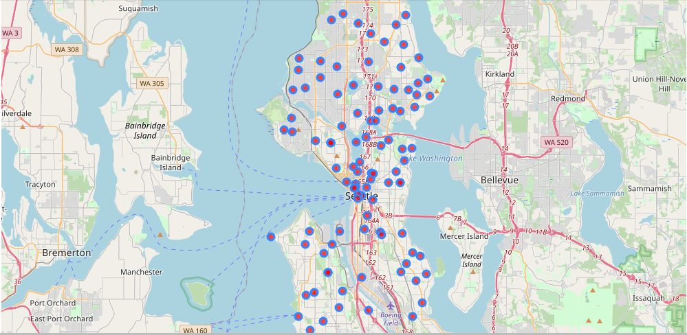
Seattle Neighborhoods

Slide 5
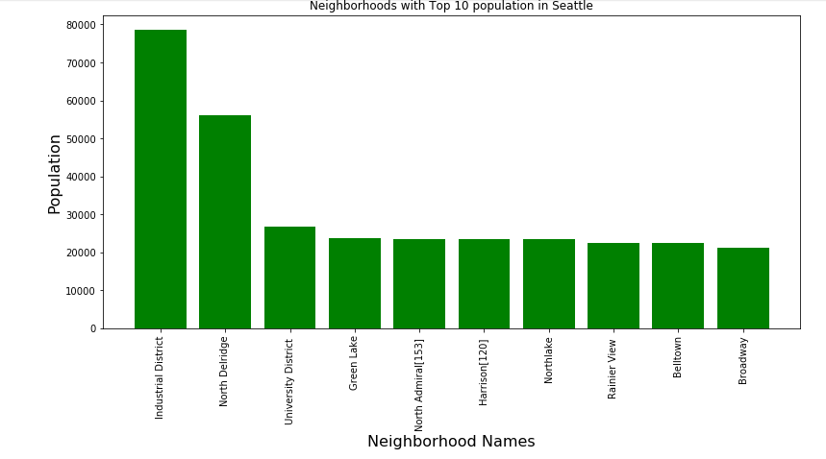
Distribution of Population by Neighborhood Top 10.

Slide 6
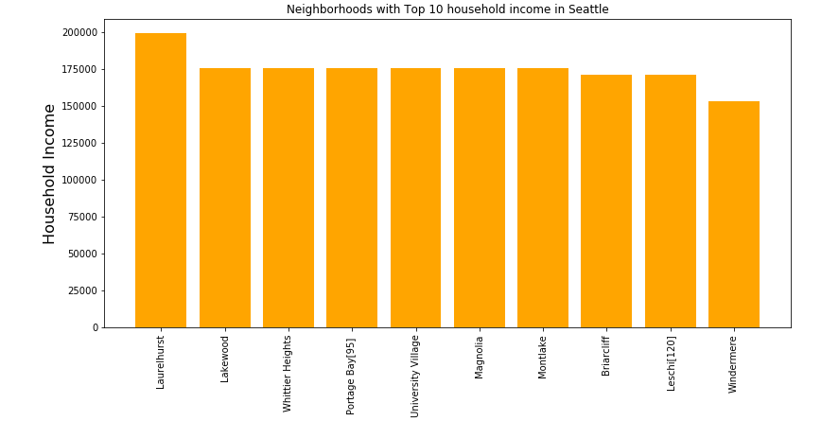
Distribution Of Household Income by Neighborhood Top 10.

Slide 7
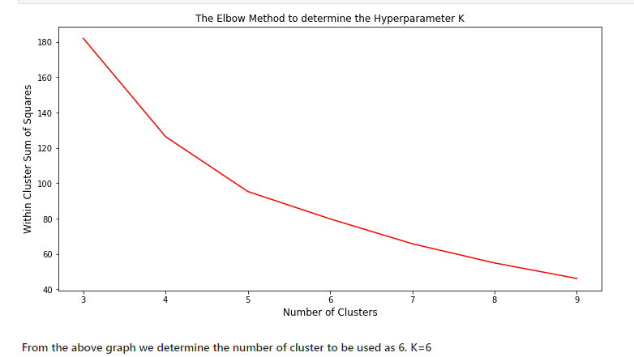
K Means Clustering Elbow Method.

Slide 8
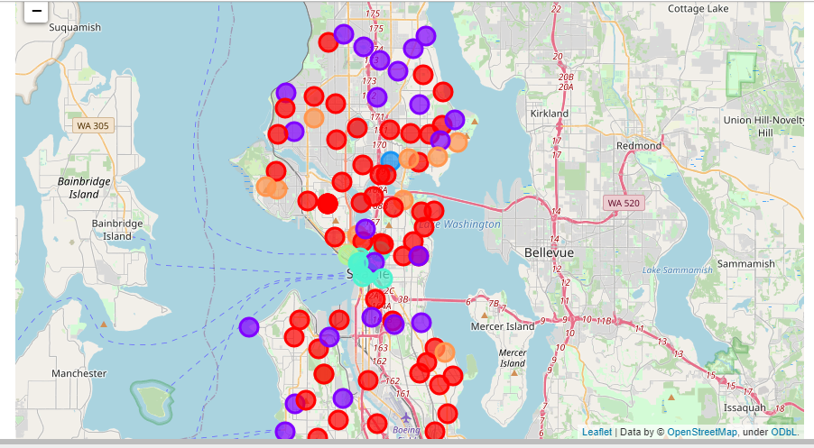
K Means Clustering – Seattle Neighborhood Clusters

Slide 9
Ideal Cluster for Establishing a Restaurant in Seattle.
With regards to Cluster 4, the residents possess above average spending power as indicated by their average incomes values. There exists a reasonable amount of Asians residing in these neighborhoods and in contrast, the number of Asian restaurants is relatively small. As a result, this cluster is the perfect for an entrepreneur who wishes to start an Asian restaurant business in Seattle.

Slide 10
Conclusion.
In this study, I have labeled the neighborhoods corresponding to their characteristics — spending power, percentage of target customers, and the number of competitors. The most promising group of neighborhoods for opening an Asian Restaurant, with a niche in Southeast Asian cuisine, appears to be ‘Cluster Label 4’. The higher spending power of the neighborhoods in this cluster allows them to readily afford the slightly up scaled prices of the client’s Asian restaurant menu. The average distribution of the percentage of target customers — the Southeast Asian demographic — indicates a relatively reasonable demand for the Asian cuisine. The number of competitors is not significant yet adequate enough to be a good indicator of demand for Asian cuisine

