Slide 1
Royalty Lite(Undercollateralized Loans)
Aditya Gautam

Slide 2
Problems
NFT Buyer does not want to pay for royalty. If they have a chance to not pay the royalty then most NFT buyers are not paying the royalty
Royalty is a way to get additional revenue for Creators for the long term.
If a Platform enforces royalty NFT Buyer will find a different platform to buy the NFTs.

Slide 3
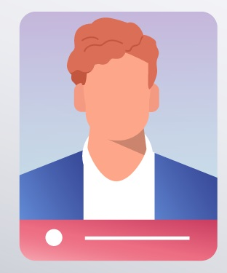




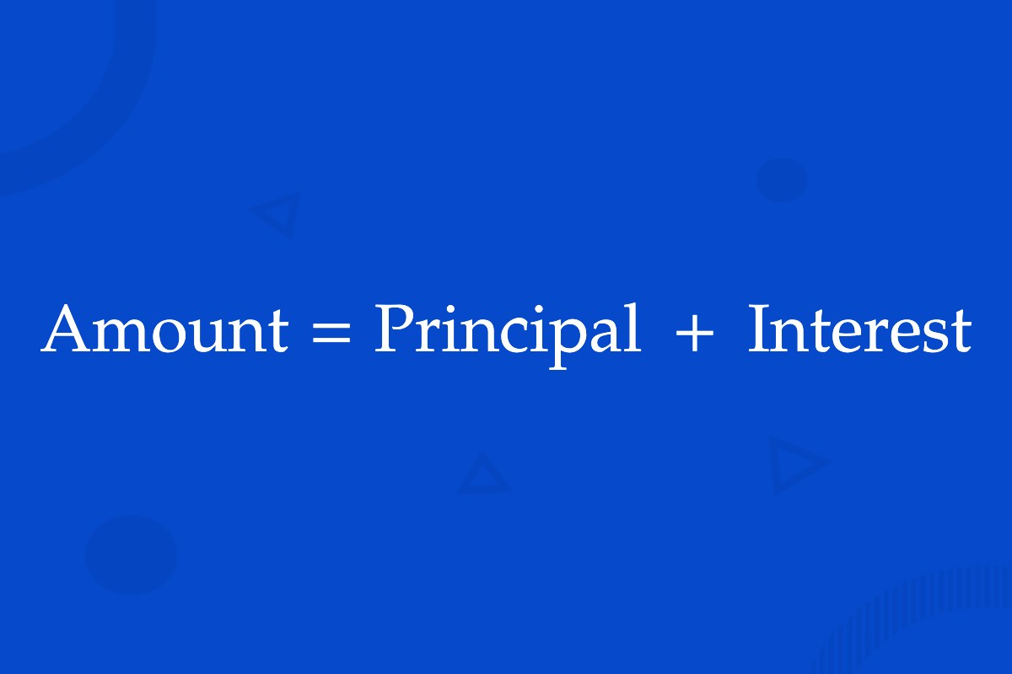
Solution
Buys
The Sol/ETH will be deposited to Interest generating Platform
Magic Eden will pay an extra 2.5%/5% with Curve Pool and this Undercollateralized Loan App
Paid Half or No Royalty
After 6/12 months the original amount will mature to get 2.5/5% which will similar to the amount paid by Magic Eden
Seller will receive Full amount and NFT Creator will get full royalty

Slide 4
Paid No Royalty
The depositor which is Owner(MagicEden) will remove the Sol/ETH from the deposited platform after 12 months and Remove the Sol/ETH by burning the mSol/mETH
Deposit Sol/ETH and receive (1.05x)mSol/mETH with a maturity of 12 months based on the APY (5%). It will be deposited to interest generating platform.
The deposited asset can not be withdrawn before the Maturity period.
The Removed Sol/ETH can be sent back to the Curve pool for liquidity or to treasury
The owner at MagicEden needs to provide liquidity to this pool.
A Private curve pool with 1:1 ratio will be created, where mSol or mETH will be converted to 1.05x (Sol/ETH)
Seller will receive their price and the extra 5% sol will be transferred to Creator. Now He will receive the full 5% royalty.

Slide 5
Paid Half Royalty
The depositor which is Owner(MagicEden) will remove the Sol/ETH from the deposited platform after 6 months and Remove the Sol/ETH by burning the mSol/mETH
Deposit Sol/ETH and receive (1.025x)mSol/mETH with a maturity of 6 months based on the APY(5%). It will be deposited to interest generating platform.
The deposited asset can not be withdrawn before the Maturity period.
The Removed Sol/ETH can be sent back to the Curve pool for liquidity or to treasury
The owner at MagicEden needs to provide liquidity to this pool.
A Private curve pool with 1:1 ratio will be created, where mSol or mETH will be converted to 1.025x (Sol/ETH)
Seller will receive their price and the extra 2.5% sol will be transferred to Creator. Now He will receive the full 5% royalty.

Slide 6
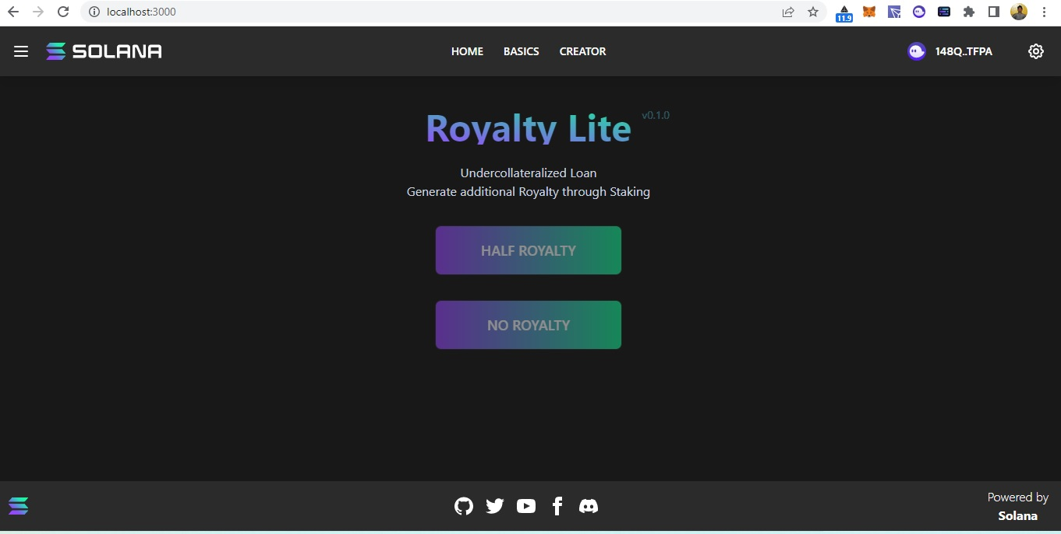

Slide 7
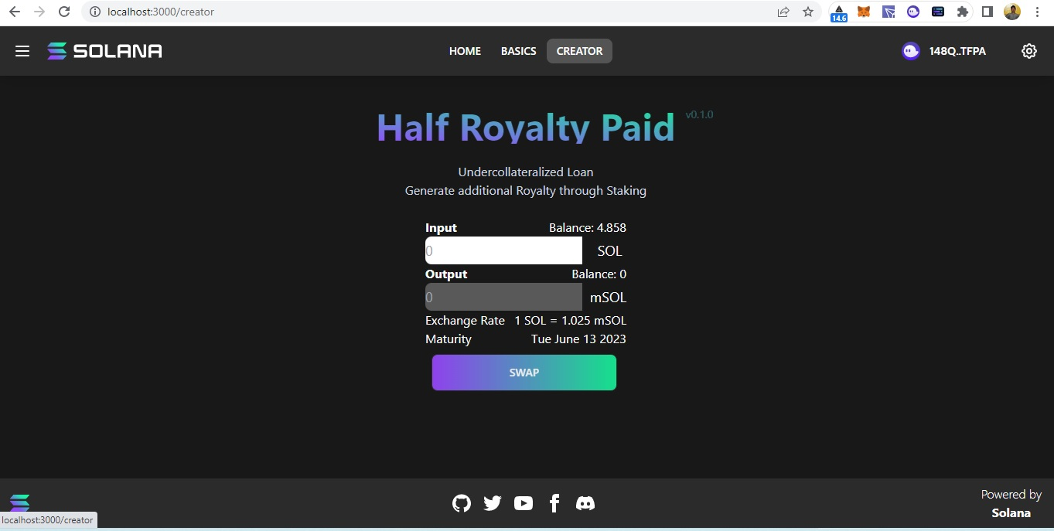
The Amount Paid will be deposited to earn interest (APY 5%) and which can be removed by the maturity period.

Slide 8
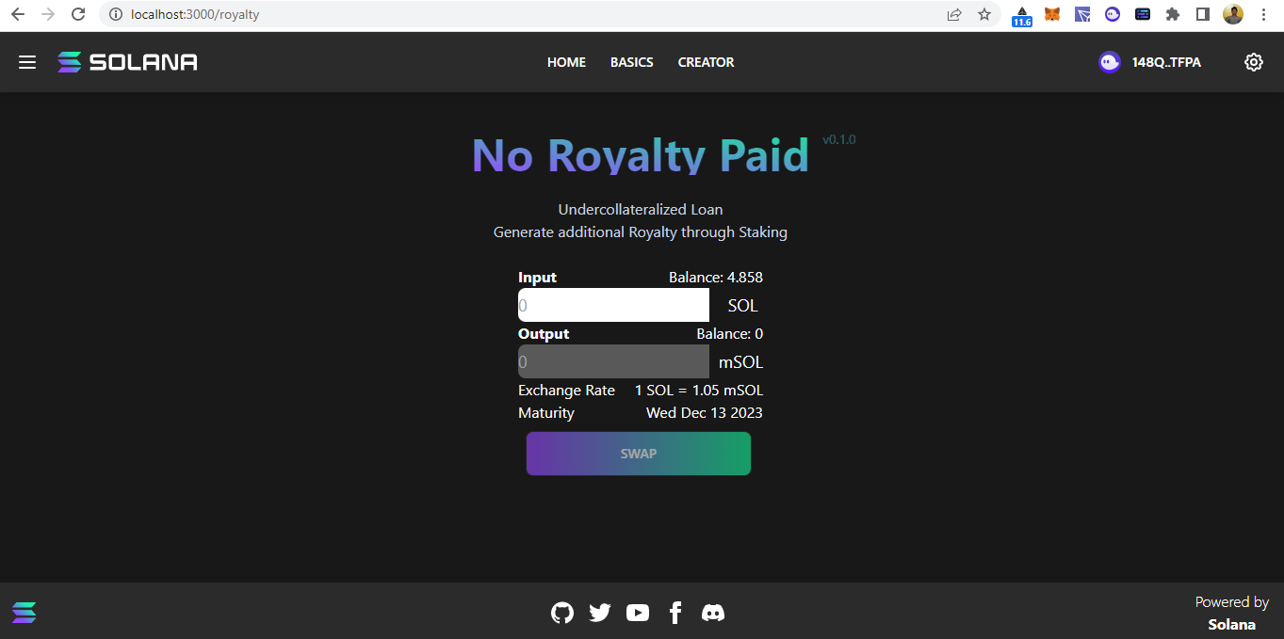
The Amount Paid will be deposited to earn interest (APY 5%) and which can be removed by the maturity period.

Slide 9
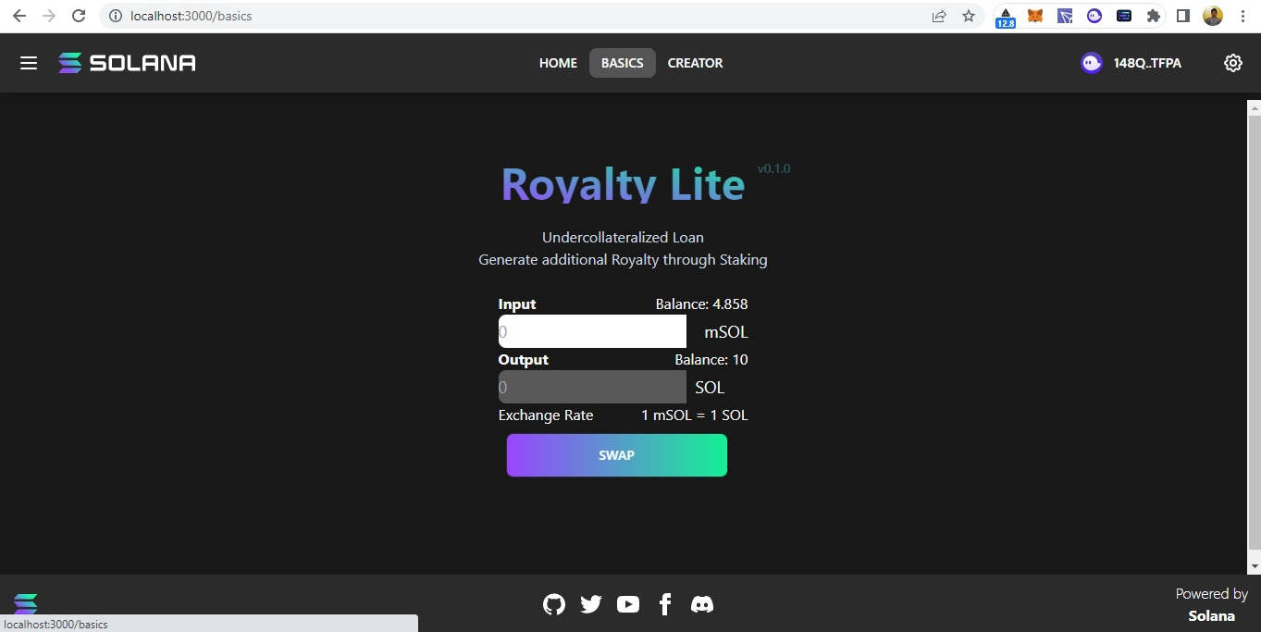
The Private Curve Pool will be used to swap the mSOL to SOL and this Pool can be owned by Magic Eden and liquidity will be provided by Magic Eden itself.

Slide 10
Thank You

