Slide 1
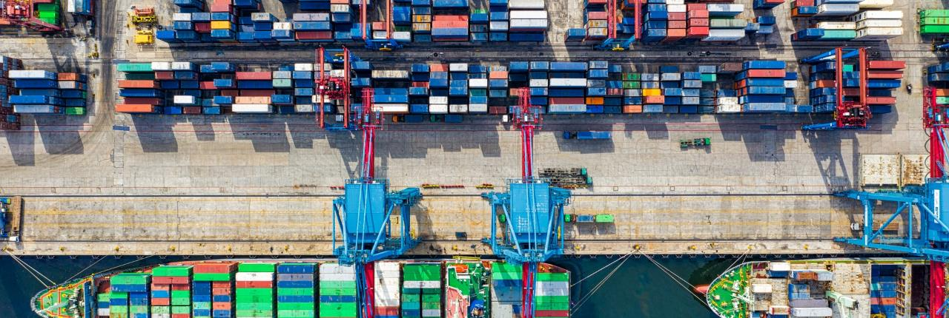

Logistics Company
GLOBAL TRADE
PRESENTATION TEMPLATE
WE DELIVER
ANYWHERE IN THE WORLD!
INTERNATIONAL TRADE LOGISTICS
357 Patterson, Chicago
Logistics website here
+123 456 7899
Notes:
Links:
https://www.pexels.com/photo/birds-eye-view-photo-of-freight-containers-2226458/
https://www.pexels.com/photo/photo-of-man-in-bubble-jacket-while-holding-tablet-computer-4484077/

Slide 2
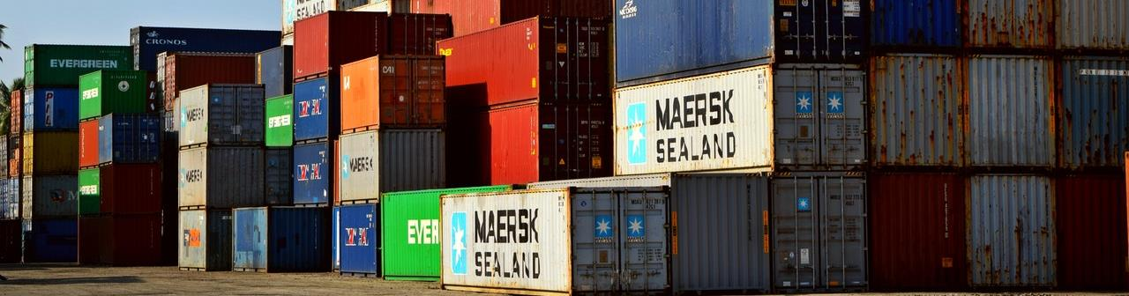
ABOUT US
GLOBAL TRADE BUSINESS
This is a placeholder for a global trade presentation template; you can edit this text and customize the presentation slides with your text relevant to a logistics presentation.
2021
12K
20M
A+
Year Founded
Total Employees
Success Deliveries
Client Ratings
Notes:
Links:
https://www.pexels.com/photo/cargo-container-lot-906494/

Slide 3
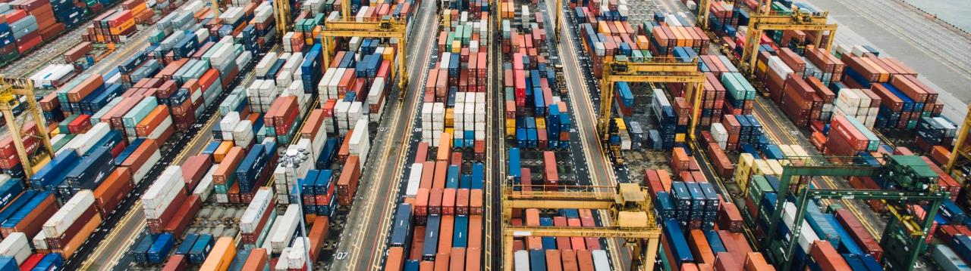
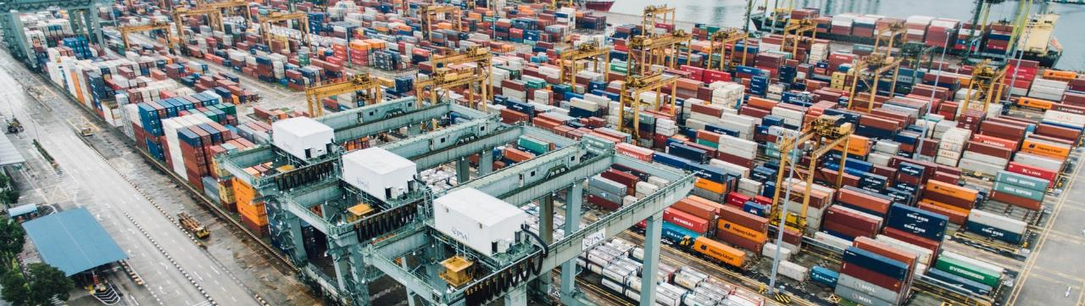
Warehouse 1
CHICAGO
WAREHOUSES
WE STORE & DELIVER!
Warehouse 2
NEW YORK
Notes:
Links:
https://unsplash.com/photos/fN603qcEA7g
https://unsplash.com/photos/eqwFWHfQipg

Slide 4
WORLDWIDE
WE HAVE BRANCHES WORLDWIDE
Canada
Russia
Asia
USA
UK
Australia

Slide 5




OUR MEMBERS
THE TEAM BEHIND OUR SUCCESS
Peter Parker
Serena Ramos
Operations Director
Inventory Specialist
Jazmine Fletcher
Paul Stevens
Marketing Manager
Human Resources
Notes:
Links:
https://unsplash.com/photos/mEZ3PoFGs_k
https://unsplash.com/photos/7YVZYZeITc8
https://www.pexels.com/photo/smiling-woman-wearing-black-sweater-1587009/
https://www.pexels.com/photo/smiling-woman-wearing-black-sweater-1587009/

Slide 6
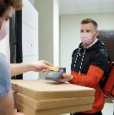
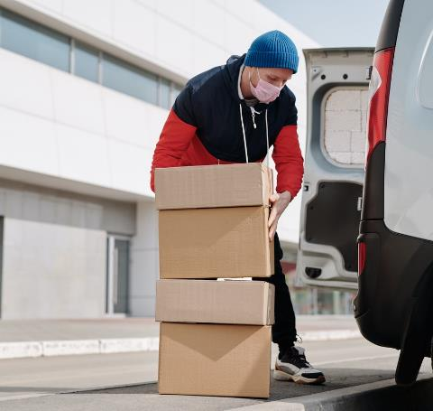


OUR SERVICES
WE STRIVE TO SERVE YOU BETTER
Service 1
Presentations are communication tools that can be used as demonstrations, lectures, speeches, reports, and more.
Service 2
Presentations are communication tools that can be used as demonstrations, lectures, speeches, reports, and more.
Service 2
Presentations are communication tools that can be used as demonstrations, lectures, speeches, reports, and more.
Notes:
Links:
https://www.pexels.com/photo/delivery-man-wearing-a-face-mask-carrying-boxes-4391478/
https://www.pexels.com/photo/man-wearing-a-face-mask-receiving-a-pizza-delivery-4393441/
https://www.pexels.com/photo/person-paying-for-food-delivery-with-a-credit-card-4393532/
https://www.pexels.com/photo/men-putting-food-on-a-thermal-bag-4393665/

Slide 7






CUSTOMER SERVICE
CLIENT SATISFACTION
This is a placeholder for a global trade presentation template; you can edit this text and customize the presentation slides with your text relevant to a logistics presentation.
24 Hour Support
Presentations are communication tools that can be used as demonstrations, lectures, speeches, reports, and more. Most of the time, they’re presented before an audience.
Notes:
Links:
https://www.pexels.com/photo/man-in-white-dress-shirt-and-black-pants-standing-near-glass-window-4604668/
https://www.pexels.com/photo/delivery-man-wearing-a-face-mask-and-riding-a-bicycle-4392030/
https://www.pexels.com/photo/focused-young-female-writing-on-cardboard-boxes-and-preparing-for-relocation-4246122/

Slide 8
OUR PROCESS
WE DO THINGS BETTER
5th
4th
PROCESS
This is a placeholder for a global trade presentation template; you can edit this text and customize the presentation.
PROCESS
3rd
PROCESS
This is a placeholder for a global trade presentation template; you can edit this text and customize the presentation slides with your text relevant to a logistics presentation.
2nd
PROCESS
1st
PROCESS

Slide 9
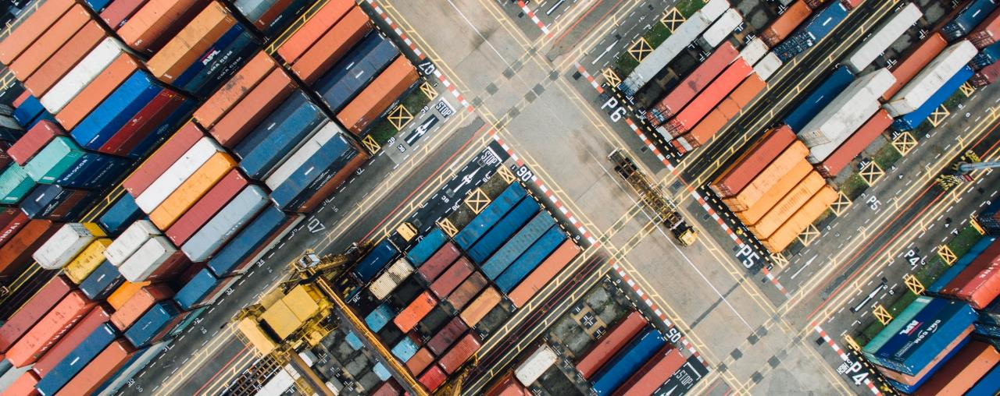

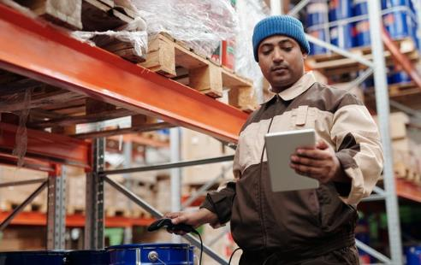

WE ARE ONLINE
VISIT US ON OUR WEBSITE FOR MORE INFORMATION AND TRACKING YOUR PACKAGES
Your logistics website
Notes:
Links:
https://unsplash.com/photos/9cCeS9Sg6nU
https://www.pexels.com/photo/man-holding-digital-tablet-4484155/

Slide 10
LOGISTICS COMPANY
THANK YOU!
WE DELIVER
ANYWHERE IN THE WORLD!
357 Patterson, Chicago
Logistics website here
+123 456 7899
Notes:
Links:
https://www.pexels.com/photo/birds-eye-view-photo-of-freight-containers-2226458/
https://www.pexels.com/photo/photo-of-man-in-bubble-jacket-while-holding-tablet-computer-4484077/

