Slide 1

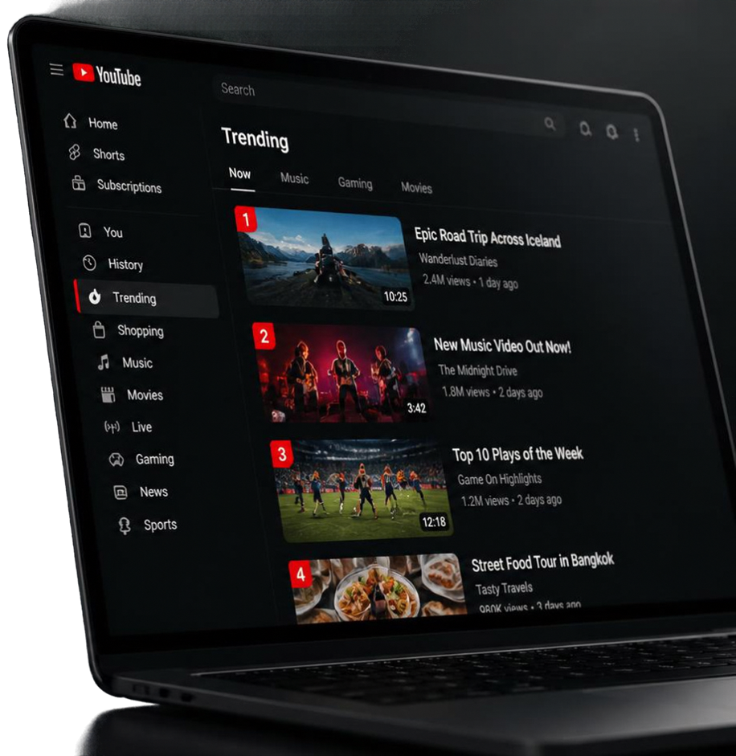

YOUTUBE TRENDING ANALYSIS DASHBOARD
ADIA ANI-B24CS1105
ANGEL ROSE PRINCE-B24CS1115
ANUGRAHA S.D.-B24CS1117
LIYA SHAJU-B24CS1142

Slide 2

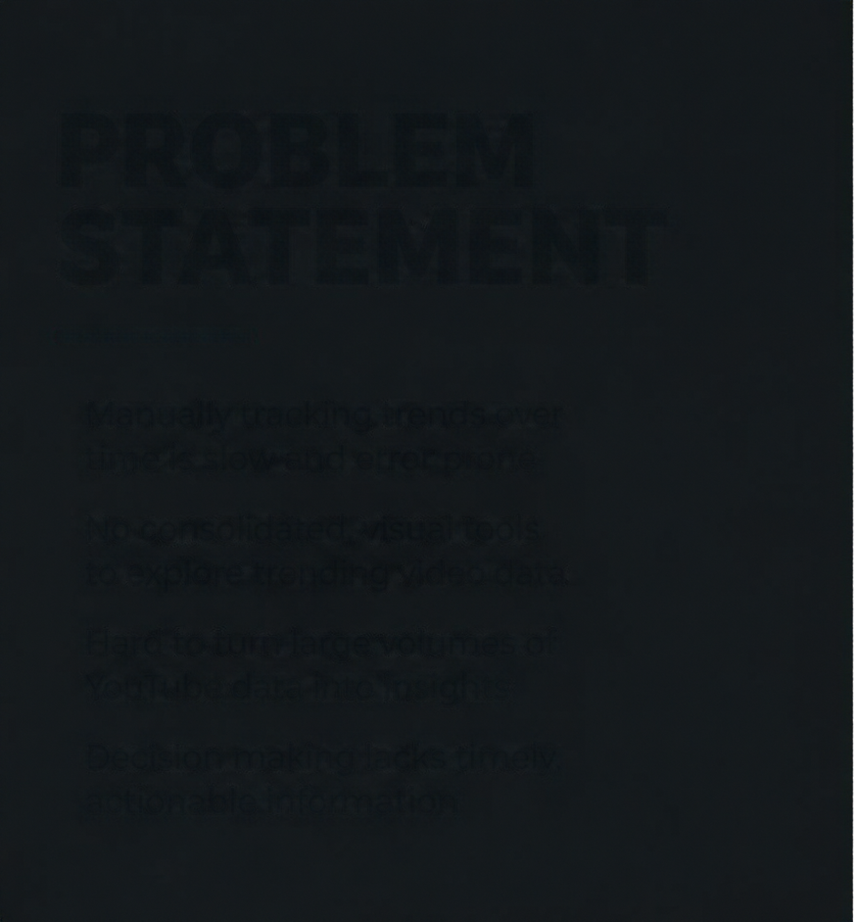
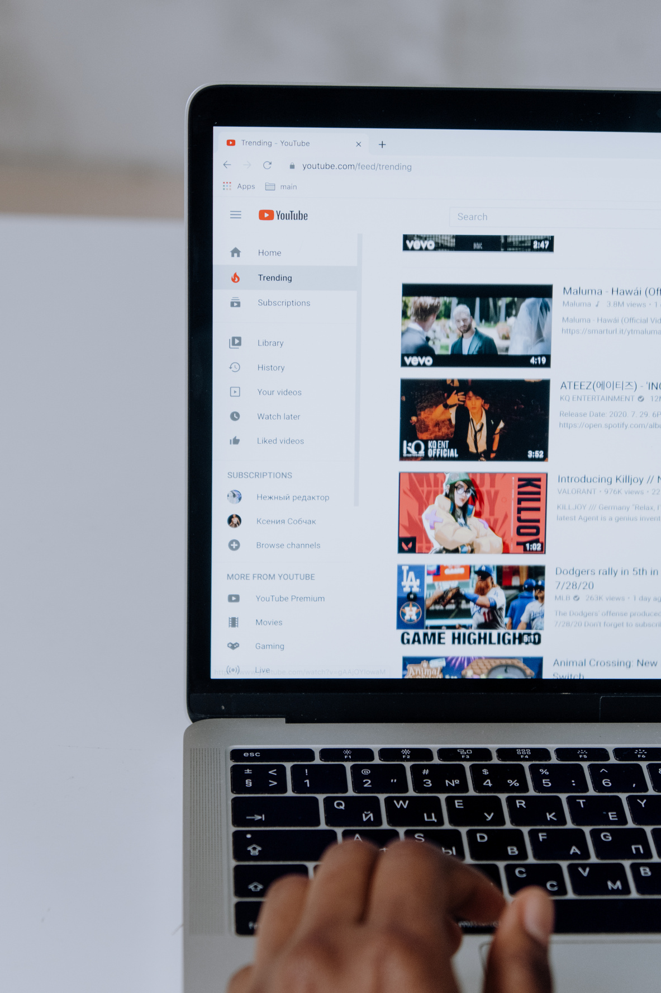
INTRODUCTION
  YouTube is one of the most influential platforms for digital content.
  Millions of videos are uploaded every day, but only some become trending.
  Trending videos often show distinct patterns in views, likes, comments,
categories, and publishing time.
  This project analyzes the YouTube Trending Videos Stats 2026
dataset to identify the characteristics associated with trending videos.
  The analysis aims to understand audience engagement and content
trends using data-driven techniques.

Slide 3








PROBLEM STATEMENT
To identify the patterns and characteristics associated with YouTube trending videos by analyzing factors such as views, likes, comments, categories, publishing time, and audience engagement, and to understand the key factors that contribute to a video becoming trending.

Slide 4

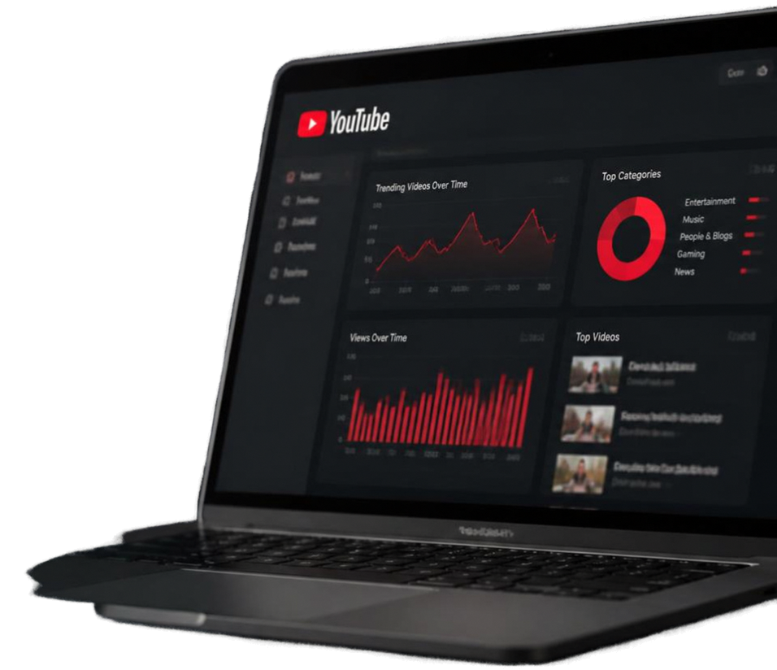
OBJECTIVES
01
To clean and preprocess the YouTube trending video dataset.
02
To perform EDA and analyze views, likes, comments, categories, and publishing patterns.
03
To derive useful features such as engagement rate, like rate, comment rate, and video age.
04
To identify key insights and present the findings using visualizations and an interactive dashboard.

Slide 5

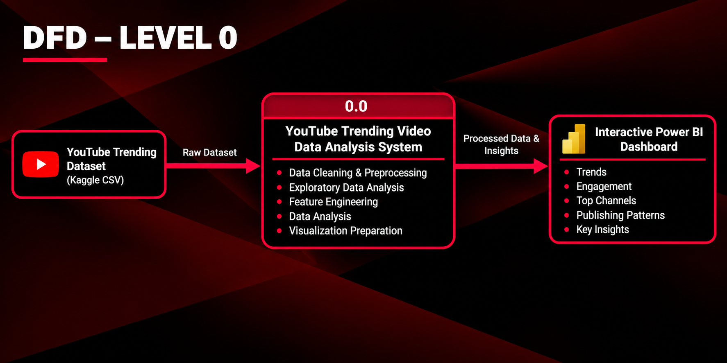

Slide 6
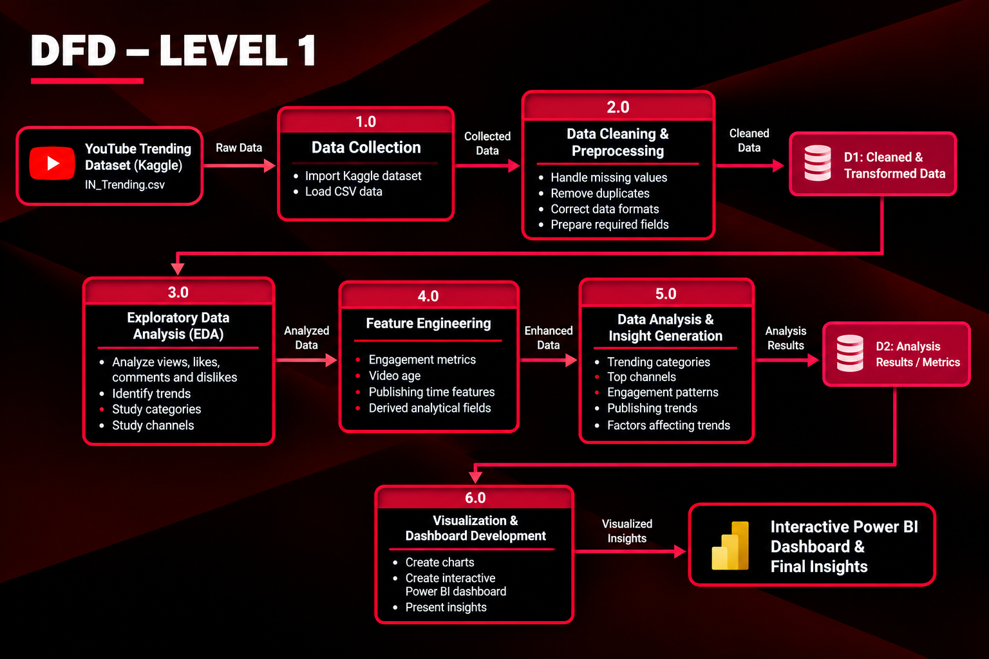

Slide 7






MODULES
01
DATA COLLECTION
  Downloaded YouTube Trending Videos dataset from Kaggle.
  Collected video details including views, likes, categories and channels.
DATA PROCESSING
02
  Cleaned and prepared the dataset for analysis.
  Structured relevant fields for Power BI visualization.
03
EXPLORATORY DATA ANALYSIS (EDA)
  Analyzed views, likes, categories and channel performance.
  Explored viewing patterns based on publishing hours.

Slide 8

MODULES
04
DATA TRANSFORMATION
  Derived Publish Hour from video publishing data.
  Aggregated views and likes by category, channel and publish hour.
DATA MODELING
05
  Structured the cleaned dataset for Power BI analysis.
  Created measures for metrics such as Total Views and Total Likes.
06
INTERPRETATION & INSIGHTS
  Identified high-performing categories and channels.
  Analyzed relationships between views, likes and publishing time.
07
VISUALIZATION & REPORTING
  Developed an interactive Power BI dashboard.
  Used charts, KPI cards and category filters to present insights.

Slide 9


IMPLEMENTATION DETAILS
SOFTWARE STACK
  Programming Language:Python
  Data Processing:Pandas,Numpy
  Data Visualisation:Matplotlib,Seaborn
  Dashboard:Microsoft Power BI
  Data Set:Youtube Trending Vedios Stats 2026 -IN_Trending.csv
  Development Platform:Google Collab

Slide 10
IMPLEMENTATION DETAILS
HARDWARE REQUIREMENTS
  System: Laptop / Desktop
  RAM: Minimum 4 GB
  Processor: Intel Core i3 or equivalent
  Storage: Sufficient space for dataset and required software
  Input Devices: Keyboard and Mouse
  Internet: Required for Google Colab and dataset/software setup

Slide 11

CONCEPTS USED
  Data Acquisition & Preprocessing – Dataset collection, data cleaning, handling missing values and duplicates, and data type conversion.
  Exploratory Data Analysis (EDA) – Analyzing category distribution, average views, top channels, publishing patterns, and relationships between variables.
  Statistical Analysis – Using descriptive statistics to understand data distributions and identify patterns and relationships.
  Data Transformation & Feature Engineering – Creating features such as engagement rate, like rate, comment rate, publishing time, title length, and tag count.
  Data Visualization – Using charts and graphs to communicate findings and presenting the results through a Power BI dashboard.

Slide 12
CONCLUSION
  The project analyzes the characteristics and patterns of YouTube trending videos.
  Data analysis helps identify relationships between performance, engagement, categories, and publishing patterns.
  Feature engineering provides additional measures for better comparison of videos.
  Visualizations and the interactive dashboard make the findings easier to understand.
  The insights can help content creators make more data-driven decisions when planning and improving their videos.

Slide 13
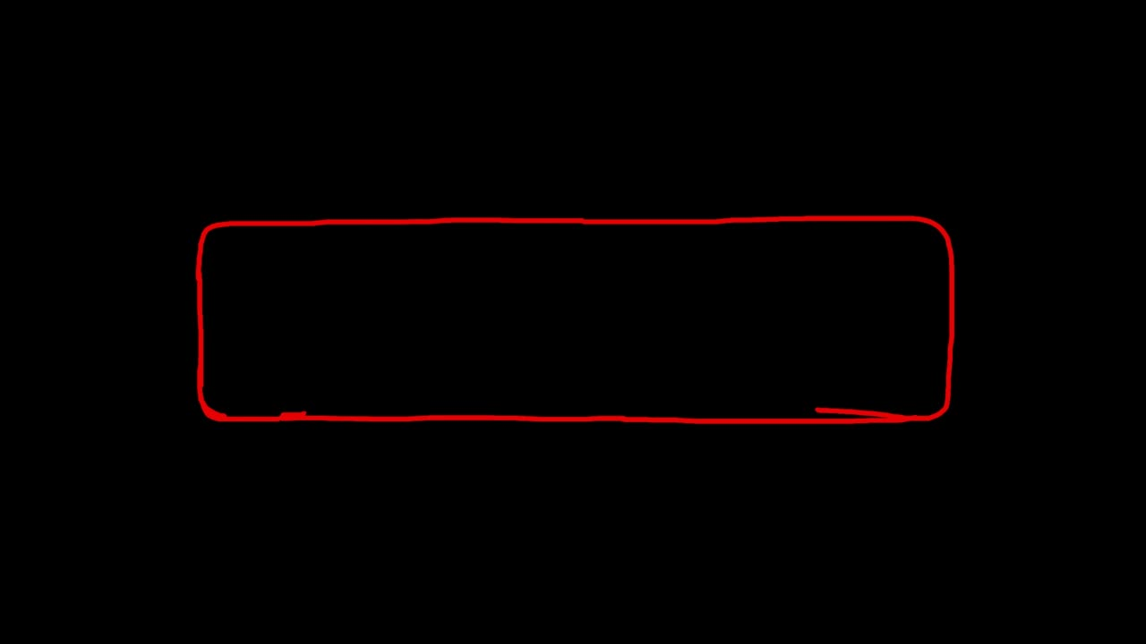

REFERENCES
[1] Kaggle, “Kaggle: Your Machine Learning and Data Science Community,” [Online]. Available: https://www.kaggle.com/
[2] Pandas, “Pandas: Python Data Analysis Library,” [Online]. Available: https://pandas.pydata.org/
[3] NumPy, “NumPy: The Fundamental Package for Scientific Computing with Python,” [Online]. Available: https://numpy.org/
[4] Matplotlib, “Matplotlib: Visualization with Python,” [Online]. Available: https://matplotlib.org/
[5] Microsoft, “Microsoft Power BI,” [Online]. Available: https://powerbi.microsoft.com/
[6] Google, “Google Colaboratory,” [Online]. Available: https://colab.research.google.com/

Slide 14

THANK YOU

