Slide 1
ONLINE FOOD ORDERING SYSTEM
Aishwarya Katkar 002961534
Rushikesh Dalvi 002922393
Anusha Das 002985875
Aditya Agarwal 002139964
Maurya Ramteke 002980963

Slide 2
PROBLEM STATEMENT
Restaurant finds it difficult to manage online orders further causing discrepancy in the data.
There is a need for an automated food ordering system to ease the process of handling customers orders , tracking restaurant sales and checking on food deliveries. which will in turn , help the restaurant manage online orders efficiently.

Slide 3
PROPOSED SOLUTIONS
SOLUTION 1
SOLUTION 4
Whenever a new customer is registered a new CUST_ID will be generated to uniquely identify that customer. Likewise, we have separate tables MANAGER and DELIVERY_AGENT which will be specific to manager and delivery agent respectively.
We have used the ORDER_ID as a PRIMARY key in Payments table and as FOREIGN key in the ORDERS table to find sales of restaurant effectively.
SOLUTION 5
SOLUTION 2
The 3 entities – ORDER, DELIVERY and DELIVERY_AGENT are linked in such a way that whenever an order is placed, ORDER_STATUS field is updated in ORDER table, and a delivery agent is assigned to that order in the DELIVERY table.
Using our database design, the Manager can obtain all the Customer order details, Menu details and Feedback details which we have defined as separate entities.
Thus, the Manager can retrieve all the Customer and Menu details and update them with ease.
SOLUTION 6
SOLUTION 3
Once the food is delivered, Delivery Agent has access to change DELIVERY_STATUS in Delivery table which in turn will update ORDER_STATUS to “Completed” in ORDER table. This is possible by using keys ORDER_ID and DELIVERY_ID.
The entity CUST_WALLET is introduced to enhance the Payment functionality. Along with regular card
payment, customers can use points in the CUST_WALLET as and when required.

Slide 4
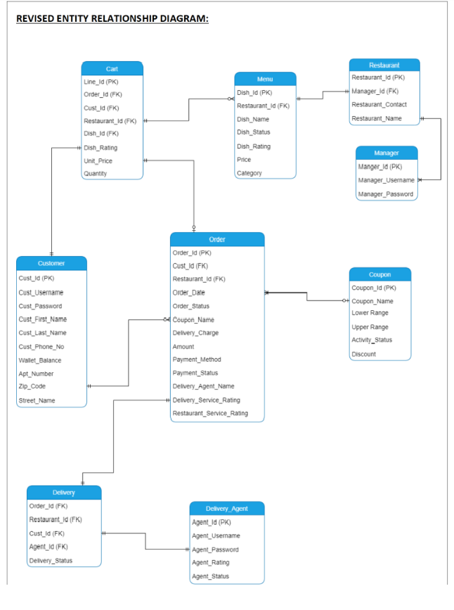

ER DIAGRAM

Slide 5








F
EATURES
FUNCTIONS
PROCEDURES
INDEXES
TRIGGERS
CURSORS
CUSTOMIZED VIEWS
USER ROLES
REPORTS

Slide 6


DB OBJECTS

Slide 7
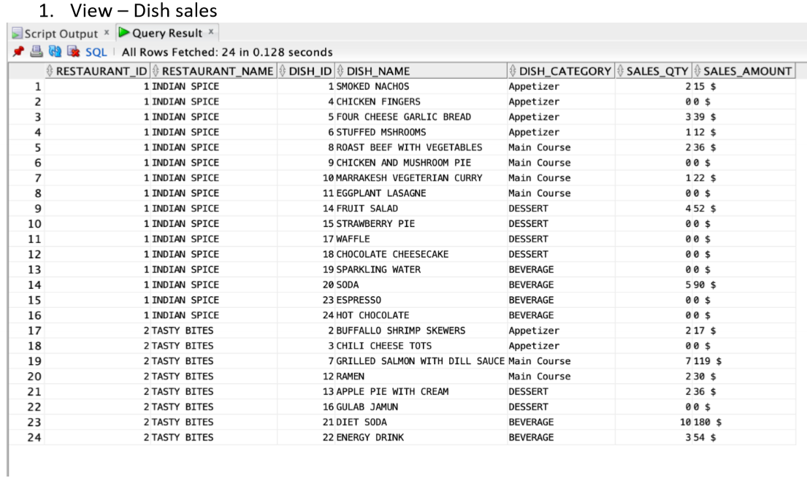
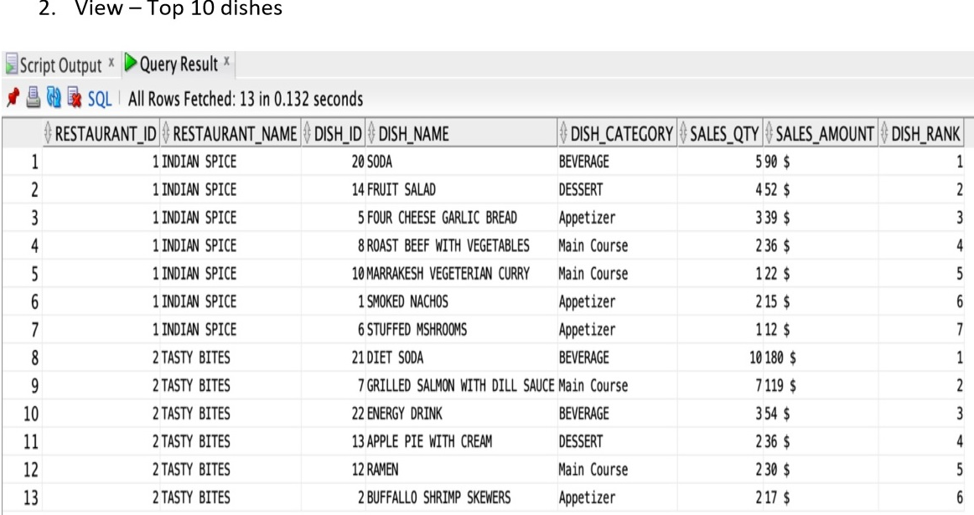
DB OBJECTS

Slide 8
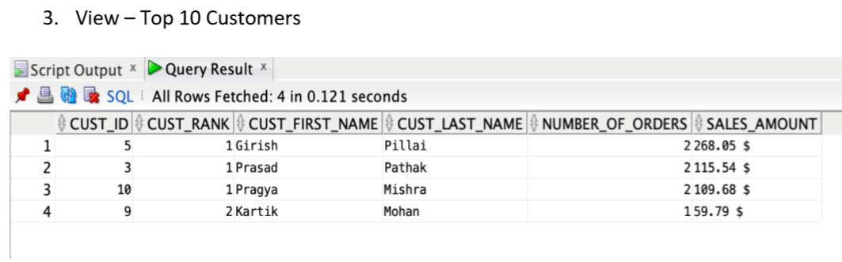
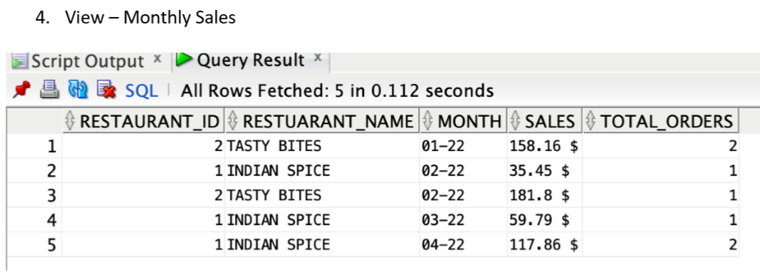
DB OBJECTS

Slide 9
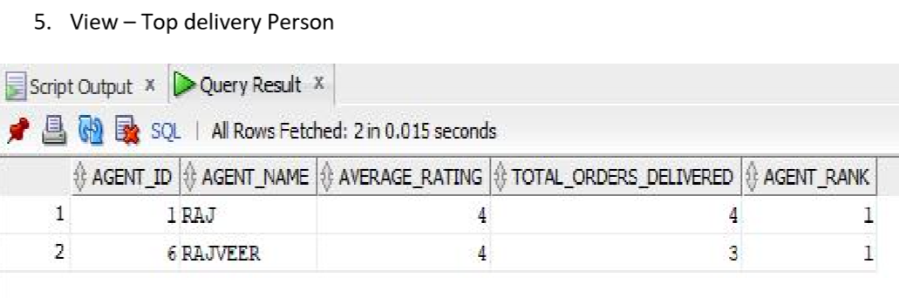
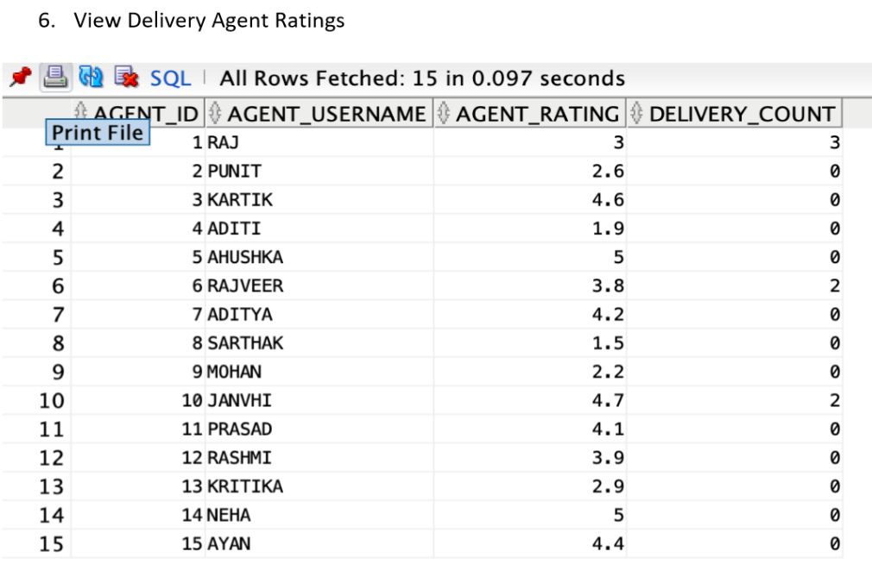
DB OBJECTS

Slide 10
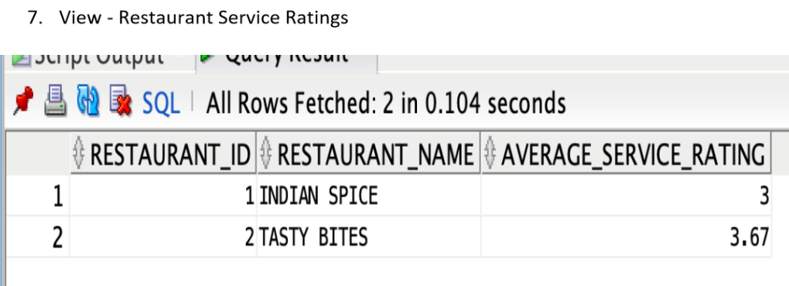
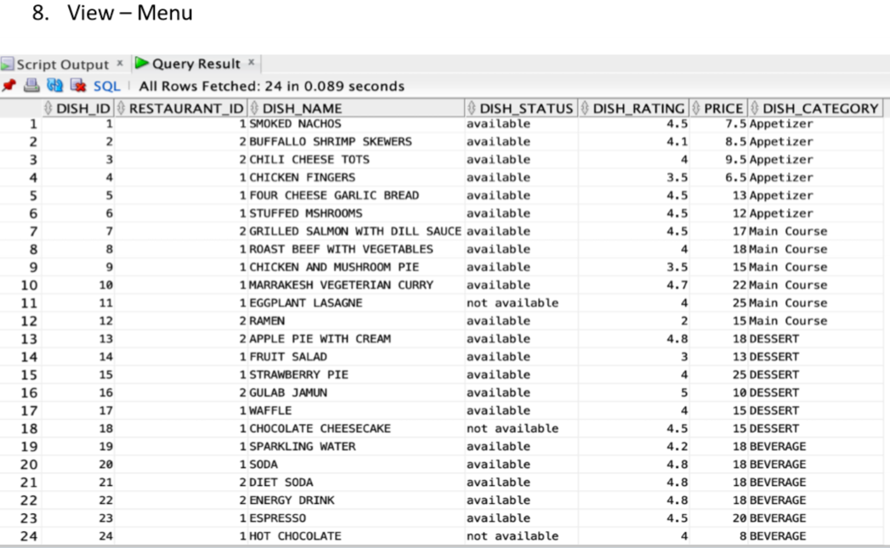
DB OBJECTS

Slide 11
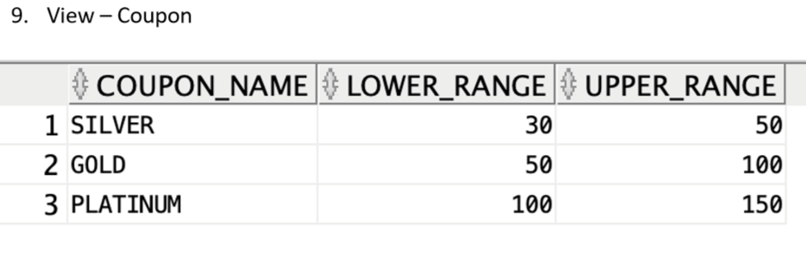
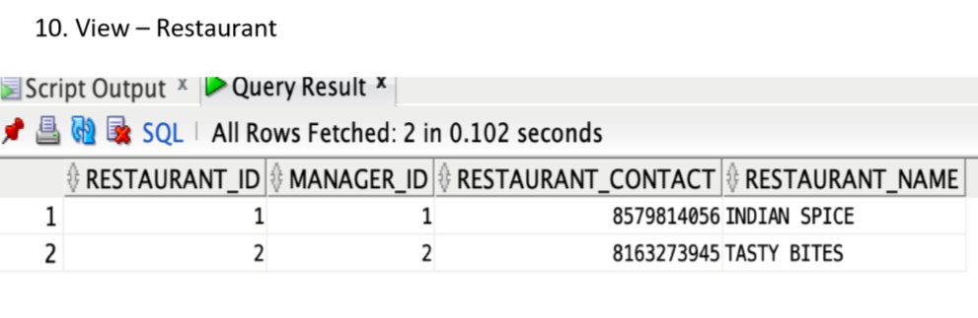
DB OBJECTS

Slide 12
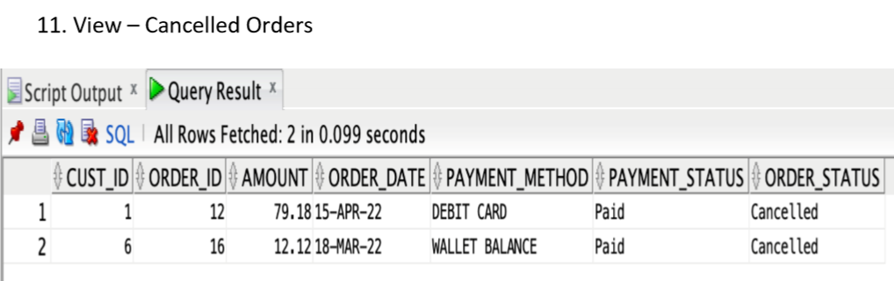
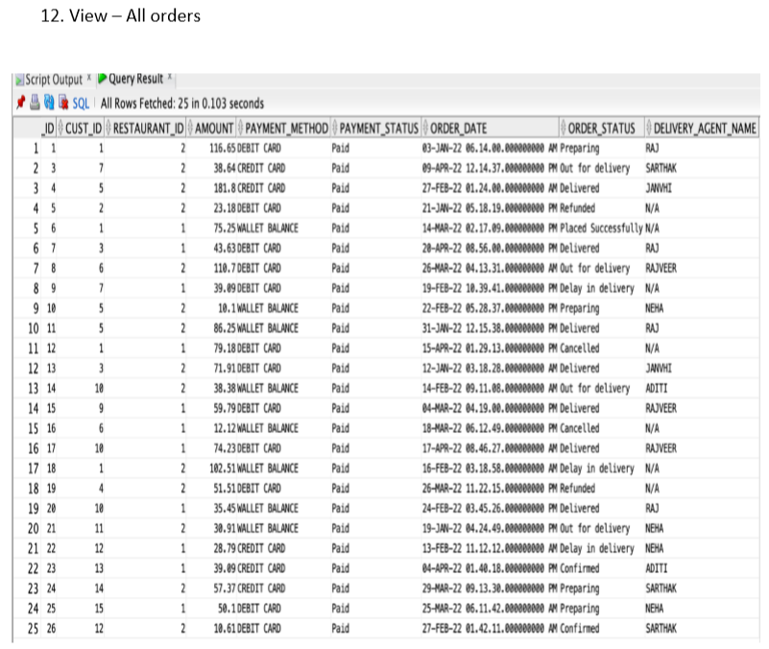
DB OBJECTS

Slide 13
TEAM MEMBER CONTRIBUTION
AISHWARYA KATKAR
Modules: create_tables, register_customer, get_bill(), make_payment(), update_wallet_balance(), assign_delivery_agent(), feedback
RUSHIKESH DALVI
Modules: Create and delete roles, login, get_cart(), update_order_status, refund(), cancel_order(), change_of_delivery_status()
ANUSHA DAS
Modules: add_to_cart(), clear_cart(), apply_coupon(), check_order_status(), update_delivery_agent(), update_manager(), views
ADITYA AGARWAL
Modules: remove_coupon(), inserting and updating data, drop object scripts, remove_item_from_cart(), update_order_status(), create_order
MAURYA RAMTEKE
Modules: Update_menu(), Update_coupon(), get_menu()

Slide 14
THANK YOU!!

