Slide 1
POSAPP (Point Of Sales App)
By Adia Mahardika

Slide 2

Node.js is software designed to develop web-based applications and is written in the syntax of the JavaScript programming language. If all this time we know JavaScript as a programming language that runs on the client / browser side only, then Node.js exists to complete the role of JavaScript so that it can also act as a programming language that runs on the server side, such as PHP, Ruby, Perl, and so on.
Sumber : https://www.codepolitan.com/mengenal-nodejs-5880234fe9ae3

Slide 3

Express.js, or simply Express, is a web application framework for Node.js, released as free and open-source software under the MIT License. It is designed for building web applications and APIs.
Sumber : https://en.wikipedia.org/wiki/Express.js

Slide 4
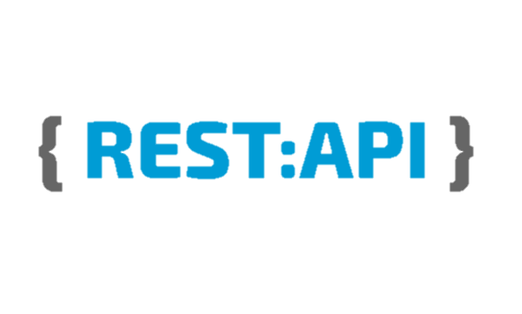
Representational state transfer (REST) is a software architectural style that defines a set of constraints to be used for creating Web services. Web services that conform to the REST architectural style, called RESTful Web services, provide interoperability between computer systems on the Internet.
Sumber: https://en.wikipedia.org/wiki/Representational_state_transfer

Slide 5
STEP-STEP PEMBUATAN
error
Membuat Database pos_app
Membuat tabel product
Membuat CRUD product
Test Postman
works
Membuat tabel category
Membuat CRUD category
Test Postman
Menggabungkan tabel product & category
Menambahkan fitur sort, pagination, dan search name
works
error
Membuat tabel user
Membuat api register dan login
Mengimplementasikan JWT ke CRUD

Slide 6
ALUR APLIKASI
Register nama, email, dan password
Login dan simpan token
Validasi
Input product dan category dengan metode POST
Cek product dan category dengan metode GET
Jika ada yang salah, edit menggunakan metode PACTH
Apabila ada product atau category yang kosong, hapus dengan metode Delete

