Slide 1
LAPORAN BULANAN CRM
April 2025
TSI Certification
Dokumen Internal – Rahasia

Slide 2
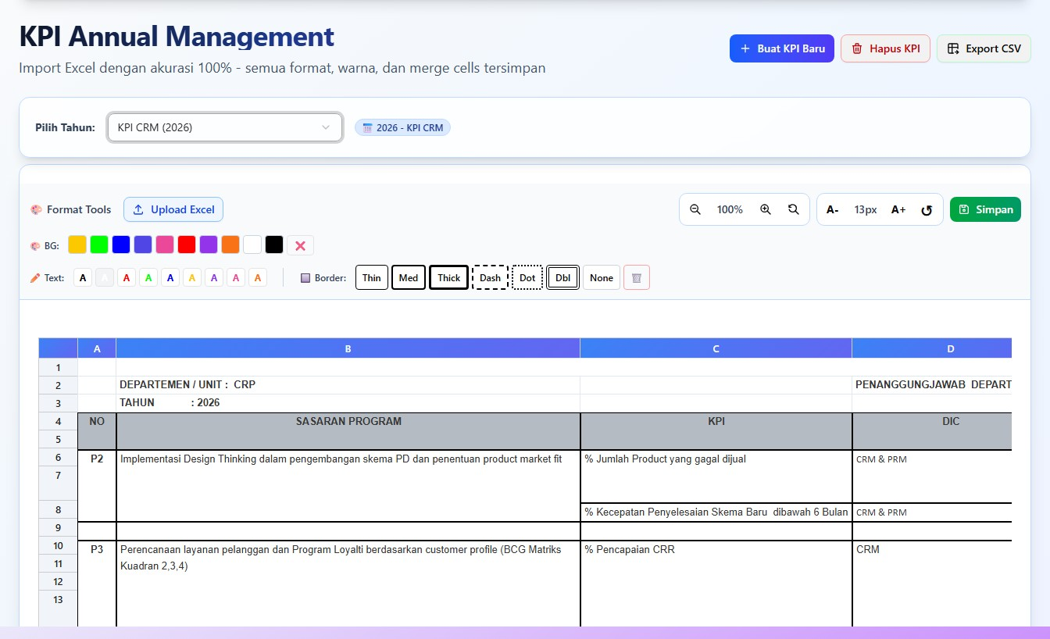
KPI
April 2025

Slide 3
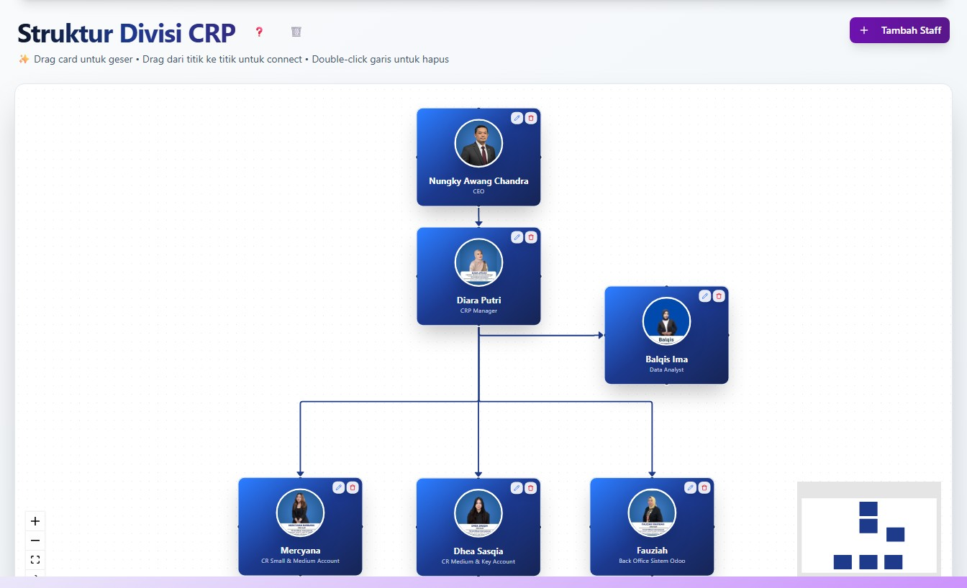
Struktur Divisi CRP
April 2025

Slide 4
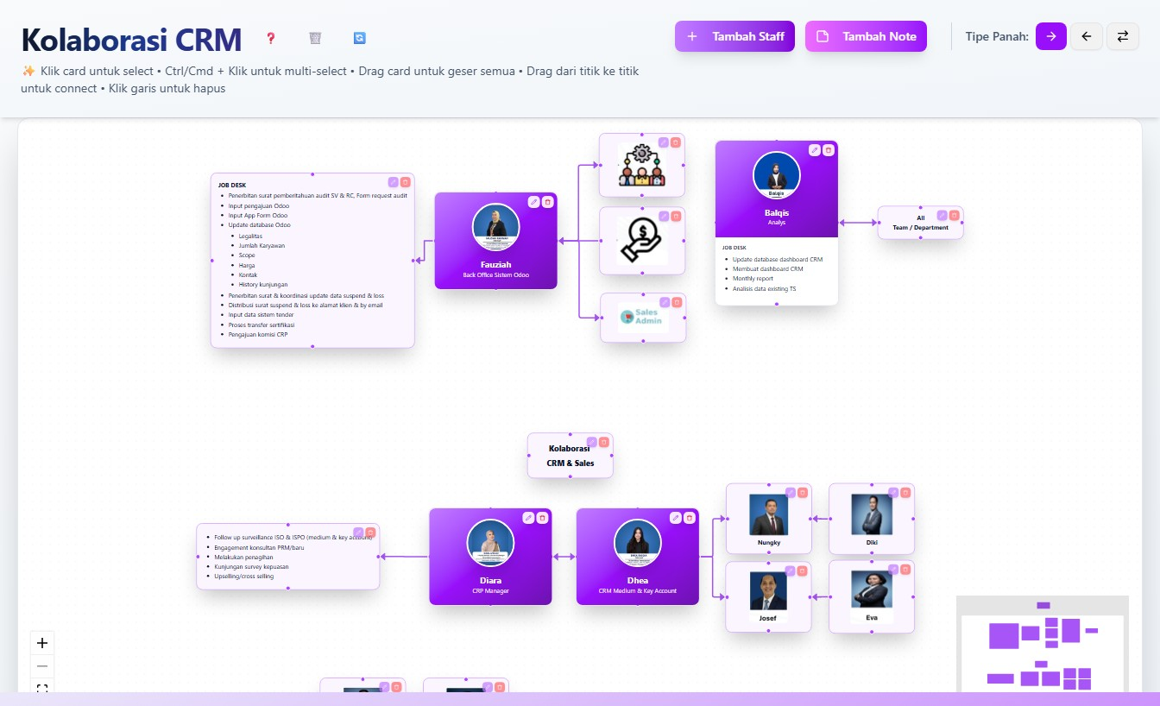
Kolaborasi CRM
April 2025

Slide 5
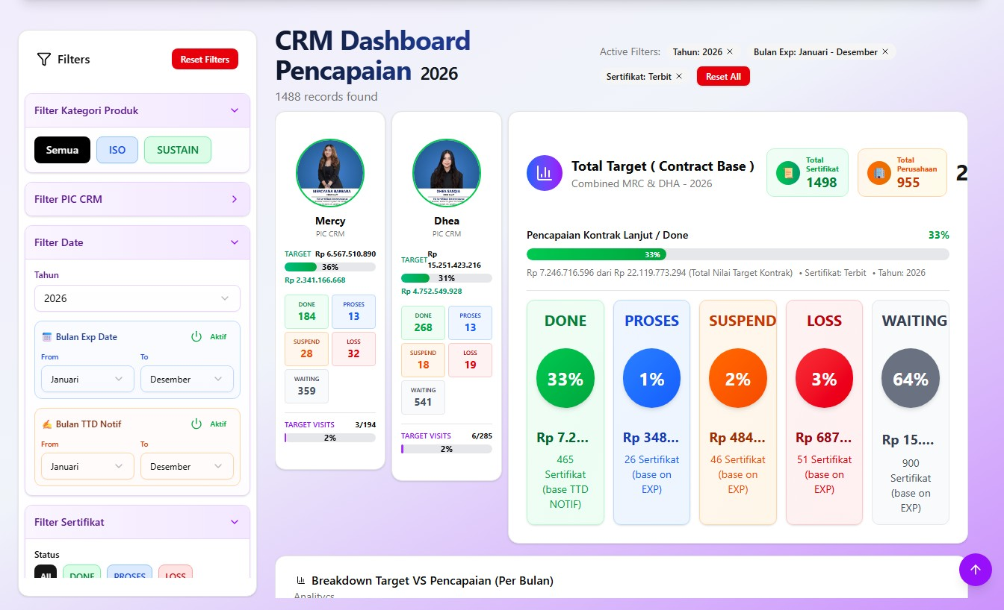
Pencapaian CRM
April 2025

Slide 6
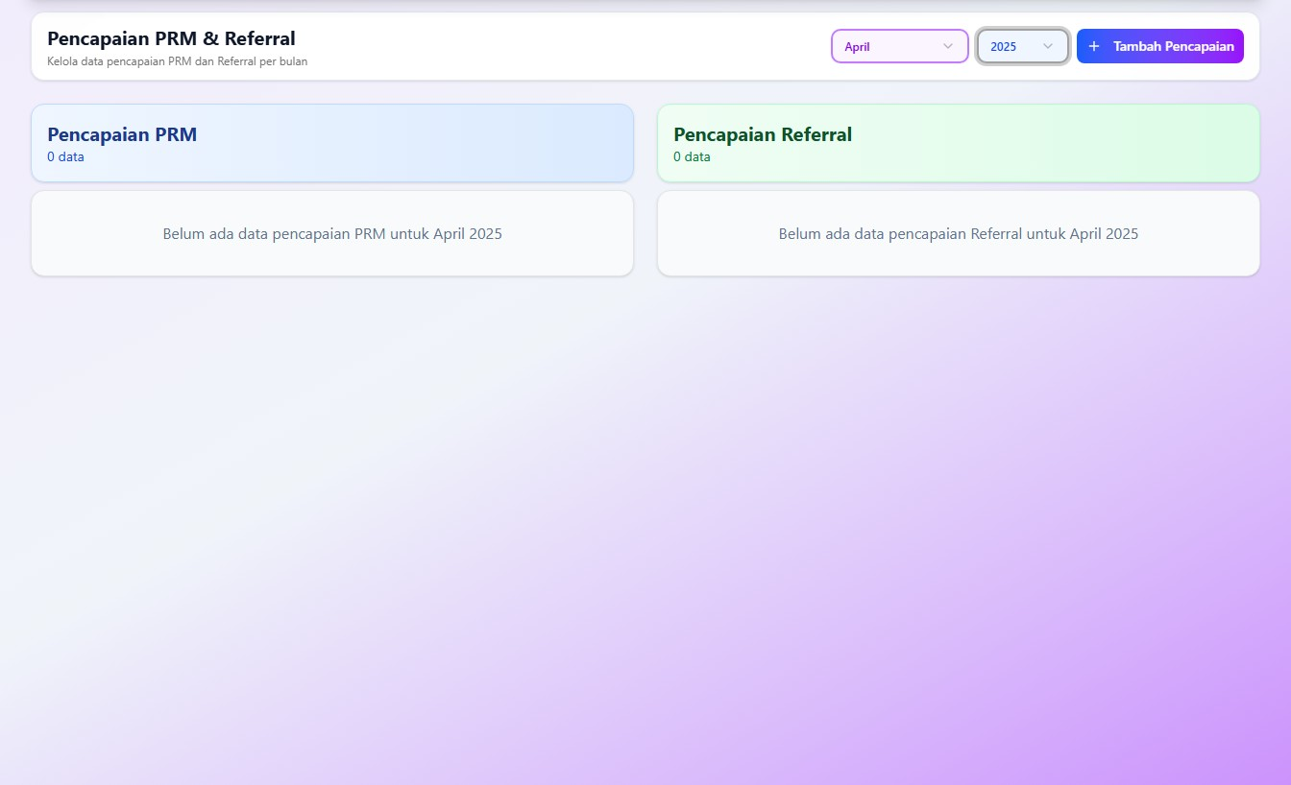
Pencapaian PRM & Referral
April 2025

Slide 7
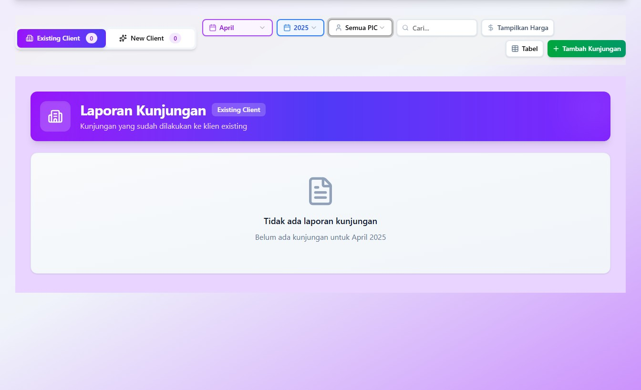
Laporan Kunjungan
April 2025

Slide 8
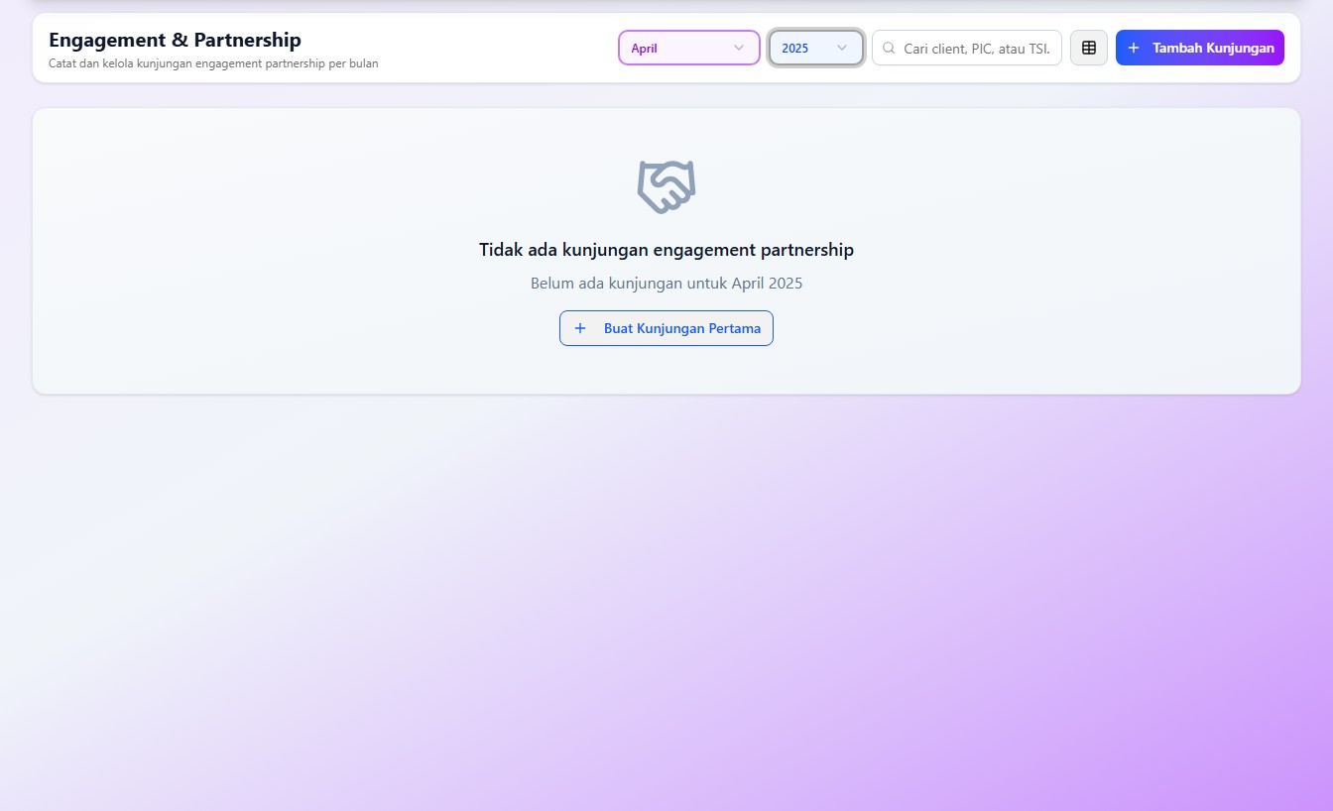
Engagement & Partnership
April 2025

Slide 9
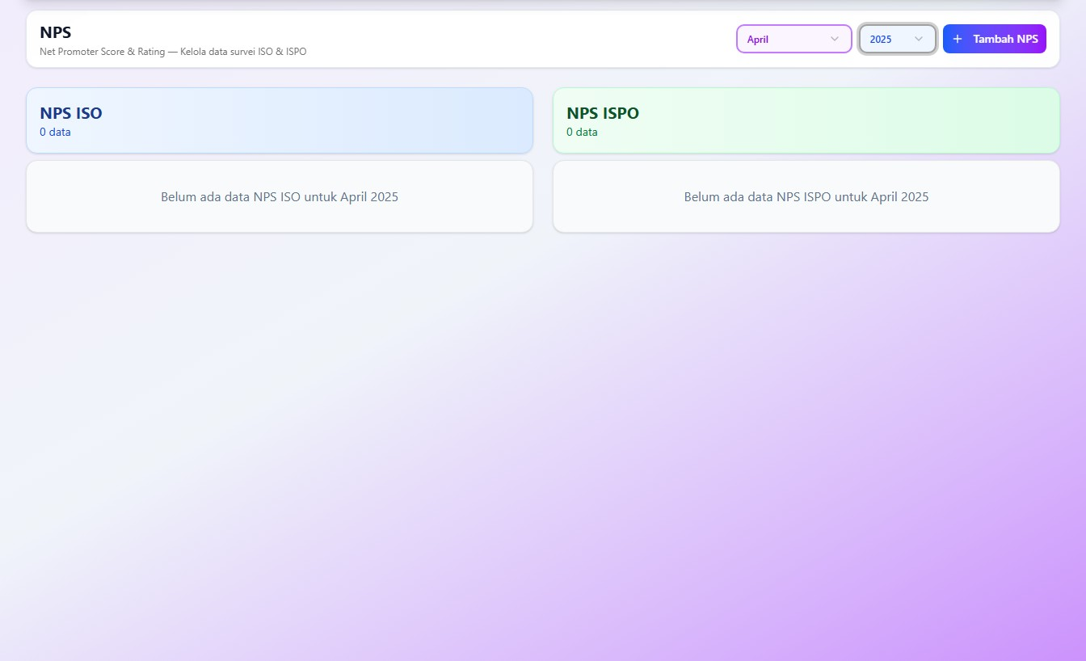
NPS
April 2025

Slide 10
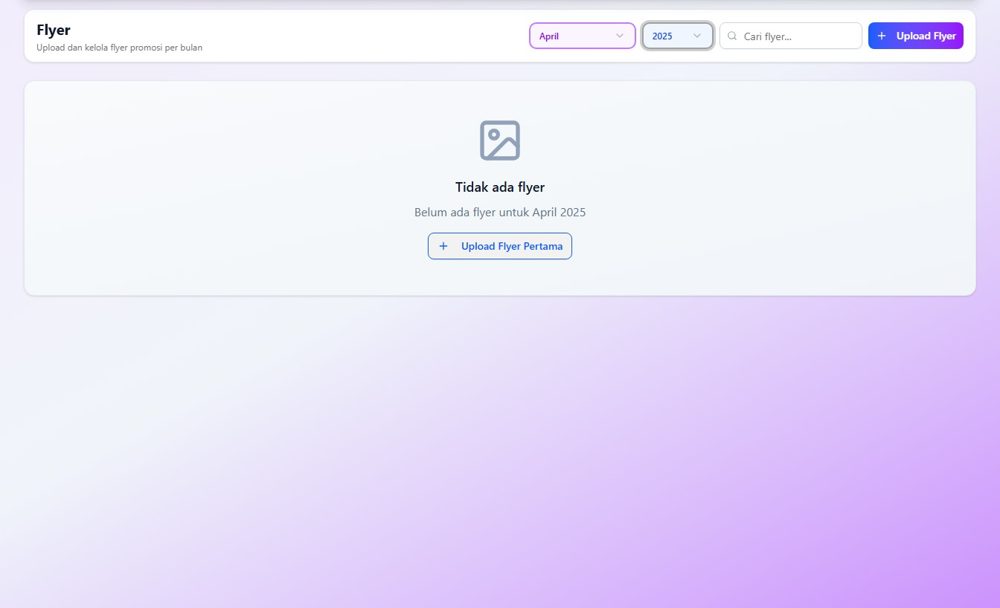
Flyer
April 2025

Slide 11
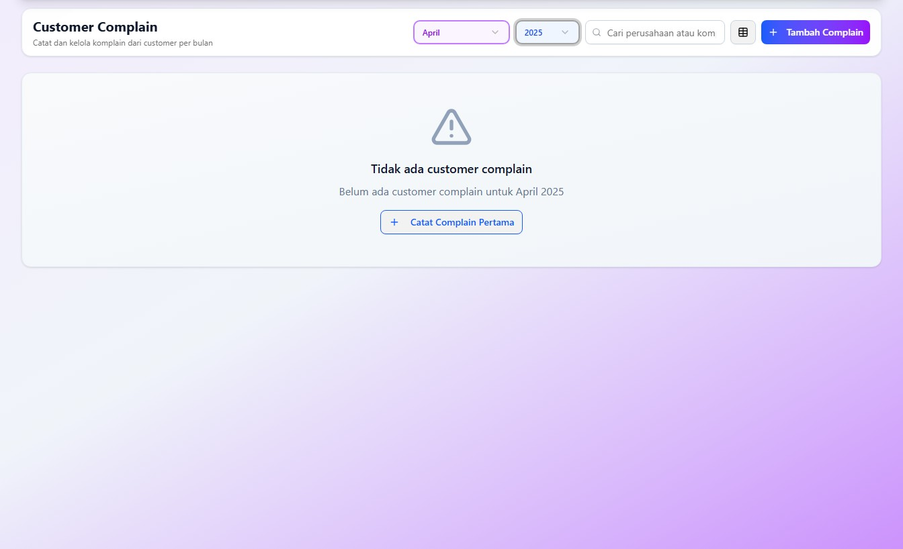
Customer Complain
April 2025

Slide 12
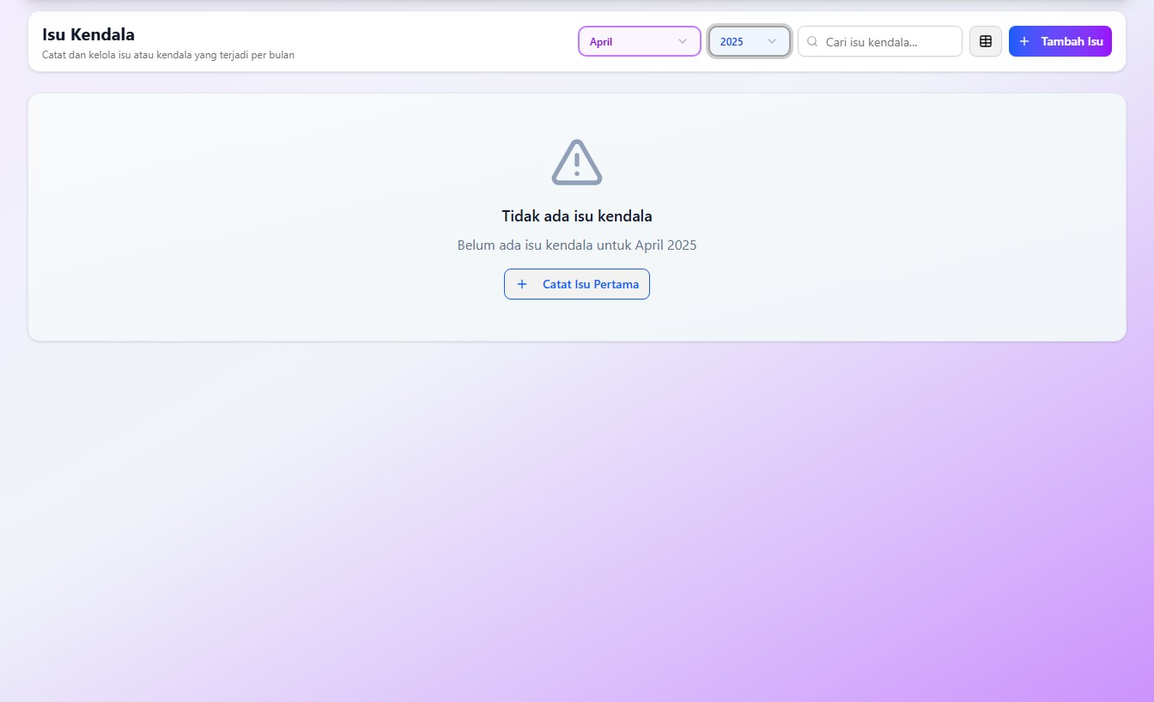
Isu & Kendala
April 2025

Slide 13
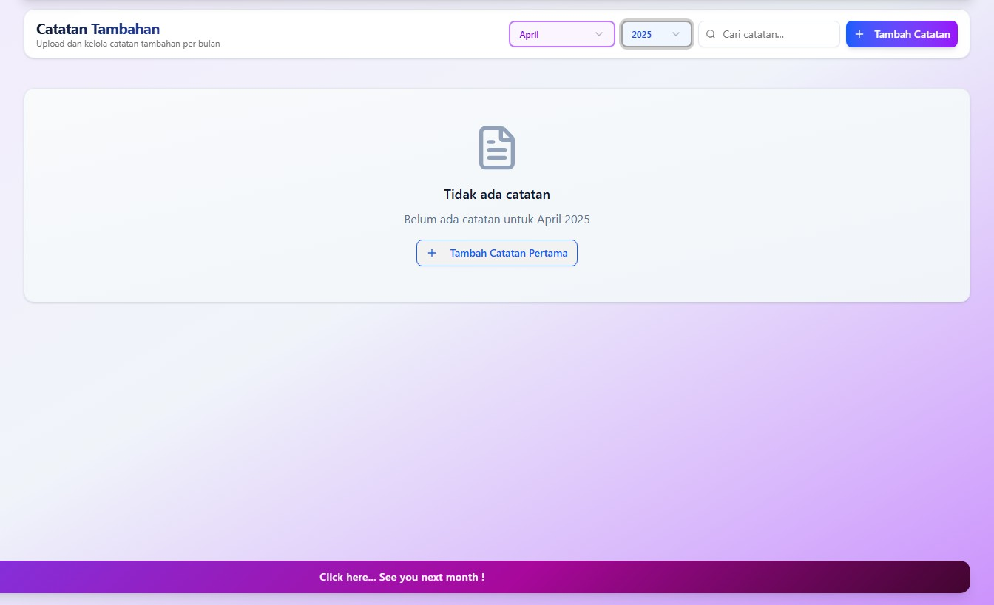
Catatan Tambahan
April 2025

Slide 14
Terima Kasih
Sampai Jumpa Bulan Depan!
April 2025 • TSI Certification
Dokumen Internal – Rahasia

