Slide 1
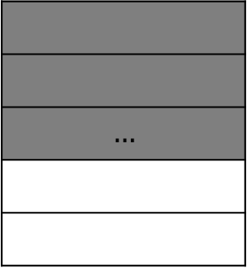
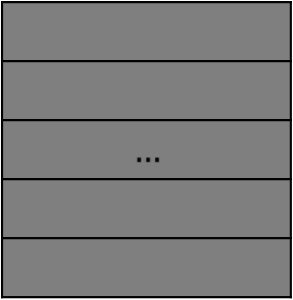

$$…$$
PTE0 Occupied 819/819
F3 entry0
F3 entry 1
$$…$$
PTE1 Occupied $≈$ 462/819

Slide 2
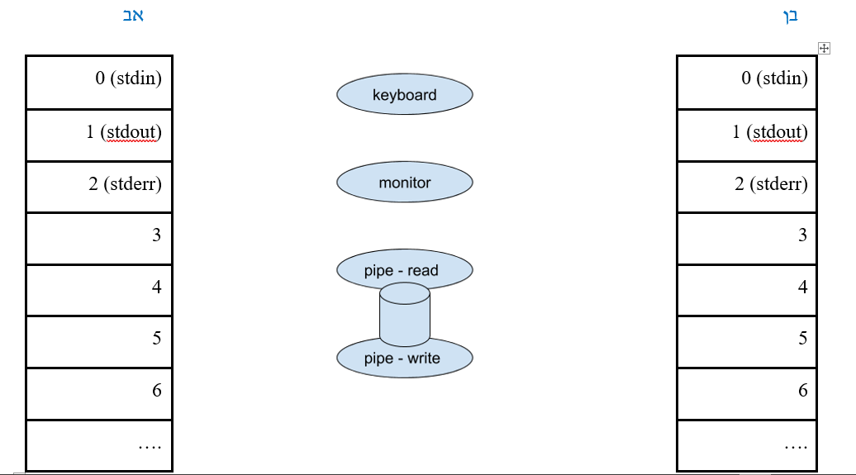
1
2
0
1

Slide 3
1
2
0
1

