Slide 1
Survey Analysis
August 08, 2019

Slide 2
Problem Statement and Approach
Exploratory Data Analysis
Data Visualization (Tableau)

Slide 3
Problem Statement and Approach

Slide 4
Problem Statement and Approach
XYZ Trade Association
The Goal is to analyse the Questionnaire data and derive insights to help the company to know more about its employees
The approach initiated by gathering data from all different sources, removed discrepancies
Performed Exploratory data analysis with R on the raw data to understand each variable and its relation with others
Later designed a Tableau dashboard to derive insights from the data so as to understand distribution among the respondent Job Position with other variables like Residence, Salary, bonus, corporate experience etc.
Enjoy the Presentation

Slide 5
Exploratory Data Analysis

Slide 6
Exploratory Data Analysis
Basic Summary
Summary About Metadata
Insights
Data Snapshot
The data contains 34 Variable for an individual respondent
It contains numeric, character, POSIXct and logical data types
In total we have 372 number of surveys in which 332 are complete, thus 89% of data is complete
We understood the data on the most basic level

Slide 7
Exploratory Data Analysis
Basic Summary
Box-Plot
Duration in Seconds
USD 2014-2015 Base Salary
Actual and Maximum Annual Bonus
We understand the range of a variable and identified Outliers and Misplaced values

Slide 8
Exploratory Data Analysis
Continuous Variable Analysis
Univariate Analysis
Histogram for USD-2014 Base
Insights
The distribution of the variable as seen is right skewed thus mean is not the right measure to analyse the data
Typically in right skewed histogram the mean is greater than median
Density Graph for USD-2014 Base
Insights
As we observe the base salary is highly dense around 100,000$- 175,000$ thus median lies in this region
To be Noted- The scale is relative to the highest value
We conclude that mean is not a good choice to analyse the data

Slide 9
Exploratory Data Analysis
Continuous Variable Analysis
Univariate Analysis
Histogram for USD-2015 Base
Insights
As the graph is right skewed thus taking mean here is not a good choice and hence the variable is better analysed by median
Density Graph for USD-2015 Base
Insights
the density graph have a slight right shift hence stating the increase in median base salary of the respondent
To be Noted- The scale is relative to the highest value
We observe a right shift in the graph but still the variable is right skewed

Slide 10
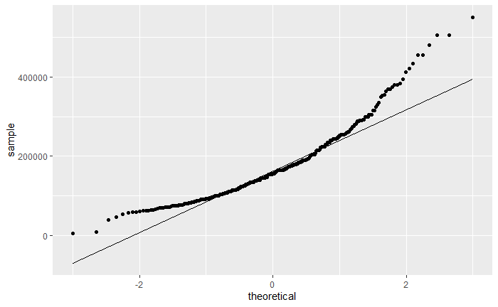
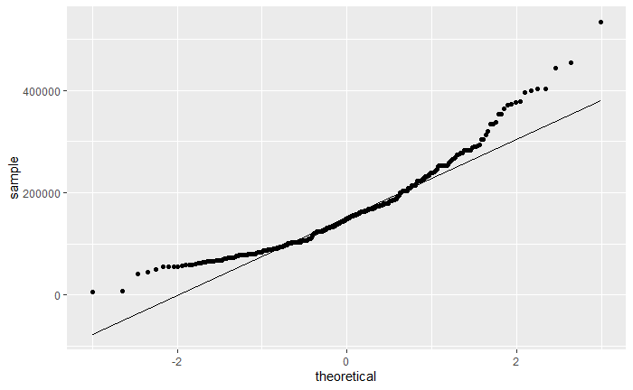
Exploratory Data Analysis
Continuous Variable Analysis
Univariate Analysis
QQ-Plot USD 2015-Base
QQ-Plot USD 2014-Base
Plots here shows variation to normal distribution of the data as the data points are not straight

Slide 11
Exploratory Data Analysis
Continuous Variable Analysis
Bivariate Analysis- Correlation Plot
As obvious, base salaries are correlated to each other

Slide 12
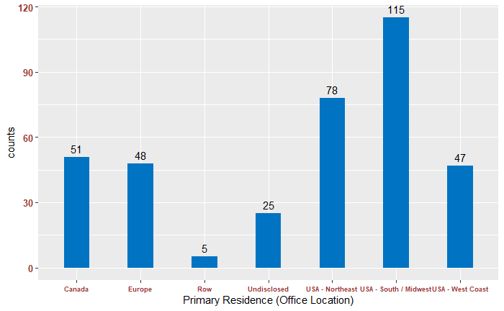
Exploratory Data Analysis
Categorical Variable Analysis
Frequency Charts
Frequency Chart for Office Location
Frequency Table for Occupation Type
Frequency Table for Occupation Type
Insights
Frequency chart help us to understand the distribution of categorical variable
Highest number of surveys were collected from USA- South/Midwest Region
Whereas highest number of employees work in public pension sector
USA ranks first, indicating a bigger market for the company in the region

Slide 13
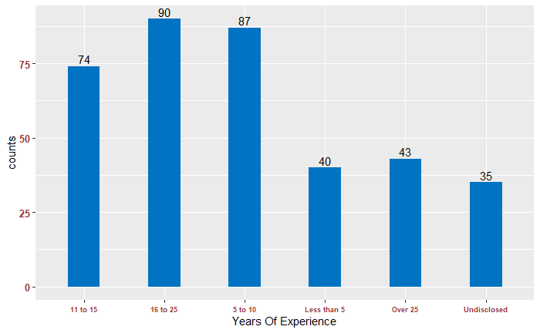
Exploratory Data Analysis
Categorical Variable Analysis
Frequency Charts
Frequency Chart for Years Of Experience
Frequency Table for Position
Insights
The company seems to have a good distribution of Years of experience which is healthy for the environment
Both the variables are distributed evenly

Slide 14
Data Visualization (Tableau)

Slide 15
Data Visualization (Tableau)
Important KPI’s
The percentage increase in expenditure of the company in terms of salary is about 7.67% in respect to 2014-15 year
Total percent of employees irrespective of there position which are eligible for bonus are 60.43%
Total percent of surveys which were completed by the respondent are 89.97%
66.7% of the employees mostly focus on investing in primary fund opportunities
CIO’s have the highest bonus gain ratio with average of 85.94 %
People with experience of 16 to 25 years have the highest count and is equal to 24.4% of the total
The KPI’s help us to understand the overall status of the company

Slide 16
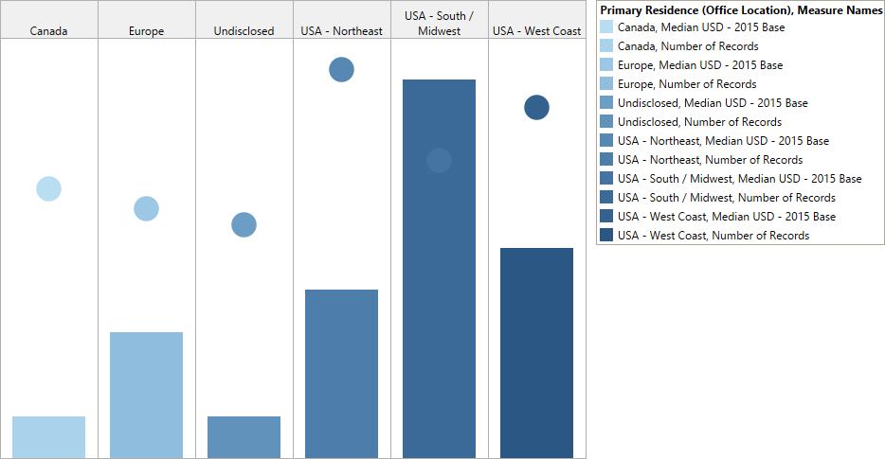
Data Visualization (Tableau)
Position Vs Residence
We can see the variation among countries for a particular positon in there Median 2015- Base Salary

Slide 17
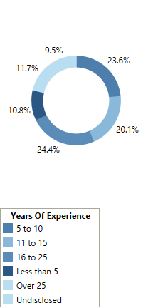
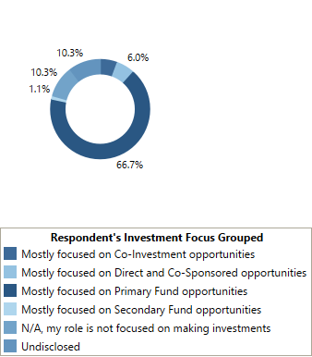
Data Visualization (Tableau)
Donut Charts
Distribution on Years of Experience
Respondent’s Investment Distribution
Company can develop schemes by looking at investment distribution for employee retention

Slide 18
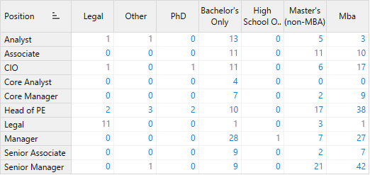
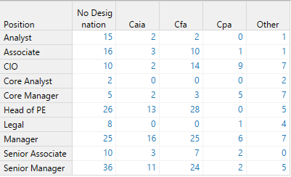
Data Visualization (Tableau)
Analysis on Respondent Position
Position Vs Respondent Education
Position Vs Professional Designation
The company majorly hires Bachelor’s and MBA’s and Cfa is most observed Professional Designation

