Slide 1

CheckedOff: Family Organization Application
Project Demo #1
Team Members:
Nathan Diaz (Leader)
Cody Hinz
Gabriel | Htet Aung Hlaing
Thiroth Khannara
Saturday | Sethouday Prum
Quan () Zhao

Slide 2
CheckedOff Demo #1 Agenda
Team Introduction
App Introduction
Key Feature Demonstrations
App Structure
Plan for Rest of Semester

Slide 3




What is CheckedOff?
CheckedOff is a family organization app designed to simplify coordination among family members by combining tasks, shared calendars, reminders, shopping lists, and document management in one place.
It’s built with a modern, user-friendly interface to keep family life organized and stress-free.

Slide 4

Purpose of CheckedOff
CheckedOff was created to address the challenges of family coordination across various tasks and schedules. Many families struggle to keep track of different activities and tasks across multiple platforms.
By centralizing family organization, CheckedOff helps families manage everything in one app, reducing stress and improving communication.

Slide 5
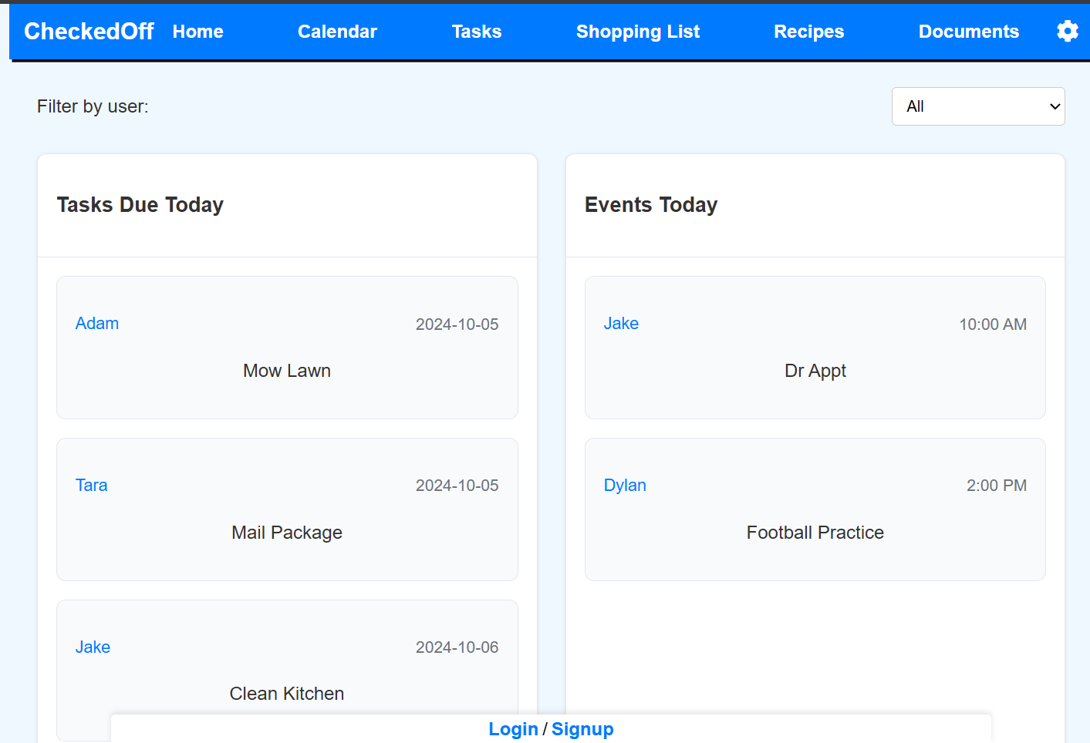
Key Features of CheckedOff
Shared Task Lists: Create and share task lists with family members. Assign tasks, set priorities, and track progress together.
Shared Calendars: Manage events on a centralized family calendar with reminders for key dates.
Reminders: Set personal or shared reminders for important tasks and events.
Document Management: Securely upload, share, and access important family documents.

Slide 6
Key Problems Solved
Problems | Solution
Multiple Apps for Different Tasks | One centralized app to manage tasks, calendars, and documents all in one place.
Lack of Shared Reminders | Shared reminders that notify all family members of important tasks and events.
Difficulty in Coordinating Schedules | A unified family calendar that displays all events, accessible by every family member.
Managing and Accessing Documents | Secure document storage and easy retrieval for all family members.
Limited Communication on Tasks | Collaborative task lists with real-time updates and assignment features.

Slide 7
Main Development Utilities
Frontend: React
Backend: Node
Database: PostgreSQL
Hosting: Heroku
Authentication: Login.js & Signup.js
File and Version Management: Github
Testing: Postman

Slide 8
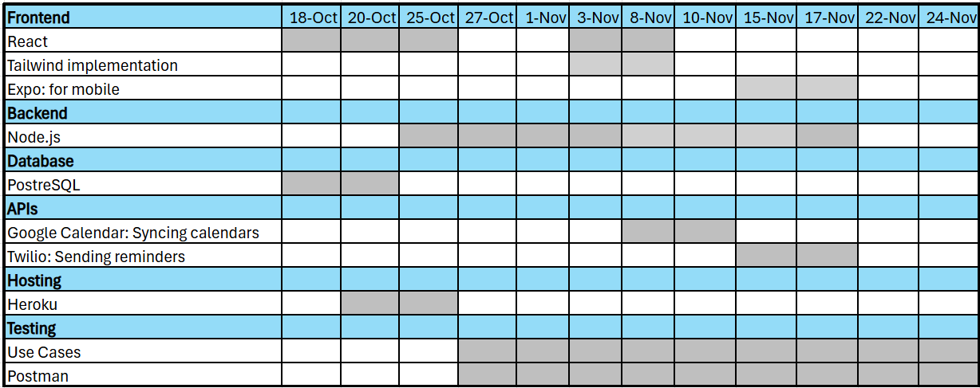
Plan for Rest of Semester
Additional Features
Implement calendar functionality
Add ability to create and send reminders
Automatic shopping list generation from recipes/meal plan
Document collaboration for shared notes and files
Development Focus
Complete backend setup
Optimization for mobile compatibility
Secure login management
Update look and feel of frontend
Various API implementations

