Slide 1

OHM PROJECT
RESISTOR CLASSIFIER
CETYS SCHOOL OF ENGINEERING
MEXICALI, BC
MEXICO
MAY 26TH, 2016

Slide 2
TEAM MEMBERS
Barranco Álvarez, Iván - Cybernetic-Electronic Engineering
Castro Toscano, José Daniel - Cybernetic-Electronic Engineering
Díaz-Montiel, Alan A. - Computer Science Engineering
Ponce Echagaray, Waltercésar - Cybernetic-Electronic Engineering
Ramírez Pérez, Víctor - Cybernetic-Electronic Engineering
Tello Flores, Alejandro - Cybernetic-Electronic Engineering

Slide 3
AGENDA
Introduction
Description and goals
Analysis and design
Implementation
Conclusion and final thoughts
Future work

Slide 4
INTRODUCTION

Slide 5
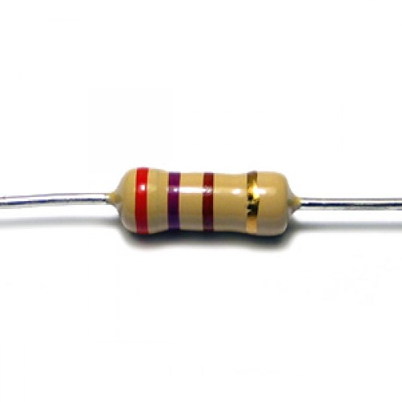
INTRODUCTION
One of the most used passive-electrical component in electrical circuits is the resistor.
Massive production of this product is performed year by year.
Each electrical-mechanical lab contains a storage structure for this important component.

Slide 6
DESCRIPTION AND GOALS

Slide 7
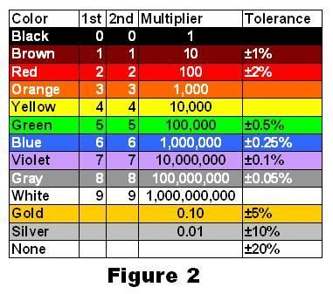
DESCRIPTION
Each resistor has an already-known value according to its colors. This colors are read and processed by a computer, computes the correspondent resistance, and classifies the object in its specific box.
Fig. 1. Resistor color code.

Slide 8
GOALS
Build a physical functional-machine.
Take and process images in real time.
Classify with +70% accuracy.

Slide 9
ANALYSIS AND DESIGN

Slide 10
ANALYSIS AND DESIGN
resistor_value(n)
PROCESS
CLASSIFY
pos(0)
START
success
pos(n+1)
CONTINUE
STOP
n
Fig. 2. Design 1.0.0. Regular flow of the Ohm project process.

Slide 11
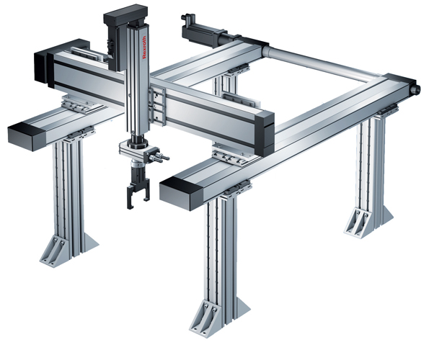
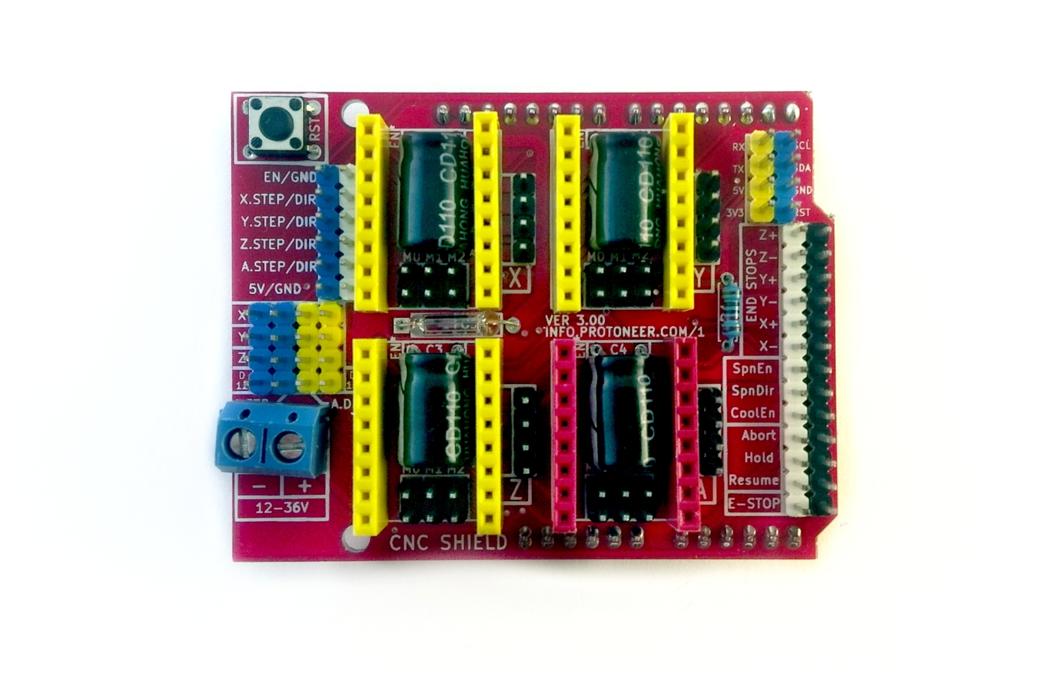
ELECTRICAL-MECHANICAL DESIGN
3-AXIS CARTESIAN ROBOT
Built with aluminum modular profiles.
Chromed-steel bars with linear ball bearings (for movement).
3-band-pulley system (X, Y AXIS).
One lead screw system (Z AXIS).
STEPPER DRIVER SYSTEM
Arduino GRBL shield.
Ramps stepper drivers.
G code-based hardware-programming.

Slide 12



SOFTWARE DESIGN
MAIN APPLICATION
Java-based development.
IMAGE PROCESSING
Java-Matlab integration.
MACHINE CONTROLLER
Java-Matlab integration.
Matlab-Arduino serial communication.

Slide 13
IMPLEMENTATION

Slide 14
FUTURE WORK

Slide 15
FUTURE WORK
resistor_value(n)
PROCESS
CLASSIFY
pos(0)
no object found
START
pos(0)
success
Currently implemented.
Not implemented.
pos(n+1)
CONTINUE
RESTART
STOP
exception
n
Fig. 3. Design 1.2.0. Regular flow of the Ohm project process.

Slide 16
CONCLUSION AND FINAL THOUGHTS

Slide 17
Q & A

