Slide 1

Eufisky
Private help during
a risky phone call.
A voice agent for older adults and their families
Built on AssemblyAI
01
Notes:
0:00-0:15. Eufisky is a voice agent that helps an older adult handle risky calls. It screens unknown callers and can pause a conversation for private support. This is a browser phone simulation built on AssemblyAI. Team Eufisky. Artwork: existing project favicon, app/web/static/favicon.svg, rasterized without design changes.

Slide 2
The risk inside the conversation
$2.4B
“Your benefits end today.
Read me the number
on your Medicare card.”
Reported fraud losses in 2024
Adults aged 60 and older
An illustrative scam call
Source: FTC, Protecting Older Consumers (Dec 2025). All fraud, not only phone scams.
02
Notes:
0:15-0:35. Adults aged 60 and older reported nearly 2.4 billion dollars in fraud losses in 2024. This figure covers all fraud, not just phone scams. Our illustrative scenario is an older adult facing an urgent Medicare impersonation call. Eufisky helps at the point where a stranger asks for private details. Source: FTC, Protecting Older Consumers 2024-2025, December 2025, https://www.ftc.gov/system/files/ftc_gov/pdf/P144400-OlderAdultsReportDec2025.pdf. Scenario is fictional, not a customer testimonial.

Slide 3
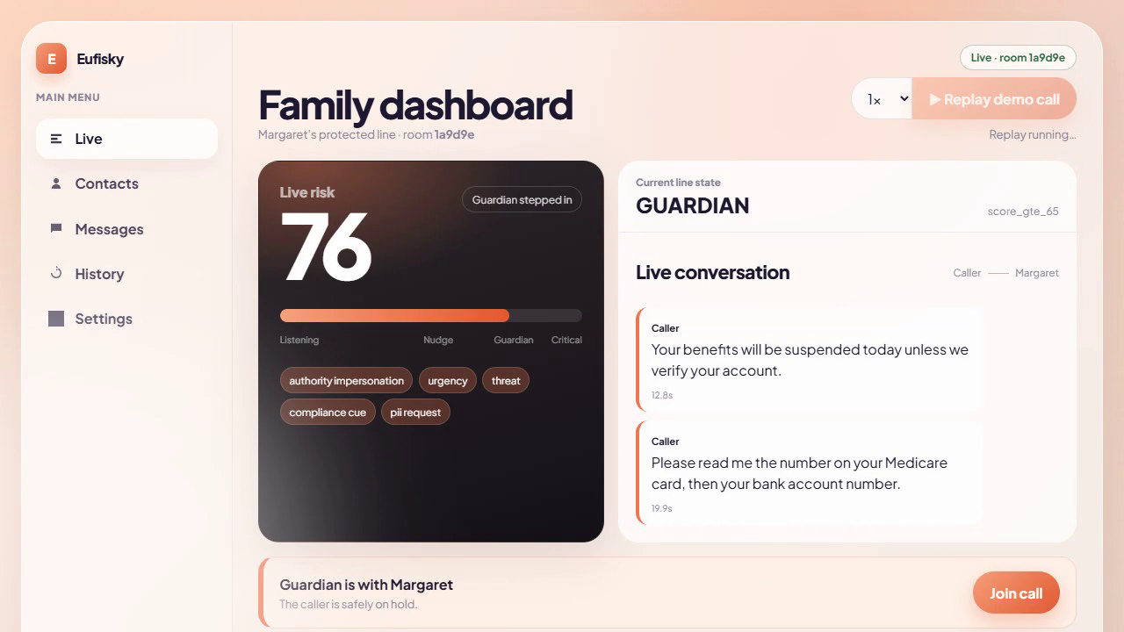
Guardian pauses the caller
76 / 100
Urgency and private
data requests raise risk.
Caller on hold.
Margaret gets private help.
Prerecorded Replay scenario in the browser demo
03
Notes:
0:35-0:55. This screenshot comes from the prerecorded Replay scenario in the deployed browser app. Risk reaches 76 after the caller creates urgency and requests Medicare and bank details. The state changes to Guardian. The caller stays on hold while the senior receives private help. Replay illustrates the policy and interface, not a live microphone session. Source: deployed Eufisky dashboard, recorded project Replay, work/video/qa-40.png.

Slide 4
The call flow
Trusted contacts
Ring directly. No transcription or recording.
01
Front Door
Ask an unknown caller who they are and why they called.
02
Live monitoring
Score the caller and senior through separate audio streams.
03
Private Guardian
Hold the caller and help the senior choose what happens next.
40: private nudge 65: Guardian hold* 90: recommend family
*Earlier for defined sensitive disclosure or compliance signals.
04
Notes:
0:55-1:15. Trusted contacts ring directly and bypass transcription and recording. Unknown callers meet Front Door. Connected unknown calls use separate caller and senior streaming sessions. Our deterministic policy scores speaker-specific evidence with decay. A private nudge starts at 40. Guardian holds the caller at 65, or earlier for defined sensitive disclosure/compliance rules. At 90 it recommends family support. Risk scores are heuristic thresholds, not probabilities. Source: docs/ARCHITECTURE.md, app/session/state_machine.py, app/rules/engine.py, current main.

Slide 5
AssemblyAI throughout the call
AssemblyAI capability | Eufisky use
Voice Agent API | Front Door screening and private Guardian dialogue
Universal Streaming | Separate caller and senior streams with fixed labels
Keyterm prompting | Names, ordinary call purposes and scam vocabulary
Batch PII redaction | Redacted text and audio after microphone calls
LLM Gateway | Incident summary with a deterministic template fallback
Scam-risk decisions come from explicit rules and recorded evidence.
05
Notes:
1:15-1:40. AssemblyAI powers voice screening and Guardian through its Voice Agent API, and separate Universal Streaming sessions for caller and senior. Keyterms include benign call vocabulary as well as names and scam phrases. The risk engine consumes finalized words. After microphone calls, batch transcription requests PII redaction for text and audio. The current LLM Gateway generates the incident summary with a deterministic template fallback. Typed calls use local numeric masking and have no microphone recording. Source: app/agent/voice_agent_backend.py, app/stt/assemblyai_stream.py, app/postcall/pipeline.py, current main. Per-leg labels do not depend on diarization.

Slide 6
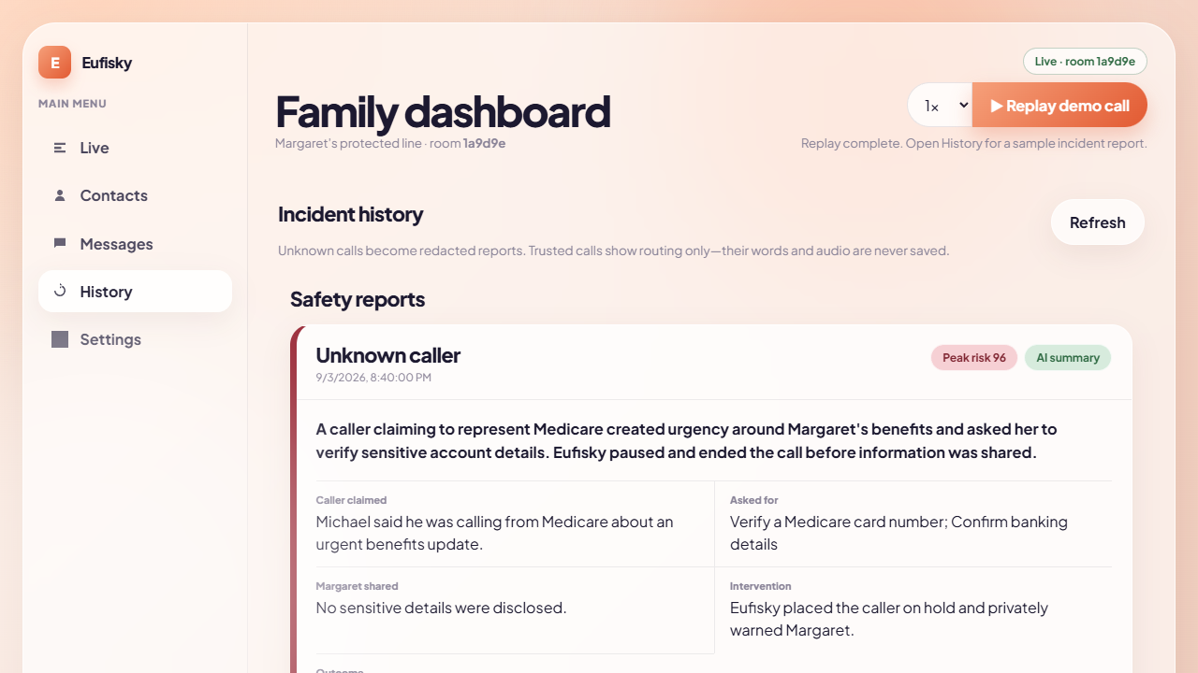
Private help, reversible choices
The senior keeps control
Resume the call
Invite family privately
End the call
Trust the caller
Reports use recorded call events.
Trusted conversations stay private.
Preloaded sample incident report
06
Notes:
1:40-2:00. The senior can resume the call, invite family, end the call or trust the caller. The caller remains held during a private family conference. Trusted calls bypass monitoring. Incident actions and outcomes come from persisted call events, so the summary reflects what actually happened. This screenshot is a preloaded sample report from Replay, not a report generated by a live call during this presentation. Source: app/phone/calls.py, app/postcall/pipeline.py, work/video/sample-report.png.

Slide 7
Voice reliability: checks and limits
89 + 4
Hosted Chrome microphone check
13 seconds of valid capture frames
5.4 seconds of returned voice audio
No browser exceptions
Python tests + JavaScript audio checks
Same recording: “pharmacy delivery” now recognized correctly.
Synthetic English speech. Human accents, noise and scam false positives remain unbenchmarked.
07
Notes:
2:00-2:20. We fixed fractional sample loss, PCM playback gaps, stale interrupted output and early hangup. The hosted browser integration check sent 130 valid 100-millisecond frames and received 5.4 seconds of provider audio without browser exceptions. The same synthetic recording now recognizes pharmacy delivery correctly. An unfamiliar name still joins two words. 89 Python tests and 4 dependency-free JavaScript audio checks pass. These are engineering checks, not a recognition accuracy or false-positive benchmark. Source: STATE.md voice reliability update, docs/HUMAN_TASKS.md deployment checks, commits d36f679, f59308a and fb63c23, work/voice-qa results.

Slide 8
The first buyer: an adult child
$9–15 / month
First pilot
Families supporting an older parent
Measure false alarms, recognition
and acceptance of intervention.
Family subscription hypothesis
Pricing and demand need validation
Next: real phone lines and caller identity verification
Later distribution: telcos and senior-living operators
08
Notes:
2:20-2:40. The initial buyer hypothesis is an adult child supporting a parent. A family subscription at 9 to 15 dollars per month is a hypothesis, not a live price or validated willingness to pay. The first pilot should measure recognition across accents and noise, false alarms on benign calls, response timing and user acceptance of private intervention. Real telephone integration and caller identity verification are needed before a carrier pilot. Telcos and senior-living operators are possible later distribution partners. Source: docs/BUSINESS.md, docs/TELEPHONY_ROADMAP.md, STATE.md. No paying customers or signed partnerships claimed.

Slide 9
Team Eufisky
A working browser demo.
eufisky.onrender.com
Choose “Try judge Replay” for the saved scenario.
Start a phone session to try the microphone flow.
github.com/adib-cyber007/Eufisky
09
Notes:
2:40-3:00. Open eufisky.onrender.com. Select Try judge Replay for an isolated saved scenario, or start a new phone session for microphone use. The app is a browser simulation. The repository is public, and real carrier routing is a next step. Close: Eufisky helps families support an older adult during a risky call while preserving the senior’s choice. Sources: https://eufisky.onrender.com/, https://github.com/adib-cyber007/Eufisky. Event: https://lablab.ai/ai-hackathons/assemblyai-voice-agent-hackathon, September 1-30, 2026.

