Slide 1
PlainSign
The button says
“Free Mint.”
The request can grant access
to an entire NFT collection.
Mohamed Adib · Sri Venkateswara College of Engineering
01
Notes:
The website says, Free Mint. But the request underneath can give someone permission to move every NFT in a collection. I'm Mohamed Adib, a student at Sri Venkateswara College of Engineering. This is PlainSign: a way to understand that permission before approving it.
Sources: https://github.com/adib-cyber007/plainsign; docs/PRE_EXISTING_WORK.md; docs/VERIFICATION.md.

Slide 2
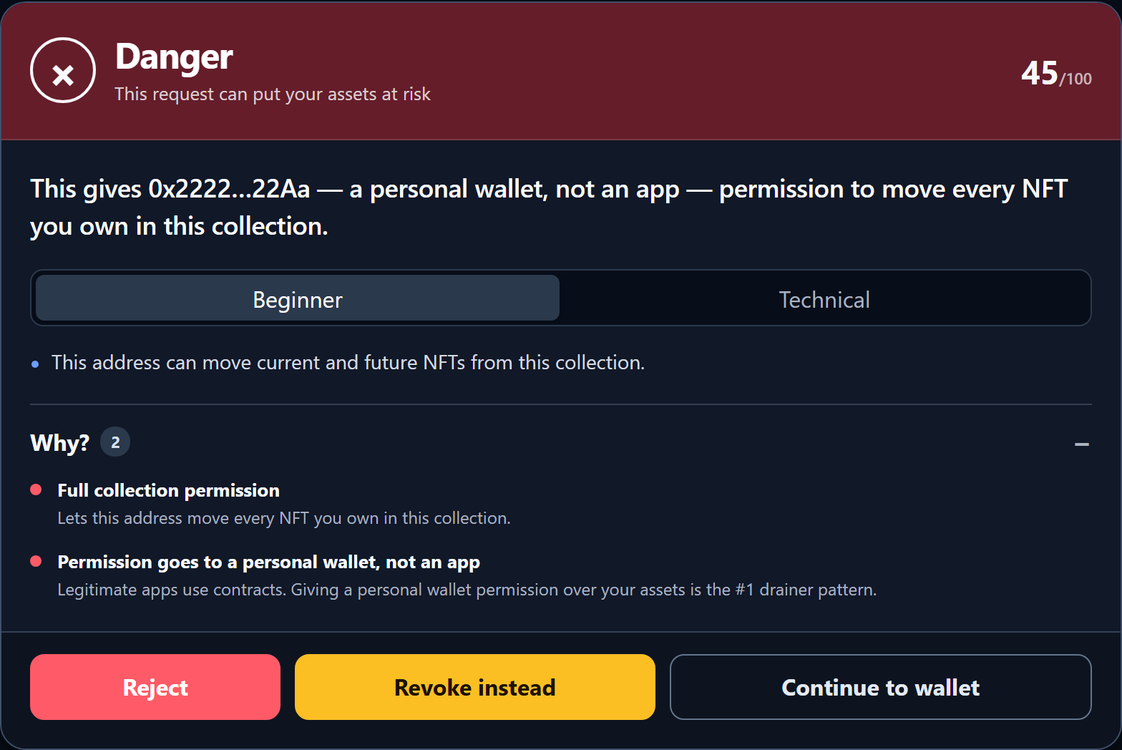
Before the
wallet opens
Who gets access?
What can they move?
Reject stops the request
Standard wallet error 4001
Controlled sample · simulated metadata
02
Notes:
Here is the permission in this test example. PlainSign pauses the request and shows the address that would get access. It explains why that permission is dangerous. If I choose Reject, it returns the wallet's standard rejection error. The request never reaches the wallet. The Continue button forwards the original request unchanged. The separate demo shows that interception working.
Sources: https://github.com/adib-cyber007/plainsign; docs/PRE_EXISTING_WORK.md; docs/VERIFICATION.md. Product card captured from the actual sample walkthrough, with simulated metadata.

Slide 3
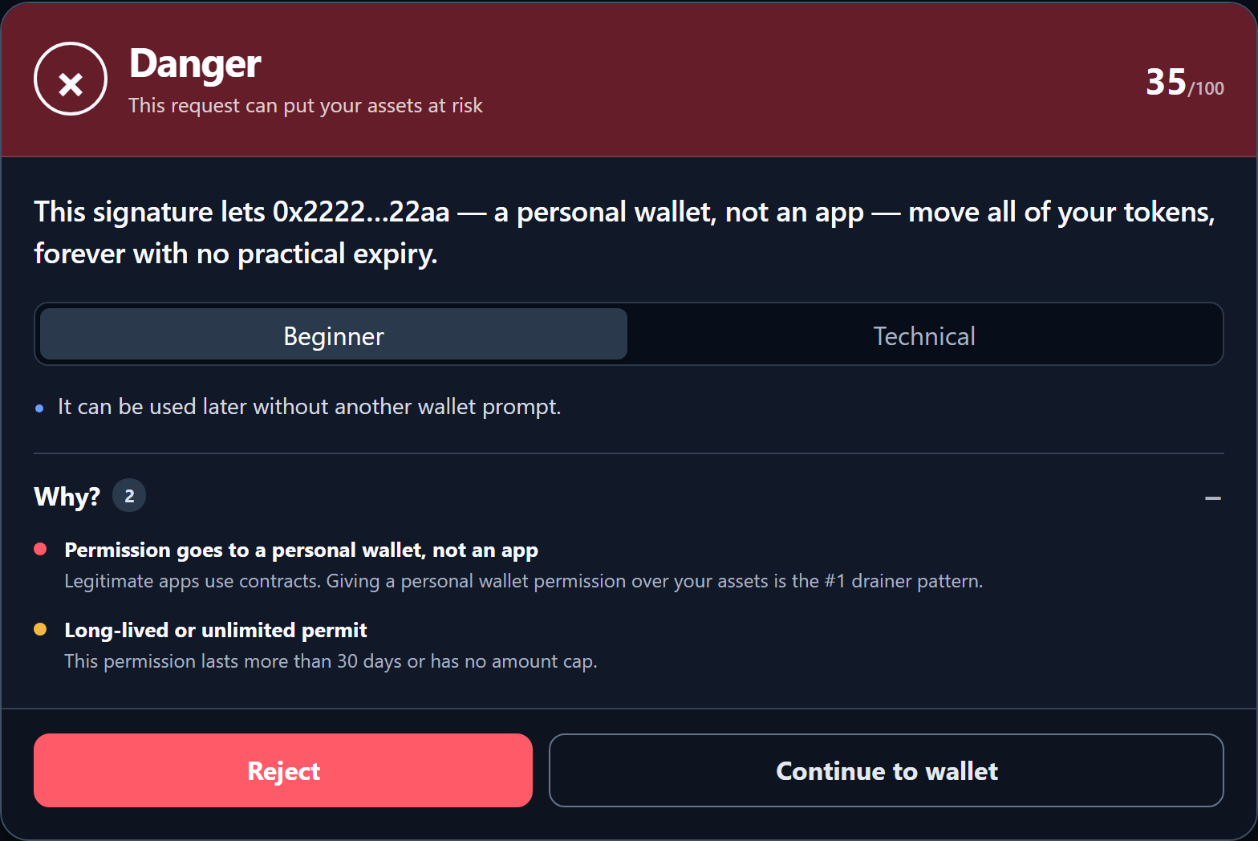
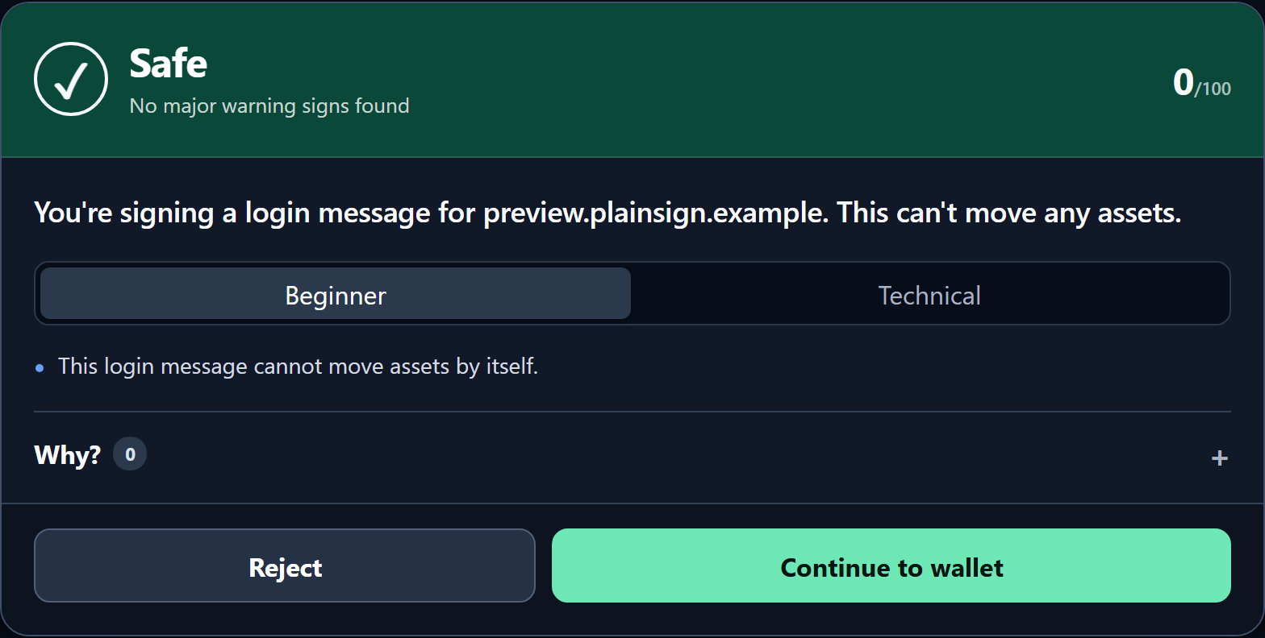
Signatures can grant permission too
Permit2: unlimited permission
Sign in: a login message
Controlled samples. Metadata is simulated. Safe is a heuristic, not a guarantee.
03
Notes:
A signature with no gas fee still deserves attention. This Permit2 example grants an unlimited token permission for a long time. A normal sign-in message has a different meaning. PlainSign decodes both and shows the difference. Green means no major warning signs were found under the rules; it is not a guarantee of safety.
Sources: https://github.com/adib-cyber007/plainsign; docs/PRE_EXISTING_WORK.md; docs/VERIFICATION.md. Two actual sample cards. Safe describes the request under current rules, not the trustworthiness of the website.

Slide 4
Open rules, visible reasons
Decode
Read the transaction or signature
Enrich
Check relevant public chain information
Decide
Show the rules behind the verdict
AI rewording is disabled in the public build
04
Notes:
The decision comes from open rules. We decode the transaction or signature, add public chain information, and explain the rules that fired. This public version does not use AI to write the explanation. It has no backend account or telemetry. These are inspectable heuristics, and provider interception is best effort.
Sources: https://github.com/adib-cyber007/plainsign; docs/PRE_EXISTING_WORK.md; docs/VERIFICATION.md.

Slide 5
The event work
September prototype
October additions
Provider interception
Decoding and risk rules
Revoke and community feed
Ethereum mainnet metadata
Warnings during RPC outages
Walkthrough without a wallet
Earlier work is disclosed. Mainnet validation used public reads.
05
Notes:
The September prototype came before this competition, and that history is disclosed. The October work adds public contract data from the main Ethereum network. It keeps warnings about known malicious addresses visible during an RPC outage. It also gives judges a walkthrough they can try without a wallet. The walkthrough uses simulated metadata. Mainnet validation uses public reads, not real asset transactions.
Sources: https://github.com/adib-cyber007/plainsign; docs/PRE_EXISTING_WORK.md; docs/VERIFICATION.md.

Slide 6
Free for users.
An SDK for teams.
Open source extension
Proposed paid integration
Individuals can inspect the rules
and try the warning layer.
Maintained rules, policy controls
and integration support.
Demand and pricing are not yet validated
06
Notes:
For individuals, the extension and rules stay free and open source. The proposed business is a software package that wallets and apps can add to their products. It would include maintained rules, policy controls, and support. I still need to test demand and pricing. I am not claiming customers or revenue today.
Sources: https://github.com/adib-cyber007/plainsign; docs/PRE_EXISTING_WORK.md; docs/VERIFICATION.md.

Slide 7
The next proof is
user understanding
Observe five people
using the demo
Can they explain the permission?
Which warnings confuse them?
How long does the decision take?
Then seek two wallet or dApp design partners
Planned experiments, not current traction
07
Notes:
The next test is simple: watch five people use the demo. Can they explain the permission before deciding? Where do warnings confuse them? How long does the decision take? Then I want to find two wallet or app teams for a small integration pilot. Those are planned experiments, not current traction.
Sources: https://github.com/adib-cyber007/plainsign; docs/PRE_EXISTING_WORK.md; docs/VERIFICATION.md.

Slide 8
PlainSign
Understand the permission.
Then decide.
Try the sample requests without a wallet
adib-cyber007.github.io/plainsign/review.html
Mohamed Adib · Solo entrant
Sri Venkateswara College of Engineering
08
Notes:
The goal is to help people make a clear decision at the moment it matters. You can try the sample requests without installing a wallet, and inspect the code and rules in the repository. My next milestones are independent security review and observed user tests. PlainSign helps people understand the permission, then decide.
Sources: https://github.com/adib-cyber007/plainsign; docs/PRE_EXISTING_WORK.md; docs/VERIFICATION.md.

