Slide 1
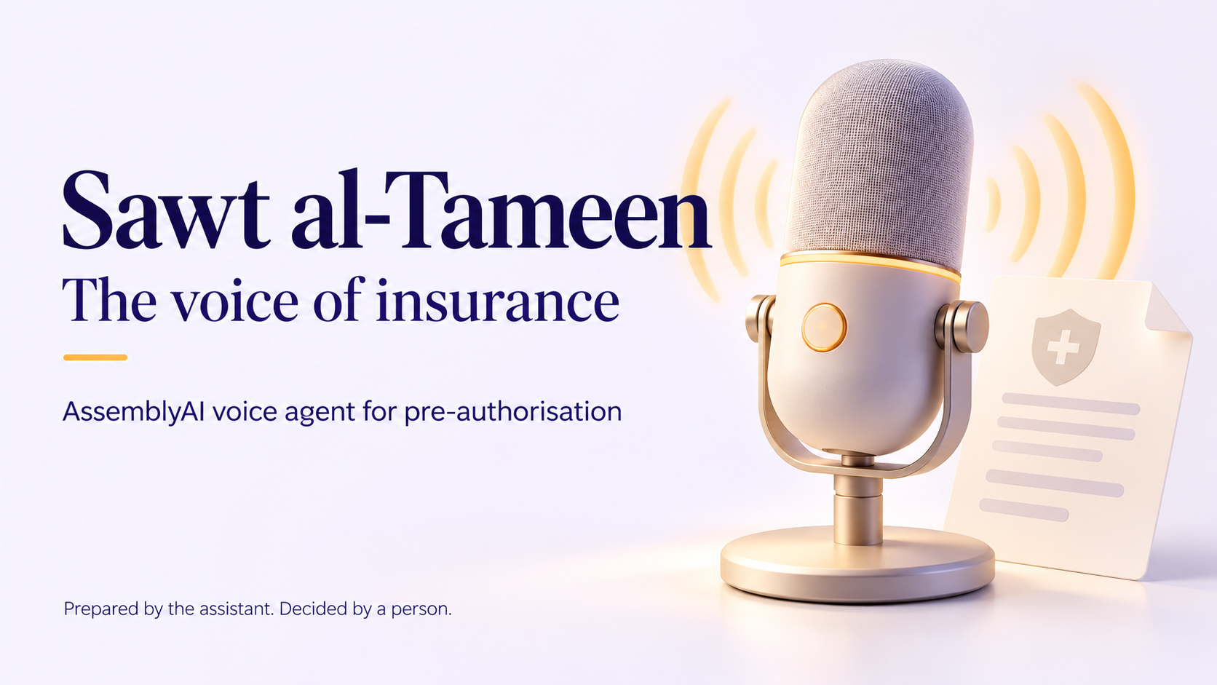
Sawt al-Tameen
Sawt al-Tameen / 1
Notes:
Sawt al Tameen is the voice of insurance. It is an English language pre authorisation agent built on AssemblyAI. A clinic describes a request by voice, and the assistant prepares an auditable case for a qualified human reviewer. This presentation uses synthetic narration and fictional demonstration data.
Evidence: Project source and docs/CONVERSATION_ACCEPTANCE.md

Slide 2
Pre-authorisation intake
The clinic needs a clear next step
A request starts with identity, procedure, cost and date.
Missing documents need a specific follow-up.
The reviewer needs the case and its conversation.
Sawt al-Tameen / 2
Notes:
A provider desk must collect the right member details, identify a treatment and understand which supporting documents are required. Missing information creates follow up work. Our prototype guides that intake conversation and makes the next step explicit. The intended users are insurer intake staff and provider authorisation desks.
Evidence: Project source and docs/CONVERSATION_ACCEPTANCE.md

Slide 3
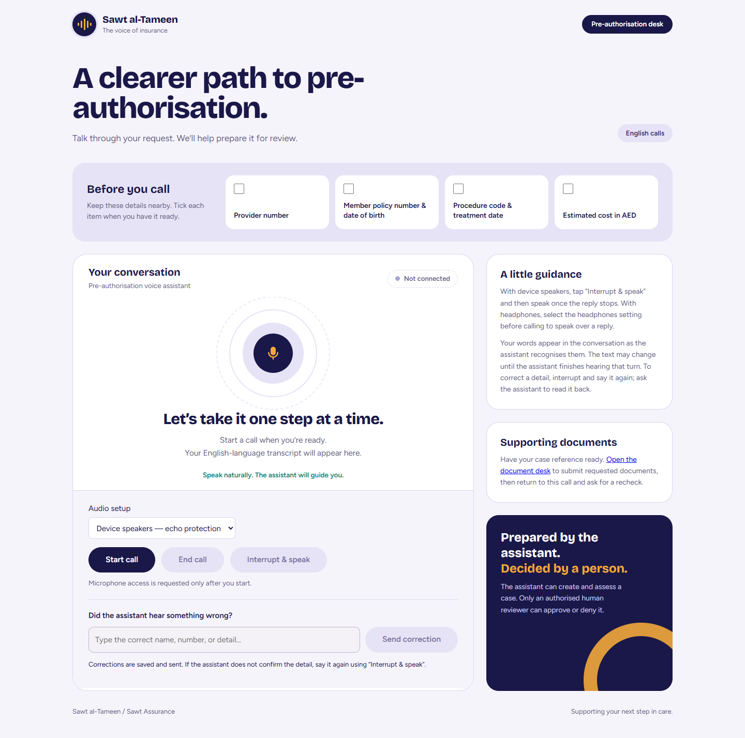
The browser voice demo
Live conversation
Caller captions
Typed corrections
English and AED
Sawt al-Tameen / 3
Notes:
The public browser demo requires no account. Choose device speakers for echo protection, or headphones for spoken interruption. Start a call and speak the fictional provider and member identifiers. Live caller captions and assistant replies appear in one conversation. You can interrupt or type a correction when a detail is wrong.
Evidence: Project source and docs/CONVERSATION_ACCEPTANCE.md

Slide 4
AssemblyAI and the case backend
AssemblyAI Voice Agent API
Speech recognition, managed model, voice output and turn handling
FastAPI executes the business tools
verify_caller
check_coverage_rule
log_transcript
Four synthetic policy tiers
50 procedures and eight escalation rules
Rule citations and case audit history
Sawt al-Tameen / 4
Notes:
AssemblyAI handles the hosted voice interaction through its Voice Agent API, including speech recognition, the managed conversational model and spoken output. Our server bridges twenty four kilohertz browser audio and executes three schema defined tools. Verification gates coverage checks. A deterministic rules engine reads the same benefit catalogue used for citations. Credentials stay on the server.
Evidence: Project source and docs/CONVERSATION_ACCEPTANCE.md

Slide 5
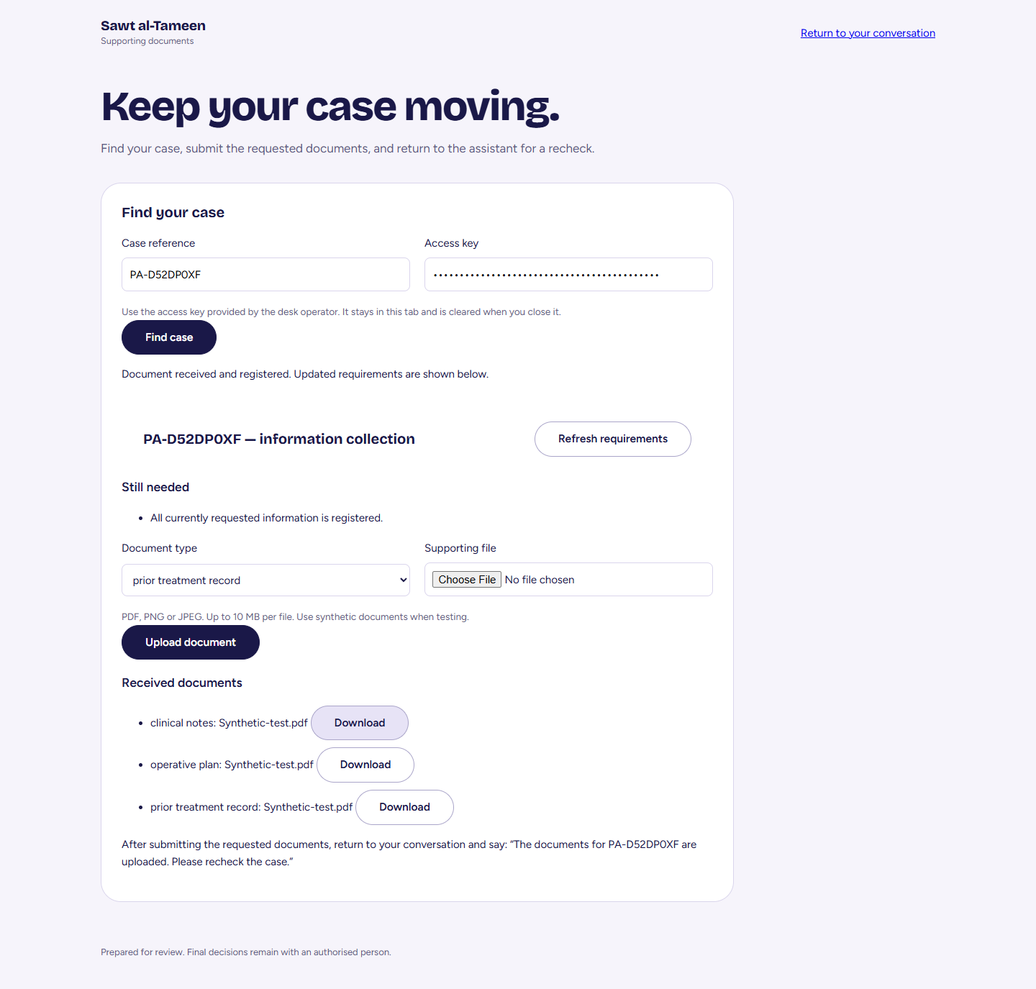
Documents and a same-case recheck
Three required documents
Authenticated upload
Requirements refresh
Same case, new evaluation
Sawt al-Tameen / 5
Notes:
This screenshot comes from the authenticated document acceptance run. The browser uploaded clinical notes, an operative plan and a prior treatment record, then downloaded matching bytes. In the actual AssemblyAI conversation, the assistant requested the missing documents and rechecked the same case after upload. The resulting recommendation still required human review. The document desk needs an operator access key.
Evidence: Project source and docs/CONVERSATION_ACCEPTANCE.md

Slide 6
Human decision authority
The voice agent prepares a recommendation
No approval or denial tool
Reviewer role required for a final decision
Completed transcript required before sign-off
Recommendation and decision retained separately
Sawt al-Tameen / 6
Notes:
The agent cannot approve or deny a request because none of its three tools provides that action. A reviewer only API and the case state machine enforce the final decision boundary. For a voice linked case, sign off remains blocked until the completed transcript is stored. The system keeps the original recommendation and the human decision separately in the audit trail.
Evidence: Project source and docs/CONVERSATION_ACCEPTANCE.md

Slide 7
Evidence from the prototype
393
46
Python tests passed
Browser and audio tests passed
26 public deployment checks passed
Two completed AssemblyAI conversations with a synthetic caller
Limits: procedure readback, physical echo and varied accents
Sawt al-Tameen / 7
Notes:
On September thirtieth, all three hundred and ninety three Python tests and forty six JavaScript browser and audio tests passed. Twenty six public deployment checks passed. Two actual AssemblyAI conversations with a synthetic spoken caller exercised document upload and recheck, and failed verification with a callback. These are small sample workflow results. Physical speaker echo and varied human accents still need evaluation, and full procedure readback remains inconsistent.
Evidence: Project source and docs/CONVERSATION_ACCEPTANCE.md

Slide 8
Business value and the next pilot
A pilot for insurer intake teams
Measure handling time and repeated calls
Track document completeness and identifier accuracy
Compare cost per completed case
Business hypothesis. No measured customer savings yet.
Sawt al-Tameen / 8
Notes:
Our business hypothesis is fewer incomplete handoffs and less repeated intake work. We would offer a paid pilot to an insurer desk, measuring handling time, document completeness, identifier accuracy and cost per completed case. There are no measured savings or clinical outcomes yet. The prototype uses only fictional policies and records. A live Twilio number is not configured, and the current demonstration host must stay online during judging.
Evidence: Project source and docs/CONVERSATION_ACCEPTANCE.md

Slide 9
Try the agent and inspect the source
Voice demo
dividable-fretted-aroma.ngrok-free.dev/voice
Public source
github.com/adib-cyber007/sawt-al-tameen
Prepared by the assistant. Decided by a person.
Sawt al-Tameen / 9
Notes:
You can test the voice agent online using the judge guide and fictional caller details. The public MIT licensed repository includes setup instructions, tests, the rules catalogue and conversation evidence. Sawt al Tameen brings a spoken request into an accountable review process. Prepared by the assistant, decided by a person.
Evidence: Project source and docs/CONVERSATION_ACCEPTANCE.md

