Slide 1

Putting Deep Hybrid Learning to Work
~ Aditya Bhattacharya
Lead AI/ML Engineer,
West Pharmaceutical Services

Slide 2



About Me
Currently, I am leading the Data Science and AI team at West Pharmaceutical Services and previously worked in Microsoft and well seasoned in domains such as Machine Learning, Deep Learning, Internet of Things (IoT), Robotics and Cloud Computing. In the Data Science domain, I am well experienced with Computer Vision, Time-Series Forecasting, NLP, Speech analysis.
Apart from my day job, I am an AI Researcher at an NGO called MUST Research, and I am one of the faculty members at MUST Research Academy. https://academy.must.co.in/
https://aditya-bhattacharya.net/
https://www.linkedin.com/in/aditya-bhattacharya-b59155b6/

Slide 3

Key topics for discussion
Introducing the framework Deep Hybrid Learning (DHL)
Why to go for Deep Hybrid Learning?
Different flavors of DHL
Case Study on NUMODRIL - Nuclear Morphology Optimized Deep Hybrid Learning

Slide 4



Deep Hybrid Learning
A fusion approach to combine a conventional Deep Learning model with other learning algorithms.
It is basically converting a standard Deep Neural Network architecture of one form and fusing with learning algorithm (typically a machine learning algorithm)
Deep Hybrid Learning can have multiple forms based on the fusion mechanism :
Early Fusion – Typically when the fusion process happens before feature extraction.
Late Fusion – Typically when the fusion process happens after the feature extraction.

Slide 5
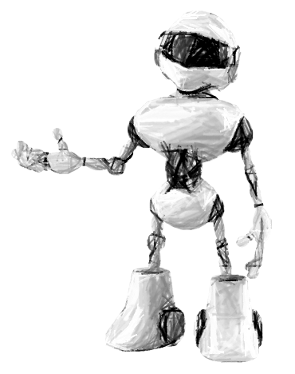
How does a Deep Hybrid Learning architecture look like?

Slide 6
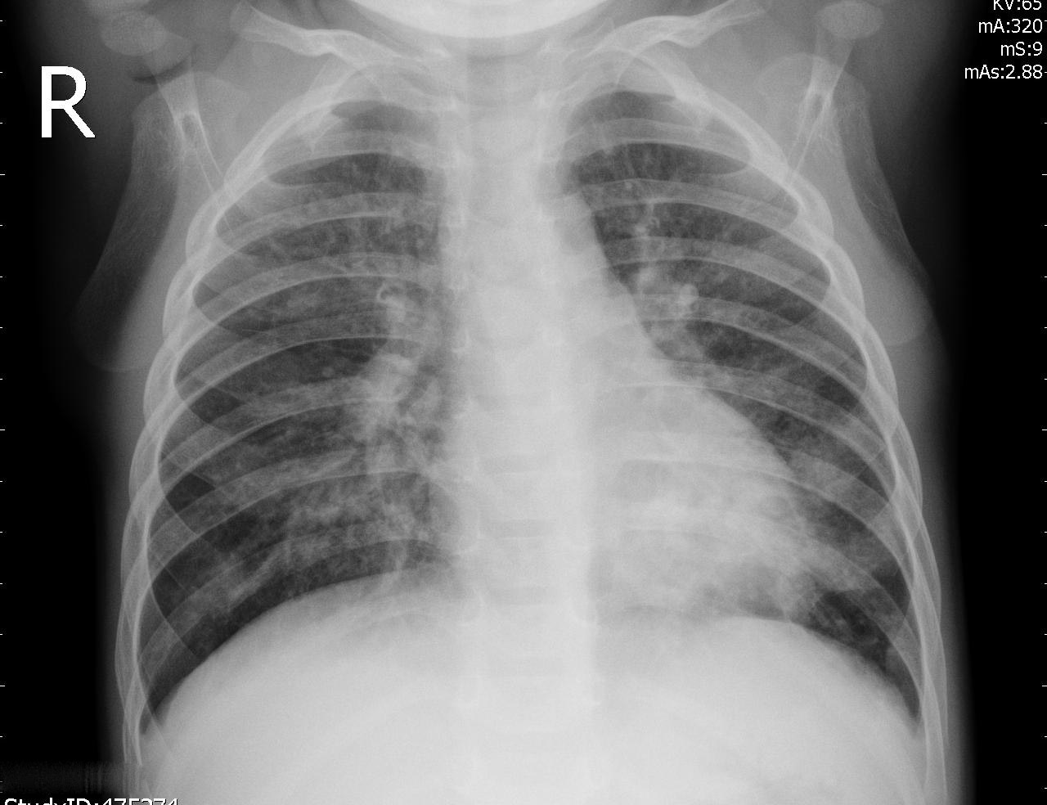
Typical Deep Learning Architecture
Convolution Neural Network Layers
Flatten
Fully Connected Layers
Final Prediction

Slide 7


Deep Hybrid Learning Architecture
Machine Learning Classifier(s)
Convolution Neural Network Layers
Flatten
Final Prediction
Late Fusion Method

Slide 8

Deep Hybrid Learning Architecture
1D CNN
Feature Vector
LSTM
LSTM
Feature Vector
Feature Extraction using 1D CNN + LSTM
Flatten
Fully Connected Layers
Final Prediction
Early Fusion Method

Slide 9
Why Deep Hybrid Learning?

Slide 10
Conventional DL vs Classical ML
A conventional Deep Learning approach removes the need of manual feature engineering.
The auto feature extraction ability of DL makes it efficient especially with unstructured data like images, text or audio.
But DL can be prone to overfitting or underfitting is insufficient amount of unstructured data is used for training the model.
And availability large amount of unstructured data in certain domains can be expensive.
A conventional Machine Learning requires manual feature engineering.
ML algorithms require less computational resources than DL algorithms
ML can give more efficient result with lesser data as compared to DL
A classical ML approach usually works better with structured data, than unstructured data.

Slide 11
DHL – A fusion of benefits of conventional approaches
DHL performs auto-feature extraction using DL methods.
DHL works well for problems where less data is available, example Medical Image analysis.
DHL (particularly the ML variant) is faster, more efficient and less computationally expensive.
DHL works well when other advanced approaches like transfer learning is not successful.
DHL is better in most cases than individual DL or classical ML approaches and combines the benefits of traditional DL and ML algorithms.

Slide 12
Different Flavors of DHL!

Slide 13
Machine Learning Variant
Deep Learning Variant
Deep Learning for feature extraction
Classical ML Learner
Encoder DL for initial feature extraction
DL Classification with encoded features
Late Fusion
Late Fusion
DL and ML for feature extraction
ML or DL Learner
DL Algorithm 1 for feature extraction
Full Connected Layer for Classification
DL Algorithm 2 for feature extraction
Early Fusion
Early Fusion

Slide 14
Case Study NUMODRIL - Nuclear Morphology Optimized Deep Hybrid Learning
Link - https://www.biorxiv.org/content/10.1101/2020.11.23.393660v1
Notes:
Joint research done by Duhita Sengupta^{1#}, ^{, 4#}, Sk Nishan Ali^{2#}, Aditya Bhattacharya^{2#}, Joy Mustafi^{2#}, Asima Mukhopadhyay^{3,4} & Kaushik Sengupta¹

Slide 15
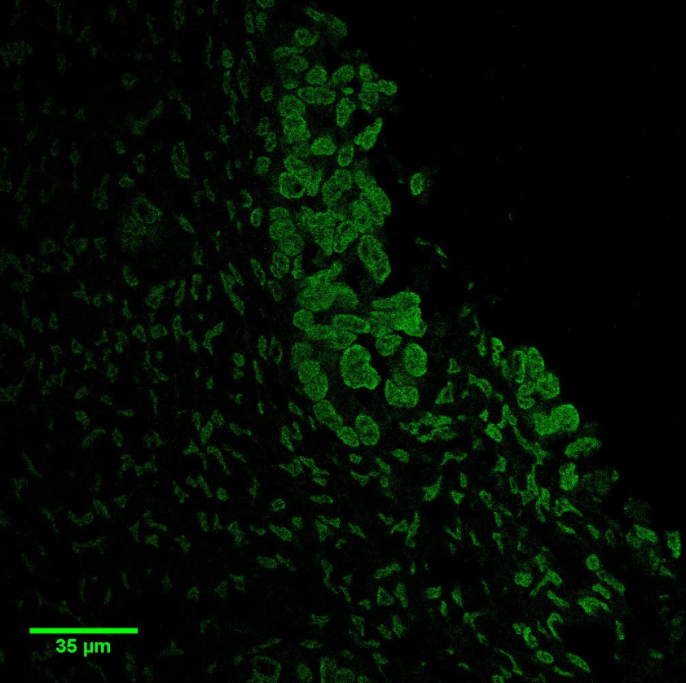
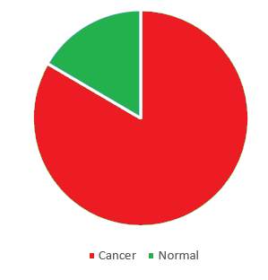
Problem Statement
Automated detection of ovarian cancer cells from nuclear morphology images with highest possible accuracy and speed, but with a highly imbalanced and small dataset.
Ovarian cancer cells can be easily distinguished from their enlarged nuclear morphology and using a DHL model to predict malignant transformations of benign nuclei for diagnosis and prognosis of ovarian cancer and compare the results with conventional state of the art DL architectures.
52
262
Notes:
Code reference - https://github.com/adib0073/NUMODRIL

Slide 16
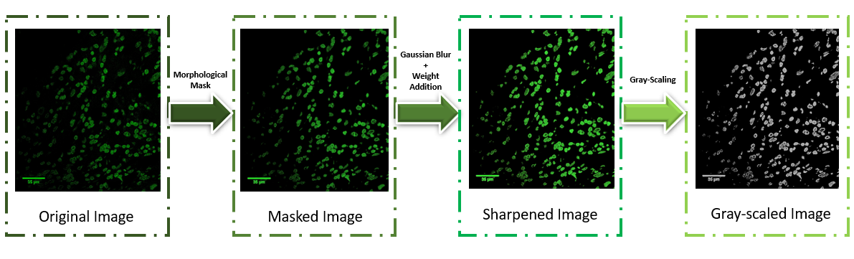
Data Pre-processing and Up-sampling
- When the image dataset is small and imbalanced, image processing and data up-sampling using Synthetic Minority Oversampling Technique (SMOTE), makes it easier for the models for auto feature extraction using DL

Slide 17
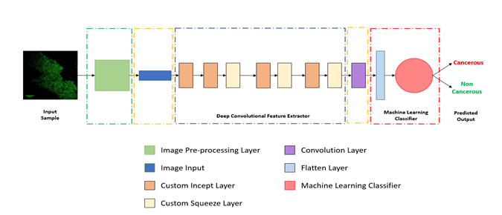
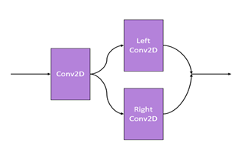
DHL Architecture
Random Forest
and
XG-Boost

Slide 18
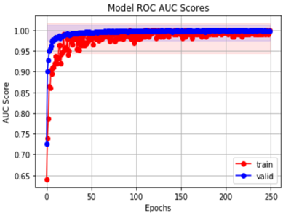
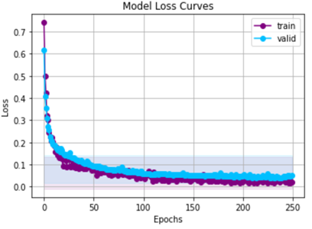
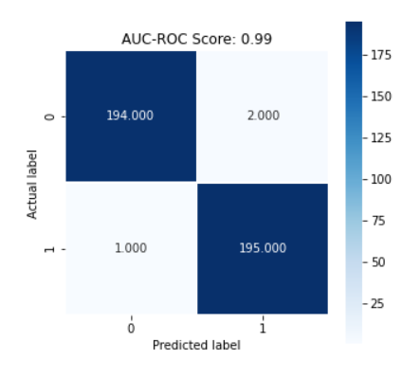
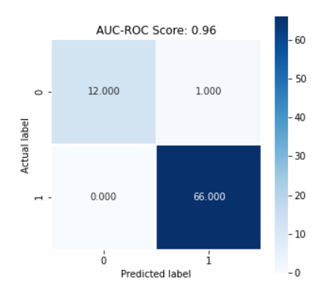
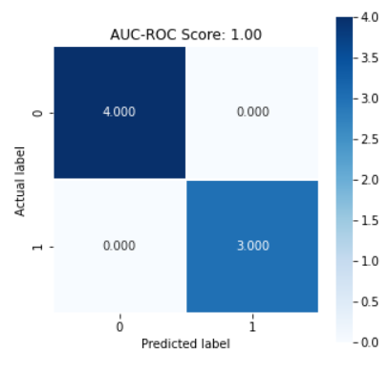
Model Results
Train Set Results
Validation Set Results
Test Set Results

Slide 19
Model Comparison
Model Architecture | Training AUC Score | Validation AUC Score | Testing AUC Score
DHL with Random Forest | 0.99 | 0.96 | 1.0
DHL with XGBoost | 0.99 | 0.96 | 1.0
Conventional Deep Learning (without Transfer Learning) | 0.99 | 0.88 | 0.88
DenseNet201 with Transfer Learning | 0.91 | 0.70 | 0.67
ResNet50 with Transfer Learning | 0.98 | 0.52 | 0.83
InceptionNet v3 with Transfer Learning | 0.90 | 0.50 | 0.50
VGG16 with Transfer Learning | 0.96 | 0.81 | 0.58

Slide 20
Summary
We learnt about Deep Hybrid Learning (DHL)
Benefits of DHL
Different types of DHL
Case Study on NUMODRIL - Nuclear Morphology Optimized Deep Hybrid Learning and Code Walkthrough

Slide 21
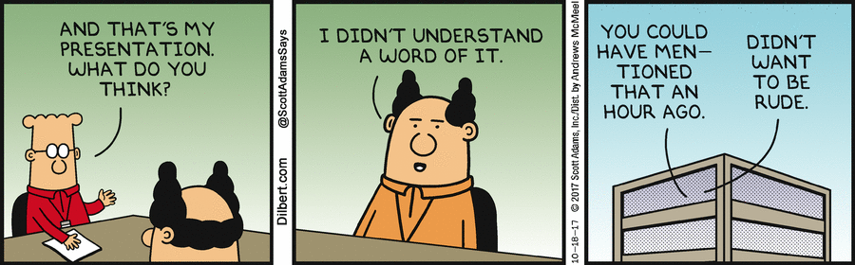
That’s all for today!
- ADITYA BHATTACHARYA
Questions?
- Want to connect over LinkedIn ?
Or email me at: aditya.bhattacharya2016@gmail.com
Follow me at: https://aditya-bhattacharya.net/

