Slide 1
Pet Care
Group Name Cengkaruks :
Adib Setiawan
Fitraldy Soefana
http://www.free-powerpoint-templates-design.com

Slide 2
Project Backgound
“
“
This Fourth Industrial Revolution, also known as Industry 4.0, greatly brings a rapid change to technology, industries, and societal patterns and processes in the 21st century which can solve various problems in our daily lives. As a national company that is engaged in the Health and Care pet field, MEOW is expected to grow following modern technologies.
Notes:
Pada perkembangan teknologi zaman sekarang, yang biasa di sebut teknologi industri 4.0, membuat banyak perubahan baik pada bidang teknologi, industri,sosial dan juga dapat menyesaikan masalah yang ada pada kehidupan sehari hari, salah satu permasalahan tersebut adalah perihal Kesehatan peliharaan.

Slide 3
Solution
From the previous problems, the MEOW company innovated by creating an API web-based application to make it easier for people who have pets to maintain and check the health of their pets.

Slide 4
The problem statment
01
How to design an entity relationship diagram
02
How to Implement Api on web
03
How to implement a CRUD web application
04
How to implement JWT

Slide 5
Goal
01
Can implement API on the web
02
Can do JWT implementation
03
Can perform CRUD on the API
04

Slide 6
Benefit
01
Make it easier for pet owners to maintain the health of their pets
02
Companies can maintain their business regularly
03
04

Slide 7
Metodologi
01
Identifikasi masalah
04
Pengujian dan Analisis
02
Analisi kebutuhan dan perancangan ( Project Charter)
05
Kesimpulan
03
Implementasi sistem

Slide 8
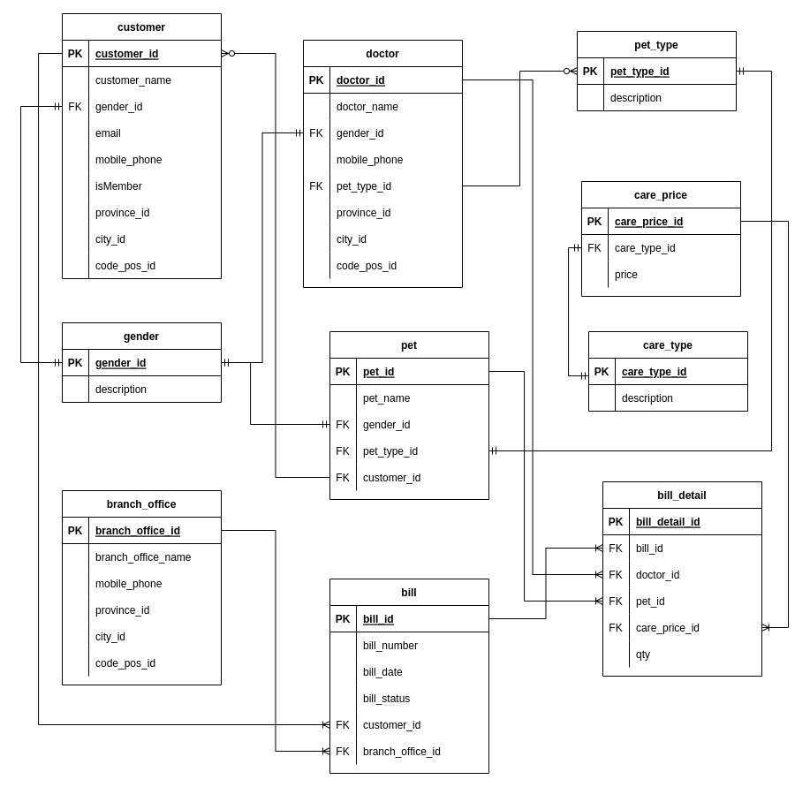
Entity Relationship Diagram

Slide 9
Implementation CRUD Customer

Slide 10
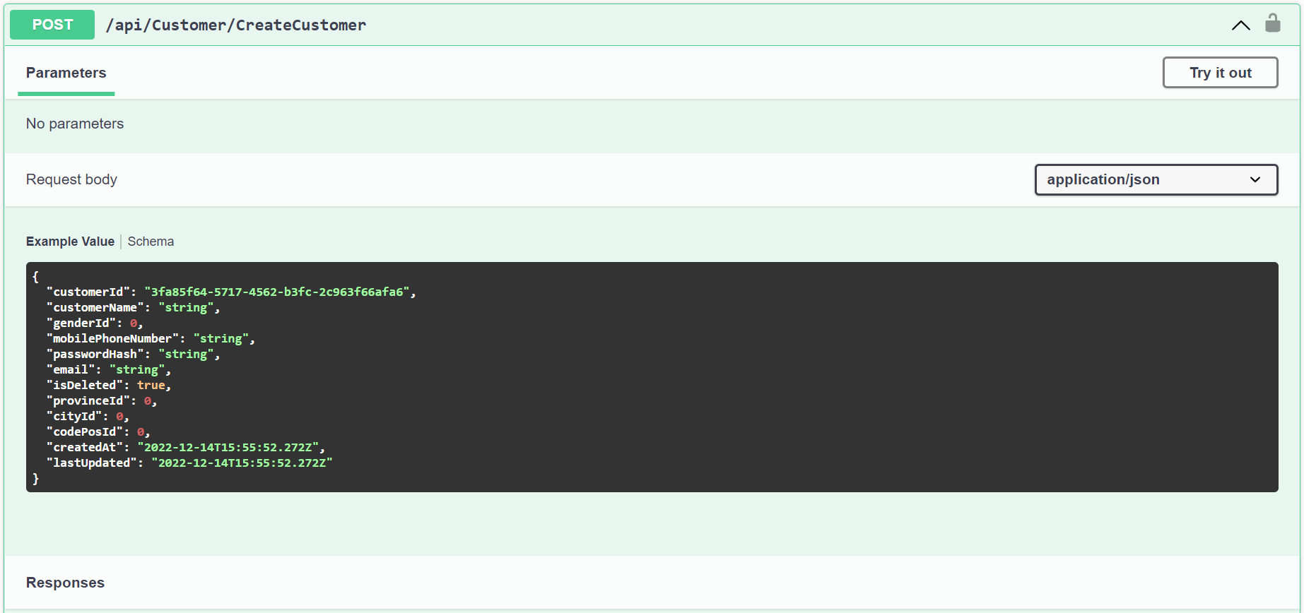
Create Customer

Slide 11
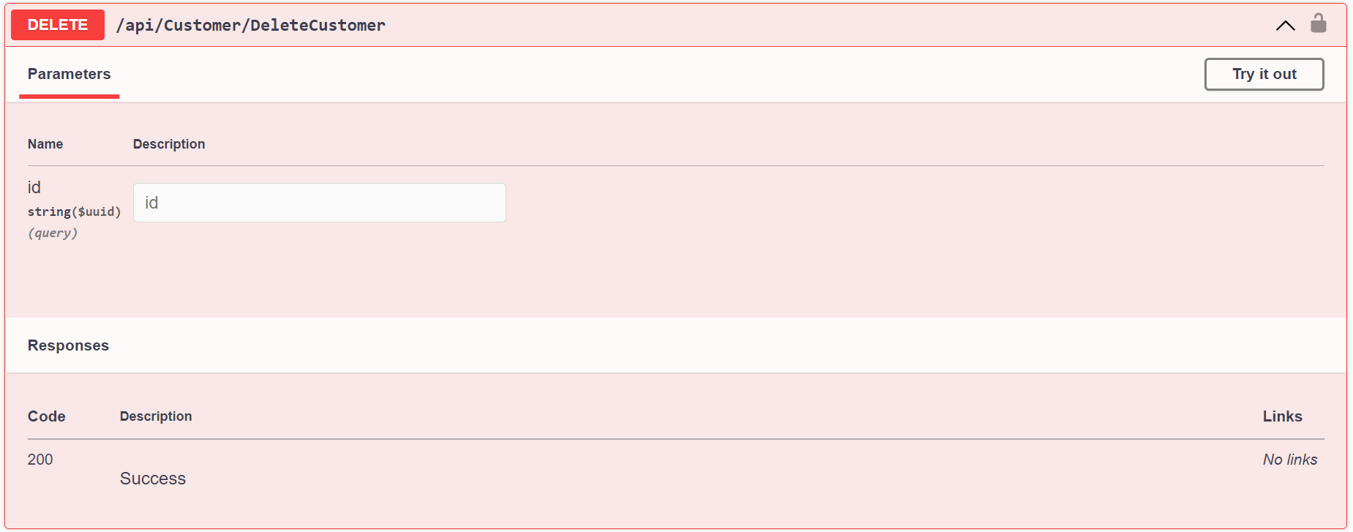
Delete Customer

Slide 12
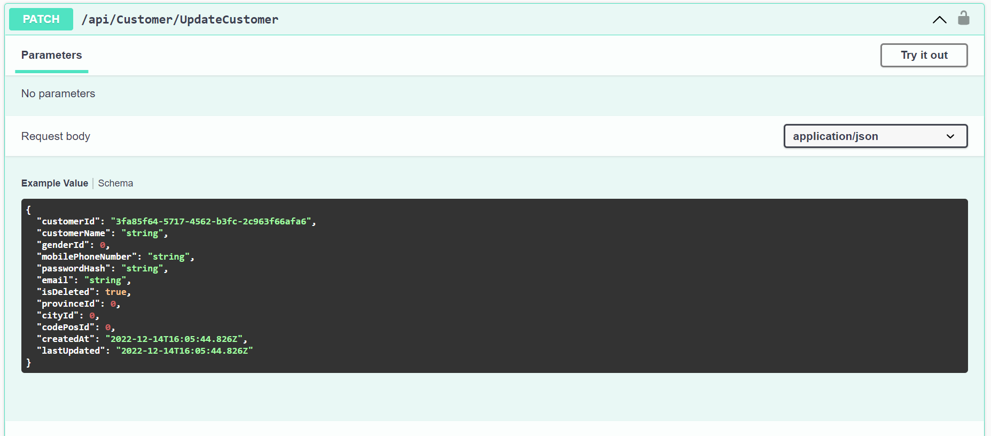
Update Customer

Slide 13
Implementation CRUD Doctor

Slide 14
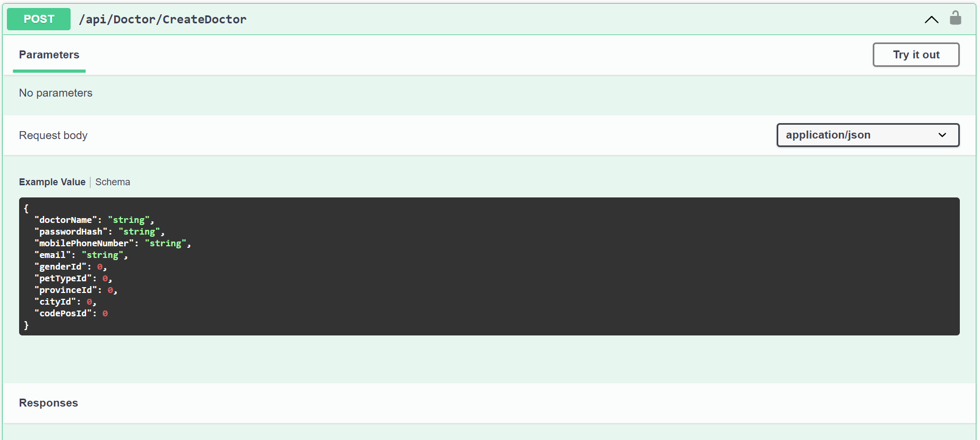
Create Doctor

Slide 15
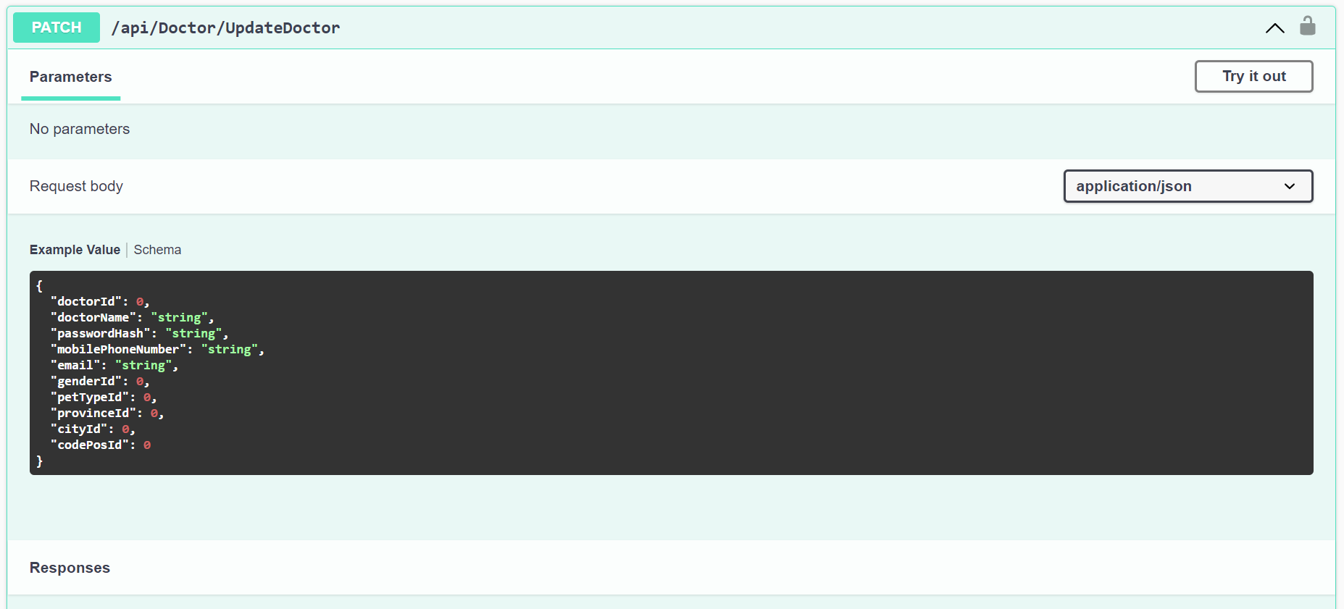
Update Doctor

Slide 16
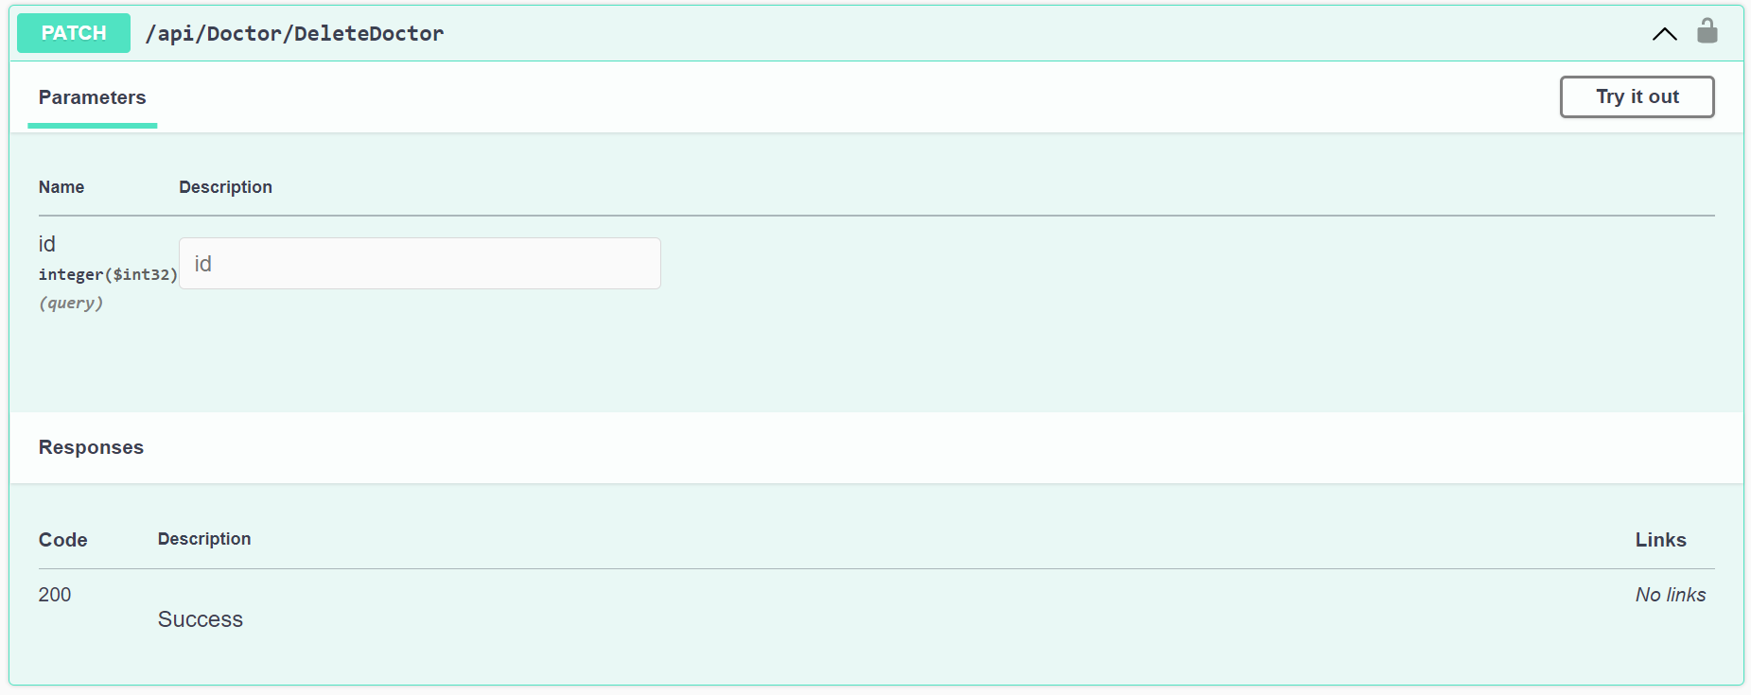
Delete Doctor

Slide 17
Implementation CRUD Bill

Slide 18
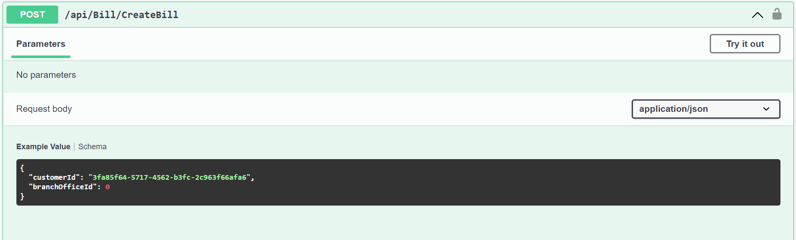
Create Bill

Slide 19
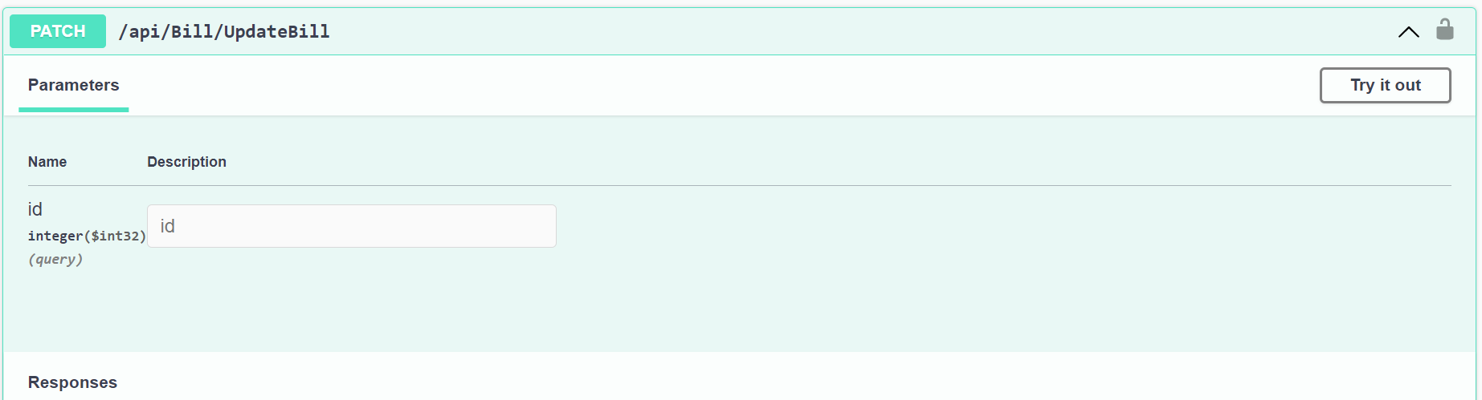
Update Bill

Slide 20
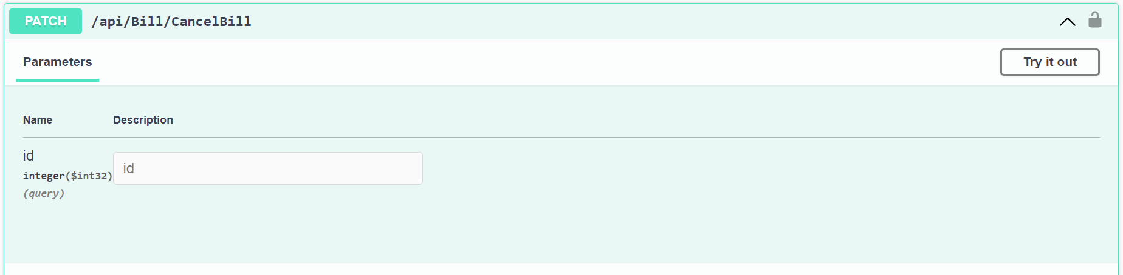
Cancel Bill

Slide 21
Implementation CRUD Bill Detail

Slide 22
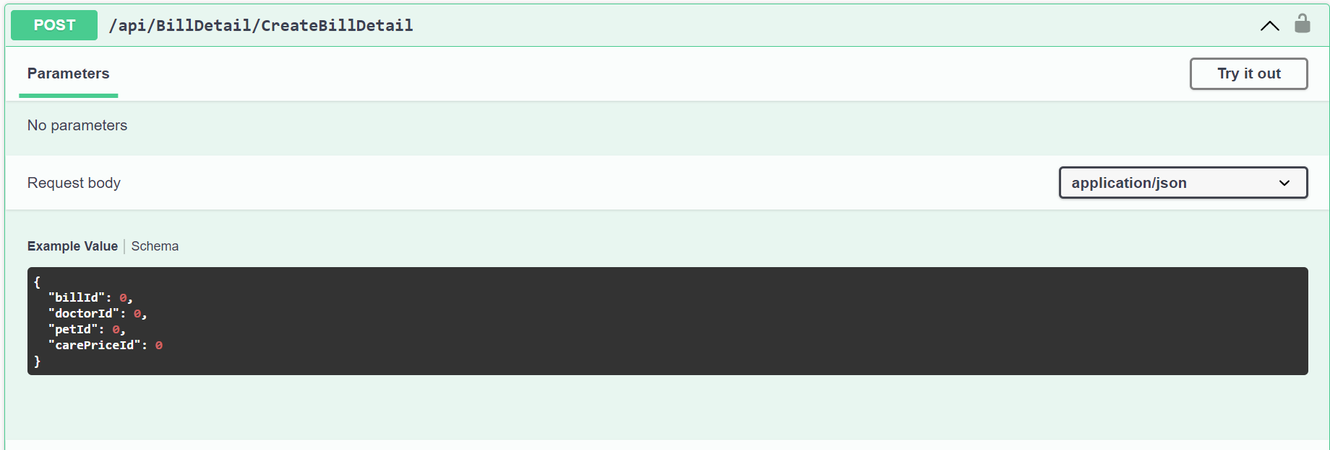
Create Bill Detail

Slide 23
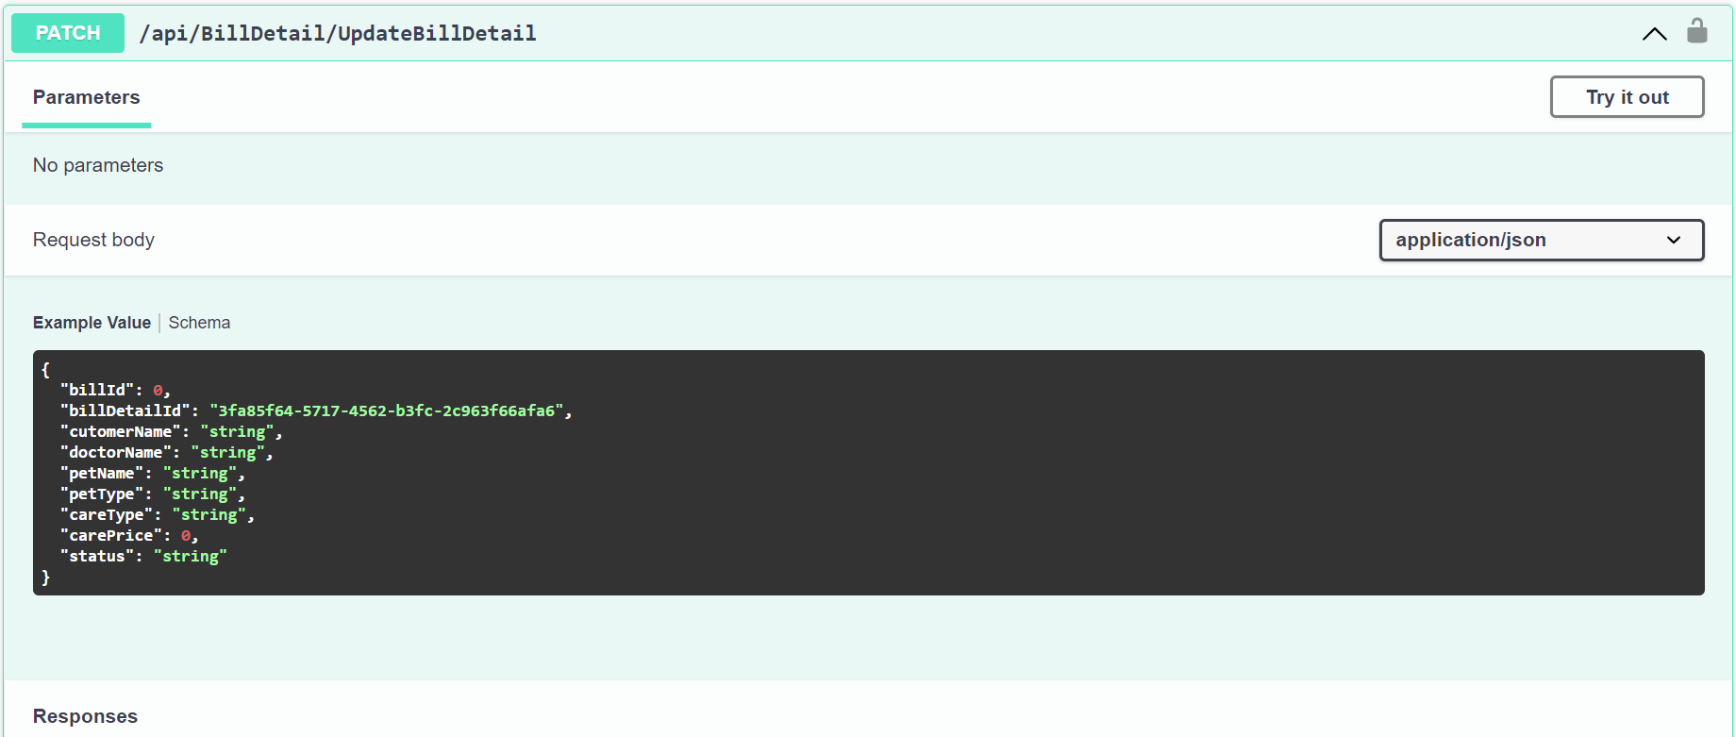
Update Bill Detail

Slide 24
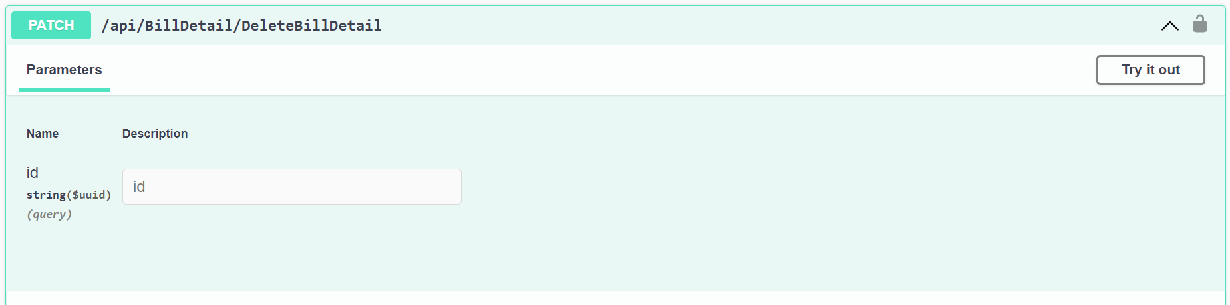
Delete Bill Detail

Slide 25
Unit Testing

Slide 26
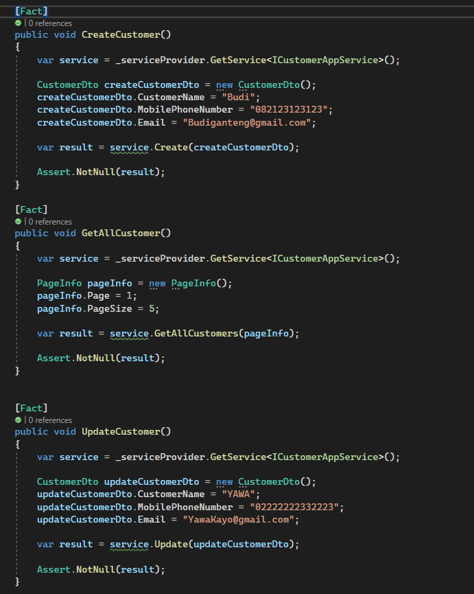
UnitTest Customer

Slide 27
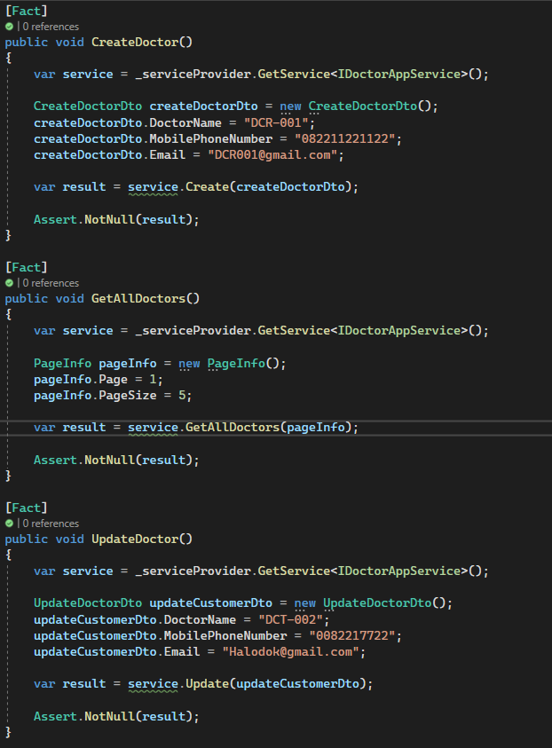
UnitTest Doctor

Slide 28
Summary
The ERD that is created can be implemented properly in web applications
Implementation using JWT and API in accordance with the design made
Making CRUD in the application goes well according to the design that was made

Slide 29
Thank you

