Slide 1
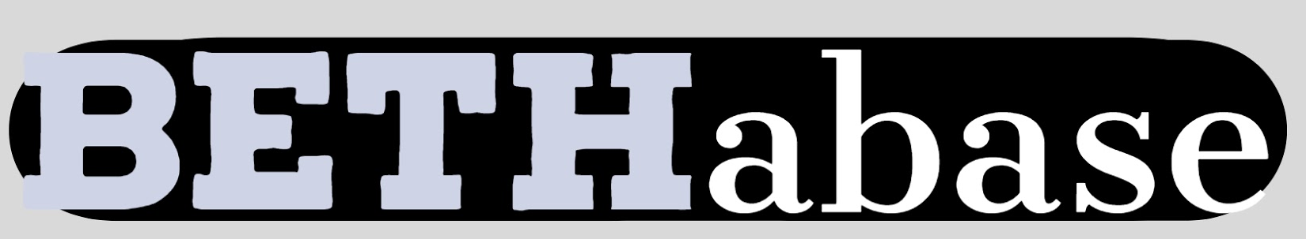

A distributed Marketplace for special image acquisition
BETH: Blockchain School for Sustainability
February 11-15, 2019
Ozan Ünal, Clemens Volk Orhun Eren, Ege Yilmaz, Adrian Balla,
Open Challenge

Slide 2
Current Difficulties
Verifying datasets based on human input
Creating Databases is costly both money and time wise
Until now no incentivation mechanism for the broad masses participating in image collection
Information is hard to verify
Only big cooperation are eligible of acquiring verified datasets limiting democratisation of technological growth
Feeding Deep Learning Algorithms
Finding big datasets of pictures for supervised learning algorithms are hard to acquire and end up being put together by Universities.
How to get 2000 pictures of Hands in front of an ATM machine

Slide 3


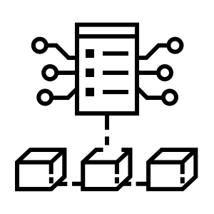

A Decentralized Solution For The Information Exchange
Acquisition of verified data through social census
Incentivizing honest collaboration
Democratization
Empower the free-flow of verified data, giving small research institutions the access to affordable datasets.
Verify
Reward
Gamification
The reputation token system enables a social gamification. of any kind of task.
Rank up and ladder up the ranking system of good behaviour
Social Consensus
easier acquisition of database

Slide 4

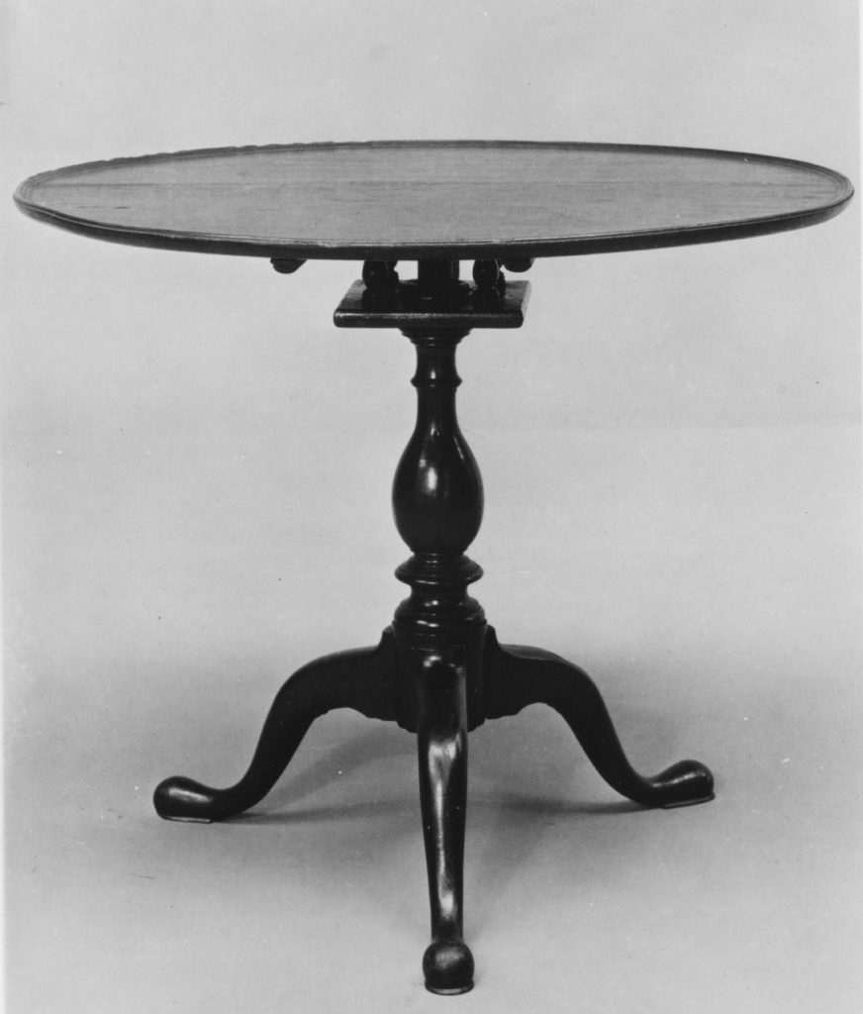
Software Demo
Working backend as Proof of Concept
Request
Upload
Vote
table
table
10 000
apple
table
Pay 10 ETH
Upload now
cow
none

Slide 5
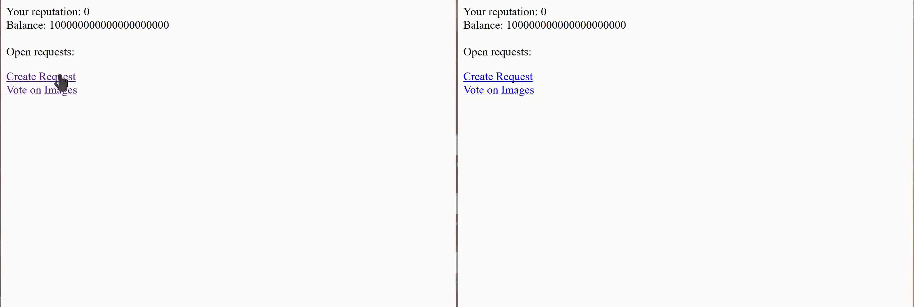
Software Demo
Working backend as Proof of Concept

Slide 6
Future Milestones
Getting the Marketplace up and running will come in the near future
Front end
IPFS integration
Full security check
Privatization of all variables and functions
Decryption of tag-image tupel

