Slide 1
AUTOMATIC STREET LIGHT CONTROL OF URBAN STREETS

Slide 2
CONTENTS:
Introduction
Problem Statement
Objectives
Solution
Object Detection using Machine Learning
Proposed Approaches
Background Subtraction
Haar Cascade
Result
Conclusions
Future Scope

Slide 3
INTRODUCTION
Automatic street light control of urban streets is a simple yet powerful system which uses machine learning algorithms to control street lights automatically.

Slide 4
PROBLEM STATEMENT
Automatic street lights in urban areas.
Notes:
Street lights are used across the globe for the purpose of providing enough light for vehicles to avoid accidents.
But, most of the times lights are turned on for extended period. Even, though no vehicle is passing through the highway or street.
Automatic street lights control in urban areas to minimize the energy consumption.

Slide 5
OBJECTIVE
Using Machine Learning, setup a mechanism to detect vehicles on a highway with a long stretch.
Determine a mechanism to trigger the street lights only when the area covered by them lies in the vehicle’s field of view.
Notes:
Using Machine Learning, setup a mechanism to detect vehicles on a highway with a long stretch.
This highway has numerous streetlights.
Determine a mechanism to trigger the street lights only when the area covered by them lies in the vehicle’s field of view.

Slide 6
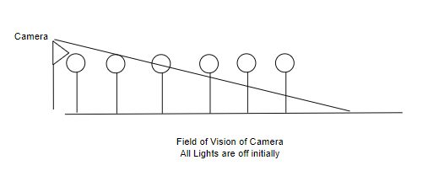
SOLUTION
Notes:
The idea is to use a camera to capture the motion of the vehicles on the highway.
After detecting the motion, the speed is to be determined using appropriate machine learning algorithms.
Since, the distance between lamp posts is known already.
Once the speed is determined, the time taken by the vehicle to reach the zone of a given lamp post can be calculated.
Hence, only turn on the given lamp post and switch off the rest of them to minimize the power consumption.

Slide 7
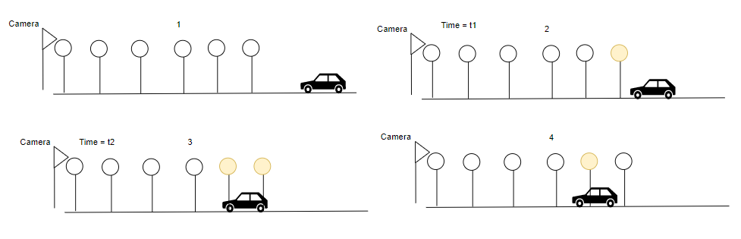
SOLUTION
V
L
Notes:
The idea is to use a camera to capture the motion of the vehicles on the highway.
After detecting the motion, the speed is to be determined using appropriate machine learning algorithms.
Since, the distance between lamp posts is known already.
Once the speed is determined, the time taken by the vehicle to reach the zone of a given lamp post can be calculated.
Hence, only turn on the given lamp post and switch off the rest of them to minimize the power consumption.

Slide 8
SOLUTION
Speed = distance / time taken
V = L / (t2-t1)
Notes:
The idea is to use a camera to capture the motion of the vehicles on the highway.
After detecting the motion, the speed is to be determined using appropriate machine learning algorithms.
Since, the distance between lamp posts is known already.
Once the speed is determined, the time taken by the vehicle to reach the zone of a given lamp post can be calculated.
Hence, only turn on the given lamp post and switch off the rest of them to minimize the power consumption.

Slide 9
OBJECT DETECTION USING MACHINE LEARNING
A Computer Vision technique for locating the instances of objects in an image or a video.
Object Detection capabilities using Machine Learning is utilized for detecting vehicles and determining their speed
Notes:
A Computer Vision technique for locating the instances of objects in an image or a video.
Algorithms used are mainly based on the principles of ML and DL.
Object Detection capabilities using Machine Learning is utilized for detecting vehicles and determining their speed

Slide 10
PROPOSED APPROACHES
Background Subtraction
Haar Cascading

Slide 11
BACKGROUND SUBTRACTION
Subtract the unnecessary background from the image.
Used to find the foreground objects by isolating them and comparing frame by frame to a frame where no object is present.
Notes:
One of the most popular object detection methods.
Compares moving parts of the video to a background and a foreground image.
Used to find the foreground objects by isolating them and comparing frame by frame to a frame where no object is present.
It finds differences between them and then creates a distance matrix.

Slide 12
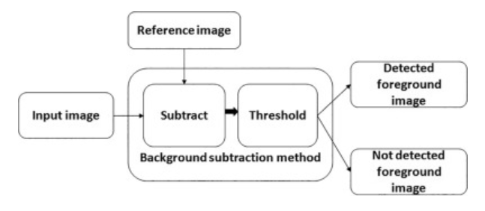
BACKGROUND SUBTRACTION

Slide 13
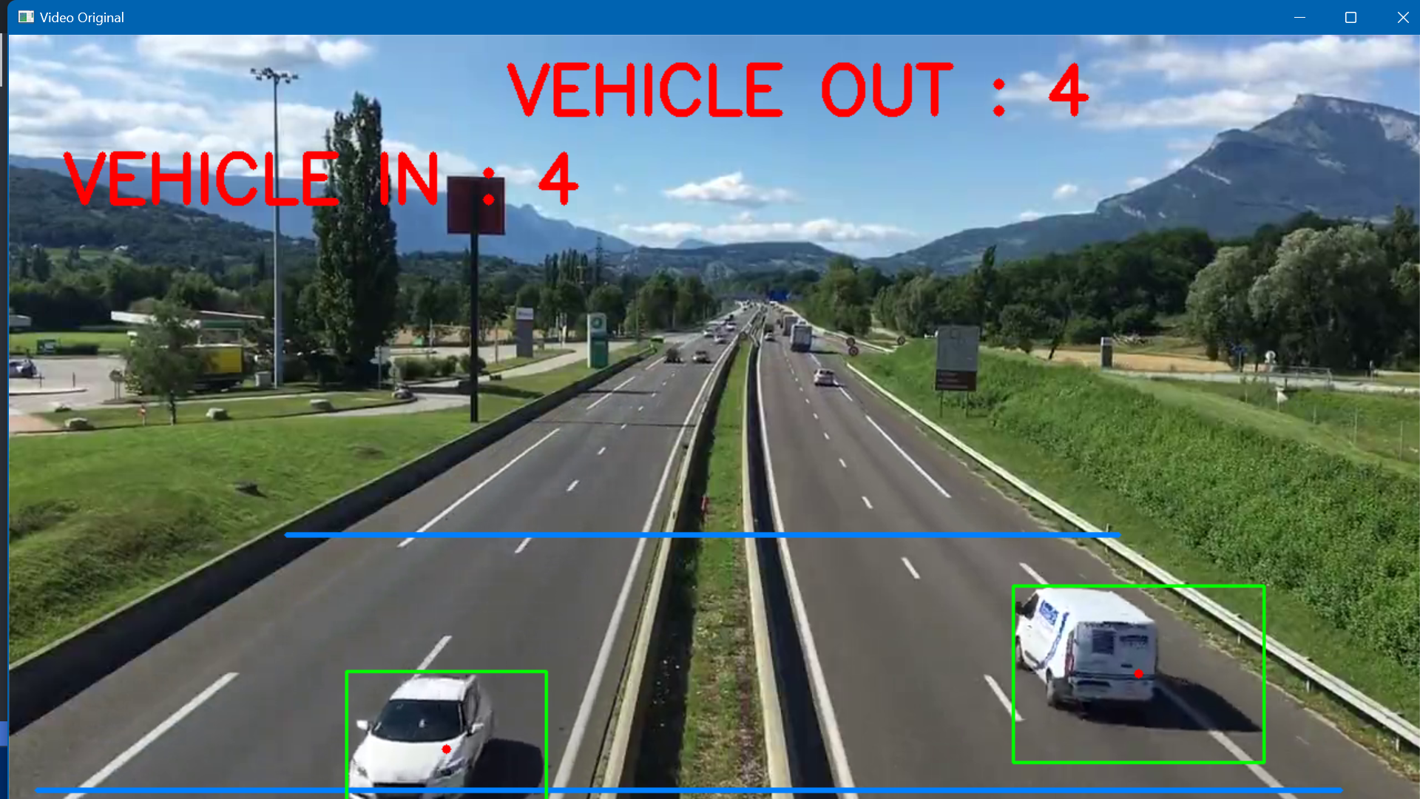
BACKGROUND SUBTRACTION
We determine a region of interest for where the object detection has to be carried out

Slide 14
BACKGROUND SUBTRACTION
Threshold value used = 4.6
By establishing a scale for the distance in the video and the actual distance on the ground, we could determine the speed of the vehicles using the timestamps of the video.
Notes:
It compares the movements of the objects in that region to the threshold value and determines if any moving objects are present in that frame.
Threshold value used = 4.6
By establishing a scale for the distance in the video and the actual distance on the ground, we could determine the speed of the vehicles using the timestamps of the video.

Slide 15
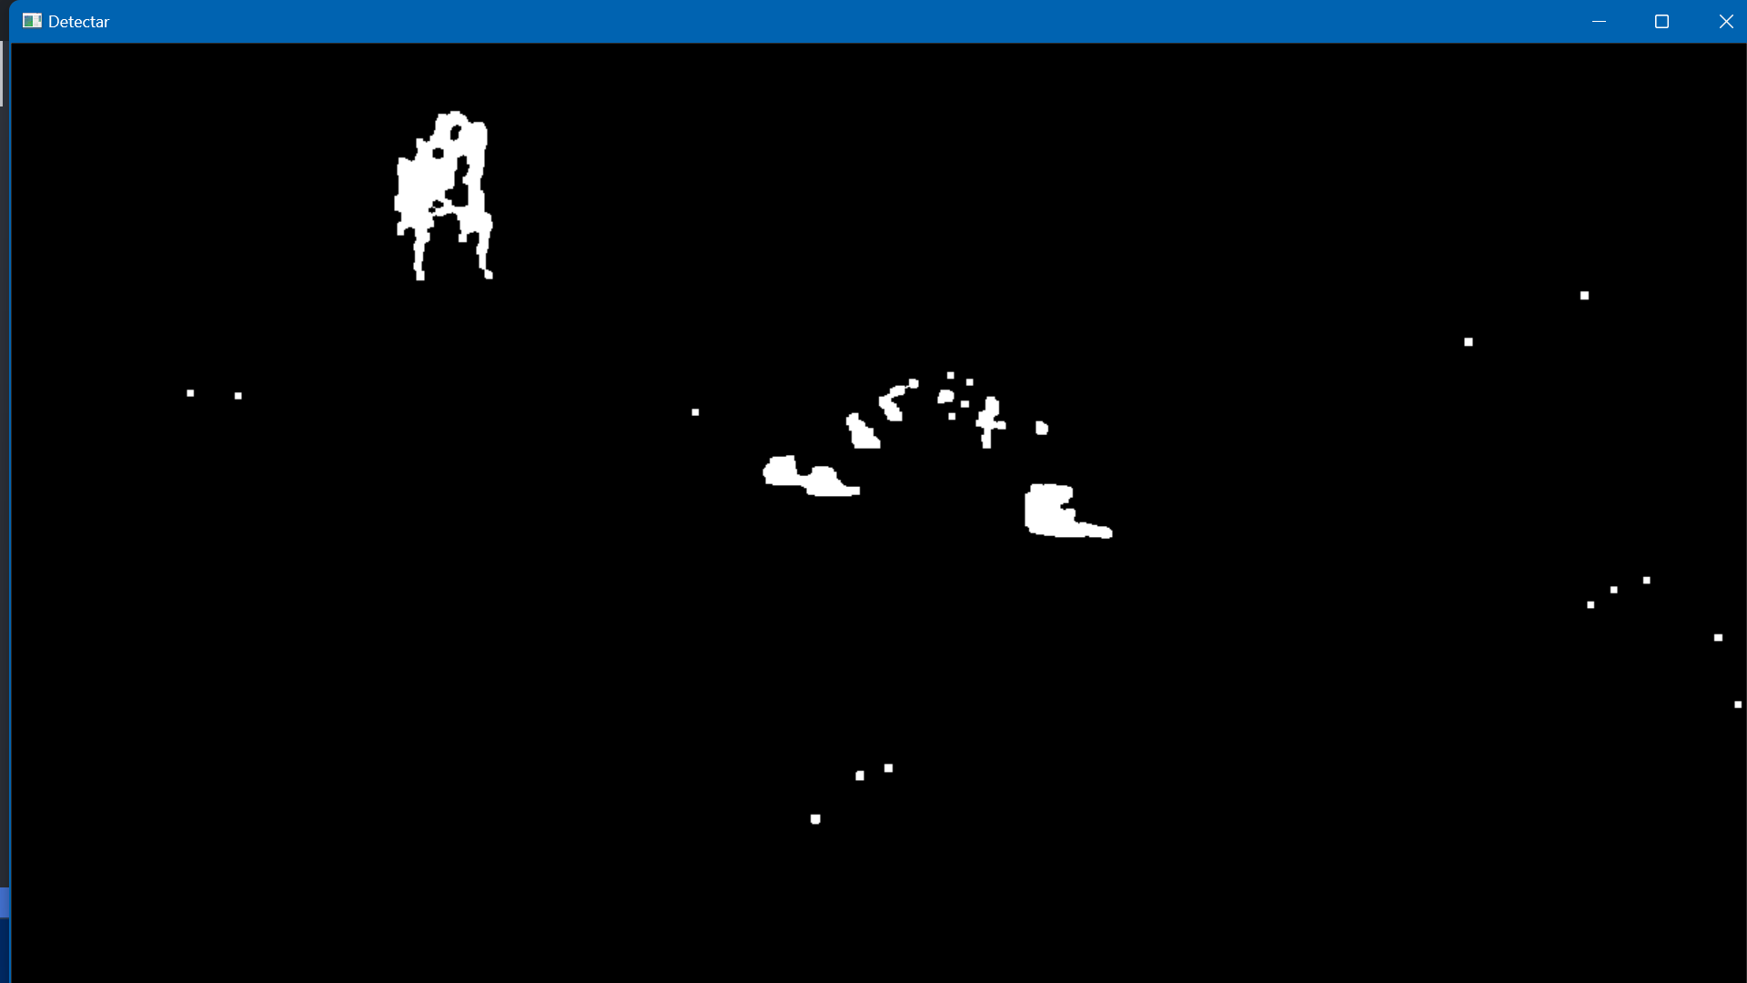
BACKGROUND SUBTRACTION

Slide 16
PROBLEMS WITH BACKGROUND SUBTRACTION
The region of interest must be reasonably sized.
Massive region of interest would also give rise to additional noise due to detecting unwanted objects.
If threshold value is too low, excessive noise would be detected along with the required objects.

Slide 17
HAAR CASCADING
Machine learning-based object detection algorithm.
This algorithm is not so complex and can run in real time.
Model is trained to both positive and negative images.
Using Haar Cascading, we can continuously track specific objects without excessive background noise.
It uses a cascading window to classify whether it could be the object we are looking for.
Notes:
Proposed in a paper by Paul Viola and Micheal Jones. Machine learning-based object detection algorithm.
This algorithm is not so complex and can run in real time.
Haar cascading is known for its fast and efficient face detection capabilities, making it suitable for real-time applications.
In Haar cascading, we train our model to both positive and negative images.
Object detection data is stored in the program's XML files.
Using Haar Cascading, we can continuously track specific objects without excessive background noise.

Slide 18
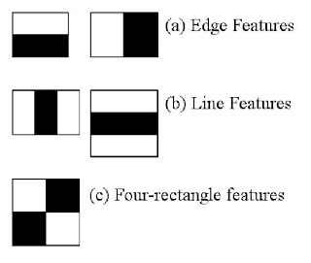
HAAR CASCADING
Step 1:
Haar Feature Selection:
It starts by selecting a set of Haar-like features.
Notes:
A Haar feature is essentially calculations that are performed on adjacent rectangular regions at a specific location in a detection window.
Haar cascading starts by selecting a set of Haar-like features, which are rectangular patterns that represent different image characteristics like edges, lines, and textures. These features act as filters to detect specific patterns in the image.

Slide 19
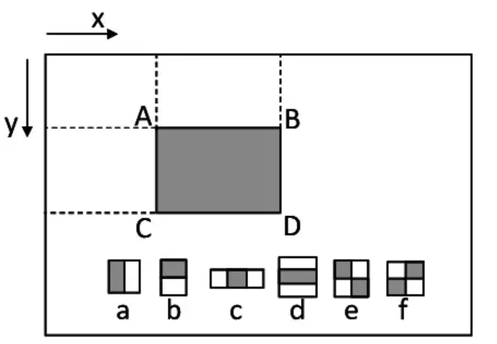
HAAR CASCADING
Step 2:
Creating Integral Images:
To efficiently compute the Haar-like features, an integral image is calculated from the original image.
The calculation involves summing the pixel intensities in each region and calculating the differences between the sums.
Notes:
To efficiently compute the Haar-like features, an integral image is calculated from the original image. The integral image allows for fast calculation of pixel sums in any rectangular region of the image, which is essential for evaluating Haar features.
The calculation involves summing the pixel intensities in each region and calculating the differences between the sums.
Haar features could be difficult to determine in case of a large image. So integral images are introduced.
Instead of computing at every pixel, it creates sub-rectangles and array references for each sub-rectangle.
Which then used to compute Haar Features.

Slide 20
HAAR CASCADING
Step 3:
Adaboost Training:
The algorithm goes through a training stage using a large dataset of positive and negative samples.
It chooses the best features and trains the classifiers to use them to create a strong classifier.
Notes:
difficult to determine the best features that represent an object from the hundreds of thousands of Haar features.
Adaboost essentially chooses the best features and trains the classifiers to use them. It uses a combination of “weak classifiers” to create a “strong classifier” that the algorithm can use to detect objects.

Slide 21
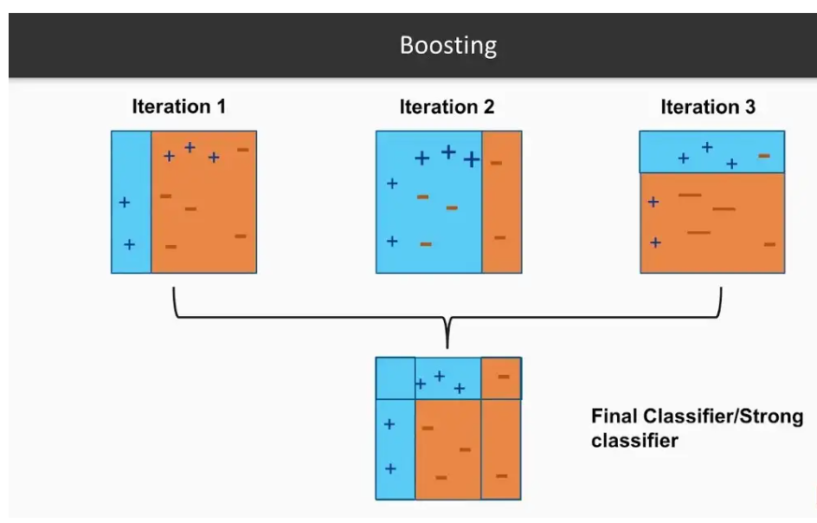
HAAR CASCADING

Slide 22
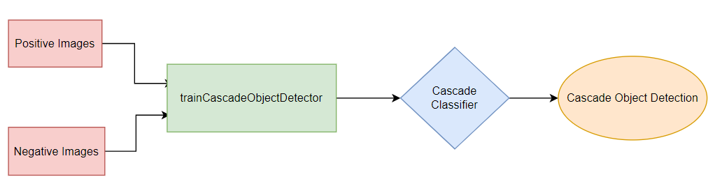
HAAR CASCADING
Step 4:
Cascading Classifier:
The last step combines these weak learners into a strong learner using cascading classifiers.
Notes:
The last step combines these weak learners into a strong learner using cascading classifiers.
The cascading structure consists of multiple stages, with each stage containing a set of weak classifiers. Each weak classifier evaluates a specific Haar feature and determines whether the region is likely to contain a face or not.
Stages are designed to reject negative samples as fast as possible because a majority of the windows do not contain anything of interest.
The object detection data is stored in the program's XML files. Using Haar Cascading, we can continuously track specific objects without excessive background noise. This method proves to be accurate to a great extent, even for objects at the far end in the video.

Slide 23
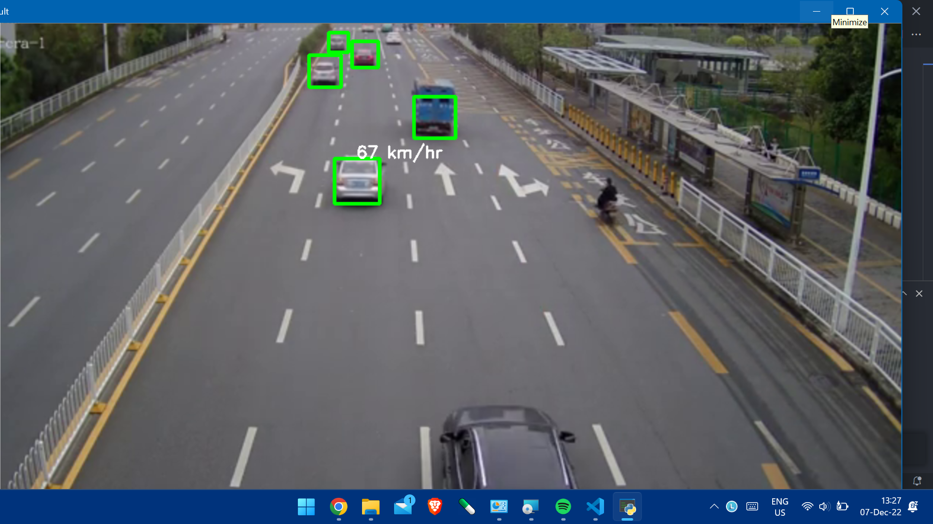
HAAR CASCADING
Notes:
After establishing proper object detection parameters, we can determine a pixel-per-meter ratio(ppm). This ratio would help us determine the actual distance on the ground that the vehicle has covered, and with the help of the video timestamps, we can determine the vehicle's speed.
With the determination of speed, it becomes now possible to determine when the vehicle will reach the region of interest of a particular street light, and depending upon the computations, the lights can be triggered just a little before the vehicle arrives in its region of interest.

Slide 24
HAAR CASCADING
Successful object detection.
Using Haar Cascading, the speed is accurately determined for the vehicles.

Slide 25
Light Triggering
After successful determination of speed, we calculate the time required by the vehicle to approach the region affected by a street light.
The light is then triggered as the vehicle about to approach the region of interest.
The light is then turned on for the amount of time the vehicle stays in the region of interest of the light.

Slide 26
Conclusion
Two approaches used for object detection and speed determination.
Background Subtraction didn’t give precise enough results.
It creates a paradox occurs which limits the accuracy of results obtained by this method.
Notes:
Two approaches used for object detection and speed determination. Background Subtraction and Haar Cascading.
Background Subtraction didn’t give precise enough results.
Since it requires a reasonably sized region of interest to produce acceptable results. But, using a massive region of interest can introduce additional noise due to detecting of unwanted objects.
It creates a paradox occurs which limits the accuracy of results obtained by this method.

Slide 27
Conclusion
Haar Cascading provided accurate object detection and speed determination.
It works well in real time as well.
After determining the distance travelled by any vehicle in a span of time, we can easily calculate their speed.
The light is then triggered as the vehicle is about to approach its region of interest and then stays on for the amount of time it stay there.
Notes:
Therefore Haar Cascading is used as an alternative.
Haar Cascading provided accurate object detection and speed determination.
It works well in real time as well.
We can tune the algorithm to detect specific types of objects only and ignore the others.
Using this with correlation tracking, we can track the vehicle thoroughly throughout the video feed and assign them IDs to keep track of them.
After determining the distance travelled by any vehicle in a span of time, we can easily calculate their speed.

Slide 28
Future Scope
Using neural networks to detect object for better accuracy.
This project can be further improved and integrated with other features of Intelligent Transportation Systems.
The data obtained from the video feeds can be analysed for things like incident handling, congestion handling, and traffic pattern prediction.

Slide 29
References
Karthni Lakshmanan, Nishanth Thilagar , S. Tamilselvi, “Two Step Algorithm Implementation for Intelligent Street Light System”, 2019 International Journal of Innovative Technology and Exploring Engineering (IJITEE) ISSN: 2278-3075, Volume-9 Issue-1, November 2019
Governmentof India’s UJALA & Street Lighting National Programme Complete Five Successful years of Illuminating India, Press Information Bureau Government of India Ministry of Power,05 January 2020
Mustafa Saad, Abdalhalim Farij, Ahmed Salah and Abdalroof Abdaljalil, “Automatic Street Light Control System Using Microcontroller ”,2013, 978-960-474-339-1, October, 2013
Muhammad Asif, Sarmad Shams, Samreen Hussain, Jawad Ali Bhatti, Munaf Rashid, and Muhammad Zeeshan-ul-Haque, “Adaptive Control of Streetlights Using Deep Learning for the Optimization of Energy Consumption during Late Hours” Energies 2022, 15, 6337.
Revathy.M, Ramya.S, Sathiyavathi.R, B.Bharathi and V. Maria Anu, “Automation of Street Light For Smart City ”, International Conference on Communication and Signal Processing, April 6-8, 2017, India
M. Karthikeyan, V. Saravanan and S. Vijayakumar, "Cloud based automatic street light monitoring system," 2014 International Conference on Green Computing Communication and Electrical Engineering (ICGCCEE), Coimbatore, 2014, pp. 1-6.
Martin Danelljan, Gustav Häger, Fahad Shahbaz Khan and Michael Felsberg, “Accurate Scale Estimation for Robust Visual Tracking”,In Proceedings British Machine Vision Conference 2014, Nottingham

Slide 30
Thank You!

