Slide 1
Phishing Website Classification using Machine Learning
Course: Data Analytics and Data-Driven Decision
University of L’Aquila – DISIM
Instructor: Prof. Andrea Manno
Group Members: Lokwo Denis, Abdoulie A Jallow, Ahsan Habib
Date:

Slide 2
Introduction
Definition of Phishing websites: Trick users into revealing personal info.
Why phishing is dangerous: A major cybersecurity risk.
Goal: Use machine learning to classify websites as phishing, suspicious, or legitimate.
Notes:
Explain what phishing is and why it matters. Emphasize the practical need for automated detection and how machine learning fits in.

Slide 3
Dataset Overview
1353 website instances
9 features + 1 target (Result)
Target classes:
-1: Phishing
0: Suspicious
1: Legitimate
Notes:
Describe the size and structure of the dataset. Highlight that this is a classification problem with three target classes.

Slide 4
Features Description
Example features:
SFH: Server Form Handler
SSLfinal_State: SSL Certificate Use
popUpWindow: Use of popups
All features encoded as -1, 0, or 1.
Notes:
Briefly explain what the features represent and how they're encoded. This helps justify later modeling steps.

Slide 5
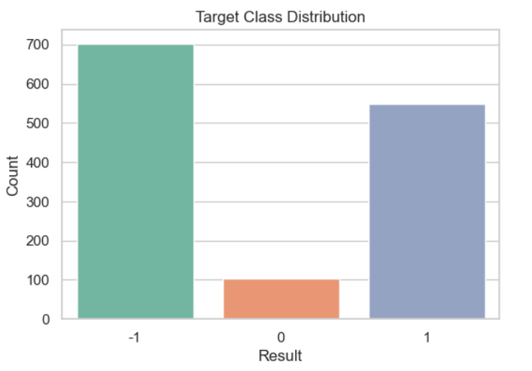
Class Distribution
Class imbalance:
Phishing (-1): 700
Legitimate (1): 550
Suspicious (0): 100
Notes:
Show the distribution of classes in the dataset. Note the imbalance — especially the underrepresentation of suspicious cases.

Slide 6
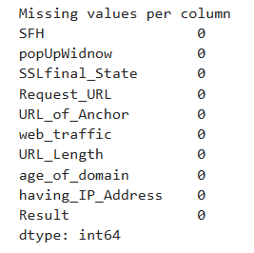
Data Cleaning
• No missing values
• 629 duplicate rows (retained after review)
• All numeric features
• Dataset ready for analysis
Notes:
Summarize the data cleaning process. Mention your decision to keep duplicates and confirm data readiness.

Slide 7
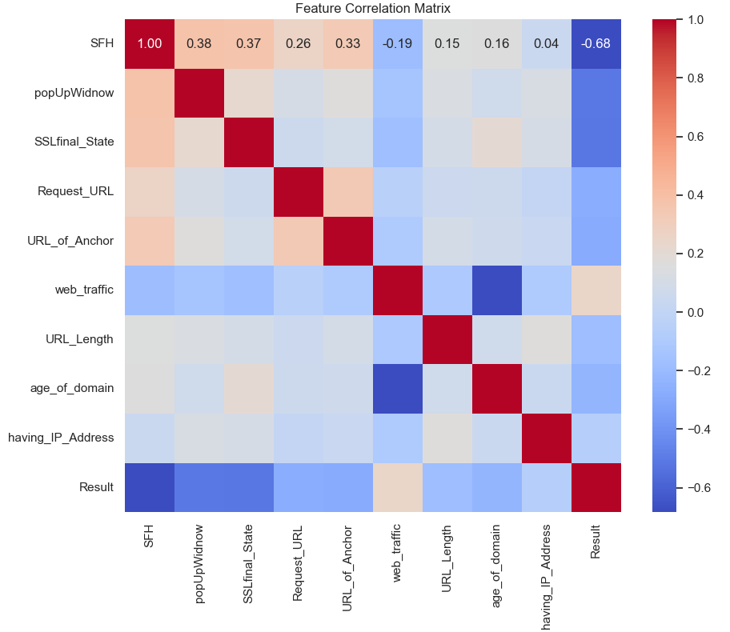
Exploratory Data Analysis
Weak correlation between most features
Suspicious class overlaps others
Notes:
Highlight findings from the heatmap and EDA. Mention potential overlap between class 0 and others.
We used a heatmap to visualize the correlation between features in the dataset. Most features have weak or no correlation, meaning they are not linearly related to each other. This is good for classification, because it shows that each feature contributes independently. There are a few moderate correlations, such as between SFH and SSLfinal_State, which might both relate to how secure a website is. However, none of the features are strongly correlated, so multicollinearity is not a concern in this case Correlation near zero means the features are independent.”
“No strong correlations means we can trust each feature adds new information.”
“Features like SSLfinal_State and SFH both relate to site trust, so a small correlation makes sense.”

Slide 8
Analysis Objective
Problem: Multi-class classification
Goal: Detect phishing websites accurately
Tools used: Python, Pandas, Seaborn, Scikit-learn
Notes:
State the objective clearly and list tools used. This sets up the modeling phase.

Slide 9
Supervised learning
Why We Used Supervised Learning
We chose supervised learning because our problem involved predicting known Result base on historical data.
Model used:
Decision Tree Model
Random Forests Model

Slide 10
Decision Tree Model
Easy to interpret
Handles categorical-like numerical features well
No need for feature scaling
Accuracy: 88%
Strong for phishing & legit classes
Struggled slightly with suspicious class
Notes:
Introduce the decision tree model, key performance metrics, and its strengths and weaknesses.

Slide 11
Random Forest Model
More robust and accurate than a single tree
Handles imbalanced data better
Accuracy: 88%
Slight improvement in class 0 precision
Notes:
Explain how Random Forest improves on a single tree and how it performs slightly better for minority class.

Slide 12
Model Comparison
Decision Tree Model | Random Forest model
Slightly better recall and F1-score for the suspicious class (0). | Slightly higher precision on the suspicious class (0), but lower recall compared to Decision Tree.
Strong performance across phishing (-1) and legitimate (1) classes. | More stable across classes due to being an ensemble of multiple trees.
More prone to overfitting | Less prone to overfitting and generally more robust, especially on unseen data
Notes:
Compare models side-by-side and highlight why one may be preferred over the other.

Slide 13
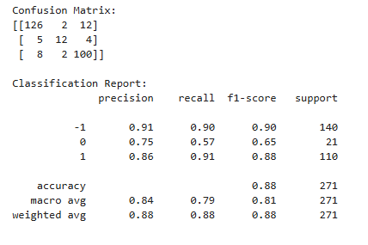
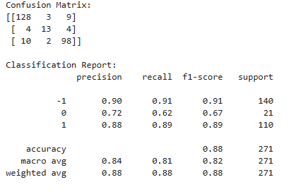
Evaluation Metrics
Overall accuracy: 88%
High F1-scores for classes -1 and 1
Class 0 remains challenging
Radom forest model
Decision tree model
Notes:
Show performance results. Discuss how class imbalance affects class 0.

Slide 14
Challenges
Class imbalance: Suspicious class underrepresented
Feature overlap across classes
Limited tuning
Notes:
Be honest about what made the project difficult and how it could impact results.

Slide 15
Conclusion
Both models achieved 88% accuracy
Random Forest slightly better overall
Future work:
- Balance classes
- Tune hyper parameters
- Add engineered features
Notes:
Summarize what you learned and where improvements could be made if more time or tools were available.

Slide 16
Questions & References
Questions?
Q&A
References:
Scikit-learn, Pandas, Seaborn
Dataset: PhishingData.arff
Class Material
Thank you for listening!
Notes:
Wrap up. Invite questions and show gratitude. Optionally list links or academic references.

