Slide 1

MINOR PROJECT
Digital Campus Event
Registration and
Management Platform
A full-stack web application for digitally managing campus events and clubs
STUDENT NAME
ROLL NUMBER
DEPARTMENT / COLLEGE
PROJECT GUIDE
ACADEMIC YEAR
Aditya
25MCC20009
University of Computing
Prof. Dhruv Shah
2025-27

Slide 2





Introduction & Problem Statement
Problems with Traditional Management
Manual Event & Club Management
Handled through registers and paperwork
Introduction
Difficult to Update Information
Any change requires redoing records manually
A digital platform designed to simplify campus event and club management through a centralized web application.
Scattered Data
Details spread across files, notices, and people
Time-Consuming Management
Coordination and updates take excessive effort
Goal
Lack of a Centralized Platform
Replace manual, paper-based processes with one connected online system.
No single place to manage all activities
Digital Campus Event Registration and Management Platform
2

Slide 3






Objectives & Proposed Solution
Objectives
Digitize campus event management
Provide a simple and responsive UI
Proposed Solution
A web platform where event and club information can be added, edited, stored, and displayed digitally.
Manage events and clubs efficiently
Store data in a centralized database
One platform. All events and clubs.
Develop a complete full-stack application
Digital Campus Event Registration and Management Platform
3

Slide 4





Technology Stack
Frontend
Backend
Database
React.js
Node.js
MongoDB
JavaScript
Express.js
Tailwind CSS
React + Tailwind
Node.js + Express
MongoDB
Digital Campus Event Registration and Management Platform
4

Slide 5





System Architecture & Workflow
User / Admin
Workflow
1
User interacts with the UI
React.js Frontend
2
Frontend sends requests to backend
Express.js + Node.js Backend
3
Backend processes the request
4
Data is stored/retrieved from MongoDB
MongoDB Database
5
Updated information is displayed on the UI
Digital Campus Event Registration and Management Platform
5

Slide 6



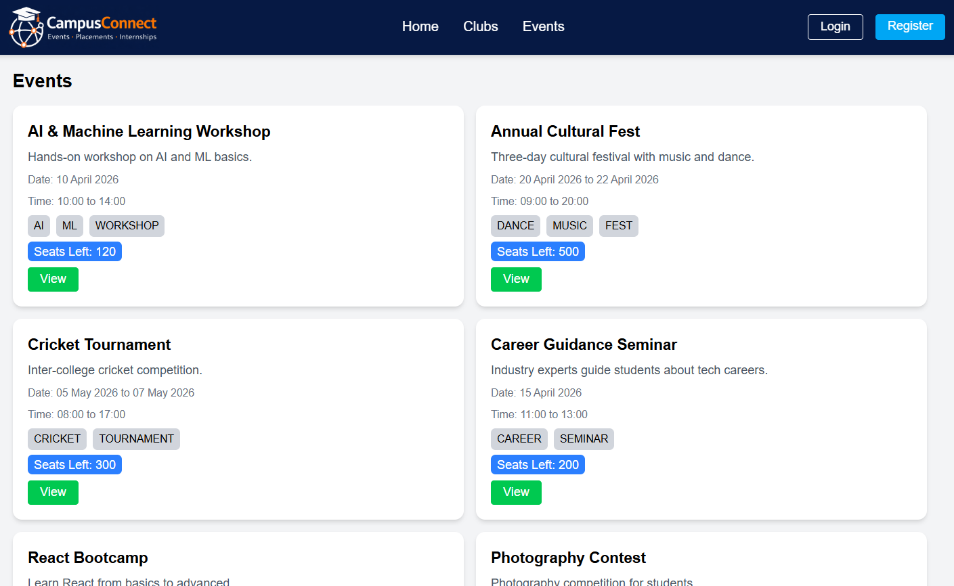
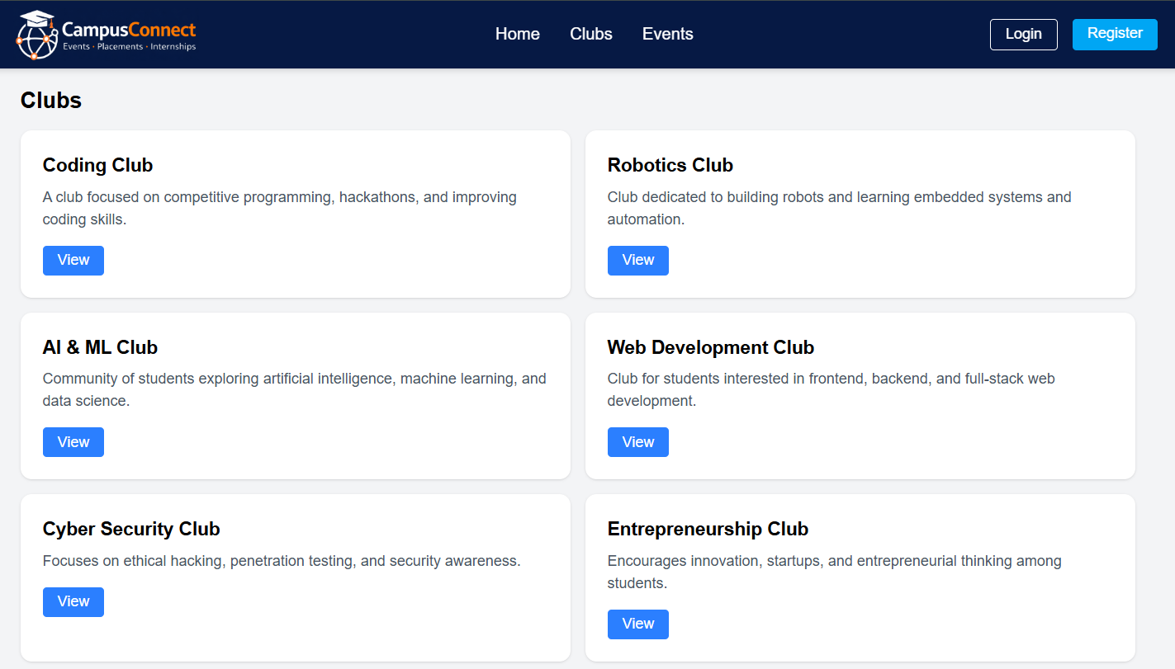
Implemented Features
Event Management
Club Management
Add Event
Add Club
Edit Event
Edit Club
Display Event Information
Display Club Information
Digital Campus Event Registration and Management Platform
6

Slide 7
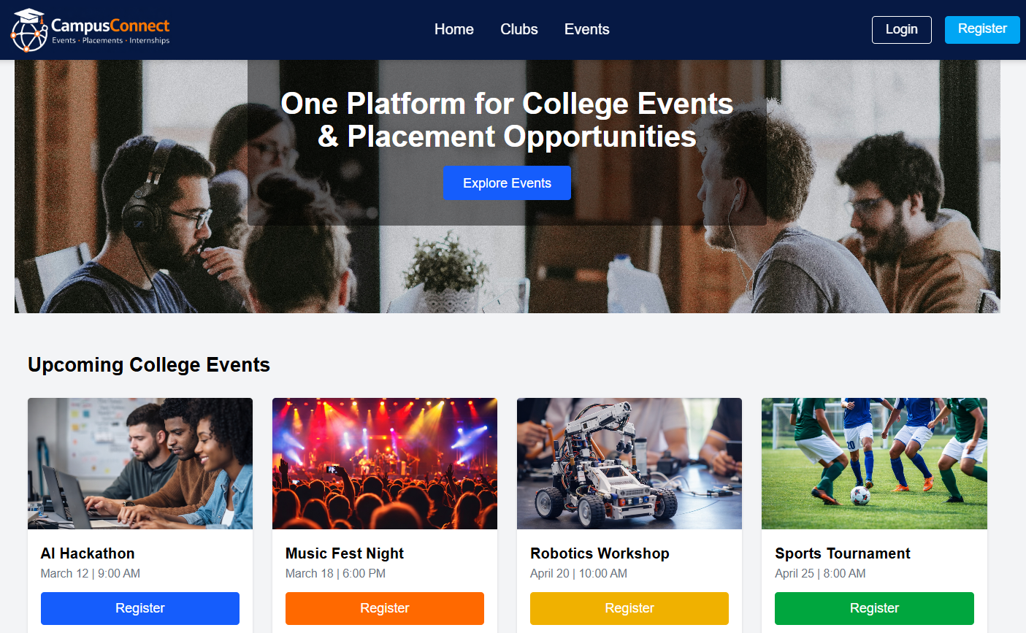

Implementation & Results
Implementation
React-based frontend developed
Responsive UI created using Tailwind CSS
Backend developed using Node.js and Express.js
MongoDB integrated for data storage
Event and Club CRUD-related functionality implemented
A functional full-stack campus event and club management platform with a modern web interface.
Result
Digital Campus Event Registration and Management Platform
7

Slide 8







Conclusion & Future Scope
The project successfully demonstrates the development of a full-stack digital campus platform using modern web technologies. Event and club management functionality has been implemented with an interactive and responsive UI.
Future Scope
Student event registration
User authentication
Event search and filtering
Notifications
Attendance tracking
Admin dashboard
Event analytics
Thank You

