Slide 1
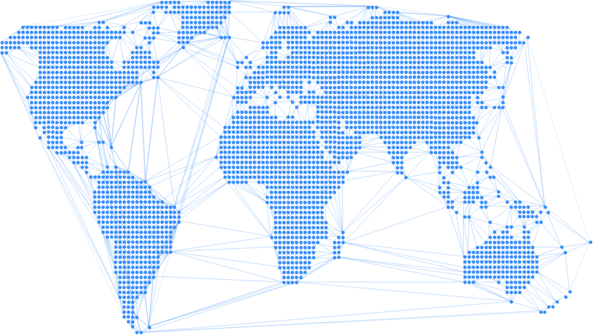

Enable
Stablecoin loans for a borderless peer-to-peer credit marketplace

Slide 2
Hi!

Slide 3
Anthony
Thomas
Daniel
Ines

Slide 4
Ines’ story

Slide 5
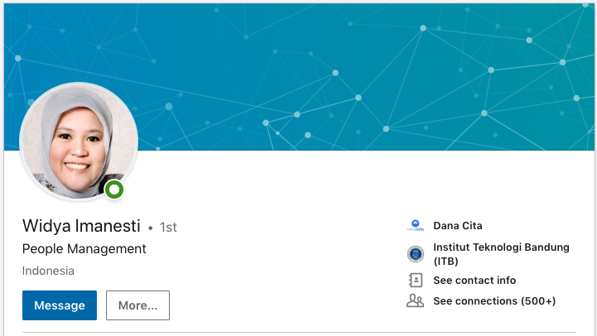
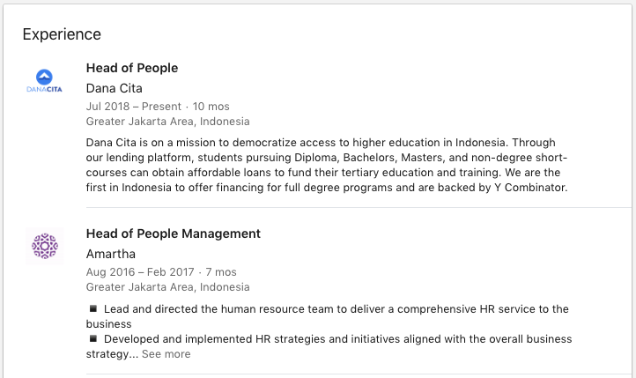
Ines’ Story
Background Executive in Indonesia (Head of HR), with credit history in Indonesia
Family Husband is also from Indonesia, currently doing a PhD in the US
New York Cornell University, Masters in HR US$60,000 due on May 20th

Slide 6
Ines’ Story
$60,000 due May 20th Cornell University, Masters in HR
High domestic interest rates Secured: 9.9% - 12.5%
Unsecured: 17% - 30+%
Inflation: 2.5-2.57%
Indonesia
No access to capital No low-interest rate federal student loan programs, private and state-owned banks only tend to give out small loans (<$3,000) and don’t fund $60,000 loans over 10 years unless it’s a mortgage or commercial loan
Lender’s Fees Traditional lenders charge origination fees (3-5% of loan amount) on top of interest to cover their operations. For a $60,000 loan, that’s $3,000.

Slide 7
Ines’ Story
$60,000 due May 20th Cornell University, Masters in HR
Cost of sending money to the US Domestic bank fees and US bank fees can amount up to 5% or more. For a $60,000 loan, that’s $3,000
Indonesia

Slide 8


Ines’ Story
$60,000 due May 20th Cornell University, Masters in HR
Immigrants have no credit history Credit score and financial reputation in Indonesia doesn’t follow Ines to the US, despite being an executive in Indonesia
Indonesia
Current Solution:
Cross-border lenders (Mpower, Prodigy)
11.99% p.a. interest for $60,000, 10 year loan term (total: $103+k)
5% origination fee (i.e. $3,000)
Only funds $25,000 out of $60,000

Slide 9
“Credit is fundamentally broken when crossing borders” Cameron Stevens Founder, Prodigy Finance

Slide 10
Solution

Slide 11
“Credit is fundamentally broken when crossing borders” Cameron Stevens Founder, Prodigy Finance
Global credit history and identity-as-collateral
Free (i.e. $0) money movement and servicing

Slide 12
“Credit is fundamentally broken when crossing borders” Cameron Stevens Founder, Prodigy Finance
Identity (if it can be verified) can be used globally
Unsecured cross-border loans can use identity as collateral
Global credit history and identity-as-collateral
Identity can be innovated on: pooled identity for group credit, socially attested loans etc
Free (i.e. $0) money movement and servicing

Slide 13
“Credit is fundamentally broken when crossing borders” Cameron Stevens Founder, Prodigy Finance
Identity (if it can be verified) can be used globally
Unsecured cross-border loans can use identity as collateral
Global Credit Reputation “identity-as-collateral”
Reduce servicing fees to near 0% on origination and repayments
Identity can be innovated on: pooled identity for group credit, socially attested loans etc
Free (i.e. $0) money movement and servicing
Free ($0) movement of money across borders
Automatic tracking of repayments and flow-of-funds handling

Slide 14
Product

Slide 15
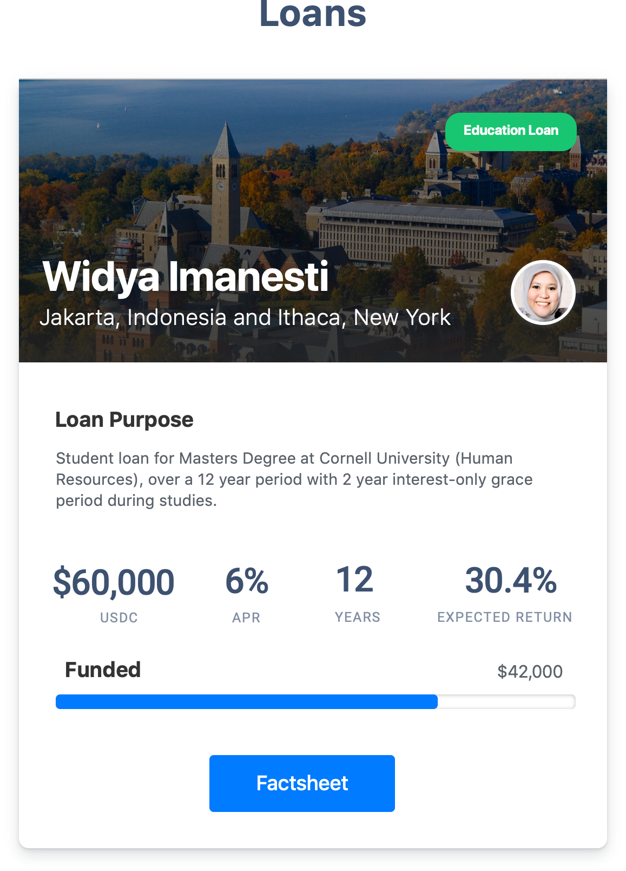
Stablecoin Loans
Near-$0 money movement across borders from wallet to wallet
Borderless Credit Marketplace
Anyone around the world with USDC can fund a loan

Slide 16
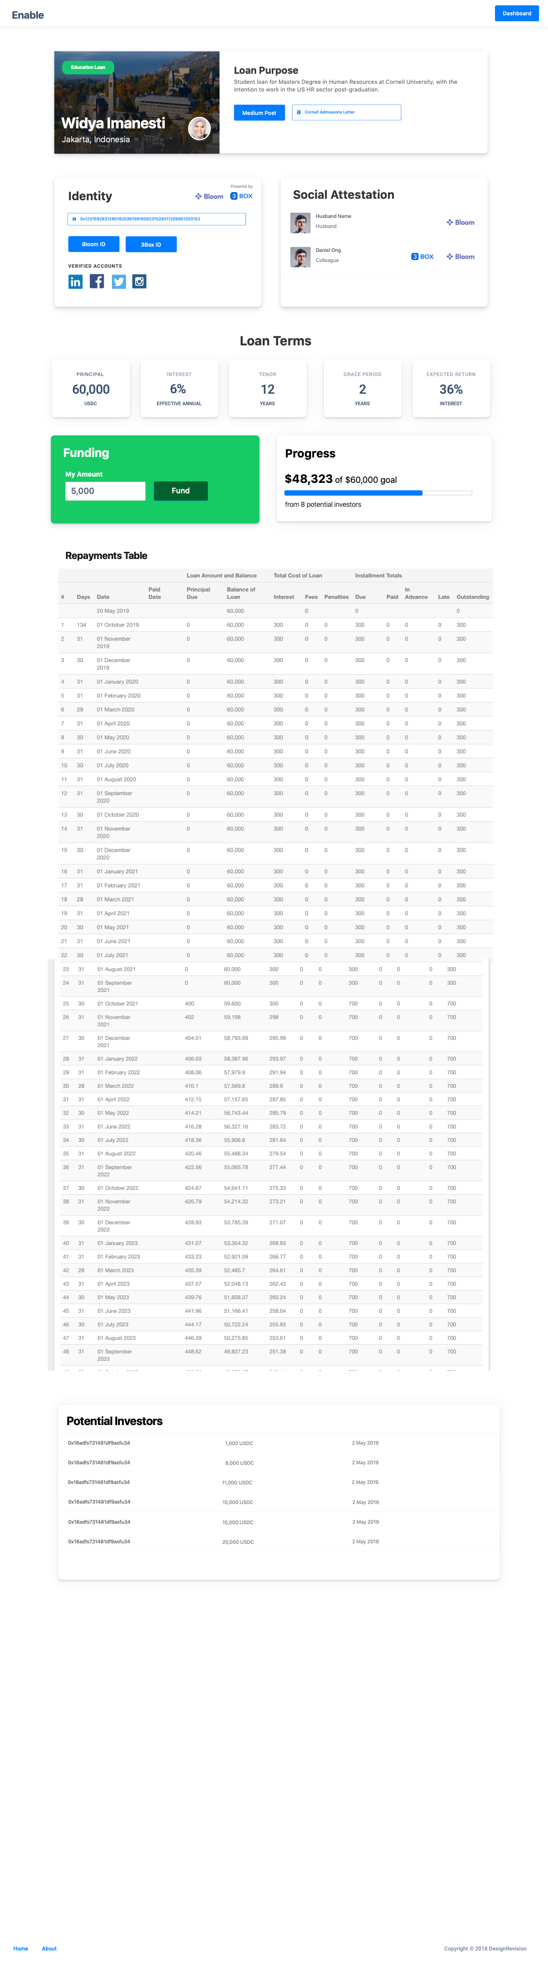

Identity-as-collateral
Real-world identity allows unsecured lending with globally verified identity as collateral
Social Attestation
Develop a richer credit profile by other verified profiles attesting for the borrower

Slide 17
ERC-20 Crowdfunding and Fractional Ownership
Innovative crowdsourcing models that allow for the issuance of verifiable ERC-20 debt tokens that are potentially tradeable for early liquidity
Automated Flow of Funds through Smart Contracts
Automated tracking of debt terms, repayment payments, and handling of flow-of-funds
Configurable Loan Contract
Flexible loan contracts with configurable terms (e.g. grace periods on interest and principal, variable tenor, Principal-Interest-Fees-Penalties breakdown

Slide 18
How it works

Slide 19



Funding flow
Creates Debt Contract
ERC-20 Contract
Contribution
Fractional Ownership Debt Token
Returns Debt Token
Lender
Disburses money to borrower
Borrower
Loan Contract

Slide 20
Repayment Flow
ERC-20 Contract
Receive fractional share of repayment
Repayment routed to debt token holders
Monthly Repayment
Lender
Borrower
Loan Contract

Slide 21
Implementation

