Slide 1
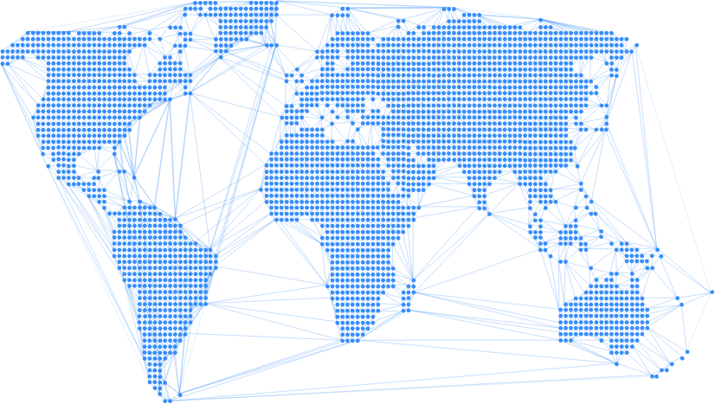

Enable
Stablecoin loans for a borderless peer-to-peer credit marketplace

Slide 2
Hi!

Slide 3
Anthony
Thomas
Daniel
Ines

Slide 4
Ines’ story

Slide 5
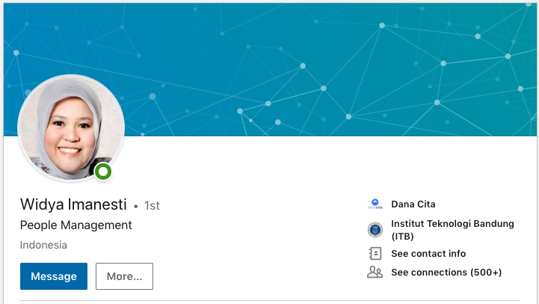
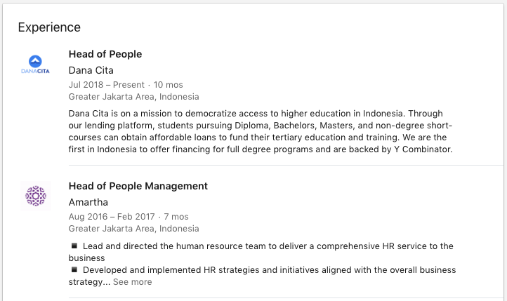
Ines’ Story
Background Executive in Indonesia (Head of HR), with credit history in Indonesia
Family Husband is also from Indonesia, currently doing a PhD in the US
New York Cornell University, Masters in HR US$60,000 due on May 20th

Slide 6
Ines’ Story
$60,000 due May 20th Cornell University, Masters in HR
High domestic interest rates Secured: 9.9% - 12.5%
Unsecured: 17% - 30+%
Inflation: 2.5-2.57%
Indonesia
No access to capital No low-interest rate federal student loan programs, private and state-owned banks only tend to give out small loans (<$3,000) and don’t fund $60,000 loans over 10 years unless it’s a mortgage or commercial loan
Lender’s Fees Traditional lenders charge origination fees (3-5% of loan amount) on top of interest to cover their operations. For a $60,000 loan, that’s $3,000.

Slide 7
Ines’ Story
$60,000 due May 20th Cornell University, Masters in HR
Cost of sending money to the US Domestic bank fees and US bank fees can amount up to 5% or more. For a $60,000 loan, that’s $3,000
Indonesia

Slide 8


Ines’ Story
$60,000 due May 20th Cornell University, Masters in HR
Immigrants have no credit history Credit score and financial reputation in Indonesia doesn’t follow Ines to the US, despite being an executive in Indonesia
Indonesia
Current Solution:
Cross-border lenders (Mpower, Prodigy)
11.99% p.a. interest for $60,000, 10 year loan term (total: $103+k)
5% origination fee (i.e. $3,000)
Only funds $25,000 out of $60,000

Slide 9
“Credit is fundamentally broken when crossing borders” Cameron Stevens Founder, Prodigy Finance

Slide 10
Product

Slide 11
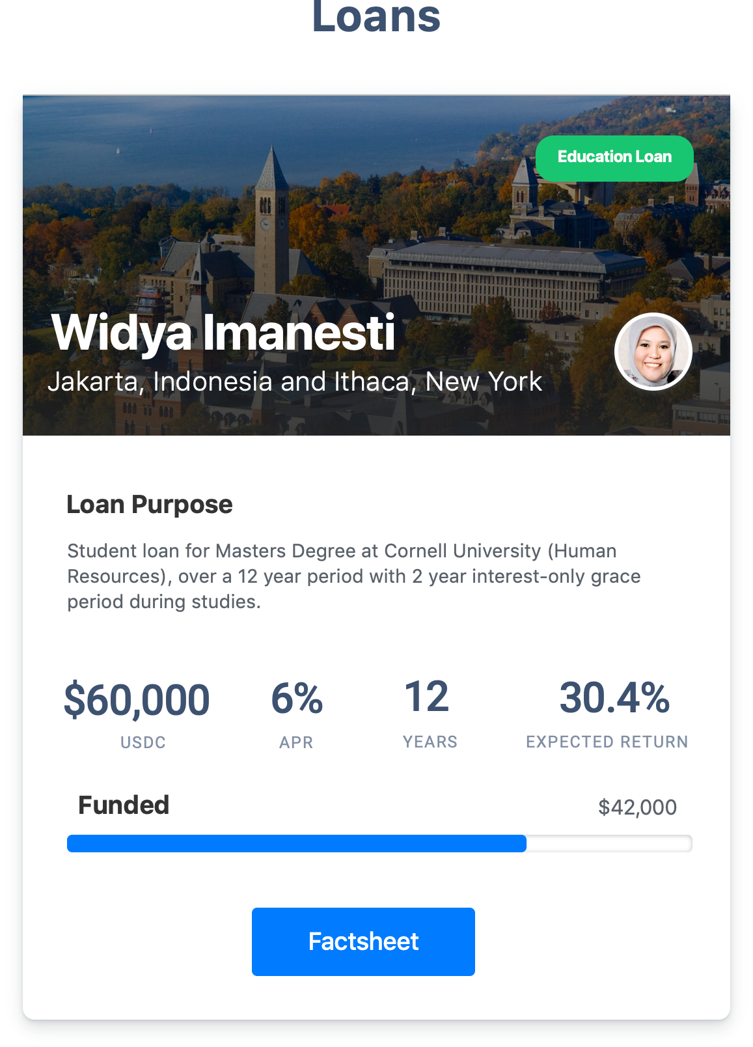
Stablecoin Loans
Near-$0 money movement across borders from wallet to wallet
Borderless Credit Marketplace
Anyone around the world with USDC can fund a loan

Slide 12
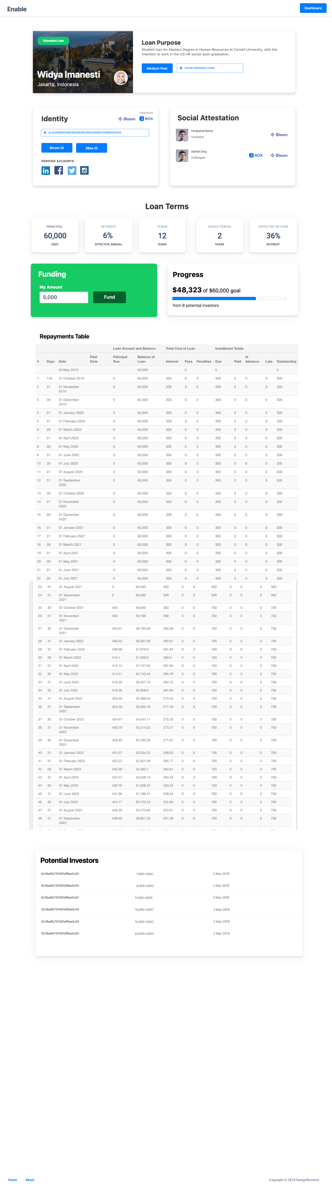

Identity-as-collateral
Real-world identity allows unsecured lending with globally verified identity as collateral
Social Attestation
Develop a richer credit profile by other verified profiles attesting for the borrower

Slide 13
ERC-20 Crowdfunding and Fractional Ownership
Innovative crowdsourcing models that allow for the issuance of verifiable ERC-20 debt tokens that are potentially tradeable for early liquidity
Automated Flow of Funds through Smart Contracts
Automated tracking of debt terms, repayment payments, and handling of flow-of-funds
Configurable Loan Contract
Flexible loan contracts with configurable terms (e.g. grace periods on interest and principal, variable tenor, Principal-Interest-Fees-Penalties breakdown

Slide 14
How it works

Slide 15



Funding flow
Creates Debt Contract
ERC-20 Contract
Contribution
Fractional Ownership Debt Token
Returns Debt Token
Lender
Disburses money to borrower
Borrower
Loan Contract

Slide 16
Repayment Flow
ERC-20 Contract
Receive fractional share of repayment
Repayment routed to debt token holders
Monthly Repayment
Lender
Borrower
Loan Contract

Slide 17
Implementation

Slide 18
Decentralized Identity
Problem:
Solution
Trusted Decentralized Identity
Oracle problem – how do you get, verify and validate a user’s identity and tie it to an on-chain entity (e.g. address)?
With Bloom as a base, leverage additional ID attestation from other providers
Decentralized + Private Data Storage
How do you verify data about users on chain, while still preserving data privacy?

Slide 19



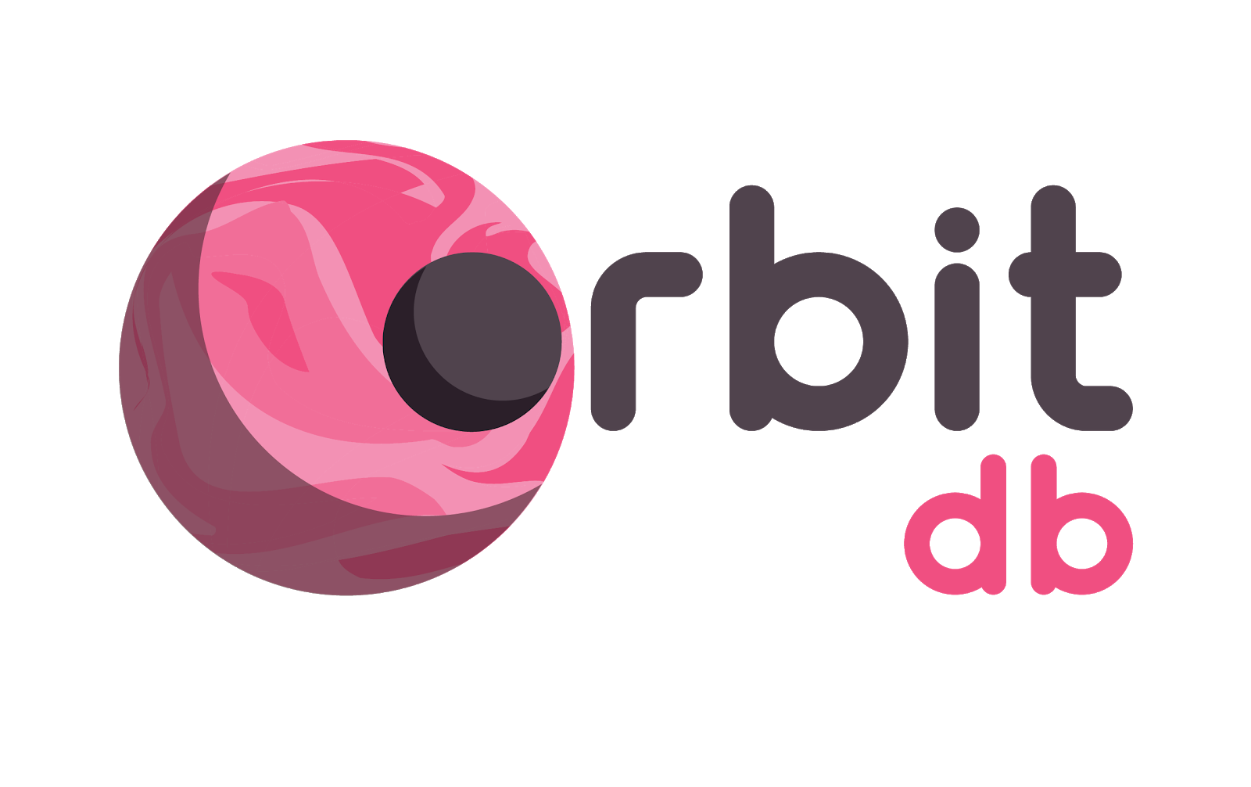

Decentralized Identity
Problem:
Solution
Trusted Decentralized Identity
Oracle problem – how do you get, verify and validate a user’s identity and tie it to an on-chain entity (e.g. address)?
<<Edit here>>
Decentralized + Private Data Storage
How do you verify data about users on chain, while still preserving data privacy?

Slide 20
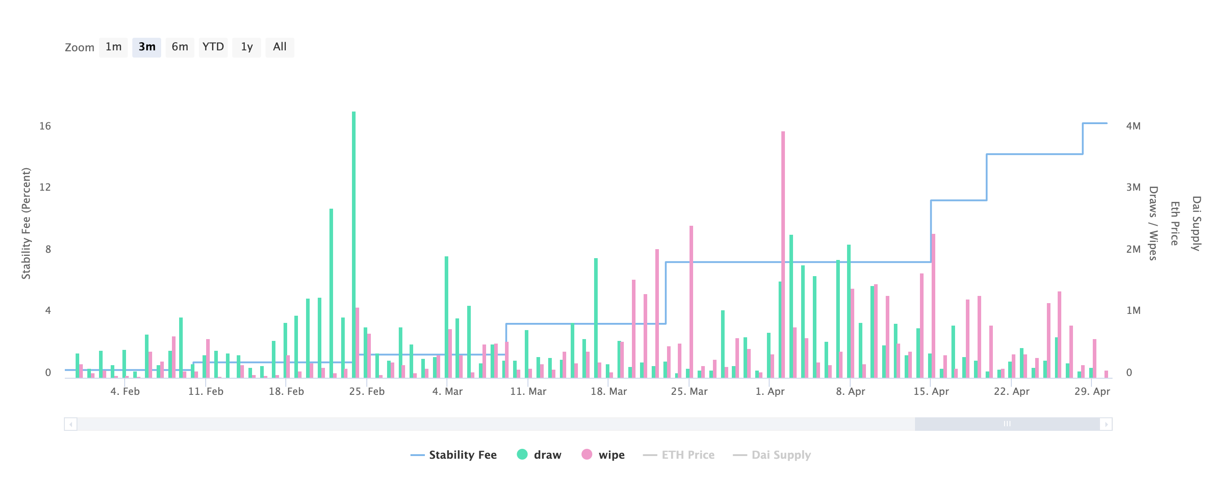

Stablecoin Interest Rates
Problem:
Solution
Stablecoin Interest Rates
With the Dai stability fees causing interest rates to rise to 14.5%, how can we issue low-interest loans using Stablecoins?
Fiat-collateralized stablecoins are unaffected by MKR stability fees and provide more predictability over 10-year term
14.5%

Slide 21
Decentralized Identity
Stablecoin Interest Rates
With the Dai stability fees causing interest rates to rise to 14.5%, how can we issue low-interest loans using Stablecoins?
Trusted Decentralized Identity
Oracle problem – how do you get, verify and validate a user’s identity and tie it to an on-chain entity (e.g. address)?
Decentralized + Private Data Storage
How do you verify data about users on chain, while still preserving data privacy?
Managing Fractional Ownership & Crowdfunding
A crowdfunded loan requires a lot of flow-of-funds operation to keep track of fractional ownership of loan, route repayments correctly to fractional share owners, and track debt obligations to each owner
UX & Blockchain
How do we minimize friction and required awareness of blockchain aspects (e.g. meta transactions?)

Slide 22
Technical Challenges
Managing Fractional Ownership & Crowdfunding
A crowdfunded loan requires a lot of flow-of-funds operation to keep track of fractional ownership of loan, route repayments correctly to fractional share owners, and track debt obligations to each owner
UX & Blockchain
How do we minimize friction and required awareness of blockchain aspects (e.g. meta transactions?)

Slide 23
Solution

Slide 24
“Credit is fundamentally broken when crossing borders” Cameron Stevens Founder, Prodigy Finance
Global credit history and identity-as-collateral
Free (i.e. $0) money movement and servicing

Slide 25
“Credit is fundamentally broken when crossing borders” Cameron Stevens Founder, Prodigy Finance
Identity (if it can be verified) can be used globally
Unsecured cross-border loans can use identity as collateral
Global credit history and identity-as-collateral
Identity can be innovated on: pooled identity for group credit, socially attested loans etc
Free (i.e. $0) money movement and servicing

Slide 26
“Credit is fundamentally broken when crossing borders” Cameron Stevens Founder, Prodigy Finance
Identity (if it can be verified) can be used globally
Unsecured cross-border loans can use identity as collateral
Global Credit Reputation “identity-as-collateral”
Reduce servicing fees to near 0% on origination and repayments
Identity can be innovated on: pooled identity for group credit, socially attested loans etc
Free (i.e. $0) money movement and servicing
Free ($0) movement of money across borders
Automatic tracking of repayments and flow-of-funds handling

