Slide 1
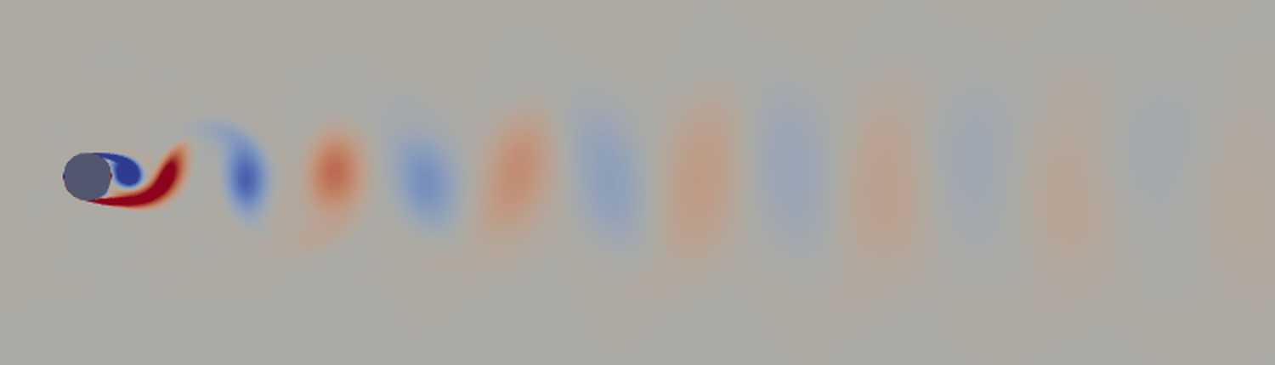
A COMPUTER EXPERIMENT
When wind meets a pole
What happens when air flows past a round object, and how we know the computer's answer can be trusted
Notes:
This is a short, non-technical tour of a simulation project. The picture is a real result: air flowing from left to right past a round pole, seen from above. The red and blue blobs are swirls of air spinning in opposite directions.

Slide 2



Why wind around round things matters
It pushes
It shakes
It can resonate
Wind pushes a pole, chimney or cable backwards. Engineers need that force to make it strong enough.
Swirls of air break off on alternate sides and tug the object sideways, back and forth, at a steady rhythm.
If that rhythm matches the structure's own natural swing, small tugs add up to large vibrations.
Notes:
Round shapes are everywhere: lamp posts, chimneys, bridge cables, offshore pipes. Wind does two things to them. It pushes them backwards, and it sheds swirls that shake them side to side. The second one is the sneaky one: a steady rhythm of small pushes, like pushing a child on a swing at the right moment, can build up large vibrations.

Slide 3
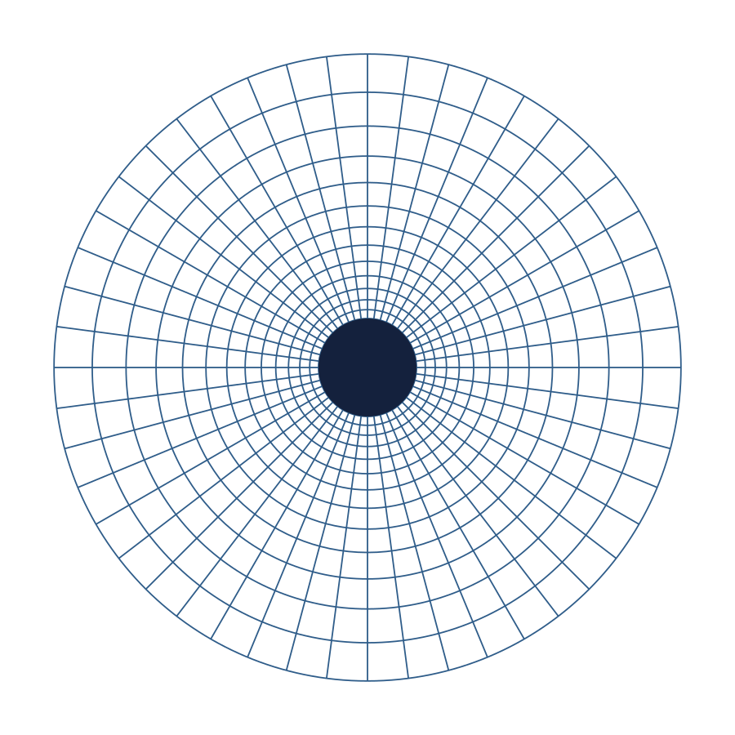
The experiment, inside a computer
A round pole 10 cm wide, in a steady breeze of 10 m/s (36 km/h)
The air around it is cut into up to 38,000 small cells
In every cell, the laws of air motion are solved, 20,000 times for every second of flow
Free, open-source software: OpenFOAM, on a laptop
Simplified sketch of the grid
Notes:
A computer cannot solve air flow everywhere at once, so it divides the space around the pole into many small cells and solves the equations of air motion cell by cell, in tiny time steps. The sketch shows the idea: cells are thinnest right against the pole, where the air changes fastest, and grow larger farther away. (The real grid is rectangular farther out; this is a simplified drawing.)

Slide 4
What the computer showed: a trail of swirls
Red swirls spin one way, blue the other.
They break off top, then bottom, about 25 times a second.
Notes:
This pattern is famous enough to have a name: a von Karman vortex street. You can see it in clouds behind islands, and feel it when a flag flaps. Each swirl that breaks off gives the pole a small sideways tug, first one way, then the other. In this case that happens about 25 times every second.

Slide 5

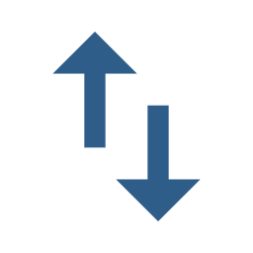
What the wind does to every metre of pole
Push backwards
Tug sideways
6 N
± 6.6 N
steady, about the weight of a 600 g bag of sugar hanging from each metre
changing direction 25 times a second, as each swirl breaks off
For a 10 cm pole in a 10 m/s breeze. N = newton, the unit of force.
Notes:
Here are the results in everyday units. The steady push is about 6 newtons on every metre of pole, roughly the weight of a 600 gram bag of sugar. The sideways tug is about as strong, but it flips direction 25 times a second. For a tall, thin structure, that rhythm matters more than the strength.

Slide 6
Can we trust the computer? Ask it three times
The same flow, solved on a coarse, a medium and a fine grid. If the answers stop changing as the cells shrink, the cells are small enough.
Grid | Cells | Swirls per second | Push (N per m)
Coarse | 7,578 | 23.9 | 6.26
Medium | 17,092 | 24.7 | 6.15
Fine | 38,418 | 25.1 | 6.12
Medium to fine: every answer moved by less than 2 %. The same test with three time-step sizes agreed too.
Notes:
This is the heart of the project. A computer answer depends on how finely you chop up the space. So the whole simulation was run three times, each time with smaller cells. The answers moved a little from coarse to medium, and much less from medium to fine: they are settling down. The same check was done for the size of the time steps. This checking step is called verification.

Slide 7
THE VERDICT
The computer's own error is small, and we know how small
± 0.4 %
± 1.6 %
on the push
on the swirl rhythm
Notes:
Combining the grid test and the time-step test gives an error band for each answer. For the push it is less than half a percent; for the rhythm of the swirls, under two percent. That does not yet mean the answer matches reality; it means the computer solved its equations accurately. Whether those equations describe real air well enough is the next question.

Slide 8


Accurate is not the same as true
Done: verification
Next: validation
Known simplifications
The computer solves its equations correctly, with a known, small error.
Compare with wind-tunnel measurements to see if the equations describe real air.
A flat slice instead of a full 3-D pole, and an approximate model of turbulence.
Notes:
It is important to be honest about what this shows. Verification means the computer solved its equations correctly. Validation means checking those equations against the real world, with measurements from wind tunnels. That comparison is the next step. The simulation also makes simplifications: it models a thin slice of the pole rather than the whole thing, and it approximates the small-scale turbulence. Those are expected to make the forces somewhat too large, and the comparison will tell by how much.

Slide 9


What it is for
Safer structures. Engineers use numbers like these to size poles, chimneys and cables, and to keep their natural sway away from the rhythm of the swirls.
A habit worth having. Any simulation, of weather, cars or traffic, should be checked like this before its answer is trusted.
Check the computer first; then check it against reality.
Notes:
Two takeaways. First, the practical one: engineers need these forces and this rhythm to design structures that stand up to wind and do not start vibrating. Second, the general one: a computer simulation is only as good as the checks behind it. Ask the same question with finer and finer detail until the answer stops changing, and then compare it with real measurements.

