Slide 1


Tactile-Feedback Teleoperation: Grip Force and Grasping Performance Across Haptic Actuator Types for Fragile and Deformable Objects
Presenter: Adriel Imaran Santoso (B4) Academic Advisor: Professor Koichi Hashimoto Intelligent Control Systems Laboratory, Graduate School of Information Sciences, Tohoku University July 25th, 2026
Notes:
Good afternoon. I am Adriel Santoso, from the Intelligent Control Systems Lab.
My graduation study asks a simple question: if you are driving a robot hand from a distance, does giving your own fingers a sense of touch make you better at picking up fragile things, and does it matter which kind of buzzer you use?

Slide 2
Contents
Introduction & Background
3
System
6
Method
10
Results
12
Discussion
15
Conclusion
16
Notes:
Here is where we are going: the problem, the system, how the experiment was run, what came out of it, and what it does and does not prove.

Slide 3
Introduction: the words in the title
Teleoperation: driving a machine from somewhere else
Tactile: to do with touch, physical contact
Tactile-feedback teleoperation
Haptic: a sensation delivered back to your skin
Sensor: turns contact into a number
Actuator: turns a number into something you feel
Notes:
Let me start with why this is hard.
Before anything else, the five words in my title, because most of you are not from robotics.
Teleoperation is driving a machine from somewhere else: a surgeon at a console, a technician outside a glovebox. Tactile means touch: information that only exists at the moment of physical contact. Haptic is the return trip: a sensation delivered back to your own skin.
A sensor turns contact into a number; an actuator turns a number back into something you can feel. This study puts a sensor on the robot's fingers and an actuator on yours, and asks whether closing that loop changes how you grasp.

Slide 4
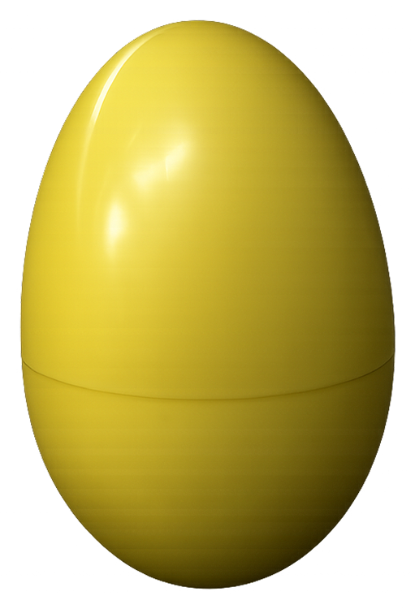
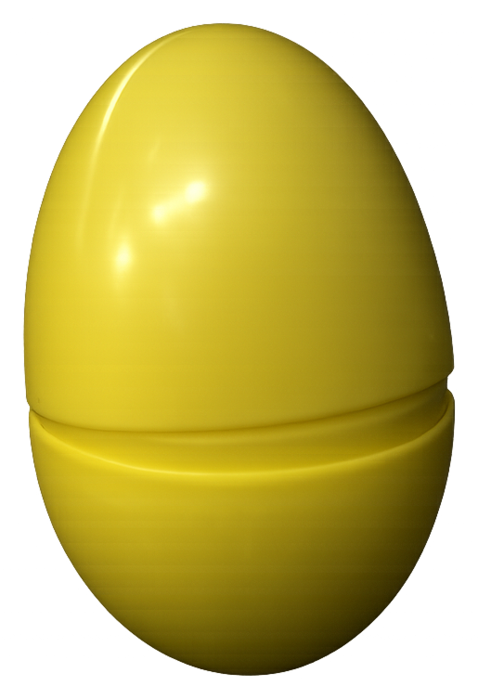
Teleoperation has no sense of touch
Your skin reports squeeze force in milliseconds, so you stop in time.
A remote operator has only video, and must guess the grip force.
Too little and the object slips; too much and it breaks.
IMAGE PLACEHOLDER
PHOTO: the operator's console, screen and hand only
The fragile object: a hollow shell
The same shell, broken at the seam
What the operator actually works from
Notes:
Think about picking up an egg. You do not calculate anything: receptors in your skin report how hard you are squeezing within milliseconds, and you stop short of cracking the shell.
Now take that away. In teleoperation you see the object but feel nothing, so grip force has to be inferred from how it looks. That works right up until the object does not visibly change before it fails. Too little force and it slips; too much and you get the picture on the right.
And the gripper cannot rescue you. The Robotiq 2F-85 estimates force from one aggregate motor current, with no contact distribution at all, and on my unit that register reads zero milliamps regardless of contact.

Slide 5
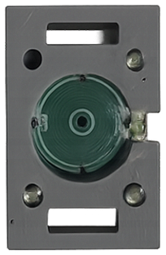
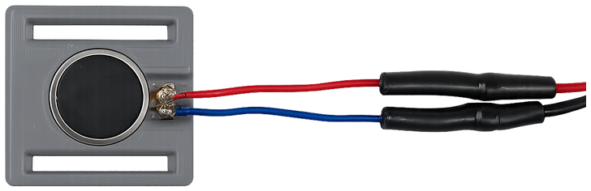
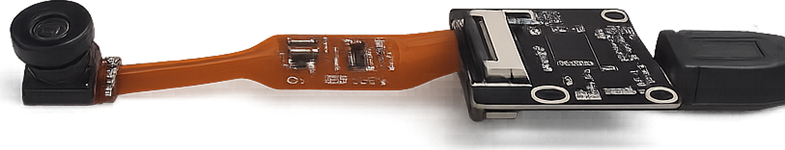
Two questions, one fixed pipeline
Does touch feedback change how people grasp fragile objects?
And does it matter which actuator delivers that touch?
Vision only
LRA
EM
baseline: the screen and nothing else
vibration motor at the finger joints
magnetic pin tapping the fingertip
Notes:
So the study asks two questions.
First: does touch feedback change how people grasp fragile and deformable objects, compared with vision alone?
Second, and this is asked less often: does the actuator type matter? Most published work picks one haptic device and compares it against a no-feedback baseline. Here the whole sensing and control pipeline is held fixed, and the only thing that changes is the hardware on the skin: a vibration motor at the finger joints, or an electromagnetic pin at the fingertip. Three conditions: vision only, LRA, EM.

Slide 6
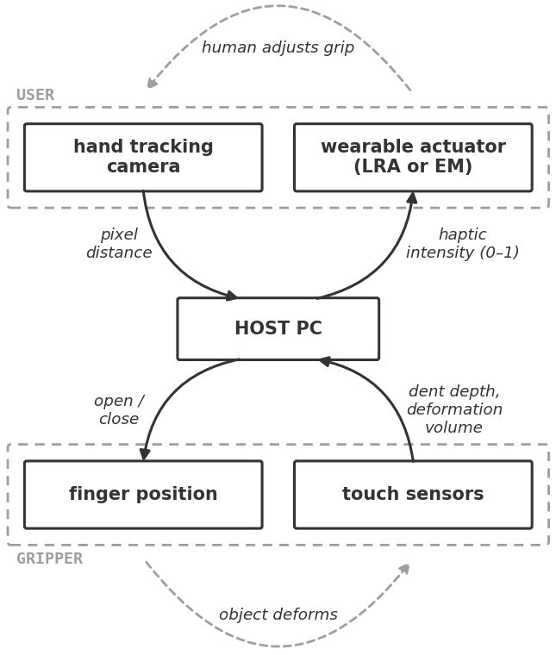
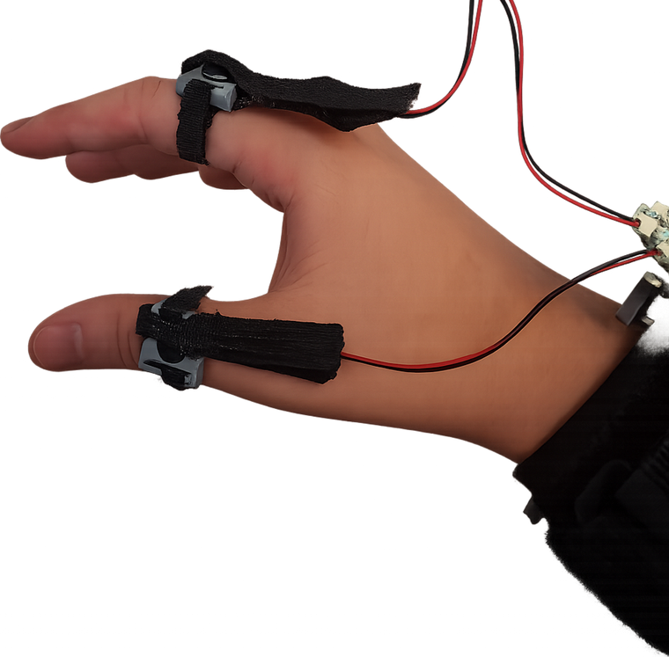
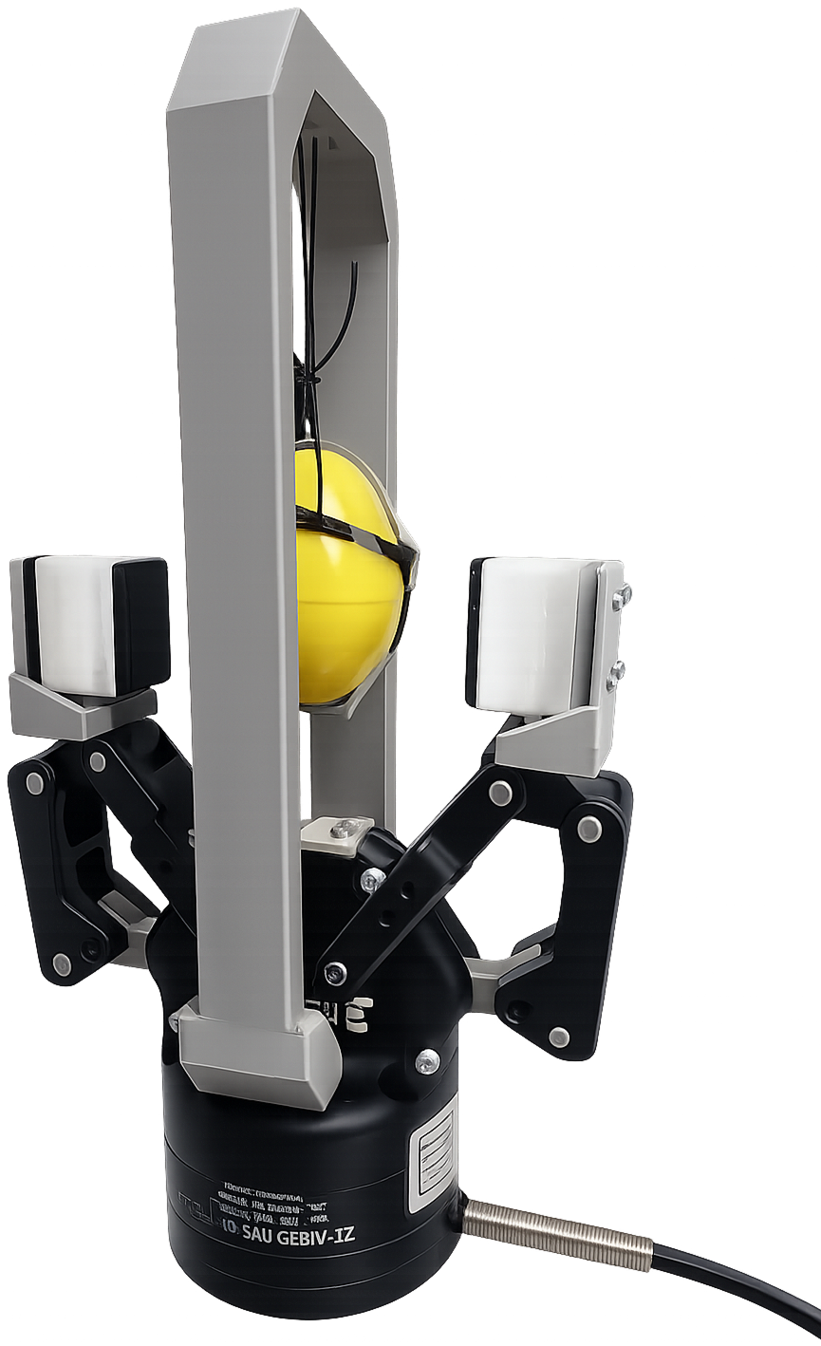
System: one closed loop, human included
A camera reads the operator's pinch; the gripper mirrors it at 25 Hz.
The gel sensors send depth back at 15 Hz, and the person eases off.
The loop, as a diagram
Operator side: actuators on the hand
Robot side: gripper and gel sensors
Notes:
Here is the system. One closed loop, with a human inside it.
Going down: a camera watches the operator's hand, MediaPipe gives me the pinch distance in pixels, and that maps to a gripper opening sent over Modbus at 25 hertz. The gripper mirrors your pinch. There is no joystick.
Coming back up: each jaw carries a soft tactile sensor. Fifteen times a second I read how deeply the gel is dented, turn it into one number between zero and one, and stream it to the wrist.
The loop closes through the person, and there is no force controller anywhere in it. Two guards: closing stops at one millimetre of indentation, and the actuators cut out after 200 milliseconds of silence.

Slide 7
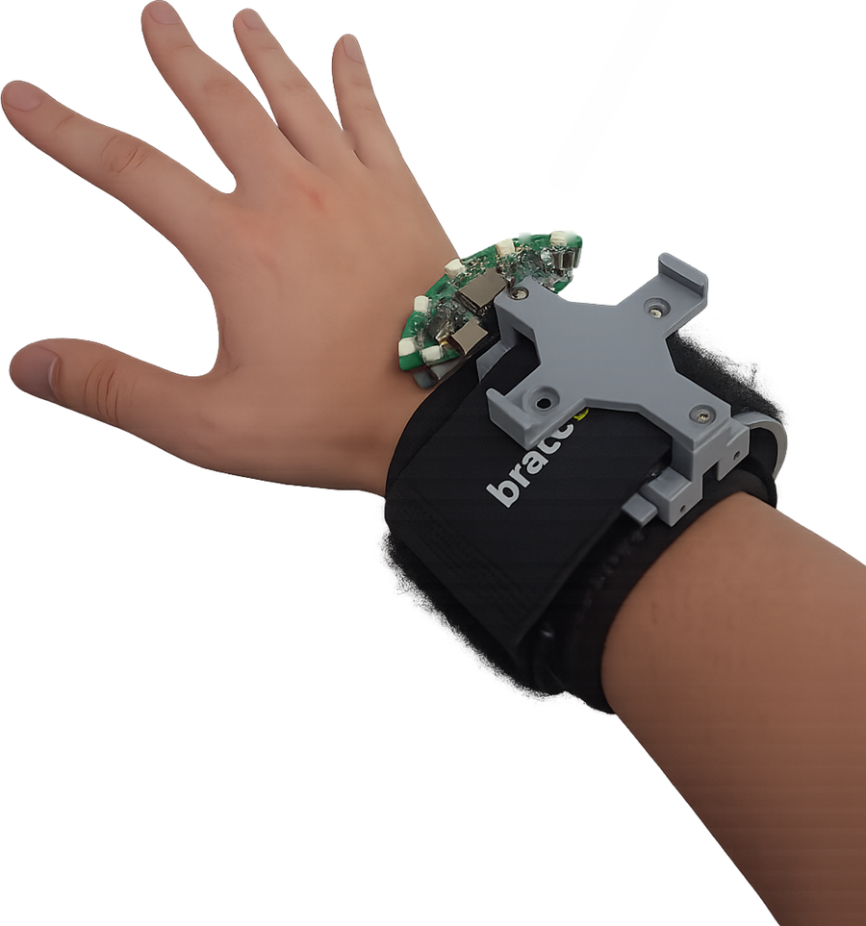
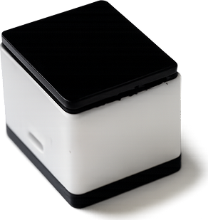
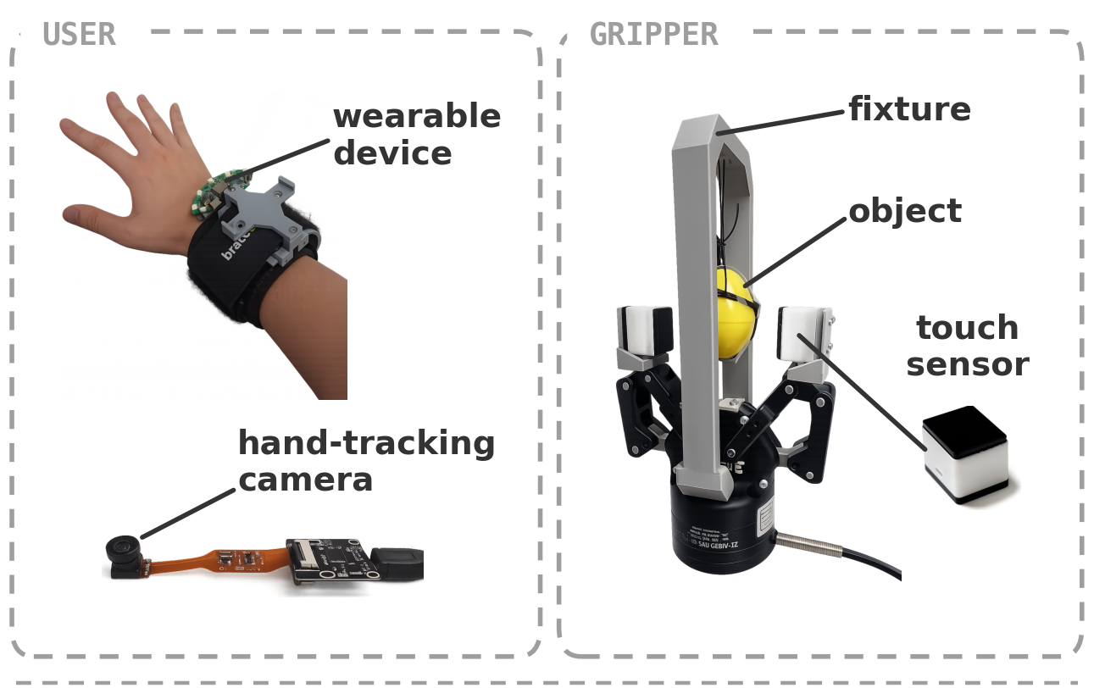
The apparatus
The operator wears the driver board and is tracked by a USB camera.
The robot is a Robotiq 2F-85 with a 9DTact gel sensor on each jaw.
Wearable: ESP32-C6, five actuator channels
The full bench, as run
One gel sensor, about a sugar cube
Notes:
The hardware. The operator wears a wrist unit carrying the driver board and five independent actuator channels, and a plain USB camera does the hand tracking, which is two-dimensional and uncalibrated.
On the robot side: the Robotiq 2F-85 gripper with a plastic egg in the fixture, and a 9DTact vision-based tactile sensor on each jaw, about the size of a sugar cube.

Slide 8
From gel dent to felt intensity
A camera behind the gel rebuilds its surface every frame.
Subtracting the untouched baseline leaves the deformation.
Its sum is the force proxy; its depth is what the operator feels.
IMAGE PLACEHOLDER
PHOTO: raw gel image under the sensor's illumination
IMAGE PLACEHOLDER
RENDER: reconstructed height map h(x, y)
IMAGE PLACEHOLDER
RENDER: deformation field d = h − h₀, contact masked
Camera image of the gel
Height map
Deformation field
Notes:
This is where the engineering actually lives: turning a squishy gel into a number.
The sensor is a camera looking at the back of a soft gel pad. Every frame it reconstructs a height map; subtract the map recorded with nothing touching it and you have the deformation field. Two quantities come out of that one field.
The first is the summed deformation over every pixel in contact. That is my grip-force proxy: monotonic in normal force, but uncalibrated, so I report arbitrary units rather than newtons.
The second is the 99th-percentile depth, and that is what the operator feels: divide by a saturation depth, clip to zero-to-one. Two millimetres for the egg, six tenths for foam, which barely dents the gel.

Slide 9
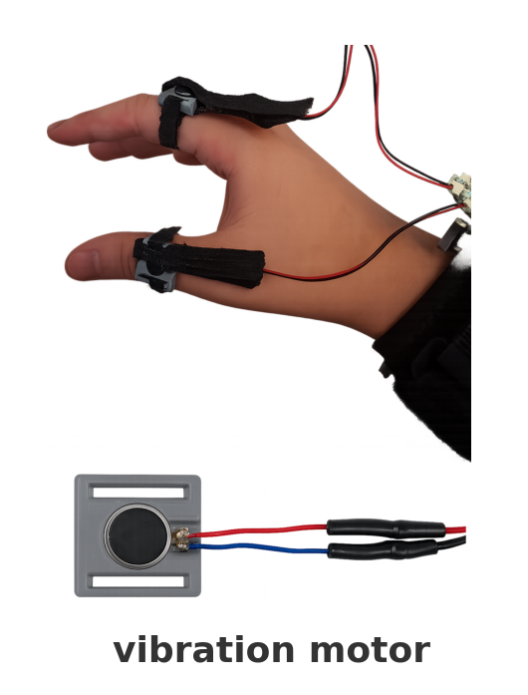
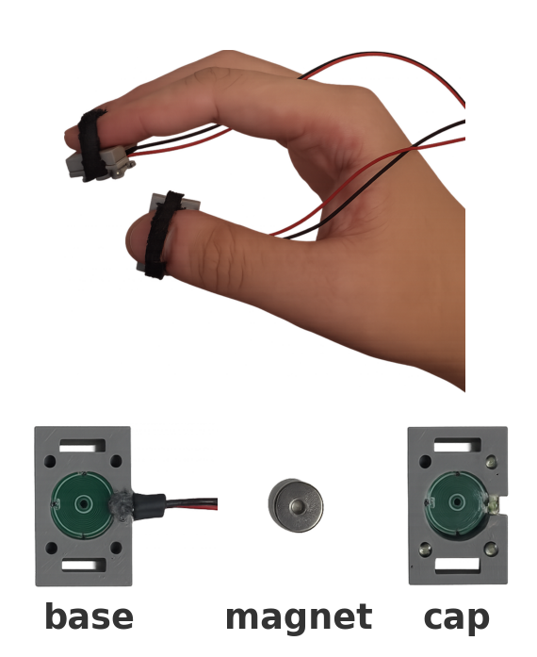
Two ways to render that number
The LRA buzzes at the finger joints; the EM taps the fingertip.
They differ in technology and in placement, so remember that.
LRA
EM
linear resonant actuator, proximal joints
bistable magnetic pin, fingertips
Notes:
Two actuators render that number.
The LRA is a linear resonant actuator, the vibration motor in your phone. A bipolar carrier at 200 hertz, with intensity setting the envelope, so it buzzes harder as you squeeze. It sits on the proximal joints and draws power throughout.
The EM is a bistable pin on an H-bridge. A four-millisecond pulse throws the pin into the skin and it latches, so it holds at zero power; intensity sets the gap between bursts. It sits on the fingertips.
Note what I just said: the two conditions differ in technology and in placement. Hold on to that, because it comes back in the discussion.

Slide 10
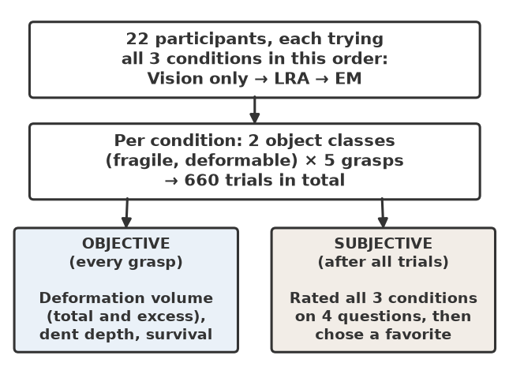
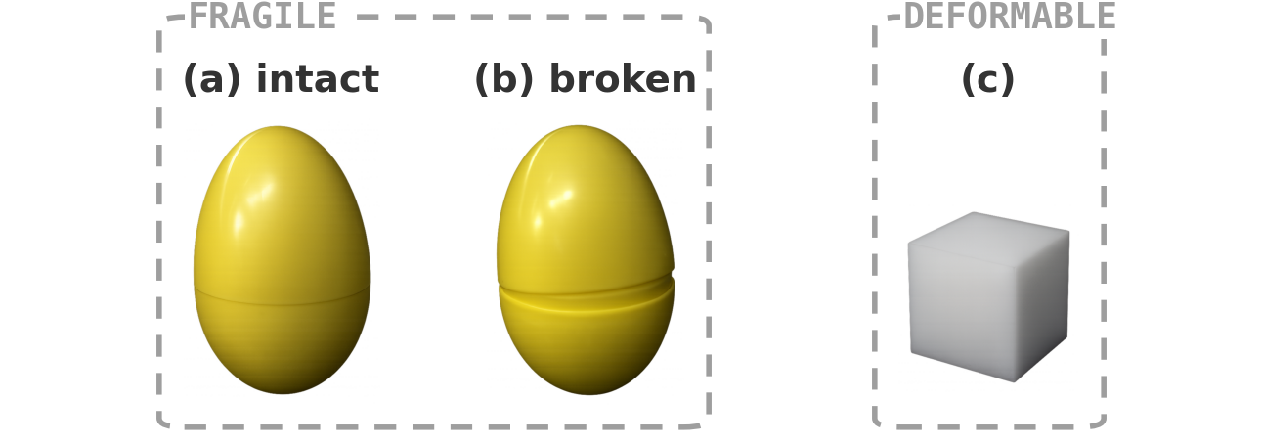
Method: how the study ran
Everyone ran all three conditions, in the fixed order vision → LRA → EM.
660 trials: 5 grasps × 2 objects × 3 conditions × 22 people.
Then they rated each condition and picked a favourite.
Session flow and condition order
Fragile: a shell that pops apart. Deformable: foam that never breaks.
Notes:
The experiment.
Twenty-two participants, each doing all three conditions in the fixed order: vision only, then LRA, then EM. Two object classes, five grasps each, so 660 trials in total.
Fragile is a hollow plastic egg that pops apart at the seam: it fails suddenly, like the real thing, but I can reassemble it. Deformable is a foam cube, which yields gradually and never breaks. Afterwards each participant rated the three conditions on four items and picked a favourite.

Slide 11
What was measured
Four measures per trial, all of them rank-tested.
Peak deformation: the hardest squeeze
IMAGE PLACEHOLDER
PLOT: one force trace, with the plateau and the post-plateau reversals marked
Excess deformation: force you cannot feel
Grip adjustments: reversals after that plateau
Survival: did the object come out intact
Where the metrics come from
Notes:
Four objective measures. Peak deformation is how hard they squeezed at the worst moment.
Excess deformation is the interesting one. Once the gel is fully dented the depth signal plateaus, and squeezing harder past that point changes nothing the operator can feel. That wasted, potentially destructive effort is what this measures.
Grip adjustments counts force reversals after the plateau: somebody hunting for a grip instead of holding steady. And survival: did the egg come out intact.
Friedman across the three conditions, then Wilcoxon with Holm correction. Medians, not means, because one crushed egg should not move the average.

Slide 12
Results: fragile objects
Median participant, three conditions; on the first three rows, lower is better.
Median per participant | Vision | LRA | EM
Peak deformation volume (a.u.) | 20100 | 12300 | 16000
Excess deformation (a.u.) | 1530 | 170 | 260
Grip adjustments (#) | 7 | 5 | 2
Objects surviving (%) | 62 | 81 | 78
Excess deformation vision→LRA p = 0.019 · grip adjustments vision→EM p = 0.021 · survival Friedman p = 0.004
Notes:
Results. Fragile objects, median participant, and for the first three rows lower is better.
Excess deformation, the wasted squeezing, falls from about 1530 units to 170 with the LRA, roughly ninefold, at p equals 0.019. Grip adjustments drop from seven to two with the EM, p equals 0.021. The two actuators help in different ways: the LRA stops you squeezing, the EM stops you fidgeting.
And the outcome people care about: survival rises from 62 percent to 81 with the LRA and 78 with the EM, Friedman p equals 0.004, both beating the baseline after correction. LRA versus EM is 0.69.
Do not read the table aloud. Point at three numbers: 1530 to 170, 7 to 2, 62 to 81.

Slide 13
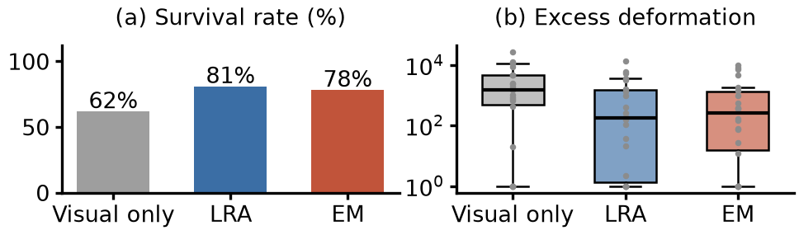
The same result, spread out
Both actuators cut the wasted squeezing, and the LRA cuts it hardest.
Two honest negatives: the safety cutoff caps peak depth, and foam moved on nothing.
Per-condition distributions on the fragile object
Notes:
The same result as distributions rather than medians.
Two honest negatives live here. Peak dent depth barely moves, because my one-millimetre safety cutoff caps it before the conditions can differ. And deformable objects showed no reliable change on anything, because foam gives you no sharp failure to avoid, so there is nothing for the feedback to buy you.

Slide 14
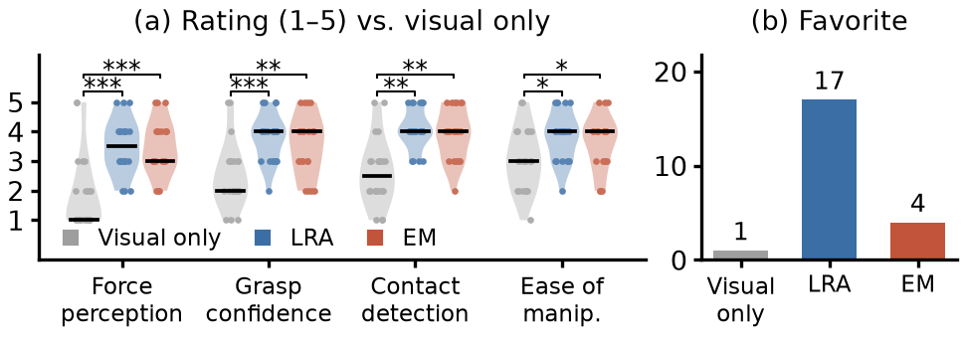
What the participants said
Both haptic conditions beat vision alone on every item (p < 0.001).
No item separated the two, yet 17 of 22 picked the LRA.
Likert ratings by condition, and the forced-choice preference
Notes:
Subjectively it is not close. On force perception, grasp confidence and contact detection, both haptic conditions beat vision only at p below 0.001, surviving Holm correction.
But no single question separated the LRA from the EM: every pairwise comparison between them sits above 0.2. And yet, asked to pick a favourite, 17 of 22 chose the LRA, 4 the EM and 1 vision only. People had a clear preference they could not articulate on any of my rating items.

Slide 15
Discussion: claims and confounds
One column I will defend; the other I will not, at least not yet.
Supported
Unfelt squeezing falls ninefold.
Survival rises 62% → 80%.
Operators notice it and want it.
Not yet supported
That the LRA is truly the better one.
That any of it holds for foam.
That the fixed order did not matter.
Notes:
So what does this mean. What I am comfortable claiming: tactile feedback reduces the squeezing the operator cannot feel, reduces regrip hunting, and raises survival on fragile objects.
What I am not comfortable claiming is that the LRA is the better actuator. Technology and placement are bundled: I never tested a fingertip LRA or a joint-mounted EM. The fingertip EM also sits on the landmarks the hand tracker uses, so the preference may be smoother control rather than better sensation. And the condition order was fixed, so practice and fatigue are inseparable from condition.
On measurement: force is in arbitrary units, and latency still needs a bench measurement. Every test here is rank-based, so a scaling error cannot move a p-value.
Expect questions on the uncalibrated force and the fixed order. Answer them from this slide.

Slide 16
Conclusion: takeaways
62% → 80%
Fragile objects survived remote grasping far more often with touch feedback.
21 of 22
Participants preferred a haptic condition over vision alone.
Still open
Which actuator is better: placement has to be separated from technology.
Notes:
To close. Three things.
Touch feedback made remote grasping of fragile objects measurably safer: about nine times less unfelt squeezing, and survival up from 62 to around 80 percent.
It is what operators want: 21 of 22 preferred a haptic condition over vision alone.
And which actuator is better is still open; answering it needs a study that separates technology from placement.

Slide 17
Where this goes next
Anywhere a person drives a gripper they cannot feel, this failure is waiting.
None of these need a new robot, only a better signal on the skin.
IMAGE PLACEHOLDER
PHOTO: surgeon at a teleoperated console
IMAGE PLACEHOLDER
PHOTO: remote manipulator handling sealed samples
IMAGE PLACEHOLDER
PHOTO: field or space manipulator on a fragile payload
Keyhole surgery
Glovebox and hot-cell work
Disaster and orbital servicing
Notes:
Where this goes next.
The setup is a laboratory one, but the problem is not. Anywhere a person drives a gripper they cannot feel, and the payload is fragile, the same failure is waiting: keyhole surgery, glovebox and hot-cell handling, disaster response, orbital servicing. None of those need a new robot. They need a better signal on the skin.
My own next steps are three: spatial feedback instead of one number per finger, force calibrated into newtons so the numbers transfer between rigs, and the crossed study that separates actuator technology from where it sits on the hand.
Thank you, and happy to take questions.

