Slide 1


Tactile-Feedback Teleoperation: Grip Force and Grasping Performance Across Haptic Actuator Types for Fragile and Deformable Objects
Presenter: Adriel Imaran Santoso (B4) Academic Advisor: Professor Koichi Hashimoto Intelligent Control Systems Laboratory, Graduate School of Information Sciences, Tohoku University July 25th, 2026
Notes:
Good afternoon. I am Adriel Santoso, from the Intelligent Control Systems Lab.
My graduation study asks a simple question: if you are driving a robot hand from a distance, does giving your own fingers a sense of touch make you better at picking up fragile things — and does it matter which kind of buzzer you use?

Slide 2
Contents
Introduction & Background
3
System
6
Method
11
Results
14
Discussion
17
Conclusion
19
Notes:
Here is where we are going: the problem, the system, how the experiment was run, what came out of it, and what it does and does not prove.

Slide 3
Introduction & Background
01
Why a remote hand is still clumsy with an egg
Notes:
Let me start with why this is hard.

Slide 4
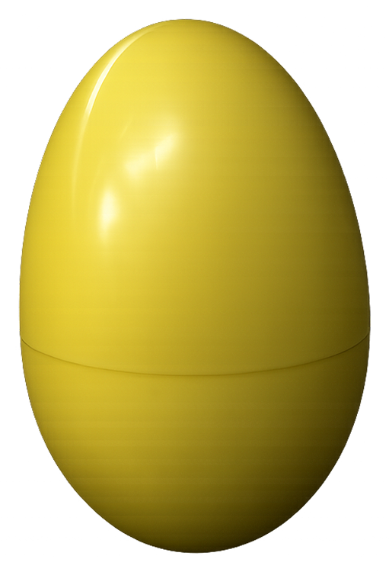
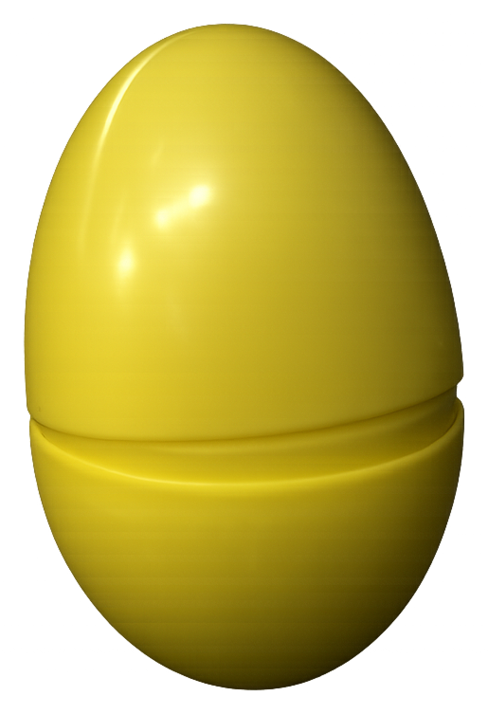
Teleoperation has no sense of touch
Your hand already solves this. Skin receptors report squeeze force in milliseconds, so you stop short of cracking the shell.
A remote operator only has video. Grip force has to be inferred from how the object looks — which fails for objects that do not visibly change before they break.
Both errors are expensive. Too little force and the object slips; too much and it is destroyed.
The gripper cannot help. The Robotiq 2F-85 estimates force from one aggregate motor current — no contact distribution — and its current register reads 0 mA regardless of contact.
intact
broken at the seam
The fragile test object: a hollow shell that fails suddenly
Notes:
Think about picking up an egg. You do not calculate anything: receptors in your skin report how hard you are squeezing within milliseconds, and you stop short of cracking the shell.
Now take that away. In teleoperation — a surgeon at a console, a technician in a glovebox — you see the object but feel nothing, so grip force has to be inferred from how it looks. That works right up until the object does not visibly change before it fails. Too little force and it slips; too much and you get the picture on the right.
And the gripper cannot rescue you. The Robotiq 2F-85 estimates force from one aggregate motor current — no contact distribution at all — and on my unit that register reads zero milliamps regardless of contact.

Slide 5
Two questions, one fixed pipeline
Q1 Does touch feedback help?
Compared with vision alone, does haptic feedback change how people grasp fragile and deformable objects?
Q2 Does the actuator type matter?
With the whole sensing and control pipeline held fixed, does it matter which hardware delivers the sensation?
Vision only
baseline — screen and nothing else
LRA
vibration motor at the finger joints
EM
magnetic pin tapping the fingertip
Most prior work evaluates a single actuator against a no-feedback baseline; here only the hardware on the skin changes.
Notes:
So the study asks two questions.
First: does touch feedback change how people grasp fragile and deformable objects, compared with vision alone?
Second, and this is asked less often: does the actuator type matter? Most published work picks one haptic device and compares it against a no-feedback baseline. Here the whole sensing and control pipeline is held fixed, and the only thing that changes is the hardware on the skin — a vibration motor at the finger joints, or an electromagnetic pin at the fingertip.

Slide 6
System
02
Gel deformation in, skin sensation out
Notes:
Here is the system.

Slide 7
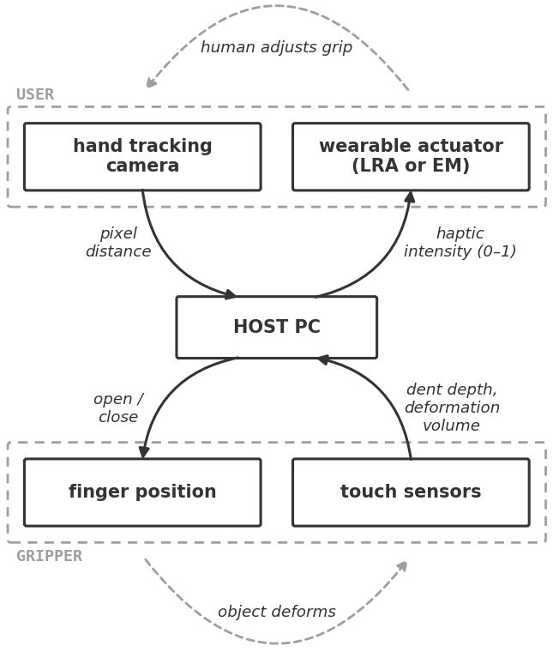
One closed loop, with a human inside it
Hand → gripper. A USB camera plus MediaPipe HandLandmarker measures the thumb–index pinch distance in pixels and maps it to a Robotiq position over Modbus RTU (115200 baud) at 25 Hz.
Gripper → hand. Each jaw's gel sensor is read at 15 Hz; dent depth is rescaled to a 0–1 intensity and streamed to a wrist-mounted ESP32-C6.
The human closes it. They feel the intensity rise and ease off — no force controller in the loop.
Two guards. Further closing is blocked once either sensor reads 1.0 mm of indentation; the actuators cut out if no packet arrives for 200 ms.
Notes:
It is one closed loop with a human inside it.
Going down: a camera watches the operator's hand, MediaPipe gives me the pixel distance between thumb tip and index tip, and that maps to a gripper opening sent over Modbus at 25 hertz. The gripper mirrors your pinch — there is no joystick.
Coming back up: each jaw carries a soft tactile sensor. Fifteen times a second I read how deeply the gel is dented, turn it into one number between zero and one, and stream it to an ESP32 on the wrist.
The loop closes through the person: they feel the intensity rise and ease off.
Two guards. Closing is blocked once either sensor reads one millimetre of indentation, which protects the sensor mount; and the actuators cut out if no packet arrives for 200 milliseconds.

Slide 8
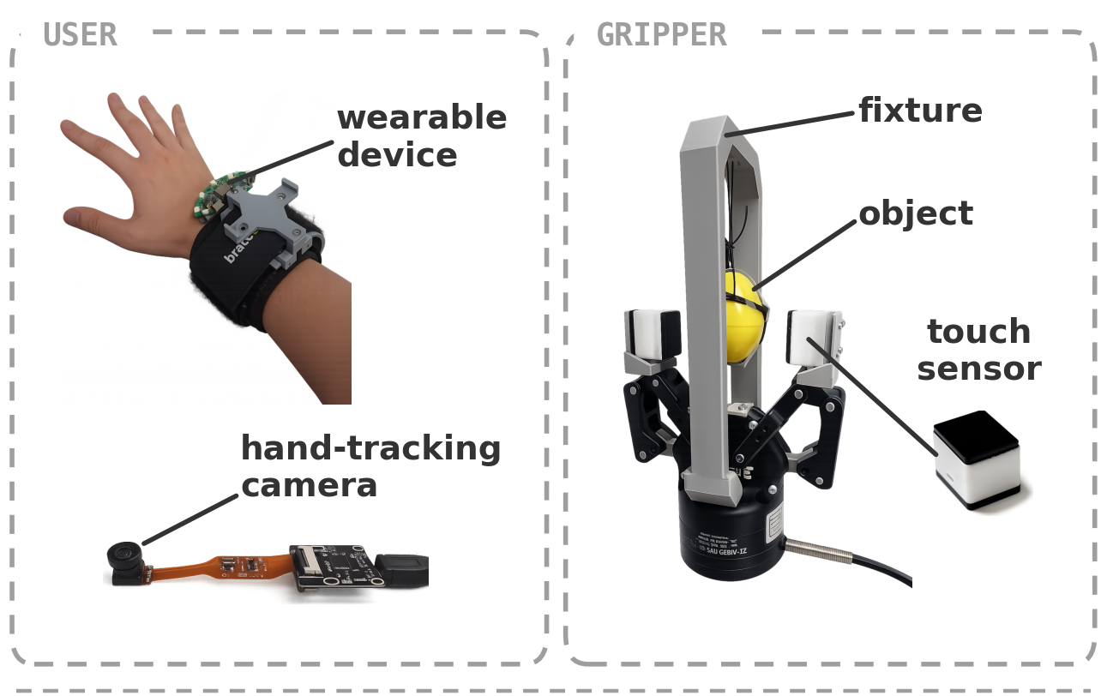
The apparatus
Gripper
Robotiq 2F-85, Modbus RTU at 115200 baud over USB-RS485
Touch
9DTact vision-based tactile sensor on each jaw
Wearable
ESP32-C6, five independent actuator channels
Tracking
USB camera + MediaPipe, 2D and uncalibrated
Notes:
The hardware. On the left, the operator: a wrist unit carrying the driver board, and the hand-tracking camera. On the right, the gripper with a plastic egg in the fixture, and one tactile sensor pulled out so you can see it — about the size of a sugar cube.

Slide 9
From gel deformation to a felt intensity
Camera images
the soft gel
Reconstruct
height map h(x,y)
Subtract baseline
d = h − h₀
Two quantities
from one field
Grip-force proxy
volume = Σ|d| over every pixel in contact (|d| > 0.1 mm). Monotonic in normal force, but uncalibrated — reported in a.u., not newtons.
Felt intensity
intensity = clip(depth / depth_sat, 0, 1) where depth is the 99th-percentile dent in mm. depth_sat is 2.0 mm for fragile, 0.6 mm for deformable objects.
Why the missing calibration is survivable: every test here is rank-based, and a monotonic rescaling cannot reorder trials — so it cannot move a p-value.
Notes:
This is where the engineering actually lives: turning a squishy gel into a number.
The sensor is a camera looking at the back of a soft gel pad under a calibrated illumination pattern. Every frame it reconstructs a height map of the gel surface; subtract the height map recorded with nothing touching it and you have the deformation field. I take two quantities from that one field.
The first is the sum of absolute deformation over every pixel actually in contact — more than a tenth of a millimetre. That is my grip-force proxy: monotonic in normal force, but uncalibrated, because the gripper exposes no force sensor. So I report arbitrary units, not newtons.
The second is the 99th-percentile depth in millimetres, and that is what the operator feels: divide by a saturation depth, clip to zero-to-one. That saturation depth is per object class — two millimetres for the egg, six tenths for foam, which barely dents the gel and otherwise felt dead.
One consequence: the force scale is uncalibrated but monotonic, and every test here is rank-based, so a scaling error cannot move a single p-value.

Slide 10
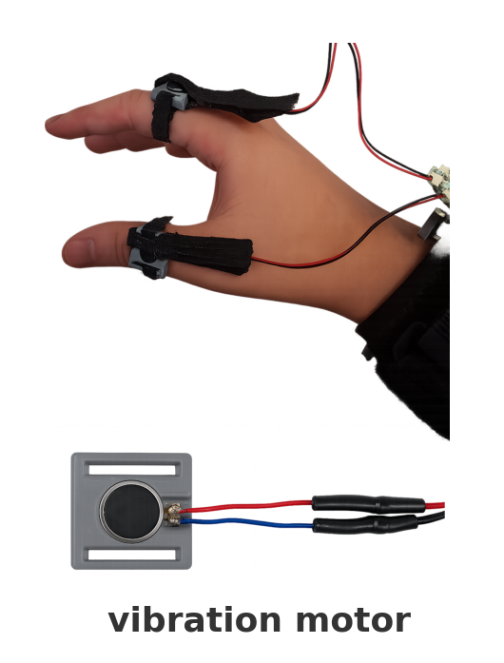
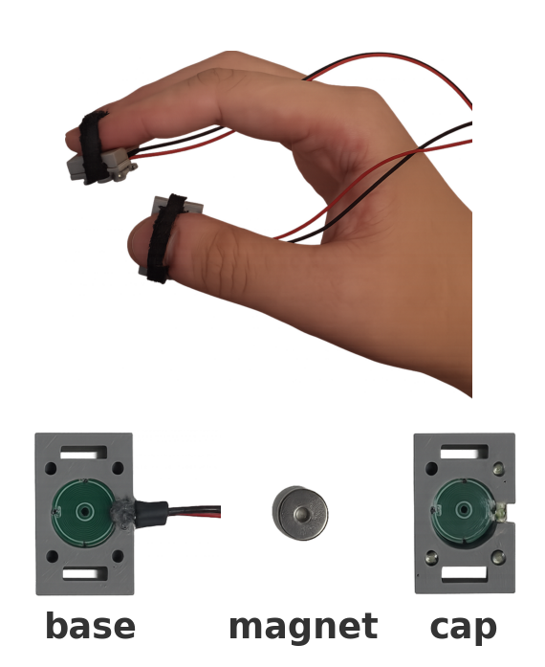
Two ways to render that number
LRA
linear resonant actuator
EM
bistable electromagnetic pin
— Bipolar PWM carrier, 10-bit duty at 200 Hz; intensity sets the envelope
— Mounted at the thumb and index proximal joints
— Buzzes continuously — draws power the whole time
— H-bridge latch: a 4 ms pulse throws the pin, the opposite pulse retracts it
— Intensity sets the burst gap (35 ms floor) to stay under ~120 switches/min
— Zero holding power; mounted at the fingertips
The two conditions differ in technology and in placement. Each actuator is mounted where it works best — deliberate in the build, a confound in the analysis.
Notes:
Two actuators render that number.
The LRA is a linear resonant actuator — the vibration motor in your phone. I drive it with a bipolar carrier at 200 hertz and let intensity set the envelope, so it buzzes harder as you squeeze. It sits on the proximal joints of the thumb and index finger.
The EM is a bistable pin actuator on an H-bridge. A four-millisecond pulse throws a pin into the skin and it latches mechanically, so it draws no power while held. For continuous feedback I fire bursts and let intensity set the gap between them, with a 35 millisecond floor to stay under the coil's thermal limit of about 120 switches a minute. It sits on the fingertips.
Note what I just said: the two conditions differ in technology and in placement. That was deliberate — each is mounted where it works best — but hold on to it, because it comes back in the discussion.

Slide 11
Method
03
22 participants, 660 grasps, three conditions
Notes:
The experiment.

Slide 12
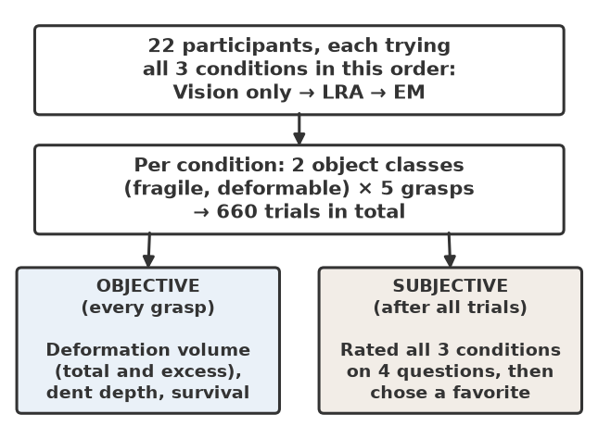
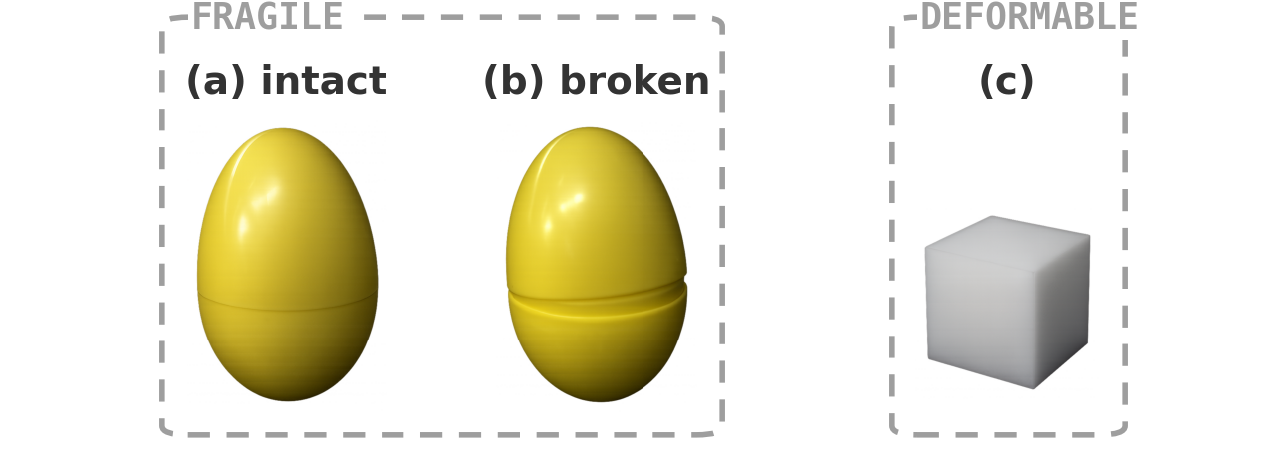
Protocol
Within-subjects. Every participant ran all three conditions, in the fixed order vision → LRA → EM.
660 trials. 5 grasps × 2 object classes × 3 conditions × 22 participants.
Then the survey. Each condition rated on four items, then a forced choice of favourite.
Fragile: a shell that pops apart. Deformable: foam that never breaks.
Notes:
Twenty-two participants, each doing all three conditions in the fixed order: vision only, then LRA, then EM. Two object classes, five grasps each — 660 trials in total.
Fragile is a hollow plastic egg that pops apart at the seam: it fails suddenly, like the real thing, but I can reassemble it. Deformable is a foam cube, which yields gradually and never breaks. Afterwards each participant rated the three conditions and picked a favourite.

Slide 13
What was measured, and how it was tested
Peak deformation volume (a.u.)
How hard they squeezed at the hardest moment of the grasp.
Excess deformation (a.u.)
Force added after dent depth reached 95% of its peak — squeezing the operator can no longer feel.
Grip adjustments (#)
Direction reversals in the force trace after that plateau: hunting for a grip instead of holding steady.
Survival (%)
Did the object come out intact, scored per trial.
Statistics. Friedman omnibus across the three conditions, then Wilcoxon signed-rank pairwise with Holm correction. Medians are reported rather than means — one crushed egg should not move the average.
Notes:
Four objective measures. Peak deformation volume is how hard they squeezed at the worst moment.
Excess deformation is the interesting one. Once the gel is fully dented the depth signal plateaus, and from that moment squeezing harder changes nothing the operator can feel. Excess deformation is the force that goes in after that point: wasted, and potentially destructive, effort.
Grip adjustments counts direction reversals in the force after that plateau — squeeze, ease, squeeze again — somebody hunting for a grip instead of holding steady. And survival: did the egg come out intact.
Statistically: Friedman across the three conditions, then Wilcoxon signed-rank pairwise with Holm correction. Medians, not means — one crushed egg should not move the average.

Slide 14
Results
04
Fragile objects moved; foam did not
Notes:
Results.

Slide 15
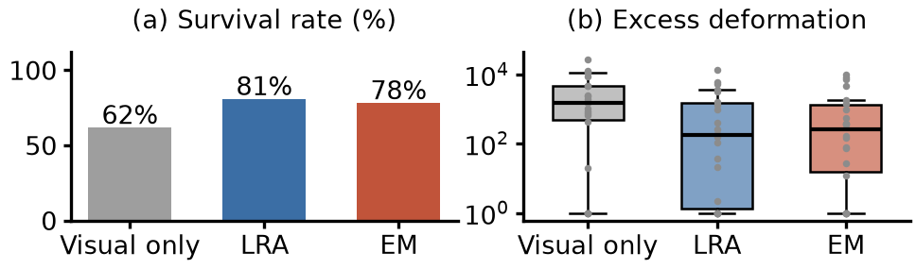
Fragile objects: what changed
Median per participant | Vision | LRA | EM
Peak deformation volume (a.u.) | 20100 | 12300 | 16000
Excess deformation (a.u.) | 1530 | 170 | 260
Grip adjustments (#) | 7 | 5 | 2
Objects surviving (%) | 62 | 81 | 78
Excess deformation vision→LRA Holm p = 0.019 · Grip adjustments vision→EM p = 0.021 · Survival Friedman p = 0.004 (vision→LRA p = 0.018, vision→EM p = 0.037; LRA vs EM p = 0.69)
Notes:
Fragile objects. Each column is the median participant, and for the first three rows lower is better.
Peak squeeze drops with feedback. Excess deformation — the wasted squeezing — falls from about 1500 units to 170 with the LRA, roughly ninefold, at p equals 0.019 after correction. Grip adjustments drop from seven to two with the EM, p equals 0.021. The two actuators help in different ways: the LRA stops you squeezing, the EM stops you fidgeting.
And the outcome people care about: egg survival rises from 62 percent with vision only to 81 with the LRA and 78 with the EM, Friedman p equals 0.004, both beating the baseline after correction.
Two honest negatives. Peak dent depth barely moves, because my one-millimetre safety cutoff caps it first. And deformable objects showed no reliable change on anything — foam gives you no sharp failure to avoid.

Slide 16
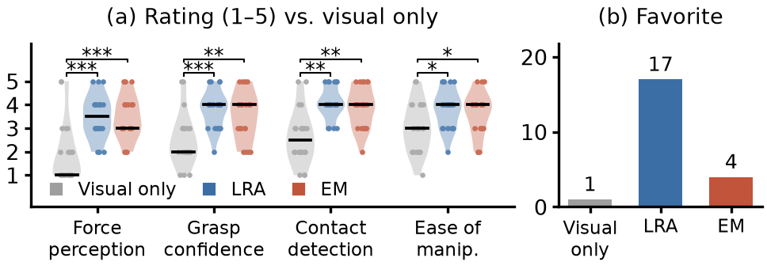
What the participants said
Feedback beats no feedback. Force perception, grasp confidence and contact detection all improved over vision only (Friedman p < 0.001; Holm-corrected pairwise p ≤ 0.002).
No item separates the actuators. Every LRA-vs-EM comparison sits above p = 0.2.
But the preference is lopsided. 17 of 22 picked the LRA as their favourite, 4 the EM, 1 vision only (χ², p < 0.001).
Notes:
Subjectively it is not close. On force perception, grasp confidence and contact detection, both haptic conditions beat vision only at p below 0.001, surviving Holm correction.
But no single question separated the LRA from the EM — every pairwise comparison between them sits above 0.2. And yet, asked to pick a favourite, 17 of 22 chose the LRA. People had a clear preference they could not articulate on any of my rating items.

Slide 17
Discussion
05
What the data supports — and what it does not
Notes:
So what does this mean.

Slide 18
Claims, and the confounds behind them
Supported
Tactile feedback cuts the squeezing the operator cannot feel (~9× with the LRA).
It cuts regrip hunting and lifts fragile-object survival from 62% to about 80%.
Operators perceive the difference and overwhelmingly prefer having it.
The gain is in excess force, not in peak dent depth — the 1.0 mm safety cutoff caps that before conditions can differ.
Not yet supported
That the LRA is the better actuator: technology and placement are bundled together.
Fingertip EM hardware occludes the tracked landmarks and adds standoff — the preference may be smoother control, not better sensation.
Fixed condition order leaves practice and fatigue inseparable from condition.
That any of this extends to deformable objects — no metric moved reliably on foam.
Measurement caveats. Force is in a.u., not newtons; the mm depth scale rests on a single ball calibration never checked against a gauge; end-to-end latency still needs a bench measurement.
Notes:
What I am comfortable claiming: tactile feedback reduces the squeezing the operator cannot feel, reduces regrip hunting, and raises survival on fragile objects — and users perceive it and want it.
What I am not comfortable claiming is that the LRA is the better actuator. Technology and placement are bundled: I never tested a fingertip LRA or a joint-mounted EM. Worse, the fingertip EM hardware sits on the very landmarks the hand tracker uses, so I had to lower the detection thresholds, and its thickness changed the usable pinch range — the LRA preference may be smoother control, not better sensation. And the condition order was fixed, so practice and fatigue are inseparable from condition.
On measurement: force is in arbitrary units, the millimetre scale rests on one ball calibration never checked against a gauge, and latency still needs a bench measurement.

Slide 19
Conclusion
06
Safer grasping, an open question on actuators
Notes:
To close.

Slide 20
Takeaways
62% → 80%
Fragile-object survival rose with either actuator, and unfelt over-squeezing fell roughly ninefold.
21 of 22
Participants preferred a haptic condition over vision alone, and rated it higher on every perception item.
Still open
Which actuator is better — technology and placement have to be separated before that can be answered.
Next. Spatial feedback instead of one scalar per finger; force calibrated into newtons; a bench-measured end-to-end latency.
Notes:
Three things. Touch feedback made remote grasping of fragile objects measurably safer: about nine times less unfelt squeezing, and survival up from 62 to around 80 percent. It is what operators want — 21 of 22 preferred a haptic condition over vision alone. And which actuator is better is still open; answering it needs a study that separates technology from placement.
Next: spatial feedback instead of one number per finger, force calibrated into newtons, and a bench-measured latency figure.
Thank you — happy to take questions.

