Slide 1
Engineering Timeplan
Phase 1
Phase 2
Phase 3
Phase 4
Conceptual design
Deliverables:
1. Product-level requirements aligned
2. Milestone timeline aligned
Prototyping Build & Test
Deliverables:
1. Engineering specifications aligned
2. Test methods verified
3. FMEA defined
Production Readiness
Deliverables:
1. Bill of Materials finalized
2. Assembly plan aligned
3. QC plan aligned
Launch
Deliverables:
1. Production
2. Yield improvement plan aligned
3. End-of-life plan aligned

Slide 2
Product-level Requirements (DRAFT)
Shall (design intents as part of commercial claim) | Should (design intents not part of commercial claim) | Must (design for regulatory compliance, user safety & comfort)
1. [product] shall detect people going in and going out a premise/s with acceptable accuracy. | 1. [product] should be aesthetically pleasing. | 1. [product] must be quiet in normal and abnormal operations.
2. [product] shall determine people’s demographic profile with acceptable accuracy. | 2. [product] should clearly show the company branding. | 2. [product] must be cool in normal operation, and safe to touch in abnormal operation.
3. [product] shall have long runtime. | 3. [product] location should be unreachable to lay people. | 3. [product] must be operable in tropical climate (low altitude, high temp, high humidity).
4. [product] shall be cheaper than conventional methods. | 4. [product] should be serviceable (easy to replace a component/s inside). | 4. [product] must not emit toxic materials in normal and abnormal operations.
5. [product] shall be easy to install. | 5. [product] should be secure (only authorized personnel can access the inside). | 5. [product] must be electrically insulated in normal and abnormal operations.
 | 6. data collected by [product] should be secure (only authorized personnel can access the data). | 6. [product] must have abnormal case detection and shut-off procedures.

Slide 3
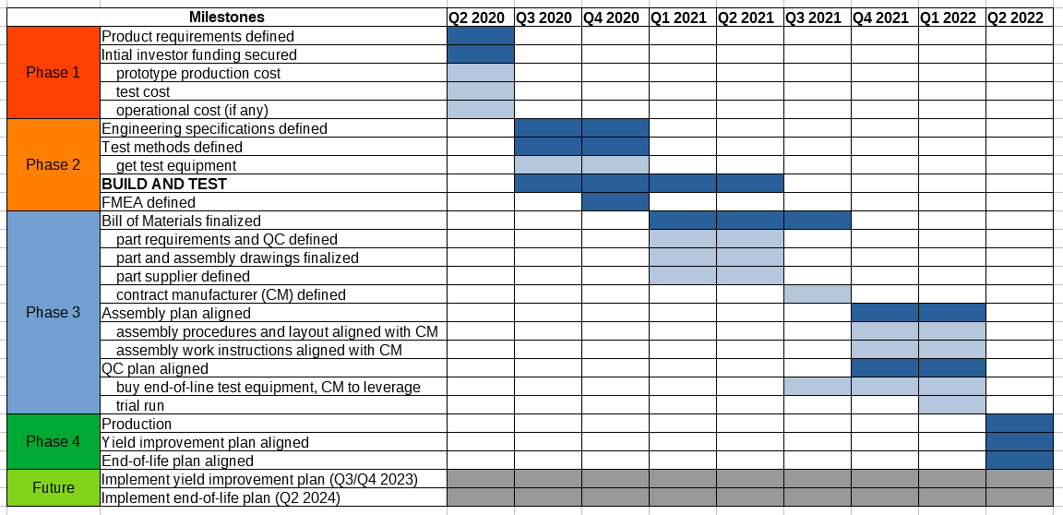
Milestone timeline (DRAFT)

