Slide 1

Project Title: Data-Driven Dining: Leveraging Bengaluru's Culinary Landscape for Restaurant Success Strategic Insights from Zomato Data Analysis
Prepared by: Aditya Bhatt
Course Name: Applied Business Analytics
Institution: Long Island University- Brooklyn Campus
Date: 4/20/2024

Slide 2

Primary Goal: Empower aspiring restaurateurs with data-driven insights and strategies to establish and differentiate their restaurants successfully in Bengaluru.
Objectives:
Understand Bengaluru's Culinary Landscape: Analyze data sourced from Zomato to gain insights into the diverse array of restaurants, cuisine preferences, thematic trends, reviews, and ratings prevalent in Bengaluru.
Identify Key Success Factors: Uncover the factors influencing restaurant success, including location dynamics, online ordering trends, booking preferences, customer reviews, and ratings.
Explore Demographic Influences: Investigate how demographic factors such as age, income, and cultural background impact dining preferences and restaurant choices in different localities of Bengaluru, reflected in reviews and ratings.
Evaluate Pricing Strategies: Analyze the relationship between pricing, menu offerings, customer reviews, and ratings to identify effective pricing strategies for restaurants in Bengaluru.
5. Provide Actionable Recommendations: Offer strategic recommendations based on data analysis, including insights from reviews and ratings, to assist aspiring restaurateurs in making informed decisions regarding location selection, menu development, pricing, and marketing strategies.

Slide 3
Data Overview
Data Definition | Features
Url | Address
Name | Online_Order
Book_table | Rate
Votes | Phone
Location | Rest_type
Dish_liked | Cuisions
Approx_cost | Review_list
Menu_Item | Listed_in
Dataset: https://www.kaggle.com/code/vahidehdashti/complete-zomato-dataset-eda
Almost 5 millions of data available

Slide 4
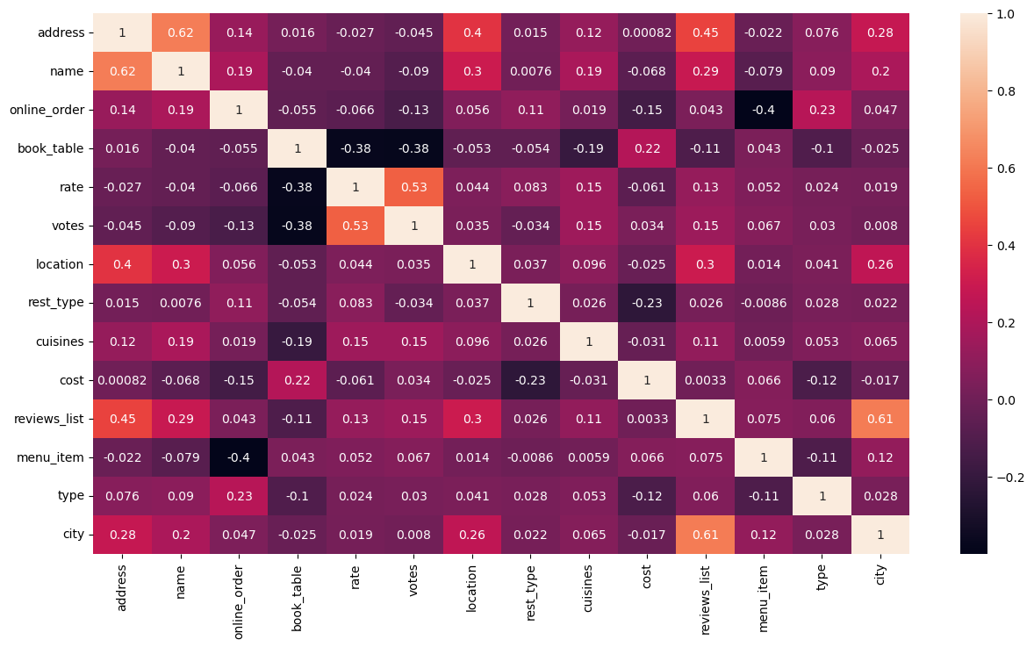
Exploratory Analysis
Heatmap:
Based on the heatmap results Reviews and Rate are mostly positive correlation with all the features excepts online orders, orders, and booking tables.

Slide 5
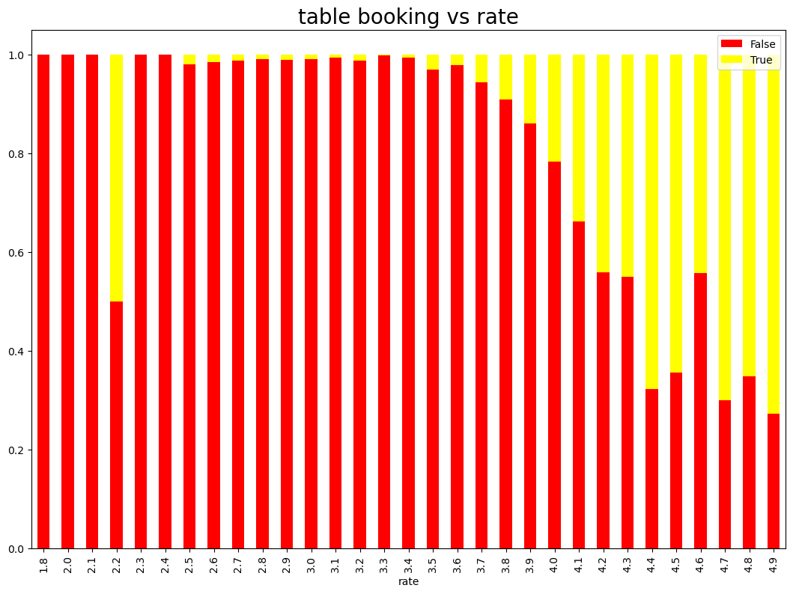
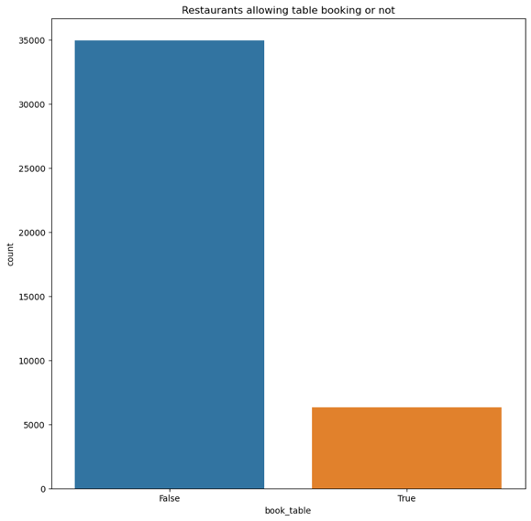
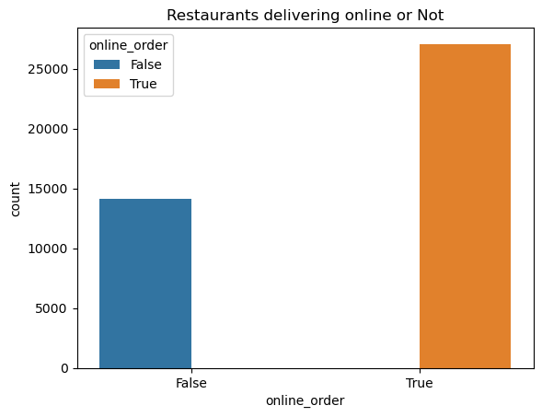
Data Visualization:

Slide 6
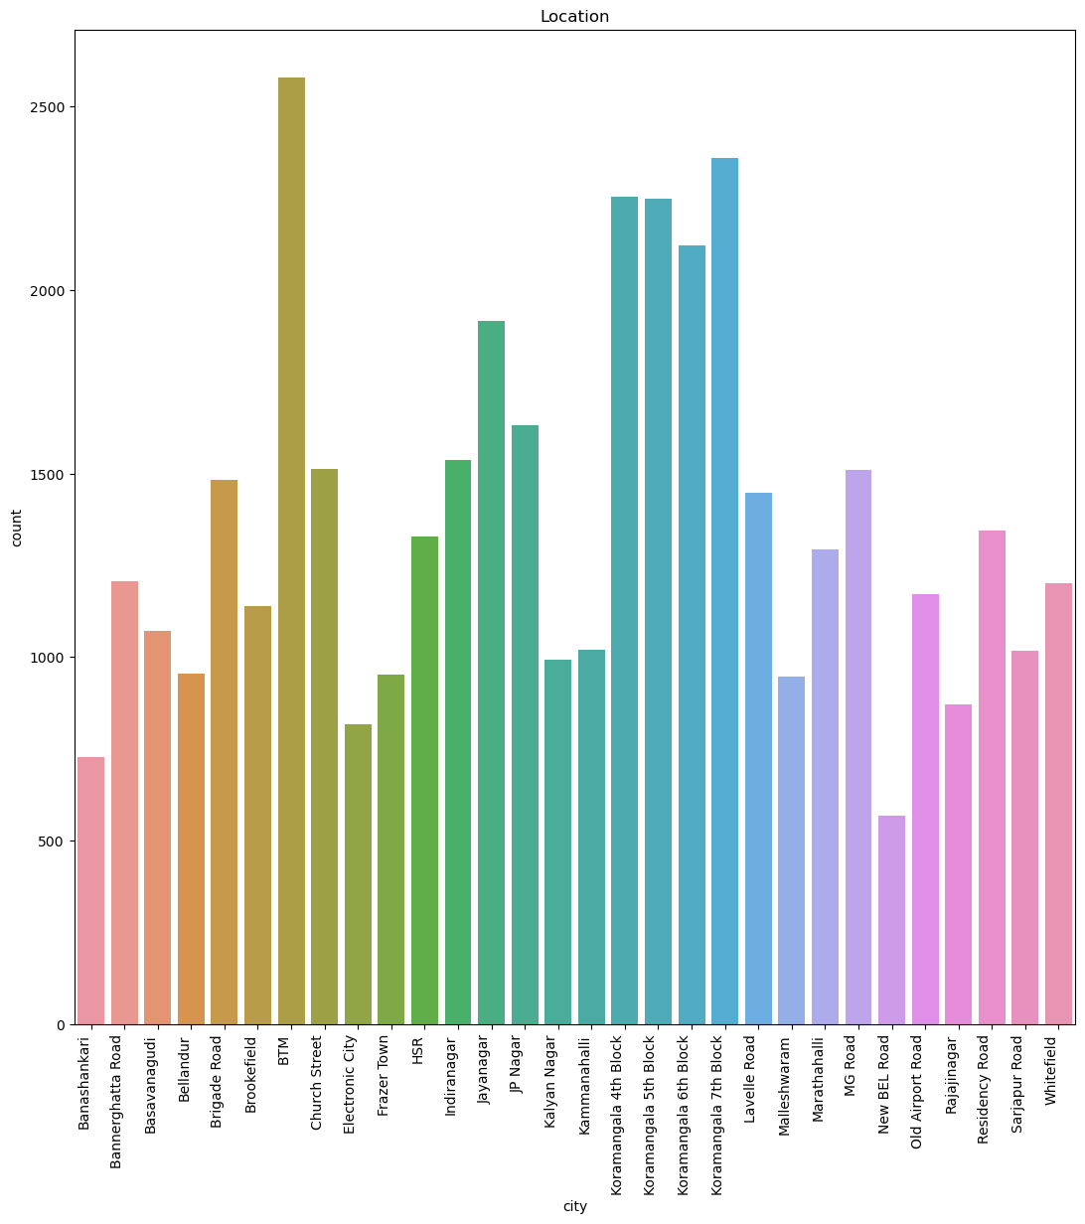
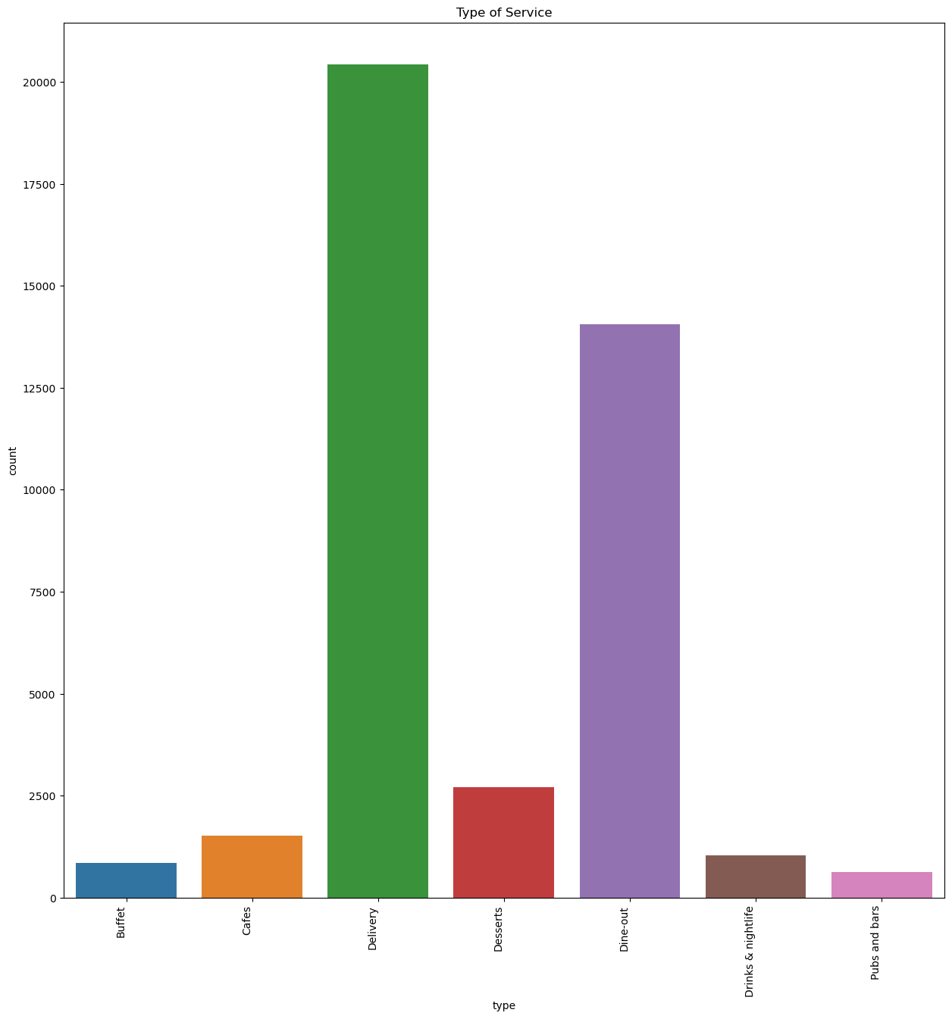

Slide 7
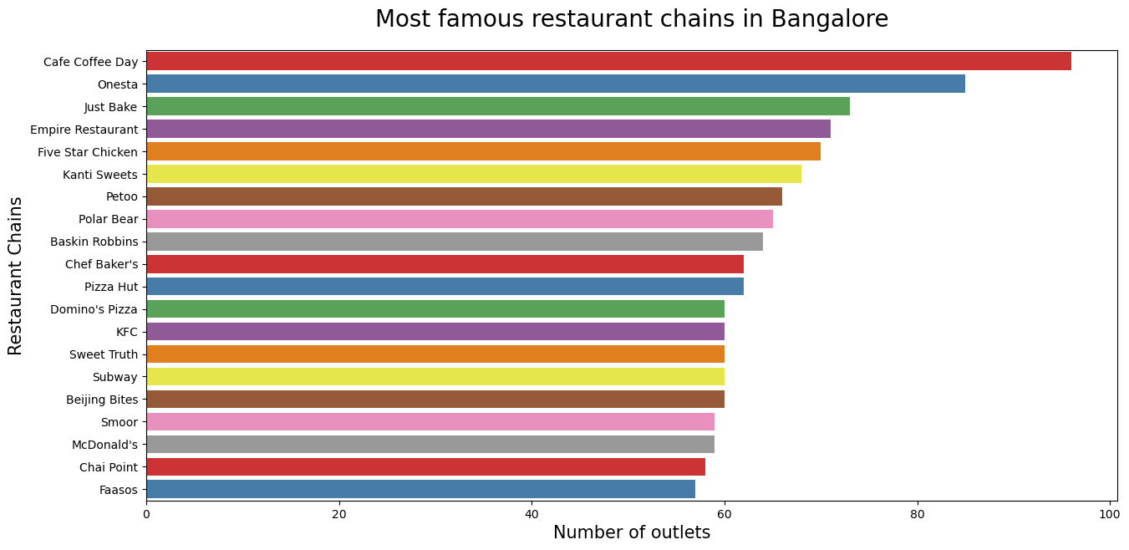
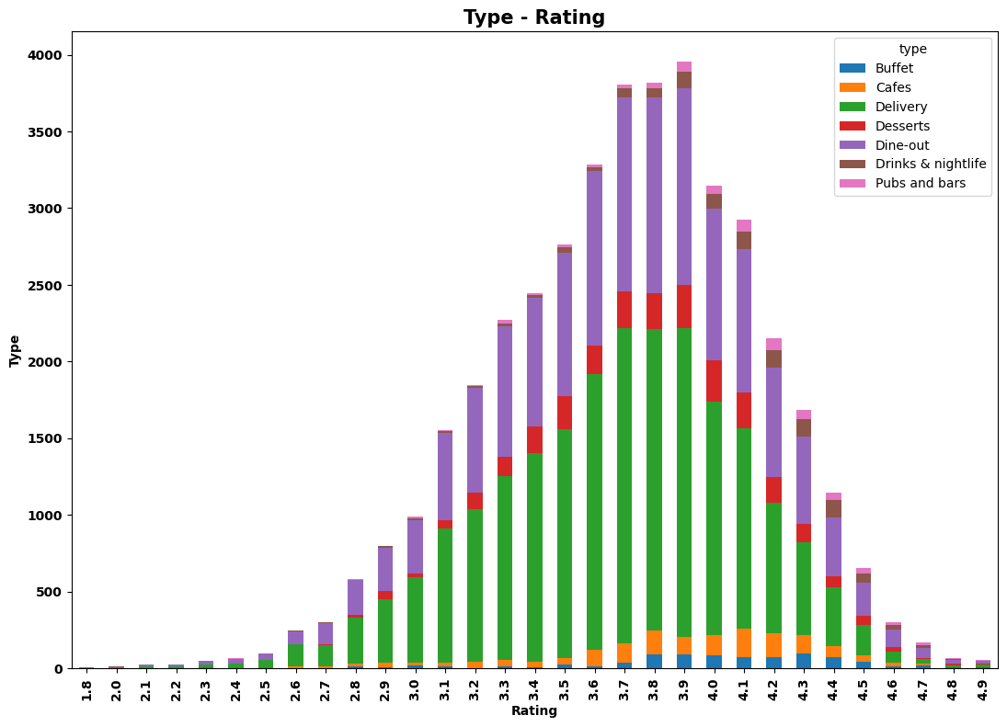

Slide 8
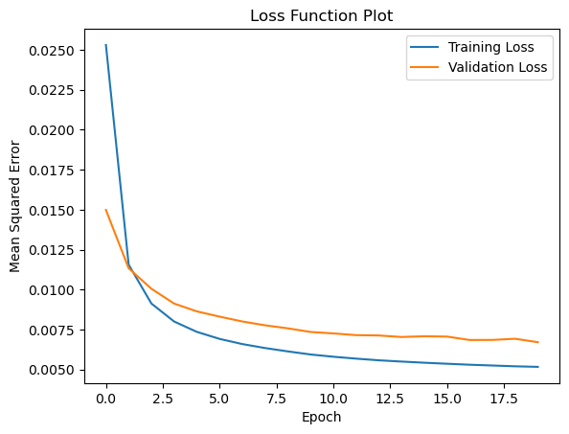
Sentimental Analysis:
Sentiment analysis is valuable for new restaurant seekers as it allows them to gauge customer feedback and opinions effectively. By analyzing sentiment expressed in reviews and social media posts, restaurant owners can understand customer satisfaction levels, identify areas for improvement, and tailor their offerings to meet customer preferences.

Slide 9
Data Models:
Model | Testing R2 | Important Features
Linear Regression | 27% | rest_type - 0.002379 votes - 0.000148 location - 0.000123 cuisines - 0.000054 menu_item - 0.000007
Decision Tree | 86% | votes - 0.556168 cuisines - 0.139283 location - 0.112614 cost - 0.091277 rest_type - 0.065752
Random Forest Regression | 88% | votes - 0.567011 cuisines - 0.134819 location - 0.103588 cost - 0.085976 rest_type - 0.068879
Extra Tree Regression | 94% | votes - 0.346757 book_table - 0.172307 cuisines - 0.130355 location - 0.116156 cost - 0.115770

Slide 10
Recommendation Engine:
recommend('Pai Vihar')
TOP 6 RESTAURANTS LIKE Pai Vihar WITH SIMILAR REVIEWS:
 | cuisines | Mean Rating | cost
Samosa Singh | North Indian, Mithai | 3.60 | 250.0
Prasiddhi Food Corner | Fast Food, North Indian, South Indian | 3.45 | 200.0
Shrusti Coffee | Cafe, South Indian | 3.45 | 150.0
Shanthi Sagar | South Indian | 3.44 | 250.0
Mayura Sagar | Chinese, North Indian, South Indian | 3.32 | 250.0
Container Coffee | South Indian | 3.11 | 200.0
Focusing on a recommendation engine for a new restaurant can offer numerous advantages and opportunities for success: Improved Decision-Making, Optimized Menu Design, Cross-Selling and Upselling.

Slide 11
Conclusion:
A new restaurant seeker should keep the following things in mind:
Service: Many restaurants seem to have high ratings for service, indicating that attentive and friendly staff can greatly enhance the dining experience. Good service appears to be a strong point for several establishments.
Ambiance: Ambiance, which likely includes factors like noise level, atmosphere, and overall vibe, is also highly rated across most restaurants. Creating an enjoyable ambiance is crucial for providing a pleasant dining experience.
Food: While ambiance and service are important, the quality of food should still be a top priority. The heatmap shows varying ratings for food across different restaurants, so researching and prioritizing establishments known for their culinary excellence is advisable.
Value: Some restaurants appear to offer better value or cost-effectiveness compared to others. For diners on a budget or seeking the best bang for their buck, considering the value aspect can be beneficial.

Slide 12
Thank you!

