Slide 1






Axian Requirements for Centralized Monitoring & Observability
Group wide centralized monitoring, observability and operations intelligence platform
Group-wide centralized monitoring, observability and operations intelligence platform
Federated operations model
Support dual role: a) Opco level b) Group level
Integration with ServiceNow for auto ticketing
Alignment with Industry best practices
and standards
Leverage existing opco monitoring investments by integrating with existing tools
Predictive and proactive operations
through AI/AIOps capabilities
Standardize KPIs, escalation models, and
runbooks across Opcos
OPEX optimization through automation and shared platform
Multi tenancy model
Scalable platform to support addition of new Opcos with additional infrastructure
Address the current Opcos including Madagascar, Togo, Senegal, Comoros, Tanzania, Kenya, Uganda & other countries
Complete proposal scope: UA core + OCI O&M + governed GenAI
UA: existing tools, telecom assurance & topology
OCI APM: applications, traces, topology & synthetics
OEM retained: database, Exadata & middleware depth
Log Analytics: OKE + open collection for EKS/VKS/OpenShift
One Zurich ServiceNow • native UA integration
OCI GenAI: governed correlation, evidence, zero-touch roadmap
Notes:
[Sources]
- https://docs.oracle.com/en/industries/communications/unified-assurance/7.0/concepts/what-is-unified-assurance.html (accessed 2026-07-31)
- https://docs.oracle.com/en-us/iaas/application-performance-monitoring/home.htm (accessed 2026-07-31)
- https://docs.oracle.com/iaas/log-analytics/doc/kubernetes-solution.html (accessed 2026-07-31)
- https://docs.oracle.com/en-us/iaas/Content/generative-ai-agents/overview.htm (accessed 2026-07-31)
[/Sources]

Slide 2
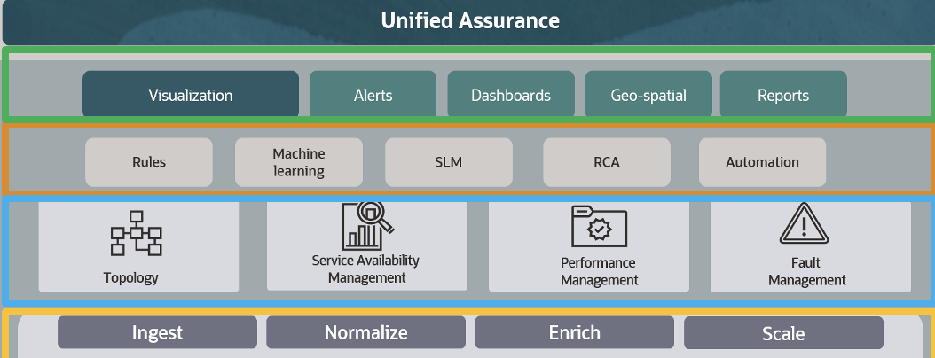
End-to-end workflow — UA core, OCI evidence and GenAI correlation
IAM • Vault • Audit
Cloud Guard
Unified Assurance: deterministic core
OCI evidence & AI only for gaps
Telecom faults, performance,
topology and RCA
APM • synthetics • OTel topology
4 ServiceNow
native UA adapter
OEM retained for deep diagnostics
Monitoring • Logging • Connector Hub
Group assurance, evidence & AI platform in OCI
Native UA → ServiceNow workflow
Log Analytics / OKE • OCI GenAI correlation
2 Unified Assurance
Deduplicate • correlate • RCA
Per OpCo / product tools
1 Edge collection
UA • OTel • collectors
UA ingest
Native APIs
Network
Huawei
U2020
Ericsson
EMS
Nokia
NetAct
ZTE
NetNeuman
Metrics
Existing
Assurance
Tools
Network Devices
Faults
Topology
3 OCI evidence & GenAI correlation
Monitoring • Logging • Connector Hub • Log Analytics / OKE
APM • synthetics • cited hypotheses • confidence • evidence package
Native Infrastructure
Mgmt Agent/Gateway
Streaming • Object Storage
Functions • OKE
buffer • normalize • replay
canonical event / entity IDs
5 Product teams
diagnose • approve • remediate
Notes:
[Sources]
- https://docs.oracle.com/en/industries/communications/unified-assurance/7.0/concepts/what-is-unified-assurance.html (accessed 2026-07-31)
- https://docs.oracle.com/en/industries/communications/unified-assurance/7.0/enterprise-licensing-info/licensing-information.html (accessed 2026-07-31)
- https://docs.oracle.com/en-us/iaas/application-performance-monitoring/home.htm (accessed 2026-07-31)
- https://docs.oracle.com/iaas/log-analytics/doc/kubernetes-solution.html (accessed 2026-07-31)
- https://docs.oracle.com/en-us/iaas/Content/generative-ai/responses-api.htm (accessed 2026-07-31)
- https://docs.oracle.com/en-us/iaas/Content/generative-ai-agents/agent-as-tool-guidelines.htm (accessed 2026-07-31)
[/Sources]

