Slide 1




ECONOMIC ENVIRONMENT OF GLOBAL BUSINESS · MEMBA 14 · PART I
SESSION 1
Course Overview &
Data Literacy for Managers
From markets, to macro, to decisions that matter — in Nigeria and the world.
Reading: Mankiw ch. 1, 2, 22, 23 · Note on Microeconomics for Managers · Facilitator: Bongo Adi
Lagos Business School · Pan-Atlantic University · MEMBA 14 · Prof. Bongo Adi, Kelechi Nnamdi, Elvis Ozegbe, Sumendra Dash
Notes:
Welcome to EEGB. Open with the board's '30% growth' and leave it unanswered until Part 2. Ask each participant for one macro number that hit their business in the last year: the exchange rate, inflation or interest rates will dominate. That is the course in a sentence — and the macro-to-P&L map on the next slide is how we will organise it.

Slide 2




THE QUESTION FOR TODAY
“Sales Are Up 30%. The Board Is Delighted.”
FY2024: a Lagos FMCG firm reports naira revenue of ₦52bn, up from ₦40bn. Did the business grow?
Before anyone celebrates, an economist runs three checks. By the end of today you will run all three:
1 · Real or nominal?
2 · In which currency?
3 · Compared with whom?
Consumer prices rose about 33% on average in 2024. If prices rose faster than sales, volume fell.
The naira averaged about ₦645/$ in 2023 and ₦1,479/$ in 2024. Imported inputs are priced in dollars.
If the category grew faster than 30% in naira, we lost market share.
Notes:
Cold-call two or three participants: 'What was your company's revenue growth last year? And inflation?' Most have never deflated their own sales.
Leave the question open. We answer it in Part 2 (slide 'Back to the 30% question').
Sources: World Bank WDI — inflation, consumer prices, Nigeria 2024 = 33.24% (FP.CPI.TOTL.ZG); official exchange rate, period average, 2023 = ₦645.19, 2024 = ₦1,478.97 (PA.NUS.FCRF), last updated Oct 2026. The firm itself is illustrative.

Slide 3


THE MENTAL MODEL FOR THIS COURSE
The Macro-to-P&L Map: Where the Economy Hits Your Numbers
When this moves… it hits… | Revenue (volume × price) | Cost of sales | Operating costs | Finance costs | FX gains & balance sheet
Naira weakens | Imported rivals dearer; exports more competitive | Imported inputs and packaging cost more | Diesel, spares, software licences | Dollar loans cost more in naira | Revaluation losses on dollar liabilities
Inflation rises | Real incomes fall; customers trade down | Local inputs and freight rise | Wage pressure, rent reviews | Rates rise to fight it | Inventory gains; idle cash loses value
Interest rates rise | Less consumer and distributor credit | Supplier credit dearer |  | Overdrafts and loans reprice | Naira assets attract inflows; FX steadier
Growth and incomes rise | Volumes up; premium mix sells | Tighter input markets | Competition for skilled staff | Banks lend on better terms
Policy shifts (subsidy, tax, tariffs) | Tariffs shield or expose you | Duties, fuel price | Transport, levies | Government borrowing crowds out credit | Tax treatment of FX gains
Large effect
Moderate
Small
We will fill in this map session by session. Every economic idea in EEGB ends with the question: which cell does it move — and by how much?
LAGOS BUSINESS SCHOOL · EEGB · SESSION 1 · DATA LITERACY FOR MANAGERS
3
Notes:
This is the course's organising picture. Ask participants to mark the two cells that hurt their firm most in 2023–24 (most will choose naira → cost of sales and naira → FX losses). Shading is a judgement for a typical import-dependent Nigerian FMCG firm, not a measurement; a bank or an exporter would shade it differently — ask them how.

Slide 4



TODAY
Session 1: Three Parts, One Deliverable
75 minutes. The appendix holds the self-study depth.
10 min
Opening
22 min
1 · Think like an economist
25 min
2 · Read the numbers
18 min
3 · Nowcast and dashboard
BY THE END OF TODAY YOU WILL BE ABLE TO
Frame decisions like an economist
Read official data correctly
Build a board macro page
Use opportunity cost, the margin and incentives on a real decision, and apply Mankiw's ten principles.
Convert nominal to real; handle rebasing, revisions and percentage points; tell correlation from causation.
Pick six indicators, read them with fast signals, and write a 'so what' for your business.
LAGOS BUSINESS SCHOOL · EEGB · SESSION 1 · DATA LITERACY FOR MANAGERS
4

Slide 5
HOW YOU WILL BE ASSESSED
Assessment — and How Today Prepares You
Component | Weight | What it involves | Today's link
Class participation (in-person + online) | 30% | Cold calls, in-class problem-solving, polls and short reaction notes | Every check slide is a cold-call rehearsal
Short quizzes / polls | 10% | Pre-class checks on the readings | Mankiw ch. 1, 2, 22, 23 underpin today
Practice-based assignment | 20% | Data labs (FRED / IMF / CBN / NBS / World Bank), case brief, macro policy memo | Today's lab is Data Lab 1
Final exam | 40% | On-site, closed-book examination | Expect: real growth, CPI, real rates, pp vs %
Participation is a third of the grade. Read before class, bring one number from your own business, and be ready to defend a recommendation. The course roadmap is in the appendix.
LAGOS BUSINESS SCHOOL · EEGB · SESSION 1 · DATA LITERACY FOR MANAGERS
5

Slide 6

PART
01
Think Like an Economist
Mankiw's ten principles, applied to decisions a Nigerian board actually takes.
The question this part answers: How should a manager frame a decision before reaching for the numbers?

Slide 7
THE TOOLKIT · MANKIW CH. 1
Ten Principles — Translated for a Lagos Boardroom
# | Principle | In a Nigerian boardroom | Where
1 | People face trade-offs | More FX for raw materials means less for debt service. | Today
2 | The cost of something is what you give up to get it | Idle cash costs what it could have earned — and what inflation eats. | Today
3 | Rational people think at the margin | Run the night shift only if its extra revenue beats its extra cost. | Today · S4
4 | People respond to incentives | A cheap subsidised price invites smuggling; an FX gap invites round-tripping. | Today · S5
5 | Trade can make everyone better off | Gains come from comparative advantage, not from being best at everything. | Today · S12
6 | Markets are usually a good way to organise activity | Prices carry information; rationing replaces them with queues. | Today · S2
7 | Governments can sometimes improve market outcomes | Property rights, externalities, market power — if the state has capacity. | S4 · S5
8 | Living standards depend on productivity | Real output per person has fallen about 10% since 2014. | Today · S7
9 | Prices rise when the government prints too much money | Ways & Means financing preceded the 2023–24 inflation surge. | S8 · S9
10 | Short-run trade-off between inflation and unemployment | Rate hikes cool prices but squeeze sales and jobs first. | S6
LAGOS BUSINESS SCHOOL · EEGB · SESSION 1 · DATA LITERACY FOR MANAGERS
7
Notes:
Mankiw groups the principles: 1–4 how people make decisions; 5–7 how people interact; 8–10 how the economy as a whole works. Today we work through 2, 3, 4, 5, 6–7 and 8 with examples; 9 and 10 are previewed here and in the appendix, and taught fully in Sessions 6, 8 and 9.
Principle 8 figure: World Bank NY.GDP.PCAP.KD, Nigeria 2014 = $2,584, 2024 = $2,325 (constant 2015 US$), −10.0%. Ways & Means: CBN overdrafts to the FGN of about ₦22.7trn were securitised in May 2023.

Slide 8
PRINCIPLE 2 · OPPORTUNITY COST
What Did ₦1bn of Idle Cash Really Cost in 2024?
₦1bn, end-2023 → end-2024 | Naira, end-2024 | Real (Dec-23 ₦)
Leave it in a current account (0%) | ₦1.00bn | ₦0.74bn
364-day T-bill, Jan 2024 (11.5%) | ₦1.12bn | ₦0.83bn
Pre-buy $-priced inputs at ₦899/$ | worth ≈ ₦1.71bn | ≈ ₦1.27bn
STEP BY STEP
1
Inflation in the year to Dec 2024 was 34.8%: ₦1 at end-2024 bought what ₦0.74 bought a year earlier (1 ÷ 1.348).
2
Idle cash therefore lost about ₦258m of purchasing power — a real cost that no invoice ever shows.
3
A one-year T-bill bought in January 2024 yielded about 11.5%; yields near 20% came only after the February–March hikes. Real return: 1.115 ÷ 1.348 − 1 ≈ −17%.
SO WHAT FOR YOUR TREASURY
In 2024 the 'safe' choice — idle naira — was the most expensive one, and even T-bills lost in real terms. Only the dollar-linked option kept its value. With the real policy rate now about +7% (Part 2), that ranking has reversed.
4
Pre-buying hedged the naira's fall from ₦899 to ₦1,535/$ (+71%) — but tied up cash and warehouse space, and stock can spoil. That is its opportunity cost.
The cost of a decision is the best alternative given up — measured in real terms, not just in naira.
LAGOS BUSINESS SCHOOL · EEGB · SESSION 1 · DATA LITERACY FOR MANAGERS
8
Notes:
Sources: NBS CPI Dec 2024 = 34.80% y/y (CBN statistics). 364-day NTB auction yields: 8.40% (10 Jan 2024), 11.54% (24 Jan 2024) — Nairametrics, 26 Jan 2024; 19% (late Feb) and 21.49% (6 Mar 2024) — Nairametrics/ThisDay. CBN official central rate: ₦899.39/$ (29 Dec 2023), ₦1,535.32/$ (31 Dec 2024) → ×1.707; real 1.707 ÷ 1.348 = 1.27.
Hindsight point: a treasurer who waited until March got 21% — still roughly −10% real measured against 2024 inflation (1.21 ÷ 1.348 − 1). (A bill bought on 24 January matures in January 2025; close enough for the lesson.) Ask: what would you do with ₦1bn today, when the real rate is positive?

Slide 9
ILLUSTRATIVE
PRINCIPLE 3 · THINK AT THE MARGIN
Should the Factory Run a Third (Night) Shift?
Per night of the third shift | ₦ million
Extra output: 6,000 cartons × ₦4,500 net price | +27.0
Materials: 6,000 × ₦3,000 | −18.0
Night-shift labour and supervision | −3.2
Diesel — the grid is unreliable at night | −6.5
Marginal profit per night | −0.7
STEP BY STEP
1
Finance says: 'average cost per carton falls from ₦5,000 to ₦4,900 because fixed costs are spread' — true but irrelevant.
2
Fixed costs (rent, depreciation, head office) are paid whether or not the shift runs. They are not marginal.
3
Ask only: does the extra revenue exceed the extra cost? Here it falls short by ₦0.7m a night.
TRY IT
4
The decision flips if diesel falls, the grid improves or the price rises — so those are the numbers to watch.
Find the break-even. At what diesel cost does the shift pay? (₦5.8m a night.) At what net price per carton? (₦4,617.) Good managers know the two or three numbers that flip the decision.
Decide at the margin: compare extra benefit with extra cost. Averages and sunk costs mislead.
LAGOS BUSINESS SCHOOL · EEGB · SESSION 1 · DATA LITERACY FOR MANAGERS
9
Notes:
Illustrative figures. Day and evening shifts make 17,000 cartons at ₦85m a night (average ₦5,000); adding 6,000 cartons at ₦27.7m gives ₦112.7m ÷ 23,000 = ₦4,900. Break-evens: diesel 27.0 − 18.0 − 3.2 = 5.8; price (18.0 + 3.2 + 6.5) / 6,000 = ₦4,617. Sunk-cost example to add verbally: an ERP licence already paid for should not decide whether to keep using the system. Links to Session 2 (pricing) and Session 4 (cost structure).

Slide 10


PRINCIPLE 4 · INCENTIVES
People Respond to Incentives — Often Unexpectedly
Petrol subsidy
Multiple exchange rates
FX restrictions on imports
Pump price held near ₦185/litre until May 2023 while neighbours paid far more. Result: cross-border smuggling and a subsidy bill above ₦4trn in 2022.
In May 2016 the street rate was 71% above the official rate. Anyone with official access could buy cheap and sell dear; round-tripping grew while genuine importers queued.
Barring 41 items from the official FX window (2015) aimed to boost local production. It also raised prices and rewarded smuggling through porous borders.
Incentives change behaviour at the margin.
A price gap is an incentive.
Watch what people do, not what the rule says.
Before backing a policy — or a sales commission scheme — ask: who gains, who loses, and how will each change behaviour?
LAGOS BUSINESS SCHOOL · EEGB · SESSION 1 · DATA LITERACY FOR MANAGERS
10
Notes:
Sources: NNPC 'under-recovery' (petrol subsidy) ≈ ₦4.39trn in 2022; pump price ₦185/l before 29 May 2023. FX premium: CBN monthly averages, May 2016 — BDC vs official (see the exchange-rate chart in Part 2). CBN circular of June 2015 excluded 41 items from the official FX market. Company example to ask for: a commission plan that paid on volume and destroyed margin.

Slide 11
ILLUSTRATIVE
PRINCIPLE 5 · TRADE CAN MAKE EVERYONE BETTER OFF
Comparative Advantage: Why the 'Better' Producer Still Gains
120 hours of labour each | Hours per tonne of cement | Hours per bag of cocoa | Cost of 1 bag of cocoa
Nigeria | 2 | 4 | 2 t of cement
Ghana | 6 | 6 | 1 t of cement
No trade (split time evenly) | N 30 + G 10 = 40 t | N 15 + G 10 = 25
Specialise by comparative advantage | N 50 + G 0 = 50 t | N 5 + G 20 = 25 | +10 t of cement
STEP BY STEP
1
Nigeria is faster at both goods: it has the absolute advantage in each.
2
But a bag of cocoa costs Nigeria 2 tonnes of cement forgone, and Ghana only 1 tonne. Ghana has the comparative advantage in cocoa; Nigeria has it in cement.
3
If each leans towards what it gives up least to make, total output rises: the same 25 bags of cocoa plus 10 extra tonnes of cement.
4
Trade at 1.5 t per bag: Ghana swaps 10 bags for 15 t and ends with 10 bags + 15 t (was 10 + 10); Nigeria ends with 35 t + 15 bags (was 30 + 15). Both gain.
Gains from trade come from comparative advantage — differences in opportunity cost — not from being best at everything.
LAGOS BUSINESS SCHOOL · EEGB · SESSION 1 · DATA LITERACY FOR MANAGERS
11
Notes:
Mankiw ch. 3 ('Interdependence and the Gains from Trade') uses a farmer and a rancher; the logic is identical. Numbers are illustrative, not real productivities. Firm-level version: should your best salesperson also do the invoicing because she is faster at it? No — her opportunity cost is lost sales. Who loses from trade (import-competing workers and firms) is part of Session 12.

Slide 12


PRINCIPLES 6 & 7 · MARKETS AND GOVERNMENT
Markets Usually Work — Governments Can Sometimes Help
6 · Markets usually work well
7 · Governments can sometimes help
Prices carry information and incentives
When markets fail — and when the state has capacity
A price summarises scarcity: when it rises, buyers economise and sellers supply more — with no one coordinating them.
When the official naira rate was held below the market, dollars were rationed: queues and a parallel market replaced the price signal.
Price controls create shortages, queues or black markets — the price is still paid, just in another form.
Adam Smith's 'invisible hand': self-interest, guided by prices, can serve the common good.
Property rights and contracts: markets work only if courts enforce them.
Externalities: pollution, gas flaring and congestion impose costs that prices ignore (Session 5).
Market power: a dominant firm or platform can price above the efficient level (Session 4).
'Sometimes' is the key word: policy can also fail — through poor design, weak capacity or capture.
The manager's question is never 'market or state?' but 'what is failing here, and will the proposed fix work better than the failure?'
LAGOS BUSINESS SCHOOL · EEGB · SESSION 1 · DATA LITERACY FOR MANAGERS
12
Notes:
Mankiw ch. 1, principles 6–7 and the invisible-hand passage. Use FX rationing (2015–2023) as the bridge: the control did not remove the cost of dollars; it moved it into queues, premiums and lost production.

Slide 13
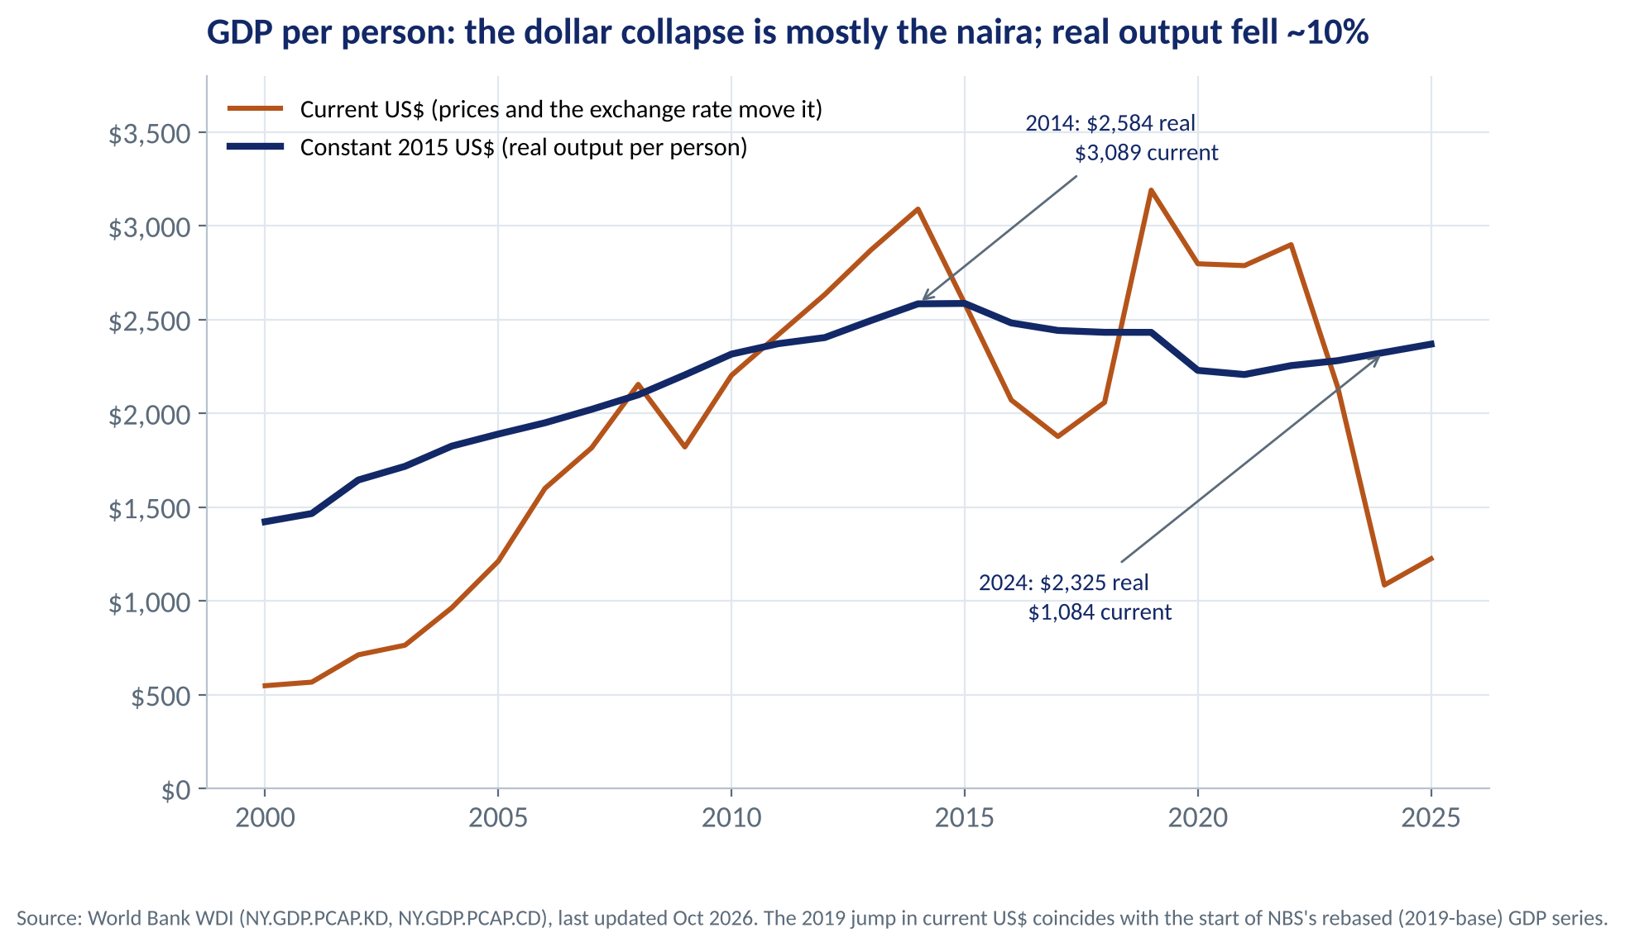
PRINCIPLE 8 · PRODUCTIVITY
Living Standards Depend on What a Country Produces
WHAT TO SEE
Real output per person (constant 2015 US$) was $2,584 in 2014, near its 2015 peak, and $2,325 in 2024: about 10% lower.
Population grew about 2–2.6% a year; output barely kept up — echoing 1992–2002, when the LBS case IB-90 reports GDP growth of 2.25% against population growth of 2.8% (older data).
The current-dollar line falls by two-thirds — mostly the naira's collapse, not lost production. It also jumps in 2019 where the rebased GDP series begins.
Wages rise sustainably only with output per worker: power, skills, technology, institutions (Session 7).
Fig S01-F05 · replicate: s01_figures.py / .R
LAGOS BUSINESS SCHOOL · EEGB · SESSION 1 · DATA LITERACY FOR MANAGERS
13
Notes:
Sources: World Bank WDI NY.GDP.PCAP.KD and NY.GDP.PCAP.CD (updated Oct 2026): 2014 $2,583.6 real (2015 peak $2,585.7) / $3,088.7 current; 2024 $2,324.6 / $1,084.2. SP.POP.GROW: 2.6% (2014) to 2.1% (2024). 'The Business Environment of Nigeria' (IB-90), p. 6, for 1992–2002.
This slide is also a data-literacy lesson: the same 'GDP per head' tells opposite stories in current and constant dollars.

Slide 14
PRINCIPLES 9 & 10 · THE ECONOMY AS A WHOLE — PREVIEW
Money, Prices and the Short-Run Trade-Off
1
Inflation is a transfer (Ferguson)
WHAT SESSIONS 6, 8 AND 9 WILL BUILD
The Ascent of Money shows inflation moving wealth from savers and bondholders to debtors. Argentina pegged, slashed inflation — and still defaulted in 2001 because fiscal discipline never followed.
9. Prices rise when the government finances itself by creating money.
10. In the short run, lowering inflation usually costs output and jobs.
2
Nigeria: money financing, then the bill
CBN 'Ways & Means' lending to the government reached about ₦22.7trn before being securitised in 2023. Inflation peaked at 34.8% in December 2024.
3
The trade-off in practice
The CBN raised its policy rate from 18.75% to 27.5% during 2024, began cutting only in September 2025 as inflation fell, and is now at 23% (September 2026). Volumes and jobs feel tightening before prices do.
4
Manager's use
Full treatment and Nigerian data in the appendix and in Part II.
When the MPC tightens, plan for slower demand and tighter working capital over the next year; when it eases, the reverse.
LAGOS BUSINESS SCHOOL · EEGB · SESSION 1 · DATA LITERACY FOR MANAGERS
14
Notes:
Sources: Ferguson, The Ascent of Money (2008), Introduction and ch. 2. Ways & Means: Senate approved securitisation of ₦22.7trn on 3–4 May 2023 (ThisDay); a further ₦7.3trn was securitised later, taking the total near ₦30trn. MPR path: CBN money-market indicators (18.75% Dec 2023; 27.50% Nov 2024; 27.0% from 23 Sep 2025; 26.5% from Feb 2026; 23.00% from 22 Sep 2026). Inflation: CBN/NBS CPI. Unemployment-measurement caveat (33.3% → 4.1% after NBS's 2023 methodology change) is in the appendix.

Slide 15

CONCEPT CHECK
Quick Check: What Would You Say?
Your CFO wants to run the night shift because 'it lowers our average cost per carton'. Which reply best applies today's principles?
A
Agree — a lower average cost means each carton is now more profitable
B
Reject it — fixed costs make night shifts unprofitable in Nigeria
C
Ask whether the shift's extra revenue covers its extra cost, ignoring fixed costs we pay anyway
D
Postpone until next quarter's GDP data show whether demand is growing
Discuss with your neighbour for 60 seconds — answer and reasoning in the speaker notes.
LAGOS BUSINESS SCHOOL · EEGB · SESSION 1 · DATA LITERACY FOR MANAGERS
15
Notes:
ANSWER: C. C. Marginal thinking: only costs that change with the decision matter. A lower average cost can coexist with a loss on the extra output (−₦0.7m a night in our example). A confuses average with marginal; B blames the fixed costs, which are irrelevant to the decision; D waits for slow data on a question your own numbers answer.

Slide 16
PART
02
Read the Numbers
How official statistics are built — and the traps that catch managers.
The question this part answers: Did our firm actually grow — and what is the economy really doing?

Slide 17




EVERY STATISTIC HAS A SUPPLY CHAIN
From Concept to Headline: Where Errors Creep In
›
›
›
›
›
Concept
Definition
Collection
Aggregation
Release
Revision
What do we want to know? e.g. the cost of living.
Which basket, households, prices, base year?
Surveys, admin and tax records. Is the informal sector covered?
Weights and index formulas turn thousands of prices into one number.
Headline first, detail later. Lags matter.
Rebasing and new data change history — even recent history.
Piketty's warning applies to every board paper: without precise sources, methods and concepts, you can see everything and its opposite.
LAGOS BUSINESS SCHOOL · EEGB · SESSION 1 · DATA LITERACY FOR MANAGERS
17
Notes:
Piketty, Capital in the Twenty-First Century (2014), Introduction, 'A Debate without Data?'. Each link maps onto a trap in this part: definition (rebasing), coverage (share of what?), aggregation (CPI weights), revision (the 2025 inflation revision).

Slide 18
ILLUSTRATIVE
MEASURING PRICES · MANKIW CH. 23
How the CPI Is Built — a Five-Step Worked Example
Monthly basket | Qty | 2024 price | 2025 price | 2024 cost | 2025 cost
Rice (50 kg bag) | 1 | ₦80,000 | ₦72,000 | ₦80,000 | ₦72,000
Garri (bucket) | 4 | ₦4,000 | ₦4,800 | ₦16,000 | ₦19,200
Petrol (litres) | 60 | ₦700 | ₦900 | ₦42,000 | ₦54,000
Transport (trips) | 40 | ₦500 | ₦600 | ₦20,000 | ₦24,000
Rent (monthly) | 1 | ₦100,000 | ₦120,000 | ₦100,000 | ₦120,000
Cost of basket |  |  |  | ₦258,000 | ₦289,200
STEP BY STEP
1
Fix the basket: what a typical household buys (quantities held constant).
2
Collect prices for each item in each period.
3
Cost the basket each year at that year's prices.
4
Pick a base year and index: 289,200 ÷ 258,000 × 100 = 112.1.
5
Inflation = 112.1 ÷ 100 − 1 = 12.1%, even though rice got cheaper.
The CPI tracks a fixed basket. Your firm's own input basket may inflate much faster or slower.
LAGOS BUSINESS SCHOOL · EEGB · SESSION 1 · DATA LITERACY FOR MANAGERS
18
Notes:
Mankiw ch. 23 uses hot dogs and hamburgers; this is a Lagos basket with illustrative prices. Ask: what is your company's 'basket' of inputs and how did its cost change? That is your firm's own inflation rate. Biases of the CPI (substitution, new goods, quality) are in the appendix.

Slide 19
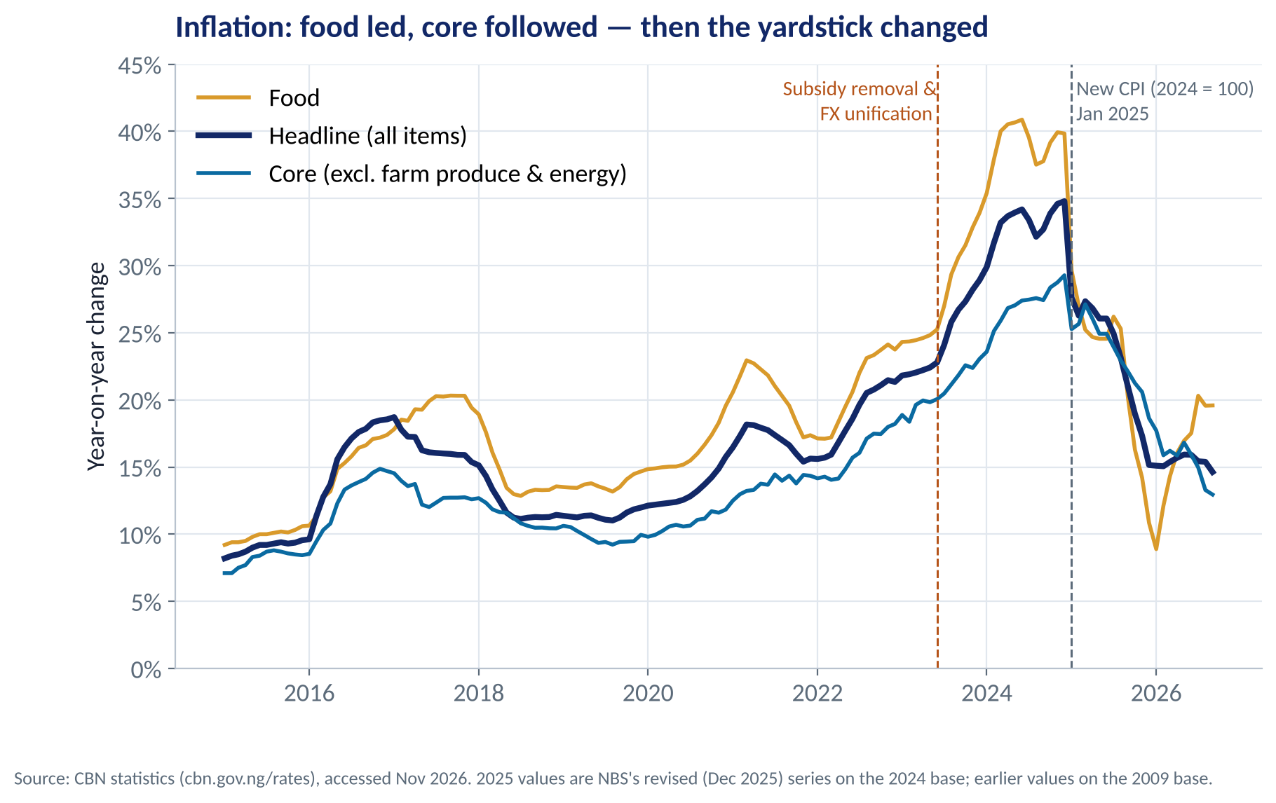
TRAP 1 · REBASING AND REVISIONS
Inflation: Food Led, Core Followed — Then the Yardstick Changed
WHAT TO SEE
Dec 2024: 34.8% on the old CPI (2009 base, food 51.8% of the basket).
Jan 2025: new CPI (2024 = 100, food weight 40%). First published as 24.48%…
…then revised to 27.61% when NBS reviewed its method in Dec 2025. Even 'latest data' changes.
Sep 2026: headline 14.6%, food 19.6%, core 13.0% — a genuine fall, on the new yardstick.
Never compare across a rebasing without the statistics office's linked series.
Fig S01-F01 · replicate: s01_figures.py / .R
LAGOS BUSINESS SCHOOL · EEGB · SESSION 1 · DATA LITERACY FOR MANAGERS
19
Notes:
Sources: CBN statistics (inflation API) reproducing NBS CPI; NBS rebasing (Feb 2025: base 2009 → 2024, food weight 51.8% → 40%, The Guardian); NBS methodology review, Dec 2025 (Jan 2025 revised 24.48% → 27.61%, Nairametrics, 16 Jan 2026). Ask: what would you tell a union negotiating wages off 'inflation has halved'?

Slide 20
TRAP 2 · REBASING GDP
The Day Nigeria's Economy 'Grew' 35%
₦372.8trn
+35.4%
0
2024 nominal GDP, rebased
vs the old estimate
Extra naira in anyone's pocket
New base year 2019 (was 2010), published by NBS in July 2025.
Same economy, better measurement: fintech, creative industries, telecoms and more informal activity captured.
Rebasing changes the level. Ratios drop overnight: debt-to-GDP, tax-to-GDP, credit-to-GDP.
Before comparing GDP ratios across years or countries, ask: which base year? A covenant of 'debt below 40% of GDP' can be met overnight by a rebasing.
LAGOS BUSINESS SCHOOL · EEGB · SESSION 1 · DATA LITERACY FOR MANAGERS
20
Notes:
Source: NBS rebased GDP release, July 2025 (2024 nominal GDP ₦372.8trn; +35.4% vs old series) — TechEconomy factsheet. Nigeria's previous rebasing (April 2014, base 1990 → 2010) raised 2013 GDP by about 89%.

Slide 21
TRAP 3 · 'SHARE OF WHAT?'
Oil Is 4% of GDP — and Still Most of Nigeria's Exports
WHAT TO SEE
Oil adds little value added in real GDP — it is capital-intensive and measured at constant prices.
But oil earns most of the dollars: crude alone was about 48% of exports; oil and gas about 86%.
So the oil price still drives the naira, reserves and government revenue.
Always ask: share of GDP, exports, revenue or FX supply?
Q2 2026. Sources: NBS GDP report; NBS Foreign Trade in Goods (crude ₦12.91trn, other ₦14.11trn incl. non-oil ₦3.72trn, of ₦27.0trn).
LAGOS BUSINESS SCHOOL · EEGB · SESSION 1 · DATA LITERACY FOR MANAGERS
21
Notes:
Sources: NBS GDP Q2 2026 (oil 4.16% of real GDP); NBS Foreign Trade in Goods Q2 2026 via Intelpoint (crude ₦12.91trn; non-crude ₦14.11trn; non-oil ₦3.72trn = 13.8% of total). Oil and gas share = (27.02 − 3.72) / 27.02 = 86.2%. In the 2000s oil supplied about 95% of FX earnings (LBS case IB-90).

Slide 22
TRAP 4 · PERCENT VS PERCENTAGE POINTS
Small Words, Big Mistakes
Change | Percentage points | Percent
Inflation 34.8% → 14.6% | −20.2 pp | −58%
MPR 26.5% → 23.0% | −3.5 pp (350 bp) | −13.2%
CPI food weight 51.8% → 40% | −11.8 pp | −22.8%
STEP BY STEP
1
A percentage point (pp) is the simple difference between two rates.
2
A percent change is the change relative to the starting level.
WORKED EXAMPLE
3
Markets speak in basis points: 1 pp = 100 bp. The September 2026 MPC cut was 350 bp.
A loan priced at 'MPR + 4%' fell from 30.5% to 27.0% after the September 2026 cut: a 3.5 pp fall in the rate, which cuts the interest bill by 11.5%. Both numbers are right; they answer different questions.
4
'Food weight cut by over 22 per cent' (Feb 2025 headline) is right as a percent — the weight fell 11.8 points.
Say pp for changes in rates. Mixing the two misstates a change by a factor of two to four.
LAGOS BUSINESS SCHOOL · EEGB · SESSION 1 · DATA LITERACY FOR MANAGERS
22
Notes:
Sources: CBN/NBS CPI (Dec 2024 34.80%, Sep 2026 14.63%); CBN MPC (MPR 26.5% → 23%, Sep 2026); The Guardian, Feb 2025, 'NBS unveils new inflation template, reduces food weight to 40%' (guardian.ng/news/nbs-unveils-new-inflation-template-reduces-food-weight-to-40/). Year-on-year vs month-on-month and base effects are in the appendix.

Slide 23
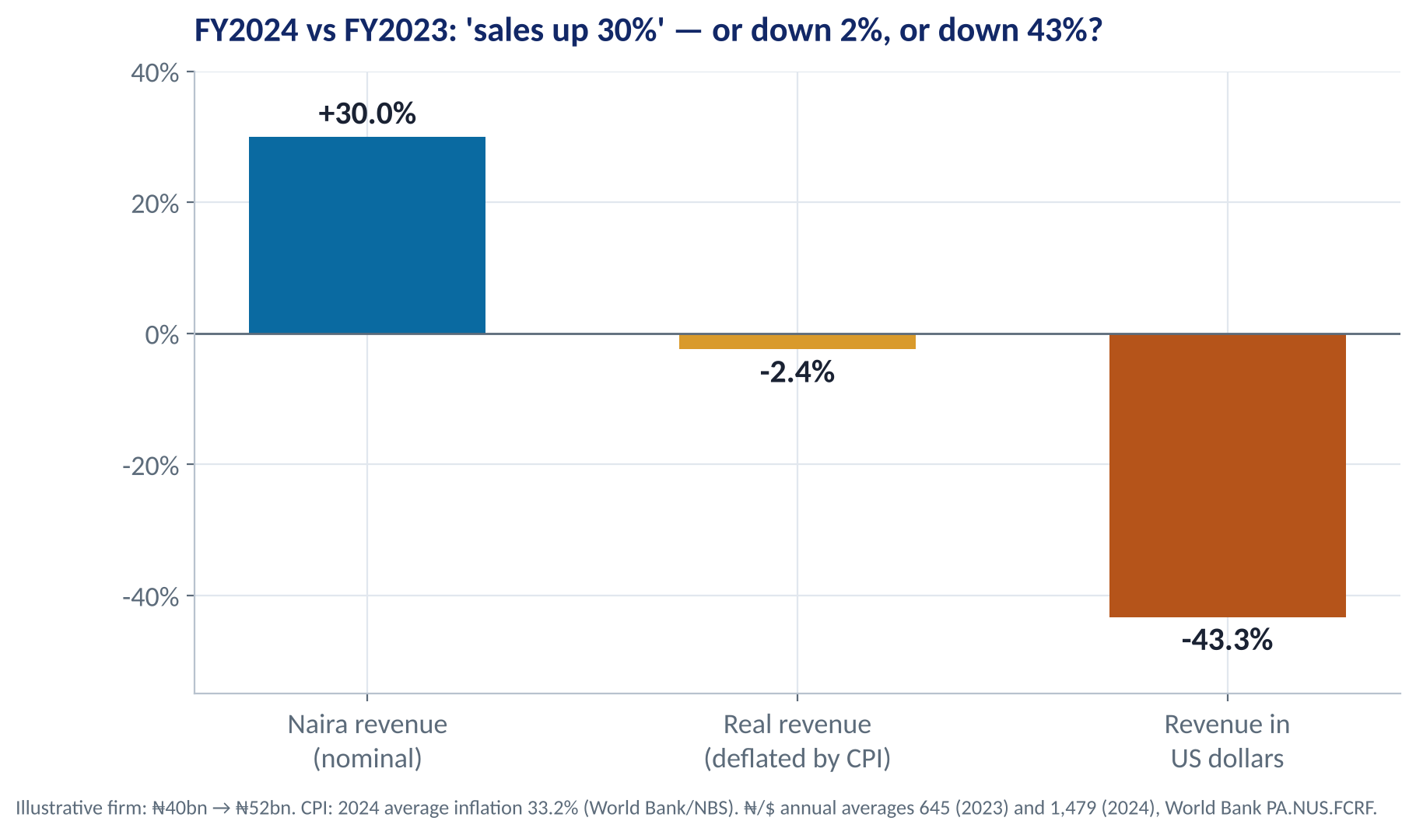
BACK TO THE 30% QUESTION
Real vs Nominal: One Revenue Figure, Three Answers
WHAT TO SEE
Real growth: (1 + nominal) ÷ (1 + inflation) − 1 = 1.30 ÷ 1.332 − 1 ≈ −2.4%. Volume fell.
The shortcut 'nominal − inflation' gives −3.2%: fine for small rates, off at Nigerian rates.
In dollars: ₦40bn ÷ 645 = $62.0m → ₦52bn ÷ 1,479 = $35.2m: down 43%.
The board was celebrating a business that shrank. Report real, naira and dollar figures side by side.
Targets and bonuses set in nominal naira reward inflation, not performance.
Fig S01-F07 · replicate: s01_figures.py / .R
LAGOS BUSINESS SCHOOL · EEGB · SESSION 1 · DATA LITERACY FOR MANAGERS
23
Notes:
Uses 2024 average inflation (33.24%) and annual-average exchange rates (₦645.19, ₦1,478.97), World Bank WDI. Which deflator? The firm's own price index gives volume growth; the CPI gives the customers' purchasing-power view. Ask participants to redo this for their own firm before Session 2.

Slide 24
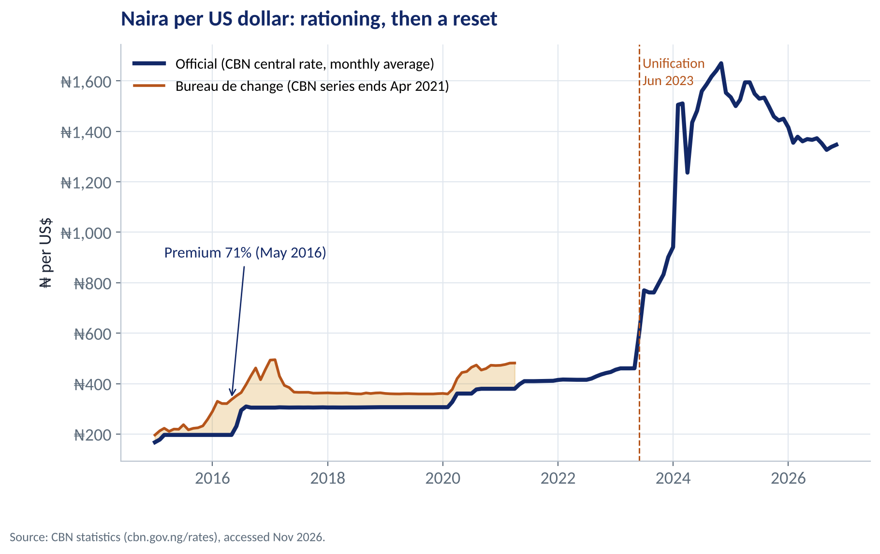
THE EXCHANGE RATE
Naira per Dollar: Rationing, Then a Reset
WHAT TO SEE
Until 2023 the CBN held an official rate; the bureau-de-change rate shows the market's price. The gap peaked at 71% (May 2016).
A premium signals rationing — Principle 6 at work — and an incentive to arbitrage (Principle 4).
June 2023 unification: the naira moved from about ₦460 to ₦750/$ within weeks, then past ₦1,500.
Today: ₦1,347/$ (CBN, 4 Nov 2026). Use the rate you actually transact at.
Fig S01-F02 · replicate: s01_figures.py / .R
LAGOS BUSINESS SCHOOL · EEGB · SESSION 1 · DATA LITERACY FOR MANAGERS
24
Notes:
Source: CBN statistics — official central rate (daily, averaged monthly) and BDC monthly average (CBN series ends April 2021). Latest: CBN central rate ₦1,347.30/$, 4 Nov 2026. Session 11 covers regimes, unification and the trilemma.

Slide 25
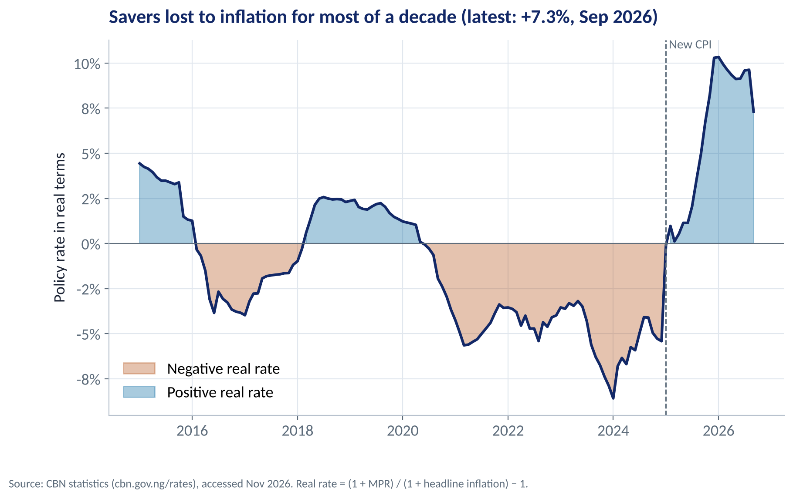
REAL INTEREST RATES
Did Savers Beat Inflation? The Real Policy Rate
WHAT TO SEE
Real rate = (1 + policy rate) ÷ (1 + inflation) − 1 — the same arithmetic as real revenue.
For most of 2016–2024 it was negative, falling below −8% in 2024: naira savings lost value, pushing savers into dollars, land and stock.
Today: MPR 23%, inflation 14.6% → real rate +7.3%. Holding naira now pays.
Part of the jump in January 2025 is the new CPI — measurement, not just policy.
Fig S01-F03 · replicate: s01_figures.py / .R
LAGOS BUSINESS SCHOOL · EEGB · SESSION 1 · DATA LITERACY FOR MANAGERS
25
Notes:
Source: CBN statistics (MPR and headline CPI, monthly). Exact Fisher formula. Sep 2026: 1.23 / 1.1463 − 1 = 7.3%. Ask: which cash and inventory habits did your firm learn when real rates were negative — and which should change now?

Slide 26
TRAP 5 · CORRELATION IS NOT CAUSATION
Four Reasons Two Series Move Together
1
A third factor drives both
THE RULE
Bank credit and inflation both jumped after the 2023 devaluation: the weaker naira revalued dollar loans and raised import prices.
Correlation tells you that two series move together. It does not tell you why — or which way the arrow points.
2
Reverse causality
Branches that spend more on marketing sell more — partly because budgets are set as a share of last year's sales.
3
Time lags
Policy and price shocks work with lags. A same-month correlation can show no link, or the wrong sign.
4
Coincidence and small samples
Before acting on 'X drives Y', rule out all four.
Two trending series always look related. Short windows and data-mining produce spurious patterns — the Kuznets curve story in the appendix is the classic.
LAGOS BUSINESS SCHOOL · EEGB · SESSION 1 · DATA LITERACY FOR MANAGERS
26
Notes:
Then show the oil–reserves chart: an obvious causal channel with a modest and unstable correlation. Then the method slide: how to get at cause.

Slide 27
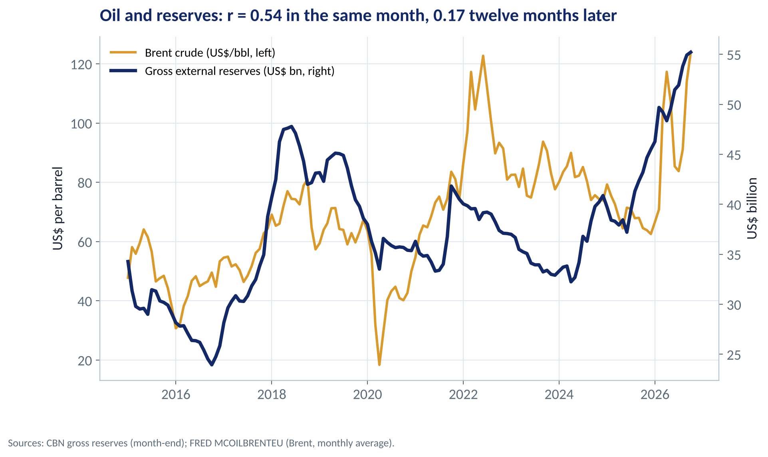
SEE IT IN THE DATA
Oil Earns Nigeria's Dollars — Yet Reserves Don't Simply Track It
WHAT TO SEE
The causal channel is clear: oil and gas earn most of the FX (Trap 3).
Yet the correlation is only 0.54 in the same month — and 0.17 a year later.
Why? Oil-backed loans and forward sales, CBN intervention, Eurobond and loan inflows, and 2026's reserve build despite a volatile oil price.
A causal link can hide inside a weak correlation, and a strong correlation can hide no link at all.
Fig S01-F04 · replicate: s01_figures.py / .R
LAGOS BUSINESS SCHOOL · EEGB · SESSION 1 · DATA LITERACY FOR MANAGERS
27
Notes:
Sources: CBN gross external reserves (month-end), FRED MCOILBRENTEU; correlations computed in s01_figures.py over Jan 2015 – Oct 2026. Brent averaged $123.9 in Oct 2026 (FRED) — a live issue for the dashboard in Part 3.

Slide 28
ILLUSTRATIVE
FROM CORRELATION TO CAUSE
Did Our Price Rise Cut Volumes? Use a Comparison Group
Volume change, Feb → Mar | Lagos (price +10%) | Abuja (no change)
Cartons sold | −8% | −5%
What else happened | Fuel-price rise | Fuel-price rise
Effect of the price rise | −8% − (−5%) = −3%
STEP BY STEP
1
Naïve reading: volumes fell 8% after a 10% price rise, so elasticity ≈ −0.8. Cut the price back?
2
But a fuel-price shock hit both cities. Abuja, with no price change, fell 5% anyway.
THE ONE QUESTION
3
Difference-in-differences: the price rise explains only −8% − (−5%) = −3% → elasticity ≈ −0.3. Demand is fairly inelastic; keep the price.
Ask of any 'X caused Y' claim: compared with what? Without a comparison group that faced the same shocks, you are measuring the shock, not your decision.
4
Stronger designs: randomised tests (price a random half of outlets), and natural experiments (a policy that hits some regions or products and not others).
Cause needs a counterfactual: what would have happened without the decision?
LAGOS BUSINESS SCHOOL · EEGB · SESSION 1 · DATA LITERACY FOR MANAGERS
28
Notes:
Illustrative numbers. The comparison works only if Lagos and Abuja would have moved alike without the price change ('parallel trends'). Link to Session 2 (elasticity) and Session 3 (forecasting). Mention that the economics of randomised experiments (Banerjee–Duflo–Kremer, Nobel 2019) and natural experiments (Card–Angrist–Imbens, Nobel 2021) are this same idea.

Slide 29
CONCEPT CHECK
Quick Check: What Would You Say?
A director says: 'Inflation fell from 34.8% in December 2024 to 24.5% in January 2025 — down 10% in a month. We can cut prices.' What is the best response?
A
The fall partly reflects the new CPI base and basket; January has since been revised to 27.6%, and it is a 10-point fall, not 10% — compare like with like before repricing
B
He is right: a 10-point fall in one month is strong evidence that price pressures have ended
C
He is right on the direction but wrong on size: it fell about 30%, so cut prices even more
D
Ignore inflation data altogether; watch only the exchange rate
Discuss with your neighbour for 60 seconds — answer and reasoning in the speaker notes.
LAGOS BUSINESS SCHOOL · EEGB · SESSION 1 · DATA LITERACY FOR MANAGERS
29
Notes:
ANSWER: A. A. Three corrections in one: a rebasing break, a later revision, and points vs percent. B ignores the measurement break; C computes the percent change correctly (−30%) but draws the wrong conclusion from a broken comparison; D throws away useful information.

Slide 30
PART
03
Nowcast and Build the Board's Page
See the economy before the statistics office does — and put it on one page.
The question this part answers: Which six numbers should the directors see every month, and what do they mean for us?

Slide 31

NOWCASTING
Seeing the Economy Before GDP Is Published
IN PLAIN ENGLISH
THE FORMULA
PMI > 50 expanding · < 50 contracting
GDP for a quarter arrives about two months after it ends. Nowcasting estimates what is happening now from faster signals: business surveys (PMI), payments, fuel and power use, port traffic — and your own orders.
A diffusion index: the balance of firms reporting improvement, centred on 50
WHY A MANAGER CARES
Your own data are nowcasting signals: daily sales, distributor orders, collections and stock levels often tell you about the economy weeks before NBS does. Combine them with the PMI and the price data on one page.
EXAMPLE
The Stanbic IBTC PMI was 55.7 in October 2026 (56.4 in September): a ninth month of growth, but input prices hit a four-month high on fuel costs — an early warning for margins.
LAGOS BUSINESS SCHOOL · EEGB · SESSION 1 · DATA LITERACY FOR MANAGERS
31
Notes:
Source: S&P Global / Stanbic IBTC Bank Nigeria PMI, October 2026 release. NBS publishes quarterly GDP roughly eight weeks after quarter-end (Q2 2026 GDP was released in late August/September 2026).

Slide 32
NIGERIA NOW · LATEST OFFICIAL DATA
The Board's Macro Page — November 2026
Indicator | Latest (date) | Direction | So what for an import-dependent FMCG firm
Headline / core inflation | 14.6% / 13.0% (Sep 26) | Falling | Real incomes recovering; core still double-digit — price rises must stay selective
Monetary policy rate | 23.0% (Sep 26) | Cut 350 bp | Working-capital costs easing; real rate ≈ +7% makes hoarding stock expensive
Naira (CBN official) | ₦1,347/$ (4 Nov 26) | Stable | Imported-input costs steady; review hedges and dollar pricing assumptions
Gross reserves | $55.1bn (3 Nov 26) | Rising | Better FX liquidity; lower risk of a disorderly devaluation
Brent crude | $123.9 (Oct 26 avg) | Up sharply | More FX and revenue for Nigeria — but costlier diesel, freight and petrochemical inputs
Real GDP / PMI | 4.43% (Q2 26) / 55.7 (Oct 26) | Growing | Volume growth possible; PMI flags rising input prices — protect margins
Each row = latest value with its date + direction + one 'so what'. Same layout every month; the chart version is in the appendix.
LAGOS BUSINESS SCHOOL · EEGB · SESSION 1 · DATA LITERACY FOR MANAGERS
32
Notes:
Sources: CBN statistics (CPI Sep 2026; MPR Sep 2026; official central rate 4 Nov 2026 ₦1,347.30; gross reserves 3 Nov 2026 $55.15bn); FRED MCOILBRENTEU (Oct 2026 $123.93); NBS GDP Q2 2026 (4.43%); S&P Global/Stanbic IBTC PMI Oct 2026 (55.7). Refresh with tools/fetch_official_data.py before each delivery.

Slide 33



HANDS-ON LAB
Lab 1: Build the Board's Macro Page
1
Load the official data and look at the latest three months — note the date of each series.
YOU WILL NEED
Data
2
Build a table of six indicators: latest value, value a year ago, change (in pp for rates).
data/official/ng_official_monthly.csv
3
Add two derived numbers: the real policy rate (exact formula) and your firm's real revenue growth.
R script
sessions/s01/R/s01_lab.R
4
Mark the January 2025 CPI break and say how you would compare inflation across it.
Python script
Write one 'so what' for your company under each number, using the macro-to-P&L map.
sessions/s01/python/s01_lab.py
5
Deliverable: a one-page dashboard: six dated numbers, two derived indicators, six 'so what' lines.
⏱ 15 minutes
LAGOS BUSINESS SCHOOL · EEGB · SESSION 1 · DATA LITERACY FOR MANAGERS
33

Slide 34
CONCEPT CHECK
Quick Check: What Would You Say?
Which pair of signals would best tell an FMCG board, this month, that demand is weakening?
A
Last quarter's GDP release and the IMF's annual forecast
B
The CPI base year and the GDP base year
C
The 10-year bond yield and the oil price
D
The PMI new-orders index and the firm's own distributor orders and collections
Discuss with your neighbour for 60 seconds — answer and reasoning in the speaker notes.
LAGOS BUSINESS SCHOOL · EEGB · SESSION 1 · DATA LITERACY FOR MANAGERS
34
Notes:
ANSWER: D. D. Fast, demand-side signals: the PMI arrives within days and the firm's own orders and collections are real-time. A is slow; B is about measurement, not demand; C matters for financing and FX, not this month's demand.

Slide 35
KEY TAKEAWAYS
Session 1 in 5 Ideas
01
Economics is a management tool: trade-offs, opportunity cost, the margin and incentives frame every decision.
02
Use the macro-to-P&L map: every economic force lands in a specific line of your accounts.
03
Every statistic has a supply chain: check base year, basket, coverage and revisions.
04
Report real, naira and dollar values side by side — '30% growth' was a 2% real fall and a 43% dollar fall.
05
Correlation is not cause — ask 'compared with what?' — and show the board one page of fast, dated signals.
NEXT › Session 2: Demand, Supply & Elasticity
Before next session: Read Mankiw ch. 4–5 and the Note on Microeconomics for Managers (demand, supply, elasticity). Bring one price your company changed in the last year and what happened to volumes — and a comparison group.

Slide 36
APPENDIX
Self-Study: Going Deeper
Read these before the quiz. They are not presented in class.
The question this part answers: What else do I need to master Session 1 on my own?

Slide 37




SELF-STUDY
WHERE WE ARE
Course Roadmap — 16 Sessions, 4 Parts
Pre-module and intra-module online sessions, sixteen on-campus sessions, and a closed-book final exam.
YOU ARE HERE
Part I
Part II
Part III
Part IV
Sessions 1–5
Sessions 6–10
Sessions 11–12
Sessions 13–16
Micro & markets
Macro, policy & risk
Open economy
Strategic frontiers
Data literacy, demand and elasticity, forecasting, market structure and platforms, market failures
AD–AS and inflation, national accounts, monetary policy, fiscal policy and debt, financial stability
Exchange rates, capital flows and the trilemma; trade, supply chains, industrial policy and AfCFTA
Climate economics, country risk and scenarios, hedging and resilience, capstone memos
LAGOS BUSINESS SCHOOL · EEGB · SESSION 1 · DATA LITERACY FOR MANAGERS
37

Slide 38
SELF-STUDY
WHAT ECONOMICS IS · MANKIW CH. 1
Economics Is the Study of Choice Under Scarcity
1
Every decision is an allocation
DEFINITION
Scarce dollars to raw materials or to a dollar loan? More 50 cl or 1 litre packs? Economic questions before they are finance questions.
Scarcity: society has limited resources and cannot produce everything people want. Economics studies how society manages those scarce resources.
2
Everyone chooses
Customers trade off food against transport; competitors trade off price against margin; government trades off subsidies against capital spending.
3
Two zoom levels
Microeconomics: households and firms in markets (Sessions 2–5). Macroeconomics: economy-wide inflation, growth, interest and exchange rates (Sessions 6–12).
A firm is a small society: limited cash, capacity, FX, management attention.
LAGOS BUSINESS SCHOOL · EEGB · SESSION 1 · DATA LITERACY FOR MANAGERS
38

Slide 39
SELF-STUDY
ECONOMISTS USE MODELS · MANKIW CH. 2
The Circular-Flow Diagram: The Simplest Model of the Economy
Revenue (= GDP)
Markets for
goods & services
Spending (= GDP)
HOW TO READ IT
A model is a simplified map: it leaves out detail on purpose so we can see how parts connect.
Households own labour, land and capital; firms hire them to produce goods and services.
Every naira one person spends is a naira of income for someone else: total spending = total income = GDP.
Left out on purpose: government, banks and the rest of the world (Sessions 7–11).
When households' real incomes fall, the flow into your goods market shrinks.
Goods & services sold
G & S bought
FIRMS
HOUSEHOLDS
Factors hired
Labour, land, capital
Markets for
factors of production
Wages, rent, profit
Income (= GDP)
Gold = flows of naira · Blue = flows of goods, services and factors
LAGOS BUSINESS SCHOOL · EEGB · SESSION 1 · DATA LITERACY FOR MANAGERS
39

Slide 40


SELF-STUDY
TWO KINDS OF STATEMENT · MANKIW CH. 2
Positive vs Normative: Scientist or Policy Adviser?
Positive statements
Normative statements
Describe how the world is — testable
Prescribe how it should be — values
'Removing the petrol subsidy raised transport fares.'
'A 10% depreciation raises the CPI by x% within a year.'
Settled with evidence.
'The CBN should cut rates to help manufacturers.'
'Nigeria ought to ban textile imports.'
Involve values and priorities, not only facts.
Why economists disagree: different scientific judgements, different values — and less often than headlines suggest.
LAGOS BUSINESS SCHOOL · EEGB · SESSION 1 · DATA LITERACY FOR MANAGERS
40

Slide 41
SELF-STUDY
TRY IT · POSITIVE OR NORMATIVE?
Classify Each Statement
# | Statement | Positive | Normative
1 | Inflation fell from 34.8% in December 2024 to 14.6% in September 2026. | ☐ | ☐
2 | Inflation of 15% is still far too high for Nigeria. | ☐ | ☐
3 | Higher minimum wages reduce formal-sector hiring of young workers. | ☐ | ☐
4 | The government should use oil windfalls to pay down debt rather than raise salaries. | ☐ | ☐
5 | Banks that raised capital in the recapitalisation have grown lending faster. | ☐ | ☐
6 | A strong naira is good for the country. | ☐ | ☐
Tip: should, ought, too high, good, fair usually signal a normative claim. A positive claim can be false and still be positive.
LAGOS BUSINESS SCHOOL · EEGB · SESSION 1 · DATA LITERACY FOR MANAGERS
41
Notes:
ANSWERS: 1 positive (true, but note the CPI break). 2 normative. 3 positive (testable; evidence is mixed). 4 normative. 5 positive (testable). 6 normative — good for whom? Importers and consumers gain; exporters and naira oil revenue lose.

Slide 42
SELF-STUDY
MEASURING OUTPUT · MANKIW CH. 22
GDP: What Is Counted, and What Is Not
1
'Market value'
Y = C + I + G + NX
Valued at market prices so we can add rice and phone calls. Unpriced work — home care, subsistence — is largely left out.
GDP is the market value of all final goods and services produced in a country in a period.
C consumption · I investment · G government purchases (not transfers) · NX exports − imports
2
'Final' goods only
Count the loaf, not the flour in it, or you double-count.
3
'Produced in a country'
GDP counts output inside Nigeria, whoever owns the factory; GNI counts income of Nigerians wherever earned.
4
Nominal vs real GDP
Because spending = income, GDP also measures total income.
Q2 2026: nominal GDP +18.4%, real +4.4%. The gap (≈13.4%) is price change — the GDP deflator.
LAGOS BUSINESS SCHOOL · EEGB · SESSION 1 · DATA LITERACY FOR MANAGERS
42
Notes:
NBS GDP Q2 2026: nominal ₦119.29trn (basic prices), +18.43%; real +4.43%. Implied deflator 1.1843 / 1.0443 − 1 = 13.4%.

Slide 43



SELF-STUDY
WHY THE CPI IS IMPERFECT · MANKIW CH. 23
Three Biases Every Price Index Carries
Substitution bias
New goods
Unmeasured quality
When rice gets dearer, families switch to garri or yam. A fixed basket ignores the switch, so it overstates the rise in the cost of living.
Mobile money and ride-hailing widened choice and cut costs. A basket fixed in an old base year misses them until it is rebased.
If a phone costs 20% more but does twice as much, part of the 'price rise' is really more quality.
These biases are why statistics offices rebase. Rebasing reduces the bias — but breaks the series.
LAGOS BUSINESS SCHOOL · EEGB · SESSION 1 · DATA LITERACY FOR MANAGERS
43

Slide 44
SELF-STUDY
READING RATES · YEAR-ON-YEAR VS MONTH-ON-MONTH
Which Change Are You Looking At?
September 2026 | Year on year | Month on month | m/m annualised
Headline | 14.63% | 0.06% | ≈ 0.7%
Food | 19.59% | −1.55% | ≈ −17%
Core | 12.95% | 1.11% | ≈ 14.2%
STEP BY STEP
1
Year on year compares with the same month last year: smooth, but it carries twelve months of history.
2
Month on month shows the latest momentum — noisy and seasonal (harvests, festive demand).
WATCH FOR BASE EFFECTS
3
Annualise a monthly rate: (1 + m)¹² − 1. Core: 1.0111¹² − 1 ≈ 14.2%.
Base effects: if prices jumped in a month last year, the y/y rate falls mechanically when that month drops out — even if nothing improves today. The mid-2023 petrol-price jump did exactly this to mid-2024 readings.
4
Reading: headline momentum looks near zero because food fell after the harvest; underlying (core) pressure still runs at about 14% a year.
Ask: compared with when? seasonally adjusted? headline or core?
LAGOS BUSINESS SCHOOL · EEGB · SESSION 1 · DATA LITERACY FOR MANAGERS
44
Notes:
Source: NBS CPI September 2026 (headline 14.63% y/y, 0.06% m/m; food 19.59%, −1.55%; core 12.95%, 1.11%), as reported by the Gazette, 16 Oct 2026.

Slide 45
SELF-STUDY
A CAUTIONARY TALE · PIKETTY
The Kuznets Curve: A Big Theory Built on a Special Period
1
Careful data
CAPITAL IN THE 21ST CENTURY, INTRODUCTION
Kuznets built the first US income-distribution series from tax returns, 1913–1948, and documented every method.
In 1955 Simon Kuznets suggested inequality naturally falls as economies develop. The idea spread worldwide.
2
One country, 35 years, two shocks
The fall in US inequality came largely from the Great Depression and World War II, not an automatic law.
3
The pattern reversed
Longer, wider data show inequality rising again in many countries from the 1980s.
4
Manager's lesson
Kuznets himself warned the data were special; the warning was forgotten.
A trend from a short or unusual window — say 2016–2020, or the post-2023 reform period — is a hypothesis, not a law.
LAGOS BUSINESS SCHOOL · EEGB · SESSION 1 · DATA LITERACY FOR MANAGERS
45
Notes:
Piketty (2014), Introduction: 'A Debate without Data?' and 'The Kuznets Curve: Good News in the Midst of the Cold War'.

Slide 46
SELF-STUDY
PRINCIPLE 10 · A DATA TRAP
Nigeria's Unemployment Rate: 33% to 4% — by Definition
1
What changed
NBS METHODOLOGY CHANGE, 2023
Under the new method, anyone who worked at least one hour for pay or profit in the past week counts as employed (the ILO standard).
The headline unemployment rate went from 33.3% (Q4 2020) to 4.1% (Q1 2023). Most of the fall is a change of definition, not of jobs.
2
Watch underemployment
Time-related underemployment — working under 40 hours and wanting more — was 12.2% in Q1 2023.
3
Why it matters for the trade-off
With most jobs informal, tightening shows up first in hours, incomes and informal sales, not in the headline rate.
4
Manager's use
The two numbers are not comparable.
Track your own footfall, basket size and distributor orders as the real-time labour-income signal.
LAGOS BUSINESS SCHOOL · EEGB · SESSION 1 · DATA LITERACY FOR MANAGERS
46
Notes:
Source: NBS Labour Force Survey, new methodology (Q1 2023, 4.1%; underemployment 12.2%); old-methodology Q4 2020 rate 33.3% — TheCable, Aug 2023.

Slide 47
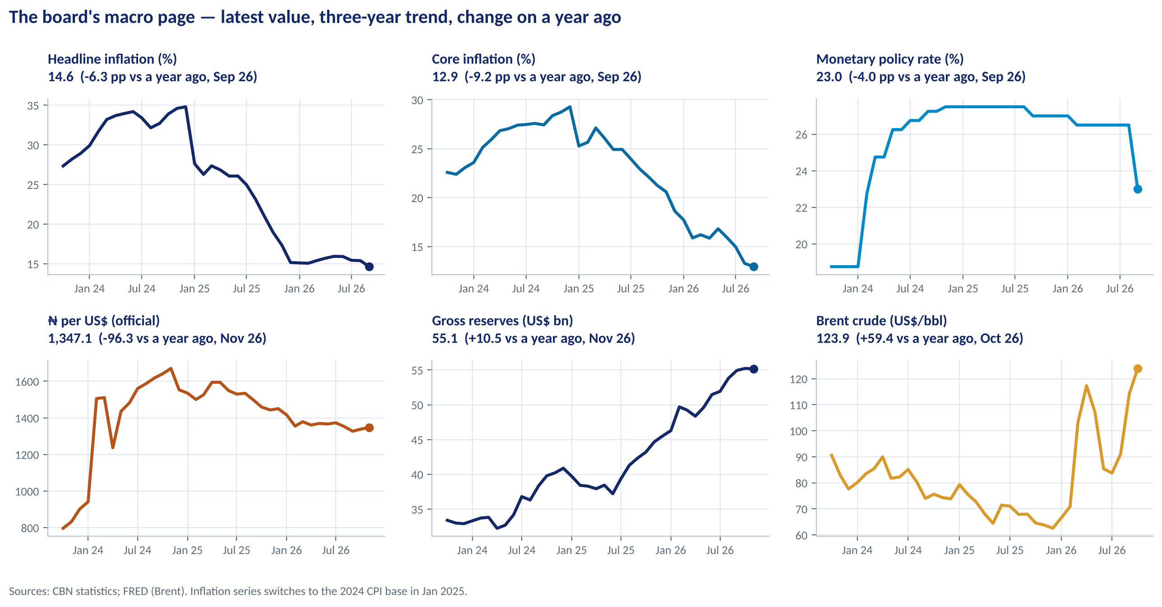
SELF-STUDY
THE DASHBOARD · CHART VERSION
Six Official Series on One Page
WHAT TO SEE
Each panel: latest value and date, a three-year trend and the change on a year ago.
Covers prices, money, the currency, external buffers and the oil price.
Same layout every month, so directors see change at a glance.
Inflation panels cross the January 2025 CPI break — label it.
Fig S01-F06 · replicate: s01_figures.py / .R
LAGOS BUSINESS SCHOOL · EEGB · SESSION 1 · DATA LITERACY FOR MANAGERS
47
Notes:
Generated from official CBN data and FRED by s01_figures.py. The lab rebuilds it.

Slide 48
SELF-STUDY
WHERE TO LOOK
The Sources Every Nigerian Manager Should Bookmark
Source | What you get | How often | Watch out for
NBS (nigerianstat.gov.ng) | CPI, GDP, labour force, foreign trade | Monthly / quarterly | Rebasing (CPI 2025, GDP 2025); revisions
CBN (cbn.gov.ng/rates) | MPR, exchange rates, reserves, money and credit; downloadable series | Daily to monthly | Series start/stop; BDC data end 2021
DMO · NUPRC · FMDQ | Public debt; oil output; FX and bond prices | Monthly / daily | Different coverage of 'debt' and 'output'
S&P Global – Stanbic IBTC PMI | Private-sector survey: output, orders, prices, jobs | Monthly (days 1–3) | >50 = more firms improving
IMF (WEO, data.imf.org) | Comparable cross-country data and forecasts | April / October | Forecasts revised often
World Bank WDI · FRED | Long annual series; global prices (Brent) | Annual / monthly | Lags; current vs constant dollars
LAGOS BUSINESS SCHOOL · EEGB · SESSION 1 · DATA LITERACY FOR MANAGERS
48
Notes:
tools/fetch_official_data.py downloads the CBN, World Bank and FRED series used in this deck.

Slide 49


SELF-STUDY
WHERE MANAGERS GO WRONG
The Traps — and the Habit That Beats Each One
THE TRAP
THE BETTER HABIT
Comparing inflation or GDP across a rebasing or before a revision.
Check the base year and vintage; use the linked series.
'Oil is only 4% of GDP, so the oil price doesn't matter to us.'
Ask share of what — exports, revenue, FX supply.
'Rates fell 3.5 percent.'
Say 3.5 percentage points (350 bp).
Reading only year-on-year rates.
Add m/m annualised and core to see momentum; watch base effects.
Celebrating nominal naira growth.
Report real, naira and dollar values side by side.
'Sales fell after the price rise, so the price rise caused it.'
Ask compared with what? — use a comparison group.
LAGOS BUSINESS SCHOOL · EEGB · SESSION 1 · DATA LITERACY FOR MANAGERS
49

Slide 50
SELF-STUDY
WORDS TO OWN
Today's Vocabulary in Plain English
Opportunity cost
The value of the best alternative given up.
CPI
Cost of a fixed basket relative to a base period.
Marginal
The extra benefit or cost of one more unit or decision.
Rebasing / revision
New base and weights / corrected past figures; both break comparisons.
Comparative advantage
Producing at a lower opportunity cost than others.
Real vs nominal
Adjusted for price changes vs in current naira.
Positive / normative
Claims about what is (testable) vs what should be (values).
Percentage point
Simple difference between two rates (1 pp = 100 bp).
GDP / GDP deflator
Market value of final output; nominal ÷ real GDP.
Difference-in-differences
Effect = change in treated group − change in comparison group.
LAGOS BUSINESS SCHOOL · EEGB · SESSION 1 · DATA LITERACY FOR MANAGERS
50

Slide 51
SELF-STUDY
GO DEEPER
Readings Behind This Session
Mankiw, Principles of Economics — ch. 1–3
Ten principles; economists as scientists and advisers; the circular flow; comparative advantage.
Mankiw — ch. 22 & 23 (course copy)
Measuring income (GDP, real vs nominal, the deflator) and the cost of living (CPI and its biases). In the 7th–9th editions these are ch. 23–24.
Ferguson, The Ascent of Money — Intro & ch. 2
Money, inflation as a transfer, bonds, and Argentina's long decline.
Piketty, Capital in the 21st Century — Introduction
'A Debate without Data?' and the Kuznets curve: how data and periods shape big conclusions.
LBS case: The Business Environment of Nigeria (IB-90)
Oil dependence, macro volatility and the 2000s reforms (excess crude account; reserves $7.5bn → $60.8bn).
Note on Microeconomics for Managers
Demand, supply and elasticity — the reading for Session 2.
LAGOS BUSINESS SCHOOL · EEGB · SESSION 1 · DATA LITERACY FOR MANAGERS
51

