Slide 1


LAGOS BUSINESS SCHOOL · MEMBA 14 · EEGB · PART I
SESSION 2
Demand, Supply & Elasticity
with Behavioural Insights
From markets, to macro, to decisions that matter — in Nigeria and the world.
Reading: Note on Microeconomics for Managers · Facilitator: Bongo Adi
Economic Environment of Global Business · Lagos Business School · Prof. Bongo Adi, Kelechi Nnamdi, Elvis Ozegbe
Notes:
Today is about the most common decision managers make: what price to charge. Open with the flour shock and get three or four participants to commit to a pass-through percentage before any analysis — revisit their numbers at the end.

Slide 2




RECAP
Session 1 in Three Ideas
Think like an economist
Incentives, opportunity cost and decisions at the margin frame every business choice.
Nominal vs real
Take inflation and the exchange rate out of the numbers before celebrating growth.
Read the data
Know your sources; watch for rebasing, multiple rates and correlations that are not causes.
SESSION 2 · DEMAND, SUPPLY & ELASTICITY
2

Slide 3



TODAY'S PLAN
Session 2 at a Glance — 75 Minutes
How prices are set, how customers respond, and how to price through a cost shock.
10'
20'
25'
20'
Recap & Hook
Demand & Supply
Elasticity
Behaviour & Pricing
Flour is up 40%. What do we charge?
Why prices move, and who bears a cost shock
Own, cross and income — and why the naive number lies
Reference prices, promotions, dynamic pricing, pass-through
SESSION 2 · DEMAND, SUPPLY & ELASTICITY
3

Slide 4

BY THE END OF TODAY
Session 2 Learning Objectives
You will be able to:
01
02
03
Read a Market
Measure Elasticity
Price Under Uncertainty
Use demand and supply to explain why a price moved, and predict who bears a cost increase.
Estimate own-price, cross-price and income elasticities from sales data — holding other things constant.
Decide how much of a cost shock to pass on, using elasticity, rivals' behaviour and customers' reference prices.
SESSION 2 · DEMAND, SUPPLY & ELASTICITY
4

Slide 5

THE HOOK
Flour Is Up 40%. What Do We Charge?
“Our flour bill has jumped 40%. Just add it to the price — customers have no choice, everybody eats noodles.”
Before signing off the new price list, a good manager asks three questions:
How sensitive are buyers?
What will rivals do?
What price feels 'fair'?
If a 10% price rise loses 13% of volume, 'just pass it on' shrinks revenue.
If competitors face the same shock and also raise prices, we lose far fewer customers.
Shoppers compare with the price they are used to. Big jumps hurt more than the arithmetic suggests.
Notes:
Ask the class: who has raised a price in the last year? What happened to volume in the first month, and after three months?

Slide 6



NIGERIAN BUSINESS CASE
Pricing Noodles Through a Flour Shock
The situation
The decision question
A Nigerian noodles maker sells a single-serve pack in three regions — Lagos, the North and the South-East. Shelf prices have more than tripled since 2022 as costs and the exchange rate moved.
Flour, about 45% of unit cost, has just risen 40%. How much of the extra cost should be passed into price, and how fast?
The data we have
What a good answer looks like
fmcg_price_volume.csv — 209 weeks × 3 regions: shelf price, competitor price, promotion weeks, an income index and packs sold. *Stylised teaching data.*
A pricing recommendation that uses measured elasticities, a view on rivals' response and the risk of breaking customers' reference price.
SESSION 2 · DEMAND, SUPPLY & ELASTICITY
6
Notes:
Unit economics on the case: ₦500 shelf price, ₦350 unit cost before the shock. 45% × 40% of ₦350 = ₦63 extra per pack.

Slide 7
PART
01
Demand, Supply and Price
The two forces behind every price tag.

Slide 8

THE TWO SIDES OF A MARKET
What Moves Demand, and What Moves Supply
Demand: willingness to buy
Supply: willingness to sell
Slopes down — higher price, fewer packs
Slopes up — higher price, more packs
Price of the product (a move along the curve)
Income, prices of substitutes and complements
Tastes, population, expectations of future prices
These shift the whole curve
Price of the product (a move along the curve)
Input costs: flour, diesel, packaging, FX
Technology, number of sellers, taxes and levies
These shift the whole curve
A change in price moves you along a curve. A change in anything else shifts the curve. Most management mistakes come from mixing the two.
SESSION 2 · DEMAND, SUPPLY & ELASTICITY
8

Slide 9
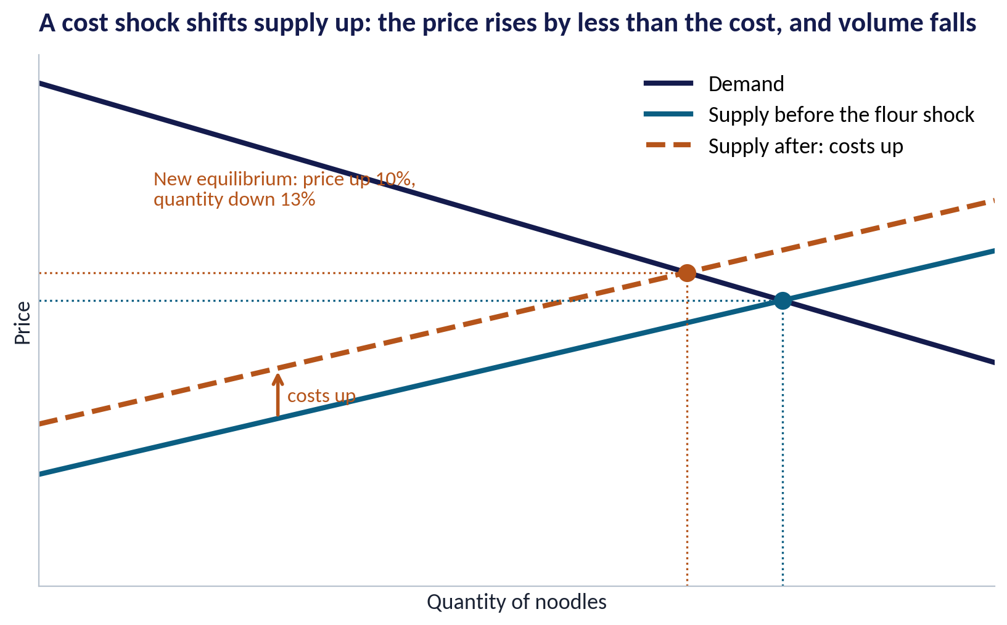
A COST SHOCK
Who Pays When Flour Gets Dearer?
WHAT TO SEE
Higher flour costs shift the supply curve up: firms need a higher price to supply the same quantity.
The new equilibrium has a higher price (+10%) and a lower quantity (−13%) in this example.
The price rises by less than the cost: part of the shock is paid by customers, part by producers.
How it splits depends on elasticity: the less sensitive the buyers, the more they pay.
Fig S02-F01 · replicate: s02_figures.R / .py
SESSION 2 · DEMAND, SUPPLY & ELASTICITY
9
Notes:
In the diagram the cost shift is 90; the price rises by about 50. Roughly 56% of the cost is passed through. With linear curves, pass-through = supply slope ÷ (supply slope + demand slope).

Slide 10



NIGERIAN EXAMPLES
Shifts You Have Lived Through
Petrol subsidy removal (2023)
Naira depreciation
A supply-side cost shock for almost every business: transport, generators and distribution all became dearer at once.
Imported wheat, packaging and machinery cost more naira: supply shifts up across manufacturing.
Falling real incomes
New sellers online
When wages lag inflation, demand for non-essentials shifts down — consumers trade down to smaller packs and cheaper brands.
E-commerce and social-media sellers add supply and make prices easier to compare — demand facing each seller becomes more elastic.
SESSION 2 · DEMAND, SUPPLY & ELASTICITY
10

Slide 11
PART
02
Elasticity: How Much Do Customers React?
One number that should sit beside every price decision.

Slide 12

THE KEY NUMBER
Own-Price Elasticity of Demand
IN PLAIN ENGLISH
THE FORMULA
elasticity = % change in quantity ÷ % change in price
Elasticity tells you by what percentage volume changes when price changes by 1%. If the number is bigger than 1 (ignoring the minus sign), demand is elastic: customers react strongly. Smaller than 1 is inelastic.
WHY A MANAGER CARES
Elastic demand means a price rise reduces revenue; inelastic demand means it raises revenue. Knowing which one you face is the start of every pricing decision.
EXAMPLE
Our noodles: elasticity ≈ −1.47. A 10% price rise loses about 13% of volume when rivals hold their prices.
SESSION 2 · DEMAND, SUPPLY & ELASTICITY
12

Slide 13
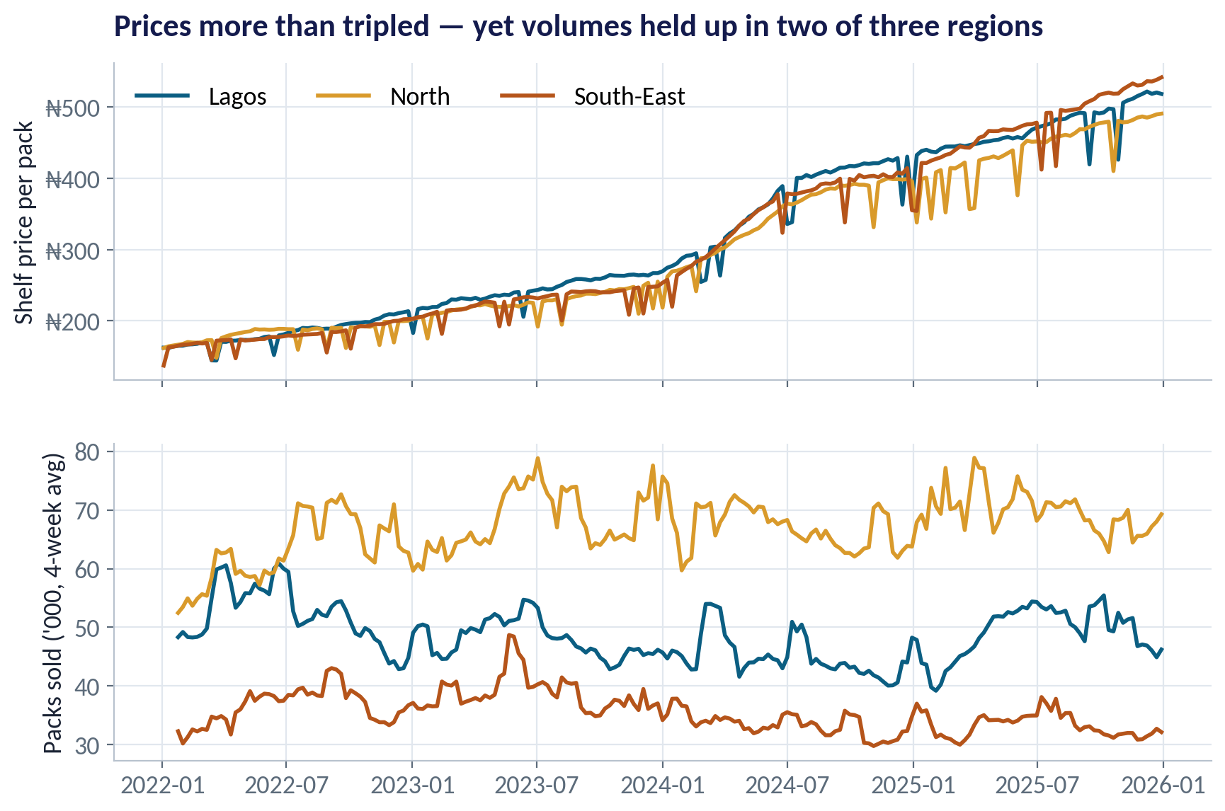
THE DATA
Prices Tripled — Volumes Did Not Collapse
WHAT TO SEE
Lagos shelf price went from about ₦162 to ₦518 a pack between 2022 and 2025.
Volumes rose in the North and Lagos, and fell in the South-East.
Looks like customers do not care about price. Do not believe it yet.
Incomes, competitors' prices and the general price level all moved at the same time.
Fig S02-F02 · replicate: s02_figures.R / .py
SESSION 2 · DEMAND, SUPPLY & ELASTICITY
13

Slide 14
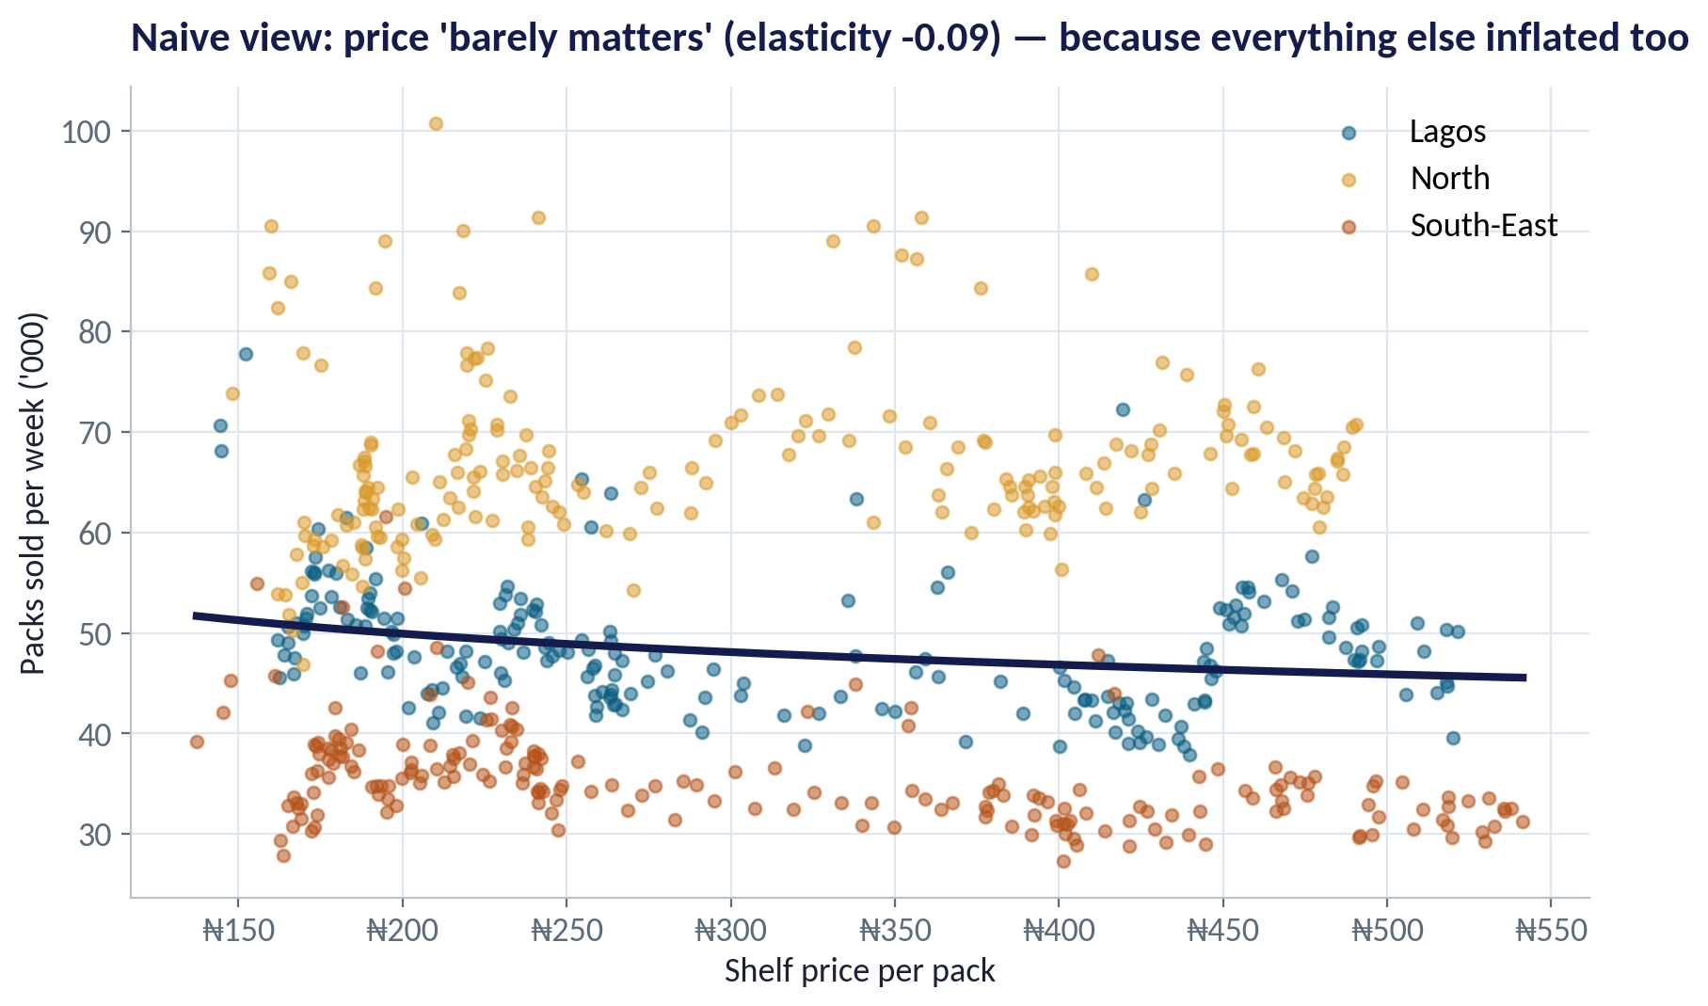
THE TRAP
Inflation Hides the Elasticity
WHAT TO SEE
Plotting units against shelf price gives an elasticity of just −0.09 — 'price barely matters'.
But every price was rising: competitors' prices, wages, the whole price level.
What matters to a shopper is our price relative to the alternatives and to their income.
To see the true response we must hold the other drivers constant.
Fig S02-F03 · replicate: s02_figures.R / .py
SESSION 2 · DEMAND, SUPPLY & ELASTICITY
14
Notes:
This is the same confusion between moving along a curve and shifting it. Over 2022–2025 demand was shifting (incomes, rivals' prices) while we moved along it.

Slide 15
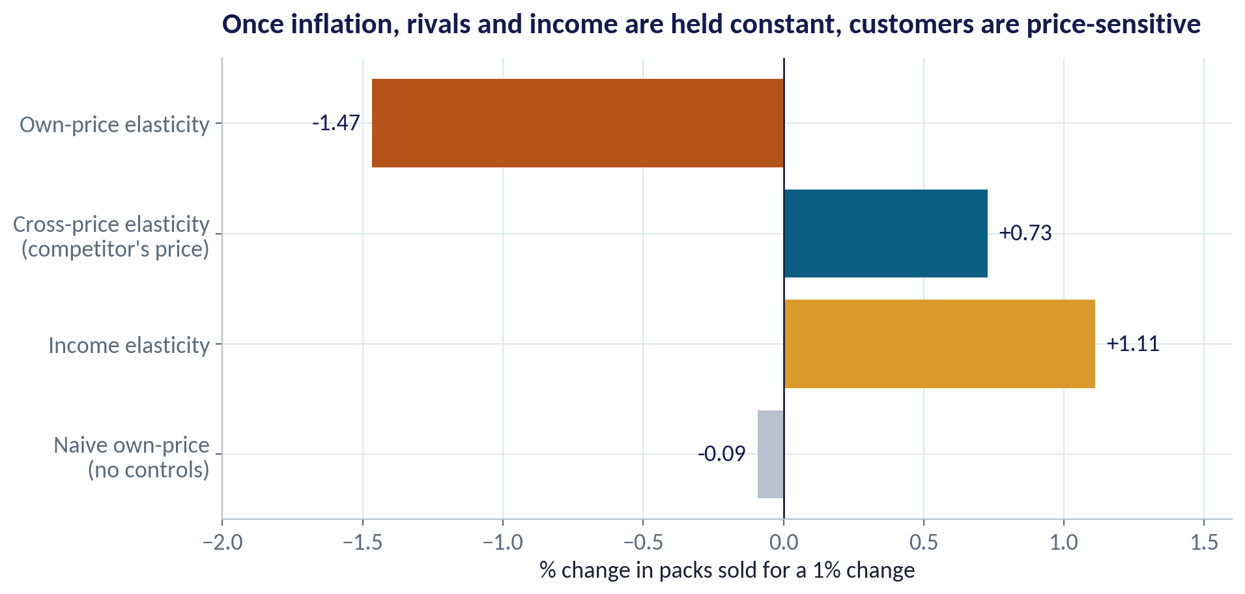
HOLDING OTHER THINGS CONSTANT
What Customers Really Respond To
WHAT TO SEE
Own price −1.47: a 1% rise in our price, all else equal, cuts volume by about 1.5%.
Cross price +0.73: when a rival raises its price by 1%, we gain about 0.7% volume — they are close substitutes.
Income +1.11: as customers' incomes rise, they buy more.
Method: one regression of log(units) on log(own price), log(rival price), log(income), a time trend and region.
Fig S02-F04 · replicate: s02_figures.R / .py
SESSION 2 · DEMAND, SUPPLY & ELASTICITY
15
Notes:
Income and the time trend move together, so the income elasticity is less precise than the price elasticities. Treat it as 'about one'.

Slide 16
THE ELASTICITY FAMILY
Three Elasticities Every Manager Should Know
Elasticity | Question it answers | Our estimate | Business use
Own-price | If we raise our price 1%, what happens to our volume? | −1.47 | Price setting, revenue forecasts
Cross-price | If a rival raises its price 1%, what happens to our volume? | +0.73 | Is the rival a close substitute? Will they follow?
Income | If customers' real income rises 1%, what happens to our volume? | +1.11 | Planning through recessions and booms; trading down
Advertising | If we spend 1% more on ads, what happens to volume? | not estimated | Marketing budgets (usually small, 0.05–0.2)
Positive cross-price elasticity = substitutes (rival noodles). Negative = complements (noodles and seasoning).
SESSION 2 · DEMAND, SUPPLY & ELASTICITY
16

Slide 17
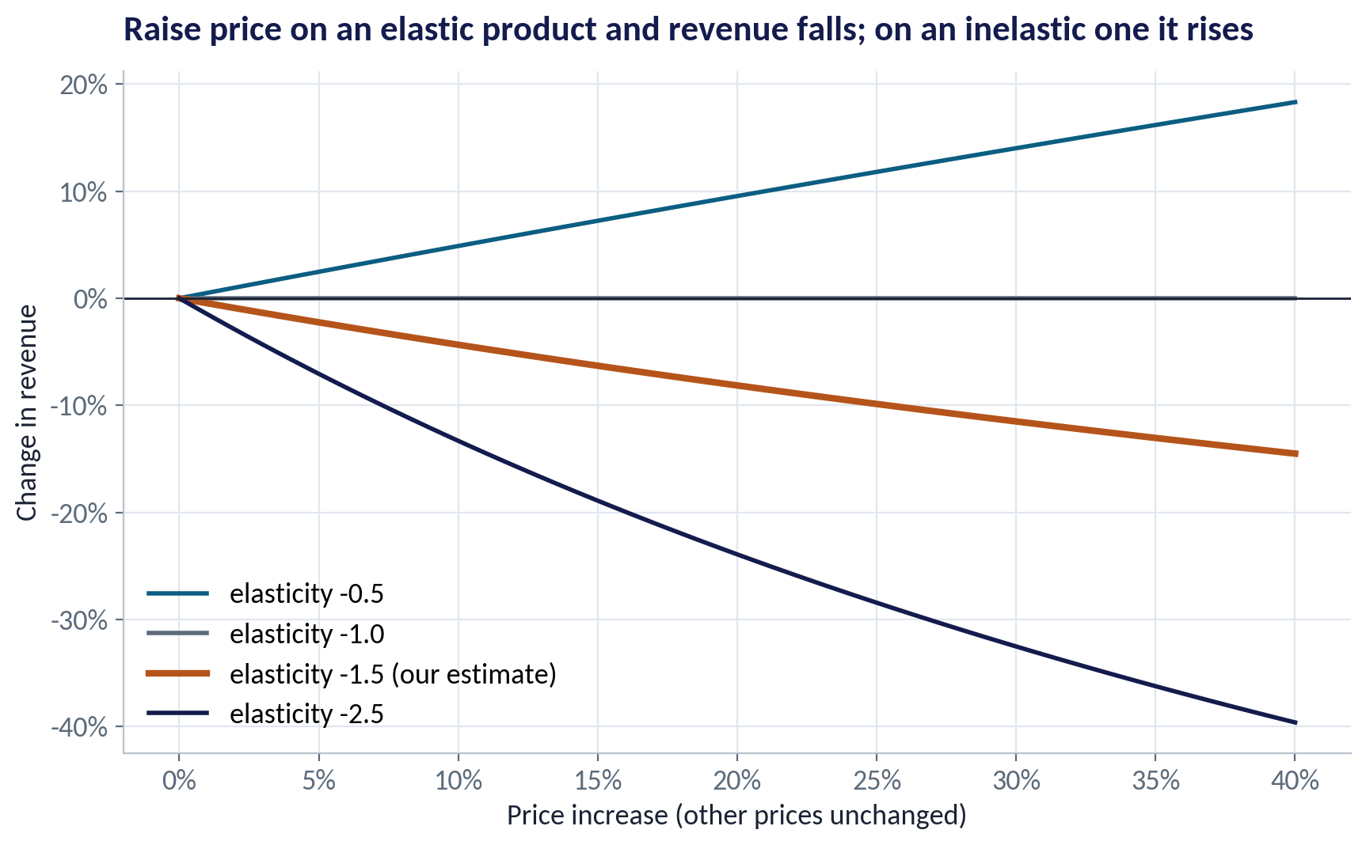
PRICE, VOLUME AND REVENUE
When Does a Price Rise Pay?
WHAT TO SEE
With elasticity −0.5, a 20% price rise raises revenue.
At our estimate (−1.47), a 20% rise cuts revenue by about 8%.
But revenue is not profit: if the price rise covers higher costs, it can still protect margin.
Elasticity is lower when all firms raise prices together — the market is less elastic than a single brand.
Fig S02-F05 · replicate: s02_figures.R / .py
SESSION 2 · DEMAND, SUPPLY & ELASTICITY
17

Slide 18
CONCEPT CHECK
Quick Check: What Would You Say?
A competitor cuts its noodle price by 10%. Our cross-price elasticity is +0.73. Holding our price, what happens to our volume?
A
Rises about 7%
B
Falls about 7%
C
Falls about 15%
D
No change — cross-price only matters for complements
Discuss with your neighbour for 60 seconds — answer and reasoning in the speaker notes.
SESSION 2 · DEMAND, SUPPLY & ELASTICITY
18
Notes:
ANSWER: B. B. Cross-price elasticity +0.73 means a 1% change in the rival's price moves our volume 0.73% in the **same** direction. A 10% cut by them → about 7% fewer packs for us. C uses the own-price elasticity; D has substitutes and complements the wrong way round.

Slide 19
PART
03
Behaviour, Promotions and Pass-Through
Customers are not calculators.

Slide 20
BEHAVIOURAL ECONOMICS
Reference Prices and Loss Aversion
IN PLAIN ENGLISH
THE FORMULA
pain of a ₦50 rise > pleasure of a ₦50 cut
Shoppers judge a price against the price they are used to — their reference price. Paying more than usual feels like a loss, and people weigh losses about twice as heavily as equal gains.
WHY A MANAGER CARES
Several small, explained increases usually cost less volume than one big jump. Pack-size changes ('shrinkflation'), clear communication and timing all manage the reference price.
EXAMPLE
Weeks priced more than 10% above the usual price sold about 7.7% fewer packs than the elasticity alone predicts.
SESSION 2 · DEMAND, SUPPLY & ELASTICITY
20

Slide 21
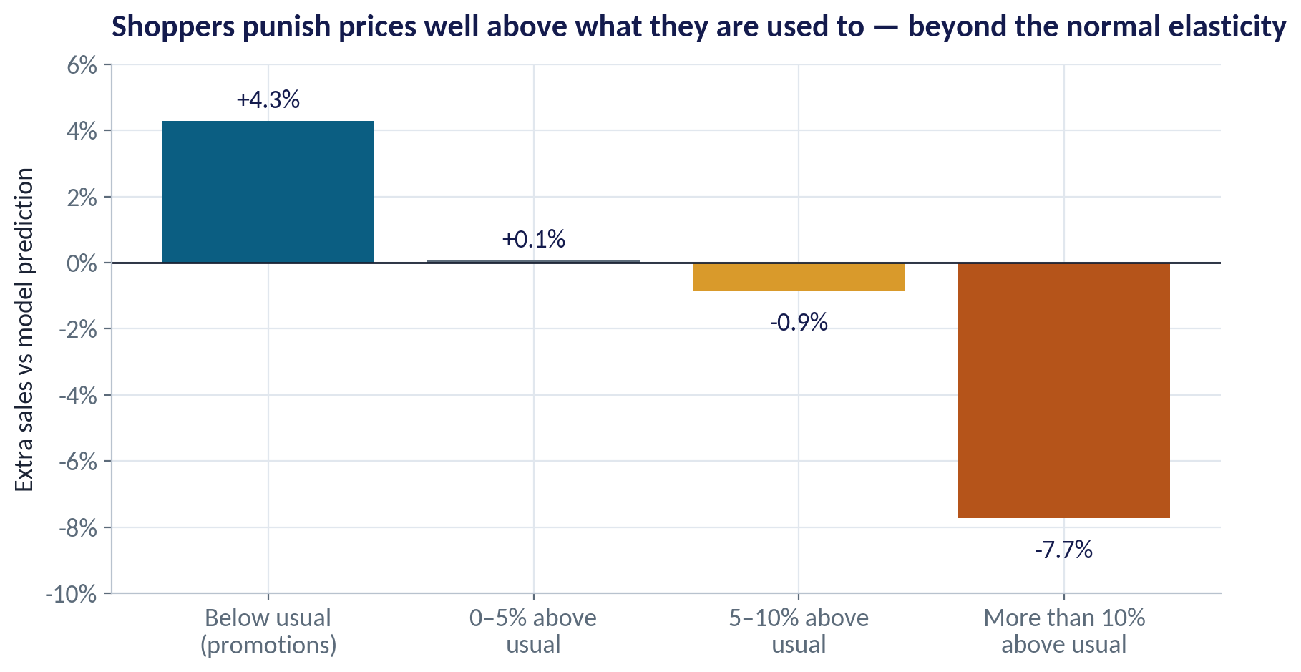
THE EVIDENCE
Big Jumps Hurt More Than the Arithmetic Says
WHAT TO SEE
We compared actual sales with what the elasticity model predicts.
Promotion weeks (price below usual) sold about 4% more than predicted.
Prices up to 5% above usual: no extra penalty. More than 10% above: −7.7%.
The penalty fades as the new price becomes the new 'normal' — reference prices adapt over weeks.
Fig S02-F06 · replicate: s02_figures.R / .py
SESSION 2 · DEMAND, SUPPLY & ELASTICITY
21
Notes:
The reference price is modelled as a moving average of past shelf prices (80% last week's reference, 20% this week's price). It is a teaching approximation of how shoppers' memories adjust.

Slide 22
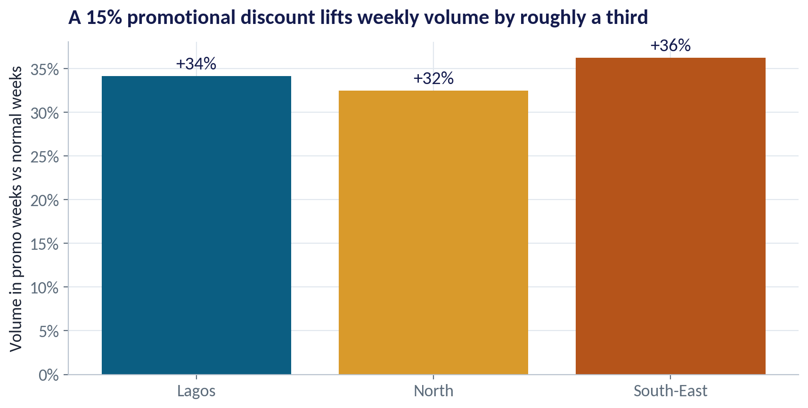
PROMOTIONS
What a 15% Discount Buys
WHAT TO SEE
Promotion weeks (15% off) sold 32–36% more packs than normal weeks.
Part of that is genuinely new demand; part is pantry loading — customers buying earlier, not more.
Measure the weeks after a promotion too: a dip means you borrowed sales from the future.
Promotions also reset reference prices downward if they run too often.
Fig S02-F07 · replicate: s02_figures.R / .py
SESSION 2 · DEMAND, SUPPLY & ELASTICITY
22

Slide 23

AI AND PRICING
Dynamic Pricing — Power and Limits
IN PLAIN ENGLISH
THE FORMULA
price ↑ when demand is high or capacity is scarce
Dynamic pricing changes prices often, using data on demand, stock, time and competitors. Ride-hailing surge pricing and airline fares are examples. AI makes it cheap to estimate elasticities by product, store and hour.
WHY A MANAGER CARES
It can raise revenue and balance supply and demand, but it can also feel unfair and invite regulators. Rules of thumb: be transparent, cap surges on essentials, and never personalise prices in ways customers would object to.
EXAMPLE
A ride-hailing app raises fares in Lagos rush hour and during heavy rain, when many riders compete for few drivers.
SESSION 2 · DEMAND, SUPPLY & ELASTICITY
23

Slide 24
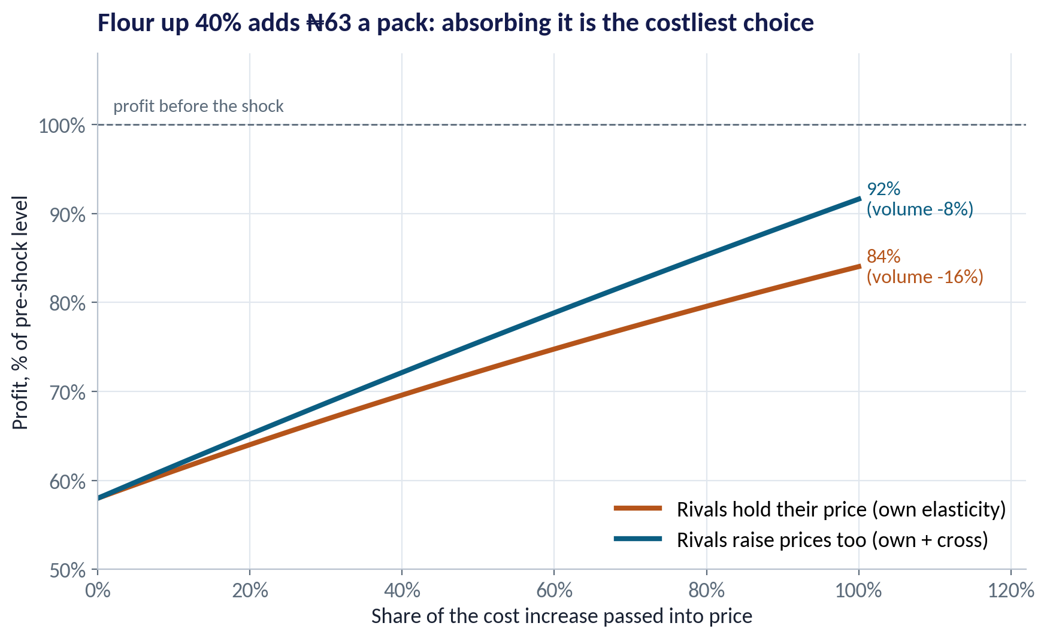
THE DECISION
How Much of the Flour Shock to Pass On?
WHAT TO SEE
The shock adds ₦63 to a pack that sells for ₦500 and costs ₦350 to make.
Absorb it all: volume holds, but profit falls to 58% of what it was.
Pass it all on, rivals holding: volume −16%, profit back to 84%. If rivals follow: volume −8%, profit 92%.
Since all millers face the same flour price, rivals are likely to follow — so passing on most of it, in steps, is the stronger option.
Fig S02-F08 · replicate: s02_figures.R / .py
SESSION 2 · DEMAND, SUPPLY & ELASTICITY
24
Notes:
Constant-elasticity model; ₦500 price and ₦350 unit cost are stylised. In practice firms also cut costs, change pack sizes and stagger increases to manage reference prices.

Slide 25


WHERE MANAGERS GO WRONG
Common Pricing Mistakes
THE TRAP
THE BETTER HABIT
“Volumes rose while prices rose, so demand is not price-sensitive.”
Hold inflation, rivals' prices and income constant before reading the elasticity.
Using one elasticity for every situation.
Distinguish our brand alone (more elastic) from the whole market moving together (less elastic).
Passing on a big cost increase in one jump.
Stagger increases and manage the reference price: explain, resize, time them.
Judging a promotion by the weeks it ran.
Count the dip afterwards and the margin given away.
Treating revenue as the goal.
Decide on profit and market position, not revenue alone.
SESSION 2 · DEMAND, SUPPLY & ELASTICITY
25

Slide 26
CONCEPT CHECK
Quick Check: What Would You Say?
Flour costs rise 40% for every noodles maker in Nigeria. Which statement is most accurate?
A
We should absorb the cost; any price rise loses customers to rivals
B
Rivals face the same shock, so the relevant elasticity is closer to the market's (less elastic) — passing on most of the cost in steps is likely to protect profit
C
Pass on exactly 40% because flour rose 40%
D
Price does not matter; the naive elasticity is close to zero
Discuss with your neighbour for 60 seconds — answer and reasoning in the speaker notes.
SESSION 2 · DEMAND, SUPPLY & ELASTICITY
26
Notes:
ANSWER: B. B. When all firms face the same cost, they tend to move together and the volume loss is smaller (own + cross ≈ −0.74). A ignores rivals' costs; C confuses the flour rise with the unit-cost rise (only 45% of cost is flour); D is the inflation trap.

Slide 27



HANDS-ON LAB
Lab: How Price-Sensitive Are Our Customers?
1
Look at prices and volumes by region from 2022 to 2025.
YOU WILL NEED
Data
2
Estimate the naive elasticity (units on price only) and explain why it misleads.
data/fmcg_price_volume.csv
3
Estimate own-price, cross-price and income elasticities holding other things constant.
R script
sessions/s02/R/s02_lab.R
4
Compute the volume and revenue effect of 5%, 10% and 20% price rises.
Python script
Test pass-through of 0%, 50% and 100% of the flour shock — with rivals holding and following.
sessions/s02/python/s02_lab.py
5
Deliverable: a 3-sentence pricing recommendation to the MD: how much to pass on, how fast, and what to watch.
⏱ 20 minutes
SESSION 2 · DEMAND, SUPPLY & ELASTICITY
27

Slide 28
WORDS TO OWN
Today's Vocabulary in Plain English
Demand curve
How much buyers want at each price, all else equal.
Cross-price elasticity
% change in our quantity for a 1% change in a rival's price.
Supply curve
How much sellers offer at each price, all else equal.
Income elasticity
% change in quantity for a 1% change in income.
Equilibrium
The price at which quantity demanded equals quantity supplied.
Reference price
The price a shopper expects, based on recent experience.
Shift vs move
Price changes move along a curve; other drivers shift it.
Loss aversion
Losses feel worse than equal-sized gains feel good.
Own-price elasticity
% change in quantity for a 1% change in own price.
Pass-through
Share of a cost change that ends up in the selling price.
SESSION 2 · DEMAND, SUPPLY & ELASTICITY
28

Slide 29
KEY TAKEAWAYS
Session 2 in 5 Ideas
01
Prices come from demand and supply; a cost shock shifts supply and is shared between buyers and sellers.
02
Separate a move along a curve from a shift of the curve.
03
Measure elasticity holding other things constant — inflation hides it.
04
Own, cross and income elasticities tell you how volume reacts to you, rivals and the economy.
05
Customers judge prices against a reference price: stagger, explain and time increases.
NEXT › Session 3: Forecasting & Market Sizing
Before next session: Read Sahay, Time Series Analysis and Forecasting (BEP8370), the chapters on trend and seasonality. Bring one demand number your company forecasts every year and how far off last year's forecast was.

