Slide 1


LAGOS BUSINESS SCHOOL · MEMBA 14 · EEGB · PART I
SESSION 3
Demand Forecasting
& Market Sizing
From markets, to macro, to decisions that matter — in Nigeria and the world.
Reading: Sahay, Time Series Analysis and Forecasting (BEP8370) · Gujarati, Basic Econometrics · Sahay, Business Analytics at a Glance (BEP8363) · Facilitator: Kelechi Nnamdi
Economic Environment of Global Business · Lagos Business School · Prof. Bongo Adi, Kelechi Nnamdi, Elvis Ozegbe
Notes:
Today we turn the demand curve into a number a board can plan around. Open with the capacity decision and ask who has seen a big investment built on an optimistic forecast.

Slide 2




RECAP
Session 2 in Three Ideas
Shifts vs moves
Price changes move you along the demand curve; income, rivals and costs shift it.
Elasticity
Measure customers' response holding other things constant — inflation hides it.
Reference prices
Big, sudden price jumps cost more volume than the arithmetic suggests.
SESSION 3 · FORECASTING & MARKET SIZING
2

Slide 3



TODAY'S PLAN
Session 3 at a Glance — 75 Minutes
From 'how many will we sell?' to a number you can plan capacity around — and defend.
10'
25'
20'
20'
Recap & Hook
Trend & Seasonality
Forecasting Honestly
Market Sizing & Lab
A ₦100bn plant rests on one forecast
Reading the shape of demand
Backtests, uncertainty, scenarios, and ML used responsibly
Top-down, bottom-up, and the 2026 plan
SESSION 3 · FORECASTING & MARKET SIZING
3

Slide 4

BY THE END OF TODAY
Session 3 Learning Objectives
You will be able to:
01
02
03
Read a Demand Series
Forecast and Test
Size a Market
Separate trend, seasonality and one-off shocks in monthly sales data.
Build a simple trend-plus-season forecast, backtest it against rules of thumb, and express it as a range.
Estimate a Nigerian market top-down and bottom-up, and reconcile the two.
SESSION 3 · FORECASTING & MARKET SIZING
4

Slide 5


THE HOOK
A ₦100 Billion Bet on One Number
“Demand grows 5% every year. Build the new line — we'll sell everything we make.”
A capacity decision is a forecast in disguise. Before approving it, ask:
Is 5% the trend?
Which month?
How wrong could we be?
What has demand actually done over ten years, through recessions and price spikes?
Cement demand in August is far below February. Capacity must cover the peak, not the average.
A forecast without a range is a guess with a decimal point.
Notes:
Ask participants how their company sets next year's sales budget. 'Last year plus X%' will be the most common answer — we will test that rule today.

Slide 6


NIGERIAN BUSINESS CASE
How Much Cement Will Nigeria Buy?
The situation
The decision question
A Nigerian cement company is deciding whether to add a new production line for 2026. Demand has grown for a decade, but it dipped in the 2016 recession, during COVID-19 and in the 2024 price spike.
How many tonnes of cement will Nigeria consume in 2026 — and how confident can we be?
The data we have
What a good answer looks like
cement_demand_monthly.csv — 168 months (2012–2025) of national cement consumption, price per bag, a rainy-season flag and a building-permits index. *Stylised teaching data.*
A 2026 forecast with a range and scenarios, checked against an independent market-sizing estimate.
SESSION 3 · FORECASTING & MARKET SIZING
6
Notes:
Real Nigerian cement consumption is in the same broad range (roughly 25–35 million tonnes a year in recent years) but the series here is stylised.

Slide 7
PART
01
Reading the Shape of Demand
Trend, season, shock.

Slide 8


THREE COMPONENTS
Every Demand Series Has Three Parts
Trend
Seasonality
Shocks & noise
The long-run direction: population growth, urbanisation, rising incomes. Cement: about 4.3% a year since 2012.
The pattern that repeats every year: the rainy season slows building from June to September.
Recessions, lockdowns, price spikes — and random month-to-month wobble that no model can predict.
SESSION 3 · FORECASTING & MARKET SIZING
8

Slide 9
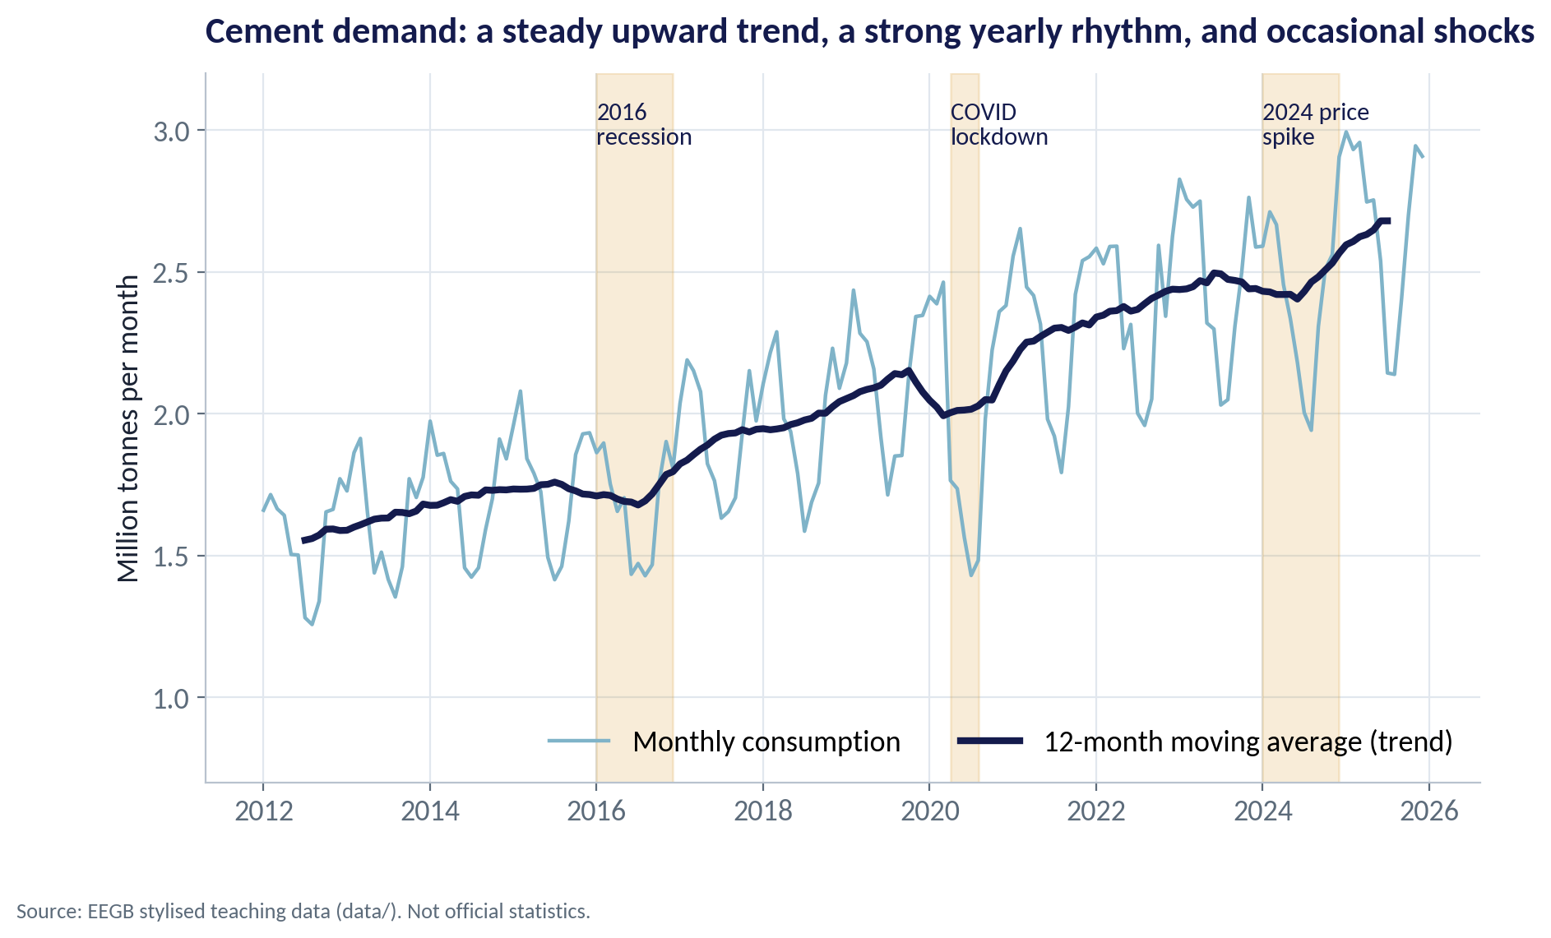
THE DATA
Ten Years of Cement Demand
WHAT TO SEE
National consumption grew from 18.7 million tonnes in 2012 to 32.2 million in 2025 — about 4.3% a year.
The 12-month moving average smooths out the seasons and shows the trend.
Three shocks: the 2016 recession, the 2020 lockdown and the 2024 price spike.
Each time, demand recovered to the trend within about a year.
Fig S03-F01 · replicate: s03_figures.R / .py
SESSION 3 · FORECASTING & MARKET SIZING
9

Slide 10
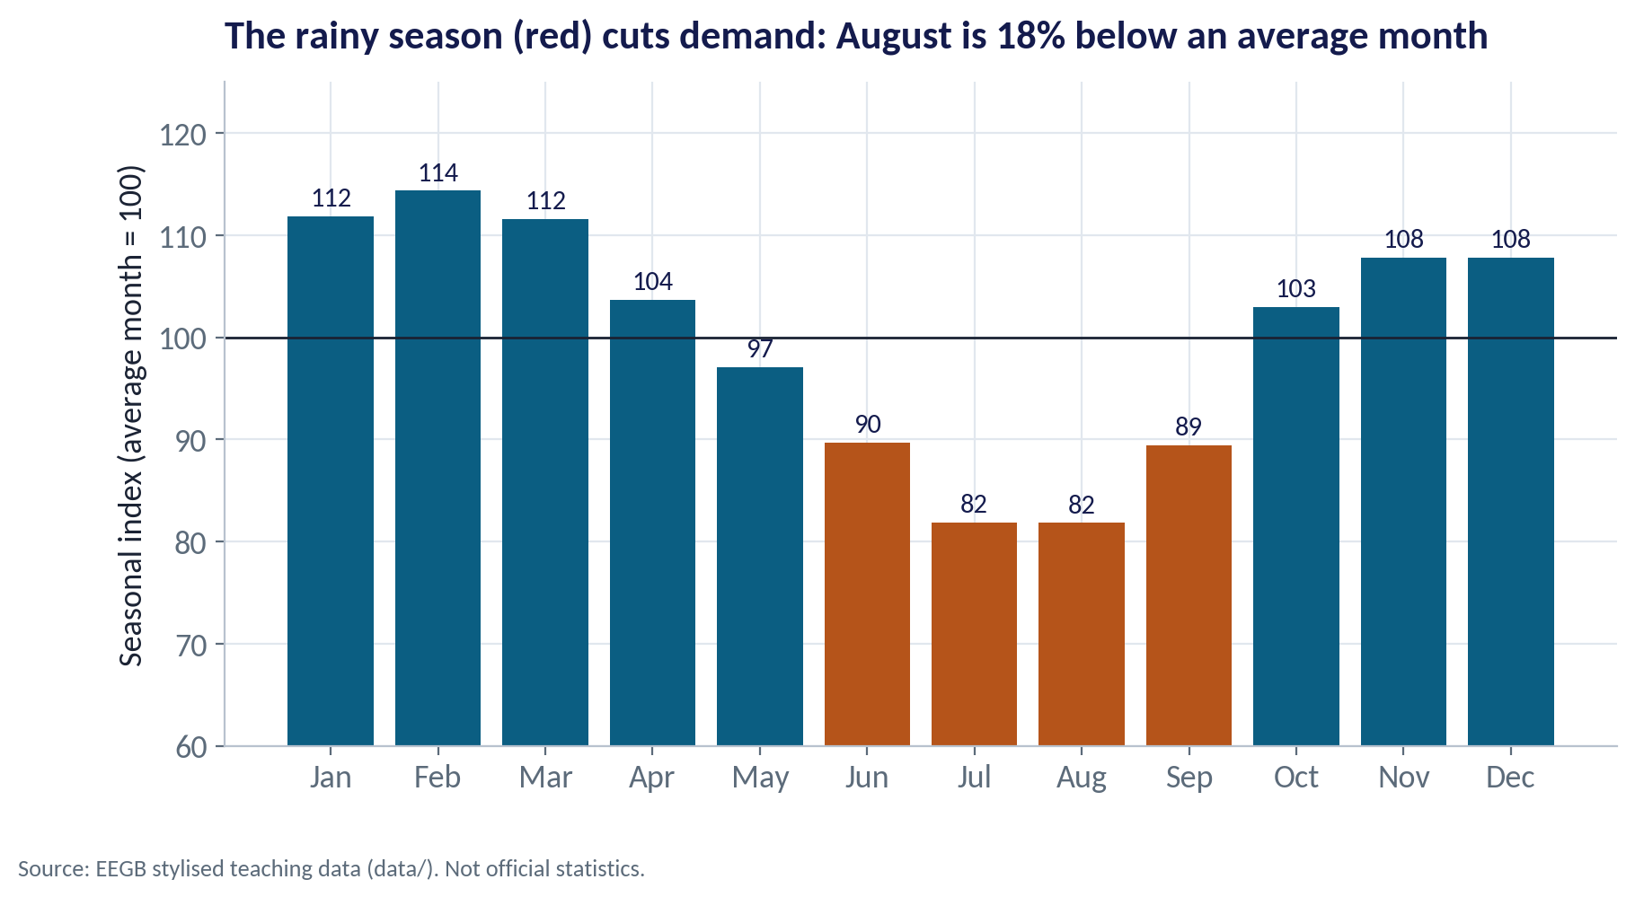
SEASONALITY
The Rainy Season Rhythm
WHAT TO SEE
February is about 14% above an average month; July and August about 18% below.
Rain stops site work, so demand dips from June to September.
Plan capacity, stock and cash for the peak months, not the annual average.
Schedule maintenance shutdowns for the rainy season, when demand is lowest.
Fig S03-F02 · replicate: s03_figures.R / .py
SESSION 3 · FORECASTING & MARKET SIZING
10

Slide 11


THE MODEL
Trend × Season: A Forecast in One Line
IN PLAIN ENGLISH
THE FORMULA
forecast = trend(t) × season(month)
Our forecast says: next month's demand = the trend level for that month × the seasonal index for that calendar month. We fit both from history with one regression.
WHY A MANAGER CARES
Simple models are transparent: a manager can see and challenge every assumption. That matters more than an extra decimal of accuracy.
EXAMPLE
Trend level for August 2026 ≈ 2.76 mt; August index ≈ 0.82 → forecast ≈ 2.26 mt.
SESSION 3 · FORECASTING & MARKET SIZING
11
Notes:
Technically: log(demand) = a + b·t + month dummies. The slope b gives growth of about 0.35% a month, or 4.3% a year.

Slide 12
PART
02
Forecasting Honestly
Test it, give a range, plan for scenarios.

Slide 13
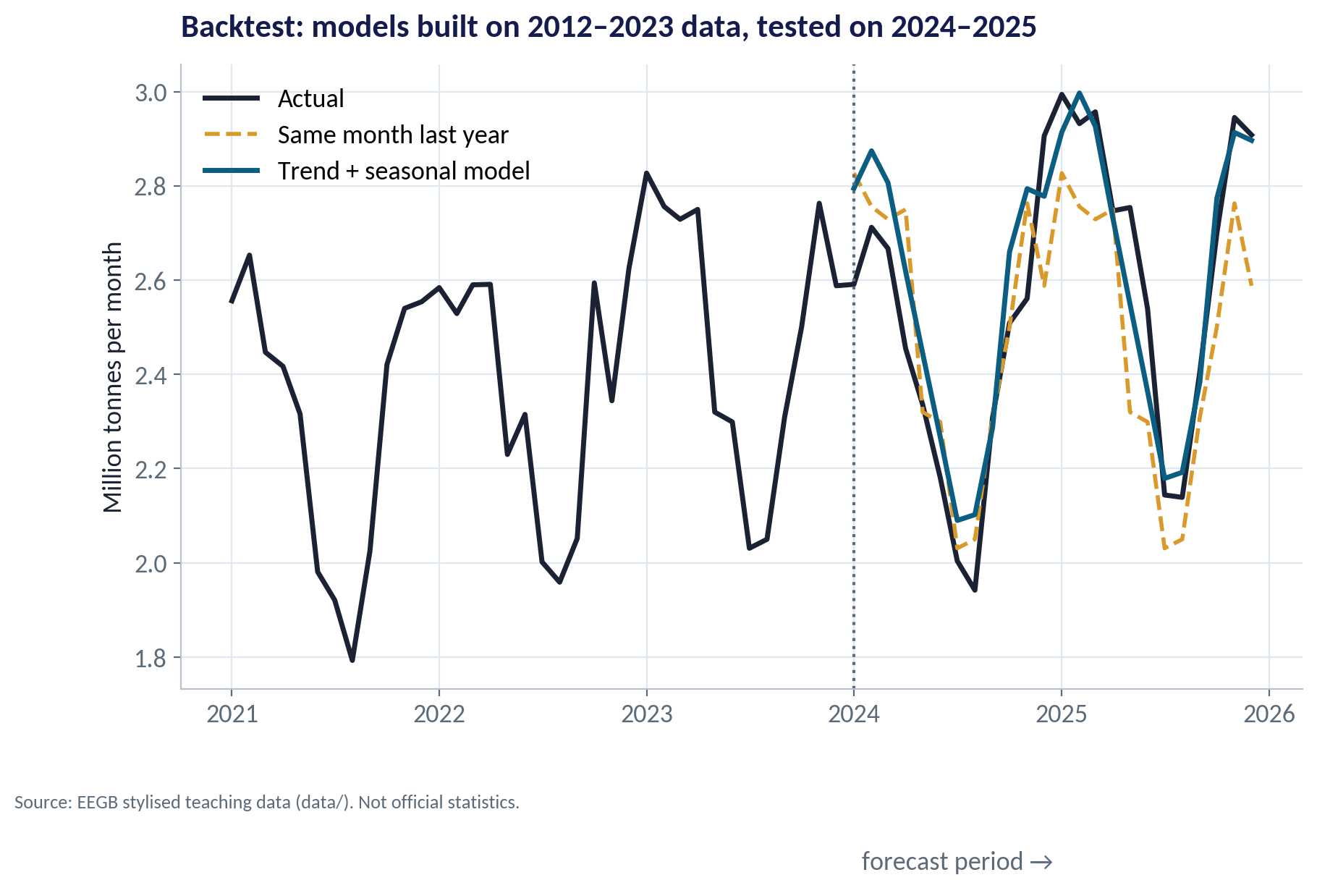
THE BACKTEST
Pretend It Is January 2024
WHAT TO SEE
We fitted each method on 2012–2023 only and asked it to forecast 2024–2025.
Then we compared the forecasts with what actually happened.
This is a backtest: the only honest way to judge a forecasting method.
The model followed both the season and the trend; 'same month last year' missed the growth.
Fig S03-F03 · replicate: s03_figures.R / .py
SESSION 3 · FORECASTING & MARKET SIZING
13

Slide 14
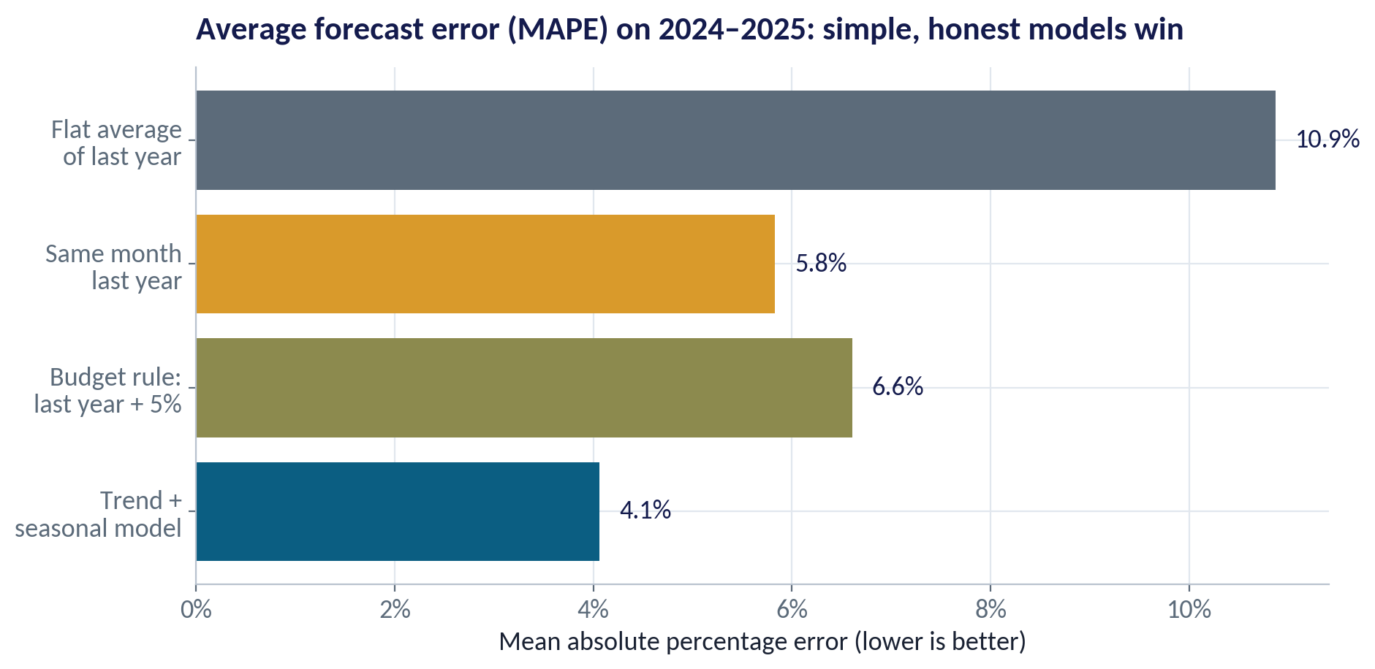
THE SCOREBOARD
Which Method Forecast Best?
WHAT TO SEE
Trend + seasonal model: 4.1% average error — the best.
'Same month last year': 5.8%. The common budget rule 'last year + 5%': 6.6%.
A flat average ignores the seasons: 10.9% error.
MAPE = mean absolute percentage error: on average, how far off were we?
Fig S03-F04 · replicate: s03_figures.R / .py
SESSION 3 · FORECASTING & MARKET SIZING
14
Notes:
The 2024 price spike hurt every method. In a backtest, no method saw it coming — which is why we also need scenarios.

Slide 15

TWO WAYS TO FORECAST
Judgement vs Models — Use Both
Judgemental forecasts
Model-based forecasts
Sales teams, experts, management
Statistics from historical data
Know about new projects, policy changes, competitor moves
Fast, cheap, easy to explain
Prone to optimism and anchoring on last year
Best for one-offs and turning points
Consistent and repeatable; easy to backtest
Capture trend and season well
Blind to events not in the data
Best for stable, repeating patterns
Good practice: start from the model, then let judgement adjust it for named, specific reasons — and record the adjustment so you can check it later.
SESSION 3 · FORECASTING & MARKET SIZING
15

Slide 16
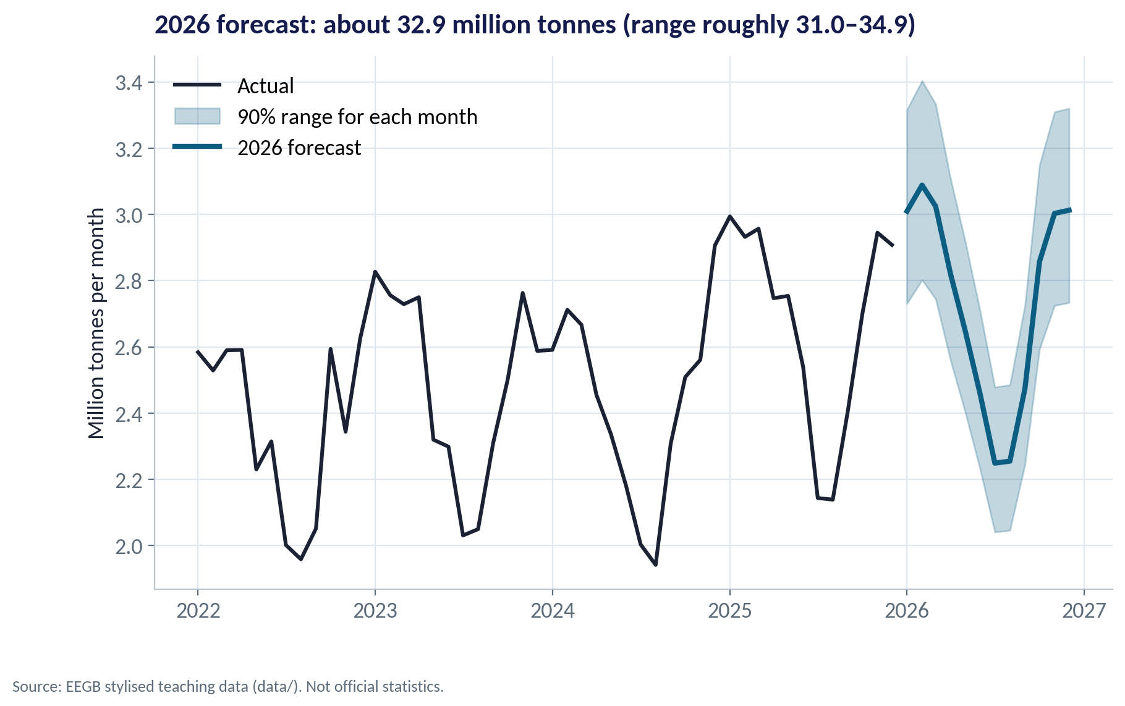
THE FORECAST
2026: A Number and a Range
WHAT TO SEE
Base forecast for 2026: about 32.9 million tonnes.
Monthly bands show where each month will probably fall (90% range).
For the year: roughly 31.0–34.9 million tonnes, based on how far past years strayed from the model.
Say it as a range: 'about 33, very likely between 31 and 35'.
Fig S03-F05 · replicate: s03_figures.R / .py
SESSION 3 · FORECASTING & MARKET SIZING
16

Slide 17
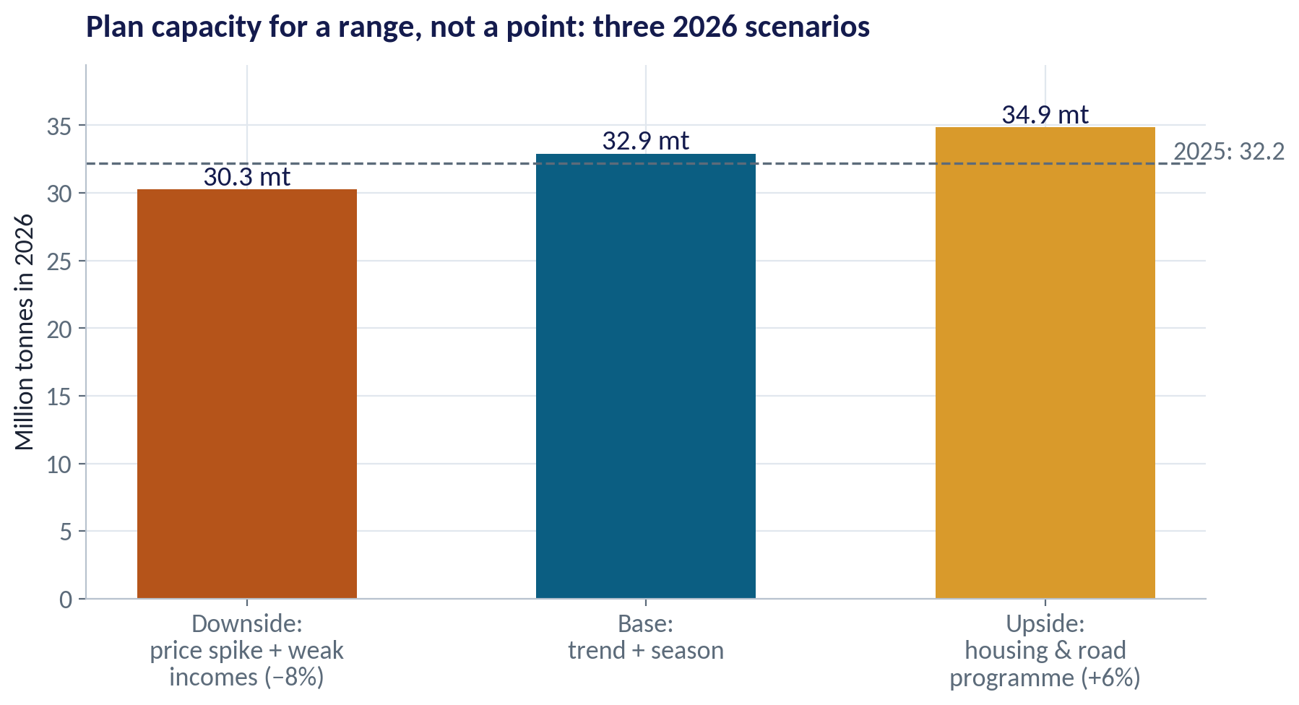
SCENARIOS
Plan for More Than One Future
WHAT TO SEE
Downside (−8%): another cement price spike and weak real incomes → 30.3 mt.
Base: trend and season continue → 32.9 mt.
Upside (+6%): a large housing and road programme → 34.9 mt.
Ask: what capacity is safe in the downside and expandable in the upside?
Fig S03-F06 · replicate: s03_figures.R / .py
SESSION 3 · FORECASTING & MARKET SIZING
17
Notes:
Scenario sizes here are illustrative. Students should argue for their own, linked to named signposts (Session 14 returns to this).

Slide 18
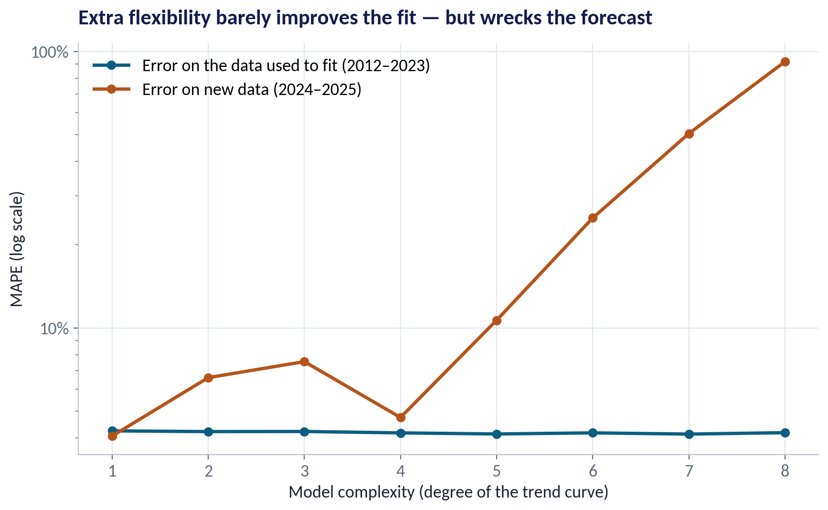
MACHINE LEARNING, RESPONSIBLY
More Complex Is Not More Accurate
WHAT TO SEE
We made the trend curve more and more flexible.
Fit to the past barely changed (about 4% error).
Forecasts of the future got much worse: from 4% to over 90% error at the most flexible.
This is overfitting: the model memorises the past instead of learning its pattern.
Fig S03-F08 · replicate: s03_figures.R / .py
SESSION 3 · FORECASTING & MARKET SIZING
18
Notes:
Machine-learning methods (gradient boosting, neural nets) can help when you have many drivers and lots of data. The rule is the same: always backtest on data the model has not seen.

Slide 19
CONCEPT CHECK
Quick Check: What Would You Say?
Your sales team forecasts next year as 'this year + 10%'. A trend-plus-seasonal model forecasts +4%, with a range of −2% to +10%. What should you do?
A
Use +10% — the sales team knows the market
B
Use +4% and ignore the sales team
C
Start from the model's +4% and ask the sales team for named, specific reasons for any upward adjustment; plan capacity for the range
D
Average the two: +7%
Discuss with your neighbour for 60 seconds — answer and reasoning in the speaker notes.
SESSION 3 · FORECASTING & MARKET SIZING
19
Notes:
ANSWER: C. C. The model is the disciplined baseline; judgement should adjust it only for specific, recorded reasons (a new contract, a new region). D splits the difference without evidence. And capacity should be planned against the range, not a point.

Slide 20
PART
03
Sizing a Market
Two routes to one number.

Slide 21
TOP-DOWN
Start From the Whole Economy
IN PLAIN ENGLISH
THE FORMULA
market = population × use per person
Top-down sizing starts from a big, known number — population, GDP, households — and multiplies by a rate of use per person or per naira.
WHY A MANAGER CARES
Quick and easy to sanity-check against other countries. But the 'use per person' assumption carries all the weight — and it differs widely between countries at similar income levels.
EXAMPLE
230 million people × about 140 kg of cement each per year ≈ 32.2 million tonnes.
SESSION 3 · FORECASTING & MARKET SIZING
21

Slide 22

BOTTOM-UP
Add Up the Uses
IN PLAIN ENGLISH
THE FORMULA
market = Σ (units of activity × cement per unit)
Bottom-up sizing builds the market from its parts: how many homes, roads, factories and repairs, times the cement each one needs.
WHY A MANAGER CARES
Slower, but it shows which segments drive demand — and which ones a new government programme or a price shock would hit.
EXAMPLE
About 450,000 new homes × ~32 tonnes = 14.4 mt, plus repairs (6.5), public works (6.0), commercial (4.5), precast (2.4) = 33.8 mt.
SESSION 3 · FORECASTING & MARKET SIZING
22

Slide 23
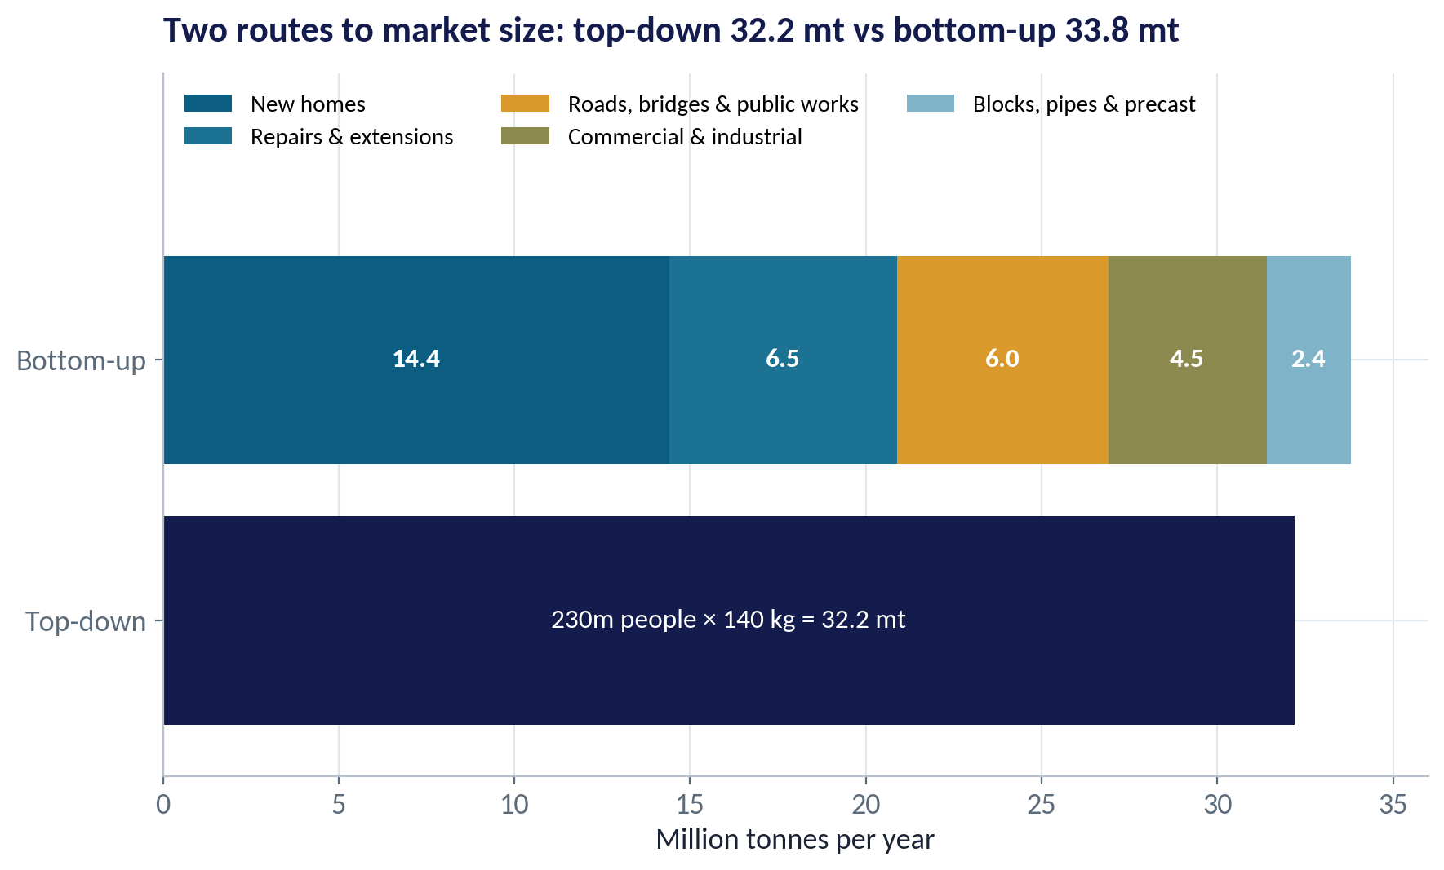
RECONCILE
Do the Two Routes Agree?
WHAT TO SEE
Top-down: 32.2 mt. Bottom-up: 33.8 mt. Within about 5% — reassuring.
If they disagree badly, one of the assumptions is wrong. Find it before you build.
New homes are the biggest segment: watch mortgage rates, real incomes and land policy.
Both estimates sit close to the time-series forecast — three independent views pointing the same way.
Fig S03-F07 · replicate: s03_figures.R / .py
SESSION 3 · FORECASTING & MARKET SIZING
23
Notes:
All sizing inputs are stylised teaching assumptions. Real sizing would use NBS housing data, cement-industry reports and project pipelines.

Slide 24


WHERE MANAGERS GO WRONG
Common Forecasting Mistakes
THE TRAP
THE BETTER HABIT
Presenting a single number as 'the forecast'.
Give a base, a range and scenarios, and say what would move you between them.
'Last year + X%' because that is how budgets are done.
Backtest your method against simple rules; keep the one that wins.
Planning capacity on the annual average.
Plan for the seasonal peak and the upside scenario.
Choosing the most complex model because it fits history best.
Judge models on data they have not seen.
Sizing the market only top-down.
Cross-check with a bottom-up build; reconcile the two.
SESSION 3 · FORECASTING & MARKET SIZING
24

Slide 25
CONCEPT CHECK
Quick Check: What Would You Say?
Top-down sizing gives 32 million tonnes; bottom-up gives 45 million tonnes. What is the best next step?
A
Average them: 38.5 mt
B
Trust the bottom-up figure because it is more detailed
C
Find which assumption explains the gap (e.g. tonnes per house or homes built) and check it against independent data
D
Use whichever supports the investment case
Discuss with your neighbour for 60 seconds — answer and reasoning in the speaker notes.
SESSION 3 · FORECASTING & MARKET SIZING
25
Notes:
ANSWER: C. C. A large gap is information: one of the inputs is wrong. Detail does not make bottom-up right — 13 extra million tonnes usually means an inflated activity count or usage rate. D is how bad investments get approved.

Slide 26



HANDS-ON LAB
Lab: Cement Demand in 2026
1
Compute annual totals and the average growth rate since 2012.
YOU WILL NEED
Data
2
Compute the seasonal index: each month versus its year's average.
data/cement_demand_monthly.csv
3
Fit a trend + seasonal model on 2012–2023.
R script
sessions/s03/R/s03_lab.R
4
Backtest it on 2024–2025 against 'same month last year' and 'last year + 5%'.
Python script
Forecast 2026, and compare with the top-down and bottom-up market sizes.
sessions/s03/python/s03_lab.py
5
Deliverable: a two-sentence 2026 capacity recommendation: how many tonnes, and what flexibility you keep.
⏱ 20 minutes
SESSION 3 · FORECASTING & MARKET SIZING
26

Slide 27
WORDS TO OWN
Today's Vocabulary in Plain English
Trend
The long-run direction of a series.
MAPE
Mean absolute percentage error: the average size of forecast misses.
Seasonality
A pattern that repeats at the same time every year.
Forecast range
The band within which the outcome will probably fall.
Seasonal index
A month's typical level relative to an average month (100).
Scenario
A coherent story of the future with its own numbers.
Moving average
An average of the last N periods; smooths out noise and seasons.
Overfitting
A model that memorises past noise and forecasts badly.
Backtest
Testing a forecasting method on past data it was not built on.
Top-down / bottom-up
Sizing from the whole economy vs adding up the uses.
SESSION 3 · FORECASTING & MARKET SIZING
27

Slide 28
KEY TAKEAWAYS
Session 3 in 5 Ideas
01
Demand = trend × season × shocks; read each part separately.
02
A transparent trend-plus-season model beats most budget rules — backtest to prove it.
03
Always give a range and scenarios, not a single number.
04
More complex is not more accurate: judge models on unseen data.
05
Size markets top-down and bottom-up, and reconcile the two.
NEXT › Session 4: Market Structure & Platforms
Before next session: Read the Ant Financial case (917-0029-1). Come ready to say: is Ant a bank, a technology company or a marketplace — and why does the answer matter for regulators?

