Slide 1


LAGOS BUSINESS SCHOOL · MEMBA 14 · EEGB · PART I
SESSION 4
Market Structure, Platforms
& Competition Policy
From markets, to macro, to decisions that matter — in Nigeria and the world.
Reading: Fintech and Finance Transformation: The Rise of Ant Financial Services (917-0029-1) · Facilitator: Kelechi Nnamdi
Economic Environment of Global Business · Lagos Business School · Prof. Bongo Adi, Kelechi Nnamdi, Elvis Ozegbe
Notes:
Today's question is one Nigerian regulators are actively wrestling with: when does a successful platform become a problem? Ask how many participants use two or more payment apps — multi-homing is a key protection against tipping.

Slide 2




RECAP
Session 3 in Three Ideas
Trend × season
Read demand as trend, seasonality and shocks — then model each part.
Backtest and range
Judge forecasts on data they have not seen; give a range and scenarios.
Size two ways
Top-down and bottom-up market sizing should roughly agree.
SESSION 4 · MARKET STRUCTURE & PLATFORMS
2

Slide 3



TODAY'S PLAN
Session 4 at a Glance — 75 Minutes
How many rivals you face — and whether a platform's size helps or hurts its customers.
10'
20'
25'
20'
Recap & Hook
Market Structure
Platforms
Competition Policy & Lab
Is the biggest payments app too big?
From perfect competition to monopoly
Two-sided markets, network effects, switching costs, data
Measuring concentration; the regulator's view
SESSION 4 · MARKET STRUCTURE & PLATFORMS
3

Slide 4
BY THE END OF TODAY
Session 4 Learning Objectives
You will be able to:
01
02
03
Classify a Market
Understand Platforms
Think Like a Regulator
Place an industry on the spectrum from perfect competition to monopoly, and say what that means for prices and profits.
Explain two-sided markets, network effects, switching costs and data as sources of market power.
Measure concentration (CR and HHI), and judge when a dominant firm or a merger becomes a competition problem.
SESSION 4 · MARKET STRUCTURE & PLATFORMS
4

Slide 5




THE HOOK
Is the Biggest App Too Big?
“Five years ago nobody had heard of them. Now every market woman in Lagos has their POS — and their fees just went up.”
Size alone is not a crime. A competition economist asks:
How did it get big?
Can rivals still enter?
What happens to prices?
By being better and cheaper (good), or by locking customers in and shutting rivals out (bad)?
If a new app can win users and merchants, the leader's power is limited.
Rising fees, falling quality or slower innovation are the warning signs.
Notes:
Mobile money, POS agents and fintech apps have transformed Nigerian payments since about 2018. The providers in today's data are fictional, but the pattern will feel familiar.

Slide 6


NIGERIAN BUSINESS CASE
Nigeria's Mobile-Payments Market
The situation
The decision question
Between 2016 and 2025, the share of payment value handled by banks' own apps and USSD fell from 78% to 28%. Fintech platforms — agents, POS terminals and apps — took the rest. One platform, 'KoboLink', now handles 30%.
Is a dominant payments platform good for customers (scale, convenience, low cost) or a competition problem (lock-in, higher fees, blocked rivals)?
The data we have
What a good answer looks like
payments_market_shares.csv — 10 years × 6 providers: share of payment value, active users, merchants and average fee. *Stylised; providers other than the banks are fictional.*
A reasoned view for the regulator: how concentrated the market is, whether fees signal market power, and what — if anything — should be done.
SESSION 4 · MARKET STRUCTURE & PLATFORMS
6

Slide 7
PART
01
Market Structure
How many rivals, and how different are they?

Slide 8
THE SPECTRUM
Four Market Structures
Structure | Sellers & products | Price power | Nigerian example
Perfect competition | Many sellers, identical products, easy entry | None — price taker | Tomatoes at Mile 12 market, foreign-exchange street traders
Monopolistic competition | Many sellers, differentiated products | Some — brand loyalty | Restaurants, fashion, hair salons, noodles brands
Oligopoly | A few large sellers; each watches the others | Significant — strategic | Cement, telecoms, breweries, large banks
Monopoly | One seller, no close substitute, high barriers | High — price maker | Electricity distribution in a franchise area, national grid transmission
Most real markets sit between these boxes. The question is always: how much can a firm raise price before customers leave?
SESSION 4 · MARKET STRUCTURE & PLATFORMS
8

Slide 9
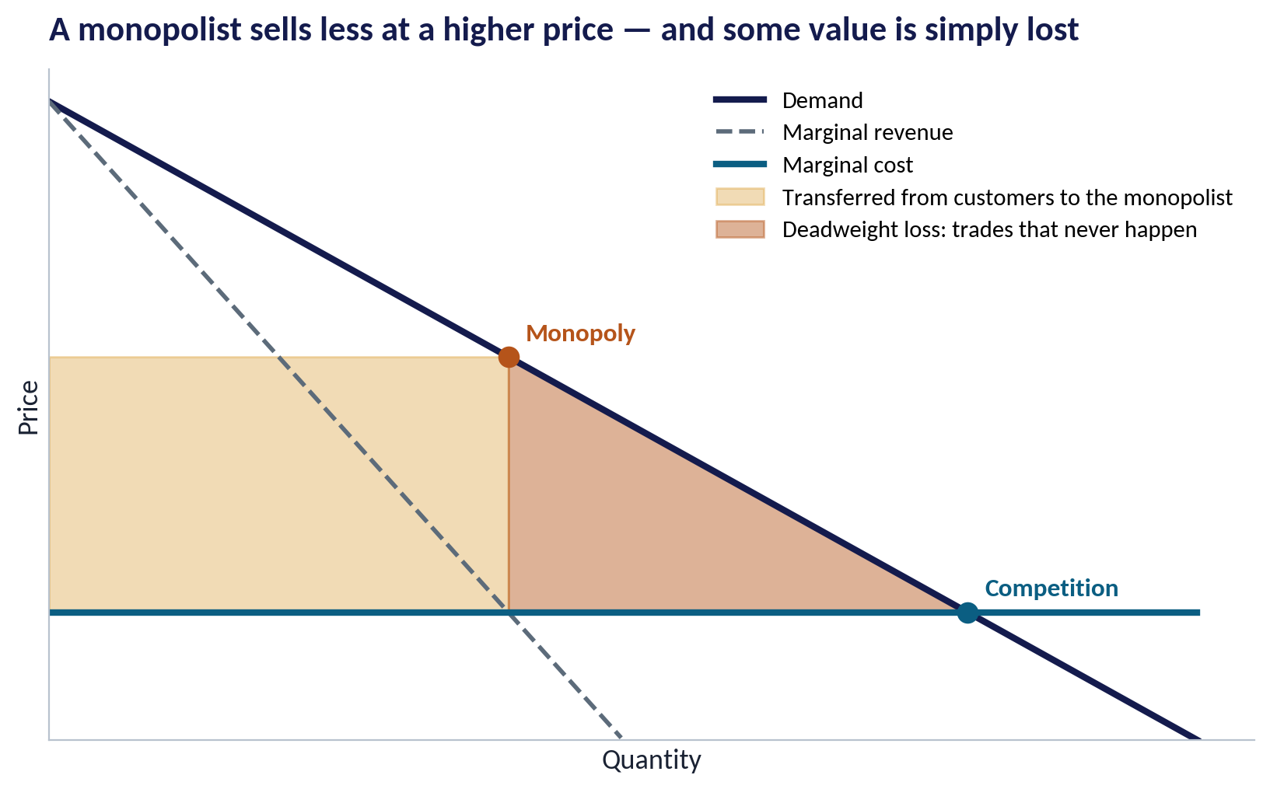
WHY IT MATTERS
What Market Power Costs Society
WHAT TO SEE
Under competition, price falls to the cost of the last unit, and output is high.
A monopolist restricts output to push the price up.
Gold area: value transferred from customers to the monopolist.
Red area: deadweight loss — purchases worth more than they cost that simply never happen.
Fig S04-F06 · replicate: s04_figures.R / .py
SESSION 4 · MARKET STRUCTURE & PLATFORMS
9
Notes:
The monopolist picks quantity where marginal revenue = marginal cost (Q = 4), then charges the highest price demand allows (P = 6).

Slide 10


MEASURING CONCENTRATION
The Herfindahl–Hirschman Index (HHI)
IN PLAIN ENGLISH
THE FORMULA
HHI = s₁² + s₂² + … + sₙ² (shares in %)
The HHI adds up the squared market shares of every firm. Squaring gives big firms more weight. A pure monopoly scores 10,000; many tiny firms score close to 0.
WHY A MANAGER CARES
Competition authorities use the HHI to screen mergers. A merger's effect on the index is roughly 2 × s₁ × s₂ — two firms of 15% and 10% add 300 points.
EXAMPLE
Four firms with 40%, 30%, 20%, 10%: 1,600 + 900 + 400 + 100 = 3,000 — highly concentrated.
SESSION 4 · MARKET STRUCTURE & PLATFORMS
10

Slide 11
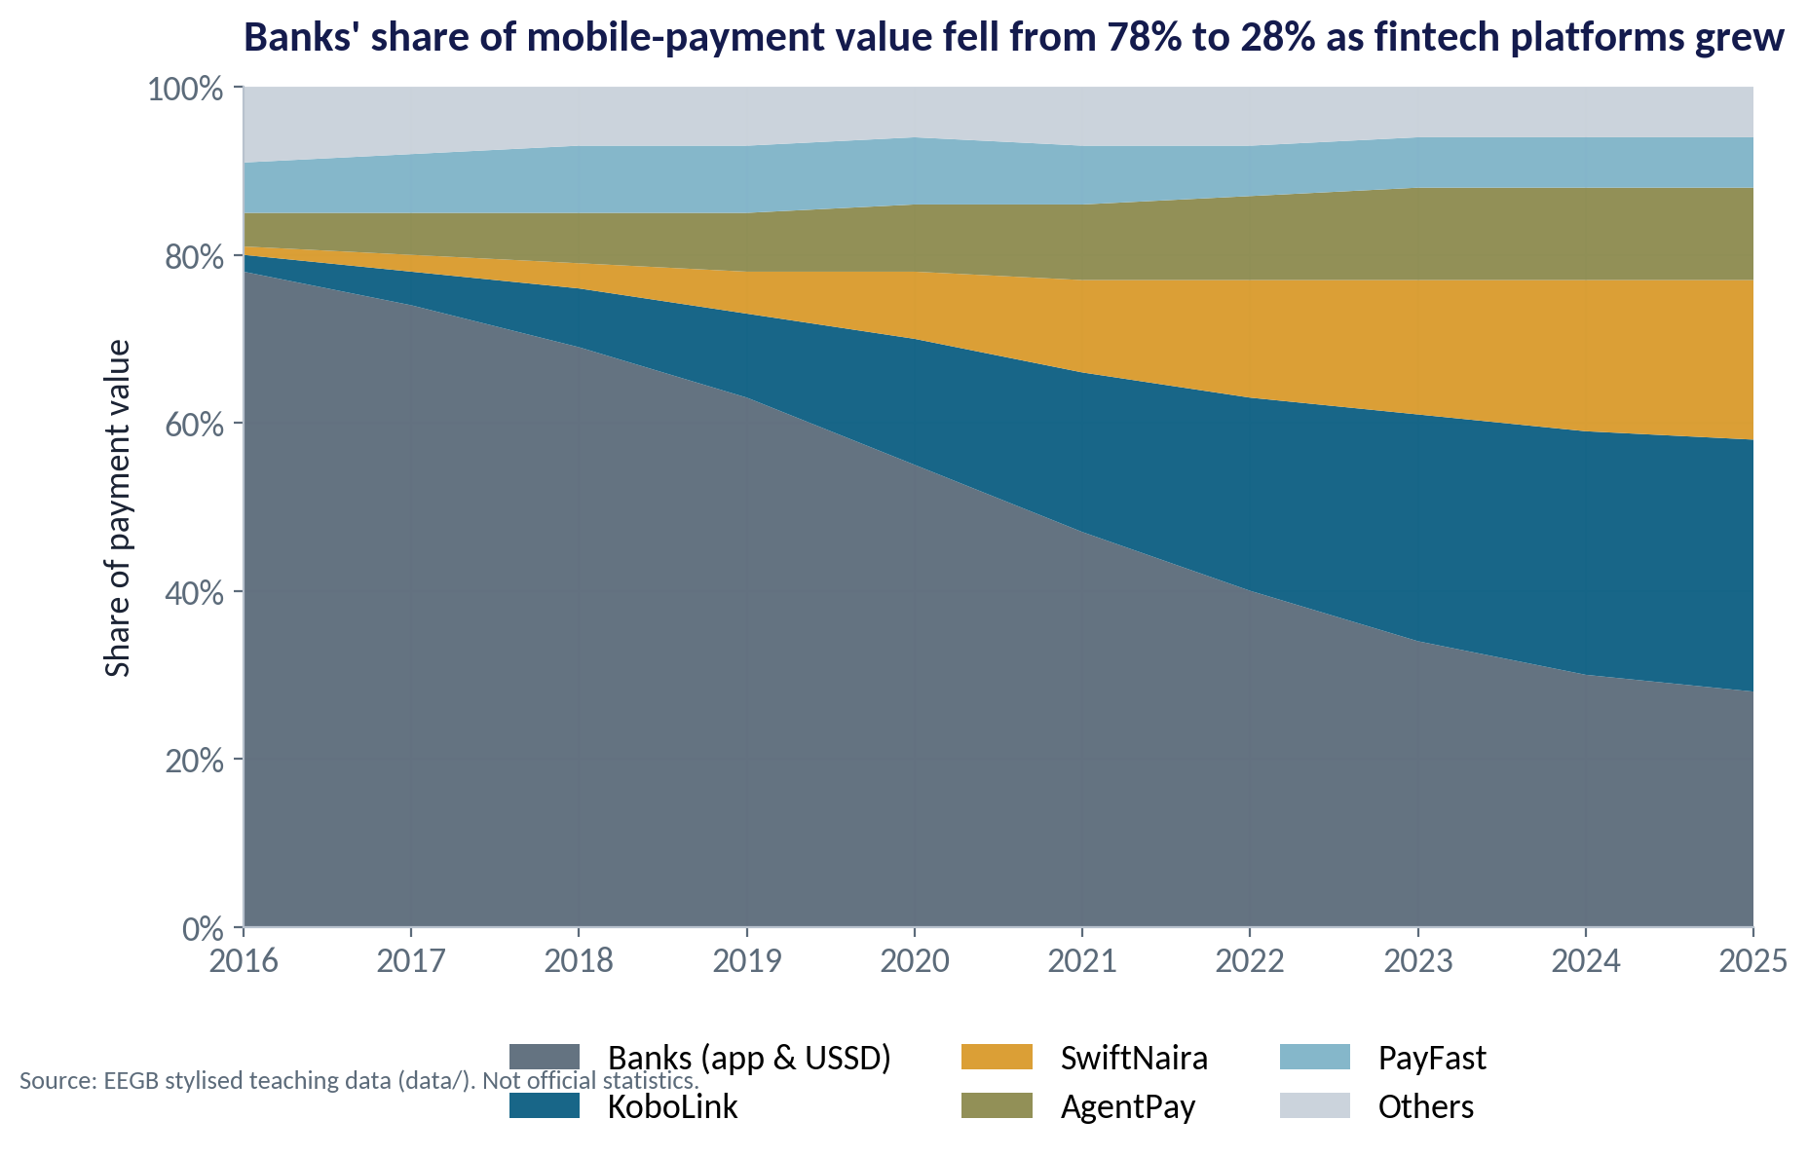
THE DATA
From Banks to Platforms
WHAT TO SEE
In 2016 banks' apps and USSD handled 78% of mobile-payment value.
By 2025: banks 28%, KoboLink 30%, SwiftNaira 19%, AgentPay 11%.
Fintechs won by going where banks were weak: agents in markets, cheap POS, simple apps.
The market became more competitive between banks and fintechs — and more concentrated among fintechs.
Fig S04-F01 · replicate: s04_figures.R / .py
SESSION 4 · MARKET STRUCTURE & PLATFORMS
11

Slide 12
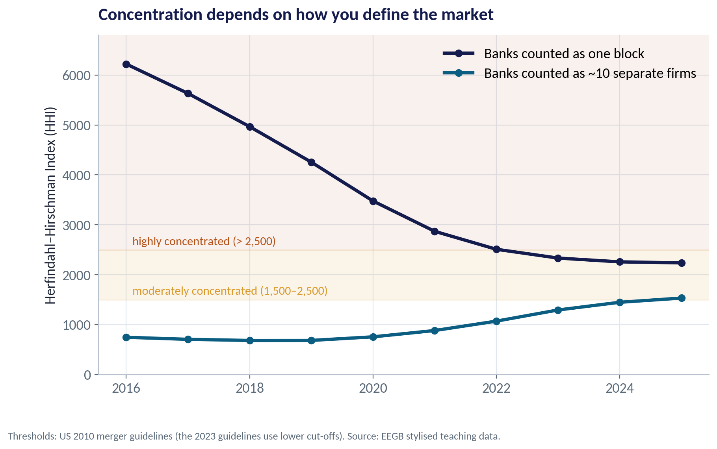
MARKET DEFINITION
Concentration Depends on How You Define the Market
WHAT TO SEE
Treat 'banks' as one block: HHI falls from 6,222 to 2,238 — the market looks ever more competitive.
Treat them as ~10 separate banks: HHI rises from 746 to 1,532 — concentration is growing.
Same data, opposite stories. Defining the market is the first and most contested step in any competition case.
Ask: who do customers actually switch to when one provider raises its price?
Fig S04-F02 · replicate: s04_figures.R / .py
SESSION 4 · MARKET STRUCTURE & PLATFORMS
12
Notes:
The 'banks as ten equal firms' version is a simplification to show the point; real bank shares are unequal.

Slide 13
CONCEPT CHECK
Quick Check: What Would You Say?
A market has five firms with shares 30%, 25%, 20%, 15% and 10%. What is the HHI?
A
100
B
2,250
C
1,000
D
10,000
Discuss with your neighbour for 60 seconds — answer and reasoning in the speaker notes.
SESSION 4 · MARKET STRUCTURE & PLATFORMS
13
Notes:
ANSWER: B. B. 900 + 625 + 400 + 225 + 100 = 2,250. A sums the shares; C is a guess; D would need a single firm with 100%. 2,250 sits in the 'moderately concentrated' band of the US 2010 guidelines.

Slide 14
PART
02
Platforms and Network Effects
Why digital markets tip towards one winner.

Slide 15
TWO-SIDED MARKETS
A Platform Serves Two Groups at Once
IN PLAIN ENGLISH
THE FORMULA
value to a user ↑ as merchants ↑ and value to a merchant ↑ as users ↑
A platform connects two groups who need each other: payers and merchants, riders and drivers, buyers and sellers. Each side values the platform more when the other side is bigger.
WHY A MANAGER CARES
Platforms often subsidise one side (free app for users, free POS for agents) to win the other. Low prices today can be a strategy, not a gift.
EXAMPLE
A trader accepts KoboLink because many customers pay with it; customers download it because many traders accept it.
SESSION 4 · MARKET STRUCTURE & PLATFORMS
15

Slide 16
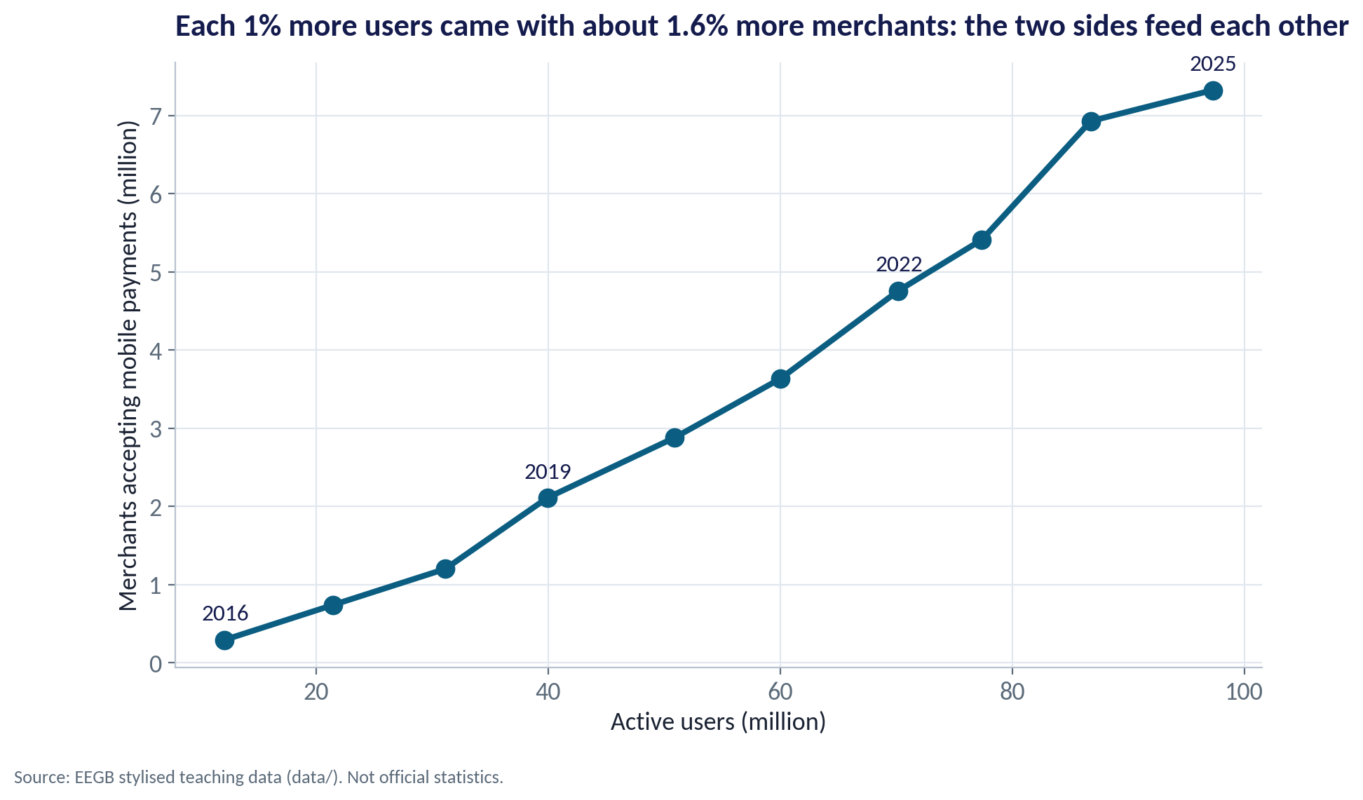
NETWORK EFFECTS IN THE DATA
Users and Merchants Grew Together
WHAT TO SEE
Active users rose from 12 million to 97 million; merchants from 0.3 million to 7.3 million.
Each 1% more users came with about 1.6% more merchants.
The two sides reinforce each other: more users attract merchants, who attract more users.
This feedback loop is why platform markets can grow very fast — and tip towards a leader.
Fig S04-F03 · replicate: s04_figures.R / .py
SESSION 4 · MARKET STRUCTURE & PLATFORMS
16

Slide 17
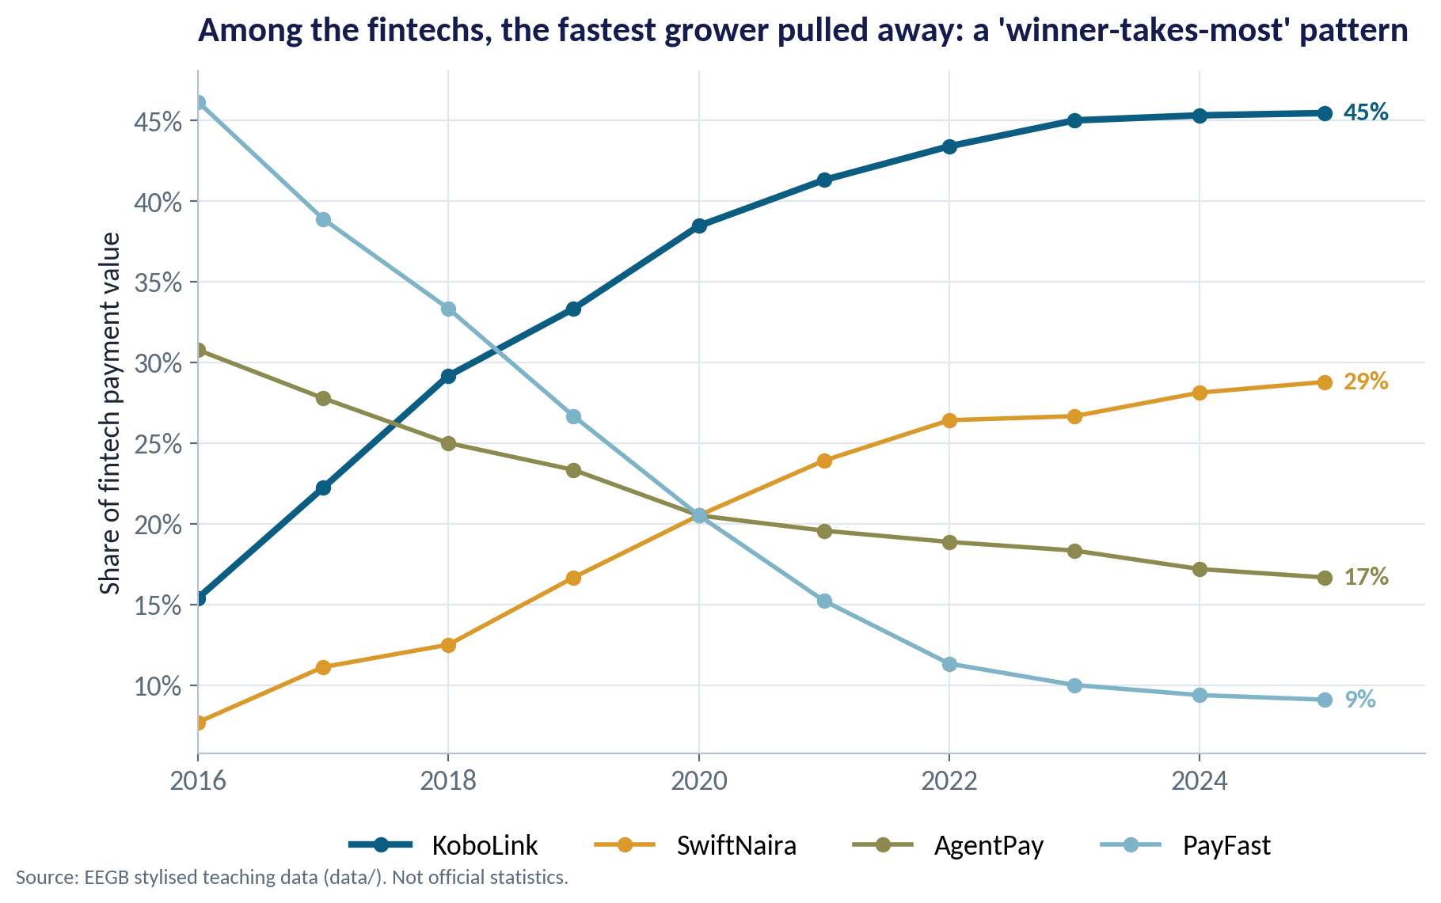
TIPPING
Winner-Takes-Most Among the Fintechs
WHAT TO SEE
Within the fintech segment, KoboLink went from 15% to 45% of payment value.
PayFast, the early leader, fell from 46% to 9%.
Being first is not enough: the platform that builds the network fastest wins.
Once a network tips, rivals need a big advantage — or regulation — to catch up.
Fig S04-F04 · replicate: s04_figures.R / .py
SESSION 4 · MARKET STRUCTURE & PLATFORMS
17

Slide 18


SOURCES OF PLATFORM POWER
Why Big Platforms Are Hard to Challenge
Network effects
Switching costs
Everyone is on the leading platform because everyone else is. A new entrant starts with an empty network.
Moving your shop's payments, savings history or credit record to a new app takes time and risk. Customers stay even when a rival is a bit cheaper.
Data
Bundling & ecosystems
Transaction data lets the leader score credit, spot fraud and target offers better than rivals — and the advantage grows with size.
Payments + loans + savings + bills in one app. Each service makes leaving the others harder.
SESSION 4 · MARKET STRUCTURE & PLATFORMS
18

Slide 19
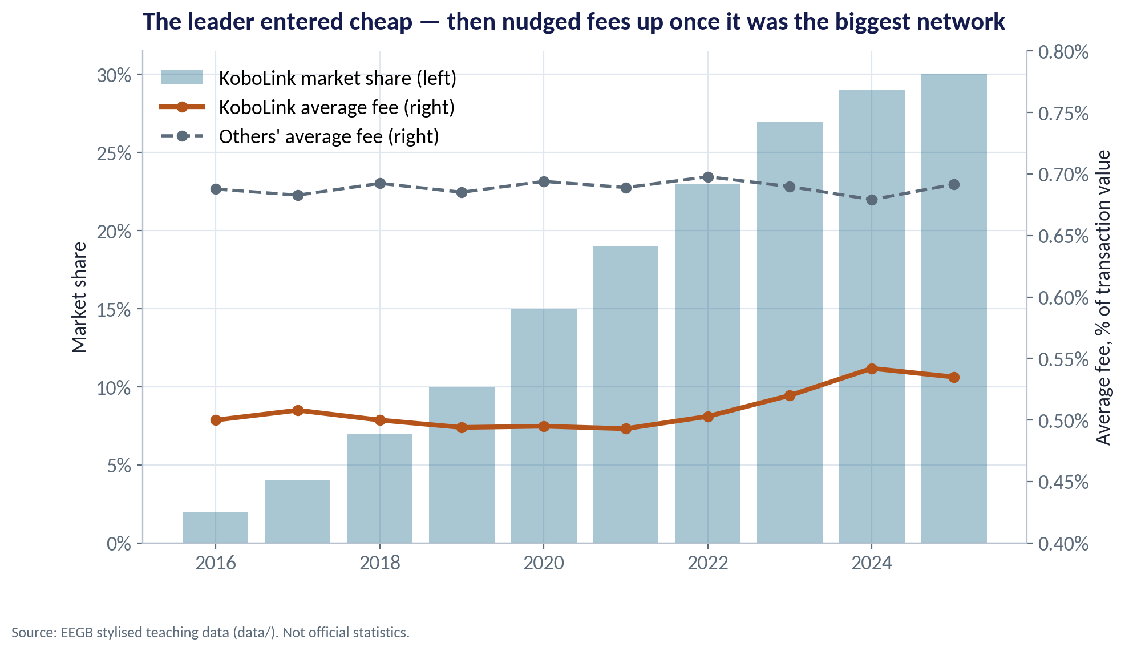
THE WARNING SIGN
Fees After Dominance
WHAT TO SEE
KoboLink entered cheaper than rivals: about 0.50% of value, against roughly 0.69% for others.
As its share passed a quarter of the market, its fee rose to about 0.54%.
Still below rivals — so customers are not obviously harmed yet.
A regulator would watch the trend, merchant complaints, and whether rivals can still win business.
Fig S04-F05 · replicate: s04_figures.R / .py
SESSION 4 · MARKET STRUCTURE & PLATFORMS
19
Notes:
Correlation of KoboLink's share and fee: 0.69. Not proof of abuse: costs (fraud, FX-linked technology costs) also rose. The point is to monitor, not to convict.

Slide 20
THE ANT FINANCIAL CASE
When a Platform Becomes a Bank
IN PLAIN ENGLISH
THE FORMULA
payments → data → credit → more payments
Ant Financial (now Ant Group) grew from Alipay, a payments tool, into lending, wealth management and insurance for hundreds of millions of Chinese users — using payments data to score credit.
WHY A MANAGER CARES
Nigerian fintechs follow a similar path from payments to lending. The case asks: should a platform that behaves like a bank be regulated like a bank?
EXAMPLE
In 2020 Chinese regulators halted Ant's planned stock-market listing and required it to restructure under bank-style rules.
SESSION 4 · MARKET STRUCTURE & PLATFORMS
20

Slide 21
PART
03
Competition Policy
When does big become bad?

Slide 22


TWO VIEWS OF A DOMINANT PLATFORM
Efficiency or Exclusion?
Good for customers
A competition problem
Scale lowers costs and adds convenience
Power used to block rivals and raise prices
One network everyone can use
Lower fees from economies of scale
Fast innovation and new services
Financial inclusion for the unbanked
Exclusive deals with agents and merchants
Rising fees once rivals are weakened
Self-preferencing its own loans and products
Data hoarding that rivals cannot match
Nigeria's FCCPC (under the 2018 competition act) and the CBN (for payments) share the job. The question is conduct, not size.
SESSION 4 · MARKET STRUCTURE & PLATFORMS
22

Slide 23
THE REGULATOR'S TOOLKIT
What Authorities Can Do
Tool | What it does | Example in payments
Merger review | Blocks or conditions deals that raise concentration too much | Screen mergers that add more than ~200 HHI points in a concentrated market
Abuse-of-dominance cases | Punishes exclusionary conduct by a dominant firm | Ban exclusive agent contracts that forbid rival POS terminals
Interoperability rules | Makes networks connect to each other | Require transfers between all wallets and banks at fair fees
Data portability | Lets customers take their data to a rival | Open banking: share transaction history with a new lender
Price or fee caps | Limits charges directly — a last resort | Caps on transfer or withdrawal fees
Interoperability and data portability weaken network effects without breaking up a successful firm.
SESSION 4 · MARKET STRUCTURE & PLATFORMS
23

Slide 24


WHERE MANAGERS GO WRONG
Common Mistakes About Competition
THE TRAP
THE BETTER HABIT
“They have 30% of the market, so they must be abusing it.”
Size is not abuse. Look at conduct, entry and price trends.
“Fees are lower than rivals', so there is no problem.”
Low prices can be penetration pricing; watch what happens after rivals weaken.
Measuring concentration without defining the market.
Start with who customers switch to; test more than one definition.
Treating free products as harmless.
When the product is free, users often pay in data or lock-in.
Assuming network effects always end in monopoly.
Interoperability, multi-homing and new technology can keep markets open.
SESSION 4 · MARKET STRUCTURE & PLATFORMS
24

Slide 25
CONCEPT CHECK
Quick Check: What Would You Say?
SwiftNaira (19%) and AgentPay (11%) want to merge. Using HHI ≈ 1,532 before the deal, what does the merger do?
A
Raises the HHI by about 30 points — no concern
B
Raises the HHI by about 418 points, taking it to about 1,950 — the deal deserves close review
C
Lowers the HHI because the merged firm can compete with KoboLink
D
Has no effect: HHI only changes when firms enter or exit
Discuss with your neighbour for 60 seconds — answer and reasoning in the speaker notes.
SESSION 4 · MARKET STRUCTURE & PLATFORMS
25
Notes:
ANSWER: B. B. ΔHHI = 2 × 19 × 11 = 418, moving the market into the moderately concentrated band. The merged firm *might* challenge KoboLink (C's argument) — that is a defence the parties would make, but the index itself goes up.

Slide 26



HANDS-ON LAB
Lab: Is the Payments Market Competitive?
1
Tabulate market shares by provider and year.
YOU WILL NEED
Data
2
Compute CR2 and the HHI for each year.
data/payments_market_shares.csv
3
Recompute the HHI treating 'Banks' as ten separate banks — compare the two stories.
R script
sessions/s04/R/s04_lab.R
4
Measure two-sided growth: % more merchants per 1% more users.
Python script
Check whether the leader's fee rises with its share; test the SwiftNaira–AgentPay merger.
sessions/s04/python/s04_lab.py
5
Deliverable: a 3-sentence note to the competition regulator on the proposed merger.
⏱ 20 minutes
SESSION 4 · MARKET STRUCTURE & PLATFORMS
26

Slide 27
WORDS TO OWN
Today's Vocabulary in Plain English
Market power
Ability to raise price above cost without losing most customers.
Two-sided market
A platform serving two groups who value each other.
Oligopoly
A market dominated by a few large, interdependent sellers.
Network effect
A product becomes more valuable as more people use it.
Deadweight loss
Value lost because worthwhile trades do not happen.
Switching cost
The cost or hassle of moving to a rival.
Concentration ratio (CR)
Combined share of the largest firms, e.g. CR2.
Tipping
When a network market swings decisively to one leader.
HHI
Sum of squared market shares; 0 to 10,000.
Interoperability
Rules that let rival networks connect and exchange.
SESSION 4 · MARKET STRUCTURE & PLATFORMS
27

Slide 28
KEY TAKEAWAYS
Session 4 in 5 Ideas
01
Market structure runs from perfect competition to monopoly; most markets sit in between.
02
Market power raises prices, cuts output and creates deadweight loss.
03
Measure concentration with CR and HHI — but define the market first.
04
Platforms grow through network effects, switching costs and data — and can tip.
05
Regulators judge conduct, not size; interoperability keeps markets open.
NEXT › Session 5: Market Failures
Before next session: Read 'Externalities: Justification for Public Goods?' (210-023-1) and the UVA note on pollution taxes and cap-and-trade. Think about one cost your industry imposes on others that it does not pay for.

