Slide 1


LAGOS BUSINESS SCHOOL · MEMBA 14 · EEGB · PART I
SESSION 5
Market Failures &
Government Intervention
From markets, to macro, to decisions that matter — in Nigeria and the world.
Reading: Externalities: Justification for Public Goods? (210-023-1) · A Framework to Think About Pollution (UVA-GEM-0104) · Facilitator: Kelechi Nnamdi
Economic Environment of Global Business · Lagos Business School · Prof. Bongo Adi, Kelechi Nnamdi, Elvis Ozegbe
Notes:
This session closes Part I. Open with a show of hands: who thinks the petrol subsidy mainly helped the poor? Revisit the vote after the incidence chart.

Slide 2



RECAP
Session 4 in Three Ideas
Market structure
Fewer, bigger rivals mean more power to raise prices — and deadweight loss.
Platforms
Network effects, switching costs and data can tip a market towards one winner.
Competition policy
Define the market, measure concentration, judge conduct — not size.
SESSION 5 · MARKET FAILURES
2

Slide 3




TODAY'S PLAN
Session 5 at a Glance — 75 Minutes
When markets get it wrong, when governments get it wrong — and the petrol subsidy as a case study in both.
10'
25'
15'
25'
Recap & Hook
Four Market Failures
The Policy Toolkit
Subsidy Case & Lab
Who really benefited from cheap petrol?
Externalities, public goods, information, market power
Taxes, cap-and-trade, rules, nudges, market design
Incidence, removal, compensation
SESSION 5 · MARKET FAILURES
3

Slide 4
BY THE END OF TODAY
Session 5 Learning Objectives
You will be able to:
01
02
03
Diagnose a Market Failure
Choose the Right Fix
Analyse a Subsidy
Recognise externalities, public goods, asymmetric information and market power in your own industry.
Compare Pigouvian taxes, cap-and-trade, regulation, nudges and market design — and when each works.
Work out who really gains from a subsidy, who loses when it goes, and what compensation should look like.
SESSION 5 · MARKET FAILURES
4

Slide 5



THE HOOK
Who Really Got Cheap Petrol?
“The petrol subsidy was the one benefit ordinary Nigerians got from the oil wealth.”
A popular claim. The economist's questions:
Who buys the most petrol?
Where did it leak?
What else could the money buy?
Households with cars and big generators — mostly the better-off — use many times more than the poor.
Cheap petrol was smuggled to neighbouring countries where pump prices were much higher.
Every naira spent on the subsidy was a naira not spent on schools, clinics or roads.
Notes:
The subsidy was removed in the President's inauguration speech on 29 May 2023. Pump prices roughly tripled within weeks — around ₦185 to over ₦600 a litre by July 2023.

Slide 6



NIGERIAN BUSINESS CASE
Petrol Subsidy Removal
The situation
The decision question
For decades Nigeria held the pump price of petrol below its cost, paying the difference from public funds. In mid-2023 the subsidy was removed and the pump price rose from about ₦185 to ₦617 per litre.
Who gained from the subsidy, who loses from its removal, and what should replace it?
The data we have
What a good answer looks like
fuel_subsidy_incidence.csv — household spending, petrol use, food and transport shares, vehicle and generator ownership, by consumption decile. *Stylised teaching data.*
A policy recommendation: how the savings should be used, and how to protect poor households at a sensible fiscal cost.
SESSION 5 · MARKET FAILURES
6
Notes:
Data are stylised: decile spending and petrol use are illustrative but follow the pattern found in household surveys — petrol use rises steeply with income.

Slide 7
PART
01
When Markets Fail
Four reasons prices give the wrong signal.

Slide 8



THE FOUR FAILURES
Why Free Markets Sometimes Get It Wrong
Externalities
Public goods
A cost or benefit falls on people outside the deal. Generator fumes, gas flaring, traffic congestion — or the benefit of a vaccinated neighbour.
Nobody can be excluded, and one person's use does not reduce another's: street lighting, flood defences, national defence. Everyone waits for someone else to pay.
Asymmetric information
Market power
One side knows more: the used-car seller, the borrower, the insurance buyer. Good products can be driven out by bad ones.
Session 4: a dominant firm restricts output and raises prices.
SESSION 5 · MARKET FAILURES
8

Slide 9
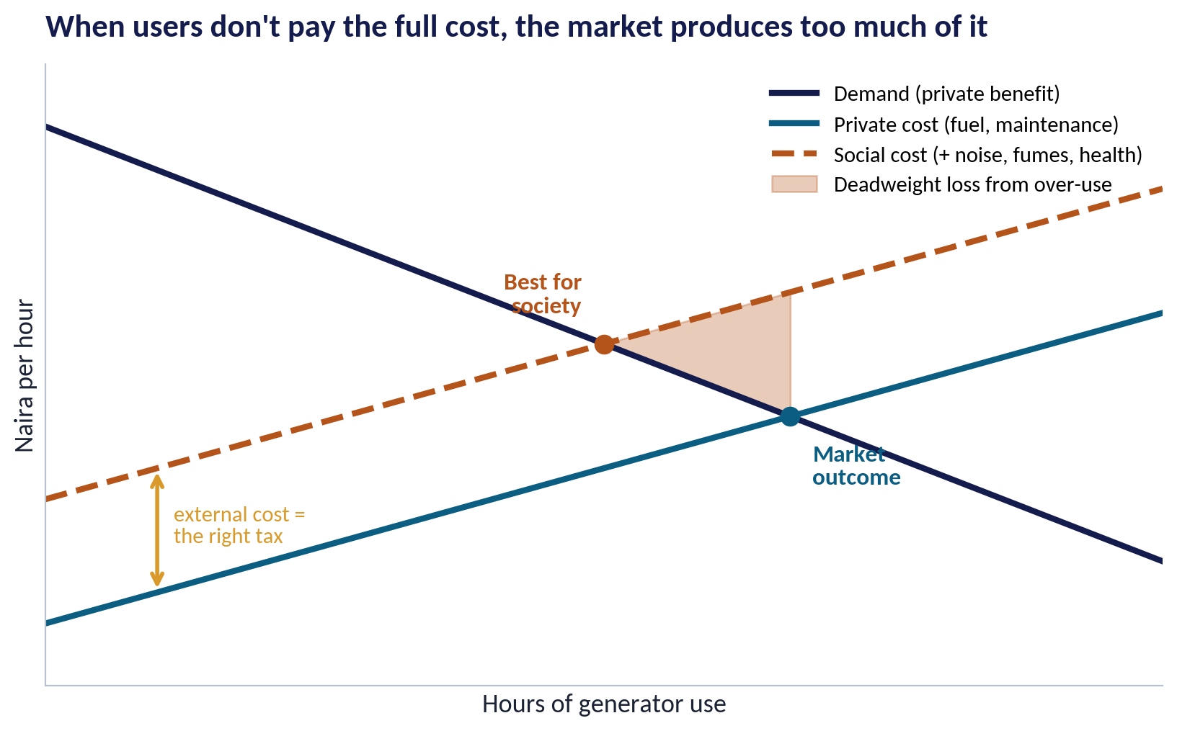
EXTERNALITIES
The Generator Next Door
WHAT TO SEE
The generator owner pays for fuel and maintenance — the private cost.
Neighbours pay too, in noise, fumes and health — the external cost.
The market uses generators up to where private cost meets benefit: too much.
A tax equal to the external cost moves use to what is best for society — the idea behind a Pigouvian tax.
Fig S05-F01 · replicate: s05_figures.R / .py
SESSION 5 · MARKET FAILURES
9
Notes:
Named after the economist Arthur Pigou. The same diagram applies to gas flaring, carbon emissions and congestion.

Slide 10

ASYMMETRIC INFORMATION
The Lemons Problem
IN PLAIN ENGLISH
THE FORMULA
hidden quality → average price → good sellers leave
When buyers cannot tell good from bad, they pay an average price. Owners of good products then refuse to sell, the average quality falls, and the market can unravel.
WHY A MANAGER CARES
Your business can profit from solving information problems: warranties, ratings, certification, track records, and data-based credit scoring all build trust.
EXAMPLE
Lenders cannot tell safe from risky small businesses, so they charge everyone high rates — which drives away the safest borrowers first. Credit bureaus and collateral registries exist to fix this.
SESSION 5 · MARKET FAILURES
10

Slide 11

PUBLIC GOODS
Private Goods vs Public Goods
Private goods
Public goods
Excludable and rival
Non-excludable and non-rival
You can stop non-payers using it
My use leaves less for you
Markets supply them well
Bread, phones, haircuts
Hard to stop non-payers
My use does not reduce yours
Markets under-supply them: free riding
Street lights, flood control, basic research, security
Many Nigerian firms self-supply public goods — power, water, security, roads to the factory. That is a hidden tax on doing business here.
SESSION 5 · MARKET FAILURES
11

Slide 12
PART
02
The Policy Toolkit
Prices, quantities, rules and nudges.

Slide 13
FIVE WAYS TO INTERVENE
Matching the Tool to the Failure
Tool | How it works | Strength | Weakness
Pigouvian tax | Charge the polluter the external cost per unit | Firms cut pollution where it is cheapest | Hard to set the right rate; unpopular
Cap-and-trade | Fix total pollution; issue tradable permits | Certainty about the total | Price can swing; needs strong monitoring
Regulation | Set standards: emission limits, bans | Simple and visible | Same rule for all, so costly for some
Nudges | Change defaults and framing: auto-enrol pensions | Cheap; keeps choice | Small effects; can be manipulative
Market design | Build the market: auctions, registries, ratings | Fixes information and allocation | Needs institutions and data
The economist's preference: price the harm (tax or permits) and let people decide how to adjust — rather than dictate one solution.
SESSION 5 · MARKET FAILURES
13

Slide 14
TAX OR PERMITS?
Pigouvian Taxes vs Cap-and-Trade
IN PLAIN ENGLISH
THE FORMULA
tax: price fixed, quantity varies · cap: quantity fixed, price varies
A tax fixes the price of pollution and lets the quantity adjust. Cap-and-trade fixes the quantity and lets the price adjust. Both make polluting costly, so firms that can cut cheaply do the most cutting.
WHY A MANAGER CARES
For your business: either tool turns pollution into a cost line. Firms that cut emissions early gain a cost advantage — or permits to sell.
EXAMPLE
A gas-flaring penalty per thousand cubic feet is a tax-style tool; a carbon market with a national emissions cap is the permit approach. Session 13 returns to carbon pricing.
SESSION 5 · MARKET FAILURES
14

Slide 15
GOVERNMENT FAILURE
Interventions Can Fail Too
IN PLAIN ENGLISH
THE FORMULA
market failure ≠ automatic case for intervention
Governments face their own problems: poor information, lobbying by those who benefit, leakage and corruption, and policies that are easy to start but hard to stop.
WHY A MANAGER CARES
The right question is not 'market or government?' but 'which imperfect arrangement does least harm here?'
EXAMPLE
The petrol subsidy was meant to share oil wealth, but it favoured car and generator owners, encouraged smuggling across borders, and became one of the largest items in the federal budget.
SESSION 5 · MARKET FAILURES
15

Slide 16
CONCEPT CHECK
Quick Check: What Would You Say?
A Lagos estate's residents all run diesel generators, and everyone complains about the noise and fumes. Which policy best fits the economics of externalities?
A
Ban generators outright
B
Charge a fee per generator-hour that reflects the harm, and use the money to co-fund a shared, cleaner power supply
C
Do nothing — residents chose to live there
D
Subsidise diesel so generators are cheaper to run
Discuss with your neighbour for 60 seconds — answer and reasoning in the speaker notes.
SESSION 5 · MARKET FAILURES
16
Notes:
ANSWER: B. B prices the externality (a Pigouvian charge) and funds an alternative. A is costly when there is no grid power; C ignores a real cost imposed on others; D makes the over-use worse.

Slide 17
PART
03
The Petrol Subsidy
Who gained, who pays, and what next.

Slide 18
INCIDENCE
Who Really Benefits From a Subsidy?
IN PLAIN ENGLISH
THE FORMULA
benefit = litres used × subsidy per litre
A per-litre subsidy goes to whoever buys the most litres. Rich households use far more petrol — for cars and generators — so they receive far more in naira, even if the subsidy is a bigger share of a poor family's budget.
WHY A MANAGER CARES
Universal price subsidies are an expensive way to help the poor. Most of the money goes to people who do not need it.
EXAMPLE
Before removal (stylised): ₦315 of subsidy per litre. A household in the richest 10% using 150 litres a month got ₦47,250; one in the poorest 10% using 4 litres got ₦1,260.
SESSION 5 · MARKET FAILURES
18

Slide 19
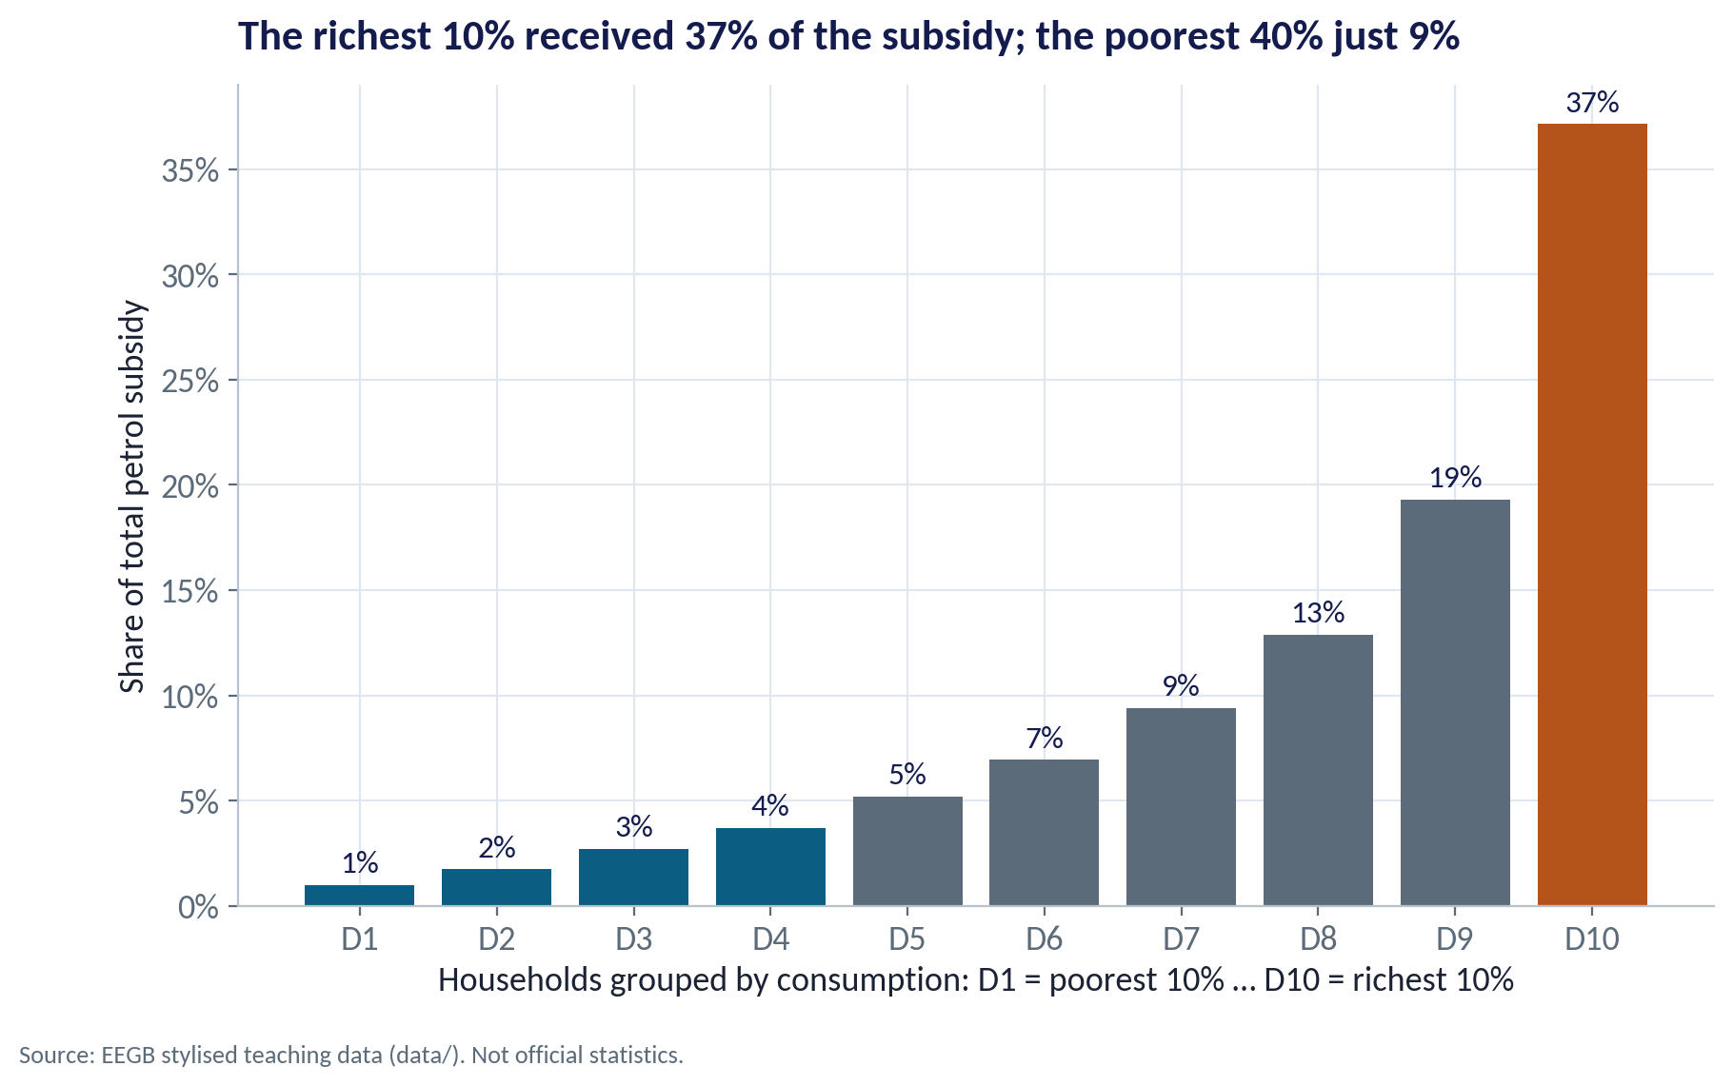
THE INCIDENCE
Most of the Money Went to the Better-Off
WHAT TO SEE
The richest 10% of households received about 37% of the household petrol subsidy.
The poorest 40% received only about 9%.
In naira, the richest households got about 38 times as much as the poorest.
This pattern — subsidies captured by the better-off — is found in fuel subsidies across many countries.
Fig S05-F02 · replicate: s05_figures.R / .py
SESSION 5 · MARKET FAILURES
19

Slide 20
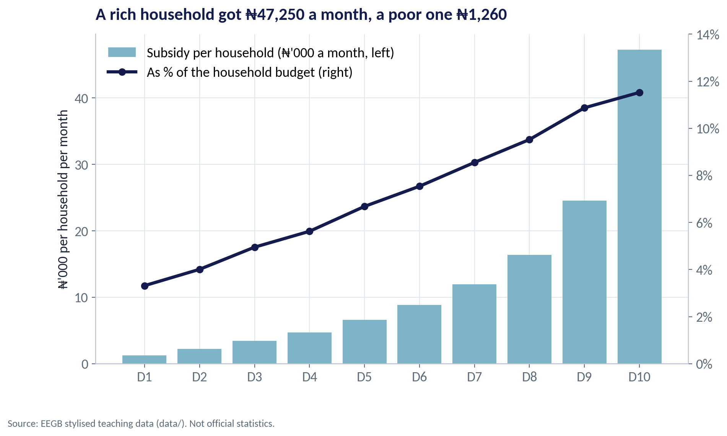
TWO LENSES
Naira Received vs Share of Budget
WHAT TO SEE
Bars: the subsidy in naira rose steeply with income.
Line: as a % of the budget, it also rose — from about 3% for the poorest to 12% for the richest.
Poor households mostly use petrol indirectly: through bus fares and the cost of moving food.
That indirect channel is why removal still hurt the poor badly.
Fig S05-F03 · replicate: s05_figures.R / .py
SESSION 5 · MARKET FAILURES
20

Slide 21
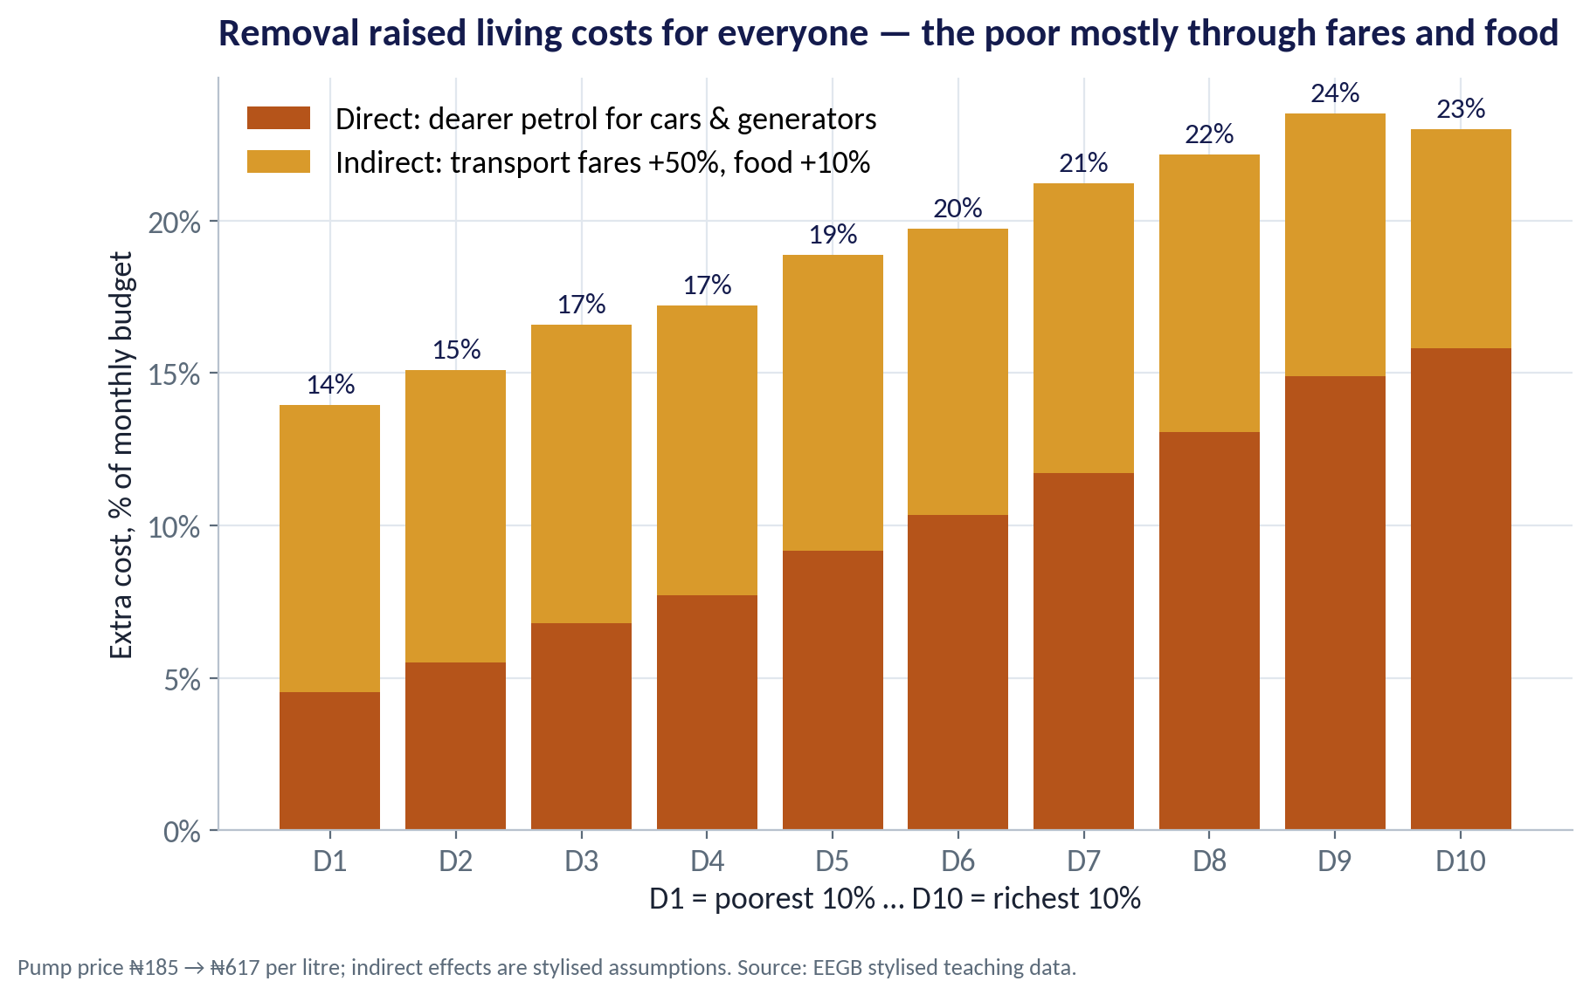
THE SHOCK
The Cost of Removal
WHAT TO SEE
Direct cost: petrol rose from ₦185 to ₦617 a litre.
Indirect cost (our assumptions): bus fares +50%, food +10%.
Extra cost: about 14% of the budget for the poorest decile, 23% for the richest.
For the poor, most of the hit is indirect — and they have the least room to cut back.
Fig S05-F04 · replicate: s05_figures.R / .py
SESSION 5 · MARKET FAILURES
21
Notes:
The indirect assumptions are stylised and deliberately simple; the lab lets students change them.

Slide 22
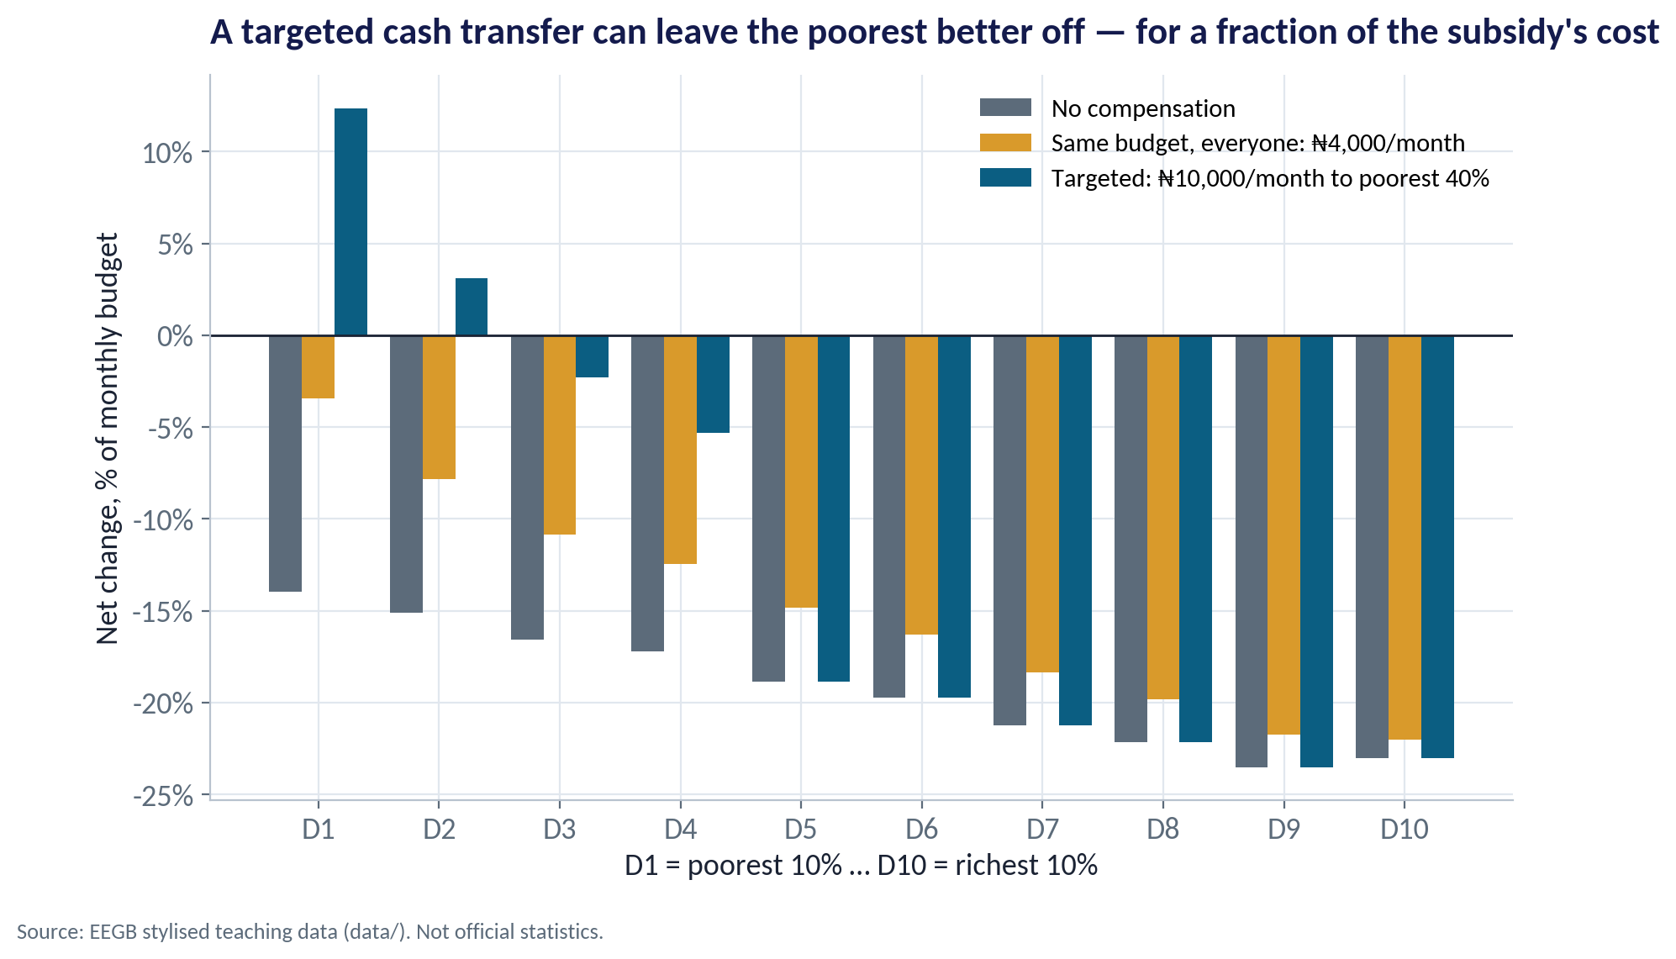
COMPENSATION
Targeted vs Universal Support
WHAT TO SEE
A ₦10,000 a month transfer to the poorest 40% leaves the poorest two deciles better off than before removal.
The same budget spread over everyone gives just ₦4,000 each — too little to protect the poor.
Better-off households still bear the full cost — but they also gained most from the subsidy.
Targeting needs a reliable social register, digital IDs and payment channels.
Fig S05-F05 · replicate: s05_figures.R / .py
SESSION 5 · MARKET FAILURES
22

Slide 23
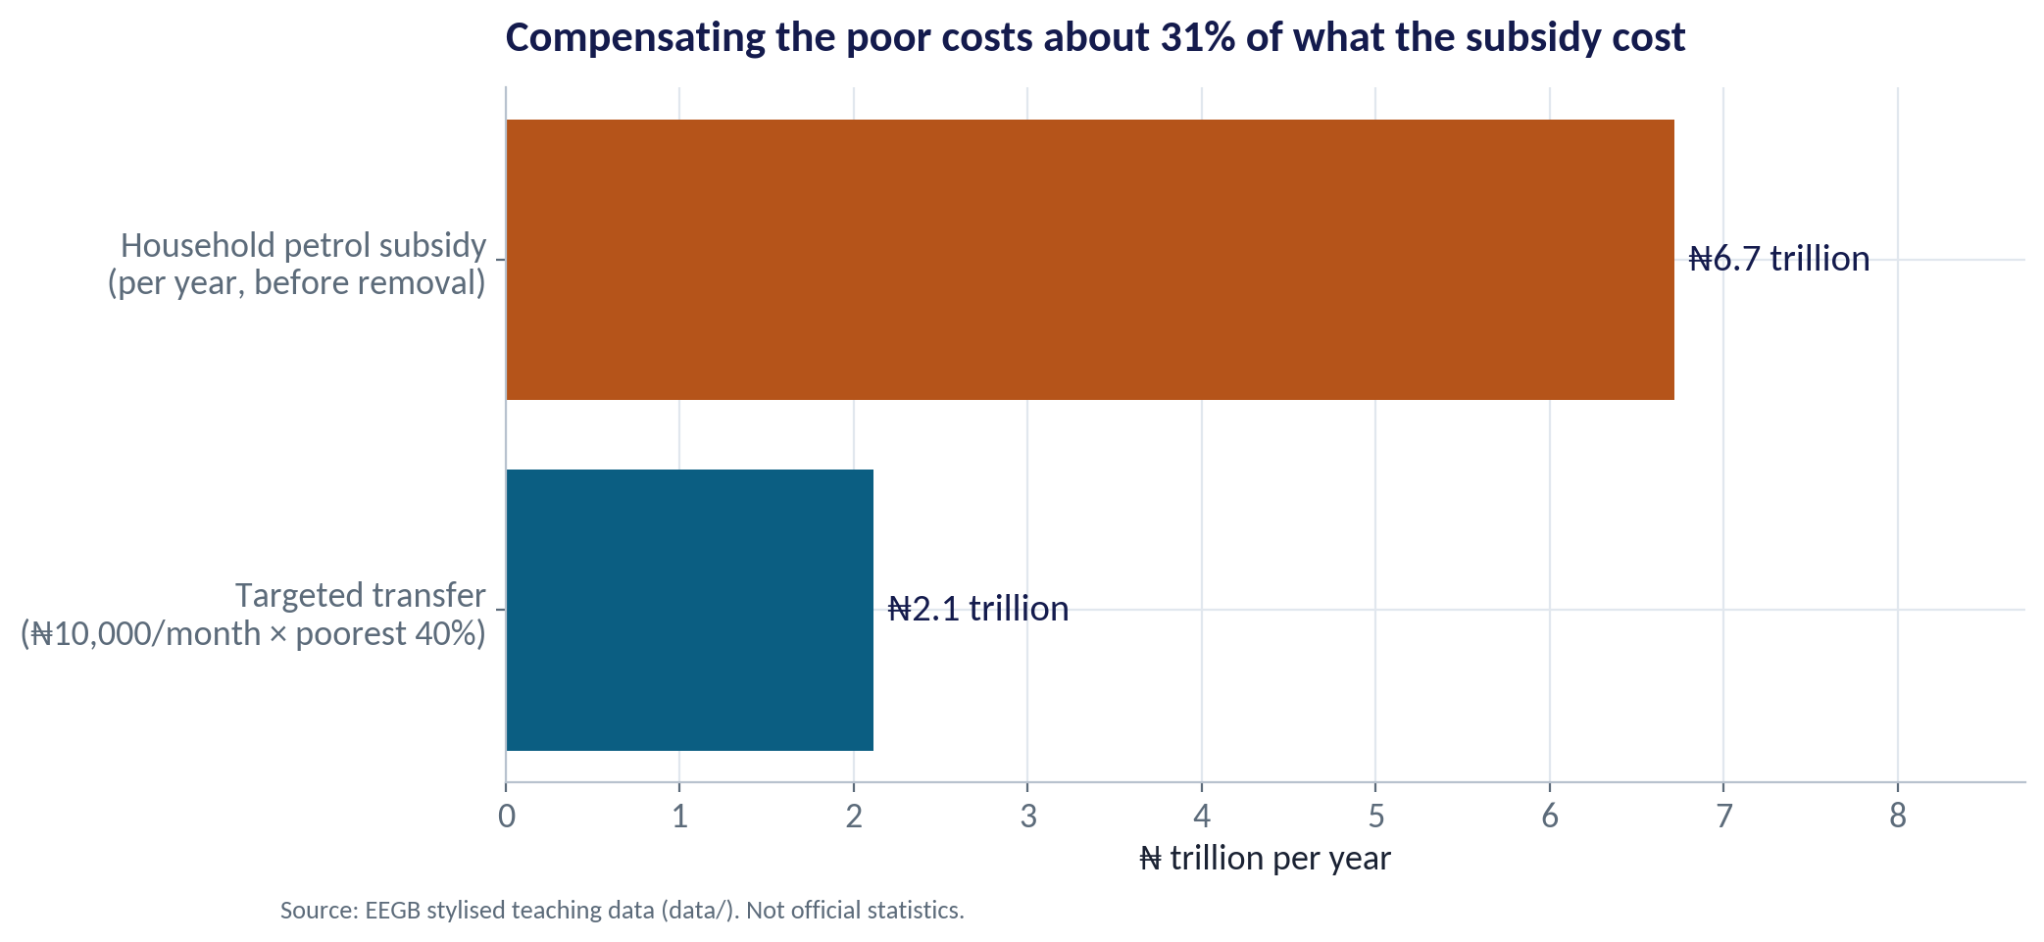
THE FISCAL ARITHMETIC
What the Savings Can Buy
WHAT TO SEE
The household petrol subsidy cost about ₦6.7 trillion a year (stylised).
The targeted transfer costs about ₦2.1 trillion — roughly 31% of that.
The rest can fund transport (e.g. CNG buses), health and education — or cut borrowing.
Credibility matters: people accept reform more readily when they can see where the savings go.
Fig S05-F06 · replicate: s05_figures.R / .py
SESSION 5 · MARKET FAILURES
23
Notes:
In 2023 the federal government announced cash transfers for poor households; delivery was slow and the programme was paused and redesigned. Implementation capacity is part of the policy choice.

Slide 24


WHERE MANAGERS GO WRONG
Common Mistakes in Thinking About Intervention
THE TRAP
THE BETTER HABIT
“A price subsidy is the best way to help the poor.”
Check who consumes the subsidised good. Targeted cash usually reaches the poor more cheaply.
“Removing the subsidy only hurts car owners.”
Count indirect effects: fares, food, and the cost of running small businesses.
Banning the polluting activity outright.
Price the harm and let people adjust; ban only where harm is severe.
Assuming any market failure justifies intervention.
Compare against government failure: leakage, lobbying, weak capacity.
Ignoring the business opportunity.
Firms that solve failures — ratings, clean power, logistics — create value.
SESSION 5 · MARKET FAILURES
24

Slide 25
CONCEPT CHECK
Quick Check: What Would You Say?
Our data show the richest 10% got 37% of the subsidy but face the largest % cost from removal (23% of budget vs 14% for the poorest). What follows?
A
Removal was regressive because the rich lost more
B
The rich lose more in % terms, but they gained most from the subsidy and can absorb it; protecting the poorest — who have little margin — is the priority for compensation
C
Compensation should go mainly to the richest decile
D
The subsidy should be restored
Discuss with your neighbour for 60 seconds — answer and reasoning in the speaker notes.
SESSION 5 · MARKET FAILURES
25
Notes:
ANSWER: B. B. The burden as a % of budget is only part of the story: the poorest are closest to subsistence, and they received least from the subsidy. A misuses 'regressive'; C and D ignore who benefited and the fiscal cost.

Slide 26



HANDS-ON LAB
Lab: Subsidy Incidence and Compensation
1
Compute the subsidy each decile received, in naira and as a % of budget.
YOU WILL NEED
Data
2
Find the shares of the richest 10% and the poorest 40%.
data/fuel_subsidy_incidence.csv
3
Estimate the direct and indirect cost of removal; change the fare and food assumptions.
R script
sessions/s05/R/s05_lab.R
4
Cost a targeted cash transfer and compare it with the old subsidy bill.
Python script
Find the transfer that leaves deciles 3 and 4 no worse off.
sessions/s05/python/s05_lab.py
5
Deliverable: a two-sentence recommendation on how the savings should be used.
⏱ 20 minutes
SESSION 5 · MARKET FAILURES
26

Slide 27
WORDS TO OWN
Today's Vocabulary in Plain English
Market failure
When a free market produces the wrong amount of something.
Pigouvian tax
A tax equal to the external cost of an activity.
Externality
A cost or benefit that falls on people outside the transaction.
Cap-and-trade
A fixed total of pollution permits that firms can trade.
Public good
Non-excludable and non-rival, so markets under-supply it.
Nudge
A change in defaults or framing that steers choices.
Free riding
Enjoying a benefit without paying towards it.
Incidence
Who actually bears a tax or receives a subsidy.
Asymmetric information
One side of a deal knows more than the other.
Government failure
When intervention makes outcomes worse.
SESSION 5 · MARKET FAILURES
27

Slide 28
KEY TAKEAWAYS
Session 5 in 5 Ideas
01
Markets fail through externalities, public goods, information gaps and market power.
02
Fix them by pricing the harm (taxes, permits), rules, nudges or market design.
03
Governments fail too: compare imperfect alternatives.
04
A per-litre subsidy goes to whoever uses the most — usually the better-off.
05
Protect the poor with targeted transfers, and show where the savings go.
NEXT › Session 6: AD–AS & Inflation
Before next session: Read the chapters on aggregate demand and aggregate supply in Blanchard, Macroeconomics. Bring one price your company raised in 2024 and say whether the cause was demand (customers buying more) or supply (your costs rising).

