Slide 1


LAGOS BUSINESS SCHOOL · MEMBA 14 · EEGB · PART II
SESSION 6
AD–AS in a
Shock-Prone World
From markets, to macro, to decisions that matter — in Nigeria and the world.
Reading: Olivier Blanchard, Macroeconomics · Facilitator: Bongo Adi
Economic Environment of Global Business · Lagos Business School · Prof. Bongo Adi, Kelechi Nnamdi, Elvis Ozegbe
Notes:
Part II begins. Ask participants how many times their company changed prices in 2024. Most will say three or more. That is inflation from the inside; today we look at it from the whole economy.

Slide 2




PART I IN REVIEW
Microeconomics in Four Ideas
Prices ration
Demand, supply and elasticity decide how much of a cost shock you can pass on.
Forecast honestly
Trend, seasonality and scenarios beat a single 'confident' number.
Structure matters
Platforms, network effects and switching costs shape who earns the profit.
Markets can fail
Externalities and subsidies change behaviour — and someone always pays.
SESSION 6 · AD–AS & INFLATION
2
Notes:
Part II now zooms out from one market to the whole economy. The tools change; the logic of incentives does not.

Slide 3



TODAY'S PLAN
Session 6 at a Glance — 75 Minutes
Why prices across the whole economy rise — and why the cause decides the cure.
10'
25'
20'
20'
Hook
The AD–AS Model
Measuring Inflation
Expectations & Lab
Nigeria's 2023–24 inflation surge
Demand shocks, supply shocks and what each does to output
Headline, food, core and the trimmed mean
Phillips curve, persistence, and the inflation diagnosis lab
SESSION 6 · AD–AS & INFLATION
3

Slide 4

BY THE END OF TODAY
Session 6 Learning Objectives
You will be able to:
01
02
03
Use the AD–AS Model
Read Inflation Measures
Respect Expectations
Tell a demand shock from a supply shock, and predict what each does to prices and output.
Explain headline, food, core and trimmed-mean inflation, and why each answers a different question.
Explain why inflation is sticky, and why central banks care so much about what people expect.
SESSION 6 · AD–AS & INFLATION
4

Slide 5



THE HOOK
From 22% to 34% in Eighteen Months
“Prices are rising because people have too much money. Raise interest rates and it will stop.”
It sounds plausible. But in 2023–24 three different forces hit Nigerian prices at once:
Petrol subsidy removed
The naira devalued
Money and credit grew
In May 2023 the pump price roughly tripled within weeks. Transport and food costs followed.
After the June 2023 unification, the naira lost well over half its dollar value. Imported goods and inputs repriced.
Broad money and credit grew very fast, partly because dollar balances were revalued at the weaker rate.
Notes:
Ask the room: which of these is a demand shock and which is a supply shock? Keep the answers on the board; we come back to them after the AD–AS model.

Slide 6




NIGERIAN BUSINESS CASE
Demand Problem, Supply Problem — or Both?
The situation
The decision question
After the May–June 2023 reforms, Nigerian inflation climbed from about 22% to the mid-30s by 2024. The CBN raised its policy rate sharply. Firms faced rising costs and weakening customers at the same time.
Was the surge mainly a demand shock (too much spending) or a supply shock (costs pushed up)? The answer decides whether higher interest rates are the right medicine.
The data we have
What a good answer looks like
ng_macro_monthly.csv — headline, food and core inflation, exchange rates, policy rate and PMI, 2015–2025. *Stylised teaching data.* We use 2015–2024 for like-for-like comparisons because the CPI was rebased in 2025.
A short diagnosis with evidence (food vs core, exchange-rate pass-through, activity), and what it implies for policy and for your pricing.
SESSION 6 · AD–AS & INFLATION
6

Slide 7
PART
01
The AD–AS Model
One diagram for the whole economy.

Slide 8

TWO CURVES
Aggregate Demand and Aggregate Supply
Aggregate demand (AD)
Aggregate supply (AS)
Total spending in the economy
What firms can produce at each price level
Households, firms, government and the rest of the world
Shifts right when credit is cheap, budgets expand or exports boom
Shifts left when rates rise or confidence falls
Policy levers: interest rates and the budget
Depends on costs: energy, imported inputs, wages, logistics
Shifts up/left when costs jump (fuel, FX, insecurity on farms)
Shifts down/right with productivity, power and better roads
Policy levers: slow, structural reforms
Where the two curves cross sets the price level and real output. Shocks move one curve or both.
SESSION 6 · AD–AS & INFLATION
8

Slide 9
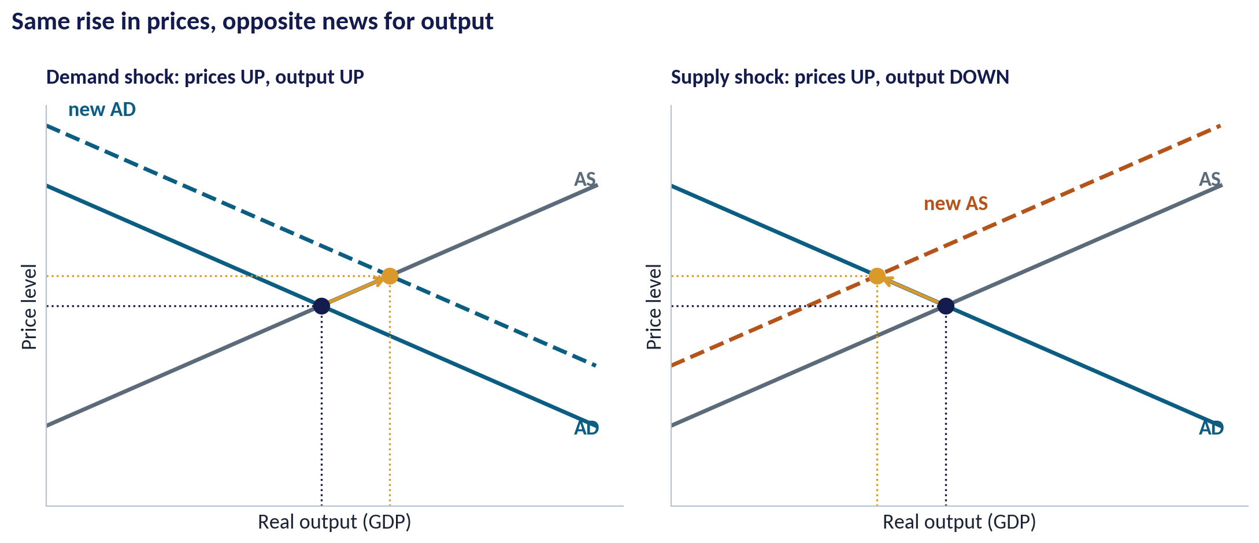
THE KEY DISTINCTION
Demand Shock vs Supply Shock
WHAT TO SEE
Demand shock: spending jumps → prices and output rise together. Overheating.
Supply shock: costs jump → prices rise but output falls. Stagflation.
Both raise inflation, so inflation alone cannot tell you which happened.
Look at output and activity too: are firms selling more, or less?
Fig S06-F01 · replicate: s06_figures.R / .py
SESSION 6 · AD–AS & INFLATION
9

Slide 10


WHY THE CAUSE MATTERS
The Same Medicine Does Not Cure Both
IN PLAIN ENGLISH
THE FORMULA
demand shock: P↑ Y↑ · supply shock: P↑ Y↓
Higher interest rates work on demand: they make borrowing dearer and cool spending. Against a supply shock they cannot bring fuel or dollars back — they mainly reduce output further, while stopping the shock from spreading into wages and expectations.
WHY A MANAGER CARES
If you misdiagnose a supply shock as demand, you expect rate rises to fix prices quickly. They won't — so plan for costs that stay high and customers who spend less.
EXAMPLE
Mid-2023 to end-2024, average inflation was 30.5% against 19.6% in the eighteen months before, while the PMI slipped from 52.7 to 49.4. Prices up, activity down: the supply-shock signature.
SESSION 6 · AD–AS & INFLATION
10
Notes:
Numbers are from the stylised dataset: averages for Jan 2022–May 2023 vs Jun 2023–Dec 2024 (s06_lab).

Slide 11
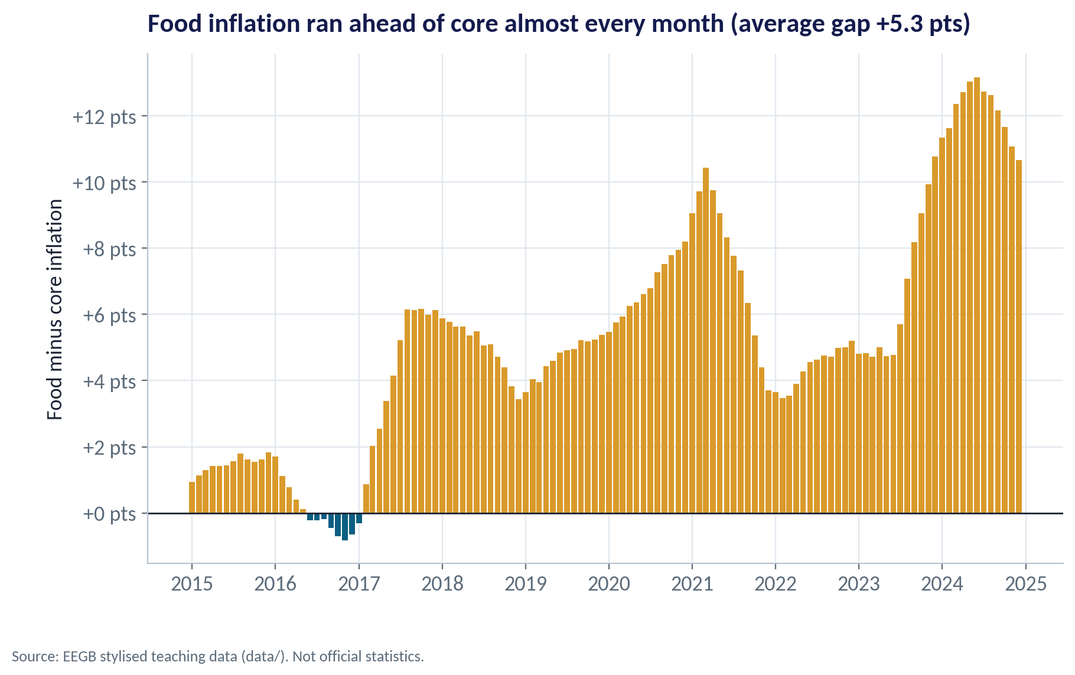
EVIDENCE 1
Food Running Ahead of Core
WHAT TO SEE
Food inflation exceeded core inflation almost every month.
The gap averaged +5.3 points over 2015–2024 and widened to about +12 points in 2024.
Food prices react to fuel, transport, insecurity and the exchange rate — mostly supply forces.
A wide food–core gap is a warning that interest rates alone will not fix the problem.
Fig S06-F02 · replicate: s06_figures.R / .py
SESSION 6 · AD–AS & INFLATION
11

Slide 12
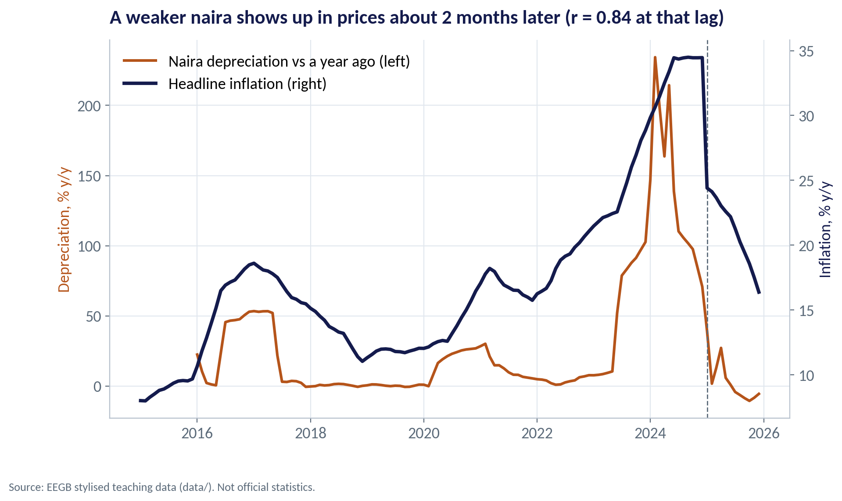
EVIDENCE 2
Exchange-Rate Pass-Through
WHAT TO SEE
When the naira weakens, imported goods and inputs cost more in naira.
In this data the link is strongest about 2 months later (correlation 0.84).
The naira's fall after mid-2023 was the single largest cost shock for many firms.
Pass-through is a supply shock to importers — but a weaker naira also helps exporters.
Fig S06-F03 · replicate: s06_figures.R / .py
SESSION 6 · AD–AS & INFLATION
12
Notes:
Correlation over 2015–2024 between year-on-year depreciation (official rate) lagged k months and headline inflation; the best lag is 2 in this stylised series. Real-world pass-through estimates vary; treat the lag as illustrative.

Slide 13
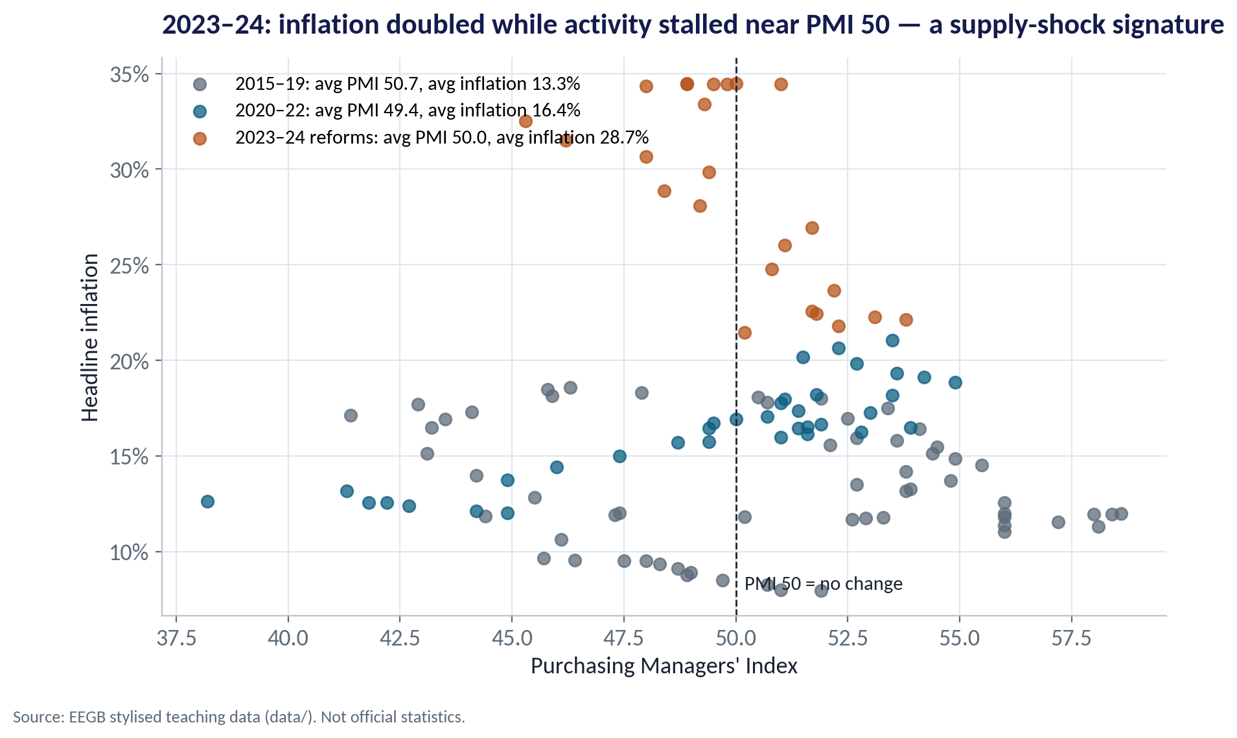
EVIDENCE 3
Prices Up, Activity Stalled
WHAT TO SEE
Each dot is one month: PMI (activity) against inflation.
In 2015–19 inflation averaged 13.3% with the PMI around 50.7.
In 2023–24 inflation averaged 28.7% while the PMI averaged only 50.0.
Inflation more than doubled without a boom in activity — consistent with a supply shock.
Fig S06-F04 · replicate: s06_figures.R / .py
SESSION 6 · AD–AS & INFLATION
13

Slide 14
CONCEPT CHECK
Quick Check: What Would You Say?
A sudden rise in diesel and imported-input costs pushes Nigerian prices up while factories cut output. In AD–AS terms this is:
A
A rightward shift of aggregate demand
B
An upward (leftward) shift of aggregate supply
C
A movement along aggregate demand caused by higher incomes
D
A fall in aggregate demand caused by lower prices
Discuss with your neighbour for 60 seconds — answer and reasoning in the speaker notes.
SESSION 6 · AD–AS & INFLATION
14
Notes:
ANSWER: B. B. Higher production costs shift AS up and to the left: prices rise and output falls. A would raise output, not cut it. C and D describe demand, which is not where this shock started.

Slide 15
PART
02
Measuring Inflation
Which number answers which question?

Slide 16
FOUR MEASURES
Headline, Food, Core and Trimmed Mean
Measure | What it includes | Question it answers | Weakness
Headline CPI | The full consumer basket | How fast is the cost of living rising? | Swings with food and fuel shocks
Food | Food items in the basket | How hard are households being squeezed? | Weather, insecurity and transport drive it
Core | Excludes farm produce and energy | What is the underlying trend? | Excludes what people actually pay for
Trimmed mean | Drops the most extreme price changes each month | What is the typical price change? | Less familiar; not always published
Use headline for wages and contracts, core or trimmed mean to judge whether inflation is truly slowing.
SESSION 6 · AD–AS & INFLATION
16

Slide 17
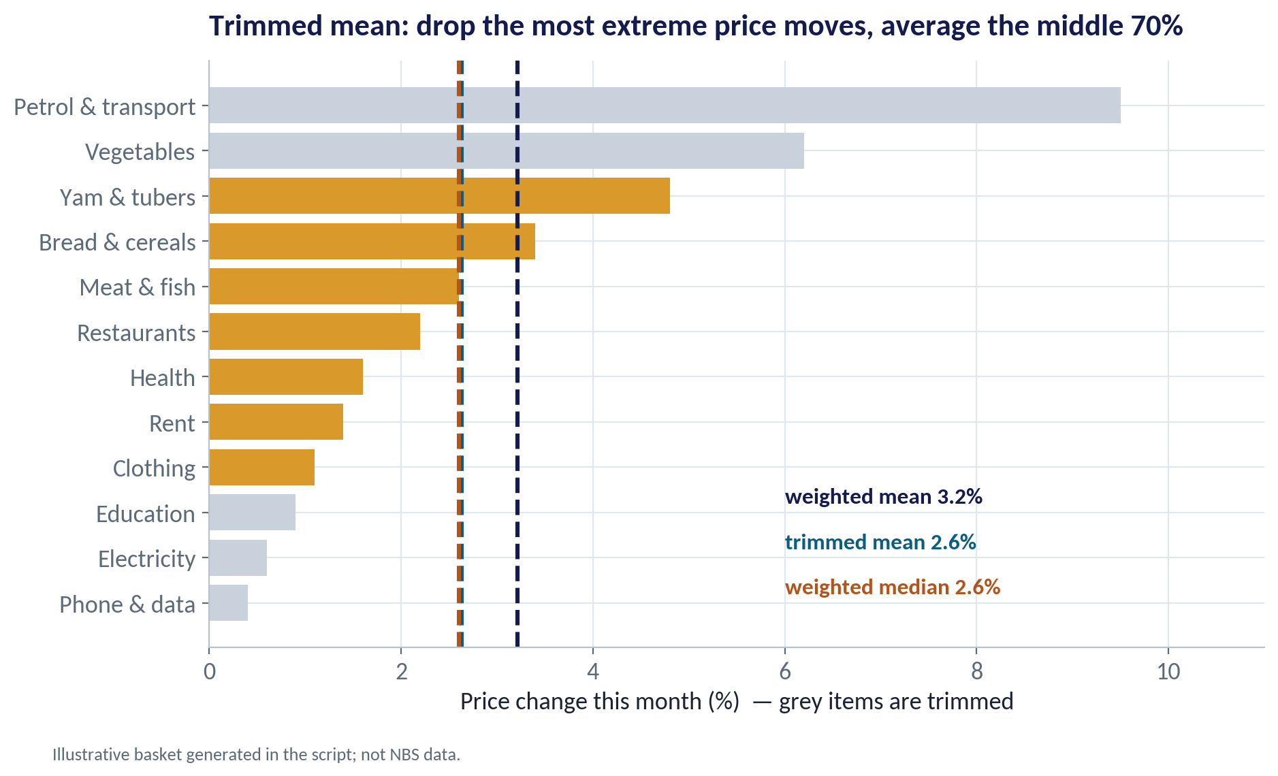
THE TRIMMED MEAN
Taking Out the Extremes
WHAT TO SEE
This illustrative month: petrol and vegetables jumped; data and electricity barely moved.
The weighted mean (headline) is 3.2% — pulled up by two big movers.
Drop the top and bottom 15% of the basket by weight: the trimmed mean is 2.6%.
When the two diverge, a few items are driving headline inflation — often a supply story.
Fig S06-F05 · replicate: s06_figures.R / .py
SESSION 6 · AD–AS & INFLATION
17
Notes:
The basket in this chart is generated in the script for teaching. Several central banks publish trimmed-mean measures; check whether the NBS or CBN publishes one in your period.

Slide 18

A WARNING ABOUT YARDSTICKS
Rebasing Changes the Ruler
IN PLAIN ENGLISH
THE FORMULA
inflation = (CPIₜ ÷ CPIₜ₋₁₂ − 1) × 100
A price index compares today's basket with a base year. When statisticians rebase, they update the base year and the basket weights. Year-on-year rates before and after are not directly comparable.
WHY A MANAGER CARES
Before you change prices, wage offers or contract indexation clauses, check which index and which base year the number uses.
EXAMPLE
Nigeria's CPI was rebased in January 2025. In this dataset headline inflation drops from about 34% in December 2024 to about 24% in January 2025 — much of that is the new ruler, not a sudden collapse in price pressure.
SESSION 6 · AD–AS & INFLATION
18

Slide 19
PART
03
Expectations and Persistence
Why inflation is easy to start and hard to stop.

Slide 20
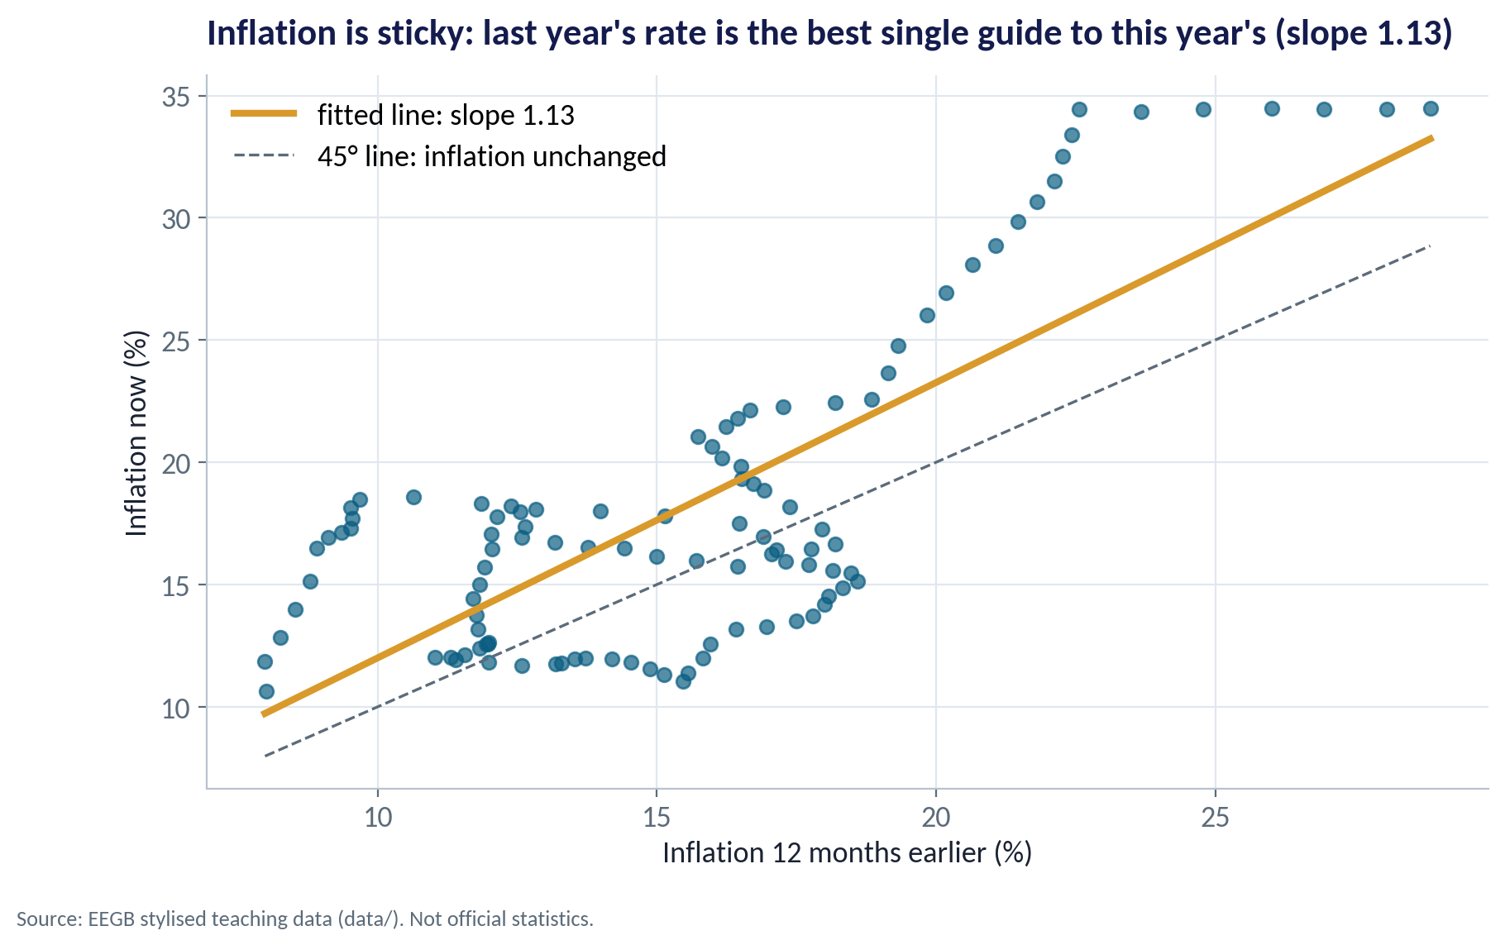
PERSISTENCE
Inflation Is Sticky
WHAT TO SEE
Each dot compares inflation now with inflation 12 months earlier.
The fitted line: inflation now ≈ 0.74 + 1.13 × last year's rate.
A slope near or above 1 means high inflation tends to stay high — or rise further.
Why? Contracts, rents, wages and prices are set looking backward and forward.
Fig S06-F06 · replicate: s06_figures.R / .py
SESSION 6 · AD–AS & INFLATION
20
Notes:
The slope above 1 reflects the accelerating inflation of 2015–2024 in this stylised series; it is a description, not a forecast rule.

Slide 21
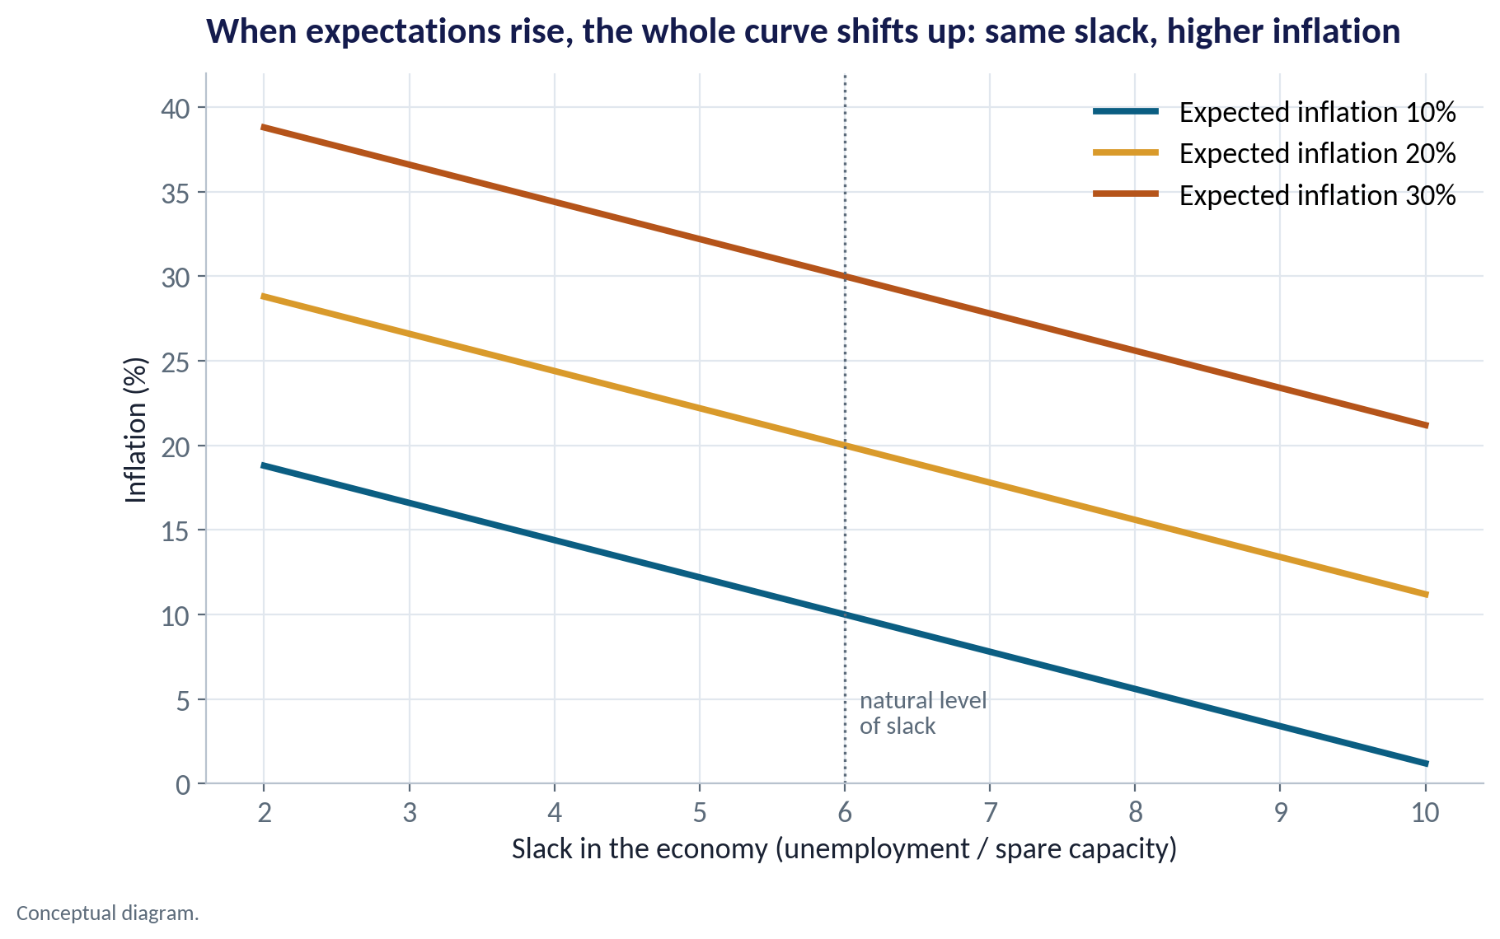
THE PHILLIPS CURVE
Expectations Shift the Curve
WHAT TO SEE
The Phillips curve links inflation to slack: less spare capacity, more pressure on prices.
But each curve is drawn for a given level of expected inflation.
If people come to expect 30%, the curve shifts up: the same slack now comes with 30%-type inflation.
So central banks fight hard to keep expectations anchored — even at the cost of growth.
Fig S06-F07 · replicate: s06_figures.R / .py
SESSION 6 · AD–AS & INFLATION
21

Slide 22


HOW EXPECTATIONS FORM
Why People Expect What They Expect
Looking backward
Looking at the central bank
Looking at the naira
Landlords, unions and suppliers ask: what did prices do last year? They build that into next year's rent, wages and price lists.
If the CBN is believed when it says it will bring inflation down, people raise prices less. Credibility is a policy tool.
In Nigeria the exchange rate is a daily, visible signal. A falling naira quickly raises inflation expectations.
SESSION 6 · AD–AS & INFLATION
22

Slide 23


WHERE MANAGERS GO WRONG
Common Mistakes When Reading Inflation
THE TRAP
THE BETTER HABIT
“Inflation is falling, so prices are falling.”
Falling inflation means prices rise more slowly. The price level is still higher.
Treating every inflation episode as too much demand.
Check food vs core, the exchange rate and activity before deciding.
Comparing inflation across a rebasing as if nothing changed.
Use the same base, or month-on-month changes on the new base.
Assuming a rate rise brings inflation down within a quarter.
Monetary policy works with long lags — often a year or more.
Indexing a contract to 'inflation' without naming the index.
Name the measure (headline, core) and the base year in the contract.
SESSION 6 · AD–AS & INFLATION
23

Slide 24
CONCEPT CHECK
Quick Check: What Would You Say?
Headline inflation is 30%, core is 22% and the trimmed mean is 23%. What is the best reading?
A
Underlying inflation is about 30%, so plan for 30% every year
B
A few items (likely food and energy) are pushing headline above the underlying trend of about 22–23%
C
Core inflation is wrong because it leaves out food
D
Inflation is under control because core is lower
Discuss with your neighbour for 60 seconds — answer and reasoning in the speaker notes.
SESSION 6 · AD–AS & INFLATION
24
Notes:
ANSWER: B. B. When core and trimmed mean agree and sit well below headline, a small group of volatile items is driving headline. Those items still hurt households (so C is a fair complaint, but not the best reading), and 22% is far from 'under control' (D).

Slide 25



HANDS-ON LAB
Lab: Diagnose the 2023–24 Inflation Surge
1
Compare headline, food, core and PMI before and after mid-2023.
YOU WILL NEED
Data
2
Compute the food minus core gap by year.
data/ng_macro_monthly.csv
3
Correlate inflation with naira depreciation at different lags — where is the link strongest?
R script
sessions/s06/R/s06_lab.R
4
Fit inflation now against inflation a year ago to measure persistence.
Python script
Check the real policy rate: were rates above or below inflation?
sessions/s06/python/s06_lab.py
5
Deliverable: a three-sentence diagnosis — demand, supply or both — citing at least two numbers, and one implication for your pricing.
⏱ 20 minutes
SESSION 6 · AD–AS & INFLATION
25

Slide 26
WORDS TO OWN
Today's Vocabulary in Plain English
Aggregate demand
Total spending on an economy's goods and services.
Core inflation
Inflation excluding volatile items such as farm produce and energy.
Aggregate supply
Total output firms will produce at each price level.
Trimmed mean
Average price change after dropping the most extreme movers.
Demand shock
A change in spending that moves prices and output the same way.
Pass-through
How much of an exchange-rate change shows up in local prices.
Supply shock
A change in costs that moves prices and output in opposite ways.
Phillips curve
The link between economic slack and inflation.
Stagflation
High inflation combined with weak or falling output.
Anchored expectations
People's belief that inflation will return to target.
SESSION 6 · AD–AS & INFLATION
26

Slide 27
KEY TAKEAWAYS
Session 6 in 5 Ideas
01
AD–AS: demand shocks move prices and output together; supply shocks move them apart.
02
Diagnose before you prescribe: rates cure demand inflation far better than supply inflation.
03
Use headline for the cost of living; core and trimmed mean for the underlying trend.
04
Watch for rebasing — a new ruler is not a new reality.
05
Inflation is sticky because of expectations; credibility is worth fighting for.
NEXT › Session 7: National Accounts
Before next session: Read the Mankiw chapters on measuring national income (GDP). Find your company's revenue for the last three years and ask: how much of the growth was real?

