Slide 1


LAGOS BUSINESS SCHOOL · MEMBA 14 · EEGB · PART II
SESSION 7
National Accounts,
Productivity & Welfare
From markets, to macro, to decisions that matter — in Nigeria and the world.
Reading: N. Gregory Mankiw, Macroeconomics · Facilitator: Bongo Adi
Economic Environment of Global Business · Lagos Business School · Prof. Bongo Adi, Kelechi Nnamdi, Elvis Ozegbe
Notes:
Open with a show of hands: who believes the average Nigerian is richer today than in 2014? Then show that the answer depends entirely on which GDP number you use.

Slide 2




RECAP
Session 6 in Three Ideas
AD vs AS
Demand shocks move prices and output together; supply shocks move them apart.
Measures
Headline for the cost of living; core and trimmed mean for the underlying trend.
Expectations
Inflation is sticky because people price in what they expect.
SESSION 7 · NATIONAL ACCOUNTS
2

Slide 3



TODAY'S PLAN
Session 7 at a Glance — 75 Minutes
How we measure the size of an economy — and why the headline number can mislead.
10'
25'
20'
20'
Hook
Measuring GDP
Growth & Living Standards
Lab & Discussion
The day Nigeria's GDP jumped
Three approaches; GDP vs GNI; nominal vs real; rebasing
Oil vs non-oil, per person, PPP, informality
Is Nigeria getting richer?
SESSION 7 · NATIONAL ACCOUNTS
3

Slide 4

BY THE END OF TODAY
Session 7 Learning Objectives
You will be able to:
01
02
03
Read the National Accounts
Find the Growth Drivers
Judge Living Standards
Explain GDP, GDI and GNI, nominal versus real, and what a rebasing does — and does not — change.
Separate oil from non-oil growth and spot which sectors are gaining share.
Use per-person, PPP and 'beyond GDP' measures to size a market honestly.
SESSION 7 · NATIONAL ACCOUNTS
4

Slide 5


THE HOOK
Bigger Overnight — Richer Overnight?
“Nigeria is now Africa's largest economy.” — headlines, April 2014
In 2014 the statistics office rebased GDP to 2010 prices and the measured economy grew by almost 90% in a single announcement. What changed?
What was counted
What was not changed
What moved with it
Telecoms, Nollywood, e-commerce and other new activities that the old 1990 base barely measured.
No household earned an extra naira that morning. Output was the same; the measurement improved.
Debt-to-GDP and tax-to-GDP ratios fell instantly — the denominator was bigger.
Notes:
Nigeria rebased again in 2025, moving the base year to 2019. Ask: when your sales figures are restated, what should change in your strategy? Usually: nothing, except your ratios.

Slide 6




NIGERIAN BUSINESS CASE
Is Nigeria Getting Richer?
The situation
The decision question
A consumer-goods company plans its five-year strategy. The CEO's slide says 'Nigeria's economy has grown 50% since 2010'. The CFO is less sure the average customer is better off.
How much has the economy really grown, which sectors are driving it, and has income per person risen enough to grow our market?
The data we have
What a good answer looks like
ng_gdp_sectors.csv — real GDP by ten sectors (₦ tn, 2010 prices), nominal GDP on old and new bases, population, 2010–2025; peer_income.csv — ten countries. *Stylised teaching data.*
A one-paragraph view for the board on real growth, growth per person, and the sectors that matter for our demand.
SESSION 7 · NATIONAL ACCOUNTS
6

Slide 7
PART
01
Measuring the Economy
One number, three ways to get it.

Slide 8


THREE ROADS TO GDP
Production, Spending and Income Give the Same Total
Output (production)
Expenditure
Income (GDI)
Add the value added of every sector: farm output, factories, banks, telecoms — minus the inputs they used. This is how NBS builds most of Nigeria's GDP.
Add what is spent on final goods: C + I + G + (X − M) — consumption, investment, government and net exports.
Add what is earned: wages, profits, rent and interest. In principle equal to GDP; in practice a 'statistical discrepancy' remains.
Value added avoids double counting: count the bread, not the flour and the bread.
SESSION 7 · NATIONAL ACCOUNTS
8

Slide 9
GDP, GNI AND FRIENDS
Which 'National Income' Number Answers Which Question?
Measure | What it counts | Why a manager cares
GDP | Value produced **inside** Nigeria, by anyone | Size of the domestic market and activity
GNI | GDP + income earned abroad by Nigerians − income paid to foreigners | Nigeria's GNI is below GDP: profits and interest flow out to foreign owners and lenders
Disposable income | Income households can spend after taxes and transfers (incl. remittances) | Closest to what customers can actually spend
GDP per person | GDP ÷ population | Average living standard — the number that matters for most consumer markets
Remittances from Nigerians abroad do not add to GDP, but they do raise what households can spend.
SESSION 7 · NATIONAL ACCOUNTS
9

Slide 10


NOMINAL VS REAL
Taking Prices Out of GDP
IN PLAIN ENGLISH
THE FORMULA
deflator = nominal GDP ÷ real GDP × 100
Nominal GDP values output at today's prices; real GDP values it at a fixed base year's prices, so it moves only when quantities move. The ratio of the two is the GDP deflator — the broadest price index we have.
WHY A MANAGER CARES
A market that grows 25% in naira while prices rise 30% is shrinking in volume. Always ask for real growth before celebrating.
EXAMPLE
In this data nominal GDP rose 6.8× from 2010 to 2025, real GDP only 1.51×. Most of the 'growth' in naira was inflation; the deflator rose about 30% in 2024 alone.
SESSION 7 · NATIONAL ACCOUNTS
10

Slide 11
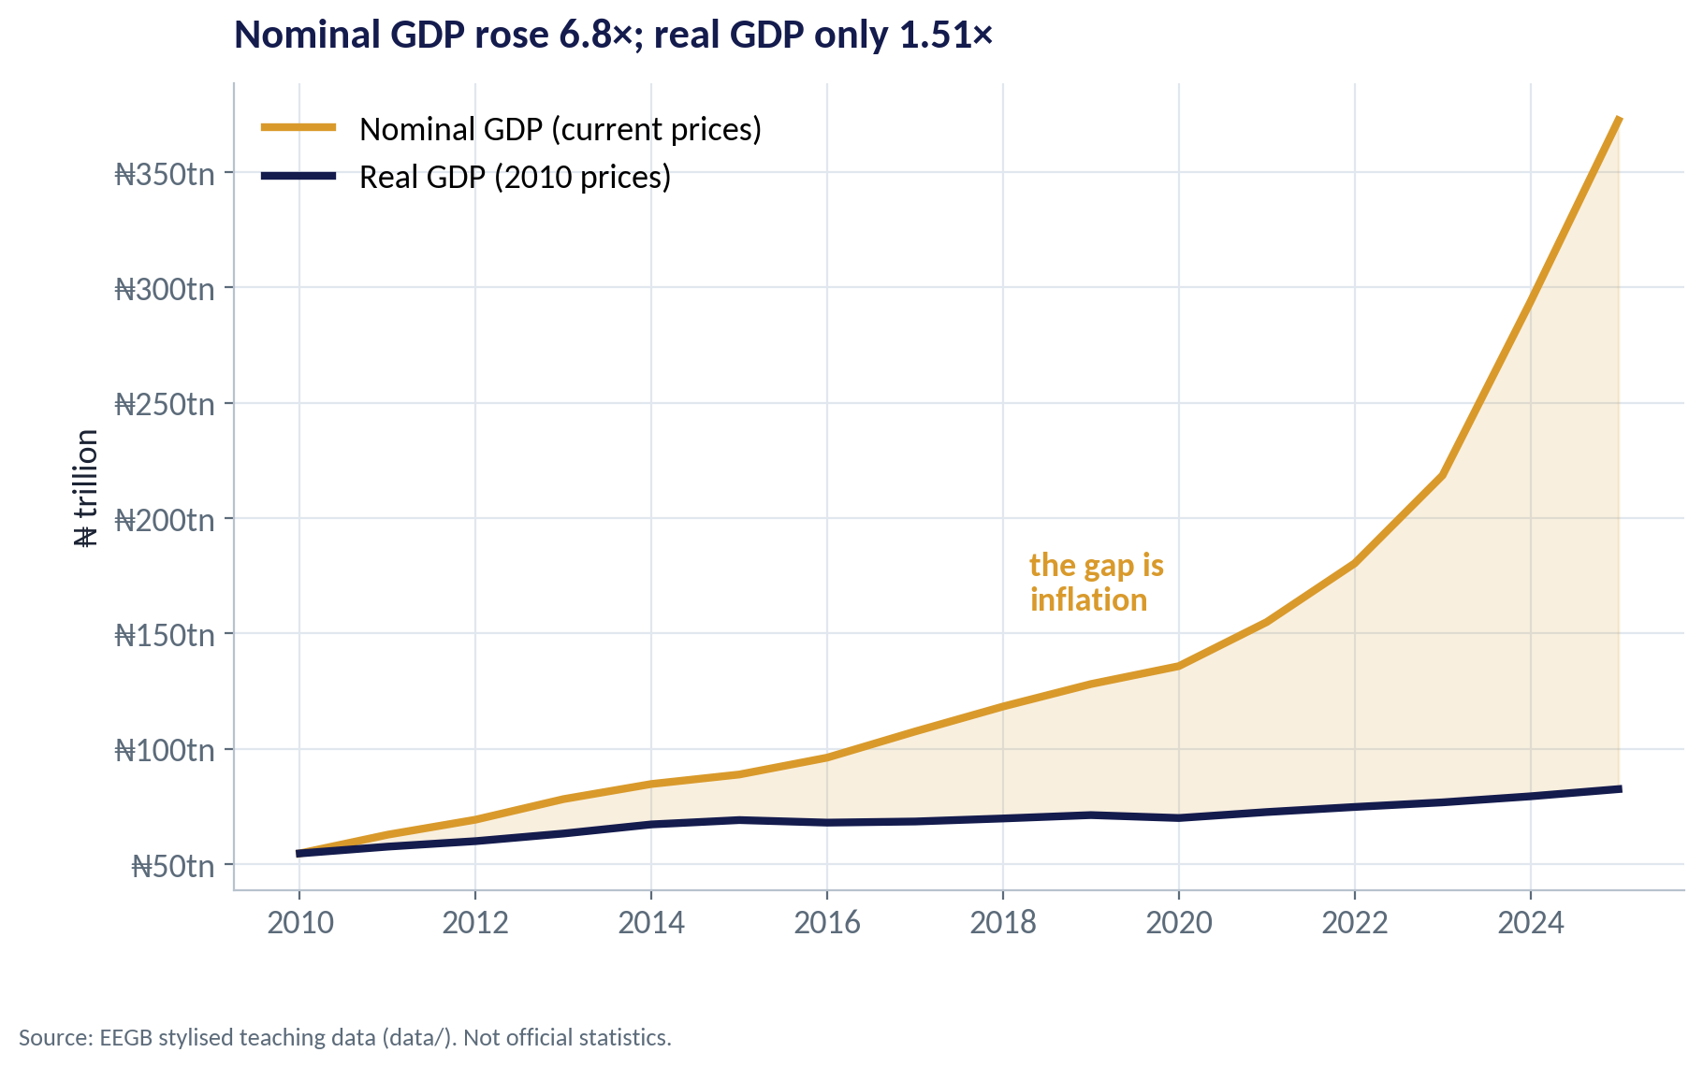
THE GAP IS INFLATION
Nominal vs Real GDP
WHAT TO SEE
The gold line is GDP in current naira; the navy line removes inflation.
From 2010 to 2025 nominal GDP rose 6.8×; real GDP rose 1.51×.
The widening gap after 2022 reflects the inflation surge you saw in Session 6.
Plan capacity on real growth; plan cash and prices on nominal.
Fig S07-F04 · replicate: s07_figures.R / .py
SESSION 7 · NATIONAL ACCOUNTS
11

Slide 12
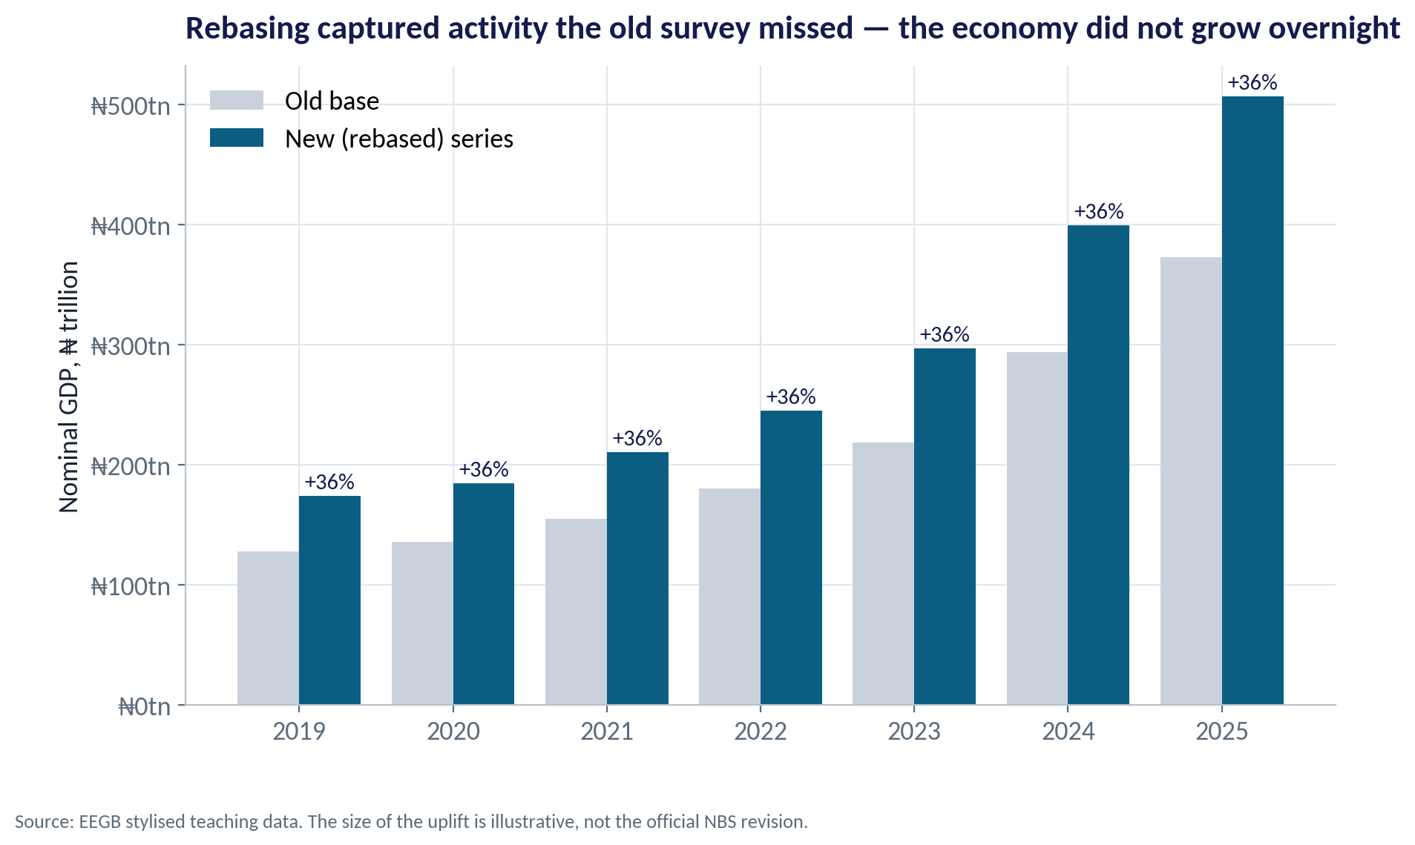
REBASING
Same Economy, Bigger Measured GDP
WHAT TO SEE
Rebasing updates the base year, the sector weights and the coverage of new activities.
Here the rebased series is about 36% higher in every year — an illustrative uplift.
Growth rates change much less than levels.
Ratios to GDP (debt, tax, credit) all fall at once — read them with care.
Fig S07-F05 · replicate: s07_figures.R / .py
SESSION 7 · NATIONAL ACCOUNTS
12
Notes:
The 36% uplift is a property of the stylised dataset, chosen to illustrate. Check the NBS release for the official size of the 2025 revision before quoting it.

Slide 13
CONCEPT CHECK
Quick Check: What Would You Say?
After a rebasing, Nigeria's measured GDP rises 36% while the debt stock is unchanged. Which statement is right?
A
The government can now borrow 36% more safely
B
Debt-to-GDP falls, but the government's ability to pay — its revenue — has not changed
C
Living standards rose 36%
D
Real growth last year was 36%
Discuss with your neighbour for 60 seconds — answer and reasoning in the speaker notes.
SESSION 7 · NATIONAL ACCOUNTS
13
Notes:
ANSWER: B. B. The denominator grew, so the ratio falls, but debt is paid from revenue, not from GDP. Nothing about incomes (C) or last year's growth rate (D) changed; borrowing capacity (A) depends on revenue and interest costs.

Slide 14
PART
02
Where Growth Comes From
Oil, non-oil, and sectors on the move.

Slide 15
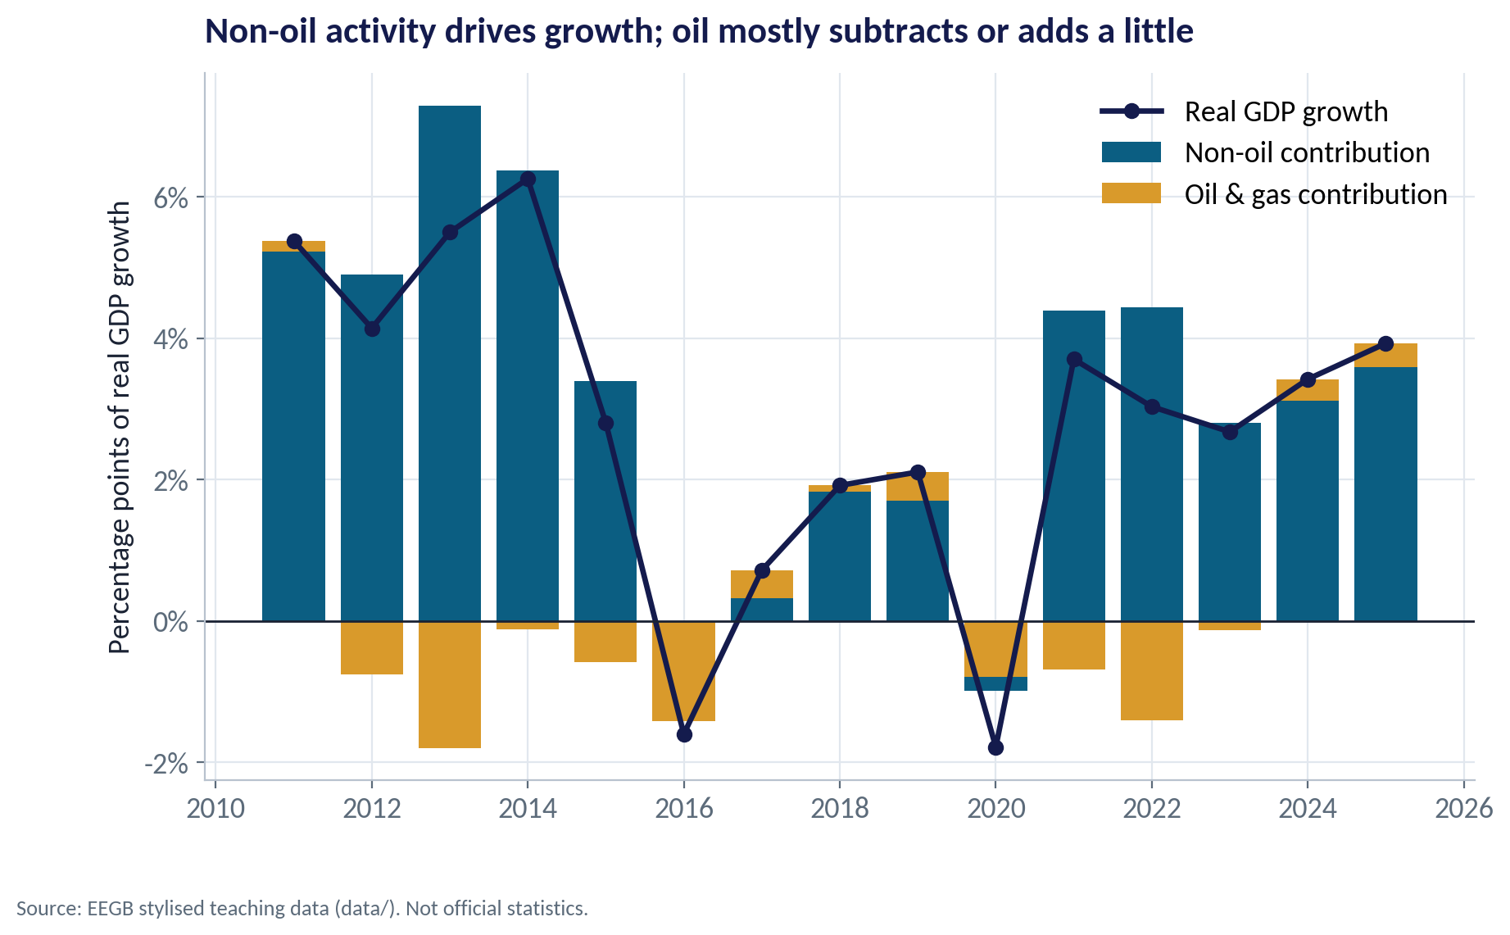
OIL VS NON-OIL
Who Contributes to Growth?
WHAT TO SEE
Bars split each year's growth into non-oil (teal) and oil & gas (gold).
Non-oil activity provided almost all the growth; oil subtracted in most years from 2012 to 2023.
In 2022 oil output fell about 19% in this data while non-oil grew 4.8%.
Oil is small in GDP but huge for dollars and government revenue — that is why it still moves the naira.
Fig S07-F01 · replicate: s07_figures.R / .py
SESSION 7 · NATIONAL ACCOUNTS
15
Notes:
Real-world note: oil and gas is a single-digit share of real GDP but the large majority of export earnings. Session 11 picks this up.

Slide 16
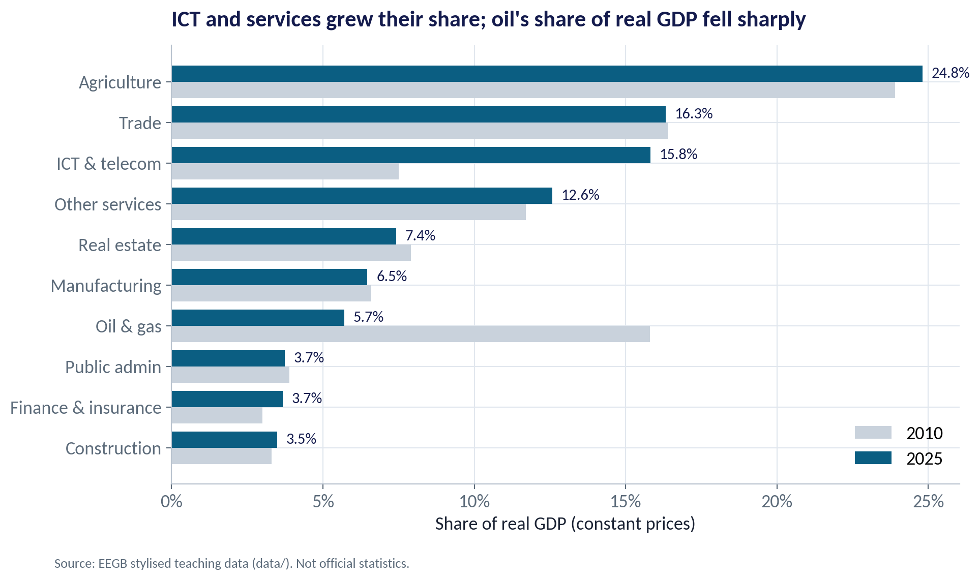
STRUCTURE
The Changing Shape of the Economy
WHAT TO SEE
ICT & telecom roughly doubled its share, from 7.5% to 15.8% of real GDP.
Oil & gas fell from 15.8% to 5.7%.
Agriculture and trade remain the largest sectors, at about a quarter and a sixth of output.
Manufacturing stayed near 6.5% — little sign of industrialisation.
Fig S07-F02 · replicate: s07_figures.R / .py
SESSION 7 · NATIONAL ACCOUNTS
16

Slide 17
WORKED EXAMPLE
Average Growth by Sector, 2010–2025
Sector | 2010 (₦tn) | 2025 (₦tn) | Growth/yr
ICT & telecom | 4.1 | 13.0 | 8.0%
Finance & insurance | 1.6 | 3.0 | 4.2%
Agriculture | 13.0 | 20.5 | 3.0%
Manufacturing | 3.6 | 5.3 | 2.6%
Oil & gas | 8.6 | 4.7 | −4.0%
STEP BY STEP
1
Take the real (constant-price) value at the start and the end.
2
Divide end by start, then take the 15th root (15 years).
3
Subtract 1: (13.0 ÷ 4.1)^(1/15) − 1 ≈ 8.0% a year for ICT.
4
Compare with population growth of about 2.6% a year.
A sector growing faster than population is a growing market per customer. Only ICT and finance clearly beat population growth here.
SESSION 7 · NATIONAL ACCOUNTS
17

Slide 18
PART
03
Growth and Living Standards
Per person, in purchasing power, and beyond GDP.

Slide 19
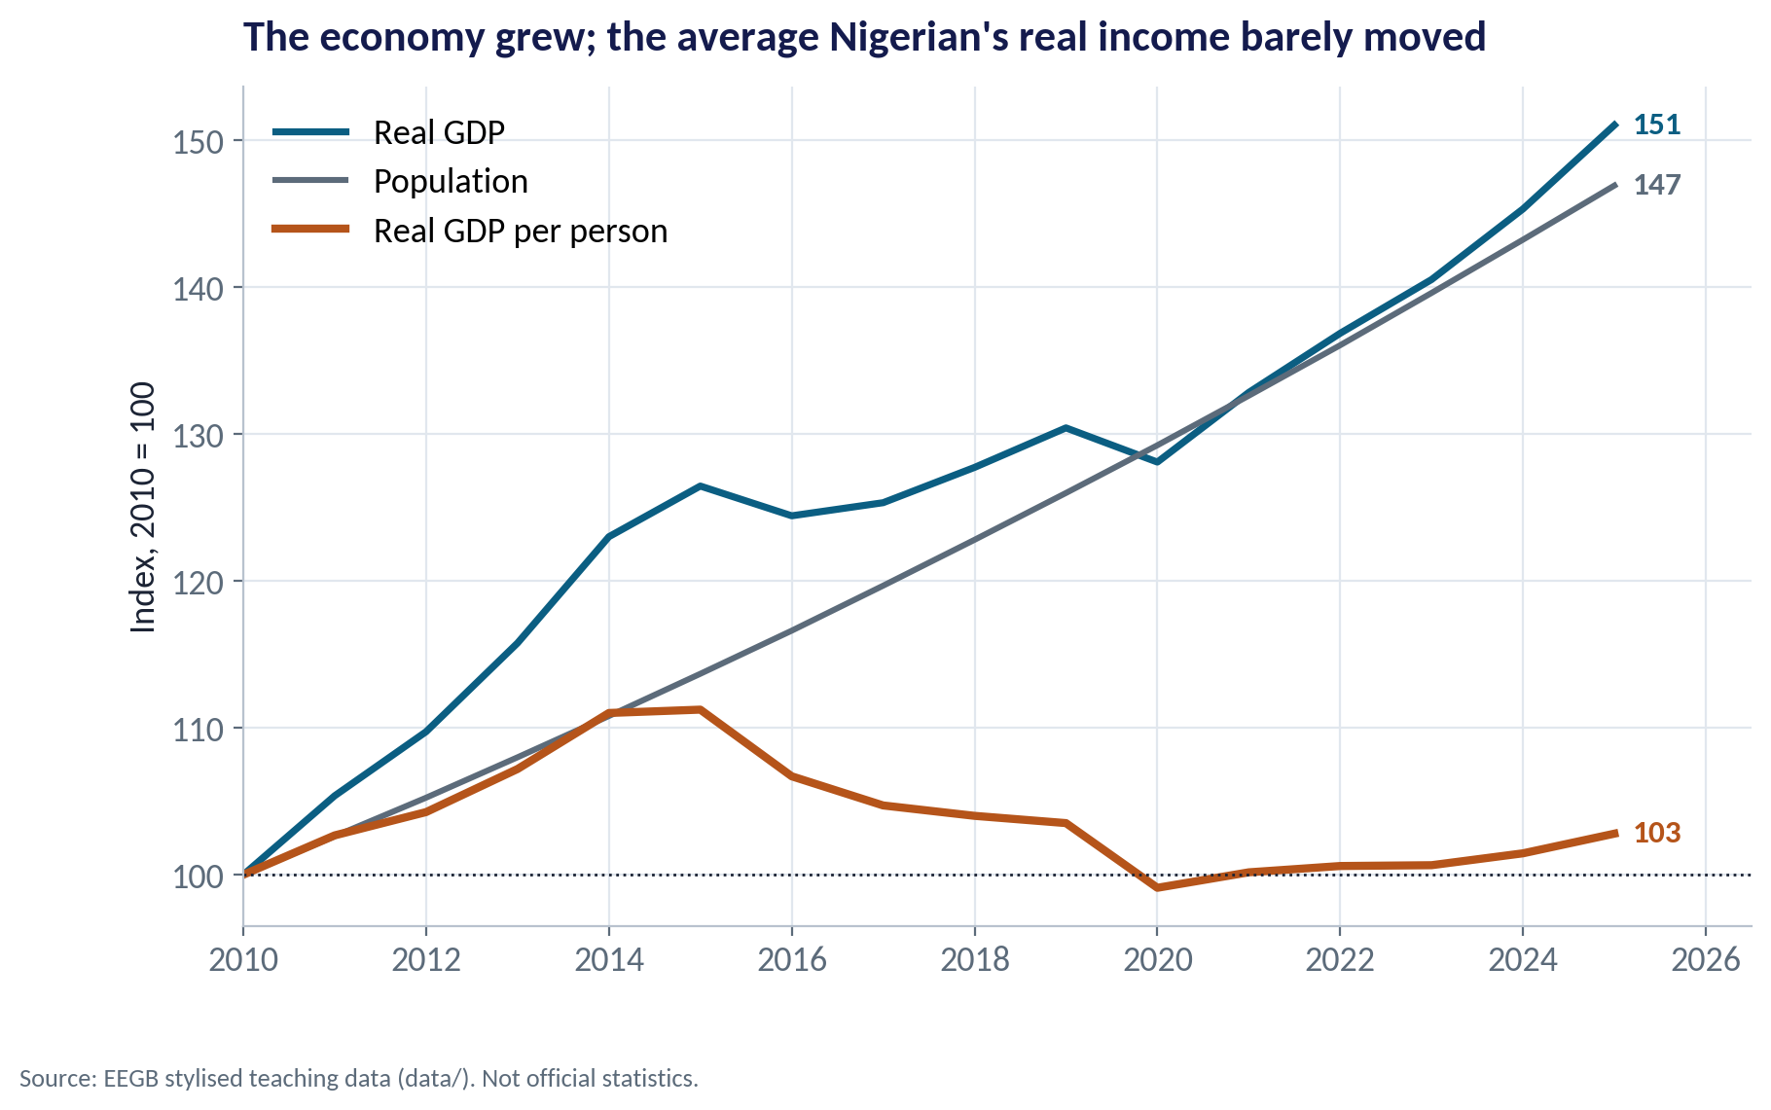
PER PERSON
Bigger Economy, Same Average Income
WHAT TO SEE
Real GDP rose to 151 (2010 = 100); population rose to 147.
Real GDP per person ended at only 103 — almost no gain in fifteen years.
Population grows about 2.6% a year; GDP must beat that just to stand still.
For consumer businesses: more customers, but not richer ones. Volume and value strategies differ.
Fig S07-F03 · replicate: s07_figures.R / .py
SESSION 7 · NATIONAL ACCOUNTS
19

Slide 20
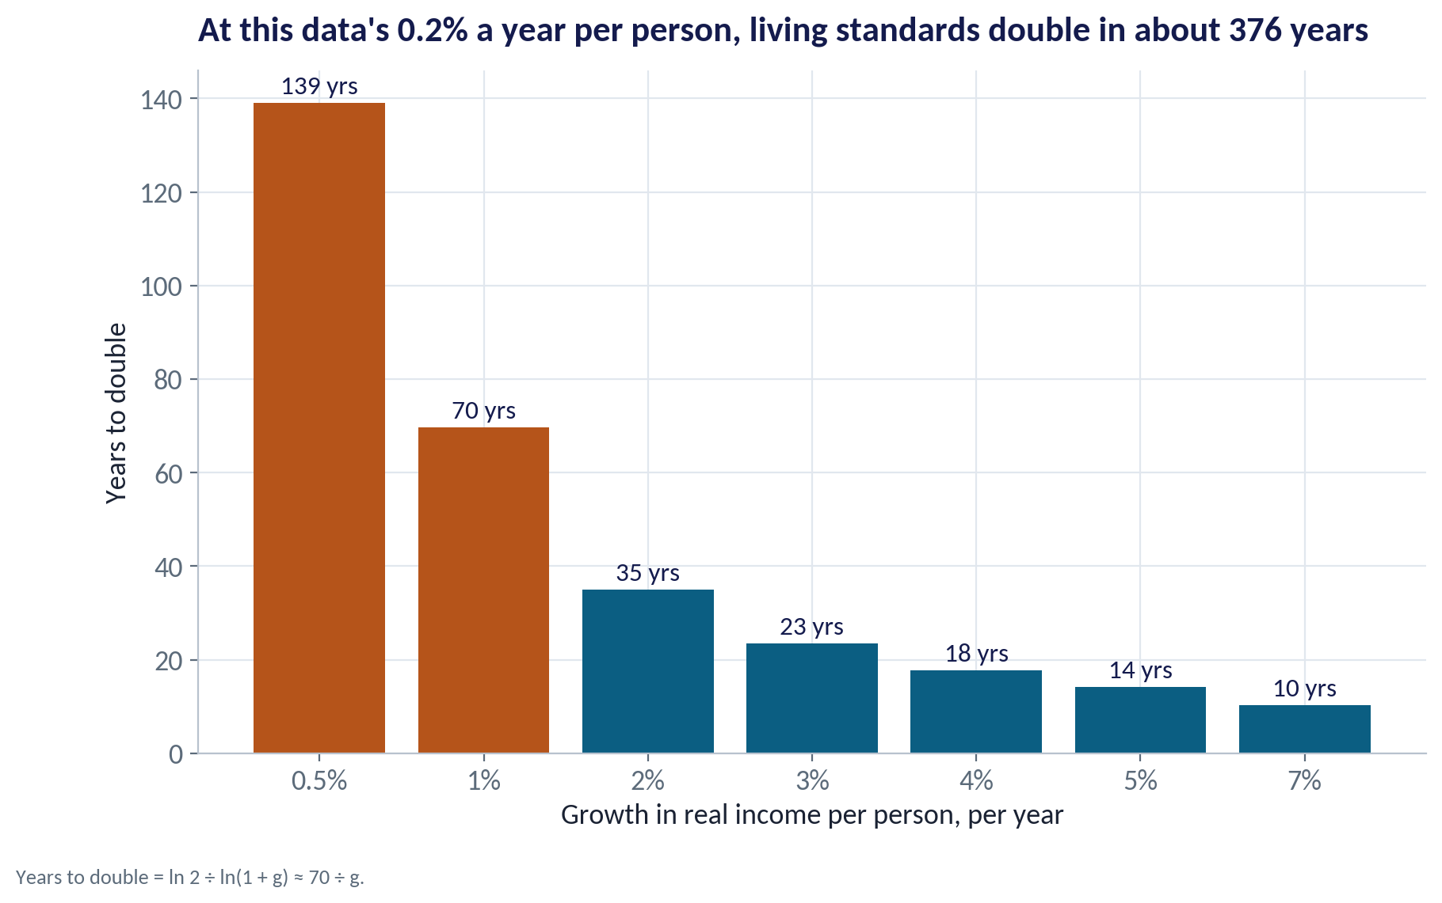
THE RULE OF 70
How Long to Double Living Standards?
WHAT TO SEE
Years to double ≈ 70 ÷ growth rate.
At 3% per person, income doubles in about 23 years; at 7%, about 10.
At this data's 0.2% per person, it takes about 376 years.
Small differences in growth, compounded, decide whether a generation gets richer.
Fig S07-F08 · replicate: s07_figures.R / .py
SESSION 7 · NATIONAL ACCOUNTS
20

Slide 21
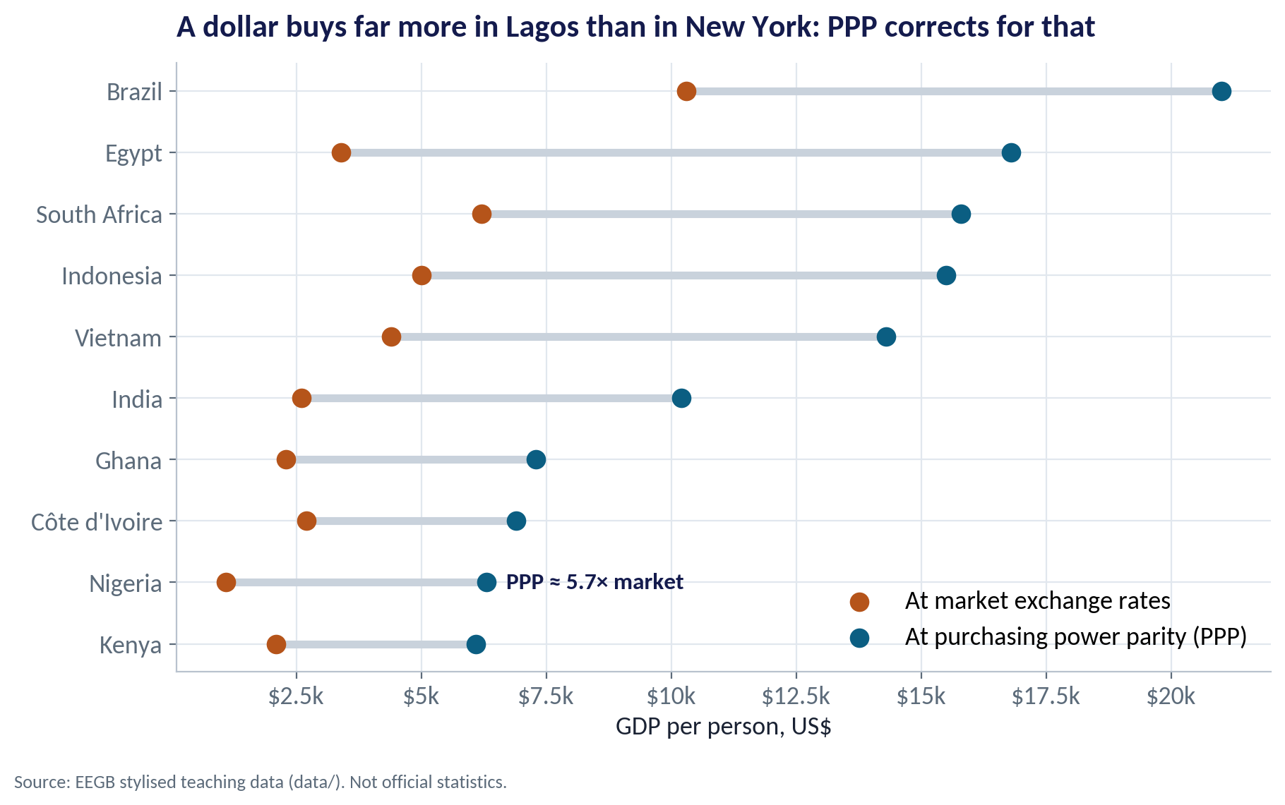
PURCHASING POWER PARITY
Market Rates vs PPP
WHAT TO SEE
At market exchange rates, GDP per person here is about $1,100; at PPP about $6,300.
PPP adjusts for the fact that haircuts, food and rent cost less in Lagos than in London.
Nigeria's PPP-to-market ratio (5.7×) is the highest in this group — partly because the naira fell so far.
Use PPP to compare living standards; use market rates to price imports or report in dollars.
Fig S07-F06 · replicate: s07_figures.R / .py
SESSION 7 · NATIONAL ACCOUNTS
21

Slide 22
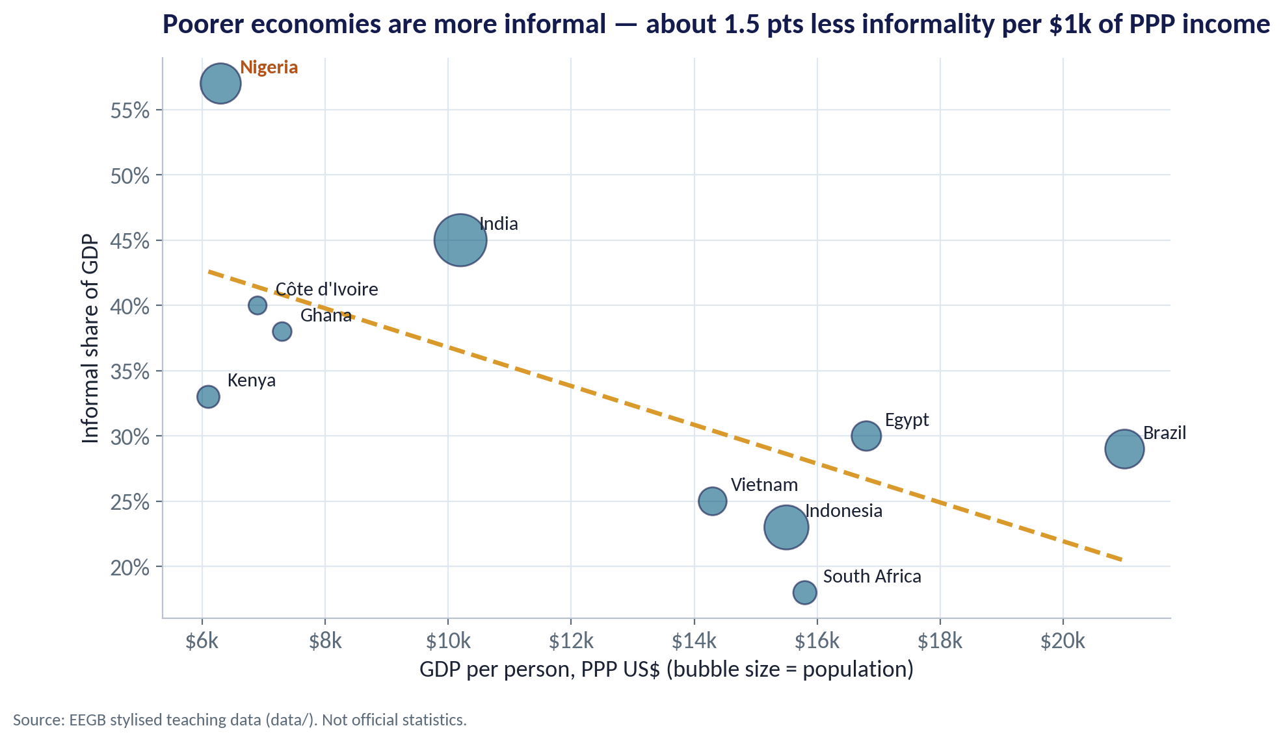
INFORMALITY
The Economy the Statistics Struggle to See
WHAT TO SEE
Informal firms are unregistered and often unseen by surveys and tax.
In this data Nigeria's informal share is about 57% of GDP — the highest of the group.
Across countries, richer economies are less informal: about 1.5 points less per $1k of PPP income.
For managers: much of your market is cash-based, informal and hard to size — triangulate with your own sales data.
Fig S07-F07 · replicate: s07_figures.R / .py
SESSION 7 · NATIONAL ACCOUNTS
22

Slide 23


BEYOND GDP
What GDP Leaves Out
Distribution
Unpaid work
Depletion
Health & education
Average income can rise while most households fall behind. Look at poverty and median income.
Care and household work are not counted, though they sustain the economy.
Selling oil counts as income; running down the reserve is not subtracted.
The Human Development Index adds life expectancy and schooling to income.
SESSION 7 · NATIONAL ACCOUNTS
23

Slide 24


WHERE MANAGERS GO WRONG
Common Mistakes With National Accounts
THE TRAP
THE BETTER HABIT
“GDP grew 50%, so our market grew 50%.”
Check growth per person and in your customers' income segment.
Reading nominal GDP growth as real growth.
Deflate: real growth ≈ nominal growth − deflator inflation.
Treating a rebasing jump as new growth.
Rebasing changes the level, not what happened last year.
Comparing countries at market exchange rates to judge living standards.
Use PPP for living standards; market rates for dollar costs.
Ignoring the informal economy because it is not in the data.
Triangulate with your own sales, distributor and payments data.
SESSION 7 · NATIONAL ACCOUNTS
24

Slide 25
CONCEPT CHECK
Quick Check: What Would You Say?
Real GDP grows 3.4% and population grows 2.6%. Roughly how fast is real income per person growing, and how long until it doubles?
A
3.4% a year; about 20 years
B
About 0.8% a year; about 90 years
C
6.0% a year; about 12 years
D
It cannot be calculated without PPP data
Discuss with your neighbour for 60 seconds — answer and reasoning in the speaker notes.
SESSION 7 · NATIONAL ACCOUNTS
25
Notes:
ANSWER: B. B. Per-person growth ≈ 3.4% − 2.6% = 0.8%. Using the rule of 70: 70 ÷ 0.8 ≈ 88 years. A ignores population; C adds instead of subtracts; D is wrong — PPP is not needed for a growth rate.

Slide 26



HANDS-ON LAB
Lab: Is Nigeria Getting Richer?
1
Compute real GDP growth year by year.
YOU WILL NEED
Data
2
Split growth into oil and non-oil.
data/ng_gdp_sectors.csv
data/peer_income.csv
3
Rank sectors by average annual growth, 2010–2025.
R script
sessions/s07/R/s07_lab.R
4
Compute real GDP per person and the years it would take to double.
Python script
Compare market-rate and PPP income across peers.
sessions/s07/python/s07_lab.py
5
Deliverable: a short paragraph for the board: real growth, growth per person, and the two sectors that matter most for your demand.
⏱ 20 minutes
SESSION 7 · NATIONAL ACCOUNTS
26

Slide 27
WORDS TO OWN
Today's Vocabulary in Plain English
GDP
Value of all final goods and services produced in a country in a period.
Rebasing
Updating the base year, weights and coverage of the accounts.
Value added
Output minus the inputs bought from other firms.
PPP
Exchange rate that equalises what money can buy across countries.
GNI
GDP plus net income received from abroad.
Informal economy
Activity that is unregistered and largely unmeasured.
Real GDP
GDP at constant prices: shows changes in volume.
Productivity
Output per worker or per hour; the root of living standards.
GDP deflator
Nominal ÷ real GDP × 100: the broadest price index.
Rule of 70
Years to double ≈ 70 ÷ the annual growth rate.
SESSION 7 · NATIONAL ACCOUNTS
27

Slide 28
KEY TAKEAWAYS
Session 7 in 5 Ideas
01
GDP can be measured by output, spending or income; Nigeria's GNI is below its GDP.
02
Always separate nominal from real; the deflator tells you how much was inflation.
03
Rebasing changes levels and ratios, not what the economy did.
04
Non-oil sectors drive growth, but oil still drives dollars and revenue.
05
What matters for customers is income per person — and here it has barely moved.
NEXT › Session 8: Monetary Policy
Before next session: Read the HBS Note on Money and Monetary Policy (9-797-076) and the CBN brief on liquidity management. Note how your company's borrowing rate changed between 2023 and 2025.

