Slide 1


LAGOS BUSINESS SCHOOL · MEMBA 14 · EEGB · PART II
SESSION 8
Monetary Policy
from QE to QT
From markets, to macro, to decisions that matter — in Nigeria and the world.
Reading: Note on Money and Monetary Policy (HBS 9-797-076) · Liquidity Management in Nigeria (CBN Brief) · Monetary Integration in West Africa (CBN Brief) · Facilitator: Elvis Ozegbe
Economic Environment of Global Business · Lagos Business School · Prof. Bongo Adi, Kelechi Nnamdi, Elvis Ozegbe
Notes:
Ask who in the room renegotiated a loan in 2024. Their stories of repricing, shorter tenors and higher collateral are the transmission mechanism in action.

Slide 2




RECAP
Session 7 in Three Ideas
Real vs nominal
Most of the growth in naira GDP was inflation; real GDP grew far less.
Per person
Population growth ate almost all of the gain in income per person.
Rebasing
A new base changes levels and ratios, not what the economy did.
SESSION 8 · MONETARY POLICY
2

Slide 3




TODAY'S PLAN
Session 8 at a Glance — 75 Minutes
What central banks do, how a rate decision reaches your P&L, and why it takes so long.
10'
25'
25'
15'
Hook
What Central Banks Do
Transmission & Nigeria
Lab
From 18.75% to 27.5% in ten months
Mandates, tools, QE and QT
Channels, lags, liquidity, fiscal dominance
How fast does the rate reach your firm?
SESSION 8 · MONETARY POLICY
3

Slide 4
BY THE END OF TODAY
Session 8 Learning Objectives
You will be able to:
01
02
03
Explain the Toolkit
Trace Transmission
Judge the Stance
Describe what a central bank targets and how it uses the policy rate, reserves, open-market operations and its balance sheet (QE and QT).
Follow a rate decision through banks, markets, the exchange rate and expectations to prices and output — and explain the lags.
Use real rates, liquidity conditions and a simple rule to judge whether policy is tight or loose.
SESSION 8 · MONETARY POLICY
4

Slide 5




THE HOOK
Nearly Nine Points in Ten Months
“The MPC voted to raise the Monetary Policy Rate by 400 basis points to 22.75%.” — CBN, February 2024
Between July 2023 and November 2024 the CBN lifted its policy rate from 18.75% to 27.5%. For a business:
Borrowing
Customers
The naira
A ₦5bn overdraft at MPR + 6 cost about ₦450m a year more by end-2024 than in mid-2023.
Consumer and SME credit became scarce and dear; big-ticket purchases were postponed.
High naira yields began to attract portfolio dollars back — helping the exchange rate stabilise in 2025.
Notes:
The ₦450m: MPR rose from 18.5% (June 2023) to 27.5% (December 2024), +9 points on ₦5bn. Ask participants what their own borrowing costs did over the same period.

Slide 6



NIGERIAN BUSINESS CASE
How Fast Does the CBN Reach Your Firm?
The situation
The decision question
In 2024 the CBN raised its policy rate sharply to fight inflation of over 30%, tightened bank reserves and mopped up liquidity. Inflation stayed high for months. Firms asked whether the medicine was working.
Through which channels does a rate rise reach a Nigerian firm, how long does it take, and was policy actually tight?
The data we have
What a good answer looks like
ng_macro_monthly.csv — policy rate, interbank rate, inflation, money, credit, exchange rate and PMI, 2015–2025; global_policy_rates.csv — seven central banks, 2019–2025. *Stylised teaching data.*
A short note for your CFO: what the 2024–25 rate path means for funding costs, customer demand and the naira over the next 12–18 months.
SESSION 8 · MONETARY POLICY
6

Slide 7
PART
01
What Central Banks Do
Mandates, tools and the balance sheet.

Slide 8

THE MANDATE
What Is a Central Bank For?
Price stability
Other roles
The core job almost everywhere
Often added — sometimes in tension
Keep inflation low and predictable
Many banks set an explicit target or band
Nigeria's CBN has long referred to a single-digit (6–9%) band
Credibility makes the job easier
Financial-system stability and bank supervision
Managing the exchange rate and reserves
Banker to the government
Development finance (CBN's past intervention schemes)
The more jobs a central bank takes on, the harder it is to hit any one of them — and the more its credibility on inflation suffers.
SESSION 8 · MONETARY POLICY
8

Slide 9
THE TOOLKIT
How the CBN Moves Money and Rates
Tool | What it does | Effect when tightened
Monetary policy rate (MPR) | Signals the price of central-bank money; anchors other rates | Loans, deposits and bond yields reprice upward
Standing facilities | Rates at which banks can borrow from or deposit with the CBN — a corridor around the MPR | Narrows where interbank rates can go
Cash reserve requirement (CRR) | Share of deposits banks must keep at the CBN, unremunerated | Less money for banks to lend
Open-market operations (OMO) | CBN sells or buys its own bills to drain or add liquidity | Drains naira; raises short-term yields
FX interventions | Selling or buying dollars from reserves | Supports or weakens the naira
In 2024 the CBN used several tools at once: large MPR hikes, a much higher CRR and heavy OMO sales.
SESSION 8 · MONETARY POLICY
9

Slide 10
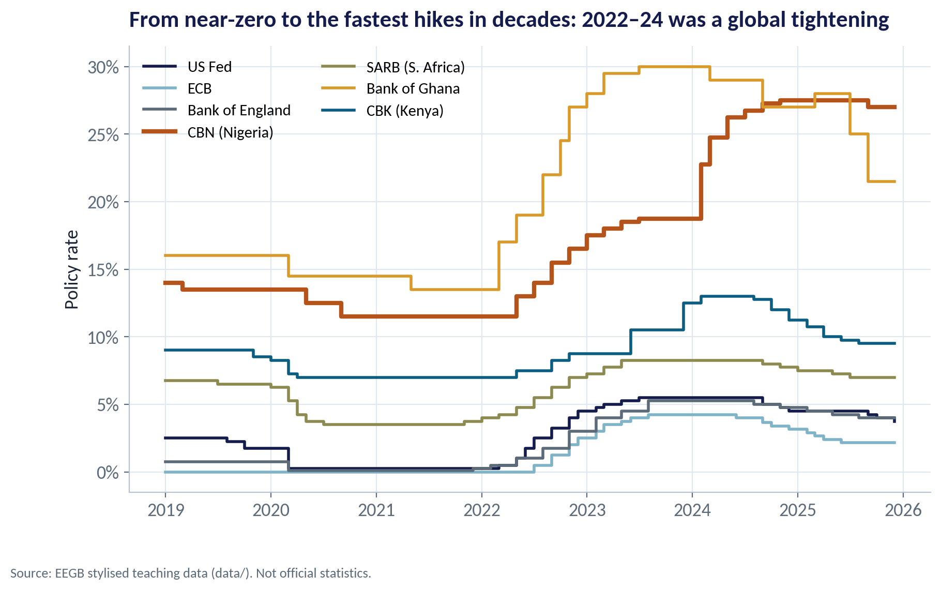
THE GLOBAL BACKDROP
A Worldwide Tightening Cycle
WHAT TO SEE
Most central banks cut to near zero in 2020 and kept rates there through 2021.
In 2022–23 the US Fed, ECB and Bank of England raised rates at the fastest pace in decades.
Higher US rates pulled dollars out of frontier markets like Nigeria and Ghana.
From 2024–25 the rich-country banks began to cut; Nigeria stayed high.
Fig S08-F01 · replicate: s08_figures.R / .py
SESSION 8 · MONETARY POLICY
10

Slide 11
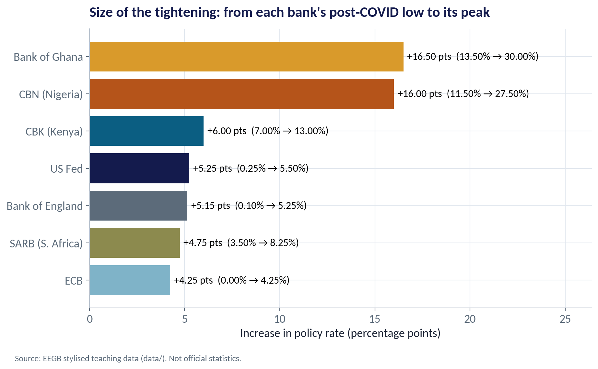
HOW MUCH THEY TIGHTENED
Size of the Hiking Cycles
WHAT TO SEE
From their post-COVID lows to their peaks: Ghana +16.5, Nigeria +16.0, Kenya +6.0 points.
The US Fed raised by 5.25 points, from 0.25% to 5.5%.
African banks hiked more because inflation and currency pressure were far higher.
Bigger hikes also had to compensate investors for currency risk.
Fig S08-F02 · replicate: s08_figures.R / .py
SESSION 8 · MONETARY POLICY
11

Slide 12


QE AND QT
When the Rate Hits Zero: The Balance Sheet
IN PLAIN ENGLISH
THE FORMULA
QE: CB buys bonds → reserves ↑, long yields ↓ · QT: reverse
Quantitative easing (QE): the central bank creates money to buy government bonds and other assets, pushing long-term rates down. Quantitative tightening (QT) is the reverse: it lets those bonds mature or sells them, draining money and pushing long rates up.
WHY A MANAGER CARES
QE and QT in Washington change the cost and availability of dollars for Nigerian firms, banks and the government — through Eurobond yields and portfolio flows.
EXAMPLE
The US Fed's balance sheet grew to almost $9 trillion by 2022, then began shrinking under QT from mid-2022. Global dollar liquidity tightened just as Nigeria needed dollars most.
SESSION 8 · MONETARY POLICY
12
Notes:
Nigeria's version of balance-sheet policy was different: large CBN 'Ways and Means' lending to the federal government, later securitised into long-term bonds (over ₦20 trillion). That is closer to monetary financing than QE — see fiscal dominance below.

Slide 13
CONCEPT CHECK
Quick Check: What Would You Say?
The CBN raises the cash reserve requirement while leaving the MPR unchanged. What is the most likely immediate effect?
A
Banks have more money to lend, so loan rates fall
B
Banks have less naira to lend or place in the interbank market, so liquidity tightens and short-term rates rise
C
The naira weakens because the CBN is printing money
D
Nothing — only the MPR matters
Discuss with your neighbour for 60 seconds — answer and reasoning in the speaker notes.
SESSION 8 · MONETARY POLICY
13
Notes:
ANSWER: B. B. A higher CRR locks more deposits at the CBN, so banks have less to lend — a tightening even with an unchanged MPR. A is the opposite; C confuses tightening with easing; D ignores the other tools.

Slide 14
PART
02
How Policy Reaches Your Firm
Channels, lags and leaks.

Slide 15

THE TRANSMISSION MECHANISM
From the MPC Meeting to Your P&L
Each link can be strong, weak or broken.
›
›
›
›
1. Policy rate
2. Market rates
3. Banks
4. Naira & expectations
5. Demand & prices
MPC raises the MPR; CBN drains liquidity
Interbank, T-bills and bond yields rise
Loan and deposit rates reprice; credit is rationed
Higher yields attract dollars; credibility lowers expected inflation
Spending and investment slow; price rises ease — after 12–24 months
In Nigeria the bank-lending link is weak (credit is small relative to GDP) while the exchange-rate link is strong.
SESSION 8 · MONETARY POLICY
15

Slide 16
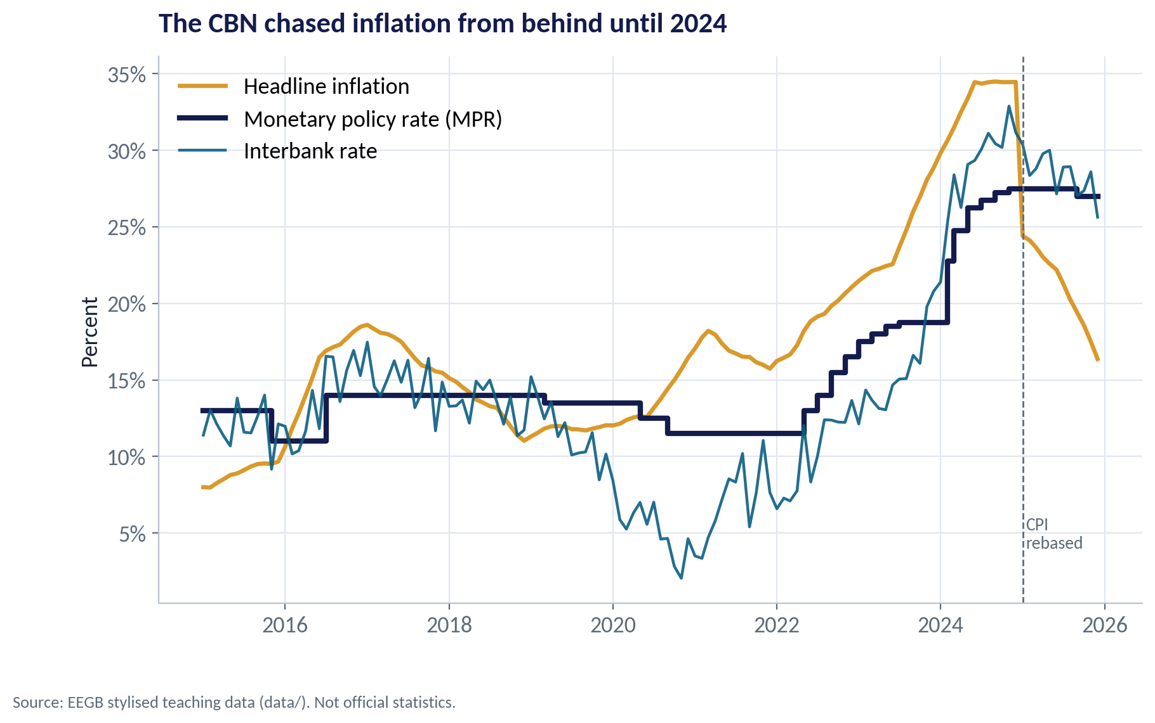
NIGERIA'S POLICY PATH
Rates, Inflation and the Interbank Market
WHAT TO SEE
For most of 2020–2023 the MPR stayed below inflation — a negative real rate.
The 2024 hikes closed much of the gap; in 2025 the real rate turned clearly positive (helped by the CPI rebasing).
The interbank rate (teal) is what banks actually pay each other — it does not always follow the MPR.
Judge policy by the real rate and the interbank rate, not the headline MPR alone.
Fig S08-F03 · replicate: s08_figures.R / .py
SESSION 8 · MONETARY POLICY
16

Slide 17
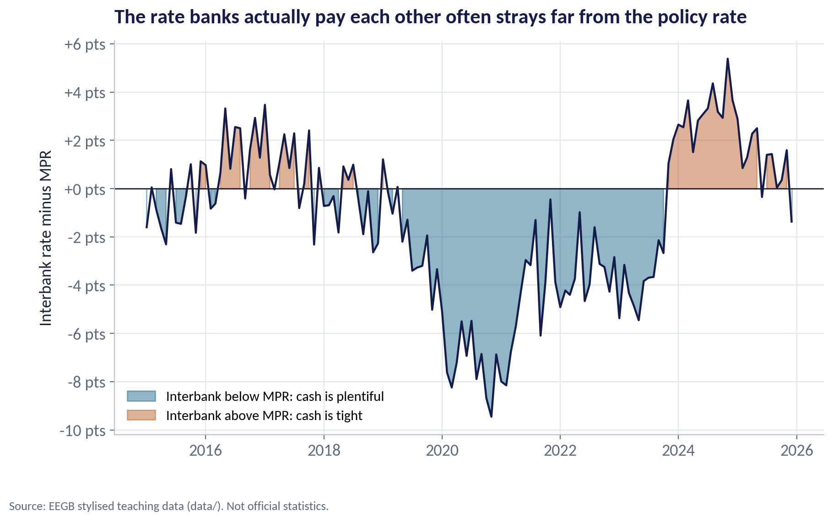
LIQUIDITY
When the Policy Rate Does Not Bind
WHAT TO SEE
When banks are flush with naira, interbank rates fall far below the MPR — down to −9.5 points in late 2020.
Then a 'high' MPR does little: money is cheap anyway.
In 2024 the CBN drained liquidity and interbank rates rose above the MPR (up to about +5.4 points).
That is when tightening really started to bite.
Fig S08-F04 · replicate: s08_figures.R / .py
SESSION 8 · MONETARY POLICY
17

Slide 18
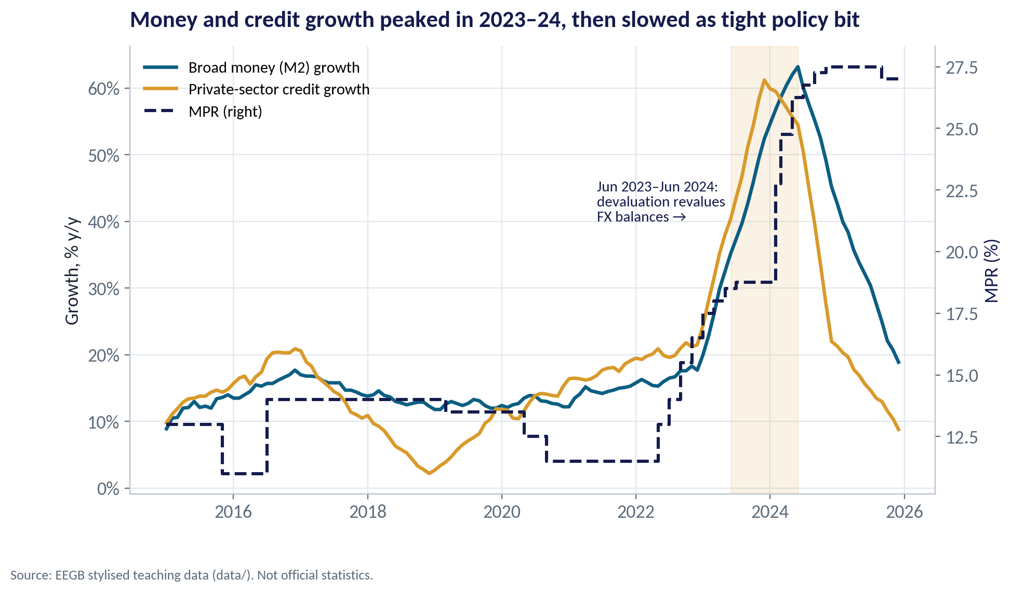
MONEY AND CREDIT
Did Tight Policy Slow Money and Credit?
WHAT TO SEE
Credit growth peaked at about 61% (Dec 2023) and broad money at about 63% (Jun 2024).
Much of that was revaluation: dollar loans and deposits were worth more naira after devaluation.
As revaluation faded and policy tightened, growth fell to about 9% (credit) and 19% (M2) by end-2025.
Lesson: in a devaluation, naira money and credit numbers overstate real expansion.
Fig S08-F05 · replicate: s08_figures.R / .py
SESSION 8 · MONETARY POLICY
18

Slide 19
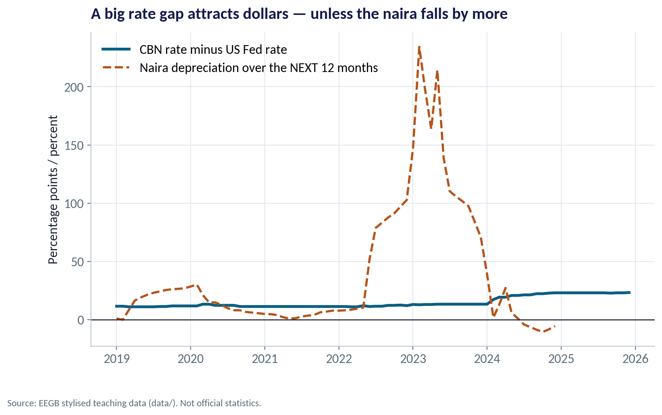
THE FOREIGN-INVESTOR VIEW
The Rate Gap and the Naira
WHAT TO SEE
The teal line is the gap between the CBN rate and the US Fed rate — what a dollar investor earns for holding naira.
The dashed line is how much the naira then fell over the next 12 months.
In 2022–23 the naira fell far more than the gap — investors lost money, so they stayed away.
Once the gap exceeded expected depreciation in 2024–25, portfolio inflows returned.
Fig S08-F07 · replicate: s08_figures.R / .py
SESSION 8 · MONETARY POLICY
19
Notes:
This is uncovered interest parity in plain English: high rates attract capital only if the expected fall in the currency is smaller than the rate gap. Session 11 develops this.

Slide 20


WHERE MANAGERS GO WRONG
How Managers Misread Monetary Policy
THE TRAP
THE BETTER HABIT
“Rates went up last month, so inflation should fall this quarter.”
Expect 12–24 months of lag; plan for high costs in the meantime.
Reading the MPR as the cost of money.
Watch the interbank, T-bill and your own loan rates.
Ignoring the CRR and OMO because they are technical.
They drain liquidity directly — often faster than the MPR.
Assuming high rates always strengthen the naira.
Only if investors expect the naira to fall less than the rate gap.
Treating central-bank lending to government as harmless.
Large monetary financing fuels inflation and undermines credibility (fiscal dominance).
SESSION 8 · MONETARY POLICY
20

Slide 21
PART
03
Judging the Stance
Tight, loose — and who is really in charge?

Slide 22

A RULE OF THUMB
The Taylor Rule
IN PLAIN ENGLISH
THE FORMULA
rate = r* + π + 0.5(π − target) + 0.5 × output gap
John Taylor proposed that a central bank should set its rate at a neutral level plus inflation, then add more when inflation is above target or the economy is running hot. It is a yardstick, not a law.
WHY A MANAGER CARES
The rule shows policy was loose by textbook standards. But against a supply shock, following it mechanically would crush output; the CBN chose to tighten hard but not that hard.
EXAMPLE
With inflation at 34.5%, a 9% target, a 2% neutral real rate and a flat PMI, the rule gives about 49% in December 2024 — far above the actual 27.5%.
SESSION 8 · MONETARY POLICY
22
Notes:
The output gap is proxied by PMI − 50. Every input (neutral rate, target, gap measure) is an assumption; change them and the answer moves.

Slide 23
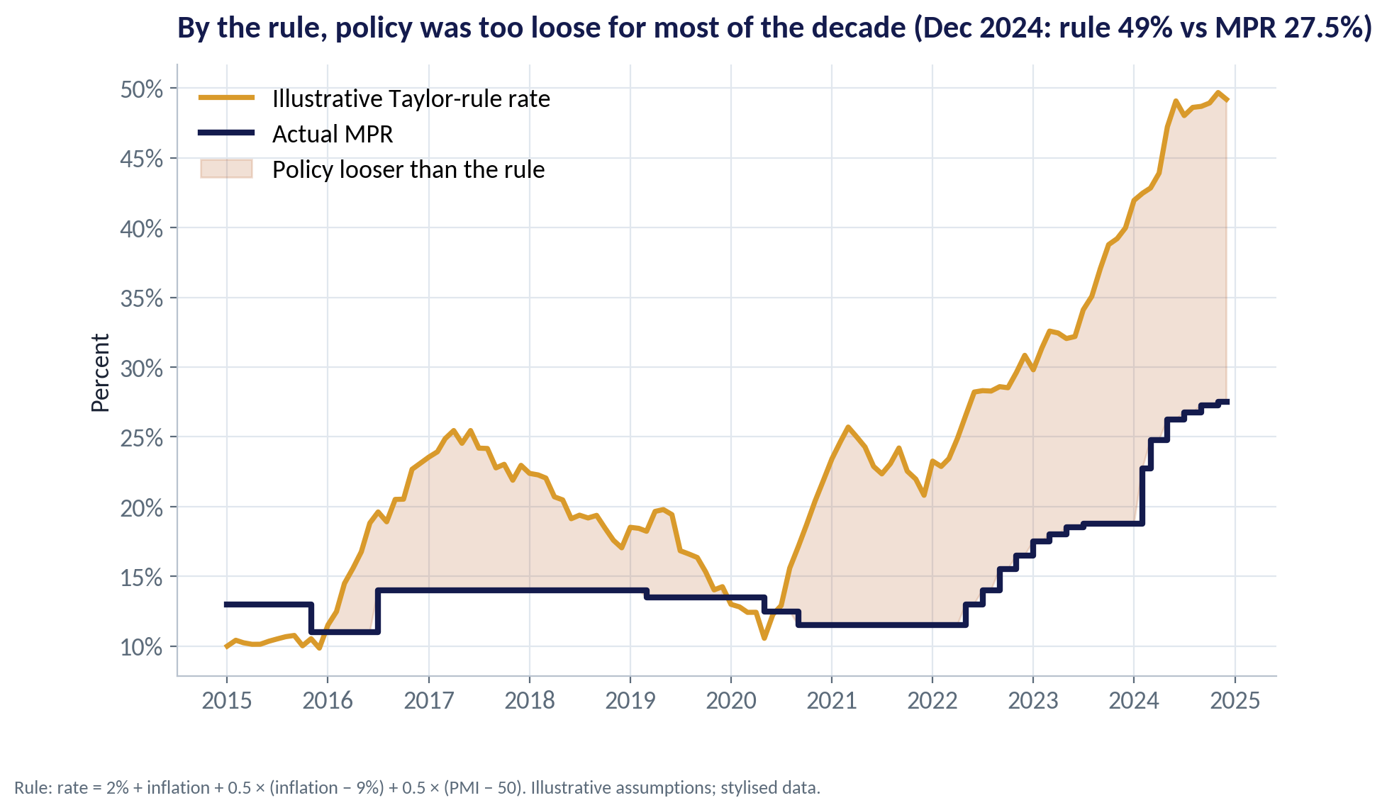
THE RULE VS REALITY
Was Policy Tight Enough?
WHAT TO SEE
The gold line is the illustrative rule; navy is the actual MPR.
The MPR sat below the rule in about 85% of months, 2015–2024.
The gap was widest in 2023–24, at the height of the inflation surge.
Use the rule to ask 'how tight?', not to forecast the next MPC decision.
Fig S08-F06 · replicate: s08_figures.R / .py
SESSION 8 · MONETARY POLICY
23

Slide 24

WHO IS REALLY IN CHARGE?
Fiscal Dominance
What it is
Nigeria's experience
Why it matters to you
When government borrowing needs force the central bank to keep rates low or to lend to the government directly, inflation control comes second.
Large CBN overdrafts to the federal government ('Ways and Means') built up before 2023 and were later converted into long-term bonds.
If markets believe the central bank serves the budget first, they expect more inflation — and price your loans and the naira accordingly.
SESSION 8 · MONETARY POLICY
24

Slide 25
CONCEPT CHECK
Quick Check: What Would You Say?
Inflation is 30%, the MPR is 27.5% and the interbank rate is 31%. Which statement best describes the stance?
A
Very loose: the MPR is below inflation
B
Roughly neutral to tight in practice: the rate banks actually pay is above inflation, though the MPR itself is slightly below
C
Very tight: the MPR is above 25%
D
Impossible to judge without the Taylor rule
Discuss with your neighbour for 60 seconds — answer and reasoning in the speaker notes.
SESSION 8 · MONETARY POLICY
25
Notes:
ANSWER: B. B. The interbank rate — the marginal cost of money — is above inflation, so conditions are tighter than the MPR alone suggests. A and C each look at one number only; D overstates the role of the rule.

Slide 26



HANDS-ON LAB
Lab: How Fast Does the Rate Reach Your Firm?
1
List every CBN policy-rate decision and its size.
YOU WILL NEED
Data
2
Compute the real policy rate by year.
data/ng_macro_monthly.csv
data/global_policy_rates.csv
3
Compare the interbank rate with the MPR to judge liquidity.
R script
sessions/s08/R/s08_lab.R
4
Correlate rate changes with credit growth at different lags — and ask why correlation misleads here.
Python script
Compute an illustrative Taylor-rule rate and compare it with the MPR.
sessions/s08/python/s08_lab.py
5
Deliverable: a short note for your CFO on funding costs, customer demand and the naira over the next 12–18 months.
⏱ 15 minutes
SESSION 8 · MONETARY POLICY
26

Slide 27
WORDS TO OWN
Today's Vocabulary in Plain English
Monetary policy rate
The CBN's benchmark rate signalling the price of money.
Quantitative tightening
Shrinking the central bank's balance sheet.
Interbank rate
The rate banks charge each other for overnight naira.
Transmission
The chain from a policy decision to prices and output.
Cash reserve requirement
Share of deposits banks must hold at the CBN.
Real policy rate
Policy rate minus inflation.
Open-market operations
Central-bank sales or purchases of securities to manage liquidity.
Taylor rule
A formula for where the policy rate 'should' be.
Quantitative easing
Central-bank asset purchases with newly created money.
Fiscal dominance
When government finance needs override inflation control.
SESSION 8 · MONETARY POLICY
27

Slide 28
KEY TAKEAWAYS
Session 8 in 5 Ideas
01
Central banks control the price of money; they use rates, reserves, OMO and their balance sheet.
02
QE and QT abroad change the cost of dollars for Nigeria.
03
Policy works through banks, markets, the naira and expectations — with long lags.
04
Judge the stance by real and interbank rates, not the headline MPR alone.
05
Fiscal dominance undermines credibility and raises everyone's borrowing costs.
NEXT › Session 9: Fiscal Policy & Debt
Before next session: Read 'Net Fiscal Operations' and the CBN brief on the Fiscal Responsibility Law. Find what share of federal revenue went on interest in the latest budget.

