Slide 1


LAGOS BUSINESS SCHOOL · MEMBA 14 · EEGB · PART II
SESSION 9
Fiscal Policy, Debt
& Sovereign Risk
From markets, to macro, to decisions that matter — in Nigeria and the world.
Reading: Net Fiscal Operations · The Fiscal Responsibility Law (CBN Brief) · Facilitator: Elvis Ozegbe
Economic Environment of Global Business · Lagos Business School · Prof. Bongo Adi, Kelechi Nnamdi, Elvis Ozegbe
Notes:
Open with the hook: ask who believes Nigeria's debt is 'low'. Then ask what share of federal revenue goes on interest. The gap between the two answers is today's session.

Slide 2




RECAP
Session 8 in Three Ideas
Policy rate
The CBN sets the price of overnight money; banks, bonds and the naira react within days.
Transmission
Rates reach your firm through credit costs, asset prices, the exchange rate and expectations — with long lags.
Fiscal dominance
When the central bank must finance the government, monetary policy loses its grip. Today we look at the government side.
SESSION 9 · FISCAL POLICY & DEBT
2

Slide 3



TODAY'S PLAN
Session 9 at a Glance — 75 Minutes
How governments raise, spend and borrow — and when debt becomes a business risk.
10'
25'
25'
15'
Recap & Hook
The Fiscal Picture
Debt Dynamics
Lab & Discussion
Is the debt the problem — or the revenue?
Revenue, spending, deficits and the interest bill
r, g, the primary balance — and three futures
Project Nigeria's debt; what it means for your firm
SESSION 9 · FISCAL POLICY & DEBT
3

Slide 4


BY THE END OF TODAY
Session 9 Learning Objectives
You will be able to:
01
02
03
Read a Budget Like an Analyst
Use the Debt-Dynamics Equation
Turn Fiscal Risk Into Business Risk
Separate revenue, primary spending and interest, and judge the burden against revenue as well as GDP.
Explain why debt/GDP rises or falls using r, g and the primary balance — and spot the 'other' items.
Link subsidy reform, tax reform, borrowing and sovereign risk to rates, the naira and demand in your market.
SESSION 9 · FISCAL POLICY & DEBT
4

Slide 5




THE HOOK
Low Debt, Heavy Burden
“Nigeria's debt is only about 40% of GDP — Japan's is over 200%. What is the fuss about?”
A treasurer at a Lagos bank asks three better questions:
What can the state collect?
What does the debt cost?
In which currency?
Debt is repaid from revenue, not GDP. FGN revenue is only about **5% of GDP** in our data.
Interest absorbed **two-thirds of revenue** in 2025 and over **90%** in 2021.
Dollar debt grows overnight in naira when the exchange rate moves — as it did in 2023–24.
Notes:
The comparison with Japan is common in Nigerian commentary. Japan collects far more revenue relative to GDP, borrows in its own currency, and pays very low interest. Debt/GDP alone is a poor guide.

Slide 6


NIGERIAN BUSINESS CASE
Is the Debt the Problem — or the Revenue?
The situation
The decision question
Federal debt rose sharply after 2022 as the CBN overdraft was converted into bonds and the naira fell. Interest payments now take most of federal revenue, and banks hold large amounts of FGN bonds.
Is Nigeria's fiscal problem too much debt, or too little revenue — and what does each answer imply for interest rates, the naira and your company's plans?
The data we have
What a good answer looks like
fgn_fiscal_annual.csv — 2010–2025: nominal GDP, FGN revenue (and oil share), spending, interest, total public debt. *Stylised teaching data.*
A short diagnosis using three ratios (debt/GDP, debt/revenue, interest/revenue), a debt-dynamics decomposition and a ten-year projection under three scenarios.
SESSION 9 · FISCAL POLICY & DEBT
6
Notes:
The data are stylised: calibrated to the broad pattern of published figures but not official. Primary balance is the FGN's; total debt covers federal, state and external debt, so the decomposition has a sizeable 'other' term by construction.

Slide 7
PART
01
The Fiscal Picture
Where the money comes from, and where it goes.

Slide 8
THE LANGUAGE OF BUDGETS
Four Numbers in Every Budget
Revenue
Primary spending
Taxes (company income tax, VAT, customs), oil and gas receipts and other income. Nigeria's oil share of federal revenue has fallen but is still large.
Everything except interest: salaries, capital projects, transfers, subsidies. This is what the government chooses each year.
Interest
Primary balance
The cost of past borrowing. It is not a choice this year — it is owed.
Revenue minus primary spending. A primary surplus means the state can pay some interest from its own income.
SESSION 9 · FISCAL POLICY & DEBT
8

Slide 9
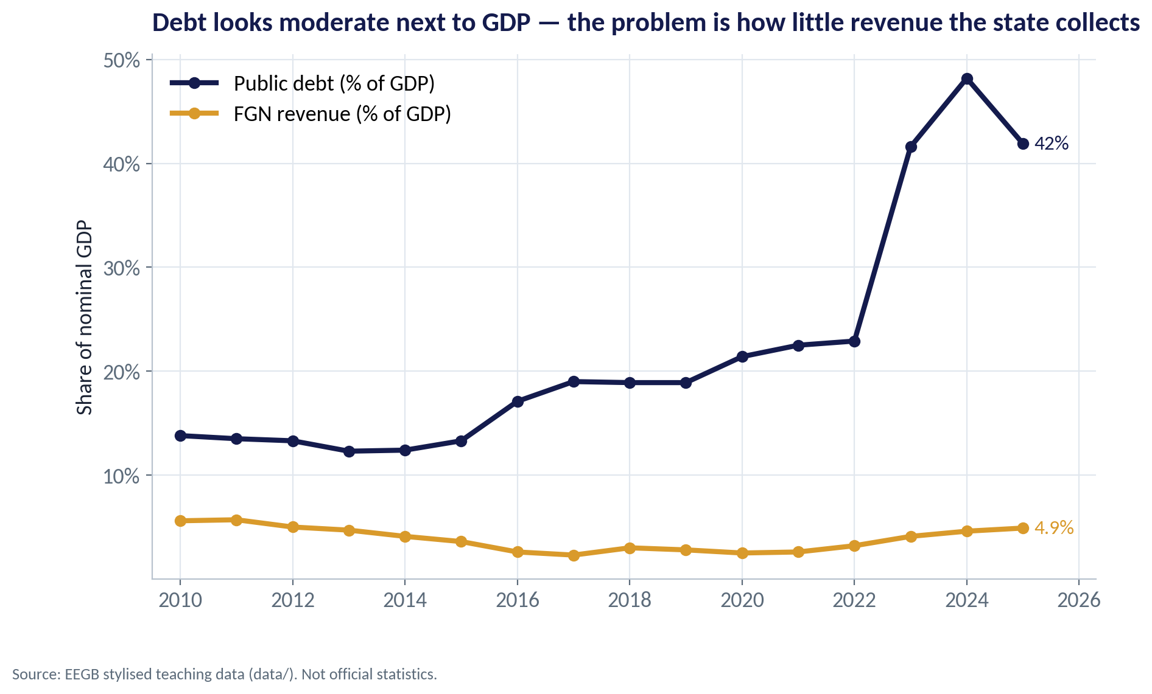
DEBT AGAINST GDP
Moderate Debt, Very Low Revenue
WHAT TO SEE
Public debt rose from 14% of GDP in 2010 to 42% in 2025 in our stylised data.
FGN revenue stayed around 3–5% of GDP — among the lowest ratios in the world for a large economy.
A debt ratio that is comfortable for a country collecting 20–30% of GDP is heavy for one collecting 5%.
So judge the debt against what the state can collect, not only against the size of the economy.
Fig S09-F01 · replicate: s09_figures.R / .py
SESSION 9 · FISCAL POLICY & DEBT
9

Slide 10
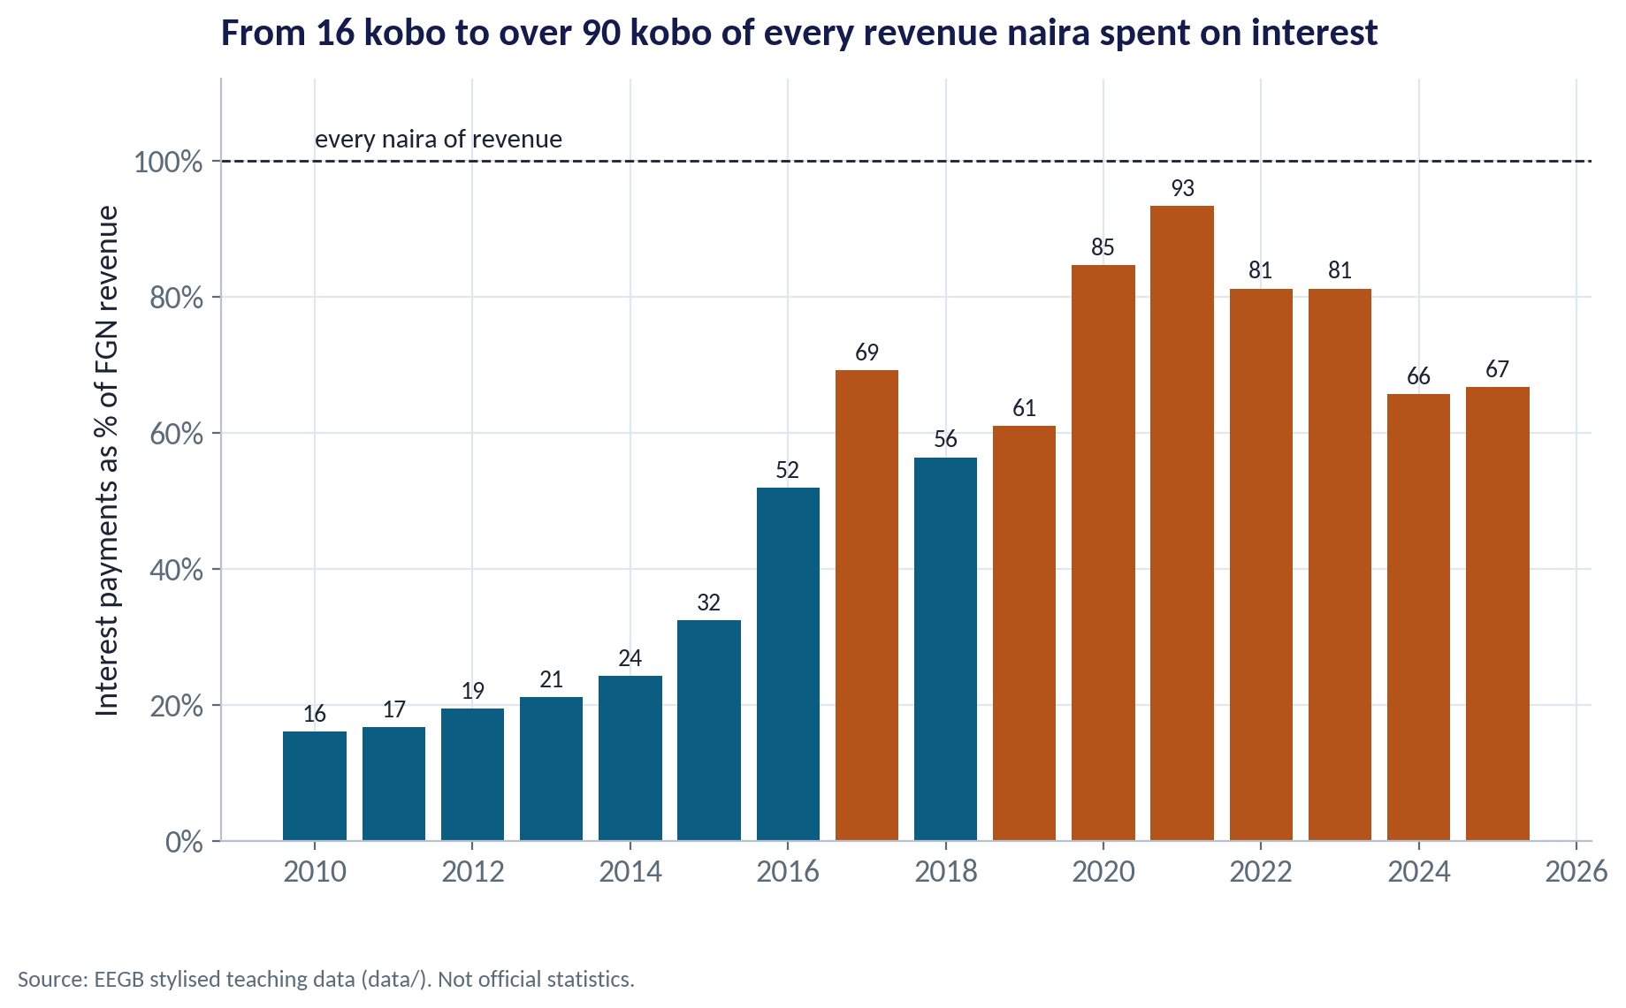
THE INTEREST BILL
How Much Revenue Goes on Interest?
WHAT TO SEE
In 2010 interest took about 16 kobo of every naira of federal revenue.
By 2021 it took 93 kobo, leaving almost nothing for salaries, roads or schools without more borrowing.
Higher oil receipts and reforms lowered the ratio to about 67% in 2025 — still very high.
Published reports showed a similar pattern; our numbers are stylised.
Fig S09-F02 · replicate: s09_figures.R / .py
SESSION 9 · FISCAL POLICY & DEBT
10
Notes:
Rating agencies watch interest/revenue closely. Above about 20–25% is generally regarded as a warning sign for emerging-market sovereigns.

Slide 11
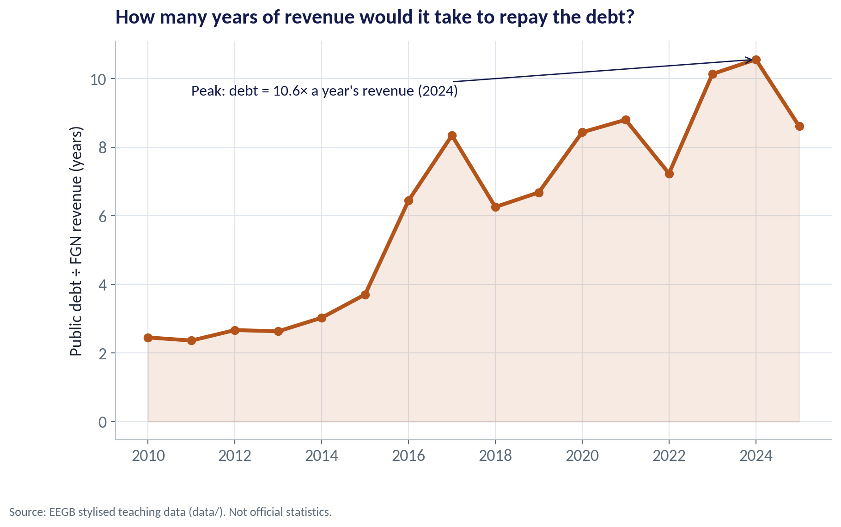
DEBT AGAINST REVENUE
Years of Revenue Needed to Repay the Debt
WHAT TO SEE
Debt ÷ revenue: how many years of all federal revenue would repay the stock of debt.
It rose from about 2.5 years in 2010 to a peak of 10.6 years in 2024.
By 2025 it eased to 8.6 years as naira revenue rose faster than debt.
This is the number that explains why investors demand high yields on FGN debt.
Fig S09-F03 · replicate: s09_figures.R / .py
SESSION 9 · FISCAL POLICY & DEBT
11

Slide 12
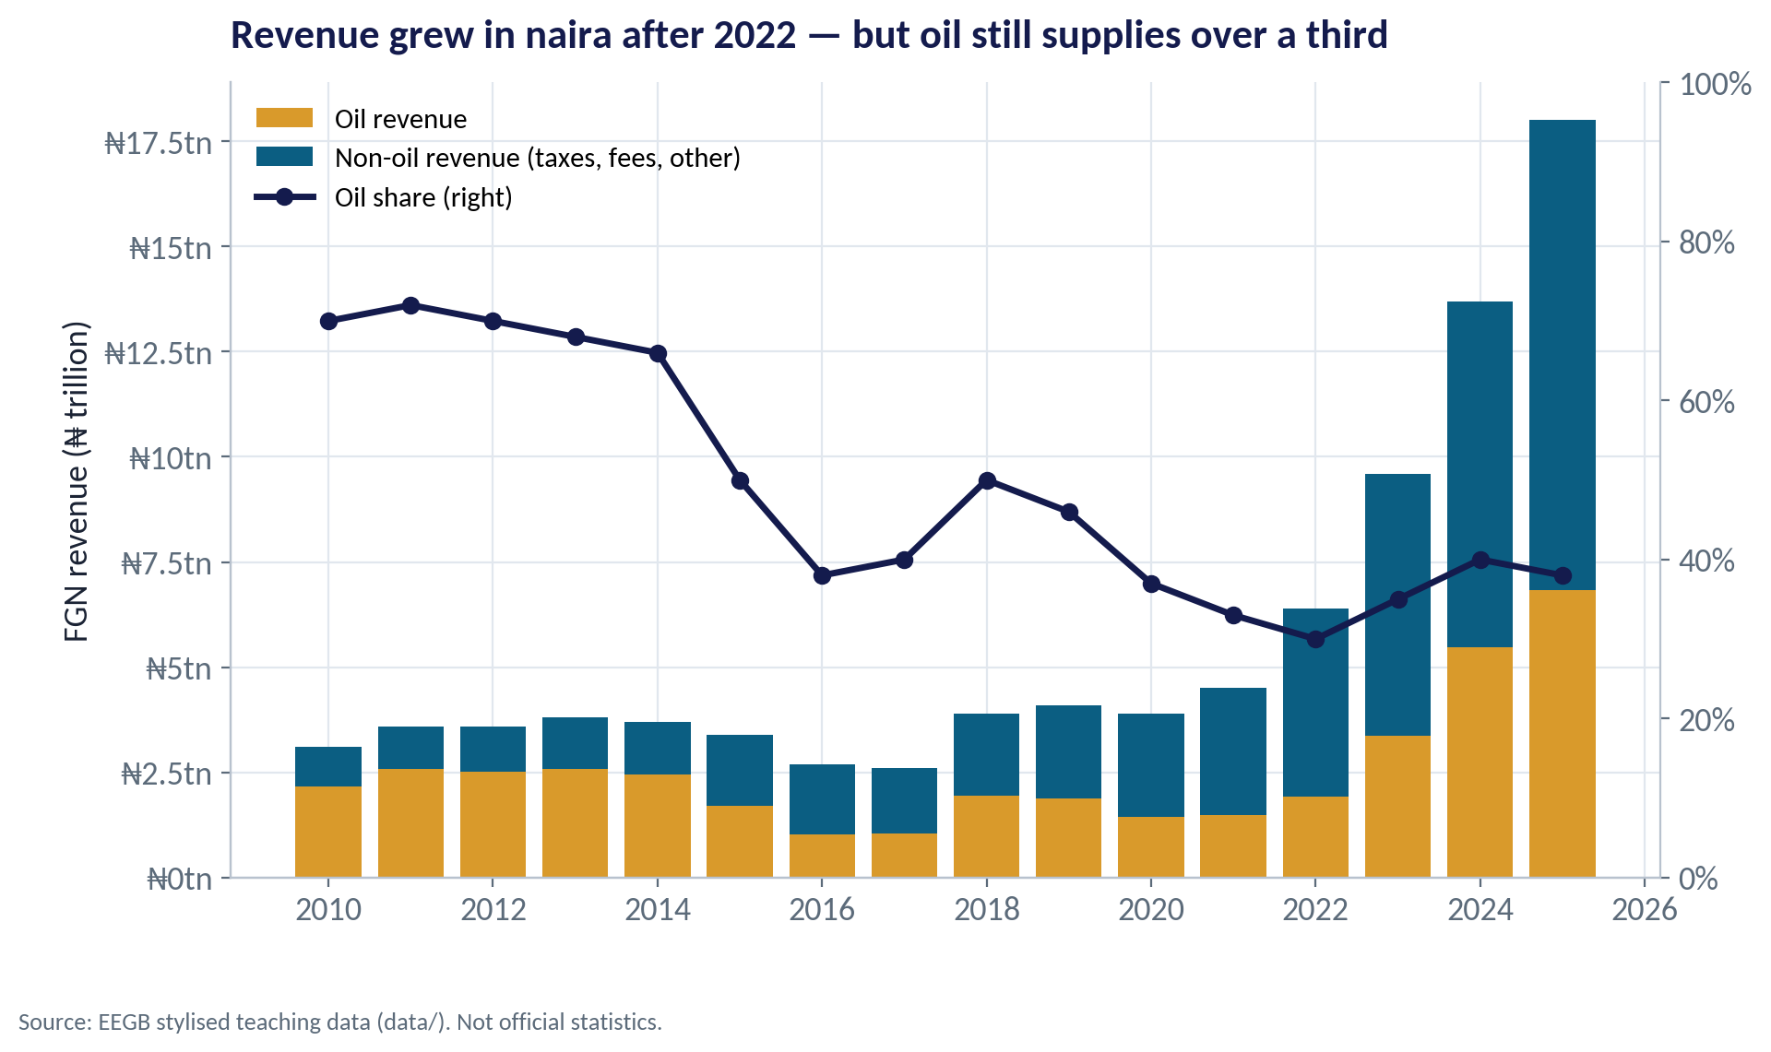
THE OIL DEPENDENCE
Revenue: Bigger in Naira, Still Oil-Heavy
WHAT TO SEE
Oil supplied about 70% of federal revenue in the early 2010s; under 40% in recent years.
Naira revenue jumped after 2022 — partly because a weaker naira raises the naira value of oil sales.
Oil prices and output still swing the budget, so fiscal risk is also commodity risk.
The 2025 tax reform laws aim to raise non-oil revenue; firms should expect tighter tax administration.
Fig S09-F07 · replicate: s09_figures.R / .py
SESSION 9 · FISCAL POLICY & DEBT
12
Notes:
Revenue sharing: the Federation Account is shared vertically among the federal government, states and local governments, after a 13% derivation share for oil-producing states. FGN retained revenue is therefore much smaller than total public revenue.

Slide 13
CONCEPT CHECK
Quick Check: What Would You Say?
Country A has debt of 40% of GDP and revenue of 5% of GDP. Country B has debt of 80% of GDP and revenue of 35% of GDP. Which is more stretched, and why?
A
Country B — its debt ratio is twice as high
B
Country A — its debt equals 8 years of revenue versus about 2.3 years in B
C
They are equally stretched
D
Neither — debt ratios below 100% are always safe
Discuss with your neighbour for 60 seconds — answer and reasoning in the speaker notes.
SESSION 9 · FISCAL POLICY & DEBT
13
Notes:
ANSWER: B. B. Debt is repaid from revenue. A's debt is 40 ÷ 5 = 8 years of revenue; B's is 80 ÷ 35 ≈ 2.3 years. Debt/GDP alone (A) misleads; there is no universally safe threshold (D).

Slide 14
PART
02
Debt Dynamics
One equation explains why debt ratios rise or fall.

Slide 15

THE KEY EQUATION
What Moves the Debt Ratio?
IN PLAIN ENGLISH
THE FORMULA
Δd = (r − g) ÷ (1 + g) × d − pb + other
The debt ratio rises when the interest rate (r) on debt is higher than the economy's nominal growth (g), and when the government runs a primary deficit. Anything else — a devaluation, a bailout, an old overdraft turned into bonds — shows up as 'other'.
WHY A MANAGER CARES
High inflation raises g and quietly erodes the debt ratio — but it also raises future interest rates. The relief lasts only while r stays below g.
EXAMPLE
In 2025 in our data: r = 8.3%, g = 23.3%. With g far above r, the interest–growth term cut the debt ratio by about 6 points on its own.
SESSION 9 · FISCAL POLICY & DEBT
15
Notes:
d = debt/GDP, pb = primary balance/GDP (positive = surplus). r is the effective rate: this year's interest ÷ last year's debt.

Slide 16
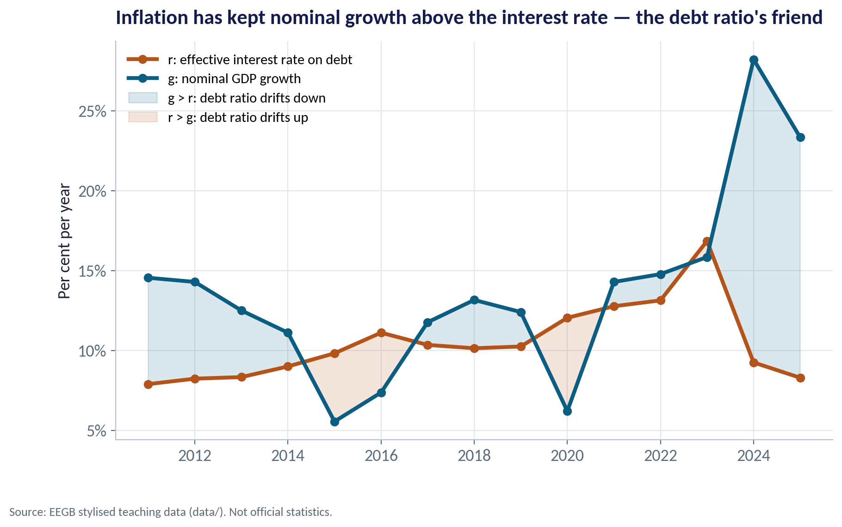
R VERSUS G
Inflation Has Been the Debt Ratio's Friend
WHAT TO SEE
g (nominal growth) includes inflation; r is the average interest rate the state pays.
In most years in our data g exceeded r, so the interest–growth term pulled the ratio down.
When inflation falls, g falls quickly; r falls only as old debt is refinanced.
Lesson: disinflation without fiscal reform can make the debt arithmetic worse.
Fig S09-F04 · replicate: s09_figures.R / .py
SESSION 9 · FISCAL POLICY & DEBT
16

Slide 17
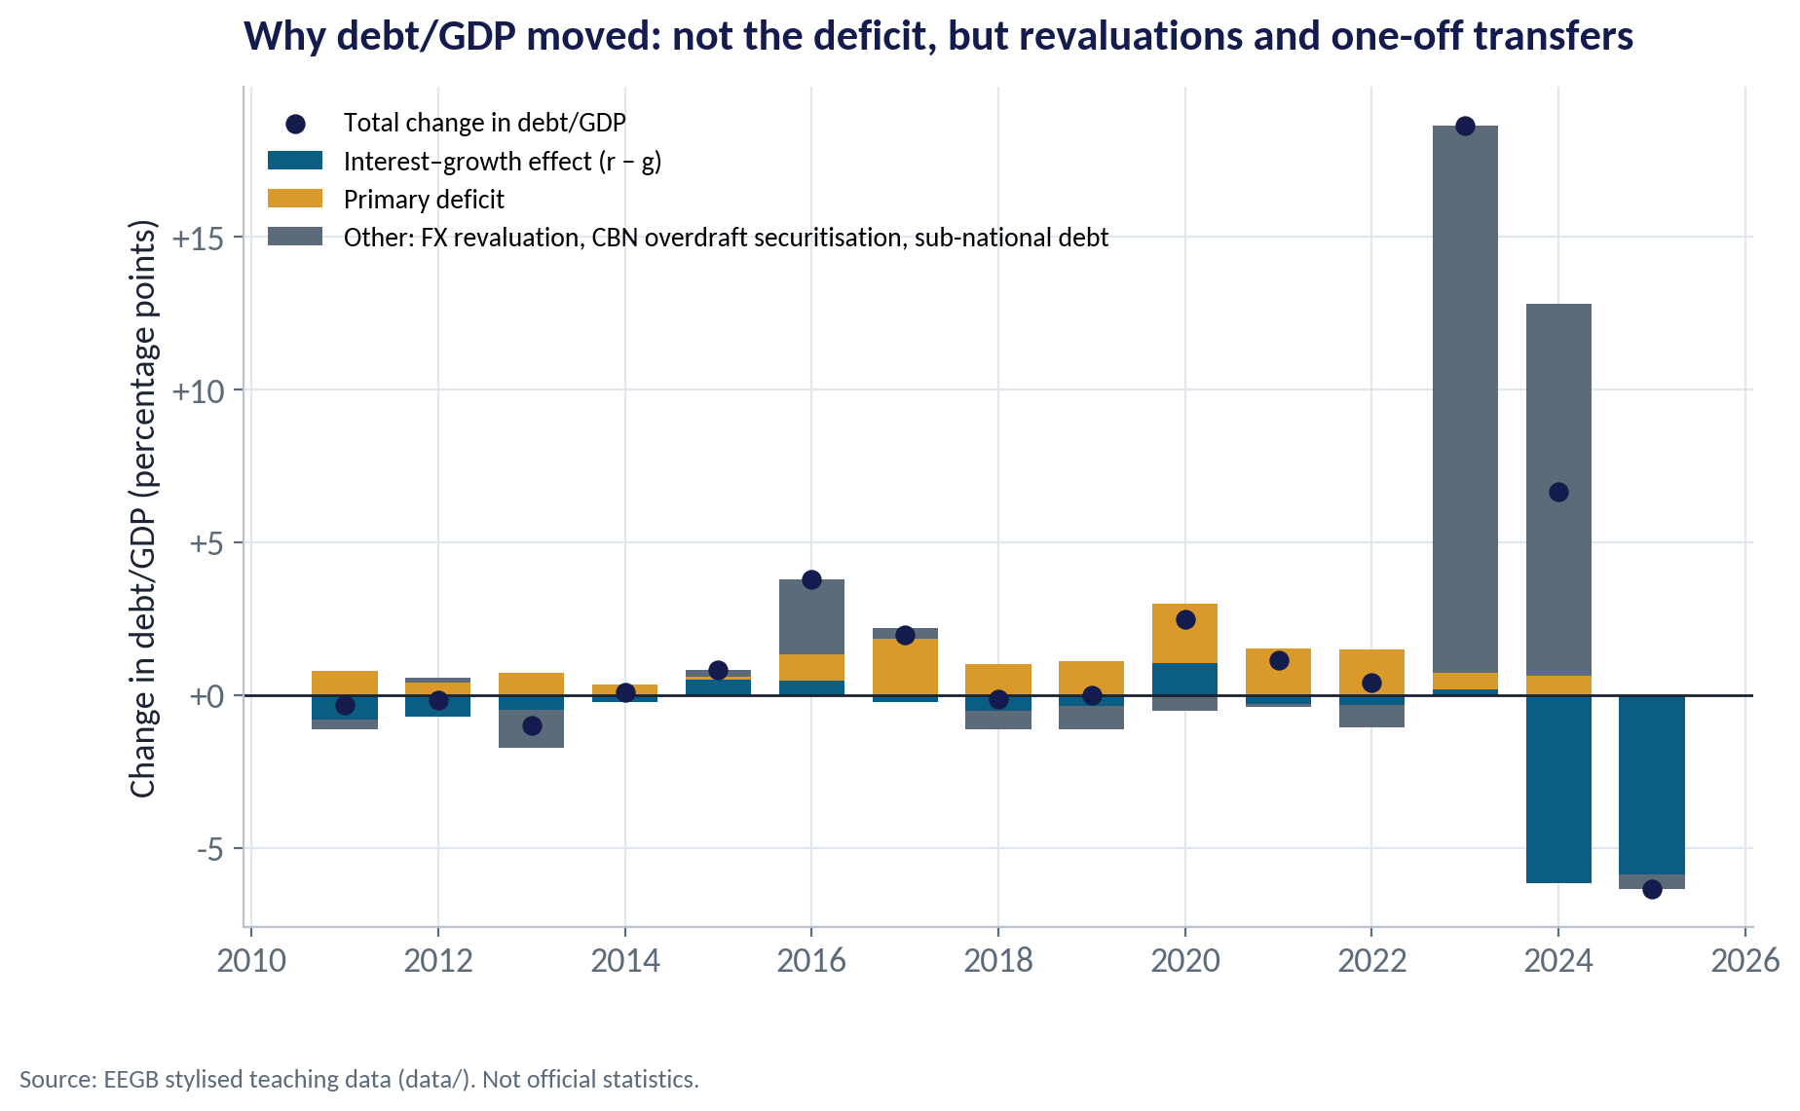
THE DECOMPOSITION
Why Did Debt/GDP Jump in 2023–24?
WHAT TO SEE
2023: debt/GDP rose 18.7 points — almost all of it (17.9) in 'other'.
That reflects the CBN overdraft ('Ways and Means') converted into bonds and the naira revaluation of dollar debt.
2024: 'other' added 12.2 points while fast nominal growth subtracted 6.1.
Deficits matter, but the big jumps came from off-budget items and the exchange rate.
Fig S09-F05 · replicate: s09_figures.R / .py
SESSION 9 · FISCAL POLICY & DEBT
17
Notes:
The National Assembly approved securitisation of the accumulated Ways and Means advances in 2023. Because the FGN primary balance excludes states and some extra-budgetary items, our 'other' term also absorbs those.

Slide 18
WORKED EXAMPLE
What Primary Balance Stabilises the Debt?
Set Δd = 0 and solve: pb* = (r − g) ÷ (1 + g) × d
r | g | d | pb* (% of GDP)
15% | 17% | 41.9% | −0.7
17% | 14% | 41.9% | +1.1
20% | 12% | 41.9% | +3.0
STEP BY STEP
1
Start from 2025's debt ratio, 41.9% of GDP.
2
If g beats r by 2 points, a small primary deficit of 0.7% of GDP still keeps the ratio flat.
3
If r beats g by 3 points, the state needs a primary surplus of 1.1% of GDP just to stand still.
4
With r 8 points above g, the required surplus is 3% of GDP — over half of current revenue.
The same debt can be safe or explosive. r − g decides how much fiscal effort is needed.
SESSION 9 · FISCAL POLICY & DEBT
18

Slide 19
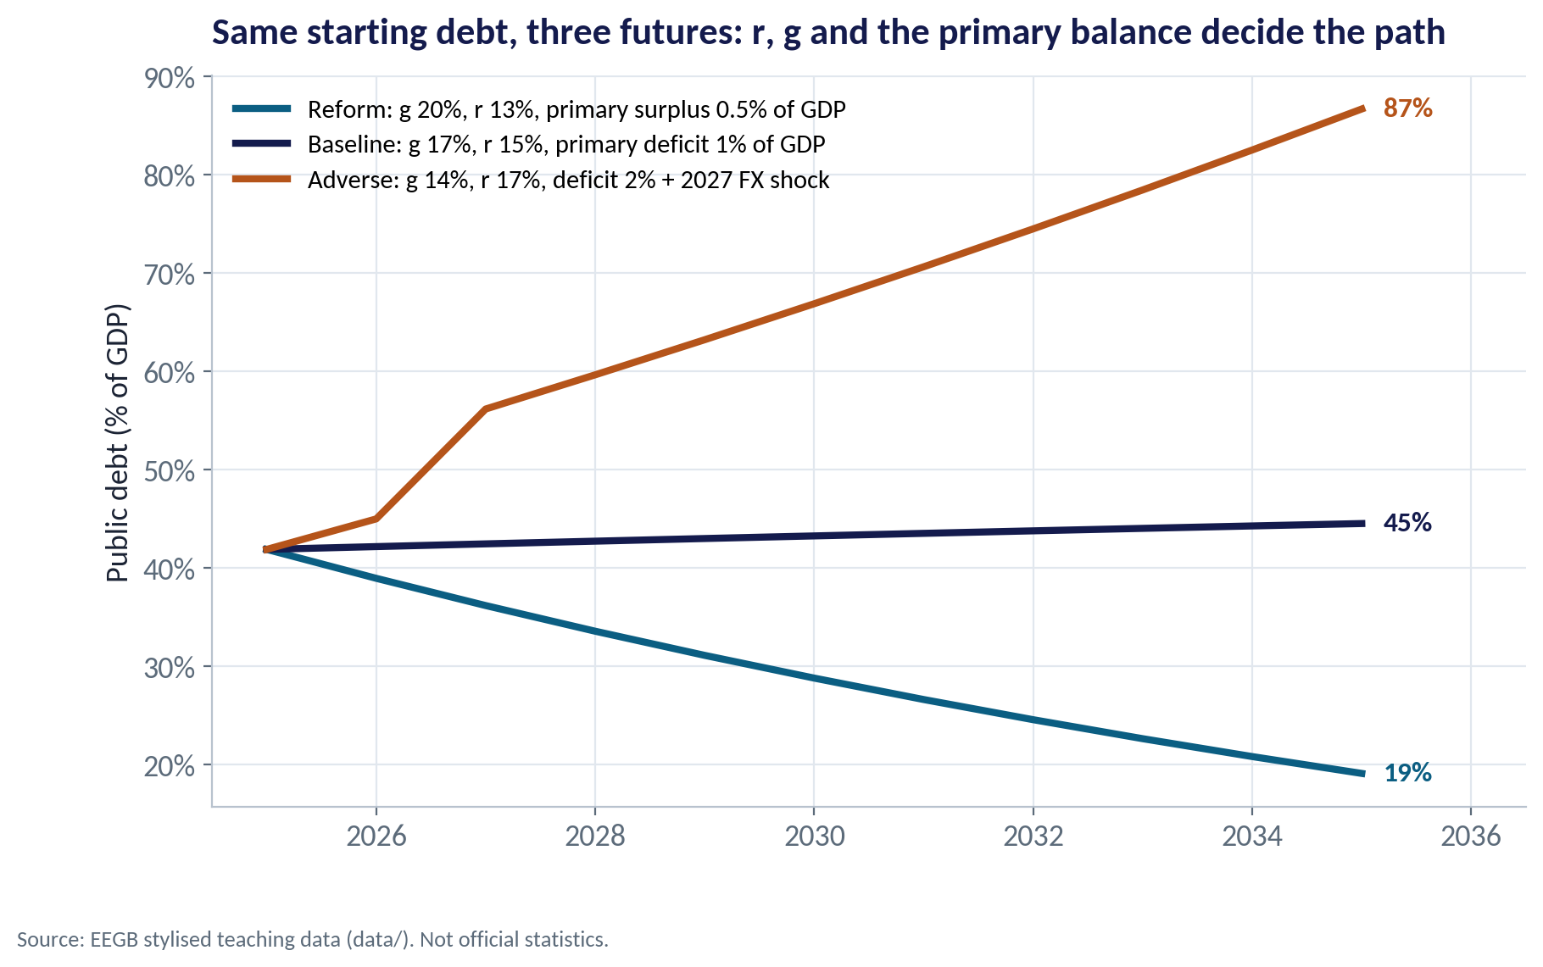
THREE FUTURES
A Ten-Year Projection
WHAT TO SEE
Reform (g 20%, r 13%, surplus 0.5%): debt falls to about 19% of GDP by 2035.
Baseline (g 17%, r 15%, deficit 1%): roughly flat at 45%.
Adverse (g 14%, r 17%, deficit 2%, an FX shock in 2027): debt more than doubles to 87%.
The difference comes from assumptions a CFO can watch: inflation, yields, the deficit and the naira.
Fig S09-F06 · replicate: s09_figures.R / .py
SESSION 9 · FISCAL POLICY & DEBT
19

Slide 20
CONCEPT CHECK
Quick Check: What Would You Say?
Inflation falls sharply, so nominal GDP growth drops from 23% to 13%, while the average interest rate on government debt stays at 15%. Holding the primary balance constant, what happens to the debt ratio?
A
It falls, because lower inflation is good news
B
It starts rising, because r is now above g
C
Nothing — inflation does not affect debt
D
It falls, because interest rates will fall immediately
Discuss with your neighbour for 60 seconds — answer and reasoning in the speaker notes.
SESSION 9 · FISCAL POLICY & DEBT
20
Notes:
ANSWER: B. B. With r (15%) above g (13%), the interest–growth term turns positive and the ratio drifts up unless the primary balance improves. Rates on existing debt adjust only slowly as bonds are refinanced (D).

Slide 21
PART
03
Fiscal Policy and Your Business
Multipliers, rules, reforms and sovereign risk.

Slide 22
THE POLICY TOOLKIT
Fiscal Levers and What They Mean for Firms
Lever | Nigerian example | Effect on firms
Subsidy reform | Petrol subsidy removal (2023) | Higher transport and energy costs now; more fiscal space later if savings are spent well
Tax reform | 2025 tax reform laws; VAT and company tax changes | Compliance costs, possible relief for small firms, tighter enforcement for large ones
Borrowing | Large domestic bond issuance | High yields crowd out private credit; banks prefer FGN bonds to loans
Central-bank financing | Ways and Means advances (before 2023) | Money growth, inflation and a weaker naira
Fiscal rules | Fiscal Responsibility Act 2007 (deficit cap of 3% of GDP) | Rules anchor expectations only if they are respected
SESSION 9 · FISCAL POLICY & DEBT
22

Slide 23

FISCAL MULTIPLIERS
Does Government Spending Grow the Economy?
IN PLAIN ENGLISH
THE FORMULA
multiplier = ΔGDP ÷ ΔG
A fiscal multiplier tells you how much GDP changes when government spending changes by ₦1. It is larger when the economy has idle capacity and smaller when spending leaks into imports or pushes up interest rates.
WHY A MANAGER CARES
When government cuts spending, your demand falls by more in sectors that sell to the state (construction, contractors) and less in export or consumer-staples sectors. Know where your revenue sits.
EXAMPLE
If ₦1 trillion of road spending raises GDP by ₦0.6 trillion, the multiplier is 0.6. Open, import-dependent economies with high interest rates tend to have multipliers below 1.
SESSION 9 · FISCAL POLICY & DEBT
23

Slide 24

SOVEREIGN RISK
How Fiscal Stress Reaches Your Firm
Through the banks
Through markets
The 'sovereign–bank doom loop'
Yields, ratings and the naira
Banks hold large amounts of FGN bonds
If bond prices fall, bank capital falls (Session 10)
Banks cut lending to firms
Credit becomes scarcer and dearer
Higher sovereign yields raise every borrower's cost
Rating downgrades raise Eurobond spreads
Foreign investors pull money; the naira weakens
Tax rises or spending cuts hit demand
A company is rarely rated above its sovereign. Your cost of capital starts from the government's.
SESSION 9 · FISCAL POLICY & DEBT
24

Slide 25


WHERE MANAGERS GO WRONG
How Managers Misread Fiscal News
THE TRAP
THE BETTER HABIT
“Debt is only 40% of GDP, so it is safe.”
Compare debt and interest with revenue, and check the currency of the debt.
Treating a big naira revenue increase as fiscal strength.
Ask how much is devaluation and inflation — real revenue may barely move.
Assuming lower inflation automatically eases the debt burden.
Check r − g: disinflation can raise the real burden of debt.
Ignoring off-budget items.
Watch for 'other': overdraft conversions, guarantees, state debt and FX revaluation.
Planning on the budget's capital spending as announced.
Track actual releases; in revenue-poor years capital budgets are cut first.
SESSION 9 · FISCAL POLICY & DEBT
25

Slide 26



HANDS-ON LAB
Lab: Is the Debt the Problem — or the Revenue?
1
Compute debt/GDP, debt/revenue and interest/revenue for every year.
YOU WILL NEED
Data
2
Compute r (interest ÷ last year's debt) and g (nominal GDP growth). In which years was g > r?
data/fgn_fiscal_annual.csv
3
Decompose each year's change in debt/GDP into r − g, primary balance and 'other'.
R script
sessions/s09/R/s09_lab.R
4
Project debt/GDP to 2035 under a baseline and a reform scenario.
Python script
Find the debt-stabilising primary balance for three combinations of r and g.
sessions/s09/python/s09_lab.py
5
Deliverable: a 150-word note to your board: is the problem debt or revenue, and what should we watch?
⏱ 15 minutes
SESSION 9 · FISCAL POLICY & DEBT
26

Slide 27
WORDS TO OWN
Today's Vocabulary in Plain English
Primary balance
Revenue minus all spending except interest.
Stock-flow adjustment
Changes in debt not explained by the deficit (FX, bailouts, conversions).
Fiscal deficit
Total spending (including interest) minus revenue.
Fiscal multiplier
Change in GDP per naira of extra government spending.
Debt-to-GDP
Public debt as a share of the economy's annual output.
Fiscal dominance
Monetary policy constrained by the need to finance the government.
Interest-to-revenue
Share of government revenue spent on interest.
Ways and Means
Central-bank overdraft to the government.
r − g
Interest rate on debt minus nominal growth; drives the debt ratio.
Sovereign spread
Extra yield investors demand on a country's debt over a safe benchmark.
SESSION 9 · FISCAL POLICY & DEBT
27

Slide 28
KEY TAKEAWAYS
Session 9 in 5 Ideas
01
Judge debt against revenue and interest, not only GDP.
02
Debt dynamics: r − g and the primary balance drive the ratio; 'other' items cause the jumps.
03
Inflation and devaluation cut both ways: they raise naira revenue and naira-valued dollar debt.
04
Fiscal stress reaches firms through banks, yields, the naira and demand.
05
Watch the few numbers that decide the path: yields, inflation, the deficit and the exchange rate.
NEXT › Session 10: Financial Stability
Before next session: Read the Silicon Valley Bank case (F-0997-E). Ask your treasury team how much of your bank's or company's investments are in long-dated FGN bonds, and at what yield they were bought.

