Slide 1


LAGOS BUSINESS SCHOOL · MEMBA 14 · EEGB · PART II
SESSION 10
Financial Stability &
Corporate Finance Conditions
From markets, to macro, to decisions that matter — in Nigeria and the world.
Reading: Risk Management at Silicon Valley Bank (F-0997-E) · Facilitator: Elvis Ozegbe
Economic Environment of Global Business · Lagos Business School · Prof. Bongo Adi, Kelechi Nnamdi, Elvis Ozegbe
Notes:
Open with the SVB story, then put the case bank's numbers on the board. The aim is for every participant to leave able to ask their own treasurer: what is our duration gap?

Slide 2




RECAP
Session 9 in Three Ideas
Debt dynamics
Debt ratios rise when the interest rate beats growth (r > g) and the primary balance is in deficit.
Revenue problem
Nigeria's debt is moderate relative to GDP but heavy relative to revenue: interest eats a large share of what government collects.
Fiscal–monetary link
When government borrows from the central bank, fiscal problems become inflation problems.
SESSION 10 · FINANCIAL STABILITY
2

Slide 3



TODAY'S PLAN
Session 10 at a Glance — 75 Minutes
Why 'safe' government bonds can sink a bank — and what that means for the cost of your firm's credit.
10'
25'
20'
20'
Recap & Hook
Yields & Bond Prices
Bank Fragility
Lab: Stress-Test a Bank
How did a bank holding safe bonds fail?
The yield curve, inversion and the price–yield seesaw
Duration gap, the SVB story, macroprudential policy
Could our bank be the next SVB?
SESSION 10 · FINANCIAL STABILITY
3

Slide 4

BY THE END OF TODAY
Session 10 Learning Objectives
You will be able to:
01
02
03
Read the Yield Curve
Spot Interest-Rate Risk
Link Stability to Your Firm
Explain what the level and slope of the FGN yield curve say about inflation, policy and the cost of long-term money.
Use duration to estimate how much a bond or a bank loses when rates rise.
Explain how bank fragility and macroprudential rules change credit availability, spreads and investment.
SESSION 10 · FINANCIAL STABILITY
4

Slide 5




THE HOOK
The Bank That Bought Safe Bonds
“We hold government bonds. They never default. What could go wrong?”
Silicon Valley Bank (SVB) failed in March 2023 without a single government bond defaulting. Three things combined:
Rates rose fast
Long assets, short funding
Depositors ran
US policy rates went from near zero to about 5% in a year. Bonds bought at low yields lost value.
SVB had put deposits — which can leave overnight — into long-dated bonds.
Once losses became public, uninsured depositors withdrew billions in a day. Selling bonds turned paper losses into real ones.
Notes:
Then ask: Nigerian yields rose from about 13–14% to 18–20% between 2023 and 2024. Which Nigerian balance sheets look like SVB's?

Slide 6


NIGERIAN BUSINESS CASE
Could a Nigerian Bank Fall Into the SVB Trap?
The situation
The decision question
A mid-sized Nigerian bank holds ₦1,850bn of FGN bonds bought around 13%, funded mostly by current and savings deposits. Yields jumped in 2024 as the CBN tightened.
How much economic value has the bank lost, how big a rate shock could wipe out its equity, and what should the board do?
The data we have
What a good answer looks like
bank_balance_sheet.csv — a fictional bank's assets and liabilities with durations and rates. ng_yield_curves.csv — five stylised FGN yield curves (2021–2025). *Stylised teaching data.*
A stress test in naira: equity left after +1 to +5 point shocks, and one or two concrete actions (shorten the bond book, hedge, raise capital, lengthen funding).
SESSION 10 · FINANCIAL STABILITY
6
Notes:
The balance sheet is invented but its shape — large bond holdings, short deposits, thin equity — is typical of many emerging-market banks.

Slide 7
PART
01
Yields and Bond Prices
The seesaw that every treasurer must understand.

Slide 8
THE PRICE OF TIME
What a Yield Curve Shows
IN PLAIN ENGLISH
THE FORMULA
long yield ≈ average expected short rate + term premium
The yield curve plots the interest rate the government pays to borrow for 3 months, 1 year, 10 years and longer. Its level tells you how expensive money is; its slope tells you what markets expect next.
WHY A MANAGER CARES
An inverted curve says markets expect rates to fall later — often because tight policy will slow the economy. It also tells you when to borrow long and when to wait.
EXAMPLE
In 2021 the curve was low and steep (2.5% for 3 months, 12.8% for 10 years). By mid-2024 it was high and inverted (17.5% for 3 months, 21% for 1 year, 18.8% for 10 years).
SESSION 10 · FINANCIAL STABILITY
8

Slide 9
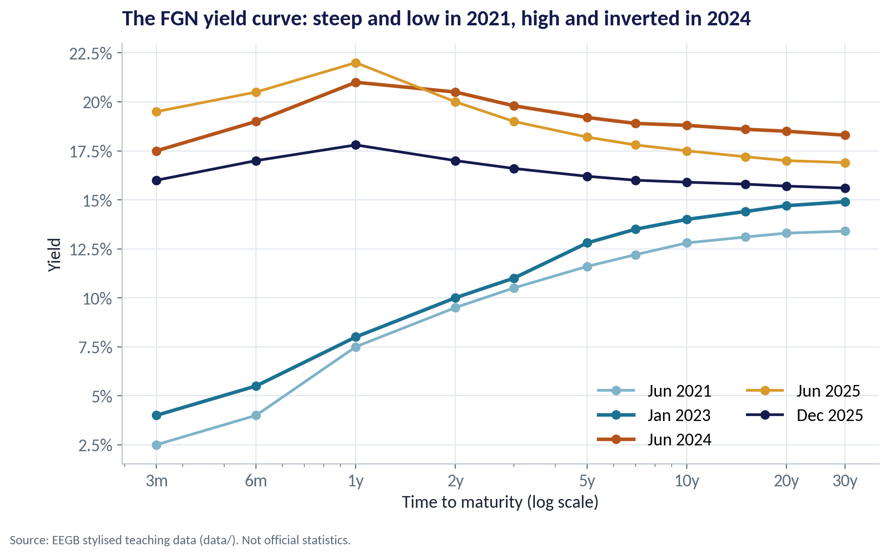
THE FGN YIELD CURVE
From Steep and Low to High and Inverted
WHAT TO SEE
2021: cheap short-term money, long rates well above short — a normal, steep curve.
Mid-2024: the CBN's tightening pushed short rates above long rates — an inverted curve.
End-2025: lower and flatter as inflation eased and rate-cut expectations built.
For a CFO the level is the cost of funds; the slope hints at whether to lock in long or stay short.
Fig S10-F01 · replicate: s10_figures.R / .py
SESSION 10 · FINANCIAL STABILITY
9

Slide 10
THE SEESAW
When Yields Rise, Bond Prices Fall
IN PLAIN ENGLISH
THE FORMULA
% price change ≈ − modified duration × change in yield
A bond pays fixed coupons. If new bonds pay more, nobody will pay full price for your old, lower-coupon bond — so its price falls until its yield matches the market.
WHY A MANAGER CARES
Duration — roughly the average time until you get your money back — measures sensitivity. The longer the bond, the bigger the fall when rates rise.
EXAMPLE
A 10-year FGN bond with a 13% coupon is worth 100 at a 13% yield, 89.8 at 15%, 77.2 at 18% and 70.2 at 20%.
SESSION 10 · FINANCIAL STABILITY
10
Notes:
Modified duration = Macaulay duration ÷ (1 + y/frequency). The 10-year 13% bond has a Macaulay duration of about 5.9 years at a 13% yield.

Slide 11
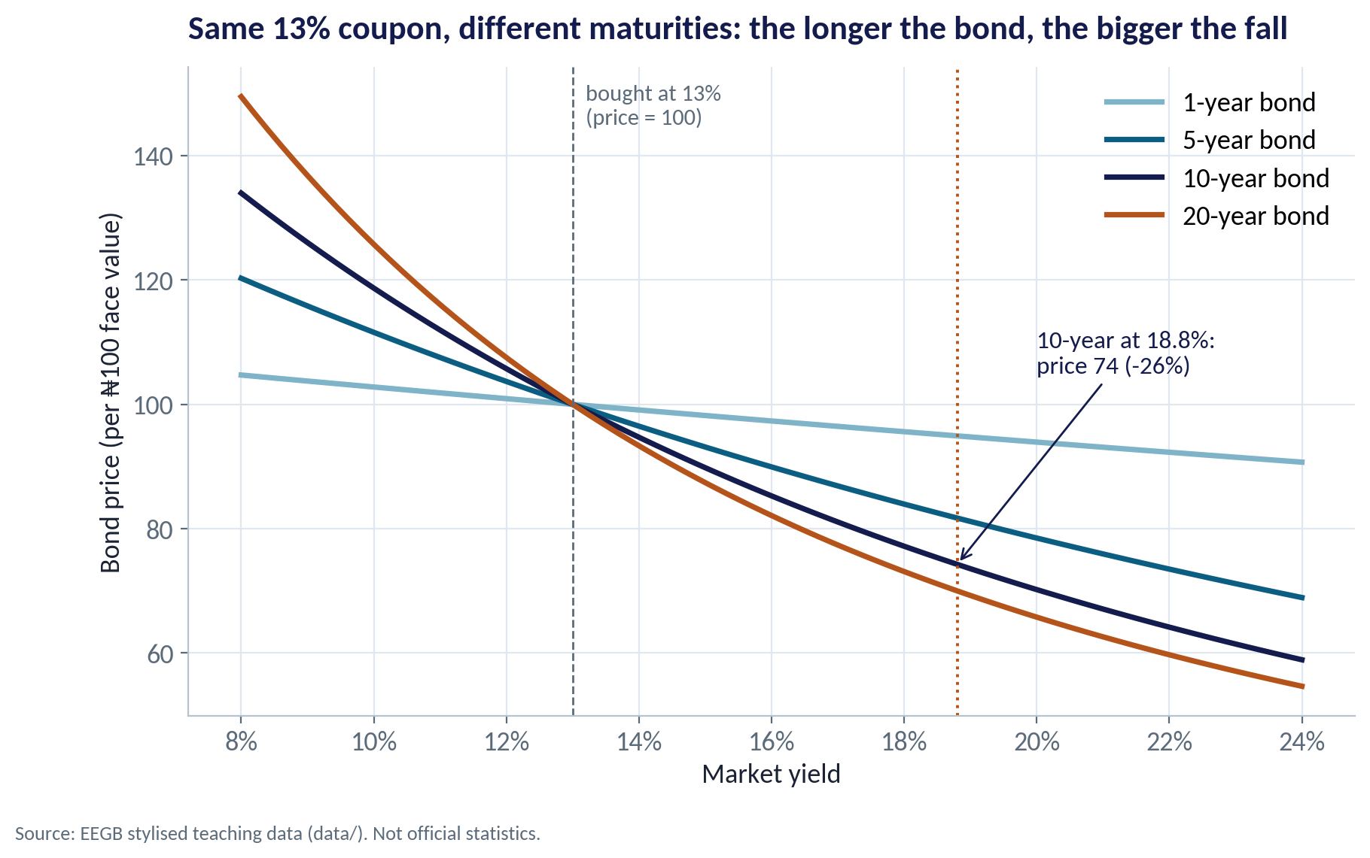
PRICE AND MATURITY
Long Bonds Fall Most
WHAT TO SEE
All four bonds pay a 13% coupon and are priced at 100 when the yield is 13%.
At an 18.8% yield the 1-year bond barely moves; the 10-year bond falls to about 74.
The 20-year bond falls further still.
Rule of thumb: more duration = more interest-rate risk.
Fig S10-F02 · replicate: s10_figures.R / .py
SESSION 10 · FINANCIAL STABILITY
11

Slide 12
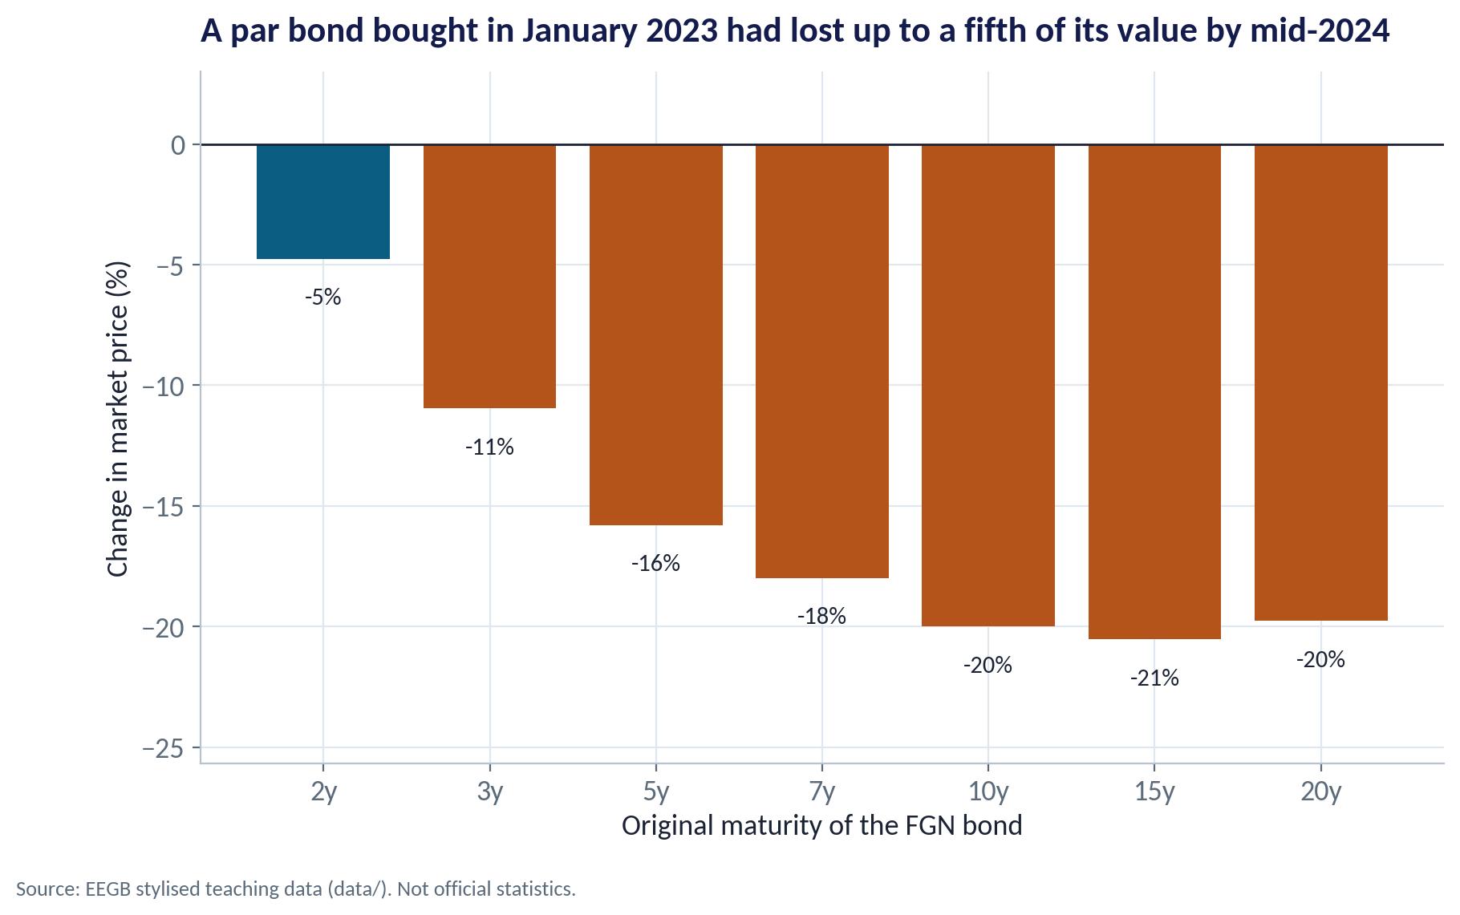
MARK-TO-MARKET
What Happened to Bonds Bought in January 2023
WHAT TO SEE
Take bonds bought at par in January 2023 and value them in June 2024.
Short bonds lost about 5%; 10- and 15-year bonds lost about 20%.
No default, no missed coupon — the loss comes purely from higher market yields.
If you must sell before maturity, that loss becomes real.
Fig S10-F03 · replicate: s10_figures.R / .py
SESSION 10 · FINANCIAL STABILITY
12

Slide 13
CONCEPT CHECK
Quick Check: What Would You Say?
Your pension fund holds a 20-year FGN bond. The CBN signals more rate hikes. What is the most likely effect on the bond's market value?
A
It rises, because higher rates mean higher coupons on the bond you already hold
B
It falls, and by more than a 2-year bond would
C
It is unchanged until the bond matures
D
It falls by the same percentage as a 2-year bond
Discuss with your neighbour for 60 seconds — answer and reasoning in the speaker notes.
SESSION 10 · FINANCIAL STABILITY
13
Notes:
ANSWER: B. B. The coupon on an existing bond is fixed, so higher market yields push its price down, and the long duration of a 20-year bond magnifies the fall. C confuses accounting value (if held to maturity) with market value.

Slide 14
PART
02
Why Banks Are Fragile
Borrow short, lend long — and hope rates behave.

Slide 15
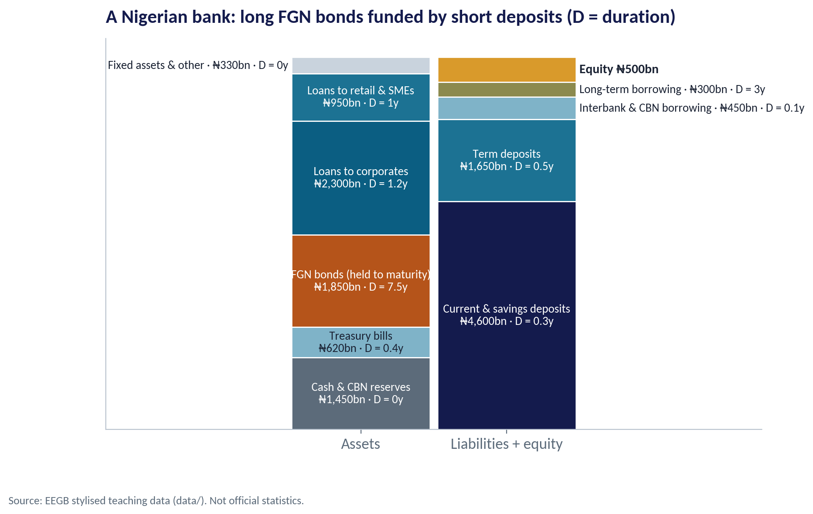
THE CASE BANK
Long Bonds Funded by Short Deposits
WHAT TO SEE
Assets ₦7,500bn; liabilities ₦7,000bn; equity only ₦500bn — leverage of 15×.
The FGN bond book (₦1,850bn) has a duration of 7.5 years.
Most funding is current and savings deposits with a duration of a few months.
Banks earn money by this mismatch — and take risk because of it.
Fig S10-F04 · replicate: s10_figures.R / .py
SESSION 10 · FINANCIAL STABILITY
15

Slide 16

THE KEY NUMBER
The Duration Gap
IN PLAIN ENGLISH
THE FORMULA
gap = D(assets) − (liabilities ÷ assets) × D(liabilities)
The duration gap compares how long the bank's assets are with how long its liabilities are. A positive gap means asset values fall more than liability values when rates rise — so equity shrinks.
WHY A MANAGER CARES
The gap turns a rate forecast into a naira number the board understands: how much of our capital a rate shock would destroy.
EXAMPLE
Asset duration 2.38 years, liability duration 0.45 years → gap 1.96 years. A +1 point rise in rates cuts economic equity by about ₦124bn.
SESSION 10 · FINANCIAL STABILITY
16
Notes:
Change in equity ≈ − gap × total assets × Δy ÷ (1 + y). With y = 18%, TA = ₦7,500bn and Δy = 1 point: −1.96 × 7,500 × 0.01 ÷ 1.18 ≈ −₦124bn.

Slide 17
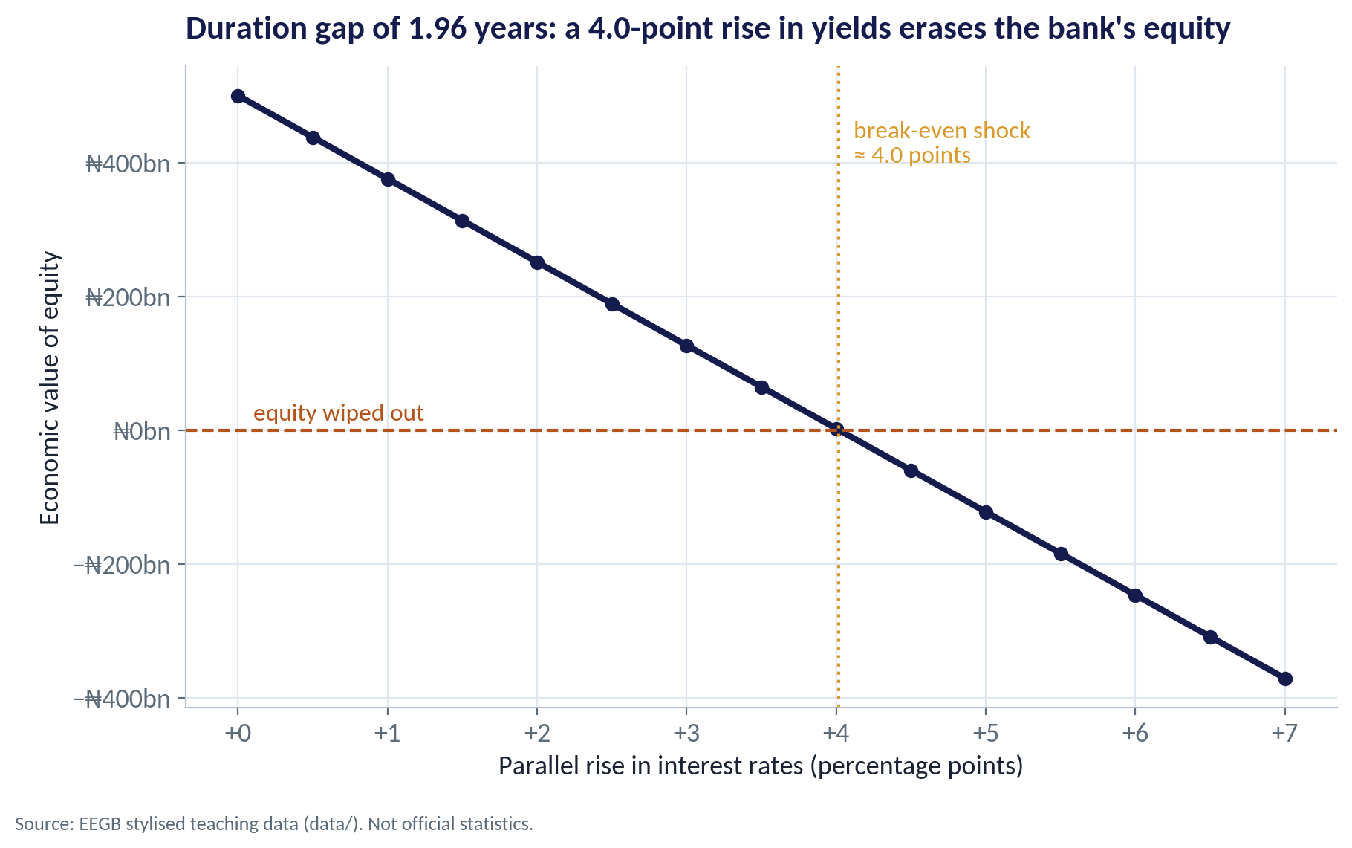
STRESS TEST
How Big a Rate Shock Can the Bank Survive?
WHAT TO SEE
Each point of higher rates removes roughly ₦124bn of economic equity.
+2 points leaves about ₦251bn; +3 points about ₦127bn.
A rise of about 4 points wipes out equity entirely.
Nigerian 10-year yields rose by almost 5 points between early 2023 and mid-2024.
Fig S10-F05 · replicate: s10_figures.R / .py
SESSION 10 · FINANCIAL STABILITY
17

Slide 18
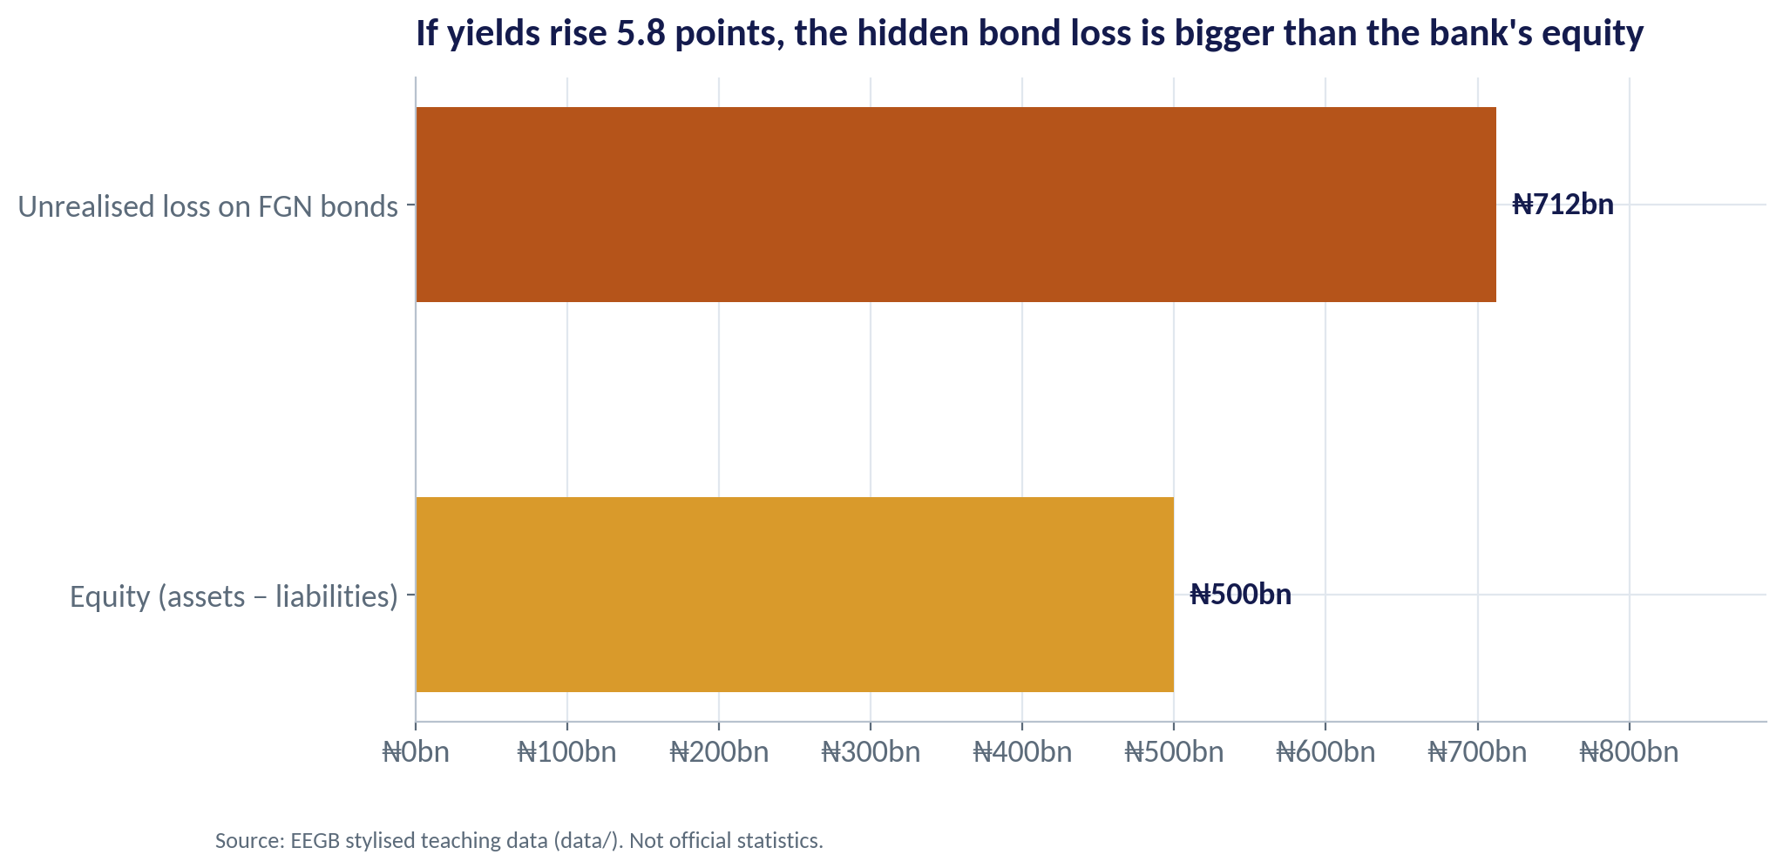
THE SVB TRAP
The Hidden Loss Can Exceed Equity
WHAT TO SEE
Using the 2024 yield curve, the bond book's unrealised loss is about ₦712bn.
That is larger than the bank's ₦500bn equity.
Accounting rules for 'held-to-maturity' bonds can keep this loss off the income statement.
It becomes real only if the bank must sell — for example, in a deposit run.
Fig S10-F06 · replicate: s10_figures.R / .py
SESSION 10 · FINANCIAL STABILITY
18
Notes:
This is exactly SVB's position in early 2023. Ask: what would make Nigerian depositors run, and how quickly can money now move by mobile app?

Slide 19

WHO GUARDS THE SYSTEM?
Micro-Prudential vs Macroprudential Policy
Micro-prudential
Macroprudential
Is each bank safe on its own?
Is the system as a whole safe?
Minimum capital and liquidity ratios
Supervision of individual loan books
Stress tests bank by bank
Deposit insurance (NDIC in Nigeria)
Counter-cyclical capital buffers
Limits on FX lending and open positions
Cash reserve requirements and loan-to-deposit rules
Recapitalisation drives when the economy changes
The CBN's 2024 bank recapitalisation programme is a macroprudential response: inflation and devaluation had shrunk the real value of banks' capital.
SESSION 10 · FINANCIAL STABILITY
19

Slide 20
PART
03
From the Bank to Your Balance Sheet
Financial conditions decide who gets credit, and at what price.

Slide 21
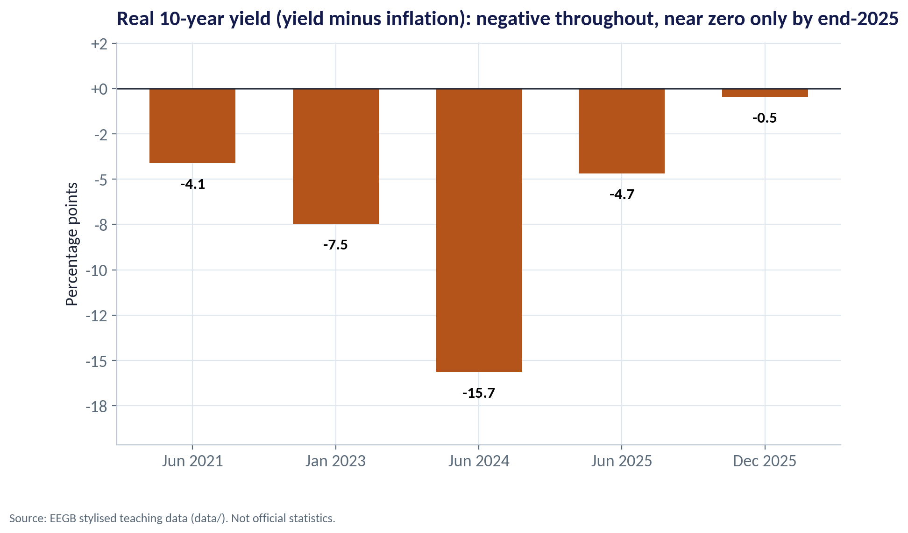
REAL YIELDS
Were Lenders Paid for Inflation?
WHAT TO SEE
Real 10-year yield = nominal yield − inflation.
It was deeply negative in 2024 (about −16 points).
By end-2025 it was close to zero (about −0.5).
Negative real yields push savers to dollars and real assets; positive ones bring them back to naira bonds.
Fig S10-F07 · replicate: s10_figures.R / .py
SESSION 10 · FINANCIAL STABILITY
21

Slide 22



TRANSMISSION TO FIRMS
How Financial Conditions Reach Your Company
Price of credit
Quantity of credit
Lending rates follow the yield curve plus a credit spread for your risk. When yields hit 20%, prime borrowers paid well above that.
Banks short of capital or liquidity ration credit: smaller limits, shorter tenors, more collateral.
Investment hurdle
Currency and tenor
A higher cost of capital kills marginal projects. A plant that earned 22% looked fine at 14% funding, not at 25%.
Firms that switch to cheaper dollar loans swap interest-rate risk for FX risk — Session 11.
SESSION 10 · FINANCIAL STABILITY
22

Slide 23


WHERE MANAGERS GO WRONG
How Treasurers and Boards Get Caught Out
THE TRAP
THE BETTER HABIT
“Government bonds are risk-free, so we can hold as many as we like.”
They are free of default risk, not of interest-rate risk. Measure duration.
Ignoring unrealised losses because they are 'held to maturity'.
Report economic value to the board as well as the accounting value.
Funding long assets with overnight money because it is cheap today.
Match tenors, or hedge the gap.
Assuming deposits are sticky.
Mobile banking lets deposits leave in hours. Stress-test liquidity as well as capital.
Borrowing short at the peak of an inverted curve without a plan.
Decide deliberately between fixed and floating, short and long.
SESSION 10 · FINANCIAL STABILITY
23

Slide 24
CONCEPT CHECK
Quick Check: What Would You Say?
The case bank's duration gap is 1.96 years and its equity is ₦500bn. A colleague says: 'A 2-point rise in yields is nothing for us.' What is the best reply?
A
Correct — the bonds will pay back at maturity, so there is no loss
B
A 2-point rise would cut economic equity by about ₦250bn, half our capital
C
A 2-point rise would wipe out all our equity
D
We cannot say without the bank's profit figures
Discuss with your neighbour for 60 seconds — answer and reasoning in the speaker notes.
SESSION 10 · FINANCIAL STABILITY
24
Notes:
ANSWER: B. B. Change in equity ≈ −1.96 × ₦7,500bn × 0.02 ÷ 1.18 ≈ −₦249bn, about half the ₦500bn. A ignores economic value and liquidity risk. C overstates — that needs about 4 points.

Slide 25



HANDS-ON LAB
Lab: Could Our Bank Be the Next SVB?
1
Tabulate the five yield curves: which are normal and which inverted?
YOU WILL NEED
Data
2
Price a 10-year, 13% bond at yields of 13%, 15%, 18% and 20%.
data/bank_balance_sheet.csv
data/ng_yield_curves.csv
3
Compute the bank's equity and leverage.
R script
sessions/s10/R/s10_lab.R
4
Compute asset duration, liability duration and the duration gap.
Python script
Stress-test equity for +1, +2, +3 and +5 point rate shocks.
sessions/s10/python/s10_lab.py
5
Deliverable: two sentences for the board on the bank's interest-rate risk and one action you would take.
⏱ 20 minutes
SESSION 10 · FINANCIAL STABILITY
25

Slide 26
WORDS TO OWN
Today's Vocabulary in Plain English
Yield
The annual return on a bond if bought at today's price and held to maturity.
Duration gap
Asset duration minus leverage-adjusted liability duration.
Yield curve
Yields on government debt plotted against maturity.
Mark-to-market
Valuing an asset at today's market price.
Inverted curve
Short-term yields above long-term yields.
Held to maturity
Accounting label that keeps bond losses off the income statement.
Term premium
Extra yield investors demand for lending long.
Credit spread
Extra interest a borrower pays above the government yield.
Duration
Weighted average time to a bond's cash flows; its rate sensitivity.
Macroprudential
Rules that protect the financial system as a whole.
SESSION 10 · FINANCIAL STABILITY
26

Slide 27
KEY TAKEAWAYS
Session 10 in 5 Ideas
01
The yield curve's level is the price of money; its slope is the market's view of what comes next.
02
When yields rise, bond prices fall — long bonds most. Government bonds carry interest-rate risk.
03
Banks are fragile because they borrow short and lend long with thin equity.
04
The duration gap turns a rate shock into a naira loss of capital.
05
Financial conditions reach your firm through the price and quantity of credit.
NEXT › Session 11: Exchange Rates & Capital Flows
Before next session: Read the Thailand: An Imbalance of Payments case. Note the exchange-rate regime, the size of short-term foreign borrowing, and what happened to reserves in 1997.

