Slide 1


LAGOS BUSINESS SCHOOL · MEMBA 14 · EEGB · PART III
SESSION 11
Exchange Rates, Capital Flows
& the Impossible Trinity
From markets, to macro, to decisions that matter — in Nigeria and the world.
Reading: Thailand: An Imbalance of Payments (209-021-1) · Krugman, Obstfeld & Melitz, International Economics · Facilitator: Elvis Ozegbe
Economic Environment of Global Business · Lagos Business School · Prof. Bongo Adi, Kelechi Nnamdi, Elvis Ozegbe
Notes:
Open with the two-price story. Most participants have lived through the 2023–24 adjustment; let them say what it did to their costs before introducing the trinity.

Slide 2




RECAP
Part II in Three Ideas
Shocks & inflation
Supply shocks (FX, fuel, food) raised Nigerian prices; expectations decide whether inflation sticks.
Policy levers
The CBN works through rates, liquidity and the balance sheet; fiscal deficits financed by the central bank undermine it.
Fragility
Higher rates hit bond values and bank capital: duration gaps turn rate shocks into capital losses.
SESSION 11 · EXCHANGE RATES & CAPITAL FLOWS
2

Slide 3




TODAY'S PLAN
Session 11 at a Glance — 75 Minutes
Why the naira moved from ₦460 to ₦1,500 per dollar — and what every importer, exporter and borrower must learn from it.
10'
25'
20'
20'
Recap & Hook
Regimes & the Trinity
Flows & Sudden Stops
Lab: Reading the Naira
One dollar, two prices
Pegs, floats, controls and the policy you must give up
The BoP, hot money, carry trades and currency mismatch
Premium, current account and a dollar loan
SESSION 11 · EXCHANGE RATES & CAPITAL FLOWS
3

Slide 4
BY THE END OF TODAY
Session 11 Learning Objectives
You will be able to:
01
02
03
Explain FX Regimes
Read the Balance of Payments
Manage Currency Risk
Compare pegs, managed floats and free floats, and explain the impossible trinity in plain language.
Trace where Nigeria's dollars come from and go to, and spot the warning signs of a sudden stop.
Identify currency mismatch in a business and explain how a weaker naira hits costs, debt and competitiveness.
SESSION 11 · EXCHANGE RATES & CAPITAL FLOWS
4

Slide 5




THE HOOK
One Dollar, Two Prices
“We buy dollars at the official rate. Our competitor pays the parallel rate. We have a cost advantage — until we don't get any dollars at all.”
For most of 2016–2023 Nigerian firms lived with this. Three questions:
Why two prices?
Who gets the dollars?
What happens at unification?
If the official price is held below what the market will pay, demand exceeds supply and dollars must be rationed.
Rationing created queues, backlogs and a valuable privilege for whoever had access.
When rationing ends, the official rate jumps toward the market rate — a big, one-off devaluation.
Notes:
Ask participants who have personally waited months for FX allocations. Their stories make the premium concrete.

Slide 6


NIGERIAN BUSINESS CASE
From ₦460 to ₦1,500: Lessons from the Naira's Unification
The situation
The decision question
Until mid-2023 Nigeria kept an official rate near ₦460/$ while the parallel market traded far weaker. In June 2023 the CBN unified its FX windows; by 2024 the naira traded around ₦1,500/$.
Why did the old system break, who gained and lost from unification, and what should a Nigerian firm do differently now?
The data we have
What a good answer looks like
ng_macro_monthly.csv — official and parallel rates, reserves, policy rate, inflation. ng_bop_quarterly.csv — trade, remittances, services, FDI and portfolio flows, 2015–2025. *Stylised teaching data.*
A clear account of the regime choice using the impossible trinity, plus a currency-risk checklist for a firm.
SESSION 11 · EXCHANGE RATES & CAPITAL FLOWS
6
Notes:
Pair with the Thailand 1997 case: a peg defended with reserves, short-term foreign borrowing, then a sudden float. The parallels with Nigeria are close.

Slide 7
PART
01
Regimes and the Impossible Trinity
You can have two of three — never all three.

Slide 8

THE PRICE OF A CURRENCY
What Sets the Exchange Rate?
IN PLAIN ENGLISH
THE FORMULA
dollar demand > dollar supply → naira weakens (or reserves fall)
An exchange rate is a price: naira per dollar. It is set by who wants dollars (importers, students abroad, investors leaving, people saving in dollars) and who supplies them (oil exporters, remittances, foreign investors coming in, the CBN).
WHY A MANAGER CARES
Every forecast of the naira is really a forecast of dollar inflows and outflows. Learn to read those flows and you will rarely be surprised.
EXAMPLE
When oil earnings fell in 2015–16 and again in 2020, dollar supply dropped. The CBN either let the naira fall or spent reserves and rationed dollars.
SESSION 11 · EXCHANGE RATES & CAPITAL FLOWS
8

Slide 9
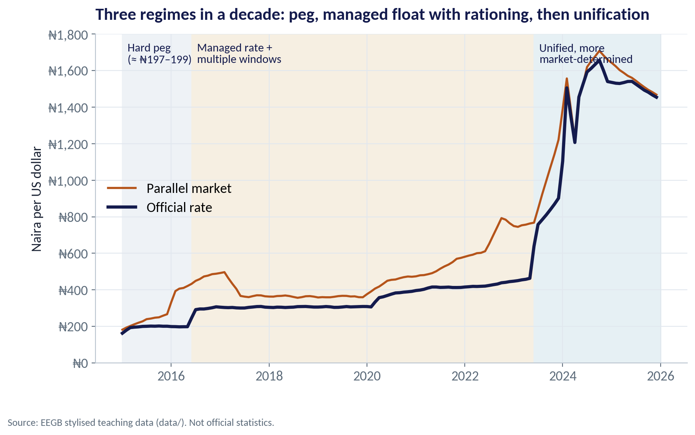
THREE REGIMES
A Decade of Naira Policy
WHAT TO SEE
2015–mid-2016: a near-fixed rate around ₦197–199 per dollar.
2016–2023: a managed rate with several official windows, and a wide parallel market.
From June 2023: windows unified; the rate became much more market-determined.
Each switch came after the old regime ran short of dollars.
Fig S11-F01 · replicate: s11_figures.R / .py
SESSION 11 · EXCHANGE RATES & CAPITAL FLOWS
9

Slide 10
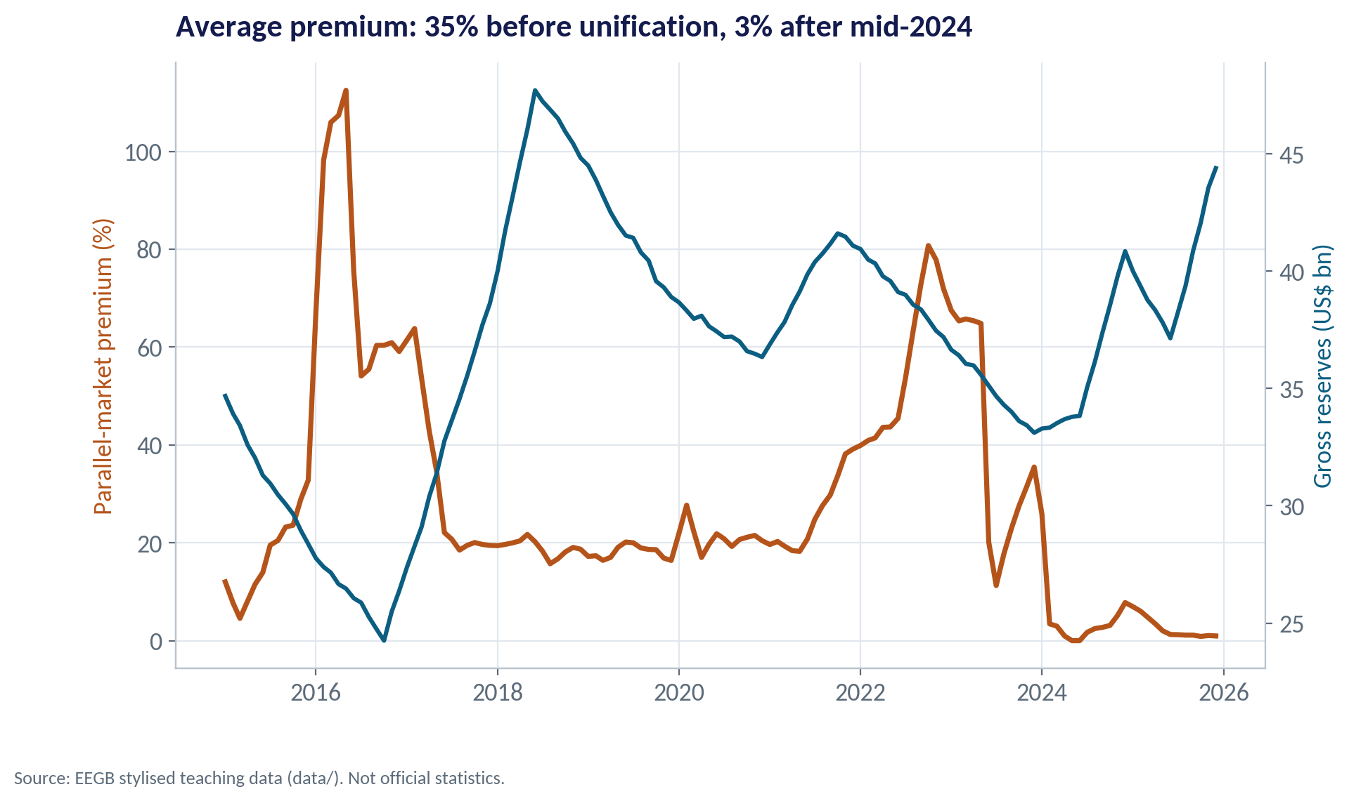
THE SIGNAL
The Premium Measures Rationing
WHAT TO SEE
The parallel premium averaged about 35% before unification and peaked above 100% in 2016.
Since mid-2024 it has averaged under 3%.
A high premium tells you official dollars are being rationed.
Falling reserves alongside a rising premium is the classic warning of a coming devaluation.
Fig S11-F02 · replicate: s11_figures.R / .py
SESSION 11 · EXCHANGE RATES & CAPITAL FLOWS
10

Slide 11
THE CORE IDEA
The Impossible Trinity
IN PLAIN ENGLISH
THE FORMULA
fixed rate + free capital + own monetary policy = impossible
A country would like three things: a stable exchange rate, free movement of capital, and its own interest-rate policy. It can only have two at a time.
WHY A MANAGER CARES
When a government promises all three, one promise will break. For a business, the question is which one, and when.
EXAMPLE
If the CBN fixes the naira and lets capital move freely, it must set interest rates to defend the peg — it loses control of domestic policy. Nigeria before 2023 kept the peg and its own rates by rationing dollars — a form of capital control.
SESSION 11 · EXCHANGE RATES & CAPITAL FLOWS
11

Slide 12
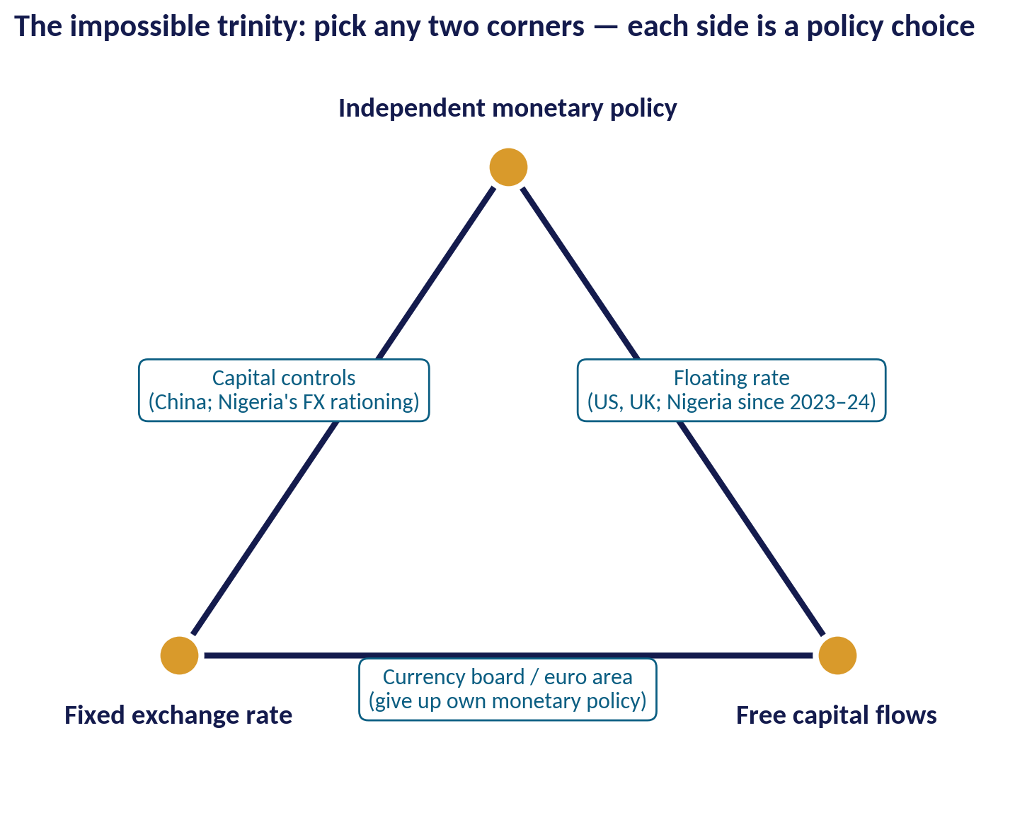
THE TRIANGLE
Pick Any Two Corners
WHAT TO SEE
Currency board / monetary union: fixed rate and open capital, but no independent rates (e.g. the euro area, the CFA franc zone).
Capital controls: fixed or managed rate with own policy — at the cost of rationing and parallel markets.
Floating rate: open capital and own policy — the exchange rate does the adjusting.
Nigeria moved from the controls side towards the floating side in 2023–24.
Fig S11-F05 · replicate: s11_figures.R / .py
SESSION 11 · EXCHANGE RATES & CAPITAL FLOWS
12

Slide 13
CONCEPT CHECK
Quick Check: What Would You Say?
A country fixes its currency, allows investors to move money freely, and wants to cut interest rates to boost growth. What is most likely to happen?
A
Growth rises and the peg holds
B
Investors move money out to earn higher returns abroad, reserves fall, and the peg comes under pressure
C
Inflation falls automatically
D
Nothing changes because the rate is fixed
Discuss with your neighbour for 60 seconds — answer and reasoning in the speaker notes.
SESSION 11 · EXCHANGE RATES & CAPITAL FLOWS
13
Notes:
ANSWER: B. B. With open capital, lower domestic rates push money out. To hold the peg the central bank must sell reserves — which cannot last. This is exactly the impossible trinity at work.

Slide 14
PART
02
Flows, Hot Money and Sudden Stops
Where the dollars come from — and how fast they can leave.

Slide 15
THE BALANCE OF PAYMENTS
Nigeria's Dollar Account in Plain English
Line | What it records | Nigeria's pattern
Goods trade balance | Exports minus imports of goods | Swings with oil: surplus when oil is high, deficit when it falls
Services & income | Freight, travel, school fees, profits and interest paid abroad | Persistently in deficit
Remittances | Money sent home by Nigerians abroad | Large and steady — about US$5bn a quarter in our data
FDI | Long-term investment in factories and firms | Small and falling in our data
Portfolio flows | Foreign money in bonds, bills and shares | Large and volatile — 'hot money'
Current account = trade + services & income + remittances. Financial flows must cover any current-account deficit — or reserves fall.
SESSION 11 · EXCHANGE RATES & CAPITAL FLOWS
15

Slide 16
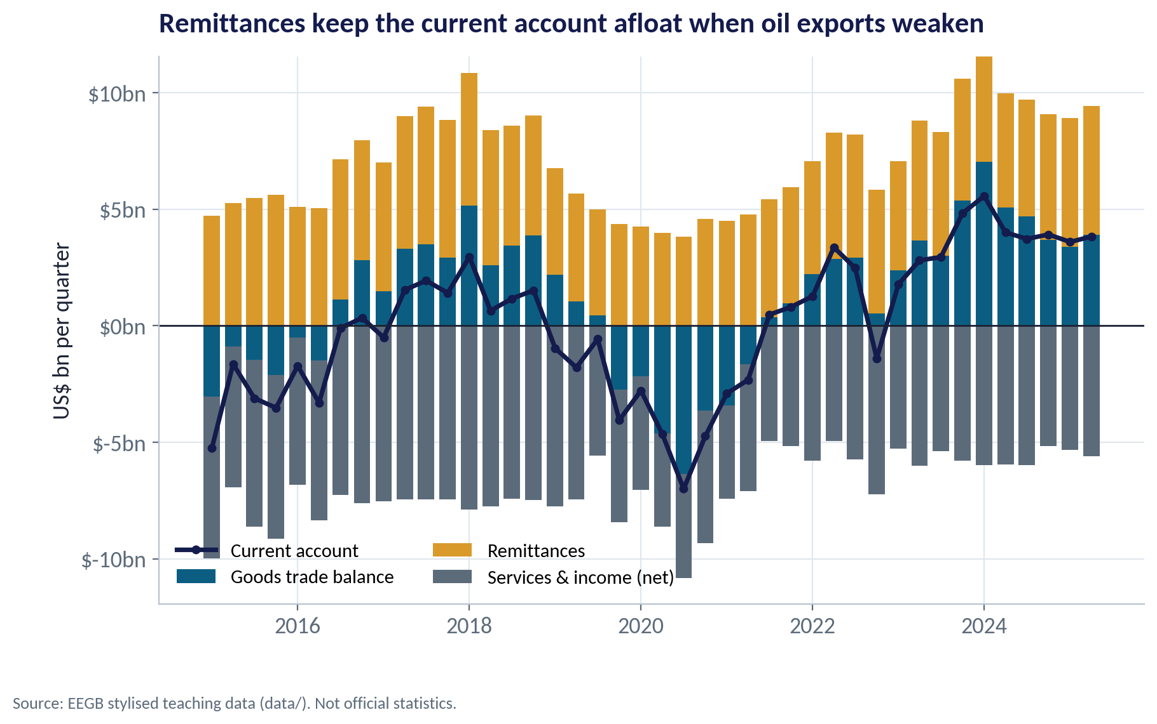
THE CURRENT ACCOUNT
Remittances Keep the Account Afloat
WHAT TO SEE
Remittances (gold) average about US$5.1bn a quarter — a stable dollar source.
Services and income (grey) are a steady drain.
The current account turns negative when oil weakens: about −US$4.6bn in 2020Q2.
Higher oil and a weaker naira restored surpluses in 2023–24.
Fig S11-F03 · replicate: s11_figures.R / .py
SESSION 11 · EXCHANGE RATES & CAPITAL FLOWS
16

Slide 17
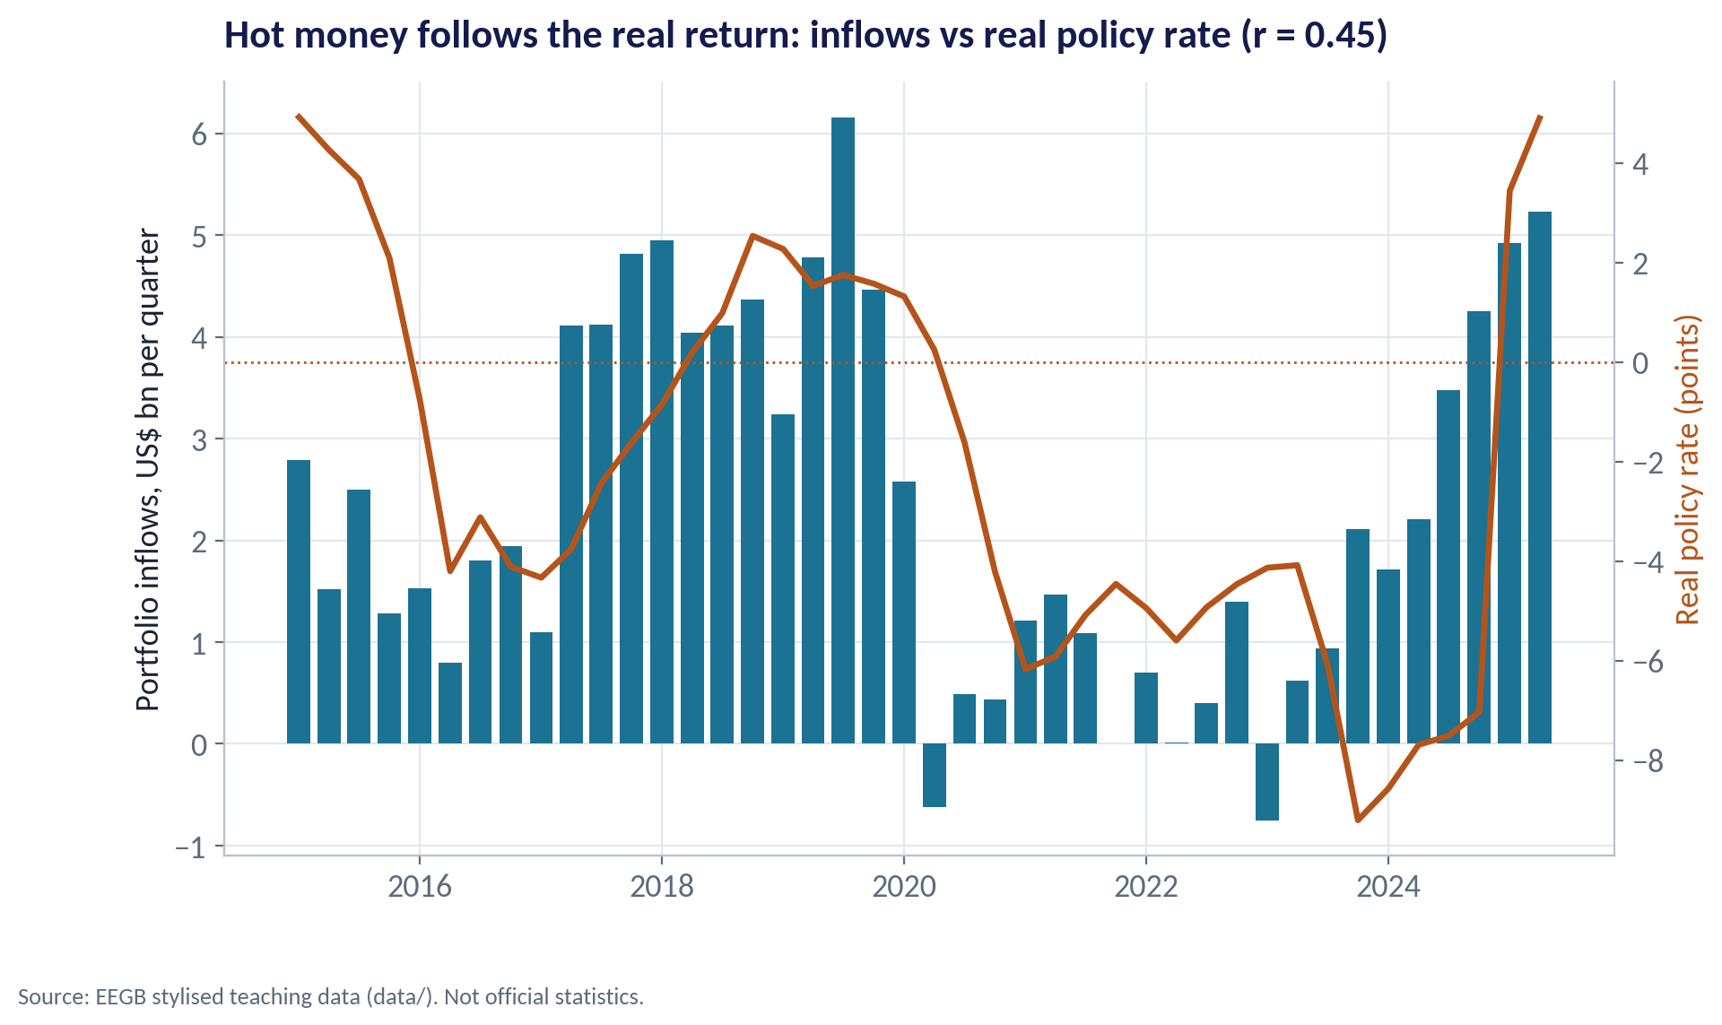
HOT MONEY
Portfolio Flows Chase the Real Return
WHAT TO SEE
Foreign portfolio investors come when the real return — interest minus inflation, adjusted for expected depreciation — is attractive.
In our data the correlation between inflows and the real policy rate is 0.45.
These flows can reverse within weeks: a sudden stop.
A central bank that relies on hot money to fund the peg is building a trap.
Fig S11-F04 · replicate: s11_figures.R / .py
SESSION 11 · EXCHANGE RATES & CAPITAL FLOWS
17

Slide 18

THE CARRY TRADE
Borrow Cheap, Lend Dear — Until the Currency Moves
IN PLAIN ENGLISH
THE FORMULA
carry return ≈ naira yield − dollar yield − naira depreciation
In a carry trade, investors borrow in a low-interest currency (dollars) and buy high-yield naira bills. They earn the interest gap — as long as the naira does not fall by more than that gap.
WHY A MANAGER CARES
When carry investors all head for the exit at once, the naira falls fast and reserves drain. Watch their positioning, not just the interest rate.
EXAMPLE
A 20% naira bill against a 5% dollar cost earns about 15% — but a 40% devaluation turns that into a large loss.
SESSION 11 · EXCHANGE RATES & CAPITAL FLOWS
18

Slide 19
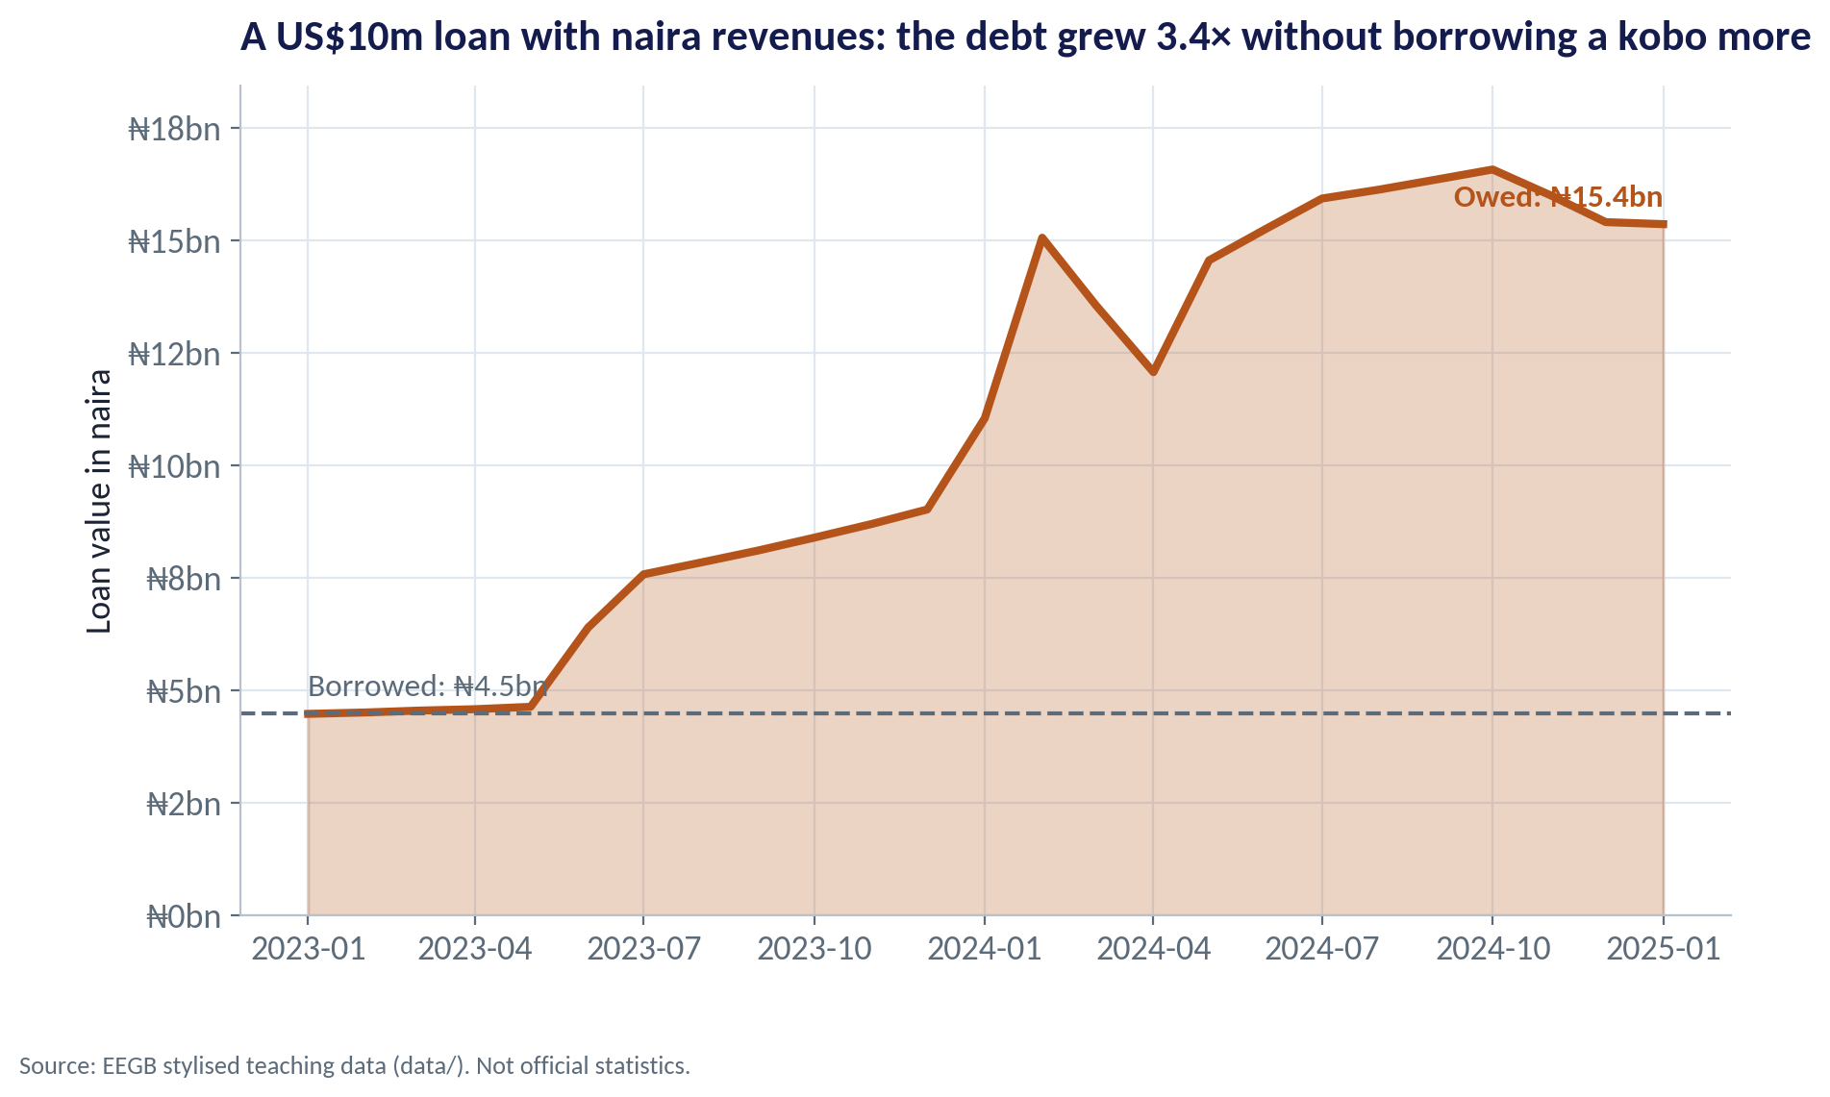
CURRENCY MISMATCH
The Dollar Loan That Tripled
WHAT TO SEE
A firm borrows US$10m in January 2023 to fund naira-earning operations: ₦4.5bn.
By January 2025 the same debt is worth ₦15.4bn.
Nothing changed in the business — only the exchange rate.
Mismatch, not the dollar itself, is the danger: borrow in the currency you earn.
Fig S11-F06 · replicate: s11_figures.R / .py
SESSION 11 · EXCHANGE RATES & CAPITAL FLOWS
19

Slide 20
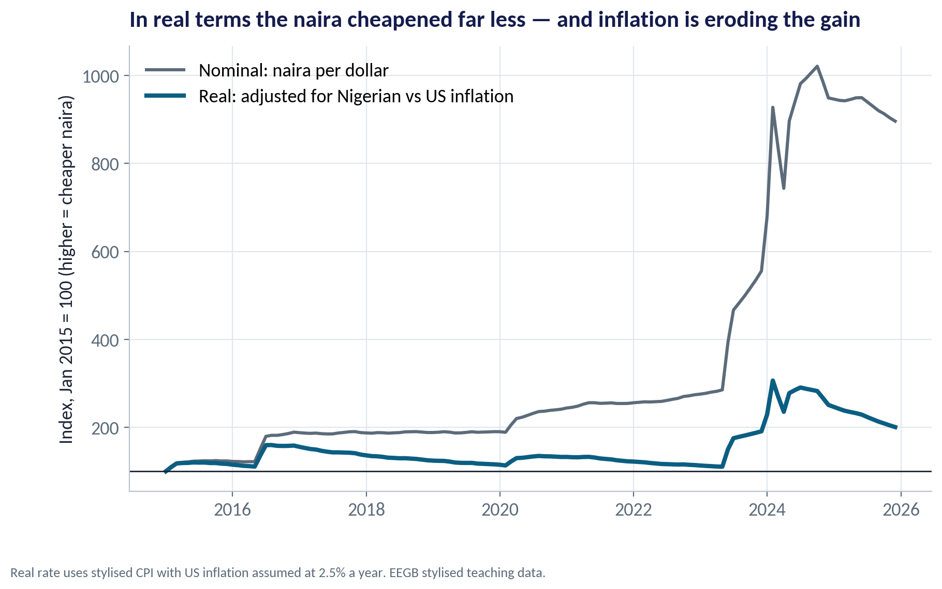
THE REAL EXCHANGE RATE
Did the Naira Really Get Cheaper?
WHAT TO SEE
The real rate adjusts the nominal rate for inflation at home and abroad.
From 2016 to 2023 the real index drifted from about 159 to 110: high inflation made the naira overvalued at a fixed rate.
Unification produced a sharp real depreciation (peak about 306 in Feb 2024).
Since then inflation has eroded part of the gain (about 201 by end-2025).
Fig S11-F07 · replicate: s11_figures.R / .py
SESSION 11 · EXCHANGE RATES & CAPITAL FLOWS
20
Notes:
The real rate uses a stylised CPI and assumes US inflation of 2.5% a year. The message — inflation erodes a nominal devaluation — is robust.

Slide 21


WHERE MANAGERS GO WRONG
How Firms Get Caught by the Currency
THE TRAP
THE BETTER HABIT
Planning on the official rate when you actually buy at another rate.
Budget at the rate you can really access, plus a stress case.
Borrowing in dollars because the interest rate is lower.
Compare all-in cost including expected depreciation; avoid mismatch.
Treating a long-stable peg as permanent.
Watch reserves, the premium and the current account: they warn early.
Assuming a weaker naira automatically makes exports competitive.
Check the real exchange rate: inflation can erase the gain.
Ignoring hot-money positioning.
Large foreign holdings of short-term naira bills are a sudden-stop risk.
SESSION 11 · EXCHANGE RATES & CAPITAL FLOWS
21

Slide 22
CONCEPT CHECK
Quick Check: What Would You Say?
Your company borrowed US$10m in January 2023 at 8% a year instead of ₦4.5bn at 18%. Using the stylised rates, what is the main lesson two years later?
A
The dollar loan was cheaper because 8% < 18%
B
The naira value of the dollar debt rose from about ₦4.5bn to ₦15.4bn, wiping out the interest saving many times over
C
The two loans cost the same
D
Exchange rates don't matter for debt
Discuss with your neighbour for 60 seconds — answer and reasoning in the speaker notes.
SESSION 11 · EXCHANGE RATES & CAPITAL FLOWS
22
Notes:
ANSWER: B. B. The interest gap saved about 10 points a year, but the naira fell by roughly 70% against the dollar, more than tripling the naira value of the principal. Always include expected depreciation.

Slide 23



HANDS-ON LAB
Lab: Reading the Naira
1
Compute the parallel premium by year and compare it with reserves.
YOU WILL NEED
Data
2
Rebuild the current account from its parts, by year.
data/ng_macro_monthly.csv
data/ng_bop_quarterly.csv
3
Correlate portfolio inflows with the real policy rate.
R script
sessions/s11/R/s11_lab.R
4
Track a US$10m loan in naira from 2023 to 2025.
Python script
Place Nigeria's pre- and post-2023 regimes on the impossible trinity.
sessions/s11/python/s11_lab.py
5
Deliverable: a one-paragraph note to your CFO: three signals that the naira is under pressure, and where to find them.
⏱ 20 minutes
SESSION 11 · EXCHANGE RATES & CAPITAL FLOWS
23

Slide 24
WORDS TO OWN
Today's Vocabulary in Plain English
Exchange-rate regime
The rules for how a currency's value is set: fixed, managed or floating.
Remittances
Money sent home by citizens working abroad.
Peg
A currency held at a fixed rate against another.
Hot money
Short-term portfolio flows that move quickly in and out.
Parallel premium
How much weaker the parallel rate is than the official rate.
Sudden stop
An abrupt halt or reversal of capital inflows.
Impossible trinity
A fixed rate, free capital and own monetary policy cannot coexist.
Carry trade
Borrowing in a low-rate currency to invest in a high-rate one.
Current account
Trade, services, income and transfers with the rest of the world.
Currency mismatch
Debts in one currency, revenues in another.
SESSION 11 · EXCHANGE RATES & CAPITAL FLOWS
24

Slide 25
KEY TAKEAWAYS
Session 11 in 5 Ideas
01
The exchange rate is a price set by dollar inflows and outflows.
02
The impossible trinity: a country must give up one of a fixed rate, free capital or its own policy.
03
A wide parallel premium means rationing; it usually ends in devaluation.
04
Hot money can leave fast; remittances are Nigeria's steadiest dollar source.
05
For firms, the killer is currency mismatch — borrow in the currency you earn.
NEXT › Session 12: Trade & Industrial Policy
Before next session: Read Sáenz & Revilla, 'Creating More Resilient Supply Chains' (MIT Sloan Management Review). List your company's three most important imported inputs and where they come from.

